Slide 1
Monte-Carlo techniques in Bayesian Inverse Problems
Michael Ireland (RSAA)

Slide 2
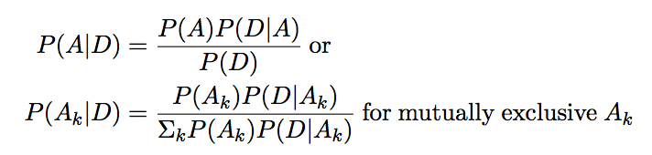
Bayes’ Theorem
The key to Bayesian probability is Bayes’ theorem, which can be written:
Derived in any good textbook, D can be any event, but is written as D because it is typically a particular set of data.
P(A) is the prior and P(A|D) is the posterior.
With many data sets D_{j}, Bayes’ theorem can be repeated, with one posterior becoming the next prior.

Slide 3
Bayesian Example
From betterexplained.com (similar to many textbook examples): 1% of women have breast cancer, 80% of mammograms detect breast cancer when it’s there and 9.6% of mammograms detect breast cancer when it’s not there. Assuming all yes/no results (no inconclusive tests) what is the chance you have breast cancer with a positive result?
  Let C=cancer, T=positive result.
  P(C|T) = P(C)P(T|C) / P(T)
  P(T) = P(~C)P(T|~C) + P(C)(T|C)
  P(~C)=0.99, P(T|~C)=0.094, P(C)=0.01, P(T|C)=0.8...
  P(C|T) = 0.08, i.e. an 8% chance.

Slide 4
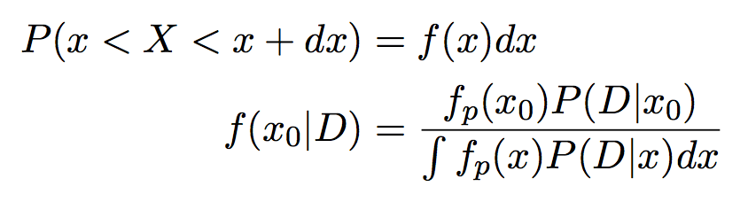
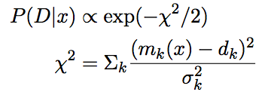
Bayes’ Theorem with Probability Densities
In astrophysics, many parameterizations are continuous, meaning that our probabilities are really n-dimensional probability densities, e.g.:
Data are often (approximated by) Normal distributions, i.e.:

Slide 5
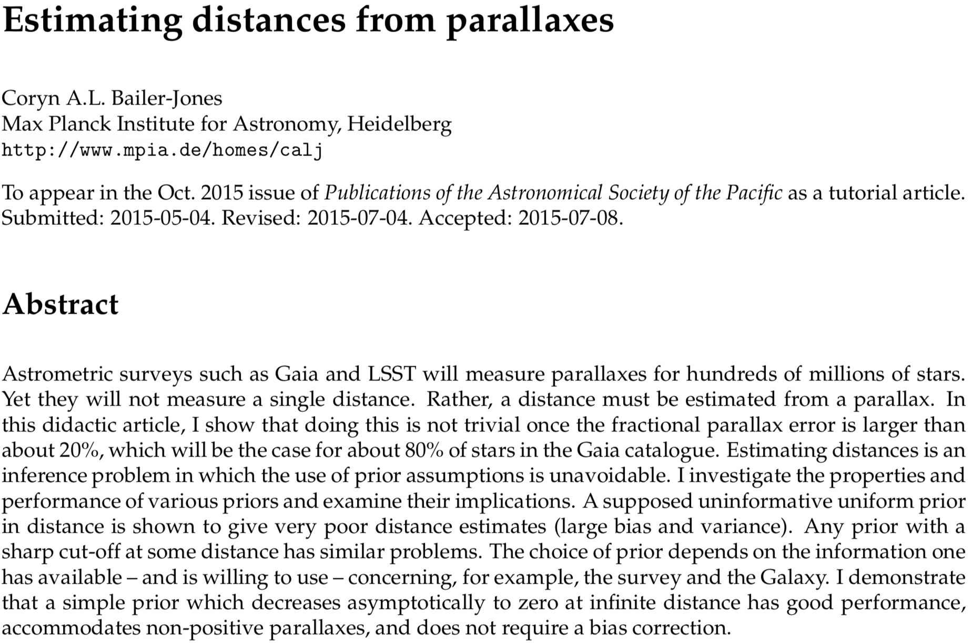
More on Priors…
If we “measure” a parallax to be 10 ± 2 milli-arcsec, what is the most likely value?
https://ui.adsabs.harvard.edu/abs/2015PASP..127..994B/abstract
https://ui.adsabs.harvard.edu/abs/2018AJ....156...58B/abstract

Slide 6
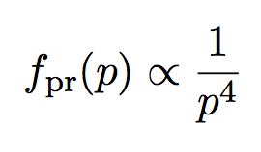
More on Priors…
If we “measure” a parallax to be 10 ± 2 milli-arcsec, what is the most likely value?
By “measure” we really mean “compute P(D|p)”.
If we know nothing else, a reasonable prior might be that the object we are observing has a uniform space density. This would give a prior distribution (exercise) of parallax p of:
So – the most likely value is much less than 10 milli-arcsec (insert python exercise here – what is the most likely distance?)

Slide 7
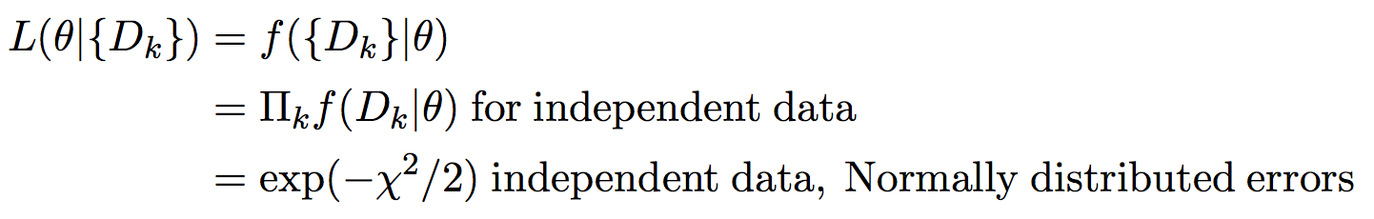

Likelihood
You’ll often hear of likelihood instead of probability. The conventional definition for a continuous random variable θ is:
Note that likelihood isn’t normalised.
The Bayesian likelihood needs a prior (e.g. last example):

Slide 8
Uninformed Priors
As the last example shows… ignoring priors can give the wrong answer. There are some typical examples (read up on Jeffreys priors if you want a formal derivation).
Unbounded numbers that can be positive or negative – a Uniform distribution, i.e. no need to write anything down.
Scale factors that have to be positive – a Logarithmic distribution with: f(a) α 1/a
Angles on a sphere, e.g. inclination in [0,180], a sinusoidal distribution with: f(i) = sin(i)/2.

Slide 9
Inverse Problems with Uncertain Data
Often a data set is reasonably removed from what we’re trying to learn. E.g.
  Observed positions of a binary star on the sky can be determined from an orbital solution… but an orbital solution is non-trivially determined from the measurements of positions.
  Interferometric measurements can be determined from a true object brightness distribution, but (esp. with self-cal etc) there is not necessarily a unique image corresponding to interferometric data.
  A CMB power spectrum and SNIa laws can be determined from a cosmology, but there is no formula to invert this.

Slide 10
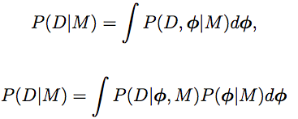
Marginalisation
Most inverse problems are phrased as problems of computing likelihood.
Sometimes, many of the parameters are nuisance parameters, and the term P(D|M) involves the probability product rule and marginalisation, i.e..

Slide 11
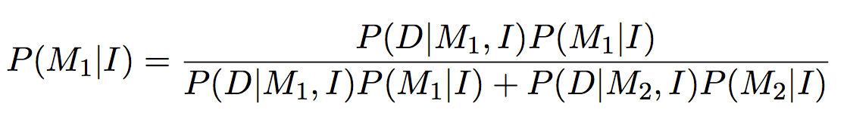
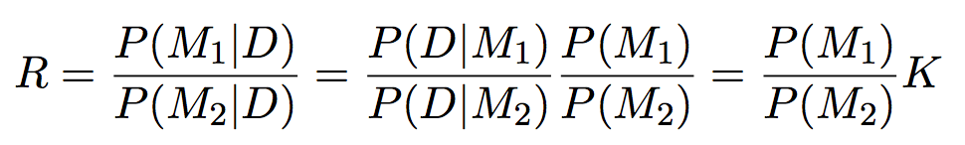
Comparing Models
If you have two models to compare, often the probability ratio is more intuitively useful than the probability.
If only 2 models are being considered, then:
More generally, we can consider a probability ratio (odds ratio) R, and a Bayes’ factor K:

Slide 12
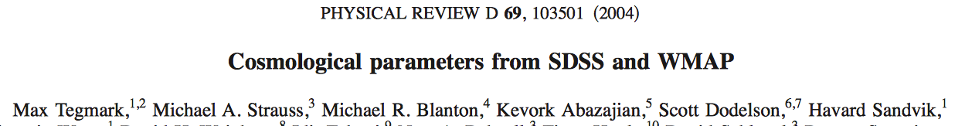
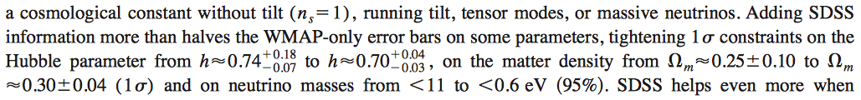
Famous Example: Tegmark (2004)
One of many early-2000s papers on Bayesian cosmological parameters, taking many data sets together and marginalising over unknown data.

Slide 13
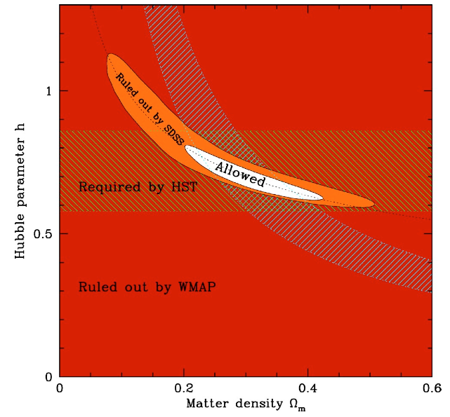
Famous Example: Tegmark (2004)

Slide 14
… and marginalisation…
(marginalisation can also be for continuous random variables)
The catch is that integrals are often highly multidimensional. How can we compute them efficiently?
(NB “parameters” above sometimes Φ, sometimes θ)

Slide 15
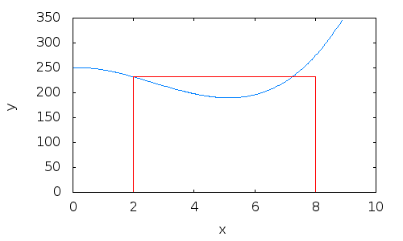
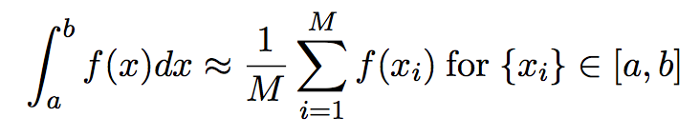
Monte-Carlo Integration
If we want to integrate a function f of a real variable over an interval, we can approximate the integral by a sum:
If we choose the x values regularly, this is rectangle integration (similar to the trapezoidal rule).
If we choose the x values randomly (Uniformly distributed), this is Monte-Carlo integration.

Slide 16
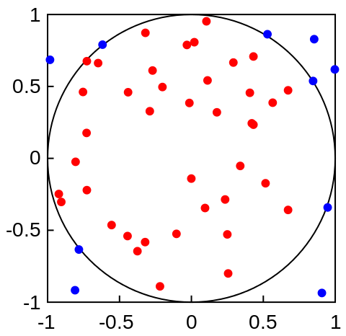
Monte-Carlo Integration
Monte-Carlo integration is obviously useless in 1D.
In N computations in M dimensions, the error in a trapezoidal-rule like integration is proportional to N^{-2/M}.
Monte-Carlo uncertainties just go as N^{-1/2}.
This means that in more than 4 dimensions, Monte-Carlo is a good idea.
E.g. Volume of a 10-dimensional hypersphere of radius 1. Should be π⁵/120. Python exercise 2…
(point out the problem… most the points lie outside the hypersphere)

Slide 17
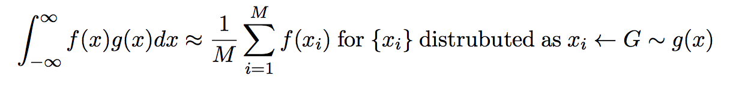
Monte-Carlo Integration with Non-Uniform distributions
Integrals that are a product of a complex function and a probability distribution can be computed like:
This may seem easy if e.g. g is a Gaussian, but how far can we take the idea of complex distributions for our {x_{i}}?

Slide 18

Monte-Carlo Markov Chains
A Markov Process is something where the future depends on the present but not the past [ P(future | present) = P(future | present,past)]
A Markov Chain is a discrete Markov process where the next step in the sequence (of numbers or vectors) depends only on the present step.
Markov Chain Monte Carlo is a way of creating a Markov Chain where, in the limit of infinite time, the distribution of parameter vectors θ match the posterior likelihood.

Slide 19
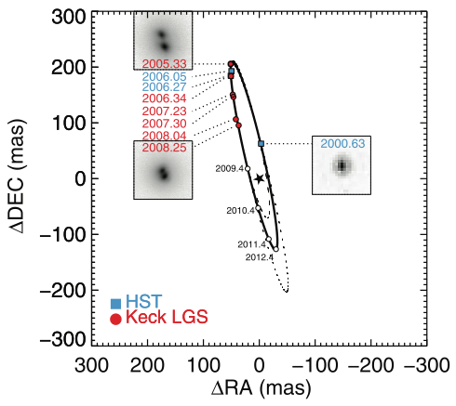
Personal Example: 2MASS J1534-2952AB
From less than half an orbit, can we find the dynamical mass a T dwarf binary?
(NB paper submitted and accepted without 2008 data)
http://adsabs.harvard.edu/abs/2008ApJ...689..436L

Slide 20
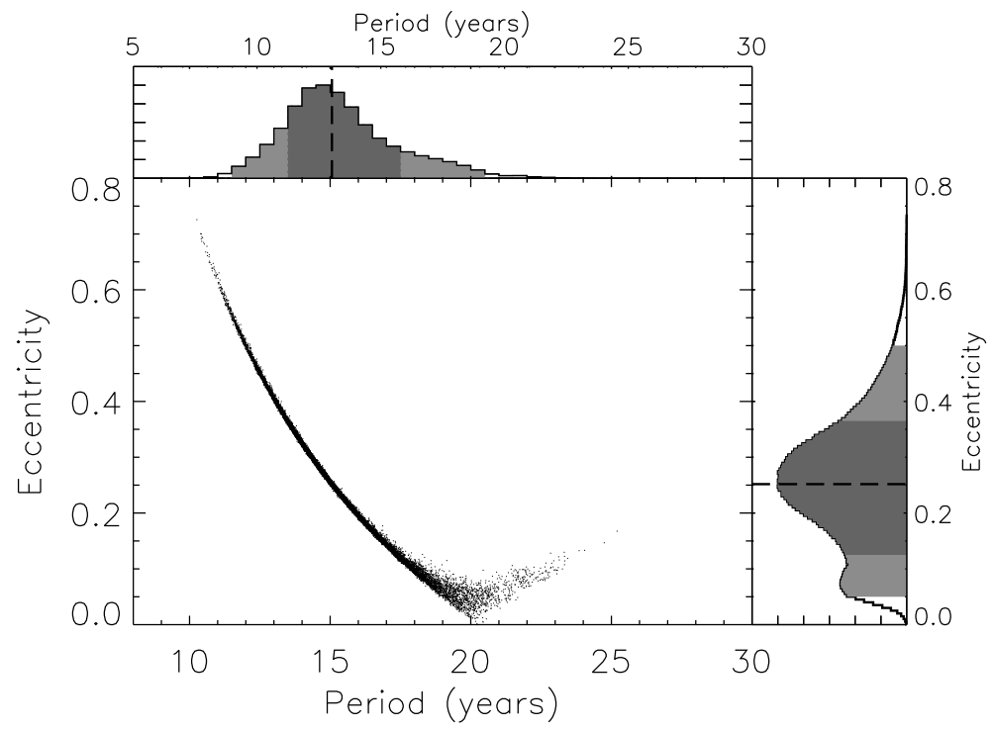

Slide 21
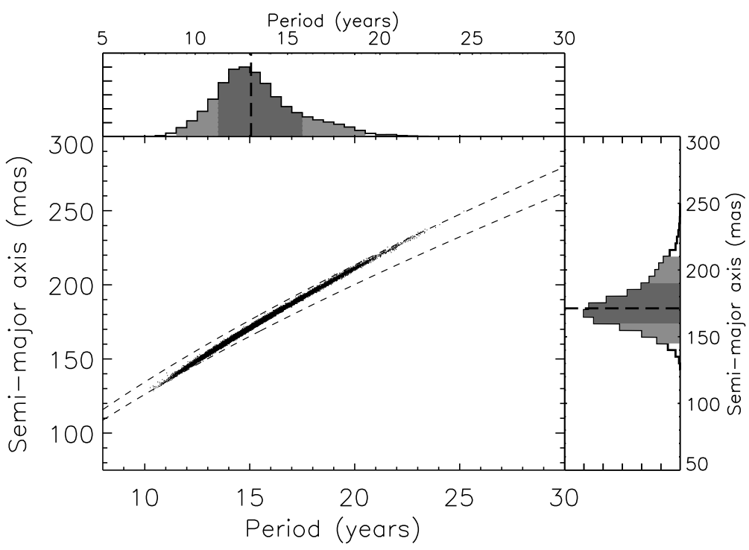

Slide 22
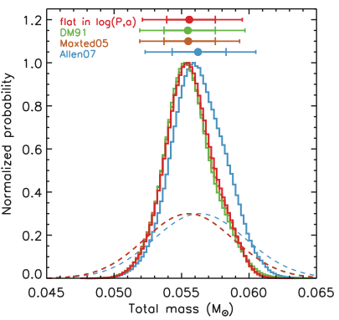
Dynamical mass M=a³/P² changes little with different orbits.
M = f(θ)
Parallax dominated the uncertainties.
Different “reasonable” priors gave nearly the same answer.

Slide 23
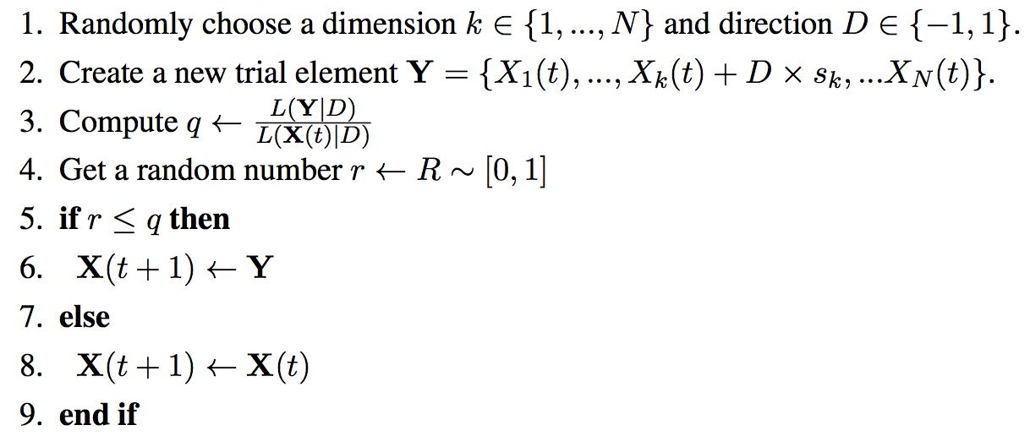
Metropolis-Hastings with Gibbs Sampler…
The simplest way to compute a chain is with the MH algorithm.
The simplest MH variant is the Gibbs Sampler, where each dimension k has its own step size s_{k} and our parameters θ are approximated by the chain X(t).
Note that this algorithm always goes “downhill” and sometimes “uphill” in chi-squared space.

Slide 24
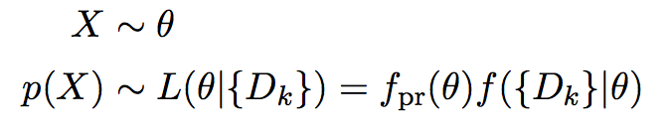
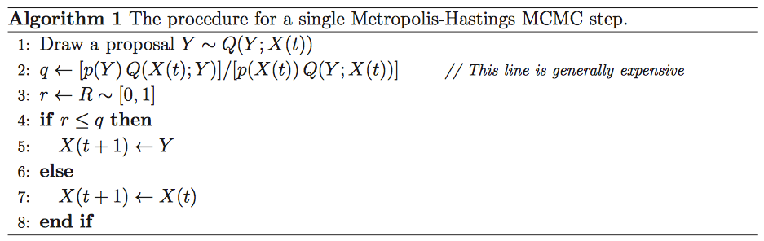
Metropolis-Hastings Algorithm
The general MH algorithm can make e.g. variable step sizes.
E.g. from http://arxiv.org/pdf/1202.3665v4.pdf, with:

Slide 25
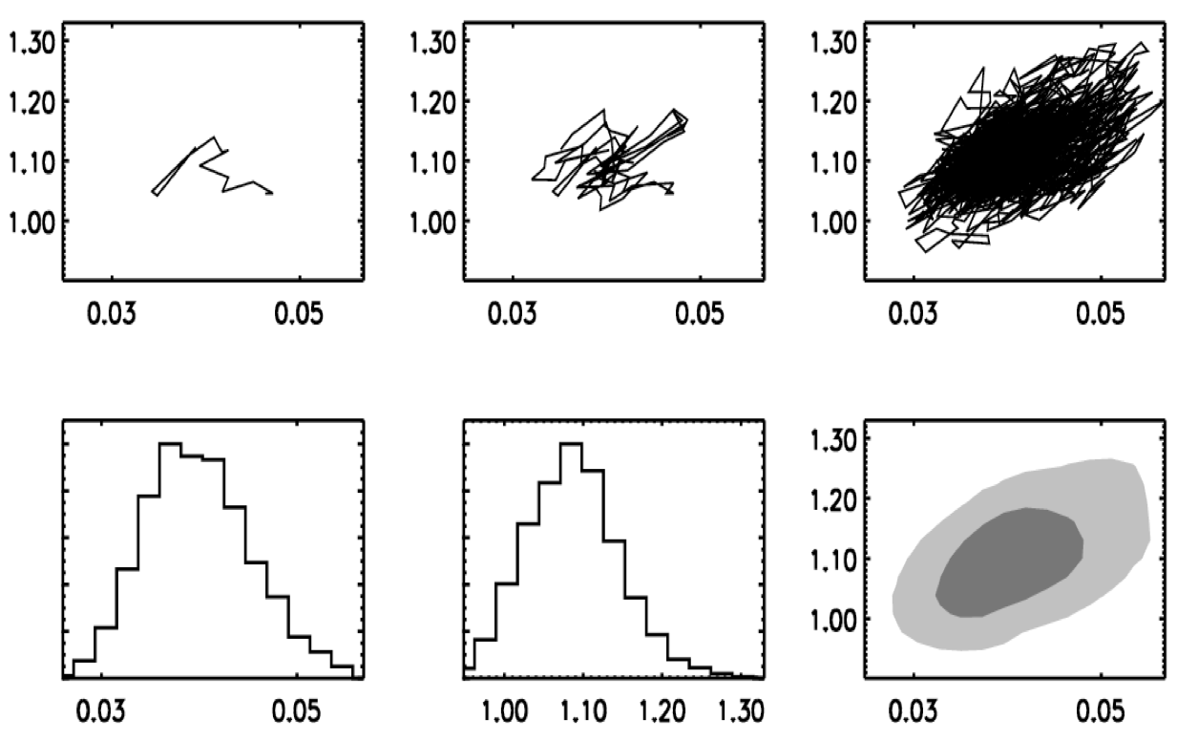

Slide 26
Tricks with Metropolis-Hastings
Unless you know you start at the global minimum (and arguably even if you do), MCMC requires a “burn-in” time to randomize the starting location.
Step sizes in the Gibbs sampler can’t be too large or too small – for optimal convergence, you want to accept new steps about half the time.
Finding credible intervals which are Bayesian confidence intervals requires care in wording. E.g. no standard on using the posterior mean, median or mode (maximum likelihood/MAP) for the “best guess” parameter.
To get reliable results, you have to make sure the chain runs for many correlation lengths.
If you have multiple solutions in totally different parts of parameter space, you need a better algorithm or annealing.
Complex distribution and pretty plots need more steps.

Slide 27
Affine-Invariant Monte-Carlo
In the Liu/Dupuy/Ireland work, we used a trial chain, then chose new Metropolis-Hastings directions as linear combinations of parameters using principle component analysis on the trial chains.
This works, but is regarded as dodgy because the algorithm as a whole violates the Markov property.
A better idea is to find an algorithm that works equally well on any linear combination of parameters.
These are trickier to code… but luckily other people have coded them for us! E.g. emcee which is in anaconda.

Slide 28
Blue chain new trial point
Red chain
Blue chain

Slide 29
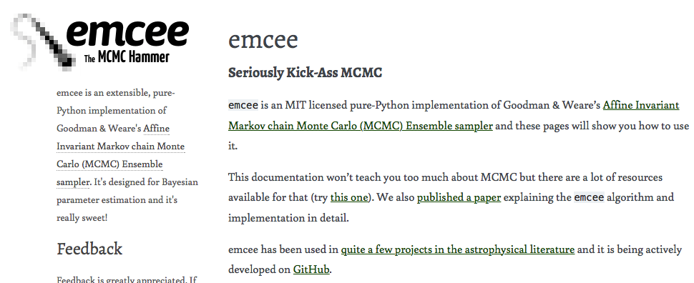
Emcee – a standard astro package
This is very popular, however please remember that emcee is best for sampling, not optimisatinon, and is best in a low to moderate number of dimensions:
https://statmodeling.stat.columbia.edu/2017/03/15/ensemble-methods-doomed-fail-high-dimensions/
If there is time, lets code up and discuss the quick-start example. If not… do it in your owm time before the assignment!
https://emcee.readthedocs.io/en/stable/user/quickstart/

Slide 30
Summary
Integrals in Bayesian inverse problems are often stupidly difficult to compute. The solution is Monte-Carlo integration.
In most situations, Monte-Carlo Markov Chain integration is fastest, because it computes P(D|θ) for parameters θ only in the region where they are most likely given the data D.
Although writing your own code for the Metropolis-Hastings algorithm is super-fun and relatively easy, once you get to affine invariant ensemble MCMC, and you want parallelizable code, it is often easier to use pre-made tools e.g. emcee.

