Slide 1

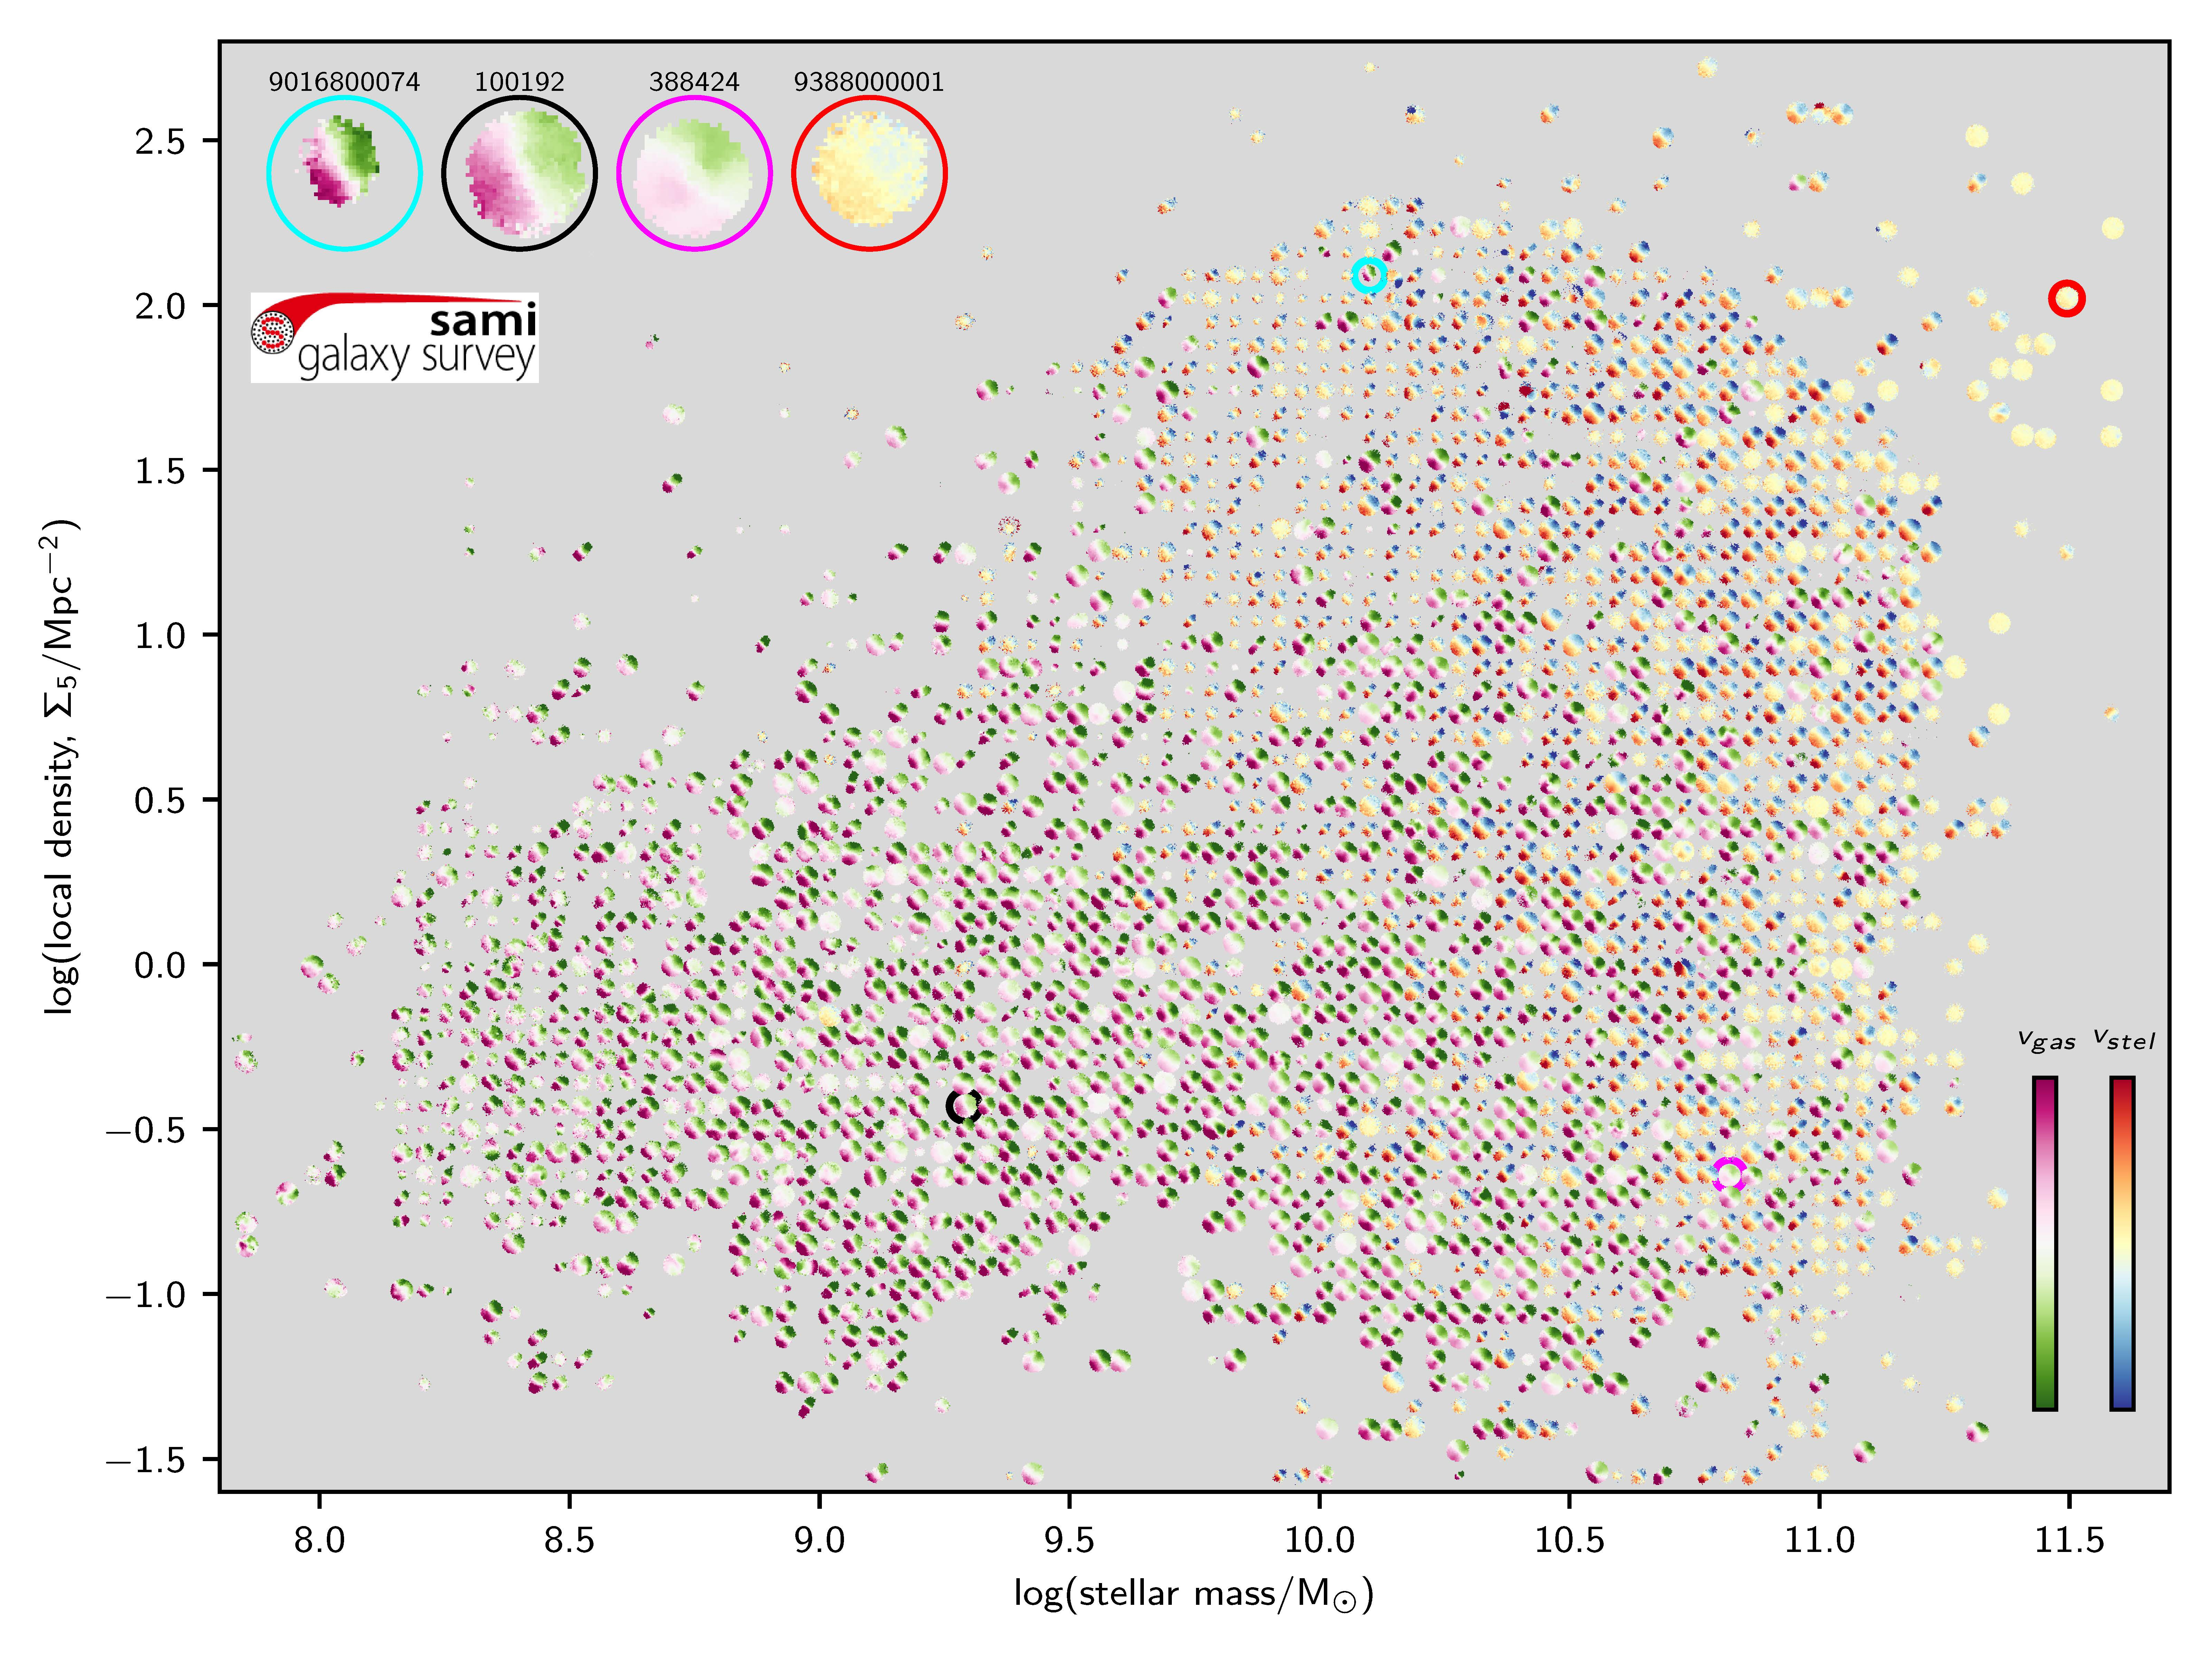


The SAMI Galaxy Survey
Scott Croom (University of Sydney, ASTRO 3D)
and the SAMI team

Slide 2
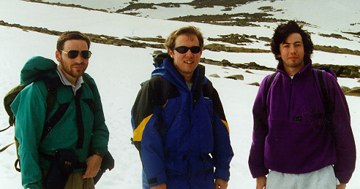
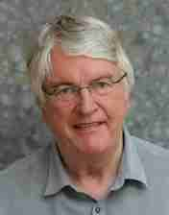
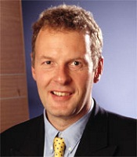
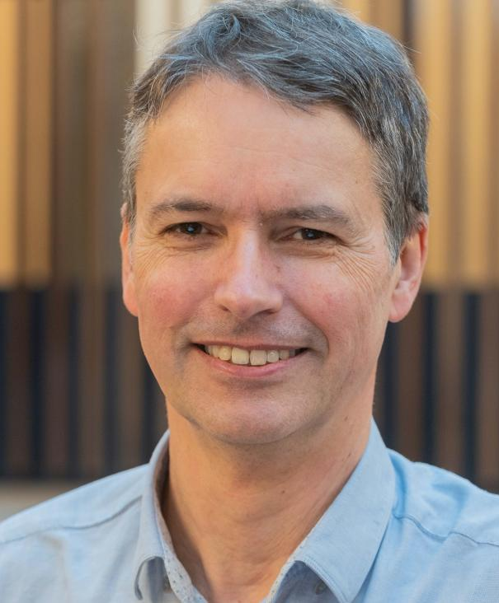
But first…..
2dF QSO Survey (2QZ).
23000 quasars.
Selected from UKST plates in u, b_{J} and r bands.
PhD work in Durham from 1993.
First visit to AAT in December 1996.
Move from Imperial to AAO in 2000.
Robert Smith Scott Croom Dave Lee
Tom Shanks Brian Boyle Lance Miller
Notes:
Like quite a few here, my connection to the AAT started with the connection to Durham.
I started my PHD in Durham in 1993 with Tom Shanks, focused on the 2dF quasar survey. This was a driven by Tom Shanks and Brian Boyle, along with Lance miller. Robert Smith and I were the PHD students on the project, so did most of the work….
However, in some ways my connections started the year before, in the undergraduate physics lab in Durham. The lab supervisor was Ian Parry, my tutor as Roger Haynes and I did an experiment using a single optical fibre running down from a telescope on the roof to spectrograph in the lab. Little did I know that 30 years later, I would still be using fibres and spectrographs…
Selecting quasars with UKST plates
My first trip to Australia was 1996 – 2nd comms run of 2dF. Relief to know that the targets we selected actually turned out to be quasars.
By 1999 Brian had moved to AAO as director and offered me a job as a research fellow. This was too good an opportunity to turn down, so in Feb 2000 I arrived at AAO.

Slide 3
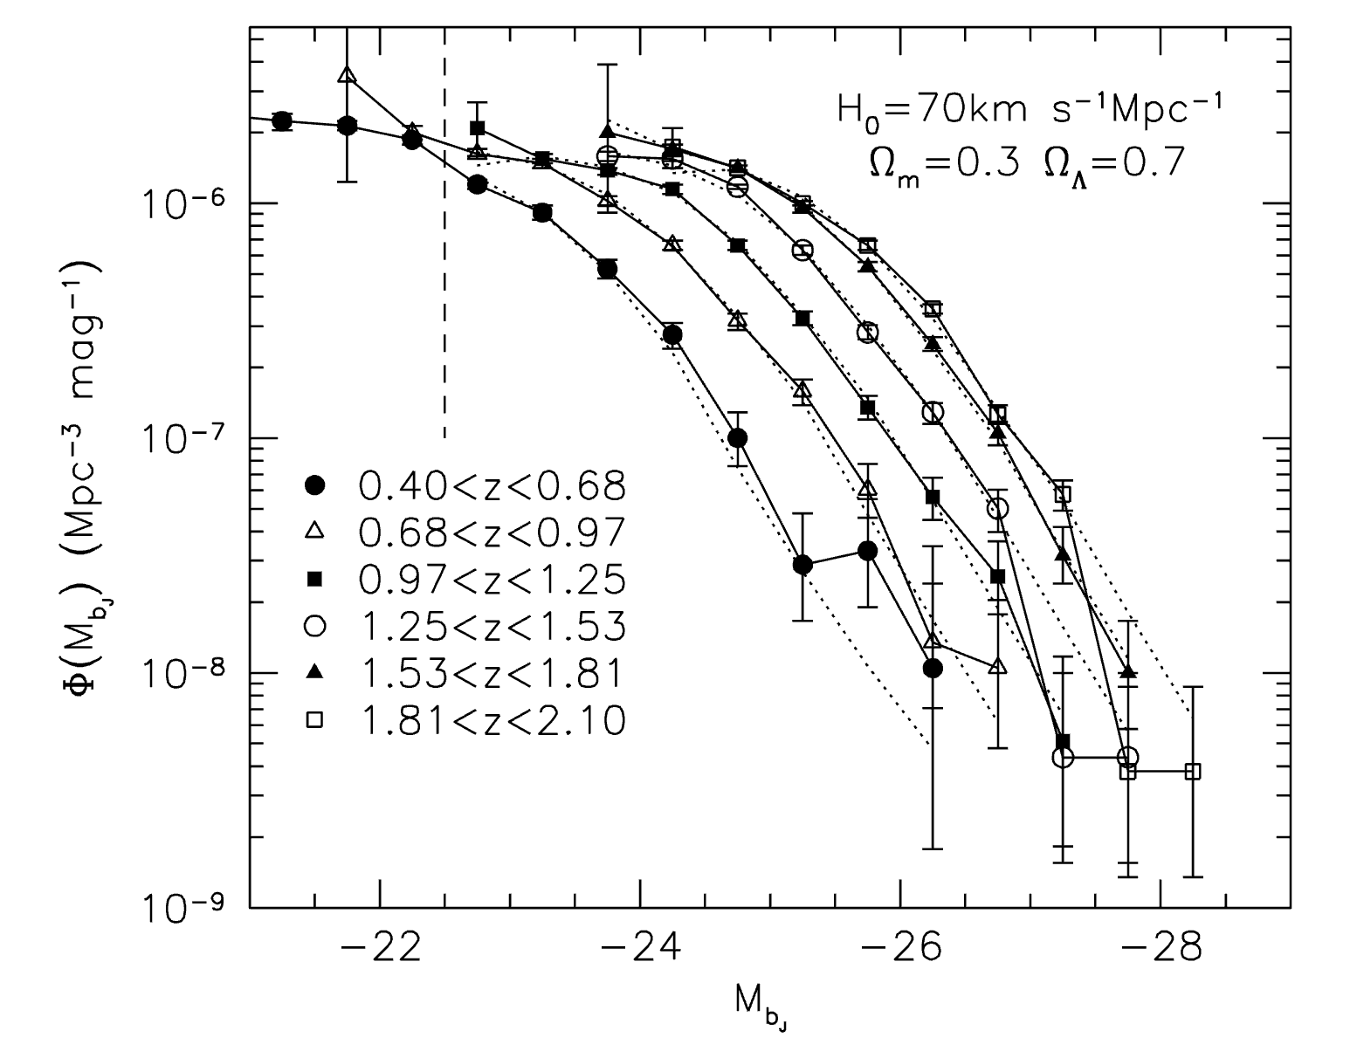
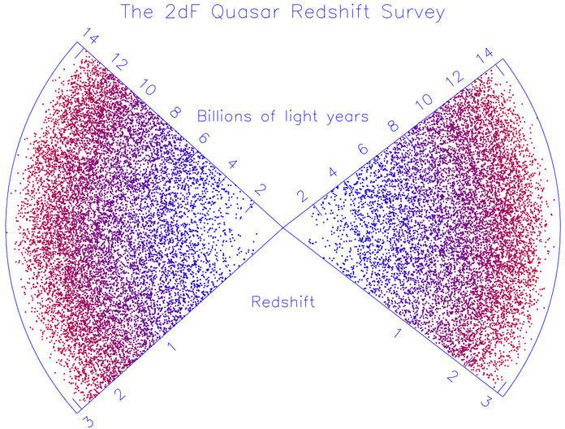
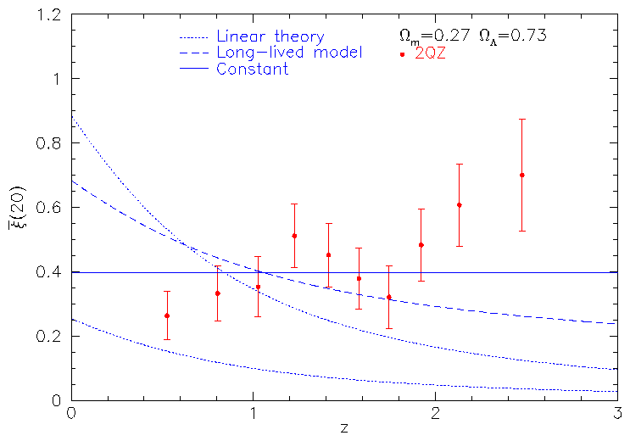
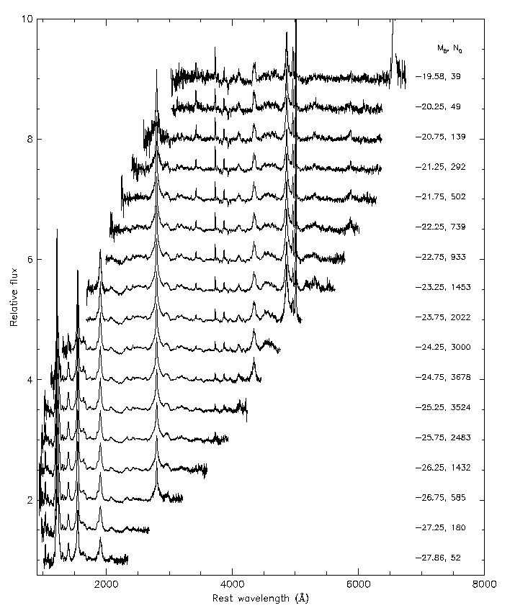
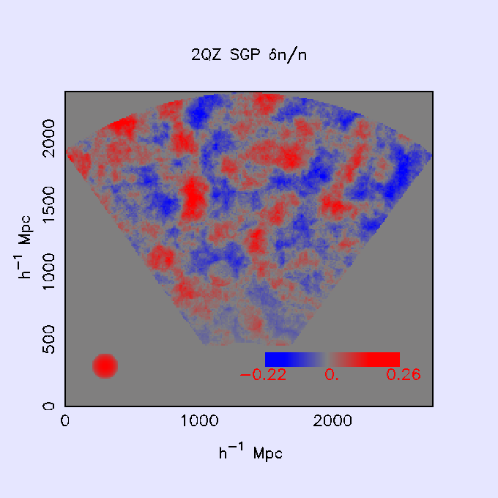
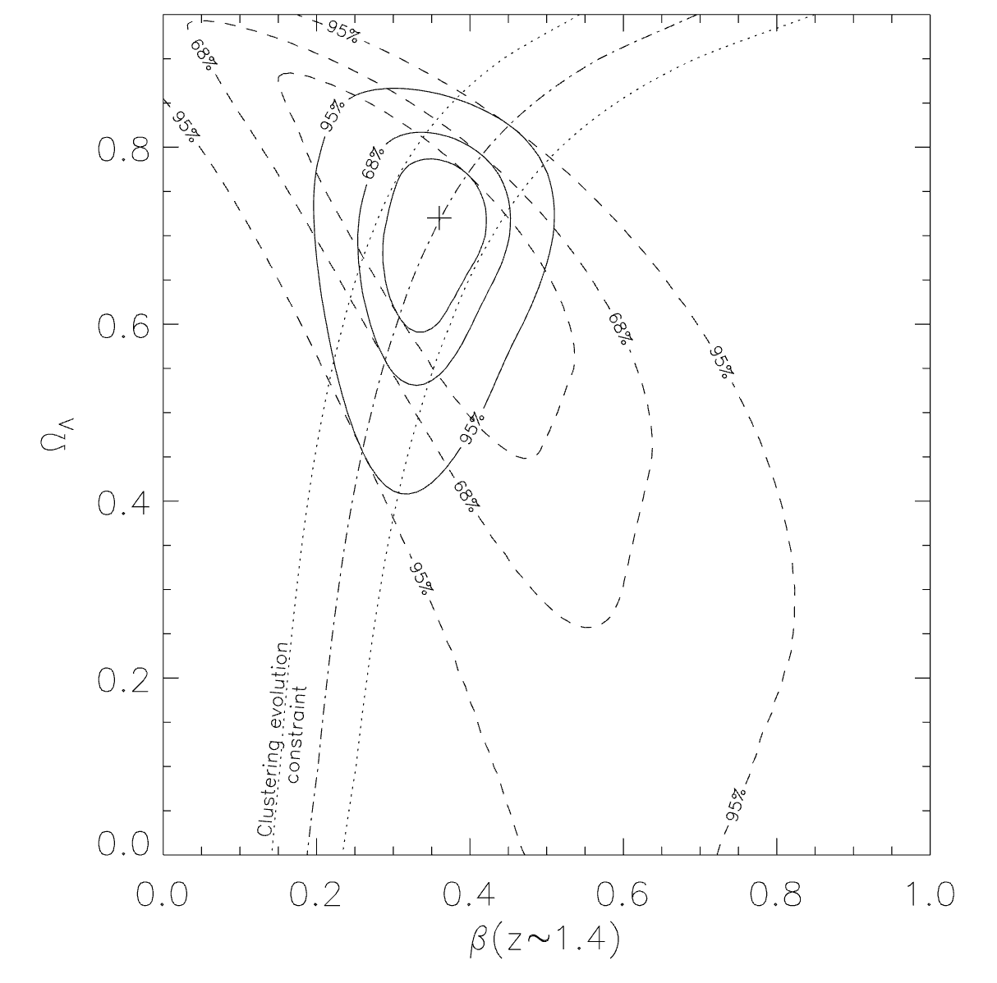
Diverse science from 2QZ
Quasar clustering evolution (Croom et al 2005)
Quasar LF evolution (Boyle et al 2001; Croom et al 2004)
Spectral properties (Croom et al 2002; Corbett et al 2003)
Cosmology measuring Lambda (Outram et al 2004)
Large-scale structure (Miller et al 2002)
Notes:
Like quite a few here, my connection to the AAT started with the connection to Durham.
I started my PHD in Durham in 1993 with Tom Shanks, focused on the 2dF quasar survey.
Selecting quasars with UKST plates
My first trip to Australia was 1996 – 2nd comms run of 2dF. Relief to know that the targets we selected actually turned out to be quasars,

Slide 4
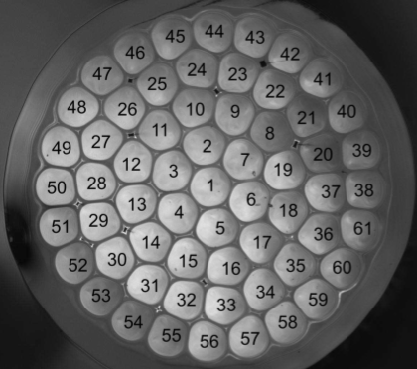
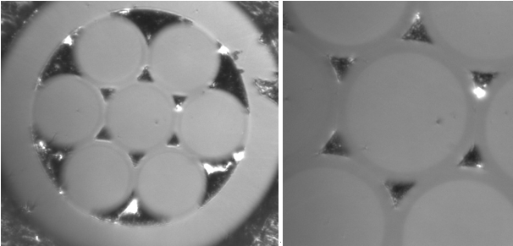

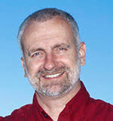
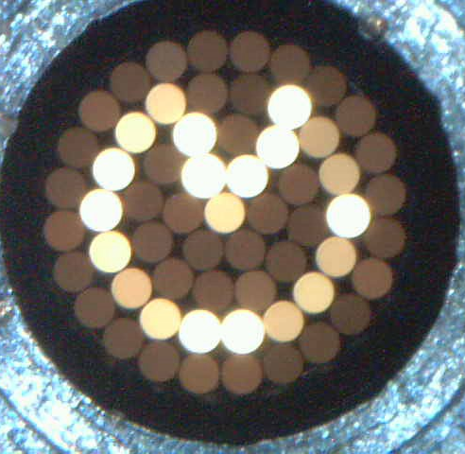
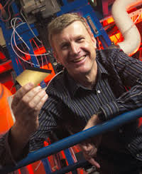
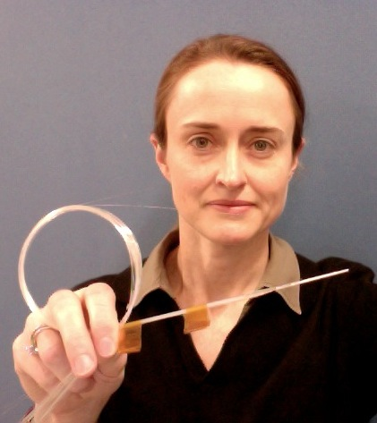
Sydney-AAO Multi-object IFS (SAMI) - origins
Large single fibre surveys (2dF/SDSS), powerful but incomplete view of galaxies.
SAURON & ATLAS3D IFS surveys with a new view of galaxies.
Hexabundle technology.
Design study for FIREBALL on VLT using OzPOS.
Fast track demonstrator on the AAT -> SAMI (first light, 2011)
Bland-Hawthorn et al. (2008)
Bryant et al. (2010)
Joss Bland-Hawthorn
Julia Bryant
Jon Lawrence
Matthew Colless
SAMI
Notes:
I was now at Sydney Uni, having moved from AAO in 2006.
2dF and SDSS had made a huge impact, but the sense the single fibres per galaxy missed a lot of the details. This was highlighted by the ground breaking work of SAURON and ATLAS 3D that Roger has already mentioned
At the same time Joss had been developing a fused fibre technology that made multiplexed IFUs easier with a high fill factor – hexabundles.
The hexabundles were further developed to give excellent optical performance by Julia Bryant.
To make use of these, we came up with a concept called fireball, to use OzPOS on the VLT to make a large IFU fed instrument, collaborating with Rolnad Bacon and Martin Roth. Now fireball didn’t end up being funded by ESO, but…
In the mean time, it became clear to me we could put these on the AAT as a demonstrator. A big thank you to Matthew Colless, director at the time, for giving us the green light to do this. Jon Lawrence was key in making the driving along all the instrumentation work to make this happen, and realsing we could use the 1 degree field top end previously used for David malin’s photography.

Slide 5
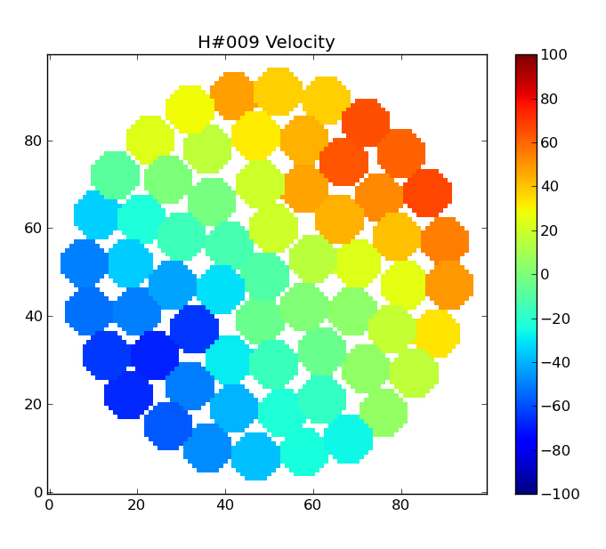
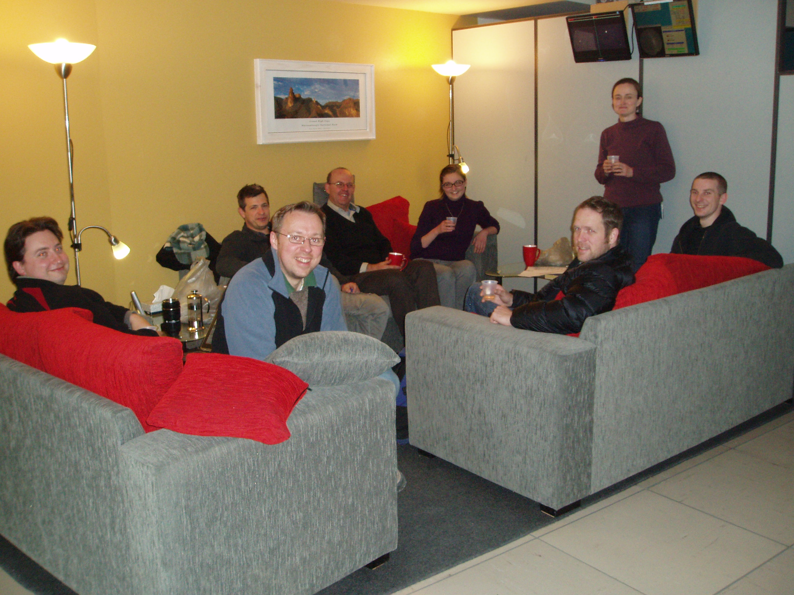
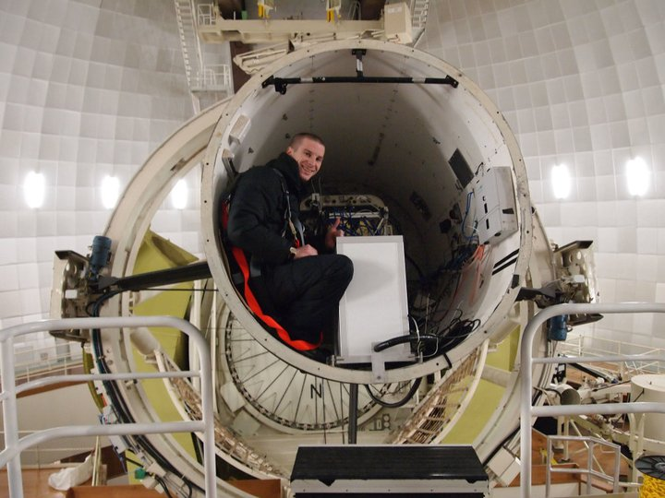
SAMI… it works….
The first SAMI velocity field from the first night of commissioning
SAMI commissioning team, July 2011
Sam Richards in the triplet top end with SAMI

Slide 6
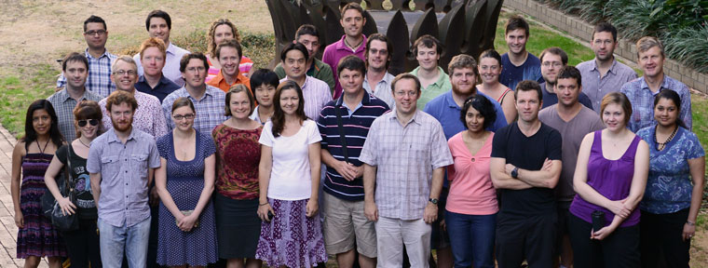
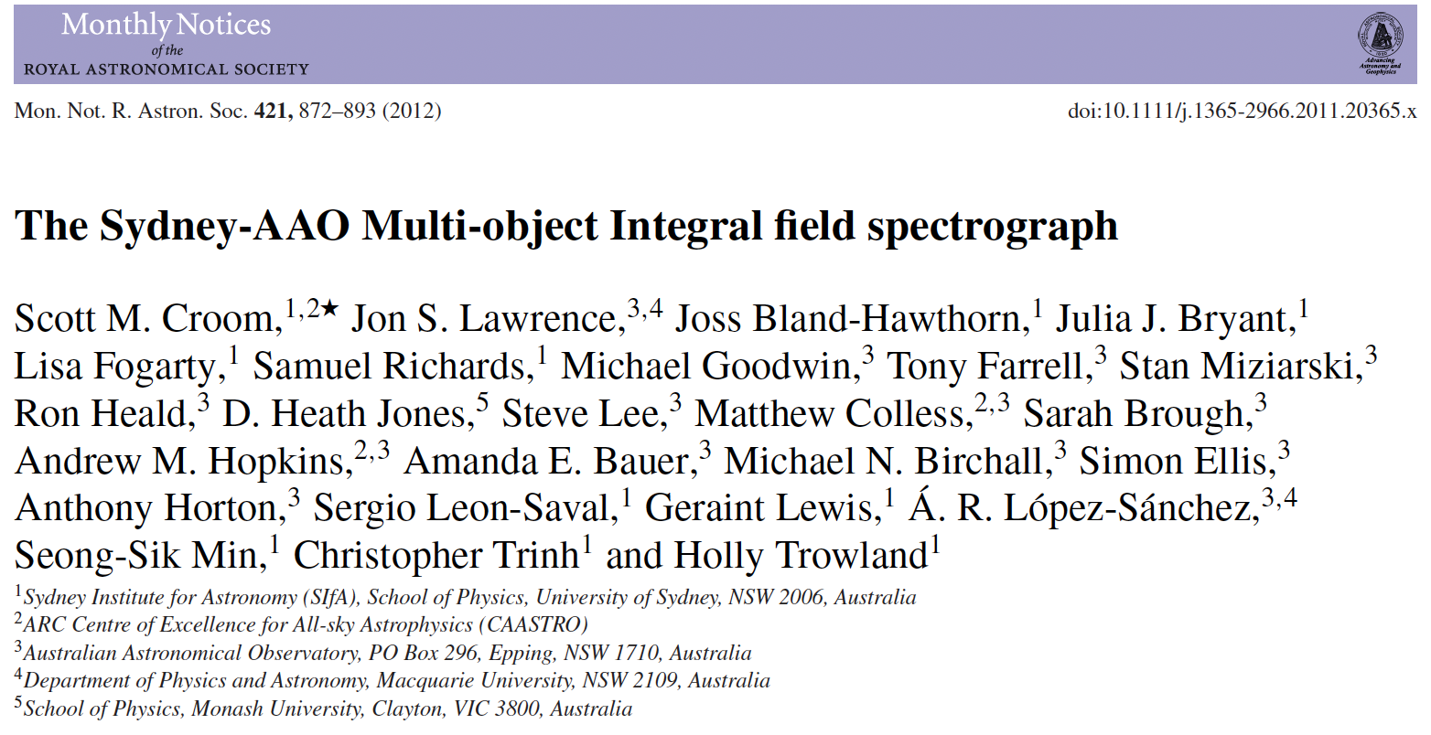


SAMI in a nutshell
1 degree diameter field-of-view.
13 x 61 fibre IFUs using hexabundles (Bland-Hawthorn et al. 2011; Bryant et al. 2014).
15” diameter IFUs, 1.6” diameter fibres.
Feeds AAT’s AAOmega spectrograph.
Wavelength coverage/resolution:
  Blue: 3700-5800A, R~1750, σ=70km/s
  Red: 6300-7400A, R~4500, σ=30km/s
6

Slide 7
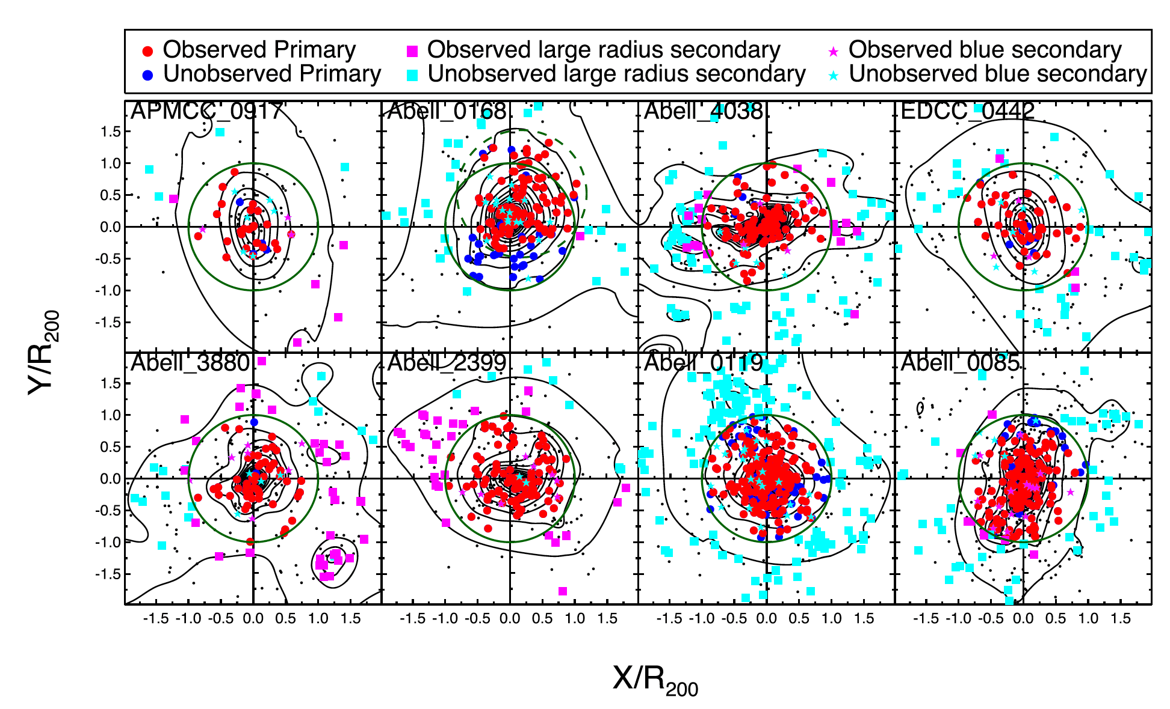
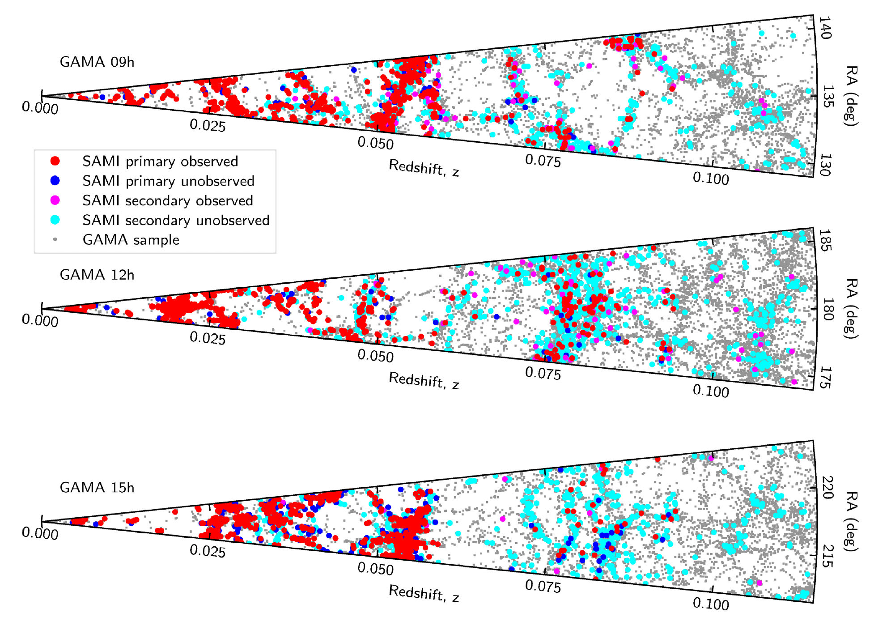

The SAMI Galaxy Survey
Stellar mass selected and volume limited (Bryant et al 2015)
Selected from the GAMA (Driver et al 2011) survey.
Additional specific clusters (Owers et al 2017).
~2/3 of galaxies in GAMA group catalogue (Robotham et al. 2011).
Croom, Owers et al (2021)
Matt Owers

Slide 8
234 AAT nights later…

Slide 9
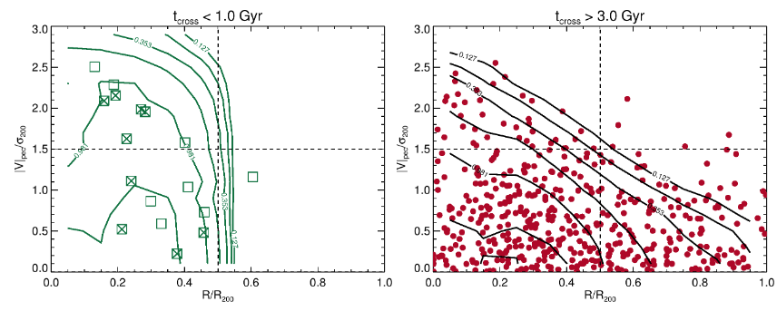
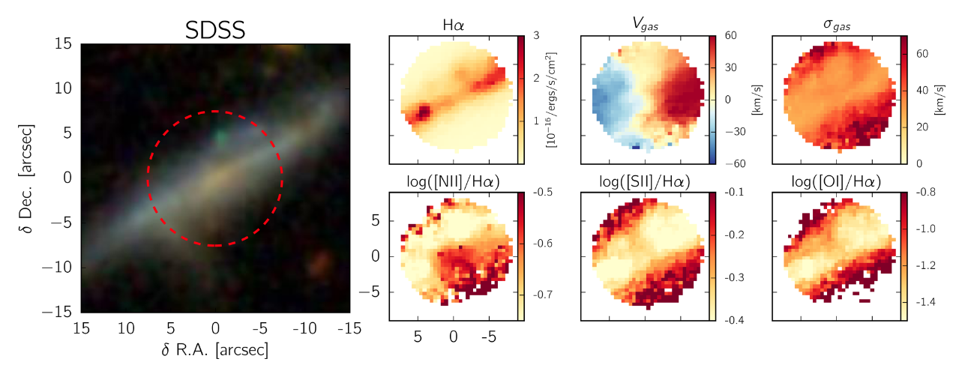
SAMI Science
Huge diversity of science. See : https://tinyurl.com/samipapers
Winds and outflows: e.g. Fogarty et al 2012; Ho et al 2014, 2016; Hogarth et al 2021; Johnston et al 2023; Zovaro et al 2024
Star formation, quenching and environment: e.g. Richards et al 2016; Schaefer et al 2017, 2019; Medling et al 2018; Owers et al 2019; Cortese et al 2019; Wang et al. 2022
Scaling relations: e.g. Cortese et al 2014; Scott et al 2015; Cortese et al 2016; Bloom et al 2017; Barat et al 2019; Catinella et al 2023; D’Eugenio et al 2021, 2024
Stellar populations, ages and metallicity: e.g. Scott et al 2017; Ferreras et al 2019; Fraser-McKelvie et al 2022; Barone et al 2018, 2022; Watson et al 2022a/b; Vaughan et al 2022; Foster et al 2023
Gas turbulence, misalignment and kinematic asymmetry: e.g. Bryant et al 2019; Varidel et al 2019, 2020; Ristea et al 2023; Watts et al 2023; Oh et al 2024.
Drivers of galaxy dynamics: e.g. Brough et al 2017; van de Sande et al 2017, 2018, 2019; Welker et al 2020; Fraser-McKelvie et al 2021; Rutherford et al 2021; van de Sande et al 2021; Mai et al 2022; Santucci et al 2023; D’Eugenio et al 2023; Barsanti et al 2022, 2023; Croom et al 2024; Vaughan et al 2024; Rutherford et al 2024
Owers et al (2019)
Ho et al (2016)
Notes:
SAMI is a mutli-object integral field spectrograph on the AAT, 12 galaxies at a time.
Allowed a survey of over 3000 galaxie, with the data now fully public.
Key points for this analysis is a wide range in stellar mass and galaxy environment, from clusters to the field.

Slide 10
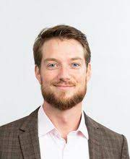
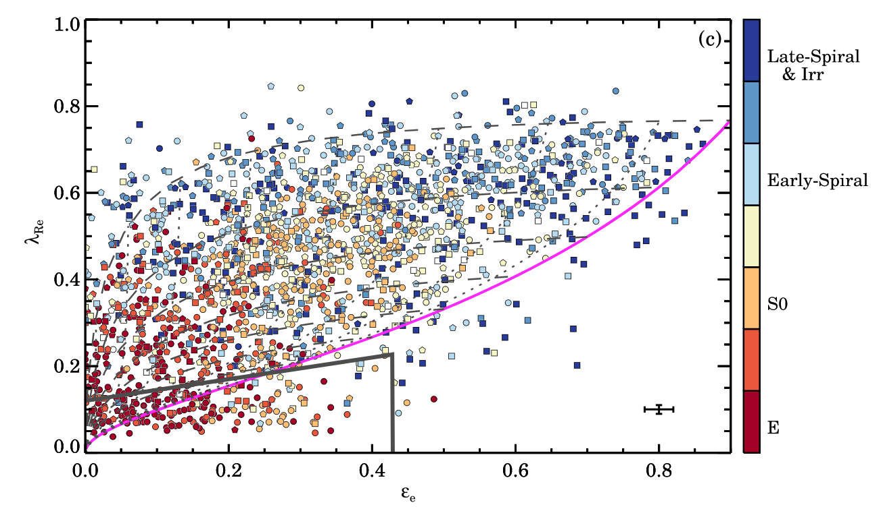
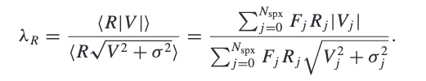
Galaxy spin and morphology
SAMI: van de Sande et al (2021)
Jesse van de Sande
Morphology ≈ dynamical state + gas content.
Notes:
Key point – morphology is dynamics – where the stars most likely to be.

Slide 11
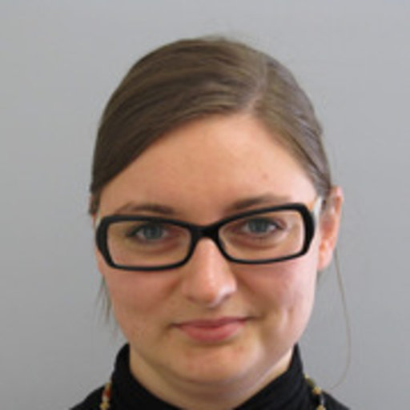
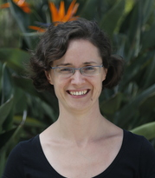
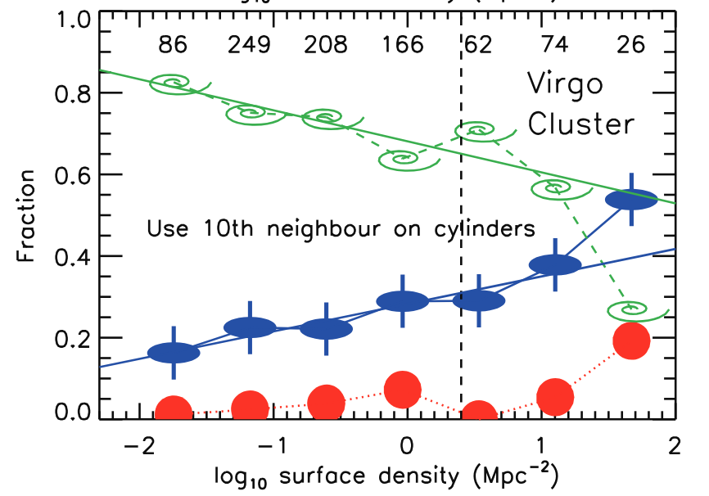
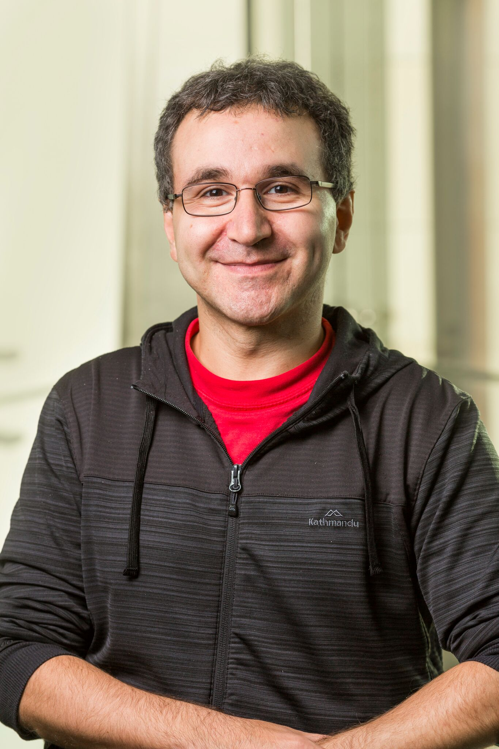
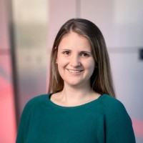
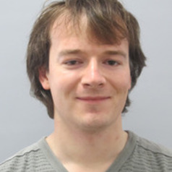
What are the drivers of galaxy spin?
Environment (e.g. Cappellari et al, 2011, Fogart et al 2014; Graham et al 2019, van de Sande et al 2021)
Mass (e.g. Brough et al 2017, Veale et al 2017, Green et al 2018, van de Sande et al. 2021)
Age/SFR (e.g. van de Sande & Scott et al 2018, Fraser-McKelvie & Cortese et al 2021)
Lisa Fogarty
ATLAS3D: Cappellari et al. (2011)
Sarah Brough
Jesse van de Sande
Amelia Fraser-McKelvie Nic Scott Luca Cortese
Notes:
Various works, including a number of Sami papers have investigated different trends that drive the spin of galaxies.
While the environmental trends seem real, supporting the early work of ATLAS3D, mass seems to be a much stringer driver than environment.
The work from jesse in 2018 showed that there is also a trend with age.
The key issue here is trying to figure out what drives changes in spin to help us get closer to the physics.

Slide 12
Putting it all together
Croom et al. (2024)
𝛌_{Re} - spin parameter within 1 R_{e} (van de Sande et al 2017, 2019).
Age_{L} (Gyr) - Light-weight age from SAMI full spectral fitting within 1R_{e} (Vaughan et al. 2022).
Log(M*/M⦿) - Stellar mass (Taylor et al 2011; Bryant et al. 2015)
Log(𝛴₅/Mpc⁻²) - 5th nearest neighbour surface density (Brough et al. 2017).
Halo mass + satellite/central – from GAMA groups catalogue (Robotham et al 2011)
Everything correlates with everything….
Notes:
As a result, what e aim to do here is compare all the likely driving parameters.
Four out work we are going to use light weighted age based on full spectal fitting (also tested mass weighted age)., stelar mass, and various environmental metrics in including he 5th nearst neghbour dernsity and whether a galaxy is a central or satellite
If we compare different parameters. We get thre unsurprising result (that you will be used to if studying galaxies) that everything correlates with everything else.

Slide 13
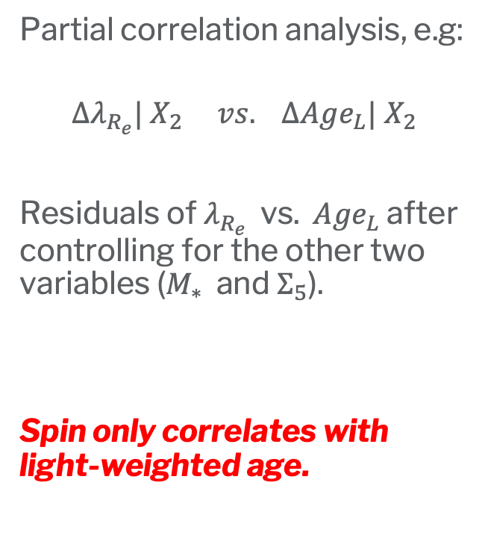
Putting it all together
Partial correlation analysis, e.g:
$$Δλ_{R_{e}}| X_{2} vs. Δ{Age}_{L}| X_{2}$$
Residuals of $λ_{R_{e}}$ vs. ${Age}_{L}$ after controlling for the other two variables ($M_{∗}$and $Σ_{5}$).
Spin only correlates with light-weighted age.
Notes:
However, this is no longer the case if we do a partial correlation analysis.
Now each plot is the correlation of the residual of two variables after correcting for the other two. E.g. spin/age controlling for….
The striking result is that spin always strongly correlates with age, but once age is accounted for there is no spin correlation with mass or environment.
Age sems to be the primary driver of spin.

Slide 14
The spin-age relation
RMS scatter in 𝛌_{Re} = 0.15
Croom et al. (2024)
Notes:
We can look at this another way by plotting spin vs age.
Here we have colour coded points by environment. The median relation is shown by the black points, and the line is a fit to the median relation.
While younger galaxies are typically at lower density and older at higher density, Here we see that there is no obvious difference in the spin-age relation for different environmental densities,

Slide 15
The spin-age relation
Croom et al. (2024)
Notes:
We can look at this another way by plotting spin vs age.
Here we have colour coded points by environment. The median relation is shown by the black points, and the line is a fit to the median relation.
While younger galaxies are typically at lower density and older at higher density, Here we see that there is no obvious difference in the spin-age relation for different environmental densities,

Slide 16
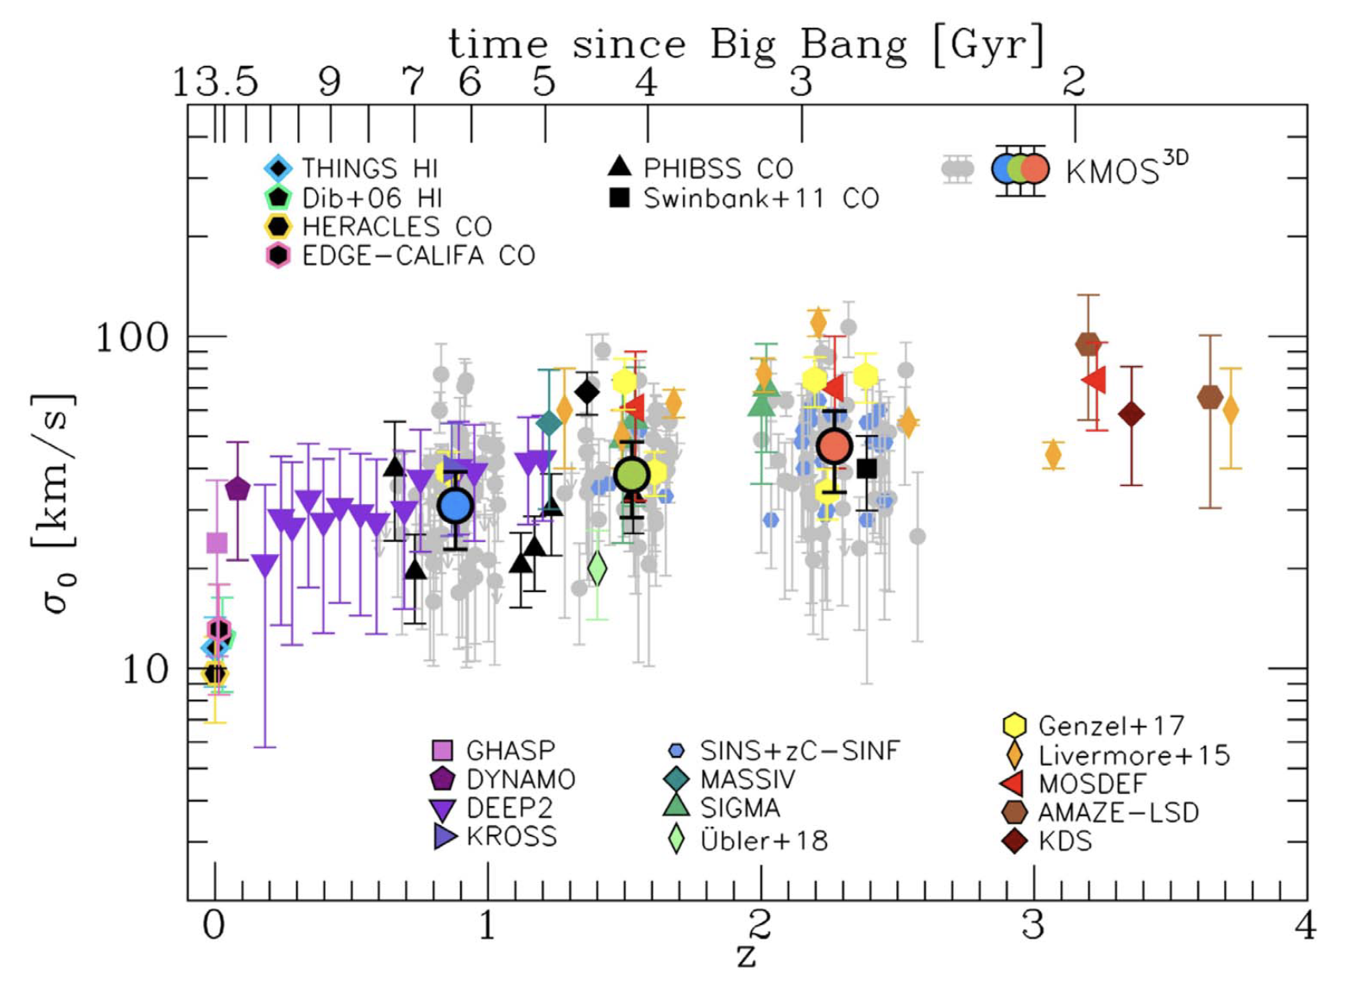
What is happening (most galaxies)?
Environment drives quenching
Quenching drives age
Age drives kinematic structure
Secular heating (e.g. from bars) after quenching?
Progenitor bias – stars born hotter at high z (e.g. Wisnioski et al. 2015; Übler et al. 2019; Yu et al 2022).
Übler et al (2019)
Notes:
So what does age driving spin mean? First we not that while this is true fot eh buk of the population, there are excpeiotn at high mass that we will talk about in a minute.
Ther are two obvious interpreations.
First, once a galaxy is quenched, so starts to age dynamical interatction in the disk, e.g. through bars can drive dynamical heating. This secular heating may drive some of the change we see.
However, an altenative is that the older stars, are born hotter.
We know that gas velocity dispersions are higher at high z, as seen in various works, partivular using MKOS and other IR IFS. If galaxies are quenched earlier 9so look older now), we only see those ht stars, not the colder disks that form later.

Slide 17
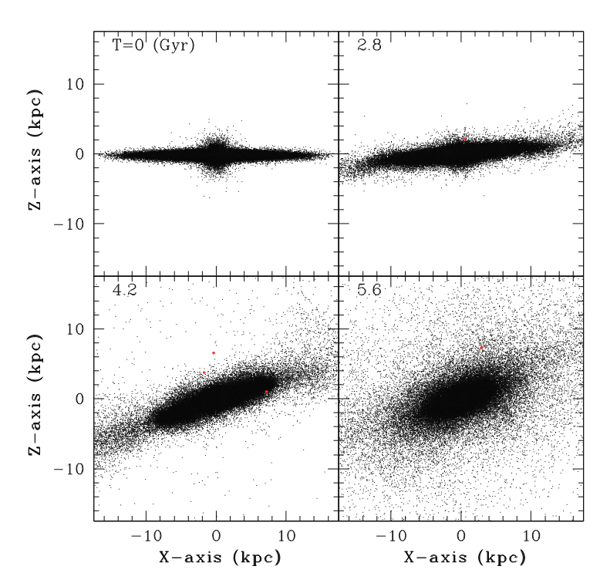
What isn’t happening (most galaxies)?
Environmentally dependent dynamical transformations are not important:
  Galaxy harassment in clusters (e.g. Moore et al 1996)
  Group galaxy-galaxy interactions (e.g. Bekki & Couch 2011)
  Galaxy-halo interactions
  Mergers?
May still have some impact at larger radius, > 1R_{e}.
Bekki & Couch (2011)
Notes:
Theat ther is no direct relation with environment (only indirect via age) suggests that any mechanisms directly related to environment are not importat, these include….
Ther is one caveat to this statement, that we are measugint kinematics within 1e, and these effects may be more important at large radius.

Slide 18
Highest mass
Above log(M*) ~ 11, residual environmental difference comparing satellites and centrals (see also van de Sande et al 2021).
Supports mergers growing high mass “slow rotators” (e.g. see Lagos et al 2022).
Age still important - dry mergers needed to spin down galaxies (Lagos et al 2018).
Notes:
While this seems like a simpke abd elegant story, its never quite that simple.
When we go to high massesgalaxies don’t follow the mean spin-age relation so well.
Here we plot the relation, but subdivided into mass intervals, and colpour coded as to whether galaxies are satellies or centrals of GAMA groups.

Slide 19
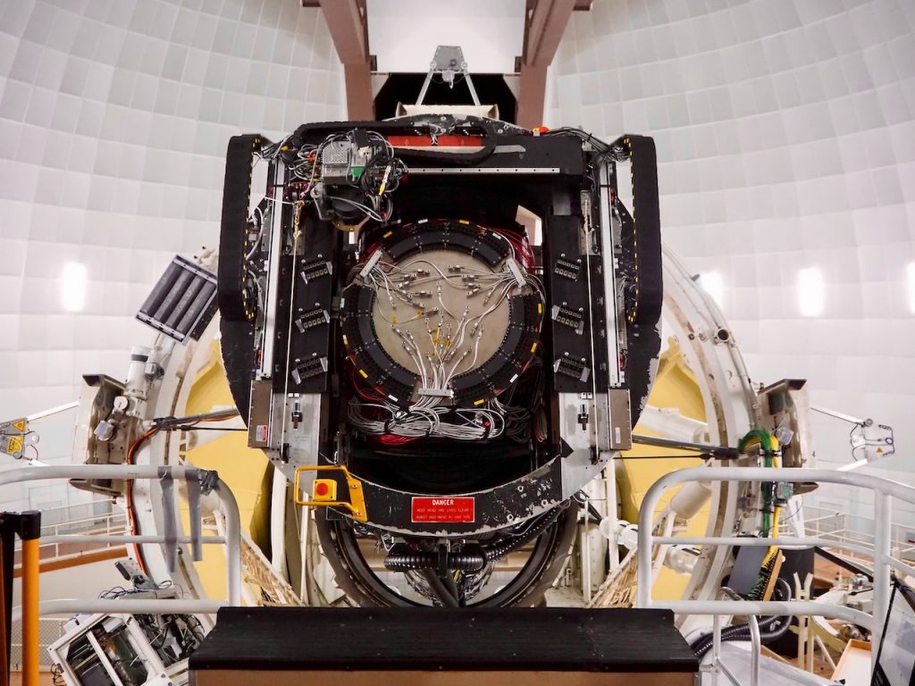
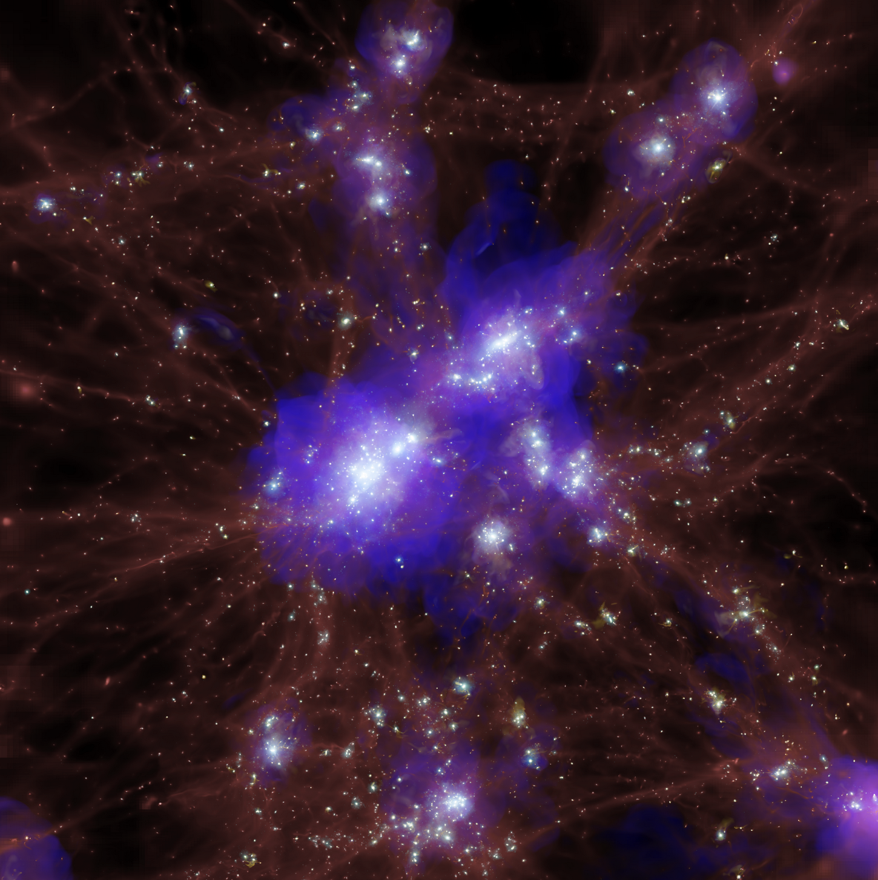
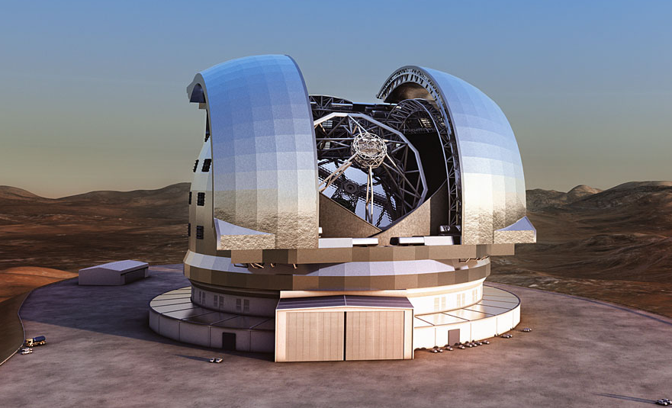


Where next?
Spin amplitude vs. spin direction (see Stefania’s talk)
Larger radius and higher spectral resolution with Hector
High resolution galaxy simulations of dense environments (NewCluster; PI Sukyoung Yi)
Pushing to high redshift: MAGPI/MUSE, GMT/ELT
Hector at the AAT
ELT Credit: ESO
NewCluster simulation at z=1.17
Notes:
We can look at this another way by plotting spin vs age.
Here we have colour coded points by environment. The median relation is shown by the black points, and the line is a fit to the median relation.
While younger galaxies are typically at lower density and older at higher density, Here we see that there is no obvious difference in the spin-age relation for different environmental densities,

Slide 20
Reflections
Observatories and instrument builders need discretionary spending for R&D. Just working on contracts is not enough.
We work best when we communicate well. Science is done by humans, for humans. Morning/afternoon teas at AAO.
Working with the wonderful people at the AAT and AAO has, and continues to be, an immense pleasure….
THANK YOU!
ELT Credit: ESO
Notes:
In summary….

