Slide 1
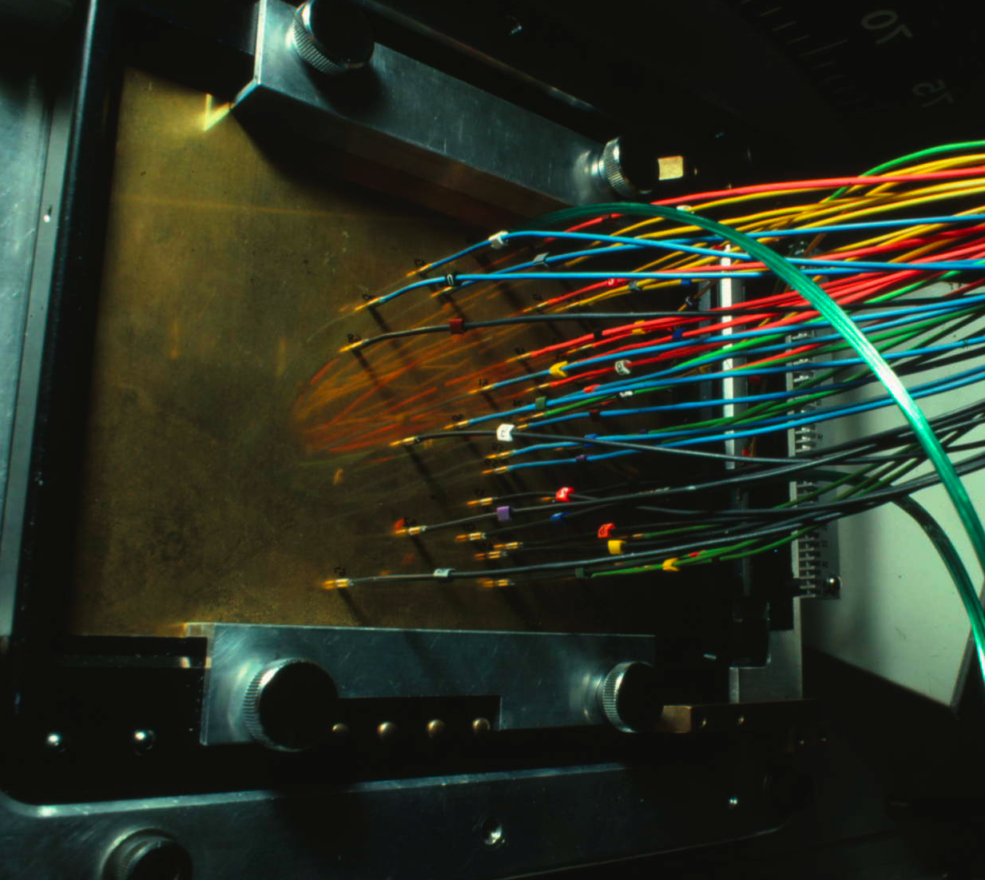
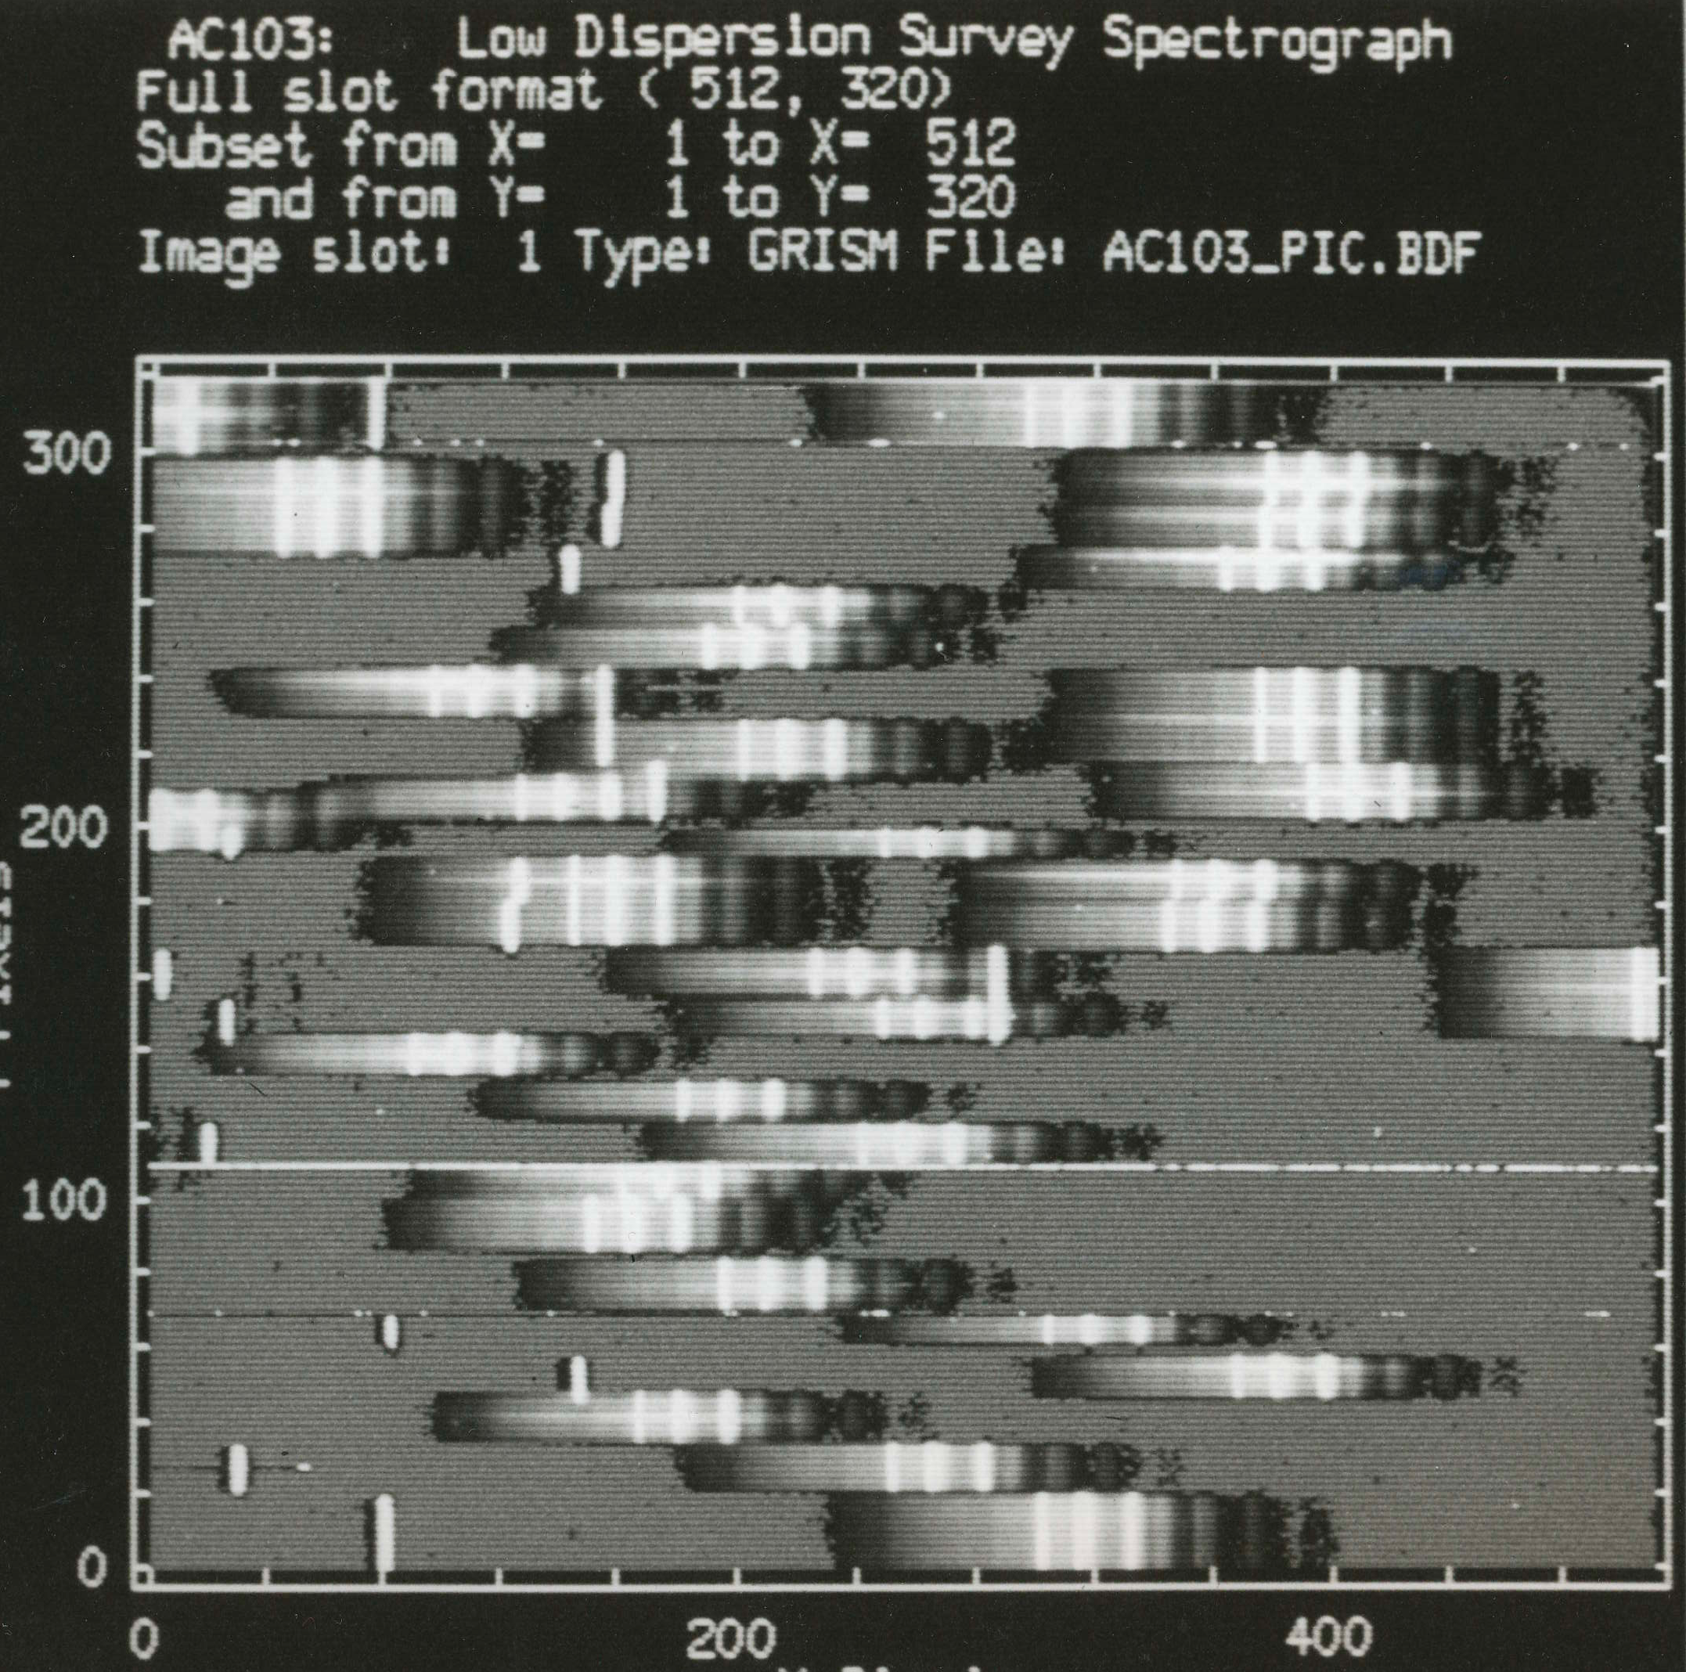
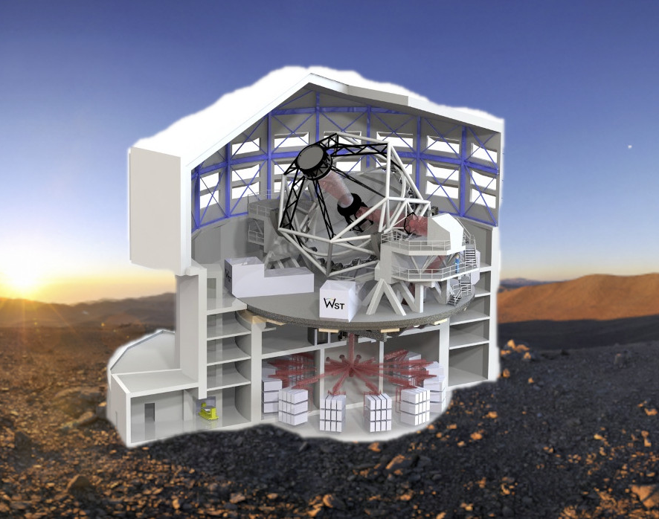
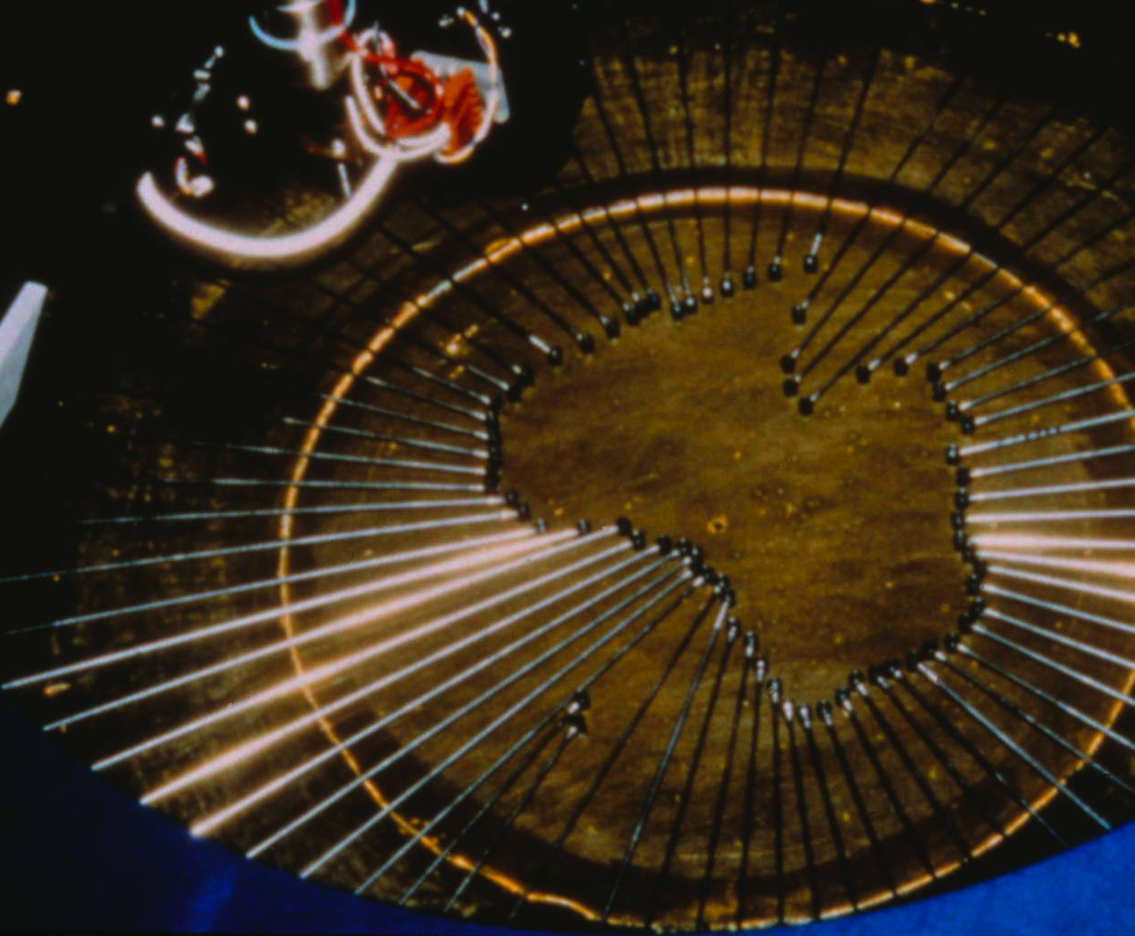
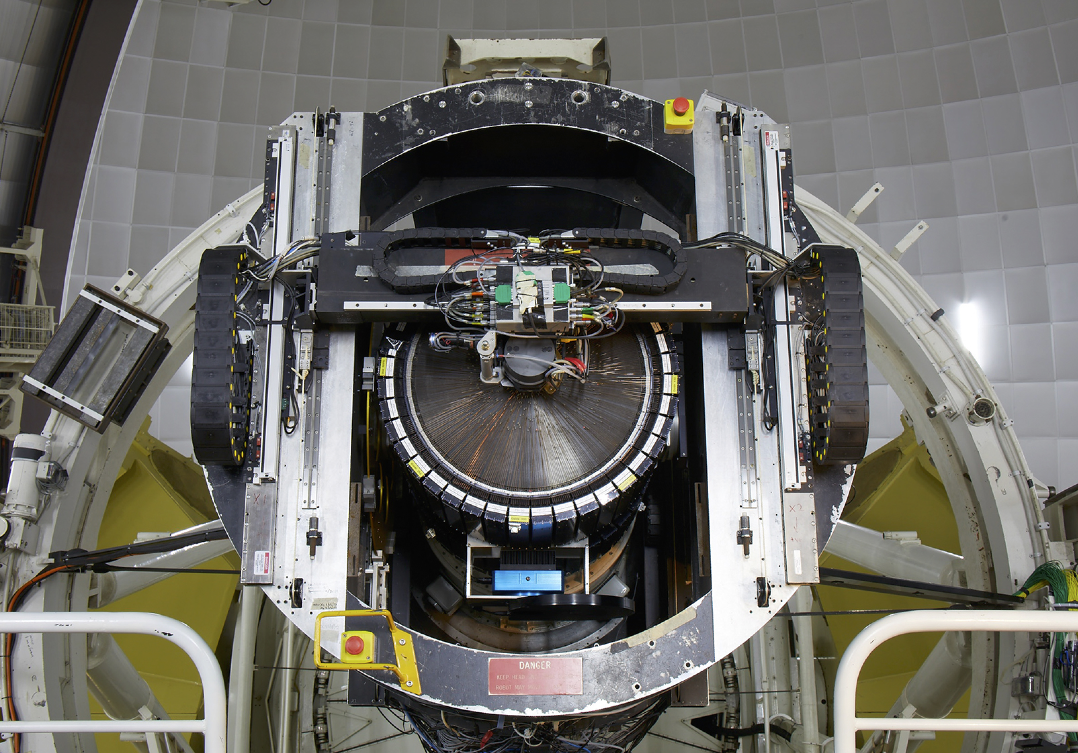
The Revolution in Multi-Object Spectroscopy: From AAT to WST
Richard Ellis, UCL
FOCAP
LDSS
Autofib
2dF
Wide Field Spectroscopic Telescope (WST)
AAT @ 50 October 2nd 2024

Slide 2
Fibres – AAT history
1979: MEDUSA 32 fibres @ Steward Obs 2.3m Cass
1980: Inspirational RAS talk about MEDUSA by Roger Angel (Arizona)
1981-83: FOCAP 50 fibres @ 12 arcmin auxiliary Cass
1983-87: FOCAP 70 fibres @ 40 arcmin Cass
1987-94: Autofib-1 70 robotically-controlled fibres
1989: Autofib-1.5 traveling prototype
1992: Autofib-2: 150 fibres @ WHT prime focus (WYFFOS)
1994-: 2dF 400 fibres @ AAT 2 degree field prime focus

Slide 3
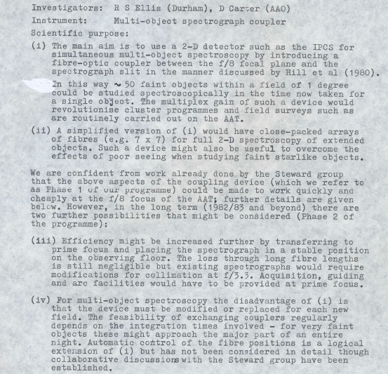
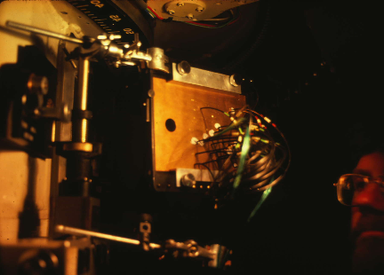
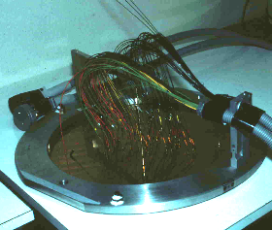
FOCAP (Fibre Optic Coupled Aperture Plate)
Original proposal to Morton: 1981
Auxiliary f/8 Cass 12’ FOV
f/8 Cass 40’ FOV

Slide 4
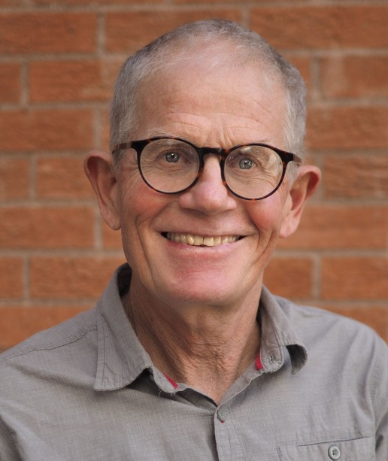
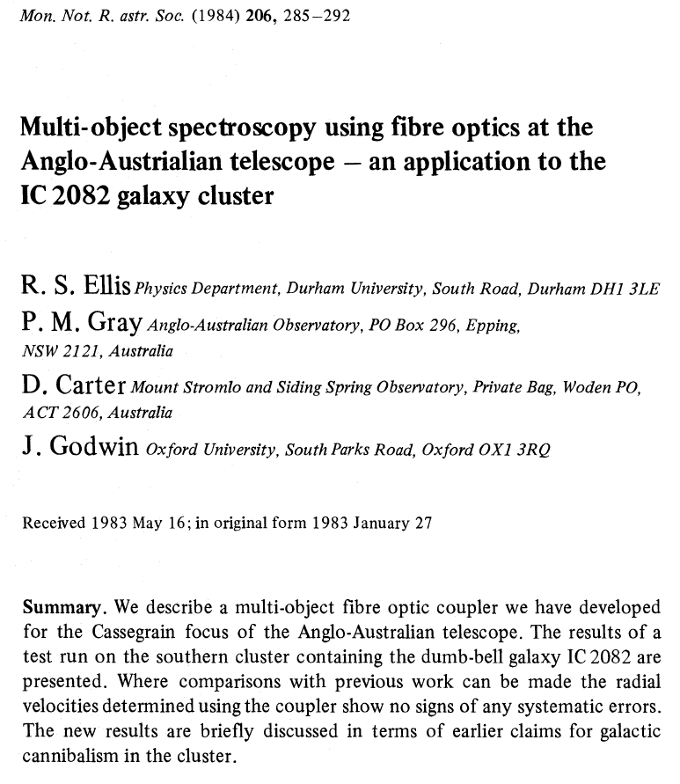
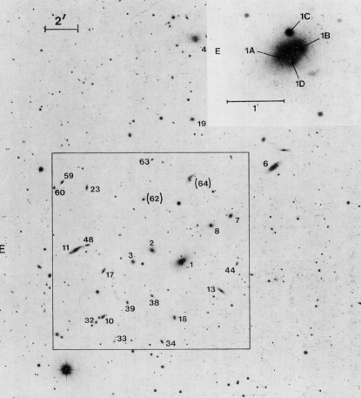
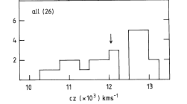
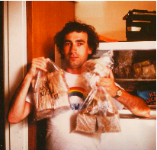
Early Demo - Galaxy cluster IC2082
Galite Polymer-clad silica fibres 36% transmission @ f/8
1981 Dec 27 5000 sec exposure

Slide 5
Selected FOCAP Highlights
Broadhurst et al 1988 Durham/AAT Faint Galaxy Survey (435 citations)
first comprehensive deep redshift survey testing nature of faint blue galaxies seen in prime focus plate number counts
Boyle et al 1988 Evolution of optically-selected QSOs (428 citations)
first comprehensive catalog of UV excess-selected QSOs with spectroscopic confirmation leading to evolving luminosity function
Kuijken & Gilmore 1989 Mass Distribution in Galactic Disk (508 citations)
radial velocity survey of K dwarfs as test particles to derive the mass density in the Milky Way disk
Couch & Sharples 1987 Spectra of 3 z~0.3 clusters (475 citations)
    stellar population analyses of blue and red galaxies in clusters demonstrating timescale of environmental evolution

Slide 6
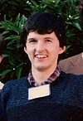
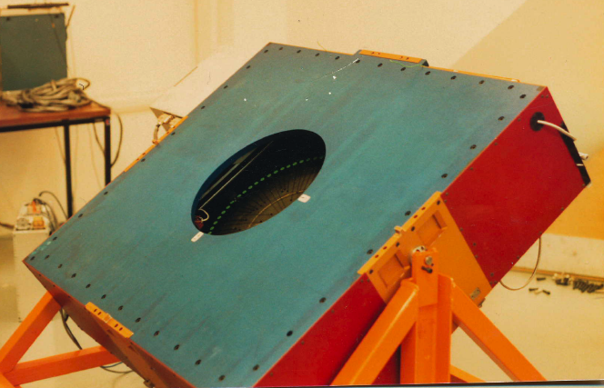
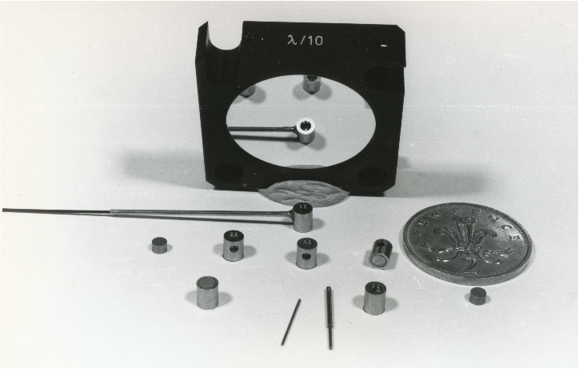
Autofib-1: Robotic positioning
FOCAP a big success: 30% of all spectroscopic time!
Aperture plates A$170 ea; inflexible to target changes/atmospheric effects
Automation would lead to better placement and more uniform transmission
Aug 1984: Parry, Ellis, Breare + Gray propose prototype robotic positioner to ACIAAT: £12,200 + 4 man-months labour
May 1985: successful review of prototype
May 1985: Autofib-1 construction with commissioning in March 1987
Total cost £20K + manpower

Slide 7
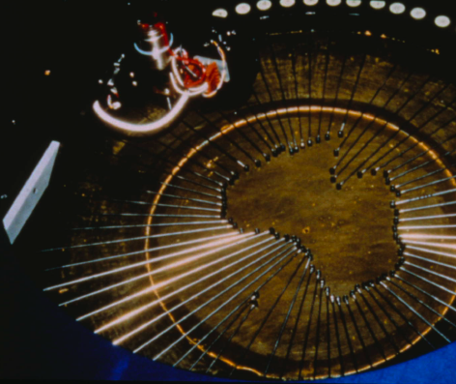
AAO Rules OK!
The Autofib concept was in great demand and led to enquiries for cloned versions
e.g. UH 2.2m, MDM 2.4m, CFHT 3.5m, ESO, NOAO & China…. but not SDSS!

Slide 8
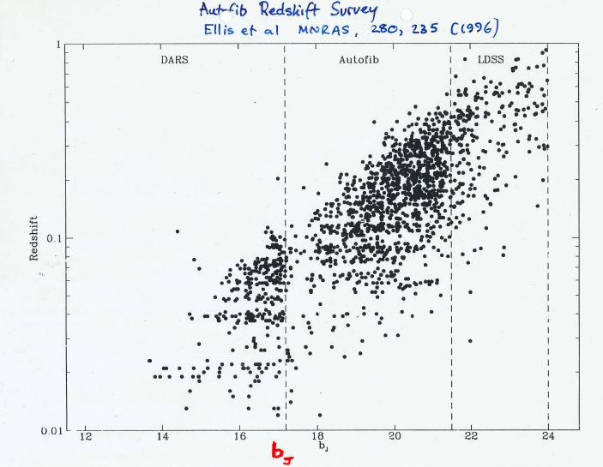
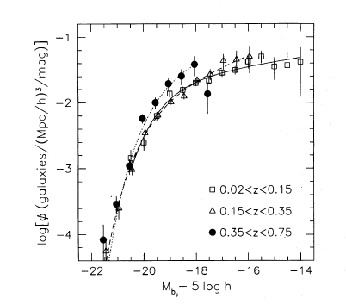
Autofib Redshift Survey
Galaxy LF 0<z<0.75
Efficiency of Autofib enabled a survey of 1028 redshifts in 32 distributed pencil beams spanning 17<b_{J}<20 and 19.5<b_{J}<22
First clear picture of evolving galaxy luminosity function
Ellis et al (1996)

Slide 9
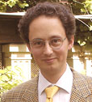
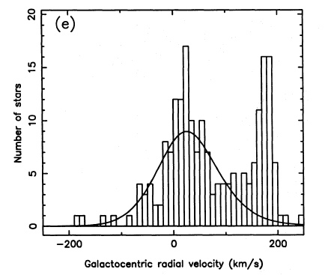
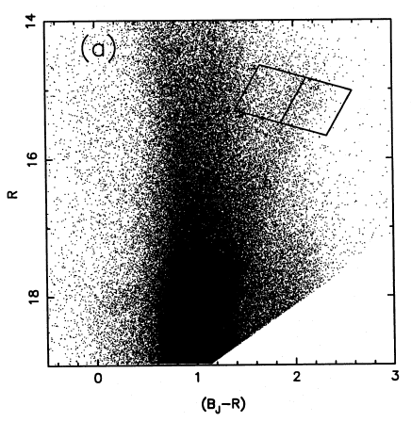
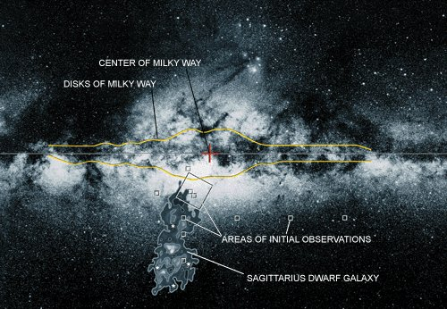
Discovery of Sagitarrius dwarf
Identification of anomalous structure combining UKST photometry and Autofib radial velocities during survey of Galactic bulge K/M giants.
Early demonstration of merger history of Milky Way.
Ibata et al (1995)

Slide 10
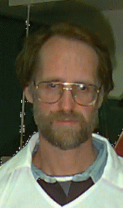
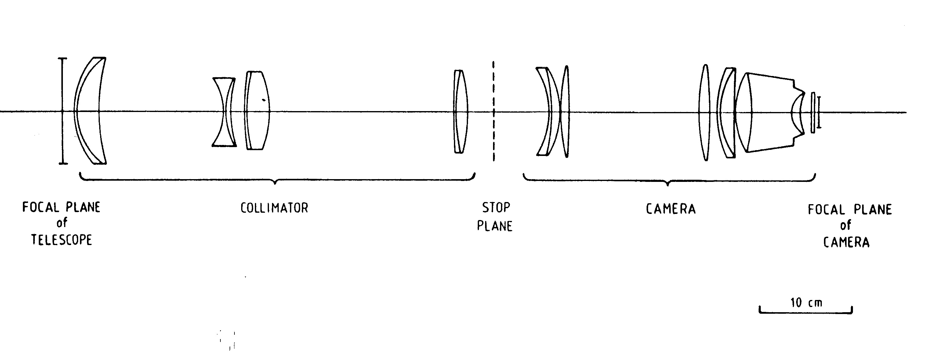
Low Dispersion Survey Spectrograph (LDSS)
May 1983: Taylor proposes LDSS to SCOT anticipating launch of HST in 1985
Optical design by Wynne & Worswick gives 12.3 arcmin field at f/8 Cass
Mar 1984: SERC grant proposal (Ellis, Taylor & Atherton) claiming commissioning in Oct 85
Optics fabrication delayed due to difficulties at ICOS with fragile glass FK54
AAO concern about length of instrument - requires modification to Cass cage
May 1986: commissioned with IPCS

Slide 11
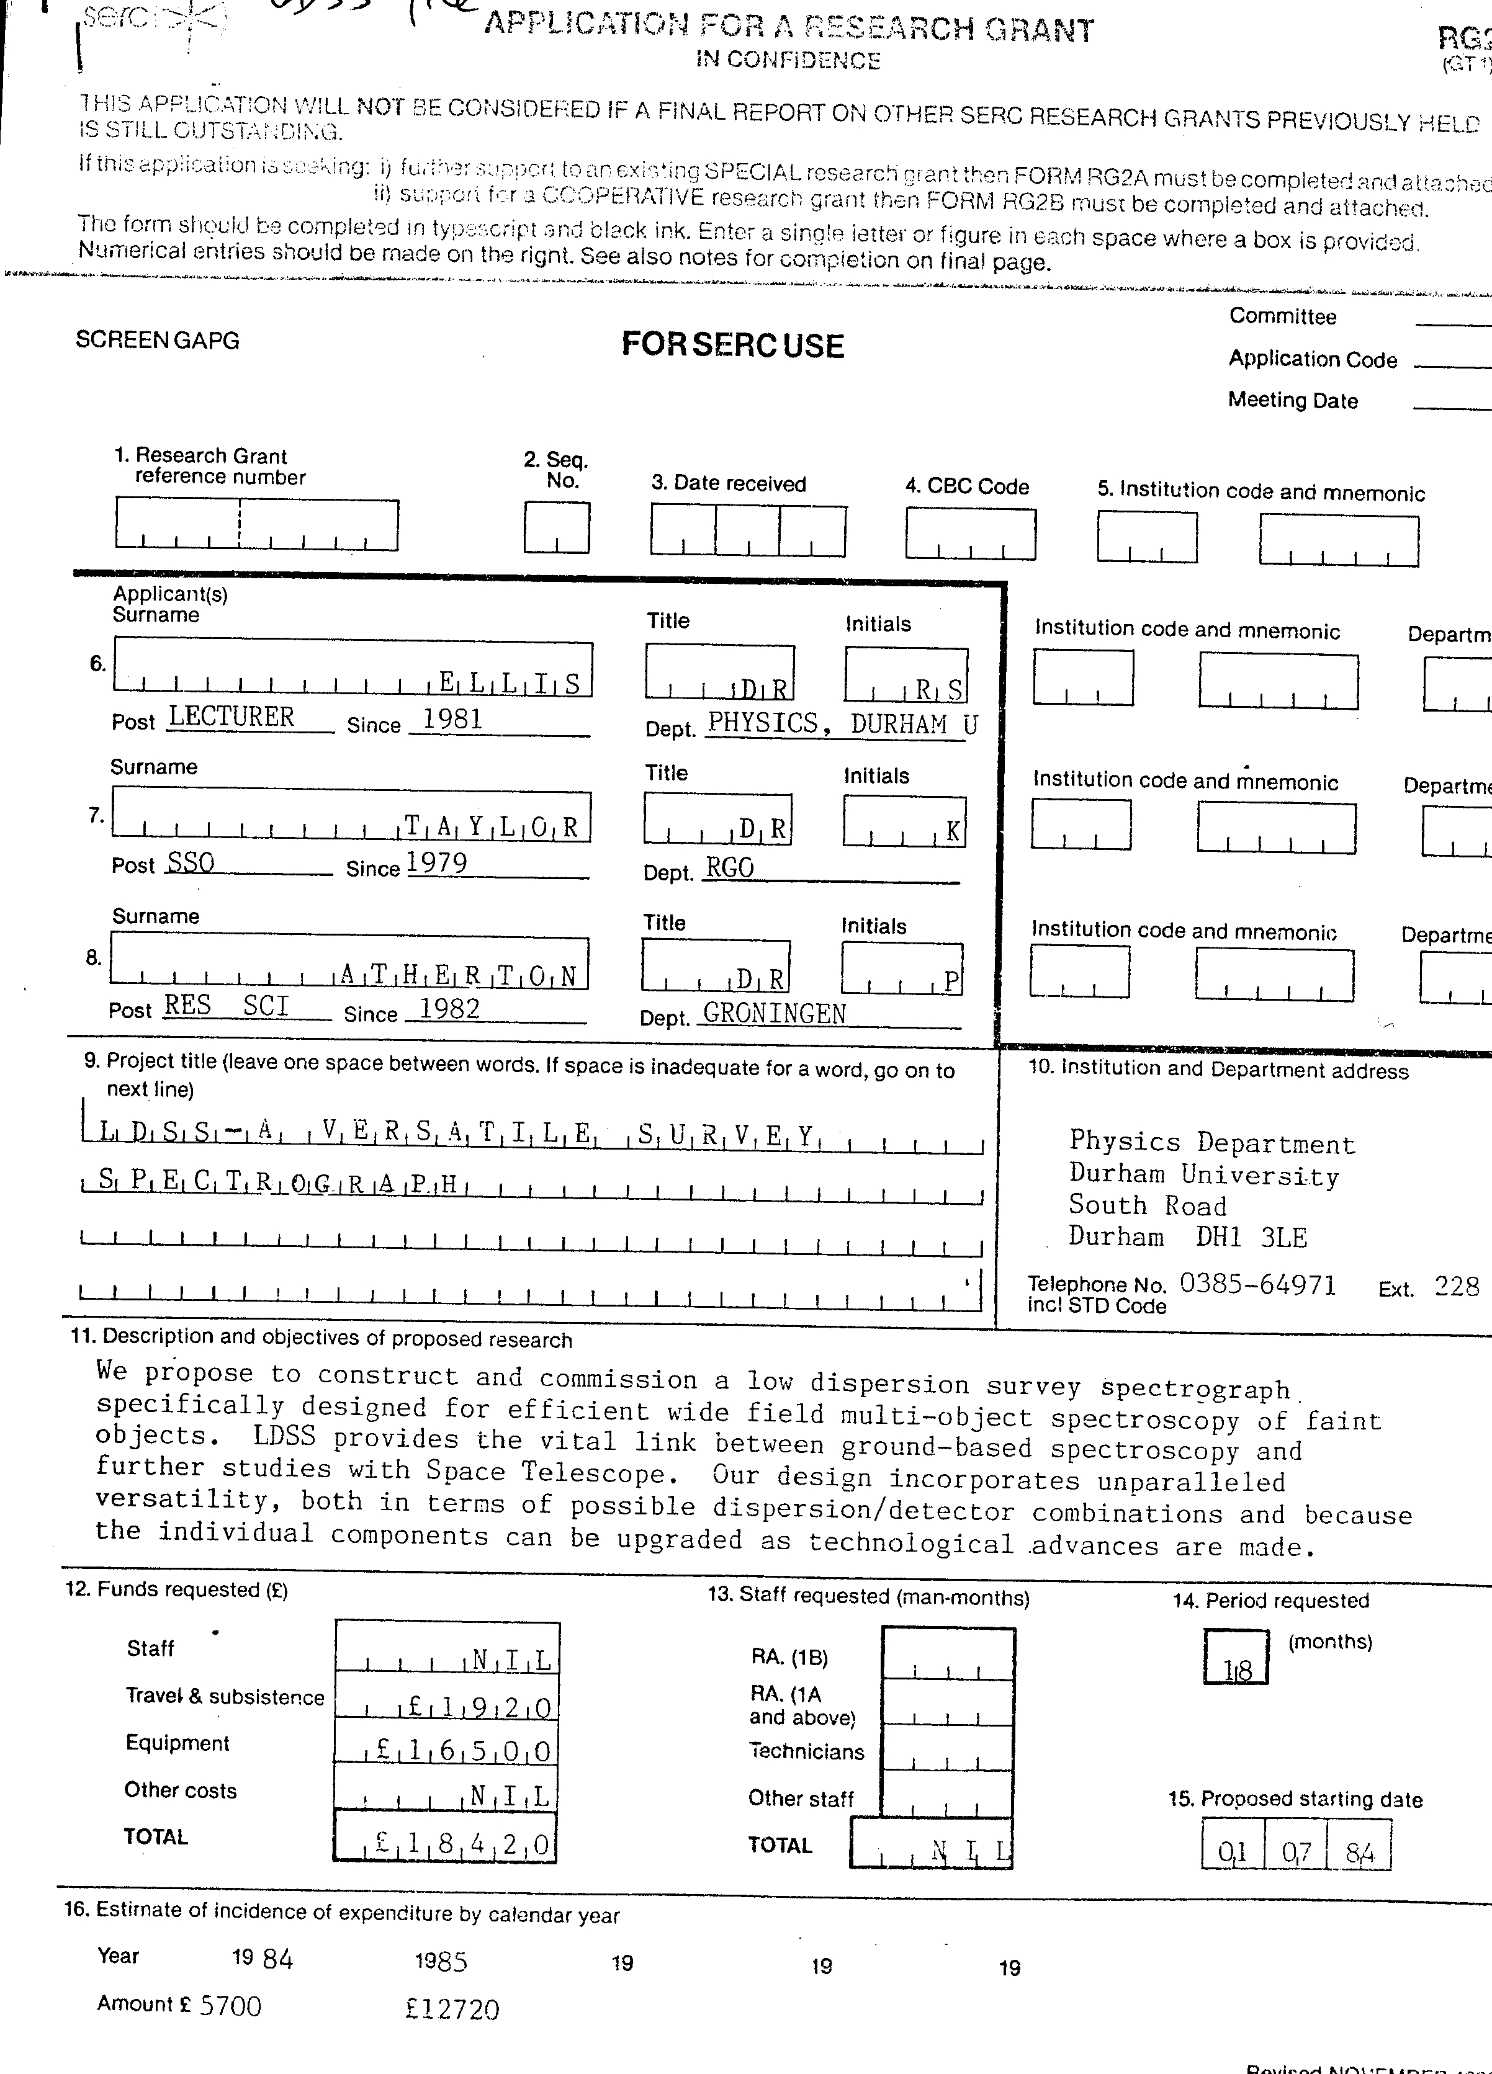
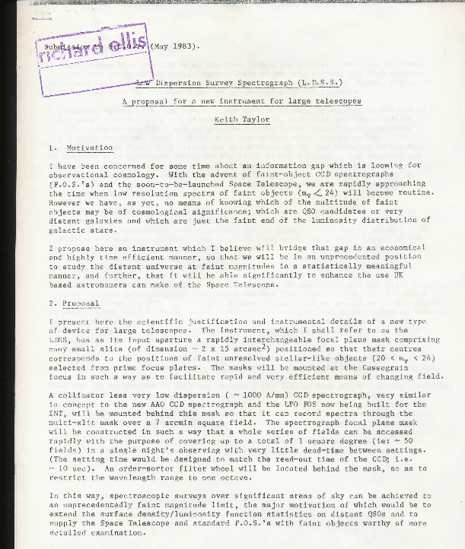
LDSS-1 - concept and proposal
Taylor’s 1983 proposal
7 arcmin field, 20<b<23
SERC grant £18,420
including £13 contingency!

Slide 12
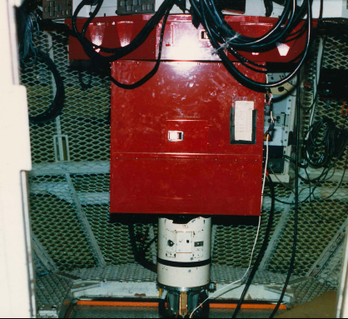
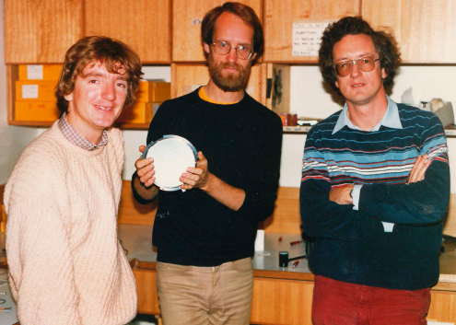
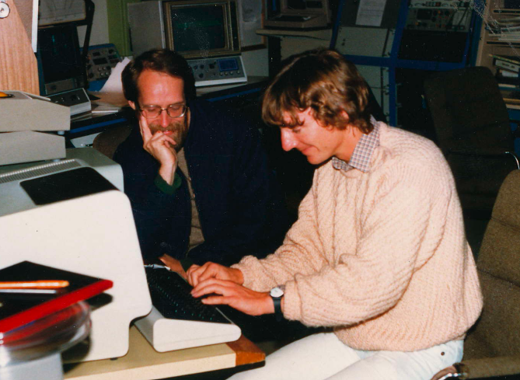
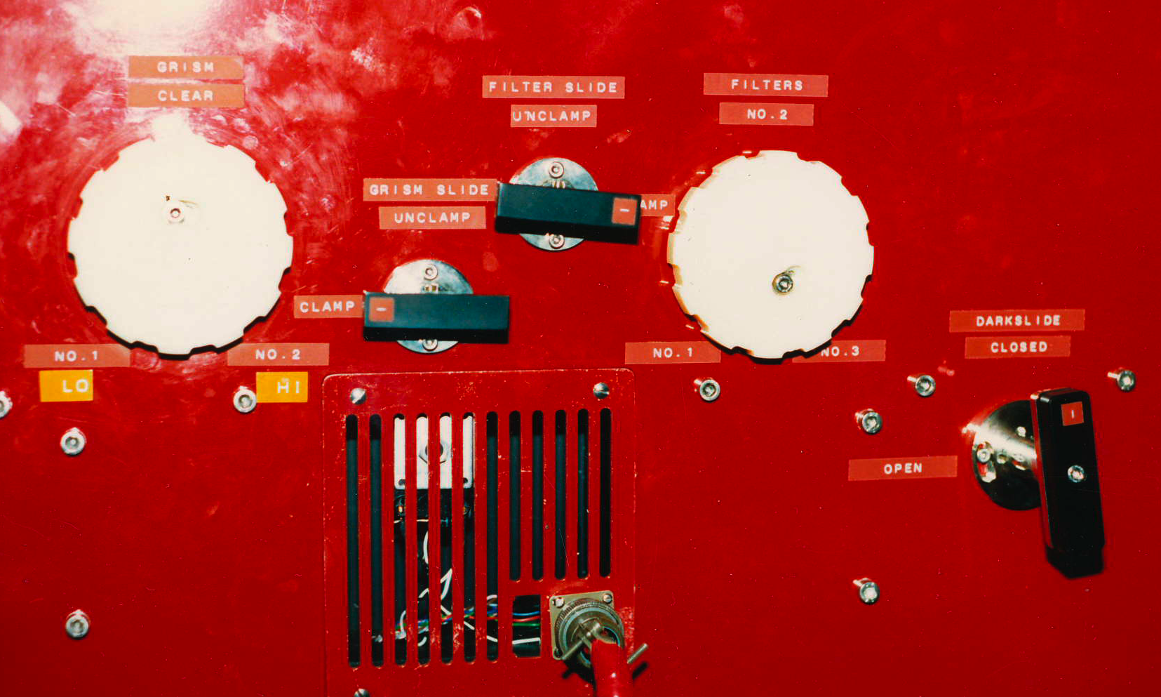
LDSS-1 Project
LDSS project was remarkably focused:
low cost, minimalistic hardware
- acquisition and data reduction software implemented as part of project
- very small, tight organised team
LDSS put AAT ahead in capability (12.3 arcmin FOV, 31% throughput + RCA CCD)
(c.f. Cryocam@KPNO, PFUEI/COSMIC @ Palomar, EFOSC @ ESO)

Slide 13
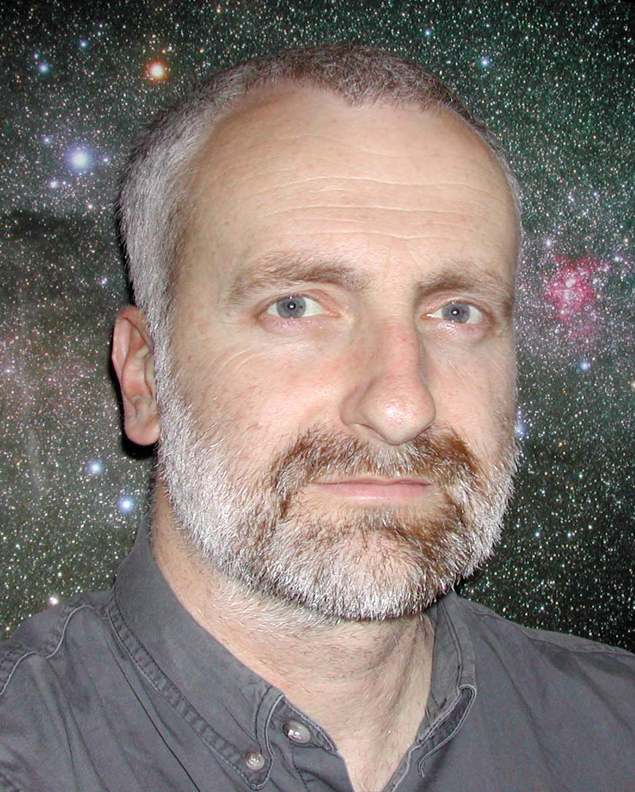
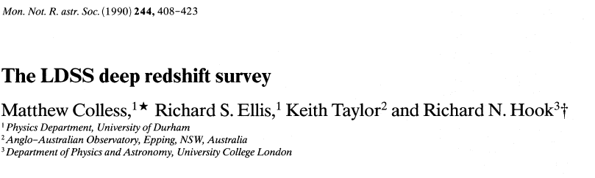
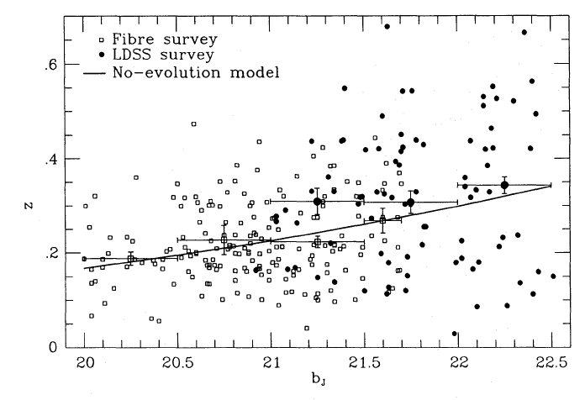
LDSS-1 Redshift Survey
LDSS-1 pushed frontier from b_{J}=21.5 to b_{J}=22.5; 1 mag deeper than FOCAP
At b_{J}~22.5, count excess over no evolution is ×2 yet no low or high z tail to distribution
Increased fraction of [O II] emitters in low luminosity systems
Consistent with increased star formation in past, primarily for low luminosity galaxies
LDSS-1
FOCAP
Colless et al (1990)

Slide 14
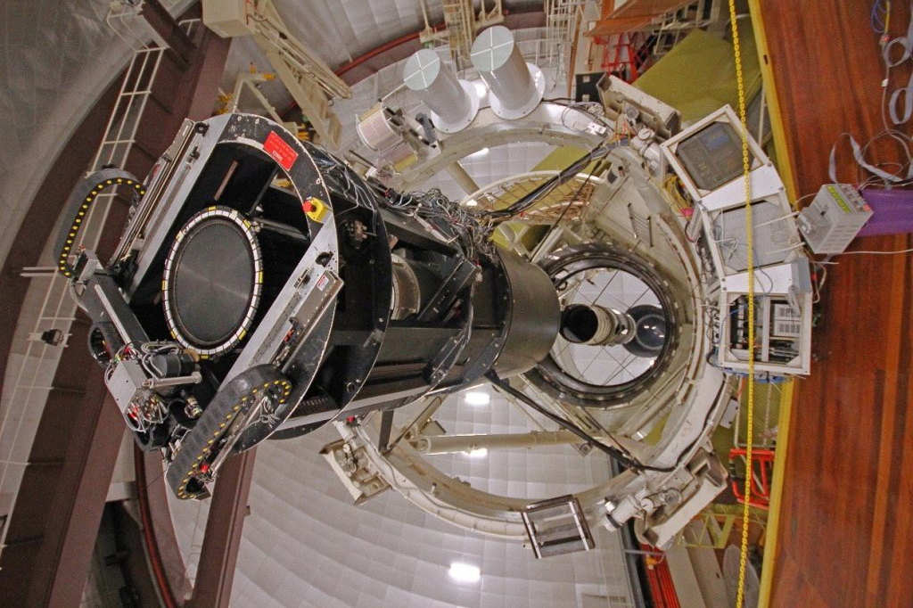
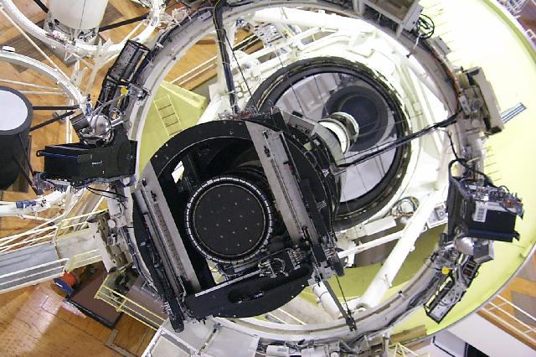
2dF
Early Milestones
1985-6: RAS UK `decadal survey’ (Chair: F. Graham Smith) ranks a wide-field spectroscopic survey telescope second (behind 8m telescope).
1986 Lynden-Bell promotes dedicated ’Willstrop telescope’ with Cassegrain wide-field
1986 SERC Large Telescope Panel (Ellis, Hough, Edmunds) consider both Cassegrain (Willstrop) and prime focus (Wynne) options in its report
Jun 1987: Ian Parry “Extensive Survey Spectroscopy with AAT” argues conversion of AAT more economic than dedicated facility.
Mar 1988: Ellis submits “Wide Field Prime Focus for AAT” to the AAT Board
Sep 1988: Taylor & Parry submit case for 2dF design study; estimated cost A$1.3M
Sep 1989: Gray & Taylor: “Design Study for 2dF” approved; estimated cost A$1.6M;
Mar 1990: AATB approves 2dF with total cost of $2.2M; Taylor (PS), Gray (PM)
June 1990: SERC supplies additional A$250K; Dec 1990 DEET matches A$250K

Slide 15
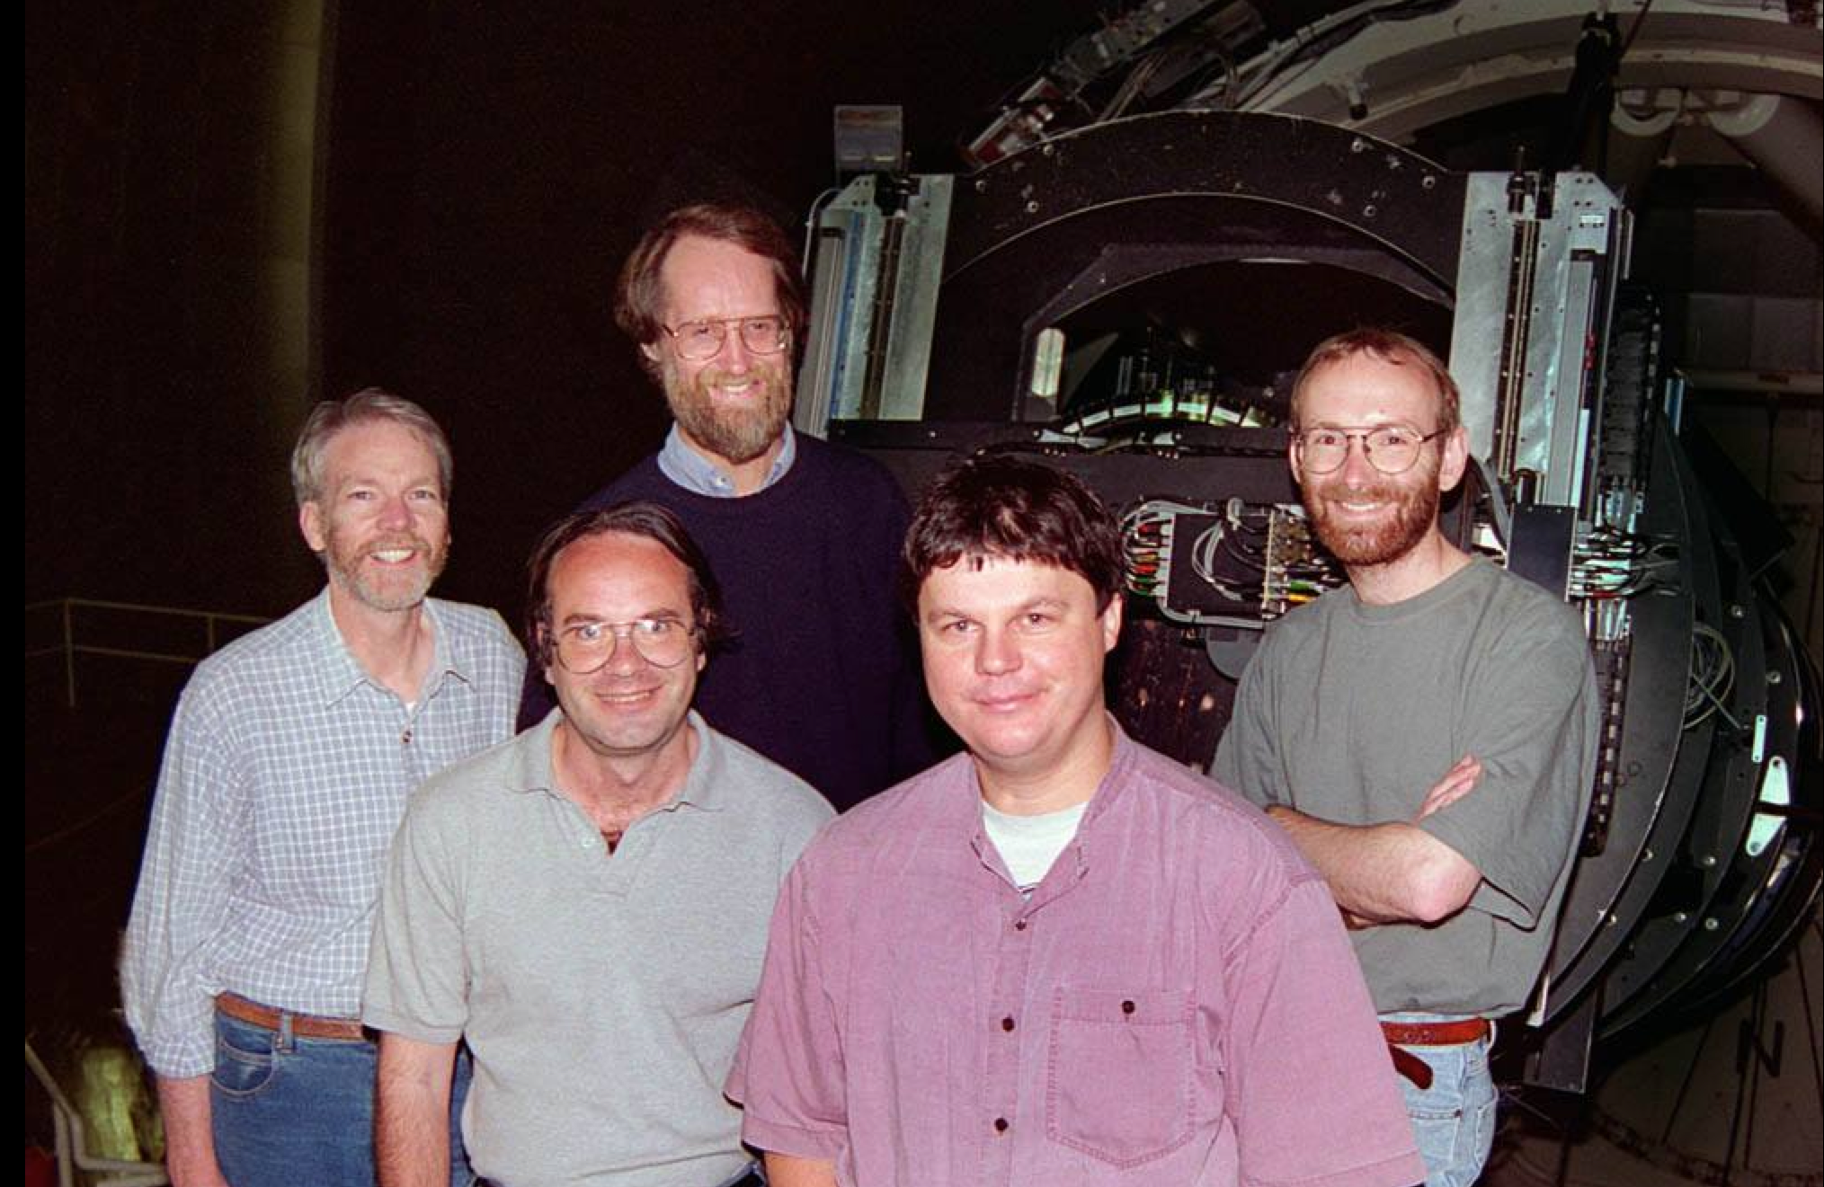
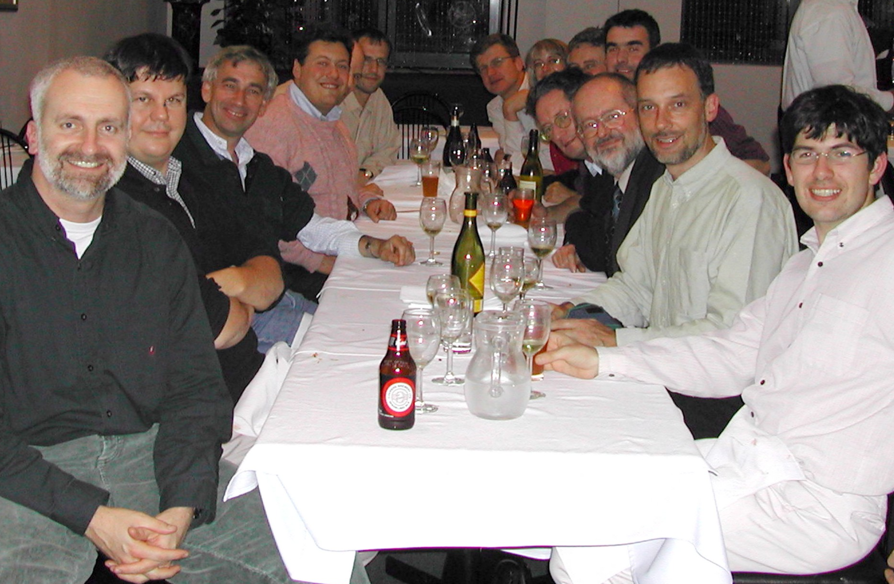
2dF
Final
Milestones
Comissioning team
2dFGRS team 2003
1992: Mike Edmunds (PATT Chair) leads discussions on time allocation for 2dF science
1991-92: AAT Board (FG Smith, then Frater) oversee project (completion June 1994?)
March 1993:
- Gray leaves AAO; Taylor takes over as PM (later RDC) and PS
- Board confirms “tumbler” mechanism ( “slider” was never a serious option)
- Problems at Contraves in corrector manufacture
September 1993: Corrector delivered: project now A$230K over budget
September 1994: Board agrees substantial allocations of time required to exploit 2dF
March 1995: - PATT/ATAC recommends a large redshift survey; not unanimous! - Glazebrook appointed as 2dF scientist
Nov 1995: Official opening of 2dF
Sep 1997: 2dF Galaxy Redshift Survey begins (PIs: Ellis/Colless, later Peacock/Colless)

Slide 16
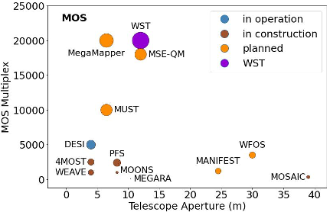
Era of Wide Field Spectroscopic Surveys!
Facility | Telescope Diameter | Aperture² | Ω (deg²) | A𝛀 Product
AAT 2dF | 3.9 | 11.57 | 3.46 | 40.0
ESO VLT (VIMOS) | 8.0 | 48.75 | 0.043 | 2.08
ESO VLT (FLAMES) | 8.0 | 48.75 | 0.136 | 6.63
ESO VISTA (4MOST) | 3.7 | 9.57 | 4.00 | 38.3
ESO VLT (MOONS) | 8.0 | 48.75 | 0.136 | 6.63
WEAVE | 4.2 | 12.2 | 3.14 | 38.3
SUBARU (PFS) | 8.0 | 48.75 | 1.33 | 64.7
MAYALL (DESI) | 3.8 | 9.6 | 8.00 | 77
Since 2dF, progress has been in 3 directions:
Larger multiplex on existing 4m’s (DESI)
Larger multiplex on existing 8m’s (PFS)
Proposed dedicated 6.5-12m facilities with huge multiplex (WST)
2dF

Slide 17
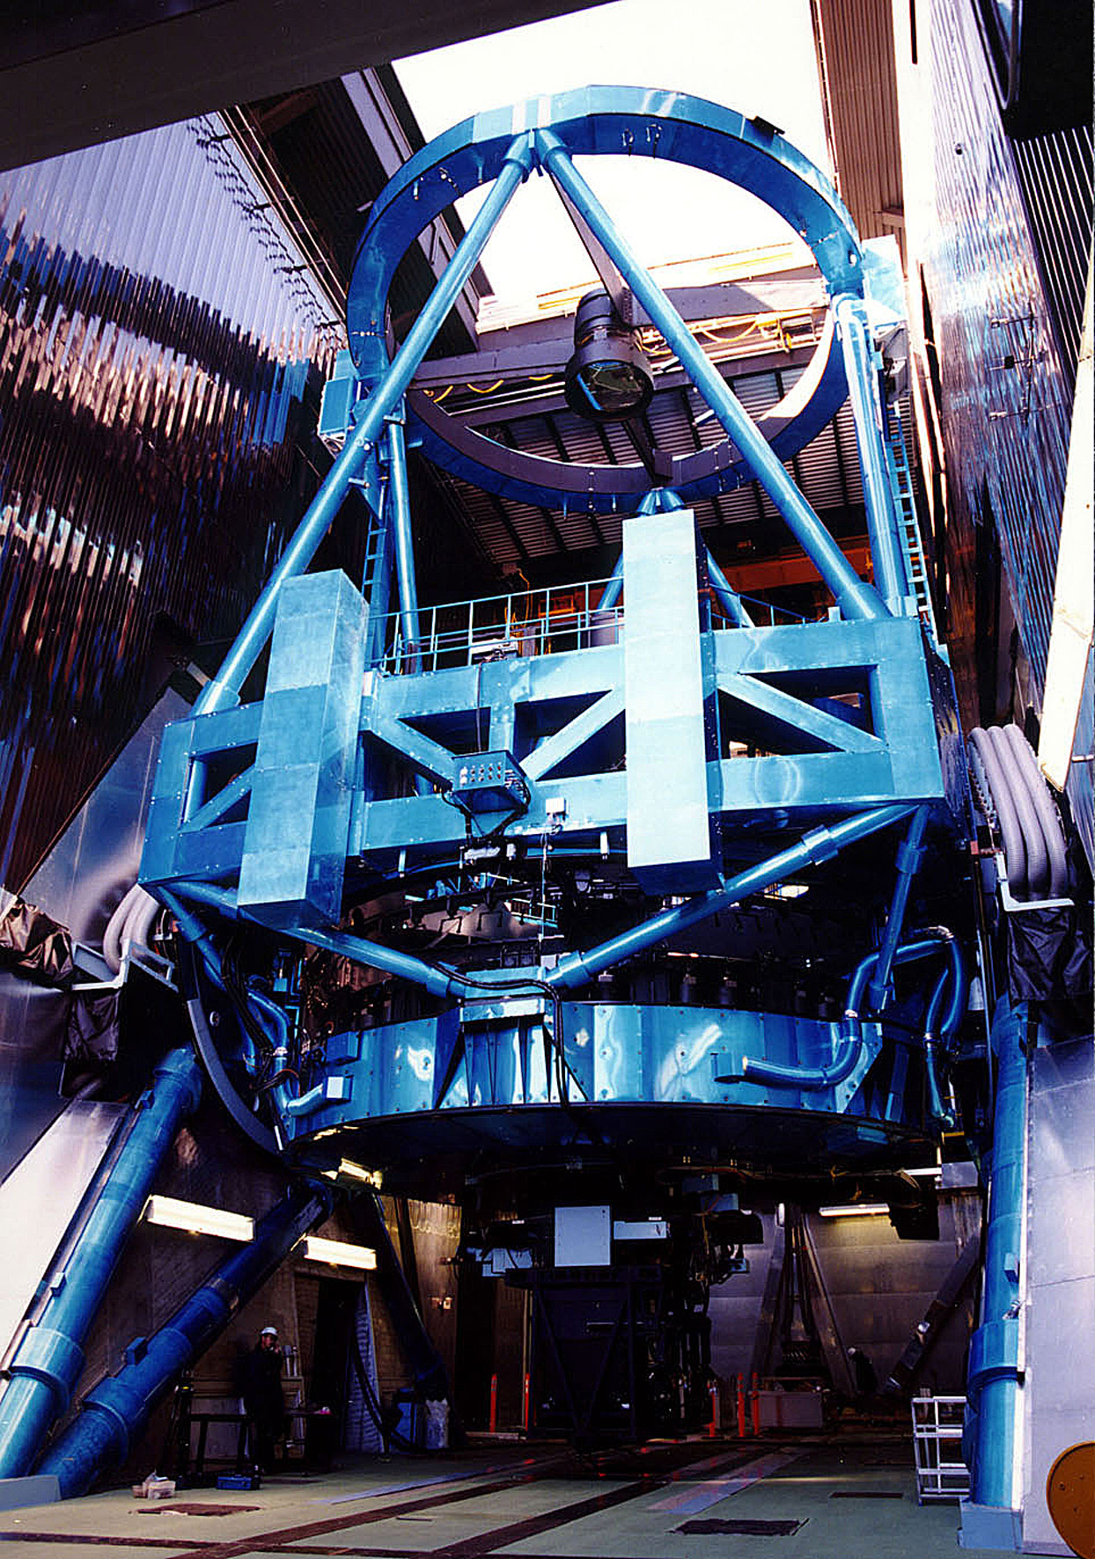
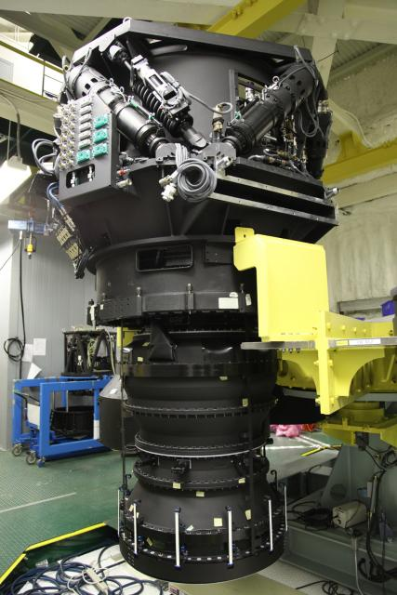
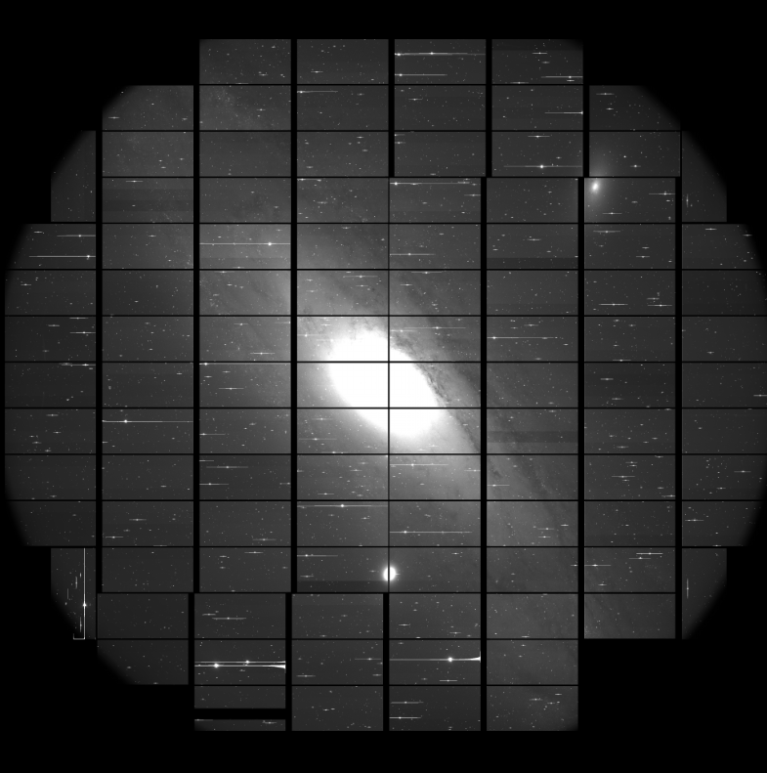
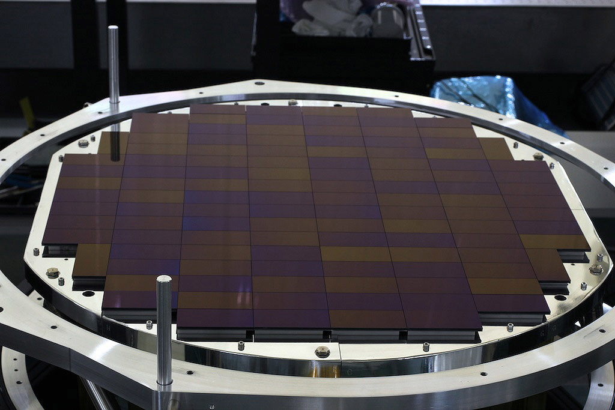
Subaru Prime Focus Spectrograph (2006..)
A monster telescope, monster optical corrector and gigantic detector…
Hyper Suprime Cam
The largest camera
3m high
weighs 3 ton
104 CCDs (~0.9B px)
~1.5 deg

Slide 18
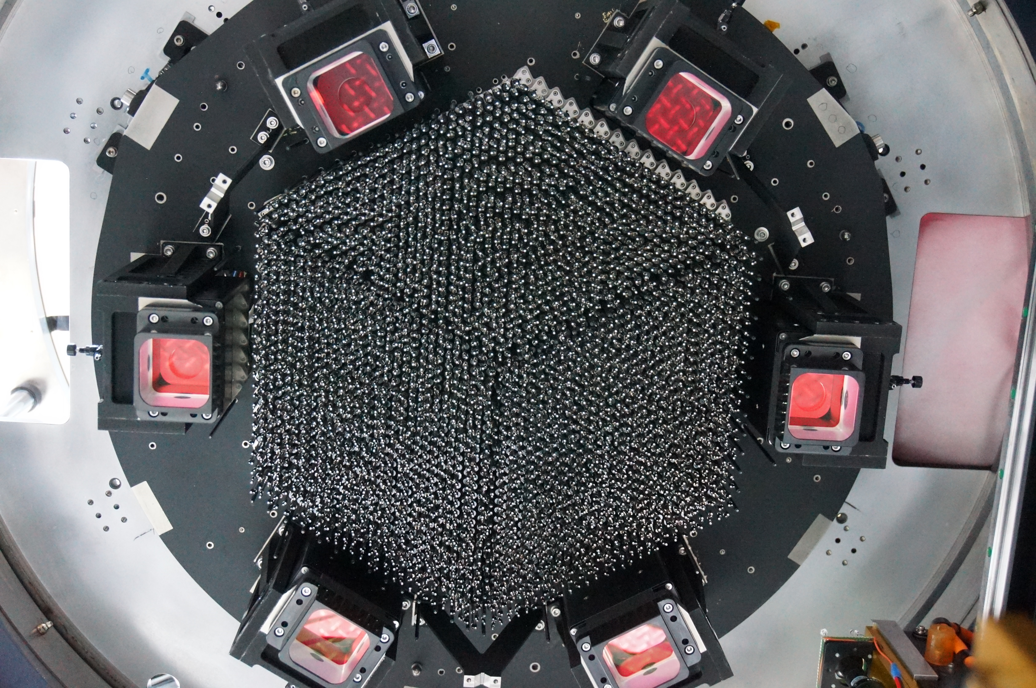
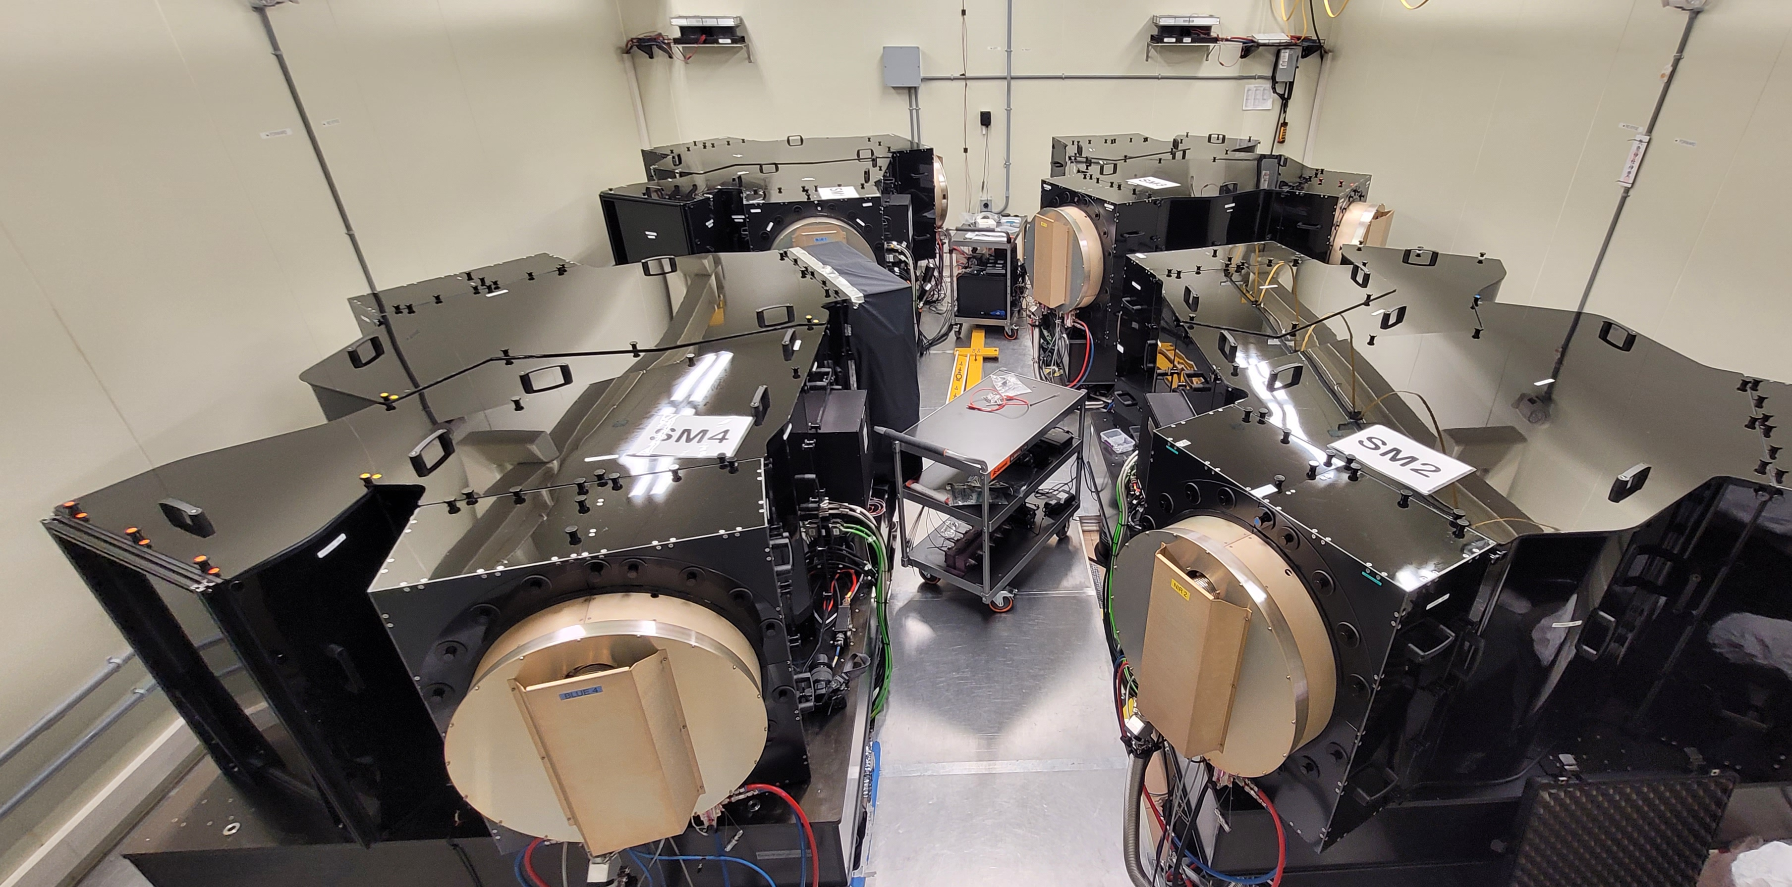
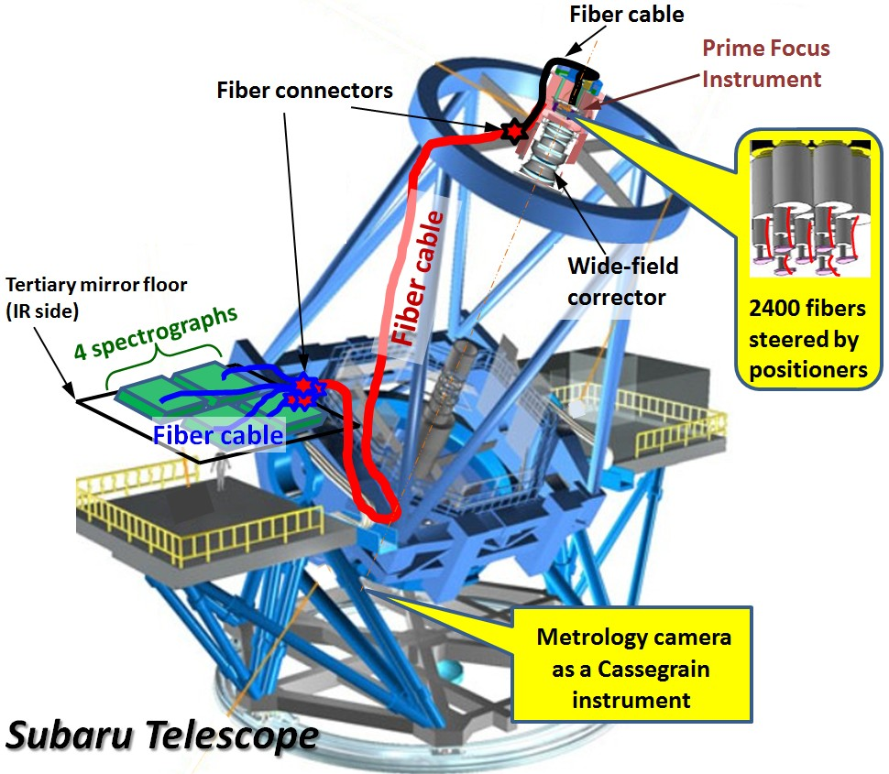
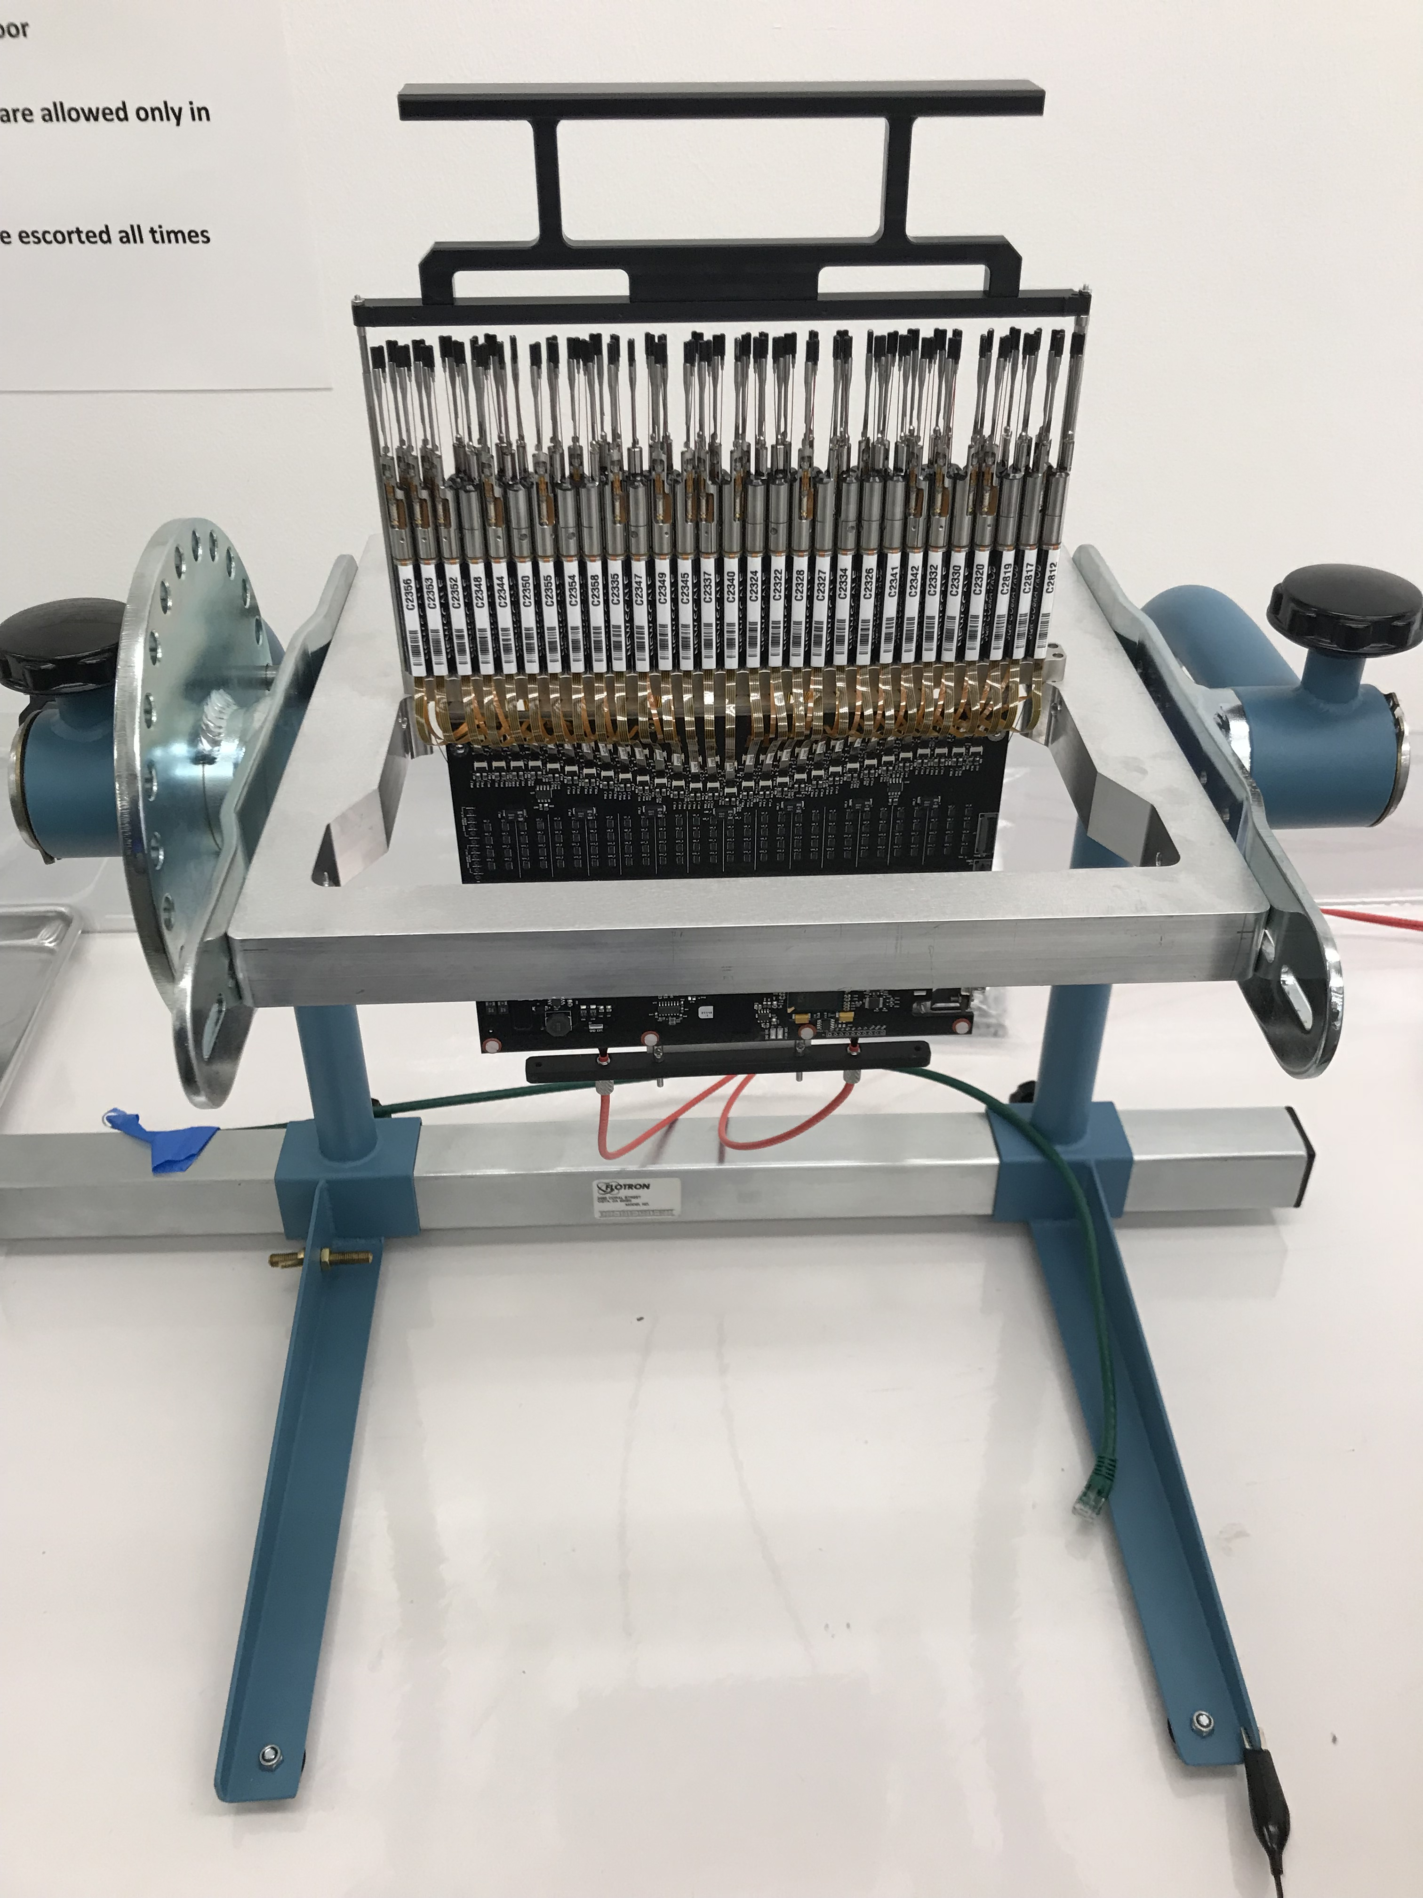
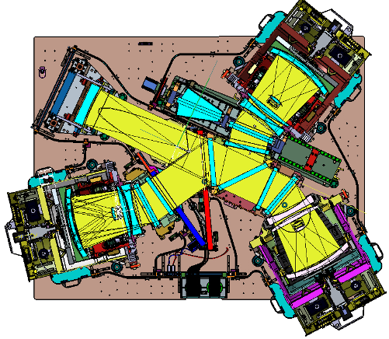
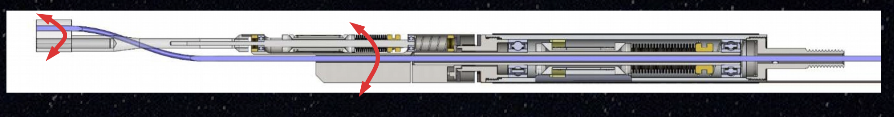
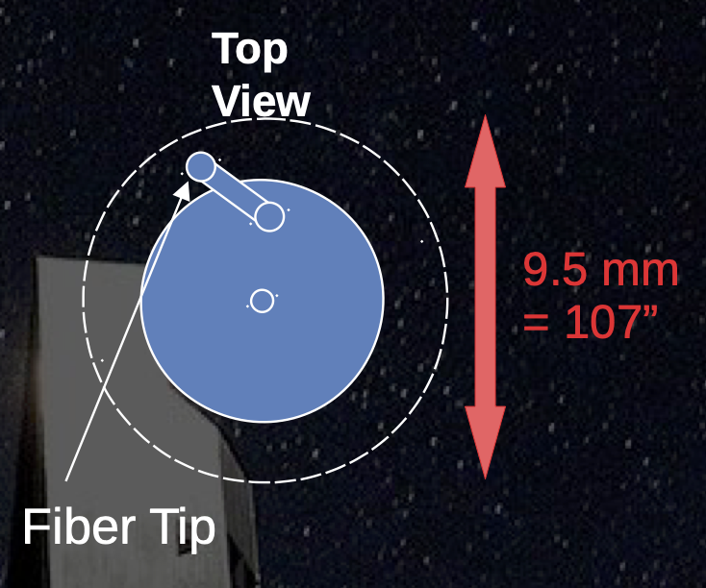
And now…8m telescope multi-object spectroscopy!
2400 “Cobra” fibre positioner
Spectrograph system (SpS)
Four monster spectrographs!
PFS fast facts:
Telescope 8 metre aperture on Mauna Kea
Field of view: 1.3 deg dia = 1.33 deg²
Multiplex 2394 fibres: 1.05 arcsec dia,
60 sec reconfiguration
Four 3-arm spectrographs 380 < 𝜆 < 1.260 nm
Low/medium resolution: 2.5/1.6 Å
Both a facility and survey instrument at Subaru
Two axis Cobras in 44 rows of 64 units

Slide 19

PFS Strategic Survey Programme
360 night survey for 5 years commencing February 2025!
Major goals in cosmology, Galactic archeology and galaxy evolution

Slide 20






Wide Field Spectroscopic Telescope (2018..)
Strong international and community support for a dedicated 10-12m class multi-object facility to exploit huge investment in imaging surveys at optical/IR (Rubin, Euclid, Roman) and radio (SKA) wavelengths

Slide 21


WST – History & Status
  WST Timeline
  2016: ESO Working Group Report ( RSE..JBH)
  Science case and technique requirements (SpecTel)
  2016: Design work by Pasquini & Delabre (ESO)
  10-12m telescope, 5 deg² FOV, N~10,000
  2022: European-Australian consortium apply to
  EU Horizon infrastructure Fund
  Revised top level requirements:
  MOS-HR, simultaneous operation of MOS & IFS
  2022: 3-year Concept Study not funded by Horizon
  Interim-study 2022-2024
  March 2024: Revised proposal submitted
  July 2024: Horizon bid accepted in full!
  2025-2027 3 year Conceptual Study
Pasquini et al, 2016

Slide 22



WST - Top Level Requirements
VLT
Re-use ELT segments
Notable features:
Simultaneous use of MOS and on-axis IFS “Super-MUSE”
Low and high spectral resolution option
Increased multiplex n~20,000
Optical facility (NIR costly but later upgrade possible)

Slide 23

Telescope and Instruments

Slide 24







Science Team (> 500 members!)
Working Groups
Cosmology
Galaxy evolution
Leads: Andrea Cimatti & Jean-Paul Kneib
Leads: Richard Ellis & Jarle Brinchmann
Galactic
Time domain
Leads: Rodolfo Smiljanic, Eline Tolstoy
& Vanessa Hill
Leads: Richard Anderson
Paula Sanchez Saez, Cyrielle Opitom

Slide 25

Get Involved – Find Out More…
See https://www.wstelescope.com/
Notes:
A community lead effort to study a new facility dedicated to large spectroscopic surveys.

Slide 26



ESO’s Next “Big Thing”?
After much procrastination, ESO has finally set out a process for post-ELT facilities
The timing dovetails well with Australia’s potential bid to fully join ESO!
ESO timetable:
Q3 2026: Call for ideas
Q4 2026: Letter of intent
Q3 2027: Full proposal
Q3 2028: Selection
Q4 2028: Approval

Slide 27

2dF
The AAT pioneered the revolution in multi-object spectroscopy both technically and scientifically
This continues due to the efforts of its dedicated and enthusiastic staff over the years
Also acknowledge the vision and dedication of all the AAO Directors, particularly Don Morton and Russell Cannon in the critical years

Slide 29



Faint Blue Galaxy Problem
Dwarf-dominated local luminosity function
All galaxies more luminous in past
Peterson et al (1979)
Broadhurst et al (1988)
Excess number of faint blue galaxies c.f. models based on local survey
Redshift survey 20 < b_{J} < 21.5 found no high or low z tails! LF must be changing shape with z

Slide 30




Environmental Effects in Clusters
Couch & Sharples (1987)
Hδ
Recovery of Hδ-strong galaxies & demonstration of duty cycle as galaxies fall into clusters

Slide 31



Mass Density in Galactic Disk
Density profile & velocity field of K dwarfs used to define force law arising from Galactic disk & hence its mean mass density (Kuijken & Gilmore 1989)

Slide 32



Evolution of Optically-selected QSOs
Spectra for 420 UV excess selected QSOs from photographic plates used to distinguish between luminosity and density evolution as origin for evolving QSO population (Boyle et al 1988)

