Slide 1
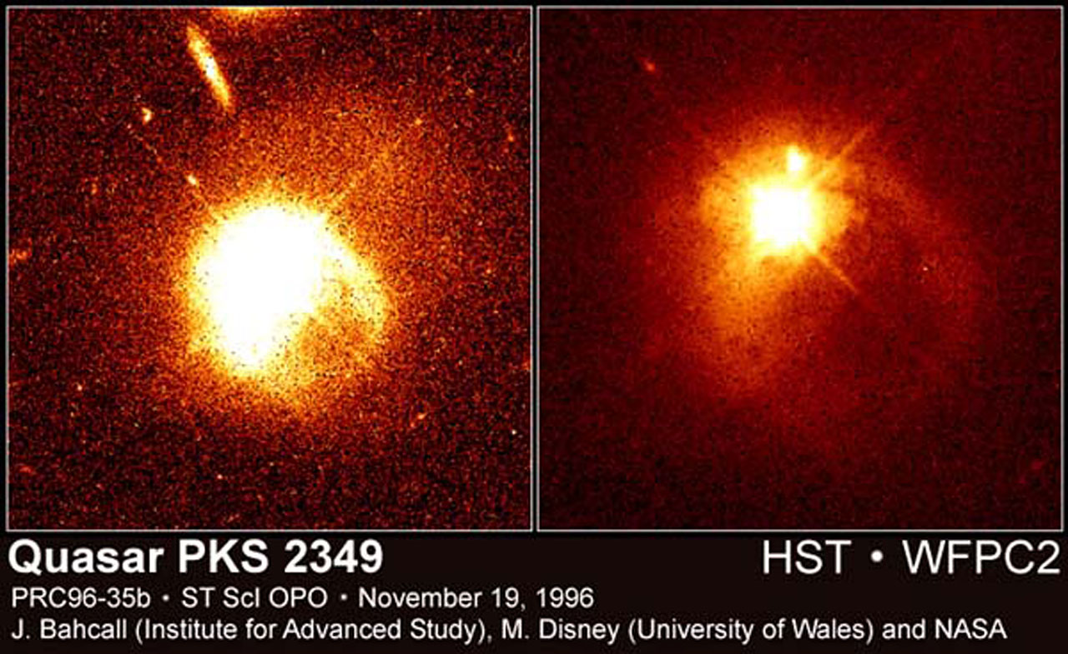
Red Radio Quasars: An early AAT Discovery
Rachel Webster, University of Melbourne
PKS2349-014: bright, low z, interacting galaxy (not quite half Jansky, and definitely blue)

Slide 2
Our project: Gravitational lensing of PKS quasars (1992-1997)
Frequency of gravitational lenses – already tested in the LBQS
Supported by ARC DP: GL in a PKS sample of quasars: $274k
PKS Flat Spectrum Half Jansky Sample: >20deg from Gal Plane $+3>δ>45,$ Drinkwater+1997
323 radio quasars: Savage, Jauncey, Wright & Peterson
105 not identified ie not found optically
Arcsec positional accuracy from the ATCA, then IR imaging with IRIS@AAT and CASPIR & PICNIC@2.3m

Slide 3
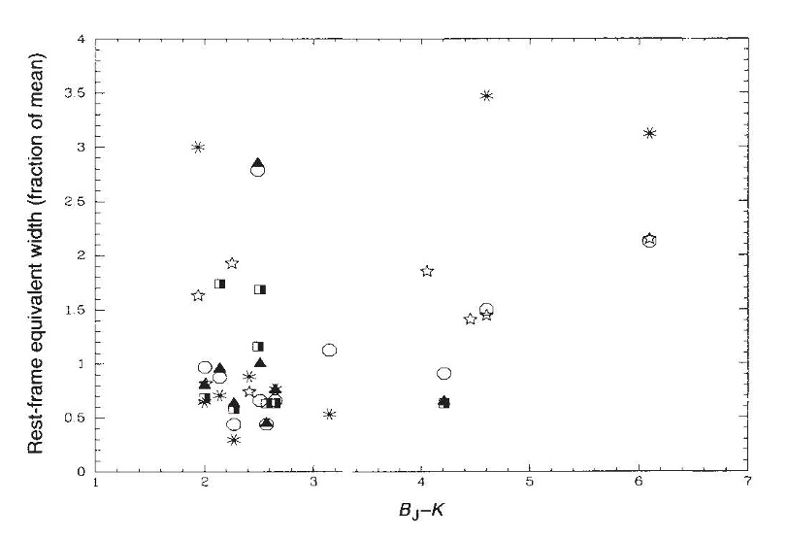
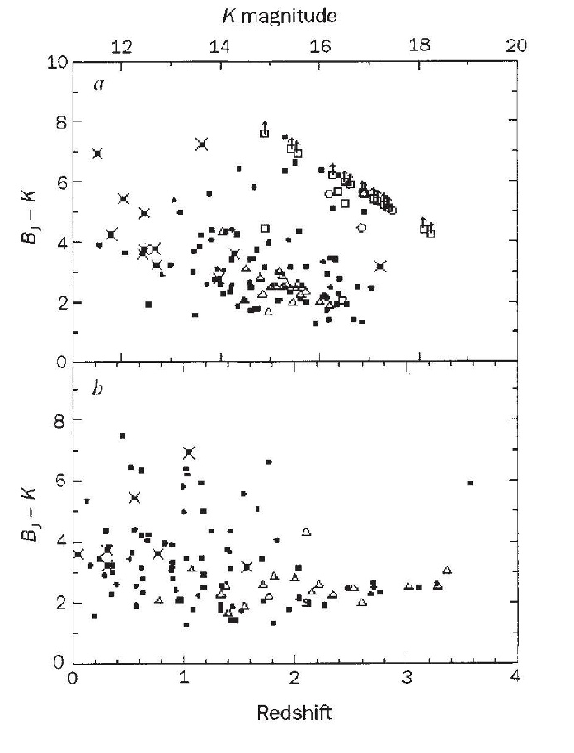
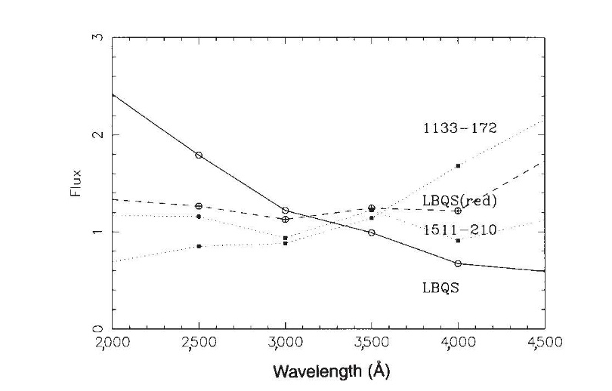
Evidence for a large
undetected population
of dust-reddened quasars
Webster, Francis, Peterson,
Drinkwater, Masci Nature (1995)
EWs of NV, CIV, CIII, MgII lines
BLR of red quasars is
seeing same UV flux as
blue quasrs
Squares: PKS quasars, filled with redshifts,
Unfilled no redshift; Squares: LBQS quasars
Examples of red quasars compared
to LBQS mean and a reddened
LBQS
Notes:
PKS have 1<b_j-K<8 cf LBQS

Slide 4
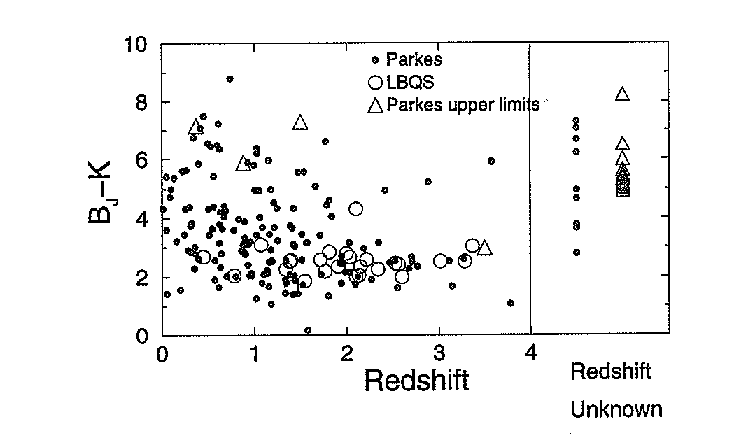
Ideas that were explored Masci, UMelb PhD, 1997
Intrinsic reddening- addition of a beamed intrinsically red component; not particularly consistent with data; possible for BL-Lacs, but required extreme synchrotron models

Slide 5
Ideas that were explored Masci, UMelb PhD, 1997
Intrinsic reddening- addition of a beamed intrinsically red component; not particularly consistent with data; possible for BL-Lacs
Host galaxy reddening – SED galaxy fitting rules this out
Line-of-sight dust- models consistent with observed local galaxies; cannot explain all the observed high z reddening or the z-dependence

Slide 6
Ideas that were explored Masci, UMelb PhD, 1997
Intrinsic reddening- addition of a beamed intrinsically red component; not particularly consistent with data; possible for BL-Lacs
Host galaxy reddening – SED galaxy fitting rules this out
Line-of-sight dust- models consistent with observed local galaxies cannot explain all the observed high z reddening or the z-dependence
Dust extinction- close to the SMBH
→ supported by fit to generic $1/λ$ extinction law and soft X-ray absorption
→ AGN selected by soft X-rays biased against absorbed sources
→ Near-IR polarization ~5% observed; unclear source

Slide 7
The team
Paul Francis: Prof ANU; ANU
Distinguished Educator, Winner
2016 Australian Award for University
Teaching, 2000 ANU VIce Chancellor’s
Award for Teaching
Michael Drinkwater: Prof/Dean
UQ, UCDs and compact galaxies
Bruce Peterson, Professor, ANU

Slide 8
Questions to be resolved
Is a ‘red’ quasar (a) always radio-loud, and (b) a brief phase after a major merger?
Are ‘blue’ optically-selected AGN samples biased against dusty sources? ie ones partially obscured by a dusty torus or dusty mergers
(Is there a ‘red’ synchrotron component in some AGN?)
We now have access to much better data at a wider range of wavelengths – how has this helped?
Key to resolving these questions: selection effects

Slide 9
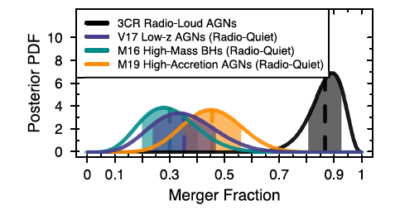
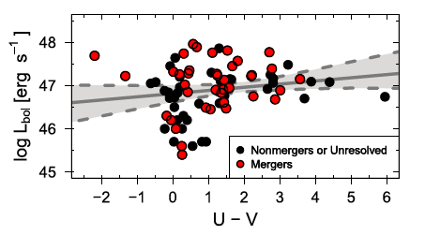
Mergers→ AGN triggering →radio-loud
Compare 3CR with radio-quiet samples selected in x-ray, high L_{edd}, high BH mass
Much higher merger fraction (HST data)
→ ‘Blowout ‘ paradigm where the newly formed jet clears the dust
Breiding+2024
‘Quasars are brightest when they are reddest’?
Notes:
If the accretion is max at reddest time then the L-bol should be highest then
However blue quasars also show evidence of major mergers

Slide 10
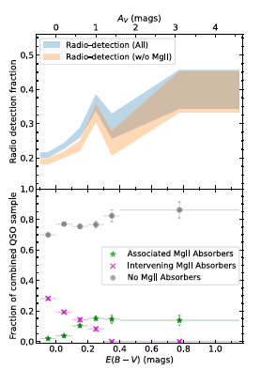
More evidence for a dusty outflow
Selecting redder candidates from DESI using WISE + optical cuts
Effective selection to E(B-V)~1mag
DES #=3038/35000 are red
Large-scale radio jets are not driving the correlation
Fawcett+2023

Slide 11
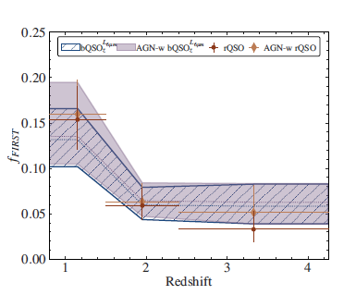
Vejlgaard+2024
But ‘red’ doesn’t mean radio -loud
Sample: u→z from SDSS, J,H,K from UKIRT etc; mostly unpublished;
Also FIRST and WISE data.
Used g-i to define red and blue: 10% samples at the extremes
Both samples have same fraction of radio-detected in FIRST
dust-reddening due to orientation ie torus obscuration
Is the red-fraction related to BAL
Questions whether Fawcett+2023 is selection biased
How to be unbiased? Gaia is based on astrometry but still optically biased

Slide 12
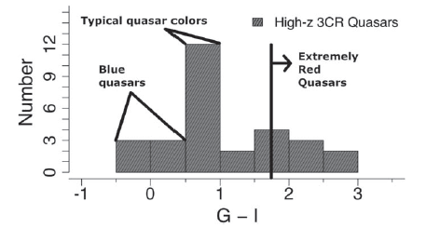
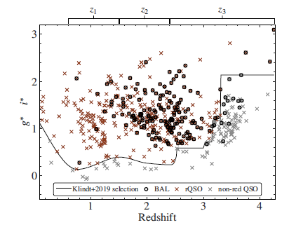
Compare Breiding & Vejigaard
samples. Are they looking at the
same objects?
3CR

Slide 13
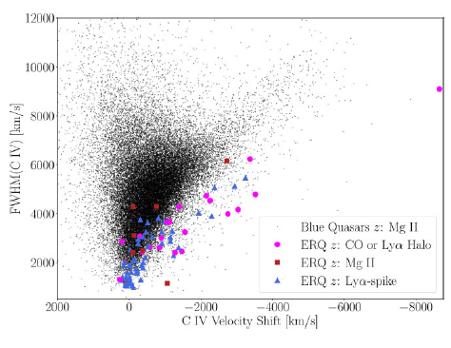
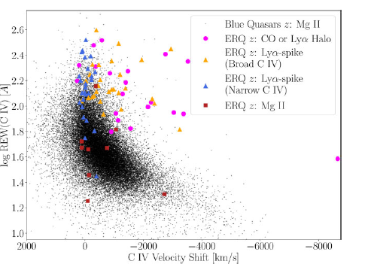
‘Red’ biased towards more massive outflows
Gillette+ 2024
‘Red’ have bigger REW, but similar FWHM;
commonly have large blueshifts
Notes:
biased

Slide 14
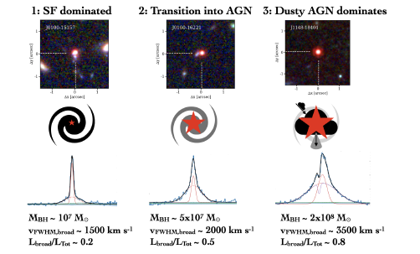
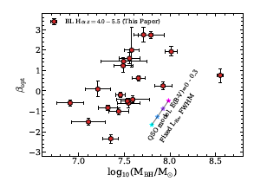
Let’s not forget JWST
UV and optical slopes present a confusing
picture, but some trends
Matthee+2024 – Broad Line emitters
Notes:
Amongst a range of relationships, show that reddening appears to be related to black hole mass
More faint AGN, than previous studies but consistent with sims

Slide 15
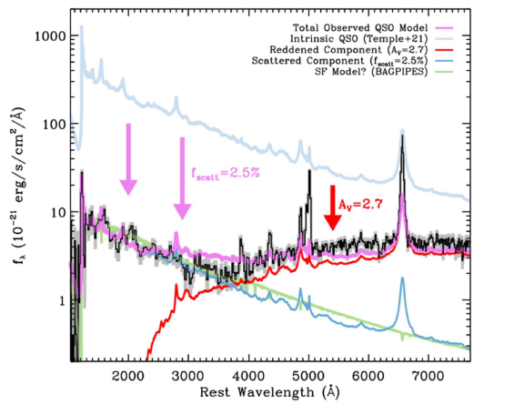
Compact red sources - LRDs
‘little red dots’
JWST is finding dust-reddened AGN at $z>5 −$ broad $Hα$, ${10}^{7}<M_{BH}<{10}^{9}M_{⊙}$
SED consistent with dust reddening
High space density x100 more than UV-selected, but similar to X-ray #s
UV-flux due to star formation?
BH masses high fraction of total mass
Clearly important!
Greene+2024
Notes:
10**-5 MPC-3 mag-1

Slide 16
Some Comments
Different studies select ‘red quasars’ in different ways; unclear that any study is ‘unbiased’ → difficult to compare studies
Most studies try to establish correlations, with rather ‘hand-wavy physics’
Central regions of AGN appear to be complex environments, not in equilibrium
Clearly some radio-loud AGN are associated with mergers and dust – timescales/stages of evolution unclear – messy physics
Relationship between dusty torus and mergers and radio emission or outflows still unclear

Slide 17
Some More Comments
We shouldn’t be surprised to find dust: we identify AGN by broad emission lines including Mg & C
Radio emission from strong emitters likely involves jets, but what other significant radio emissions?
Relationship between massive outflows and radio jets?

Slide 18
Thank you for the opportunity Rekindled my interest in red quasars & the complexity of inner regions of AGN.

Slide 20
Astronomers discover thousands of active red galaxy hearts with powerful radio signals
News By Keith Cooper
published September 29, 2023
A fraction of red quasars have been shown to be young active galaxies smothered in cosmic dust.
Fawcett, DES #=3038/35000 are red

Slide 21
Published refereed papers + conf proc
Webster+ Nature 1995, #=265
Masci+w PASA 1995 #=7
Drinkwater+ PASA 1996 #=1
Drinkwater+ MNRAS 1997 #=163
Siebert+ mnras1998 #=39
Masci+ mnras 1998 #=15
Masci+ ApJ apj 1999 #=9
Masci+w mnras 1999 #=5
Francis+ PASA 2001

Slide 22
Early catalogues of strong Parkes radio sources had a number of ‘empty fields’ listed under their identities. With my first PhD student, Frank Masci, we used the new IR imager on the AAT in the 1990’s to determine that they were actually ‘red sources’, which were not detected in the optical. At the time, a range of possibilities were explored to understand the nature of these objects. Fast forward nearly thirty years, and red quasars are again a topic of interest. During this talk, the early work will be described; however, more interestingly, an up-to-date discussion of red quasars and their role in galaxy mergers and the coevolution of black holes and their galaxy hosts will be presented.
https://cloudproject.hosted.panopto.com/Panopto/Pages/Viewer.aspx?id=f378b420-2b99-4d09-9555-afbf01706b96

Slide 23
The red quasars seem to be radiating more strongly in radio waves than the blue quasars because of interactions between outflows of radiation pouring from a quasar and the surrounding curtains of dust. As the outflows slam into the dust, they excite molecules within the dust to prompt the emission of radio waves. Over time, the outflows, driven by the energy of a supermassive black hole hungrily feeding on vast amounts of matter, will blow the dusty cloak away to leave a naked blue quasar with much weaker radio emission. Fawcett calls this the 'blow-out' phase.
Therefore, when astronomers see a red quasar, they are seeing a younger quasar than if they were to see a blue one.

