Slide 1
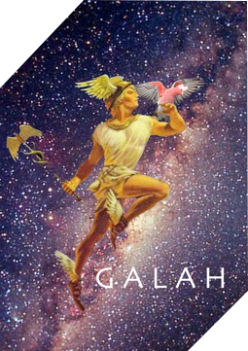
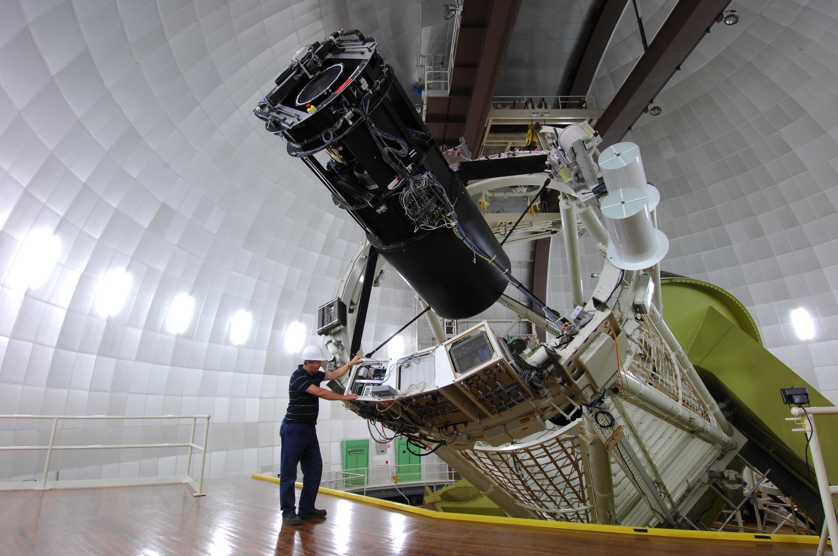
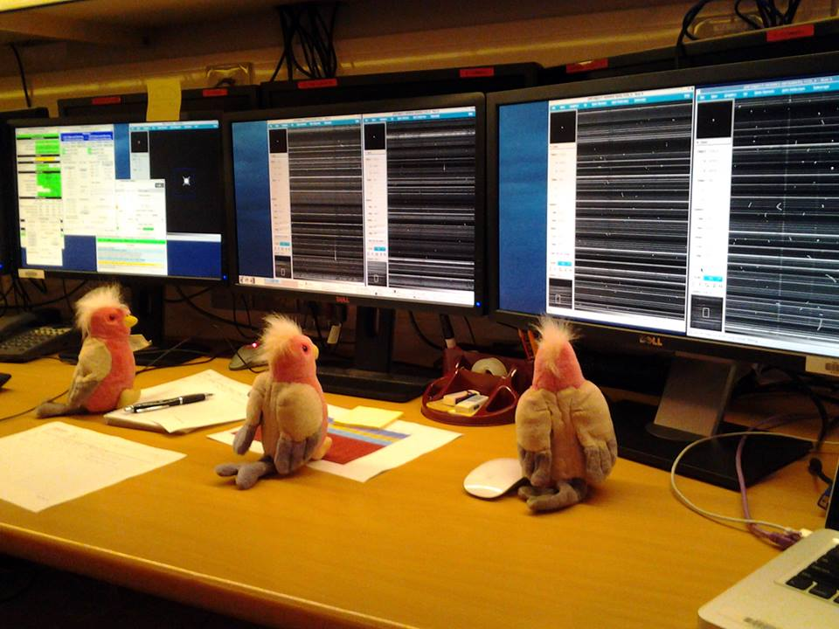

10 years of the
GALAH Survey at the AAT
Sarah Martell
UNSW

Slide 3
GALAH SCIENCE GOALS
Explore the Milky Way’s history of star formation, chemical evolution, and accretion through high-resolution spectroscopy for 1 million stars

Slide 4
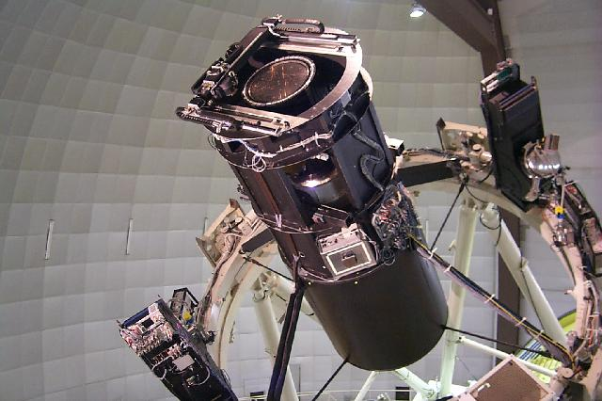
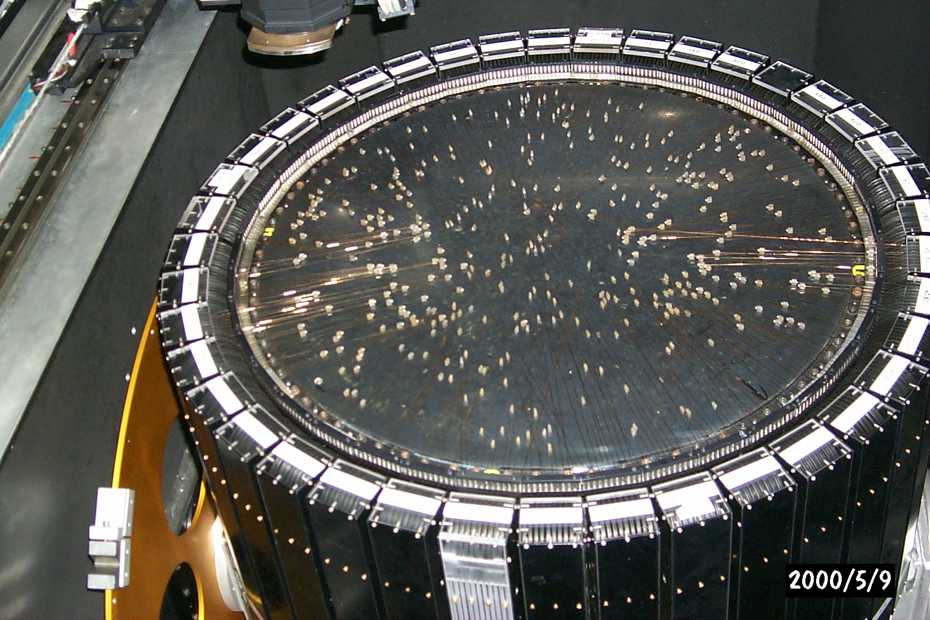
2dF and HERMES

Slide 5
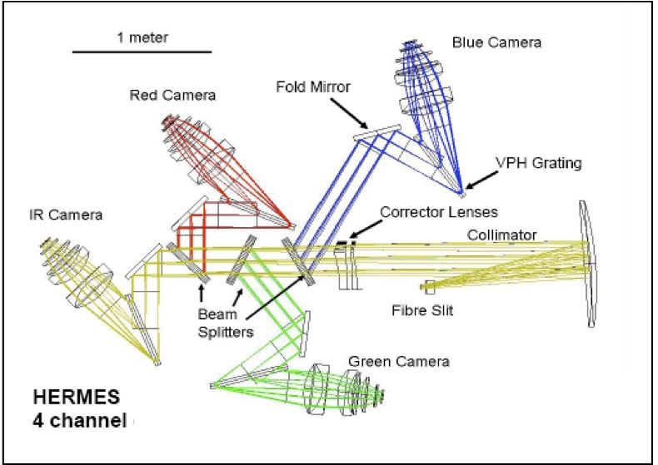
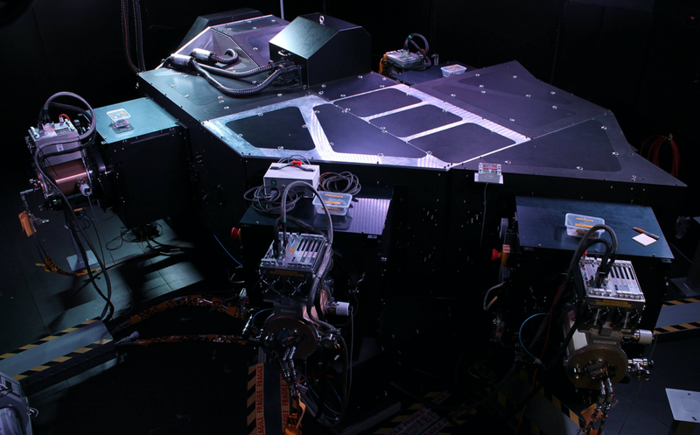
2dF and HERMES

Slide 6


Slide 7
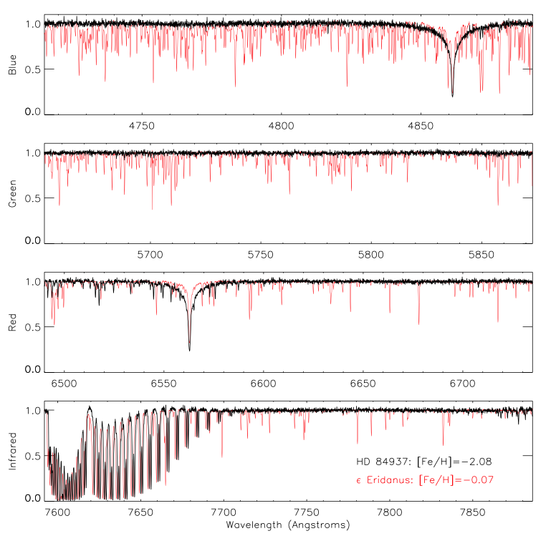

Janez Kos
(Ljubljana)

Slide 8
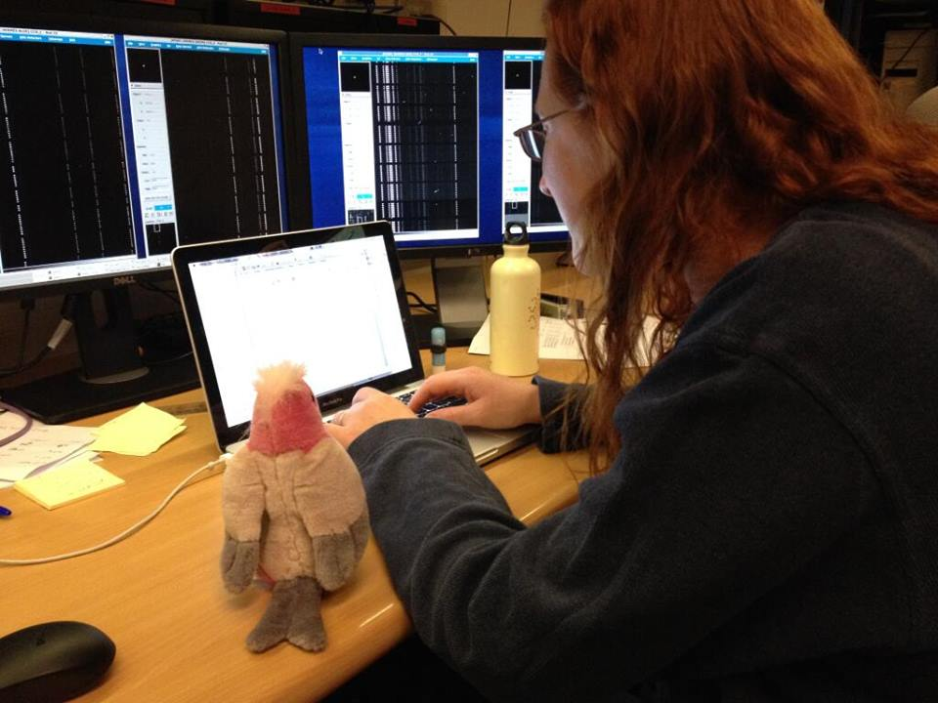
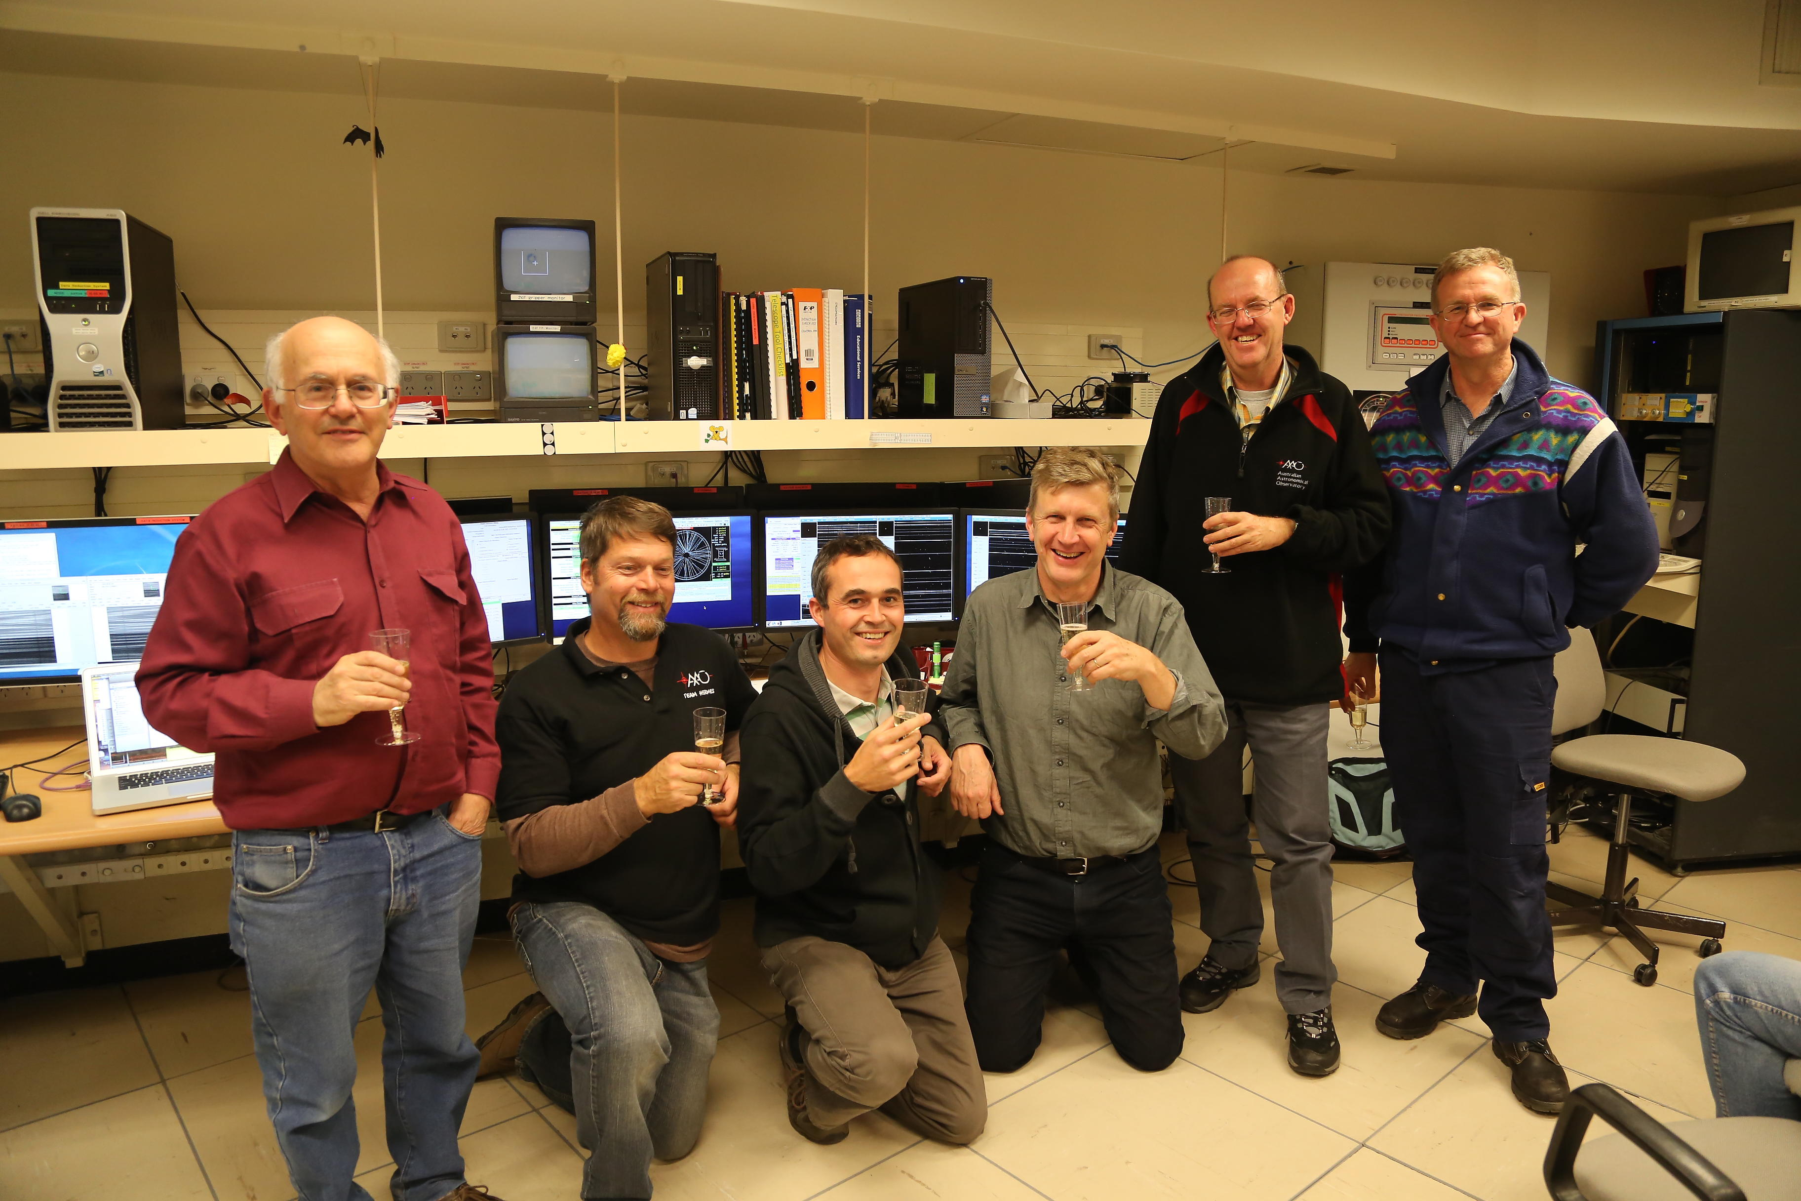
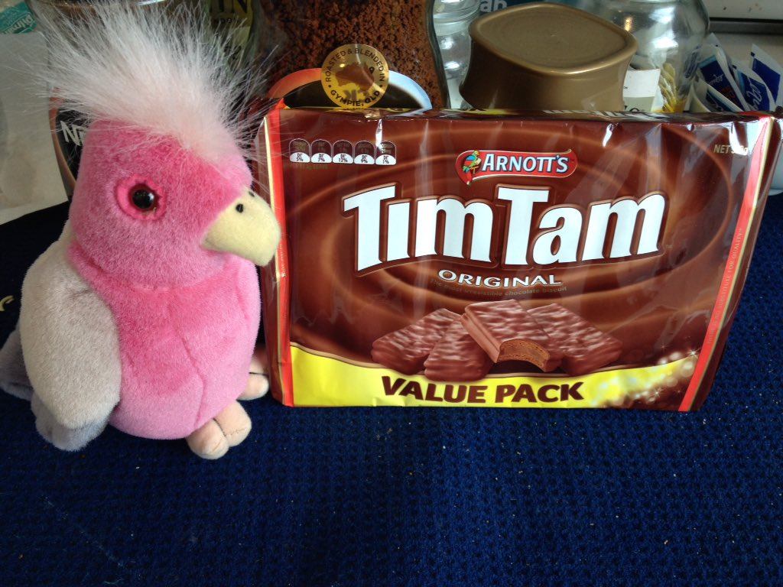
November 2013 – start of observing

Slide 9

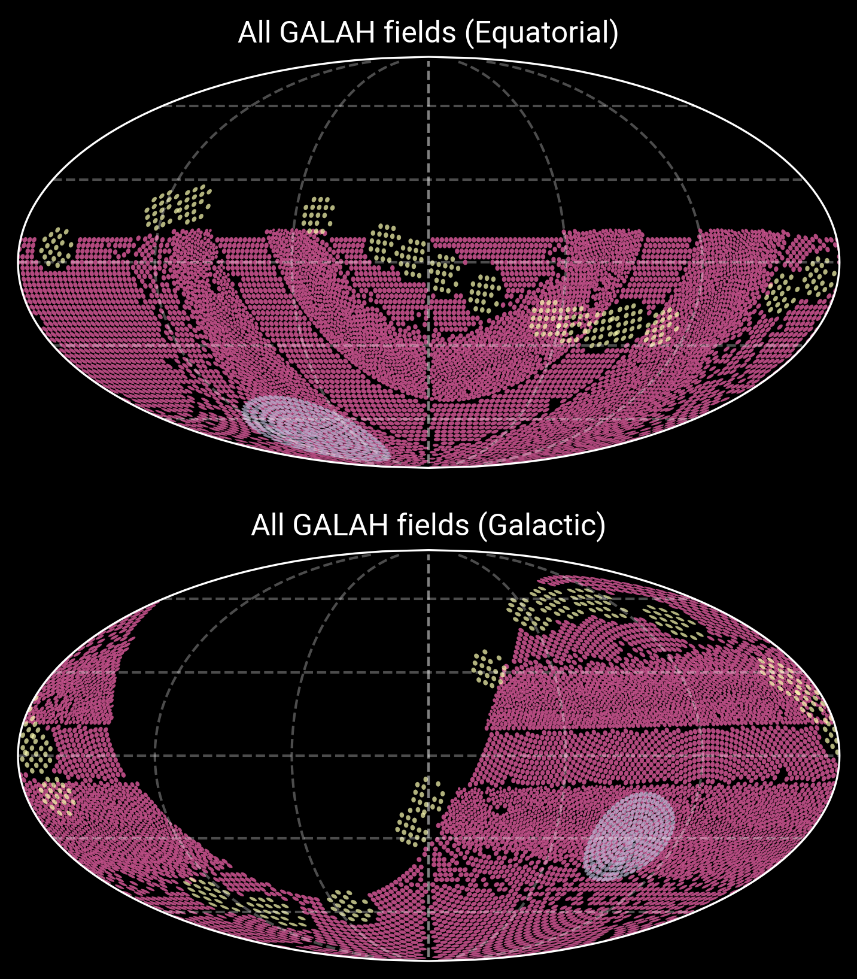
Data collection
Sanjib Sharma (STScI)

Slide 10
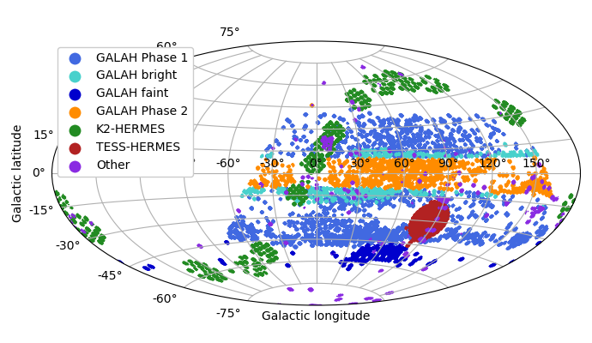
Data collection

Slide 11
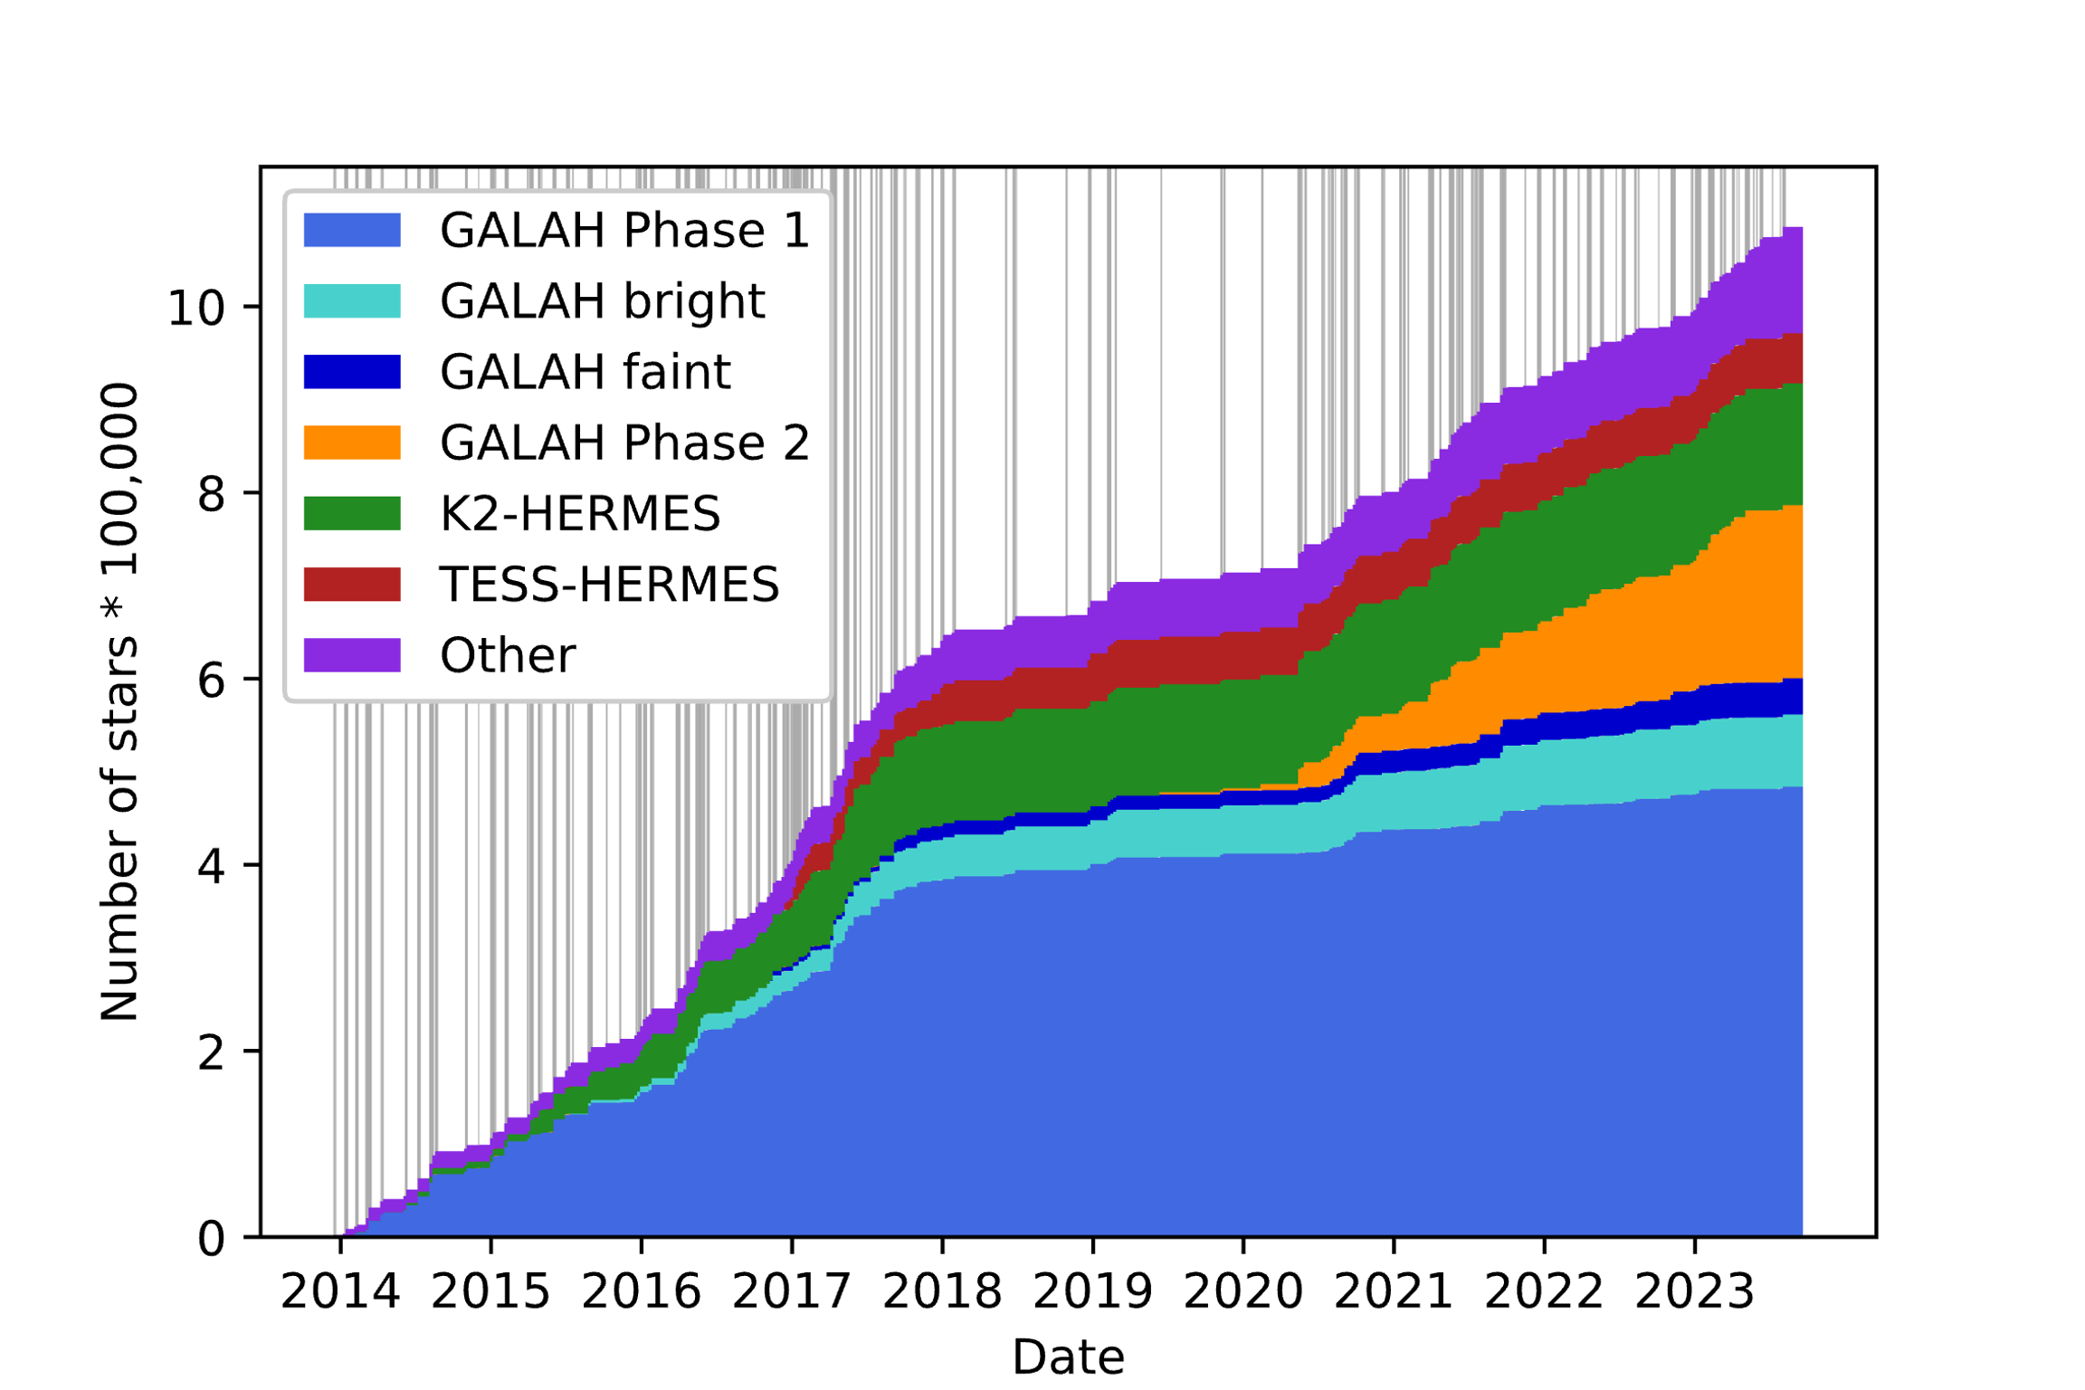
Data collection
The AAT has been collecting GALAH data for two full years out of the past decade

Slide 12
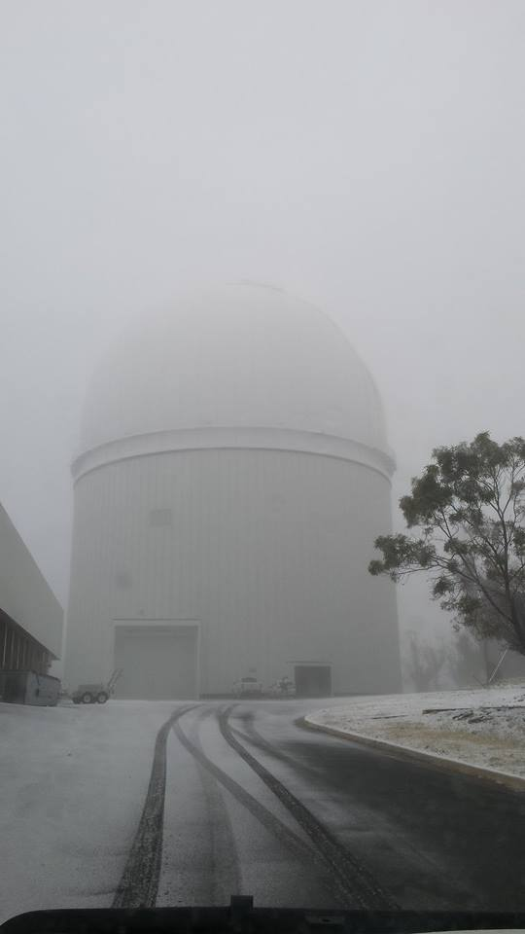
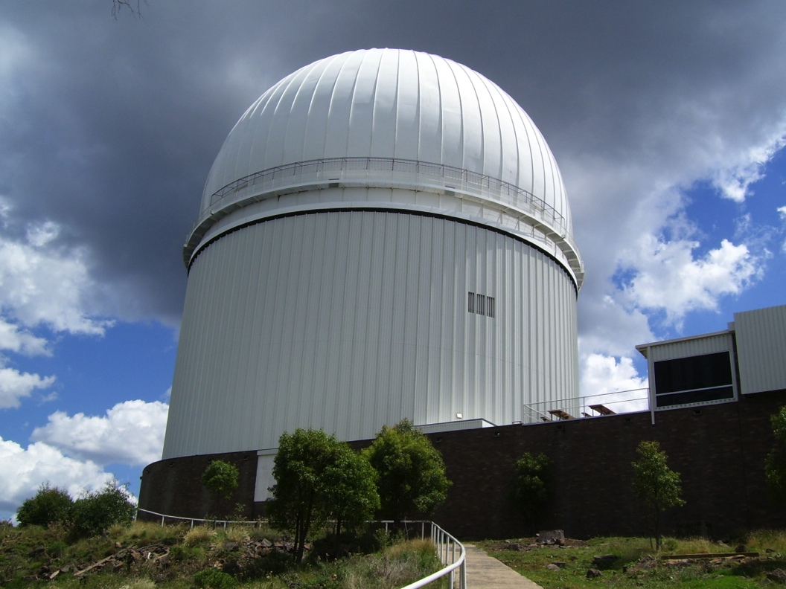

Slide 13
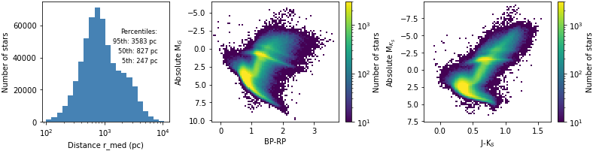
GALAH collects a wide variety of stars

Slide 14

What do we do with all this data?
Sven Buder (ANU)
Stellar parameters
Temperature, surface gravity, overall metal abundance
31 elemental abundances
All five main nucleosynthesis pathways
Extra information
- Mass, age, rotation, binarity

Slide 15

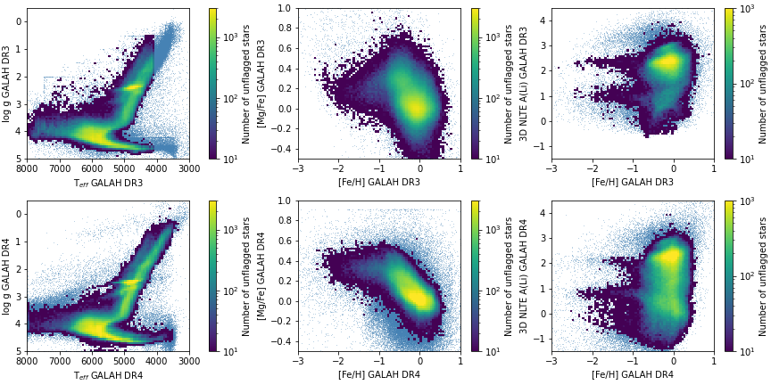
Consistently improving the analysis
Ella Wang (Stockholm)
DR3 (2020)
DR4 (2024)

Slide 16
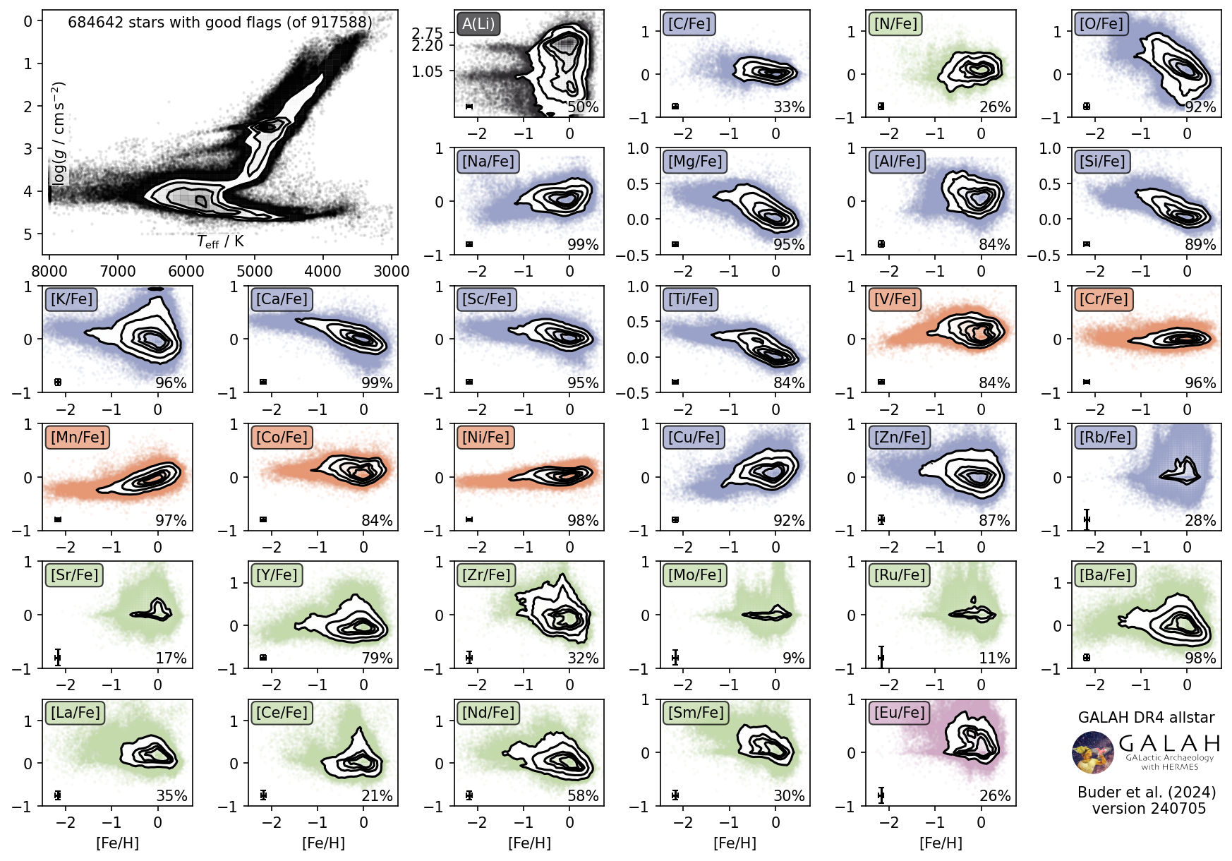

Slide 17
GALAH in combination with other data
99.5% of GALAH stars have Gaia parallax and proper motion – so we can calculate their distances and Galactic orbits
Asteroseismology gives internal structure, mass, and age for tens of thousands of GALAH stars
GALAH provides an anchor for future survey projects
GALAH is complementary to other current survey projects

Slide 18
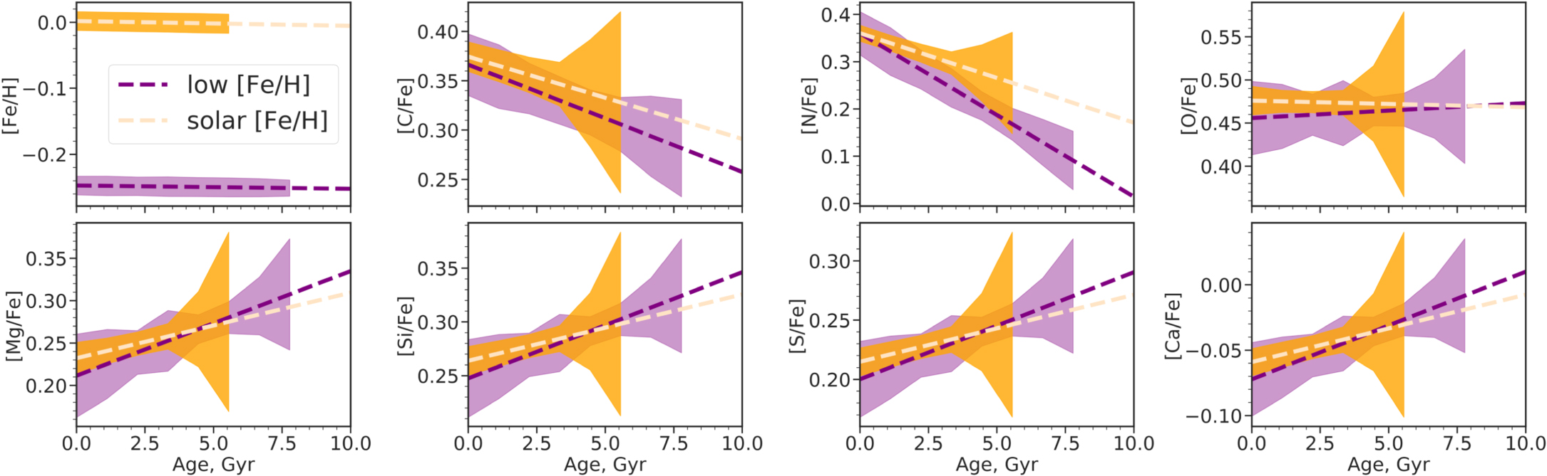

Age, abundance and kinematics
Tracing the formation of stars and elements across Galactic history
Sharma et al. 2022
Big disagreements between data sets and methods: we still have some work to do!
Sanjib Sharma (STScI)
Carillo et al. 2023
Jo Ciuca (Stanford)

Slide 19

How complicated is abundance space?
Difference between in-cluster pairs
Difference between cross-cluster pairs
Mitschang et al. 2013
Gayandhi de Silva (Macquarie)
Mitschang et al. (2013, 2014) developed and demonstrated an n-dimensional distance metric based on open clusters
De Silva et al. 2009

Slide 20

How complicated is abundance space?
1% of unrelated pairs of stars in the disk are “Doppelgängers” – as similar to each other in abundance as stars from the same open cluster
Melissa Ness (ANU)
Mitschang et al. 2013
Ness et al. 2018

Slide 21
How complicated is abundance space?
Manea et al. (2024) use GALAH abundances to explore how different nucleosynthetic families affect the doppelgänger rate
Similar setup to Ness et al. (2018), varying which elements go into the calculation
Using elements from different nucleosynthetic families helps reduce the doppelgänger rate
Manea et al. 2024

Slide 22
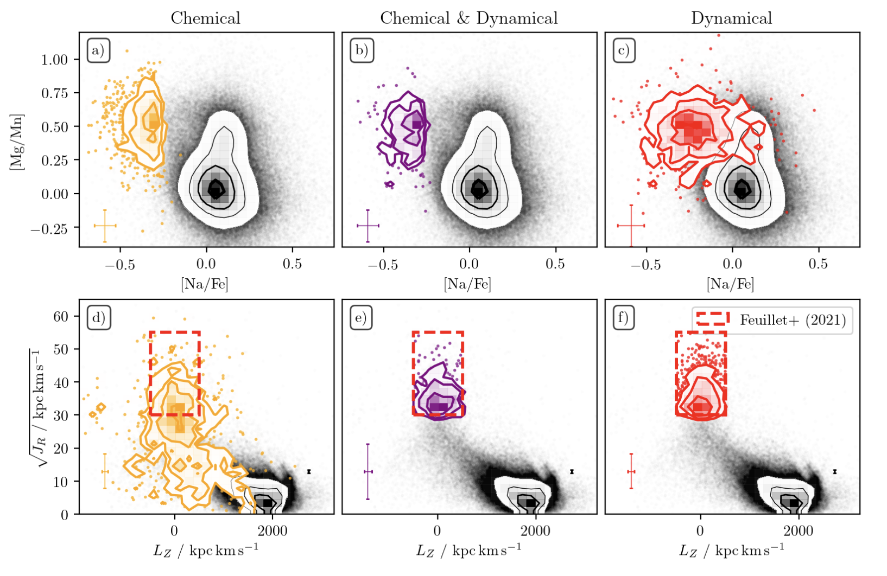
GALAH and galaxy mergers
Designing the best tools for identifying stars with extragalactic origins
Elemental abundances and orbital properties both carry information
But they don’t completely agree: we have more work to do in predicting how abundances should evolve over time and how the galaxy merger process works
Sven Buder (ANU)
Buder et al. 2022
Buder et al. 2022

Slide 23
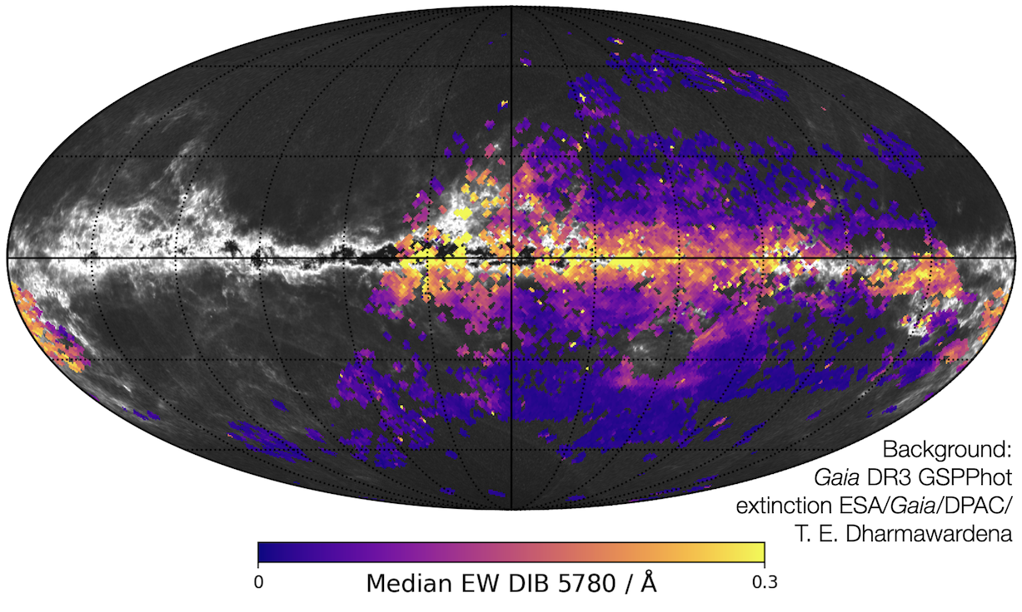
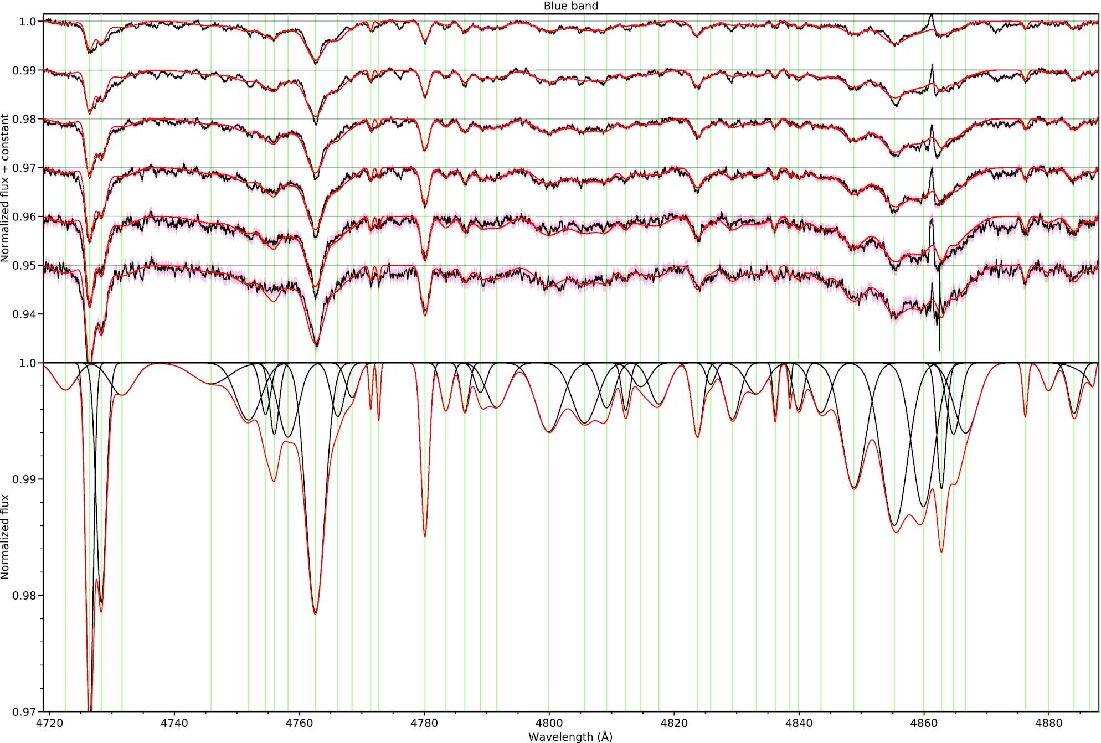

GALAH and the ISM
Measure wavelength and strength of nonstellar lines from 800,000 GALAH stellar spectra as a function of reddening
Vogrincic et al. 2023
Rok Vogrincic (Ljubljana)

Slide 24
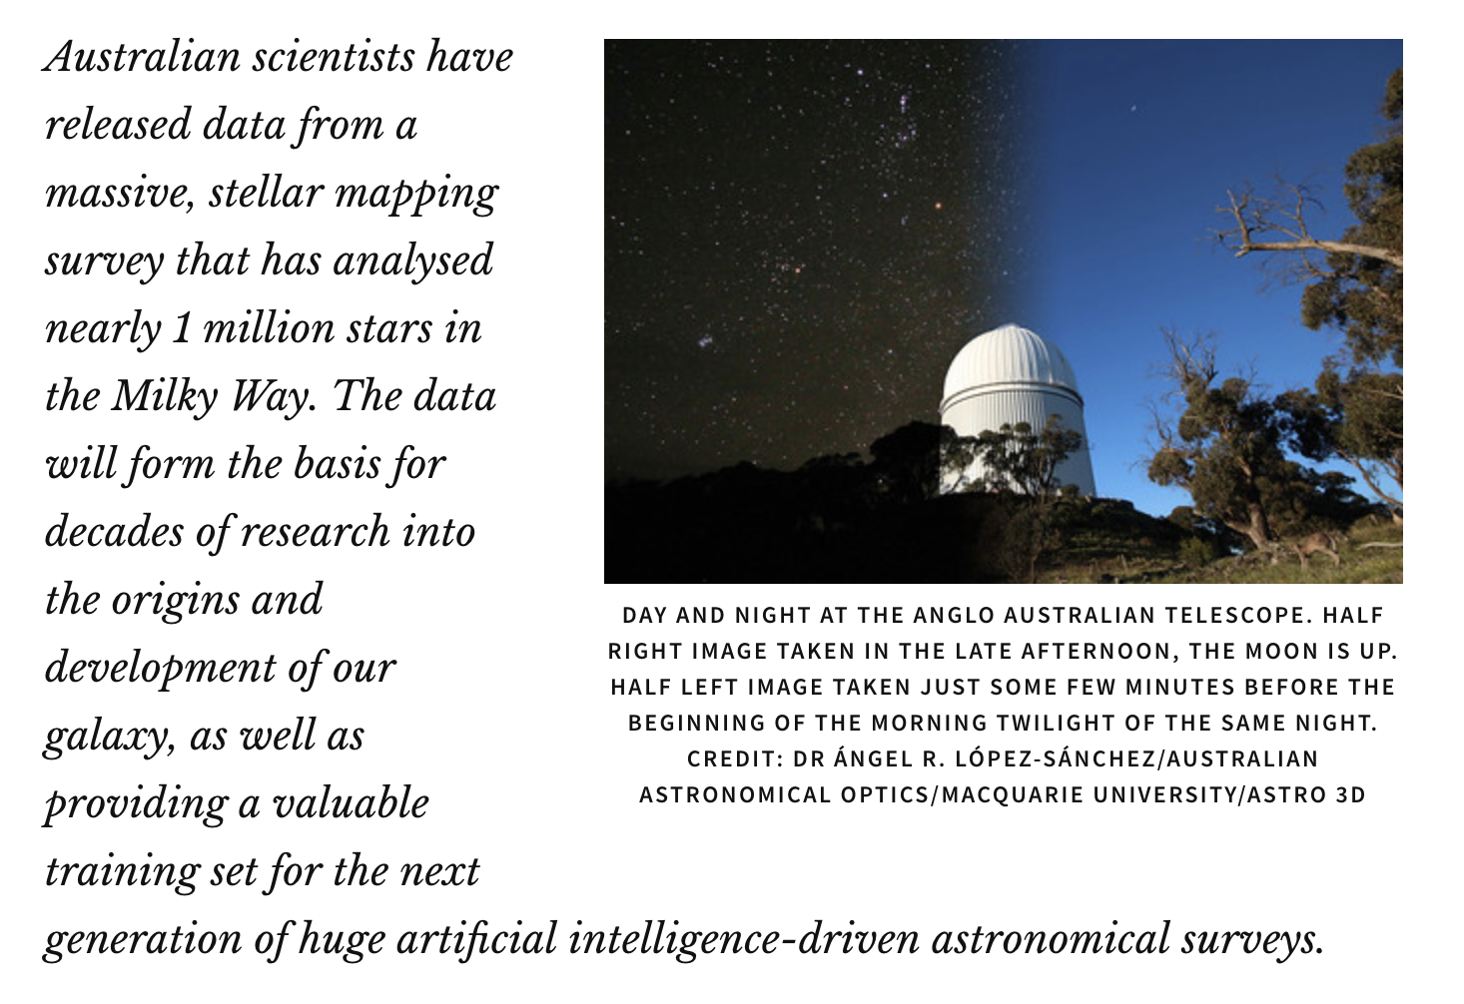
GALAH Data Release 4

Slide 25
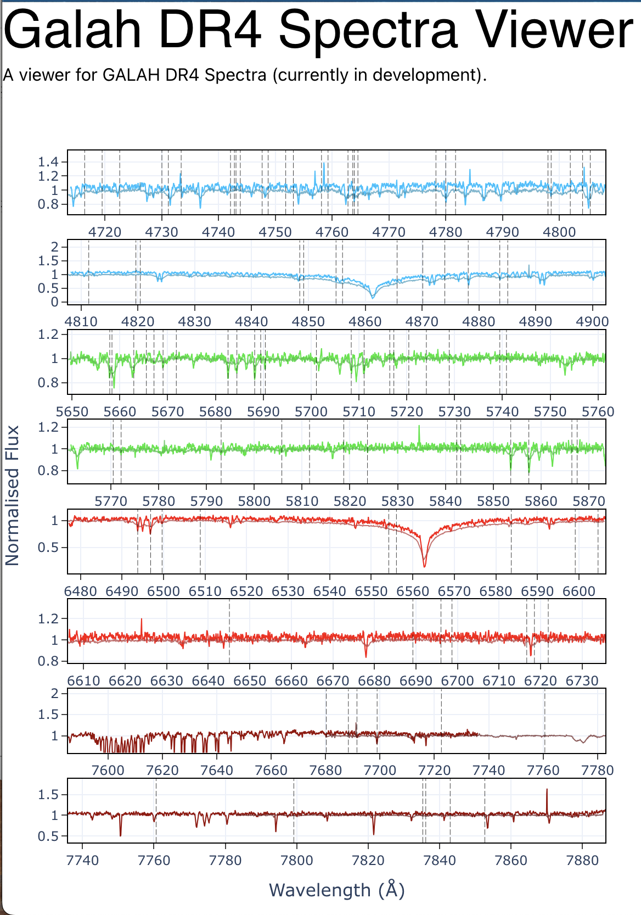
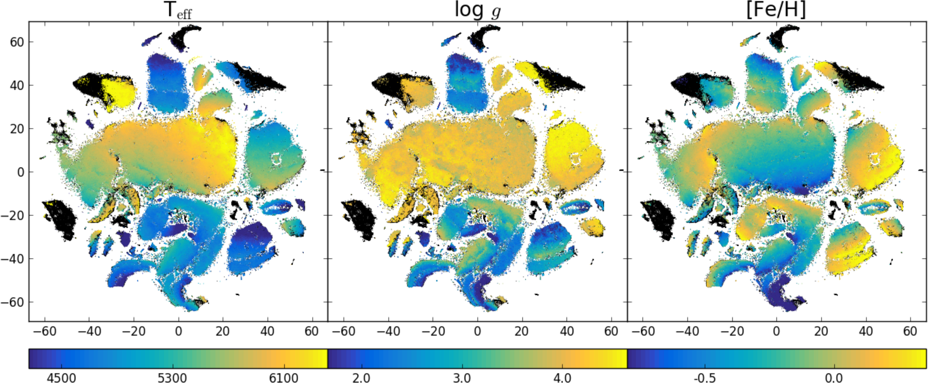
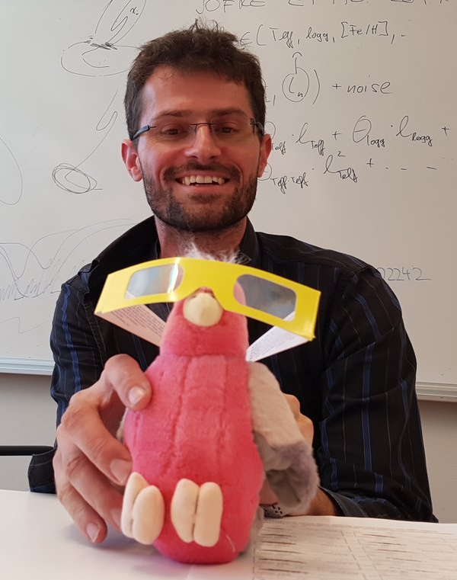
DR4
1,085,520 spectra of 917,588 stars
Catalogs and spectra are now available for download at datacentral.org.au
          You can also query the catalogs, plot the spectra, or use their jupyter notebook server to do data analysis
Buder et al. 2018
Gregor traven
(Ljubljana)

Slide 26
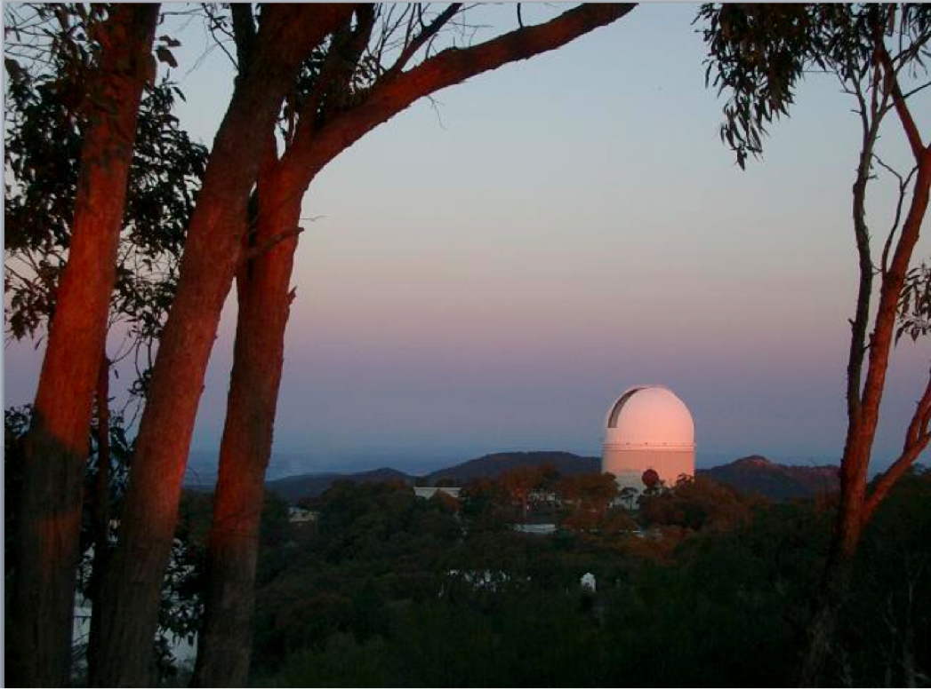
Thank you to current and former members of the GALAH Survey team, AAT staff, ATAC, AAT Council, and Data Central staff for making GALAH possible since 2013

Slide 27
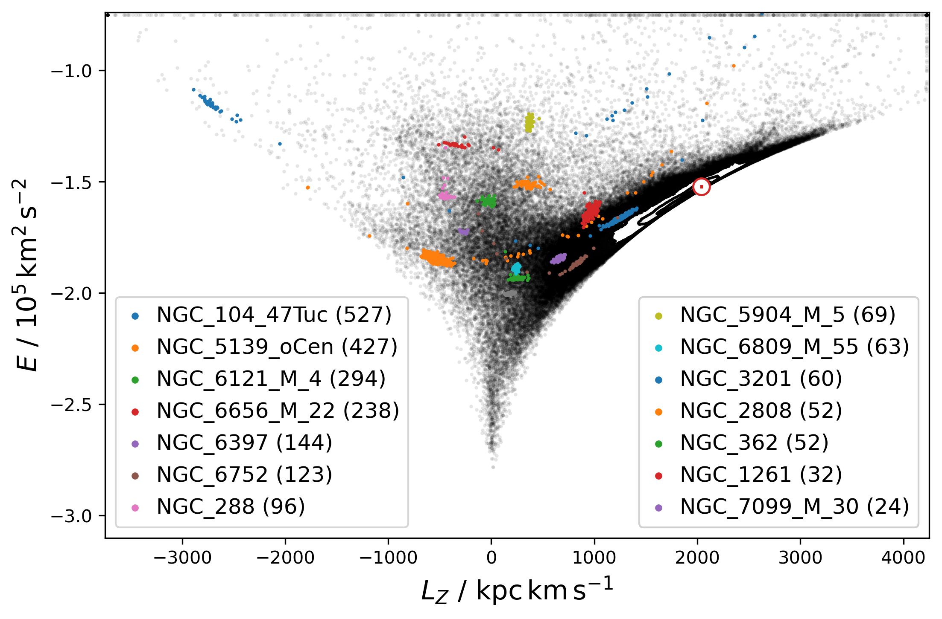

Slide 28
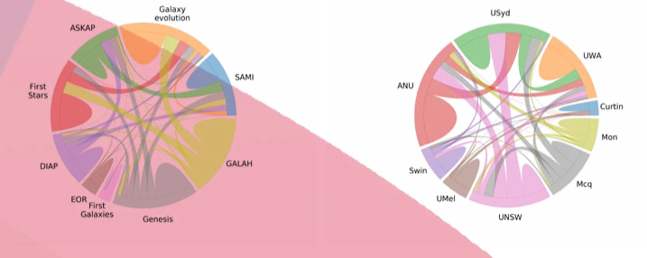
GALAH connections across ASTRO 3D

Slide 29
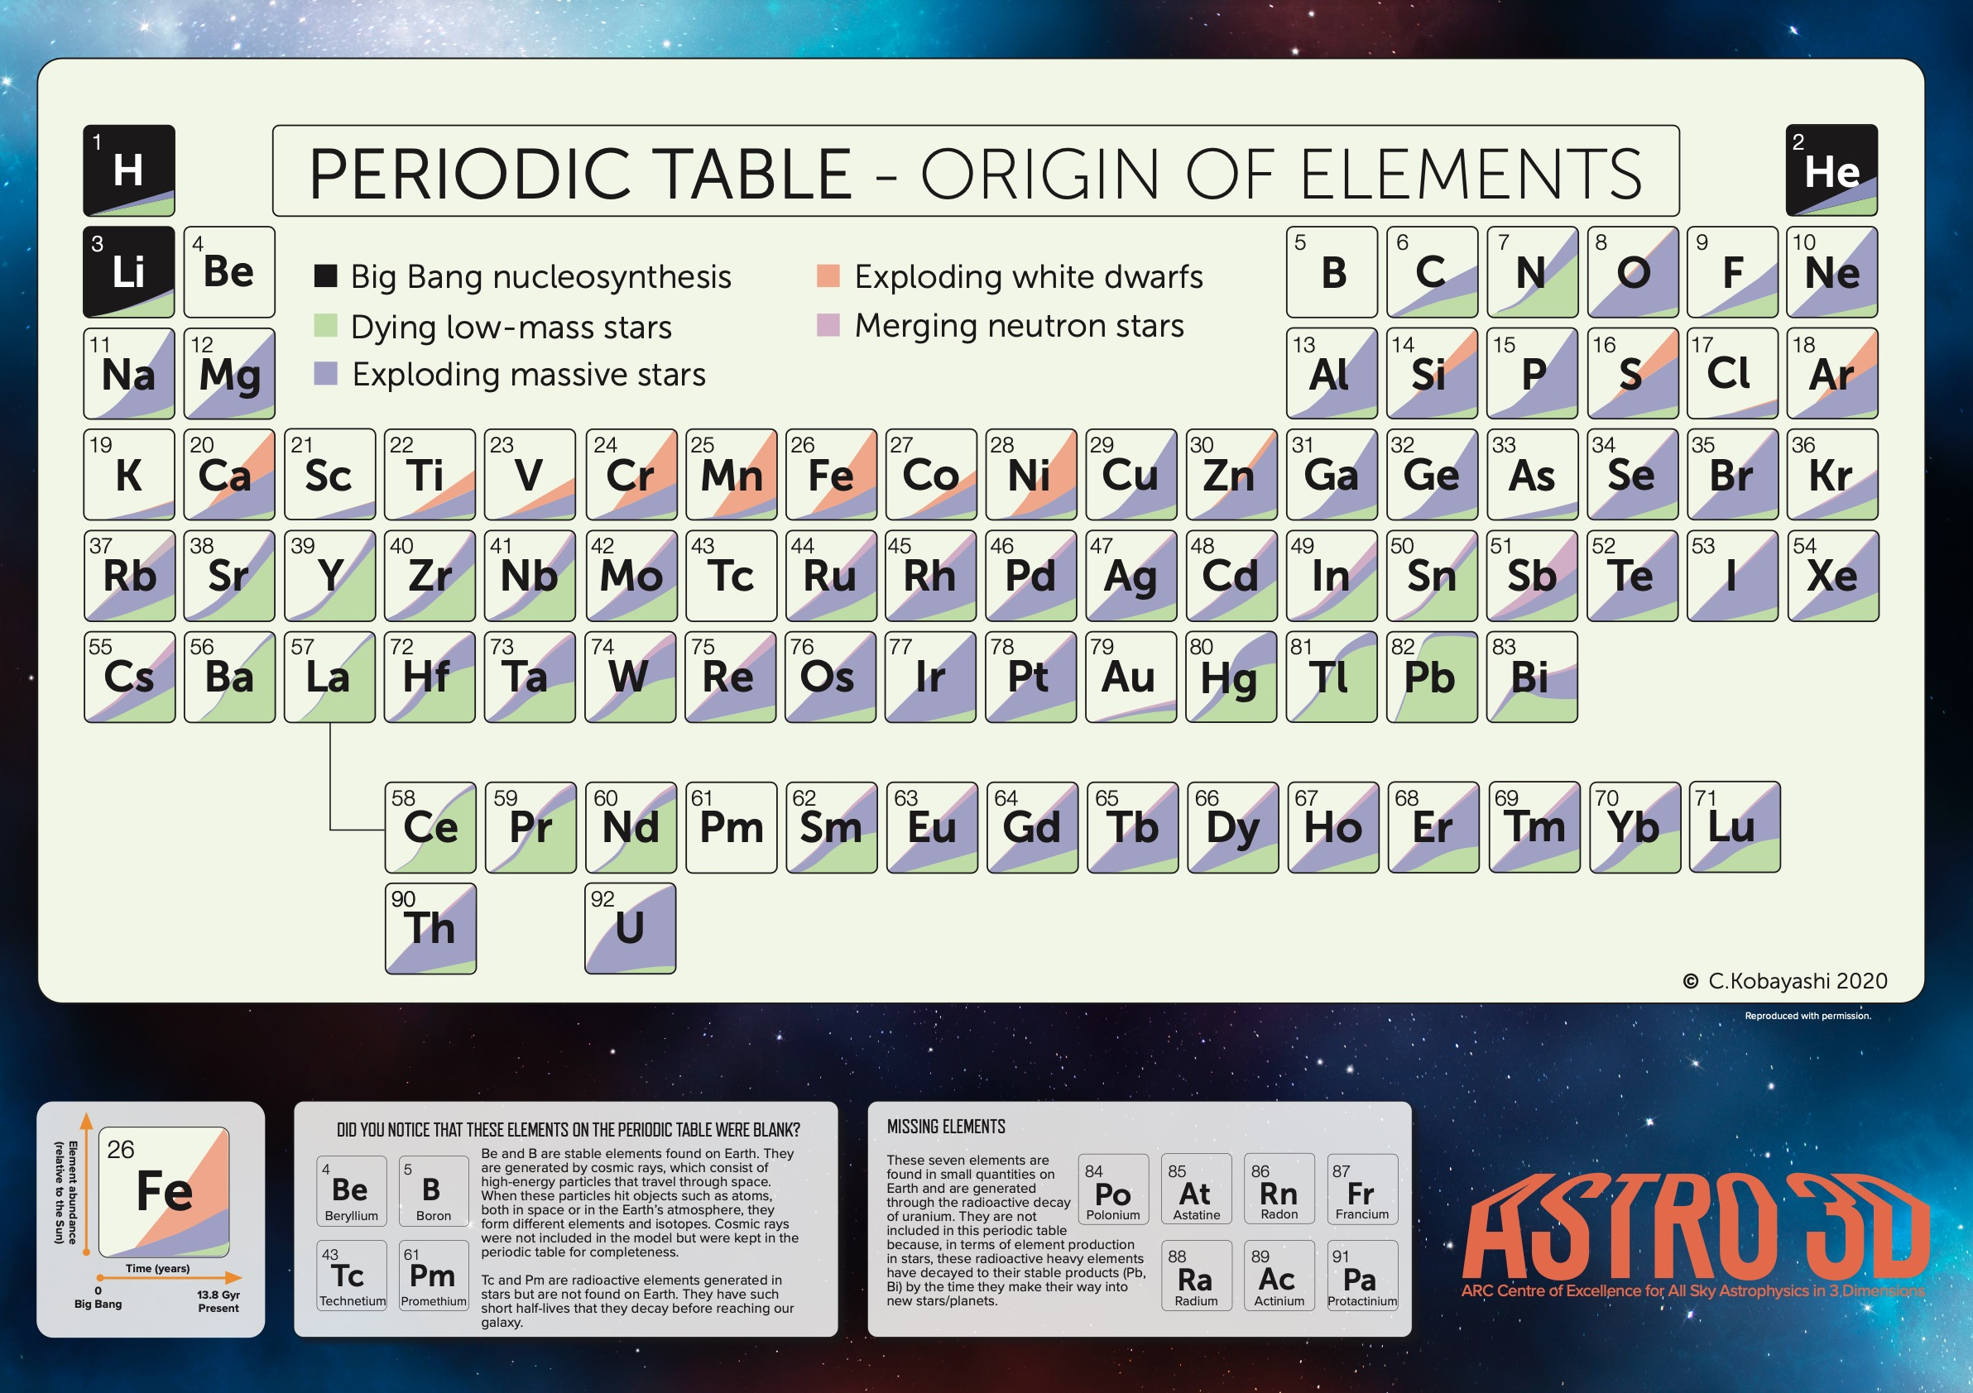
We observe distinct nucleosynthetic families because the sites where fusion happens have very different conditions

Slide 30
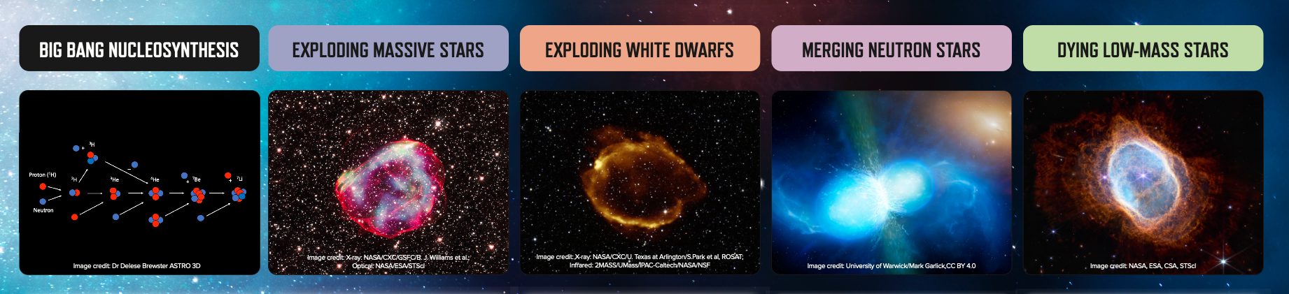
We observe distinct nucleosynthetic families because the sites where fusion happens have very different conditions
Primordial abundances: just the lightest elements
SN II: alpha elements and the iron peak
SN Ia: mainly the iron peak
Neutron star mergers: one possible site for rapid neutron capture
AGB stars: hotter hydrogen burning than in main sequence stars, and slow neutron capture

Slide 31
Chemical tagging
Stars that form together should have the same compositions
Present-day stars with matching abundances likely formed together
Abundances* don’t change over a star’s lifetime
*Most abundances

Slide 32
Looking on a smaller scale
Star formation is spatially complex, and moves around in a galaxy over time
Stellar yields in one region of a galaxy won’t necessarily have an impact on other regions
Open clusters are a way to sample individual star-forming events
We see variety in their abundance patterns: chemical enrichment is a local process
De Silva et al. 2009

Slide 33
Major GALAH science goals
High-detail mapping of the present-day Milky Way
Chemical tagging: “stellar DNA” to identify stars that formed at the same place and time
Abundances vs time and location: track star formation, chemical enrichment and accretion over time
The Milky Way as a galaxy: watch galaxy evolution from close up

Slide 34
