Slide 1
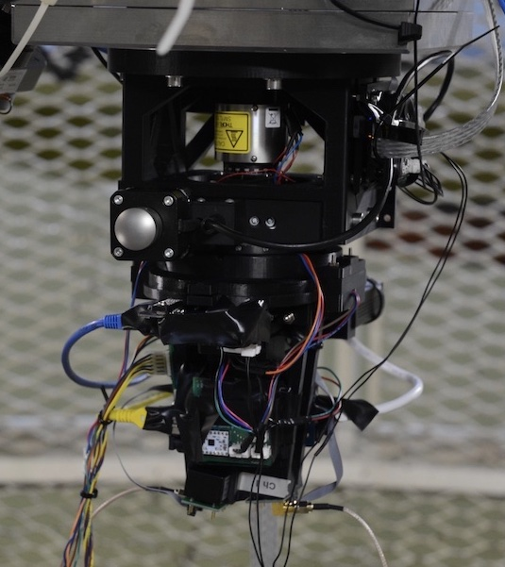
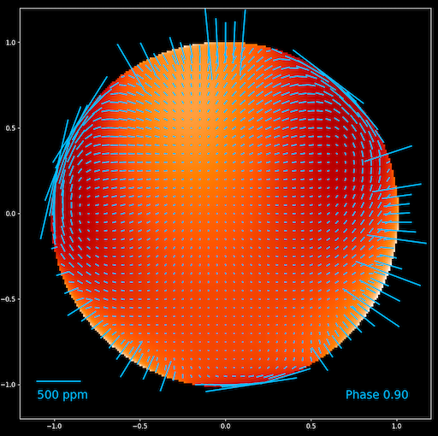
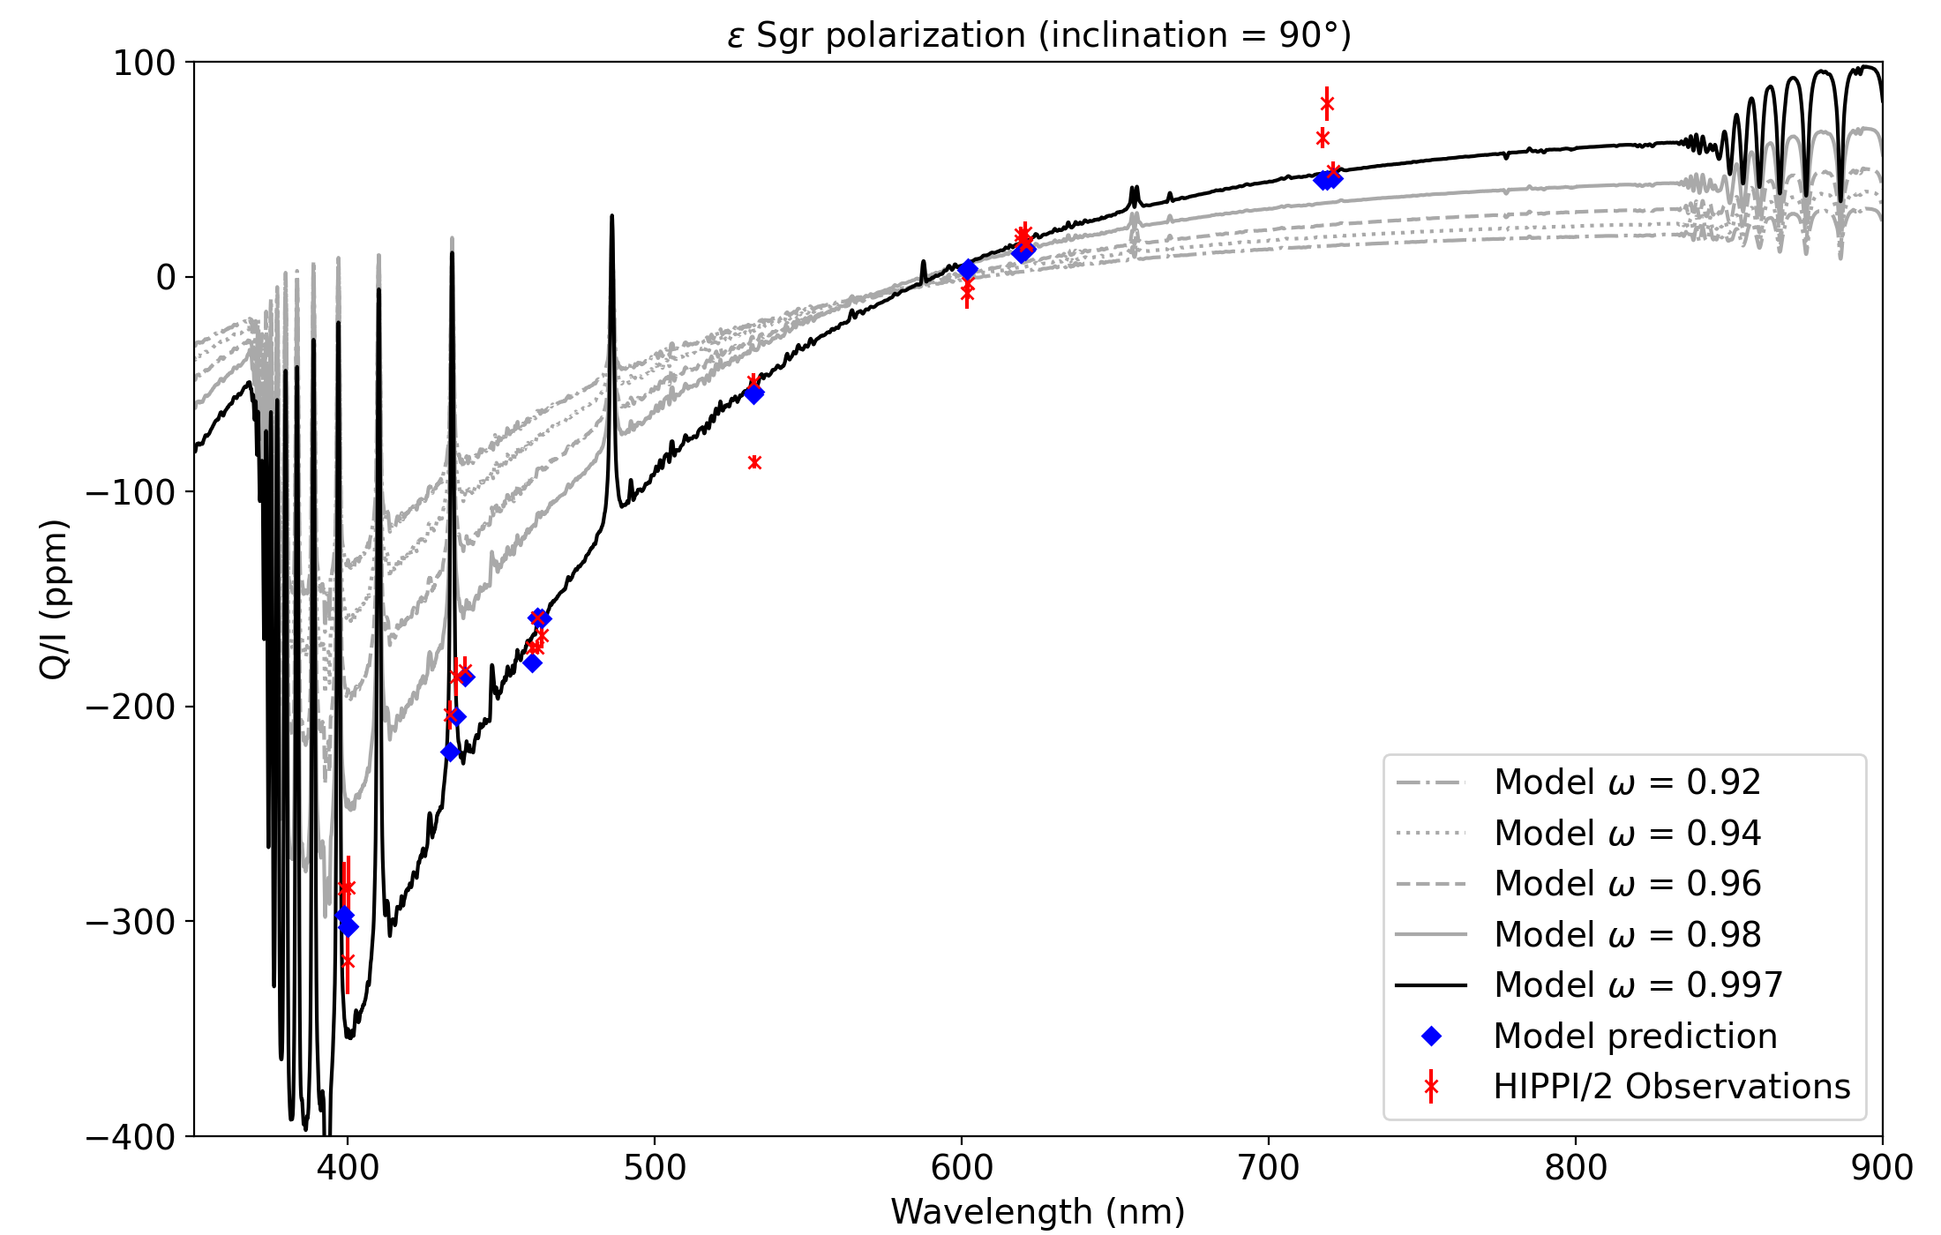
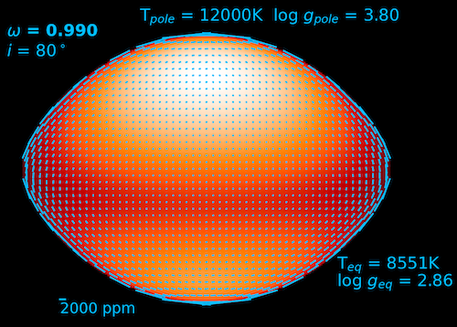
Polarimetry with the AAT
Busting the Myth of Spherical Stars
Jeremy Bailey (UNSW), Daniel V. Cotton (Monterey Institute for Research in Astronomy), Lucyna Kedziora Chudczer (UniSQ), Ian Howarth (UCL), Kim Bott (SETI Institute), Ain De Horta (WSU), Graeme Melville (UoW).

Slide 2
Polarimeters at the AAT
Facility Instruments with polarimetric modes
Visitor Instruments
Durham Electronographic Polarimeter
  Warren-Smith et al., 1979
RGO People’s Photometer/Polarimeter
  Jones et al., 1981
ROE Imaging Spectropolarimeter
  McLean et al., 1983
Hatfield 2-Channel Optical/IR Polarimeter
  Bailey & Hough, 1982
UCL IR Grating Spectrometer / Polarimeter
  Aitken et al., 1984
Durham CCD Imaging Polarimeter
  Scarrott et al., 1991
Hatfield 6-Channel Polarimeter
  Hough et al., 1991
NIMPOL (N-band Imaging Polarimeter)
  Smith et al., 1997
HIPPI (HIgh Precision Polarimetric Instrument)
  Bailey et al., 2015
HIPPI-2
  Bailey et al., 2020
Boller & Chivens Spectrograph – IDS
  Visvanathan & Wickramasinghe, 1978
RGO Spectrograph / Pockels Cell
  McLean et al., 1983
RGO Spectrograph / Waveplate
Taurus II Faint-Object Polarimeter
  Cropper et al., 1990
IRIS Imaging Polarimeter
  Hough et al., 1994
UCLES / Semel Polarimeter
  Donati et al., 1997
Taurus II Charge Shuffling Polarimeter
  Bailey & Kedziora-Chudczer, 2000

Slide 3
Polarimeters at the AAT in 2024
Facility Instruments with polarimetric modes
Visitor Instruments
Durham Electronographic Polarimeter
  Warren-Smith et al., 1979
RGO People’s Photometer/Polarimeter
  Jones et al., 1981
ROE Imaging Spectropolarimeter
  McLean et al., 1983
Hatfield 2-Channel Optical/IR Polarimeter
  Bailey & Hough, 1982
UCL IR Grating Spectrometer / Polarimeter
  Aitken et al., 1984
Durham CCD Imaging Polarimeter
  Scarrott et al., 1991
Hatfield 6-Channel Polarimeter
  Hough et al., 1991
NIMPOL (N-band Imaging Polarimeter)
  Smith et al., 1997
HIPPI (HIgh Precision Polarimetric Instrument)
  Bailey et al., 2015
HIPPI-2
  Bailey et al., 2020
Boller & Chivens Spectrograph – IDS
  Visvanathan & Wickramasinghe, 1978
RGO Spectrograph / Pockels Cell
  McLean et al., 1983
RGO Spectrograph / Waveplate
Taurus II Faint-Object Polarimeter
  Cropper et al., 1990
IRIS Imaging Polarimeter
  Hough et al., 1994
UCLES / Semel Polarimeter
  Donati et al., 1997
Taurus II Charge Shuffling Polarimeter
  Bailey & Kedziora-Chudczer, 2000

Slide 4
Polarimetry Science Highlights
Active Galactic Nuclei
  Tests of unified models – using polarimetry to detect hidden nuclei and broad-line regions.
  Favourite object NGC 1068.
AM Her Binaries (magnetic CVs)
  Detecting and measuring the magnetic fields of white dwarfs using Zeeman and Cyclotron spectra.
Supernova 1987A
  Observations of polarization and its variation allowed the asymmetry of the explosion to be studied (Cropper et al., 1988).
The Crab Pulsar
  Phase-resolved polarimetry of the optical pulses (Jones et al., 1981) showing very high polarizations.
Interstellar Polarization
  Whittet et al. (1996) studied wavelength dependence and provided a widely used list of standards.
Stellar Magnetic Fields
  Development of the Zeeman Doppler Imaging technique (Donati et al., 1997).
Star Formation Regions
  Detection of IR circular polarization and possible link to biomolecular chirality.

Slide 5
High Precision Polarimetry
Polarization can be measured to very high precision (parts per million) from ground-based telescopes.
  Unlike photometry where it is necessary to go into space to get ppm precision.
  Polarization is a differential measurement – two polarization states are measured simultaneously.
Key to High Precision – Photon Statistics.
  To measure to 10 ppm need at least 10¹⁰ photons.
  To measure to 1 ppm need at least 10¹² photons.
CCDs are not good for this – Slow readout and well-depth limitation.
Development driven by the possibility of detecting polarized reflected light from exoplanets.

Slide 6
HIPPI-2
Used on AAT since 2018. Upgraded version of the original HIPPI commissioned in 2014.
Aperture polarimeter using broad-band filters.
Precision in g’ and r’ bands of ~2 ppm.
  Measured from repeat observations of bright stars (Bailey et al., 2020).
Detectors are compact metal packaged photomultiplier tube modules.

Slide 7
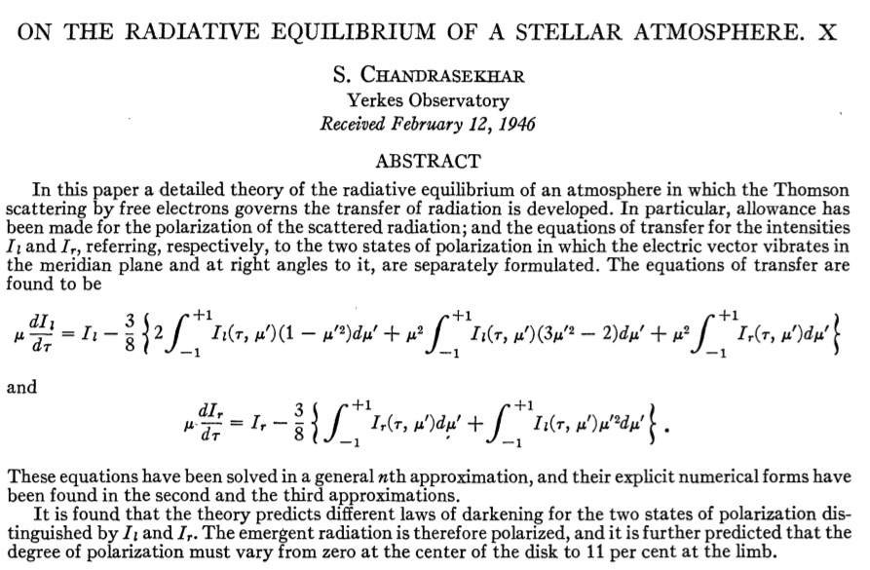
Polarization from Stellar Atmospheres
1946 — Chandrasekhar calculates polarization due to an electron scattering atmosphere.
“… must vary from zero at the
center of the disk to 11 per cent at the limb….”
Hot stars should have lots of electrons in their atmosphere and produce polarization in this way. However, for a spherical star the polarization will average to zero.

Slide 8
Polarization from Stellar Atmospheres
1946 — Chandrasekhar calculates polarization due to an electron scattering atmosphere.
“… must vary from zero at the
center of the disk to 11 per cent at the limb….
… most favourable conditions under which the phenomena could be observed … the primary minimum in an eclipsing binary …”

Slide 9
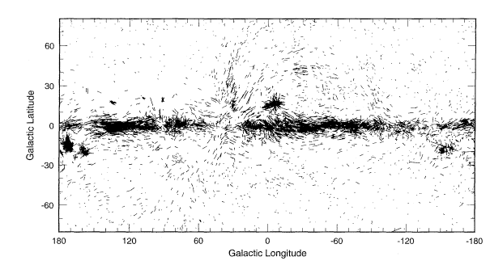
Observers go looking for this effect, but instead discover the much larger effect of interstellar polarization (Hiltner, 1948; Hall, 1949).
And then polarization due to circumstellar material around stars (e.g. Be stars, T Tauri stars, M giants etc.)
Chandrasekhar’s ideas of polarization from stellar photospheres were largely forgotten.
Seen in distant stars due to aligned interstellar dust grains.

Slide 10
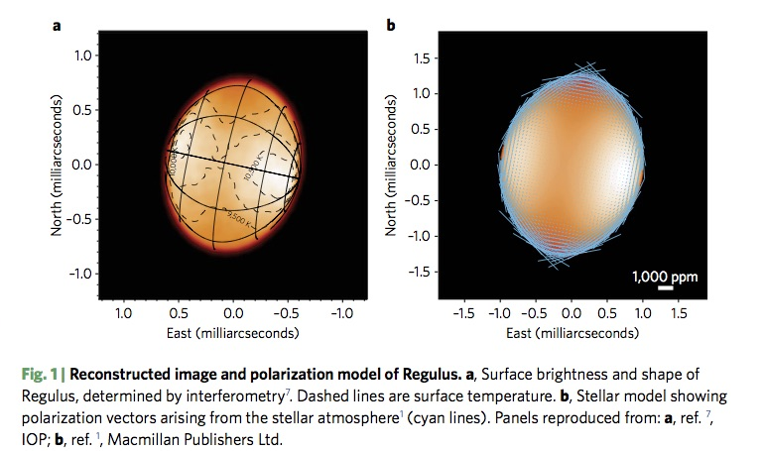
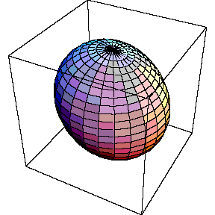
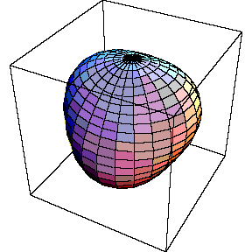
Three ways stars depart from spherical symmetry
1. Rotation (e.g. Regulus)
3. Non-Radial Pulsation
(e.g. Beta Crucis)
2. Binary Systems (e.g. Spica)
Biggest effect is reflection
Tidal distortion, occultation smaller factors in causing polarization.

Slide 11
Following Discussion applies to hot, massive stars
>2 M⊙ O, B, A stars, T_{eff} > ~8000K (on main sequence)
Hot enough for an ionized atmosphere and electron scattering.
Relatively short lived.
High binary fraction.
High rotation rates.
For lower mass stars (F, G, K, M):
A spherical approximation is much more likely to be OK.
Asteroseismology can be used for stellar parameters (M, R, Age etc.)

Slide 12
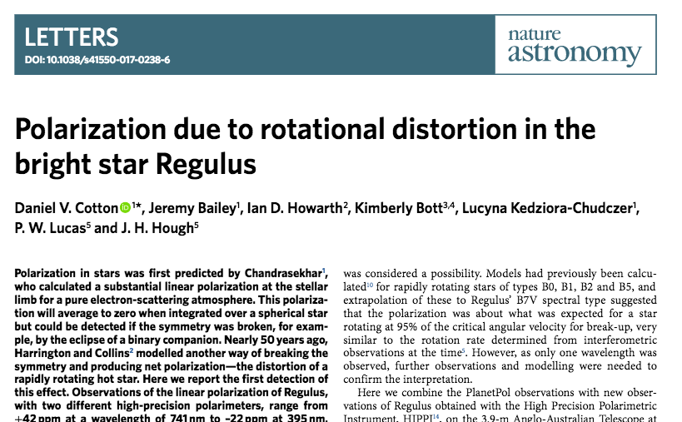
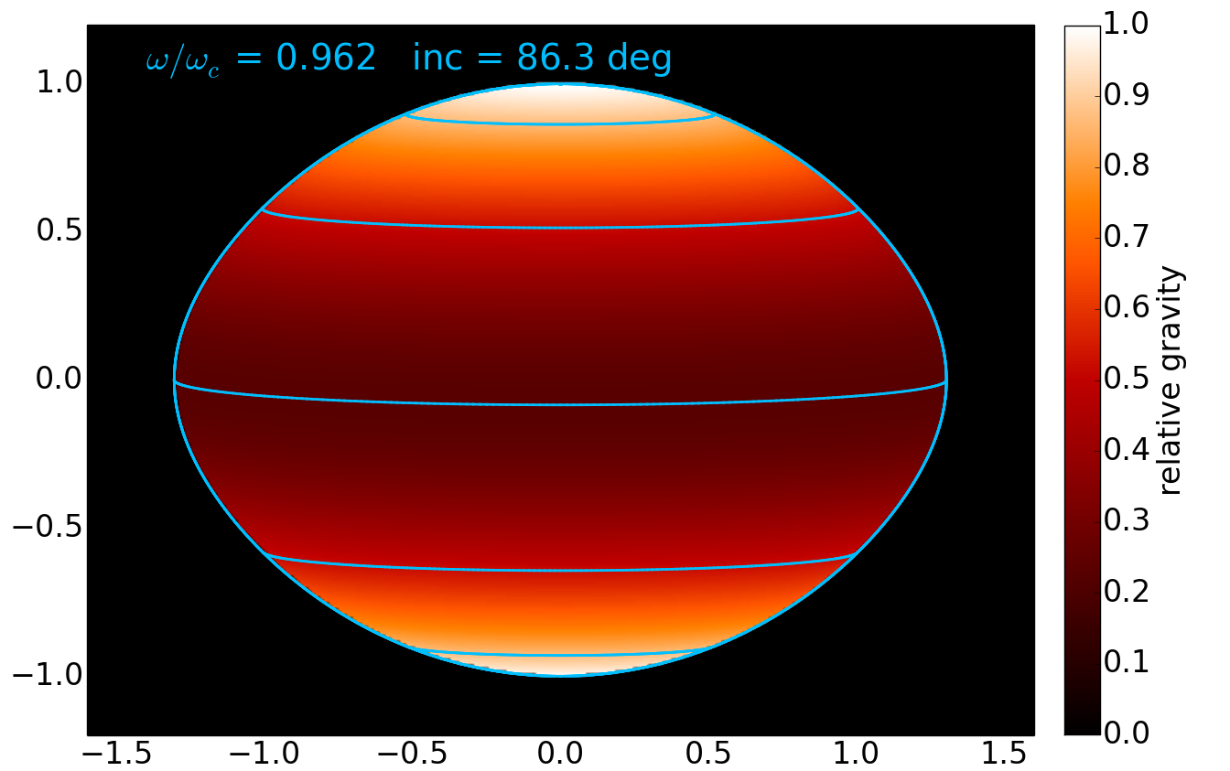
Polar T = 14375 K
log g = 3.992
Equatorial T = 11060 K
log g = 3.333
Predicted by Harrington and Collins in 1968. First detected using the AAT 50 years later.

Slide 13
Never Predicted. Polarization due to reflection in binaries was probably observed but misinterpreted in the 1970s. Identified and explained by us in 2019.

Slide 14
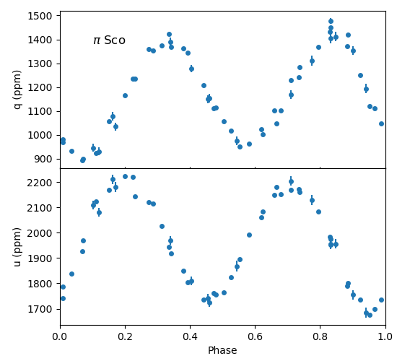
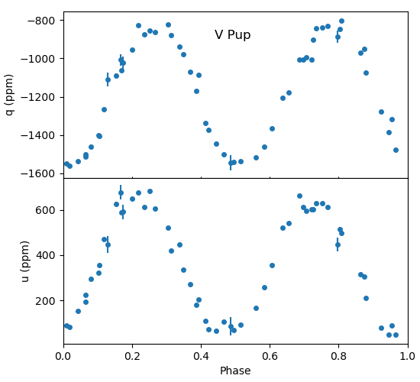
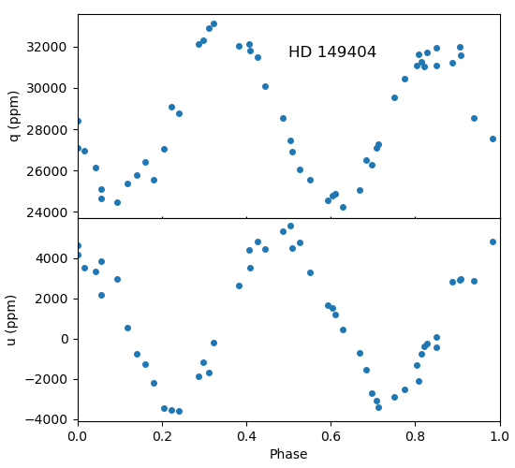
Polarization of Close Binaries (g’ band)
O7.5I + O9.7I Non-eclipsing Binary
P = 9.81d
B1V + B2V Non-eclipsing Binary
P = 1.57d
B1V + B3V Eclipsing Binary
P = 1.45d
HIPPI-2 Observations
2019 – 2023

Slide 15
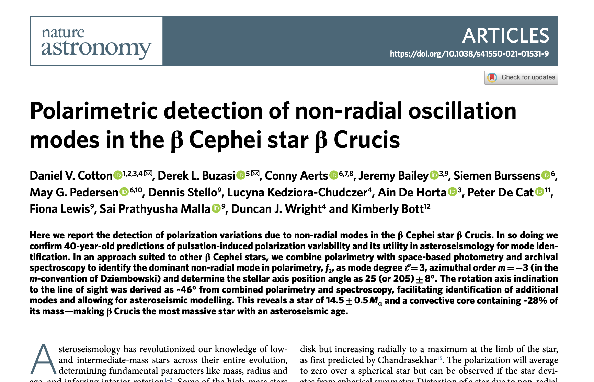
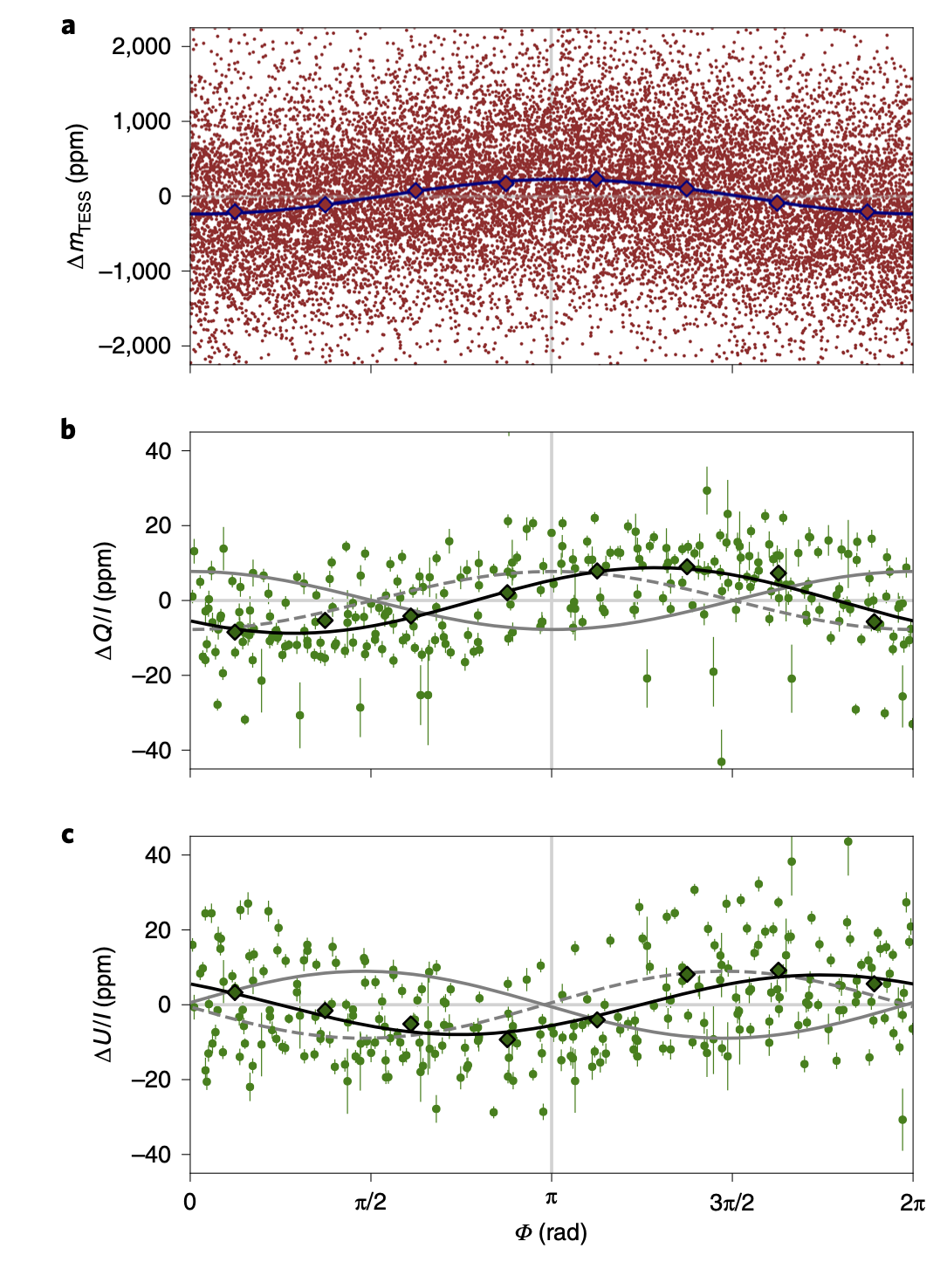
Predicted by Odell in 1979. First detected using the AAT 42 years later.

Slide 16
Pulsating Star Beta Crucis
Used 307 HIPPI-2 Observations of β Cru.
Photometry from TESS, WIRE, Hipparcos.
Pulsations with period 5.964 d^{–1} detected in photometric data and both polarization Stokes parameters as well as in spectroscopic observations.
Led to identification of the pulsation mode as l = 3, m = –3.
TESS
HIPPI-2 Q/I
HIPPI-2 U/I

Slide 17
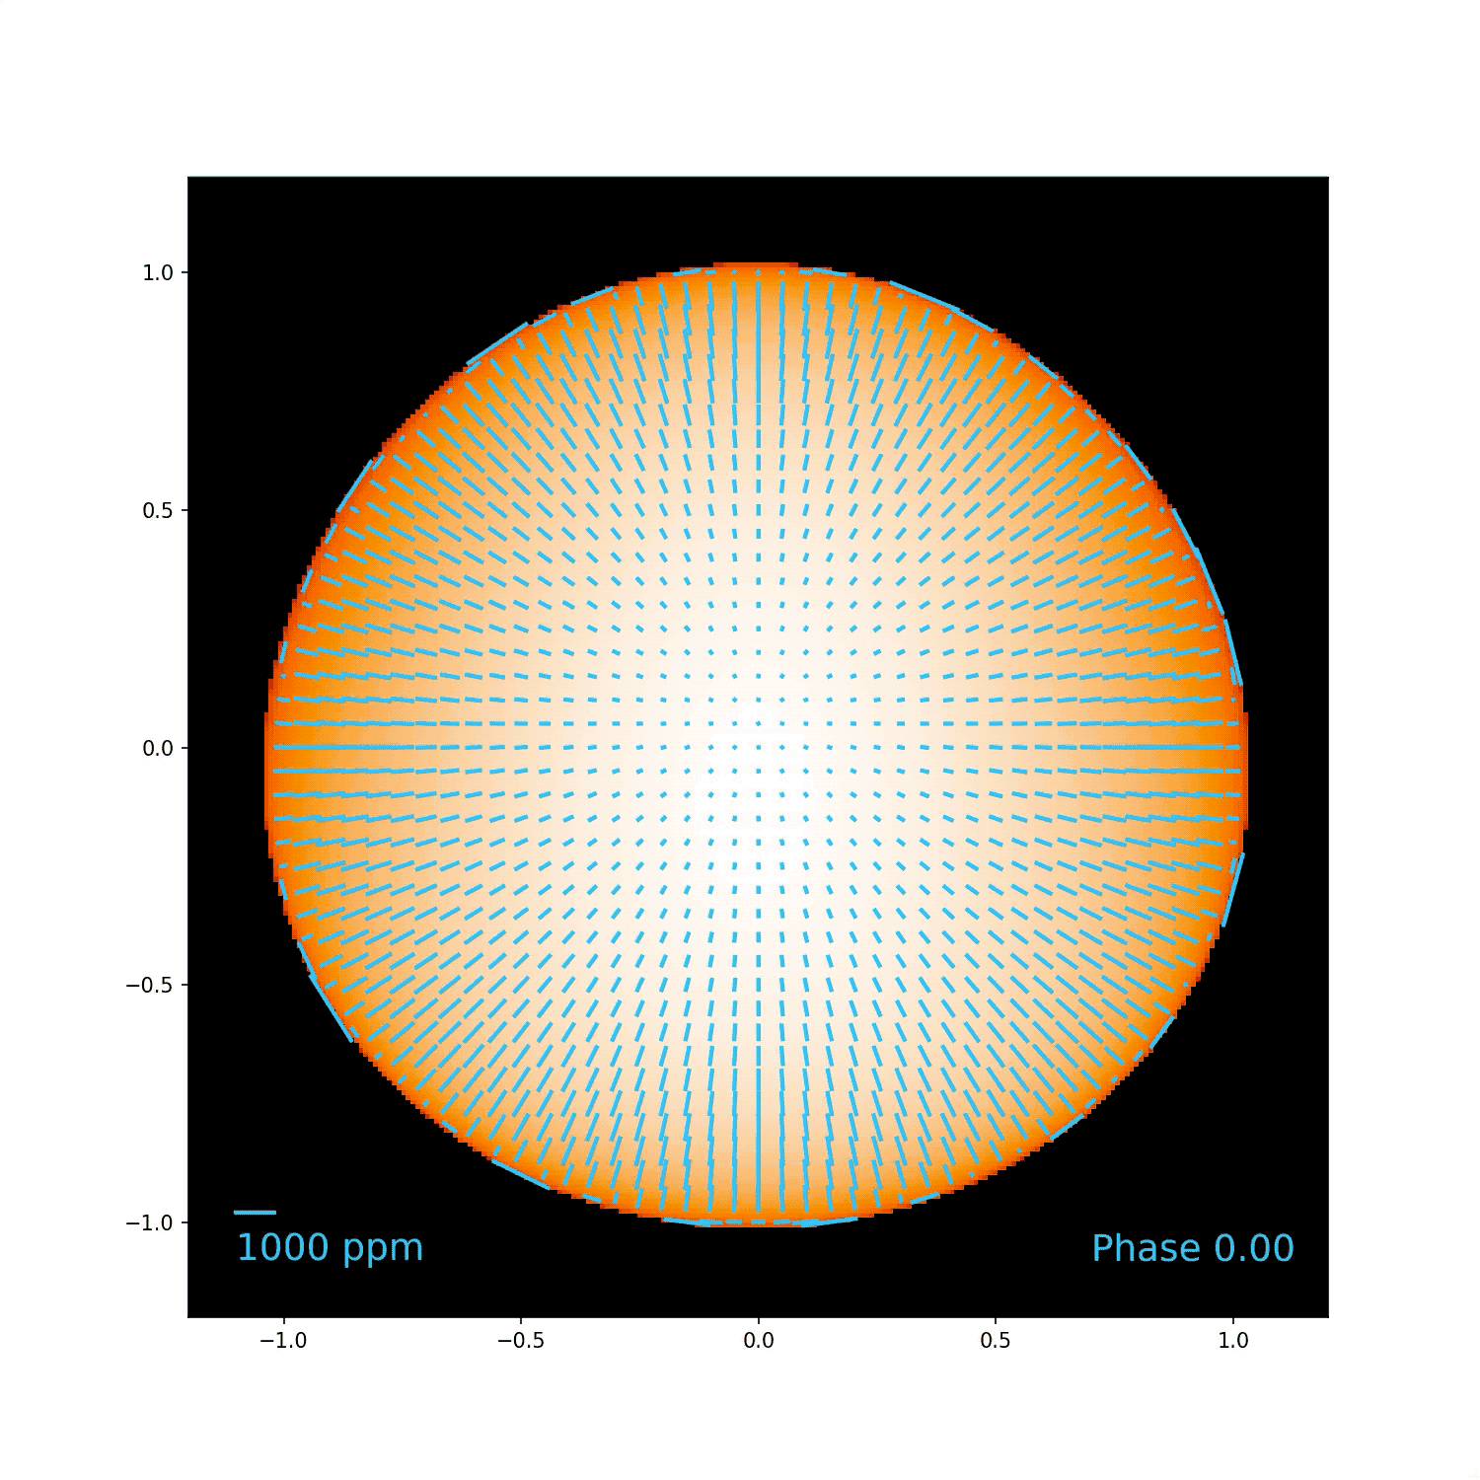
Pulsating Star Model
T_{eff} = 27000 K
R = 8.4 R⊙
M = 16 M⊙
ω/ω_{crit} = 0.36
i = 48º
Mode:
l = 3, m = –3
Intensity and overlaid polarization vectors at 460nm wavelength.

Slide 18
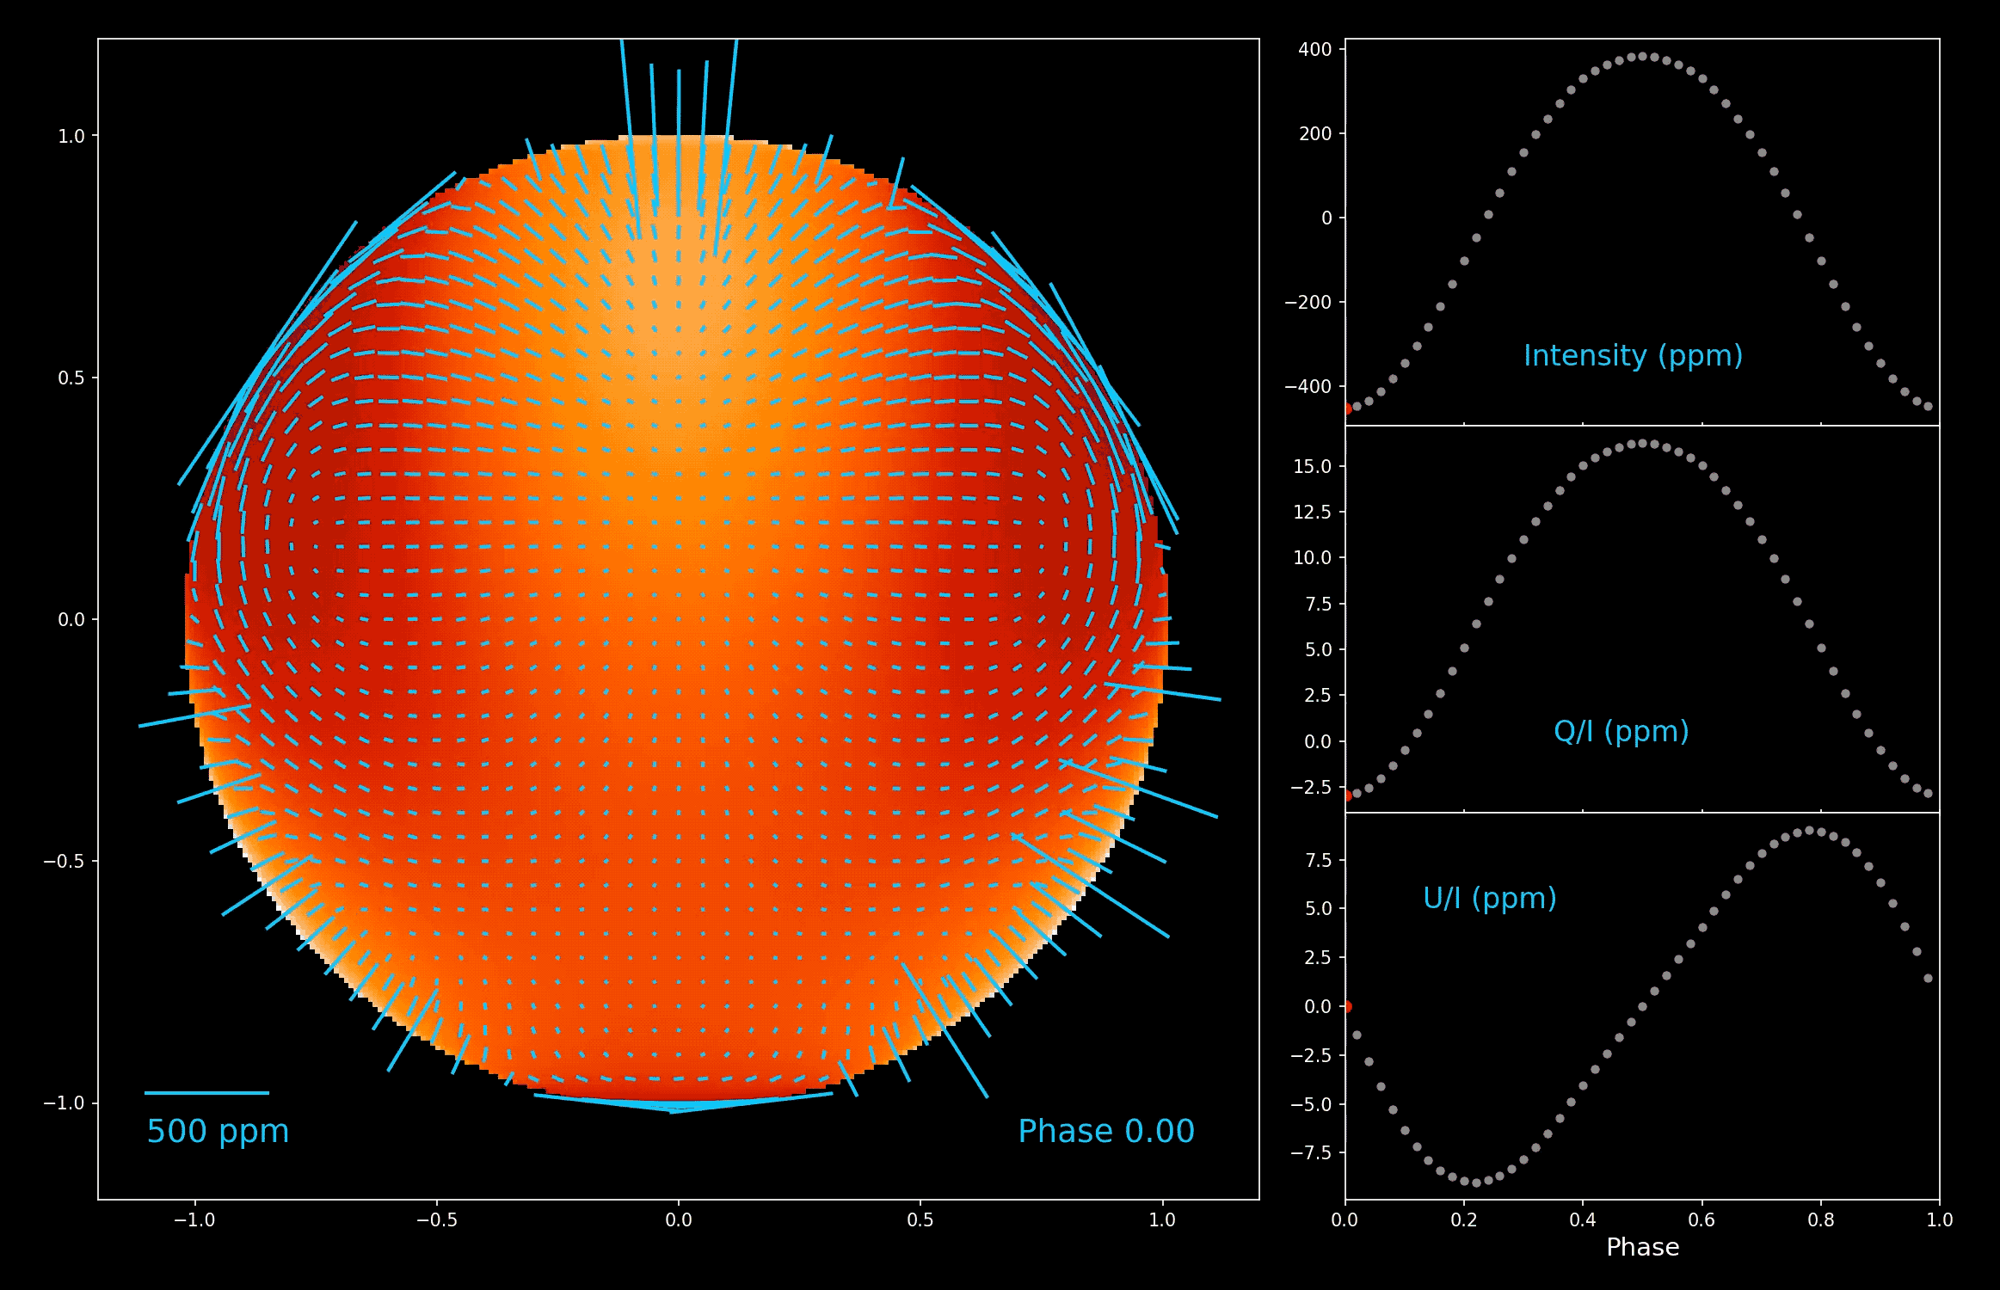
Pulsating Star Model
T_{eff} = 27000 K
R = 8.4 R⊙
M = 16 M⊙
ω/ω_{crit} = 0.36
i = 48º
Mode:
l = 3, m = –3
Intensity and overlaid polarization at 460nm with mean level subtracted.

Slide 19
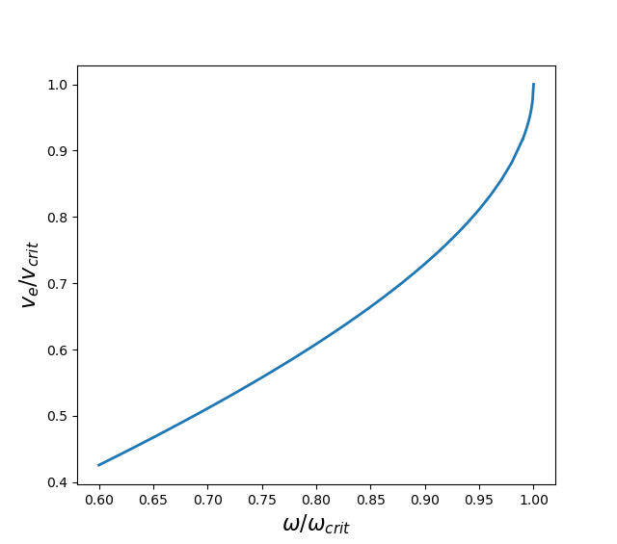
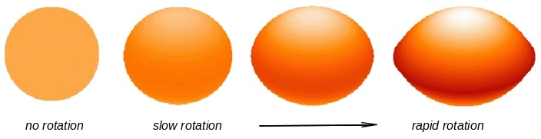
Rotating stars
Stellar rotation changes the shape of a star.
It also changes the distribution of effective gravity
(highest at the pole and lowest at the equator), and due to gravity darkening this also changes the distribution of temperature and hence intensity.
Rotation changes the evolution of a star — due to rotational mixing and mass-loss.
The past evolution of these stars is uncertain. Were they born rotating rapidly, or have they been spun up by binary interactions?
Rotation is normally measured as a fraction of critical rotation (i.e. the rotation rate at which the equatorial velocity would equal the Keplerian velocity).
Either as angular velocity 𝜔/𝜔_{crit} (often just 𝜔)
Or velocity v_{e}/v_{crit}

Slide 20
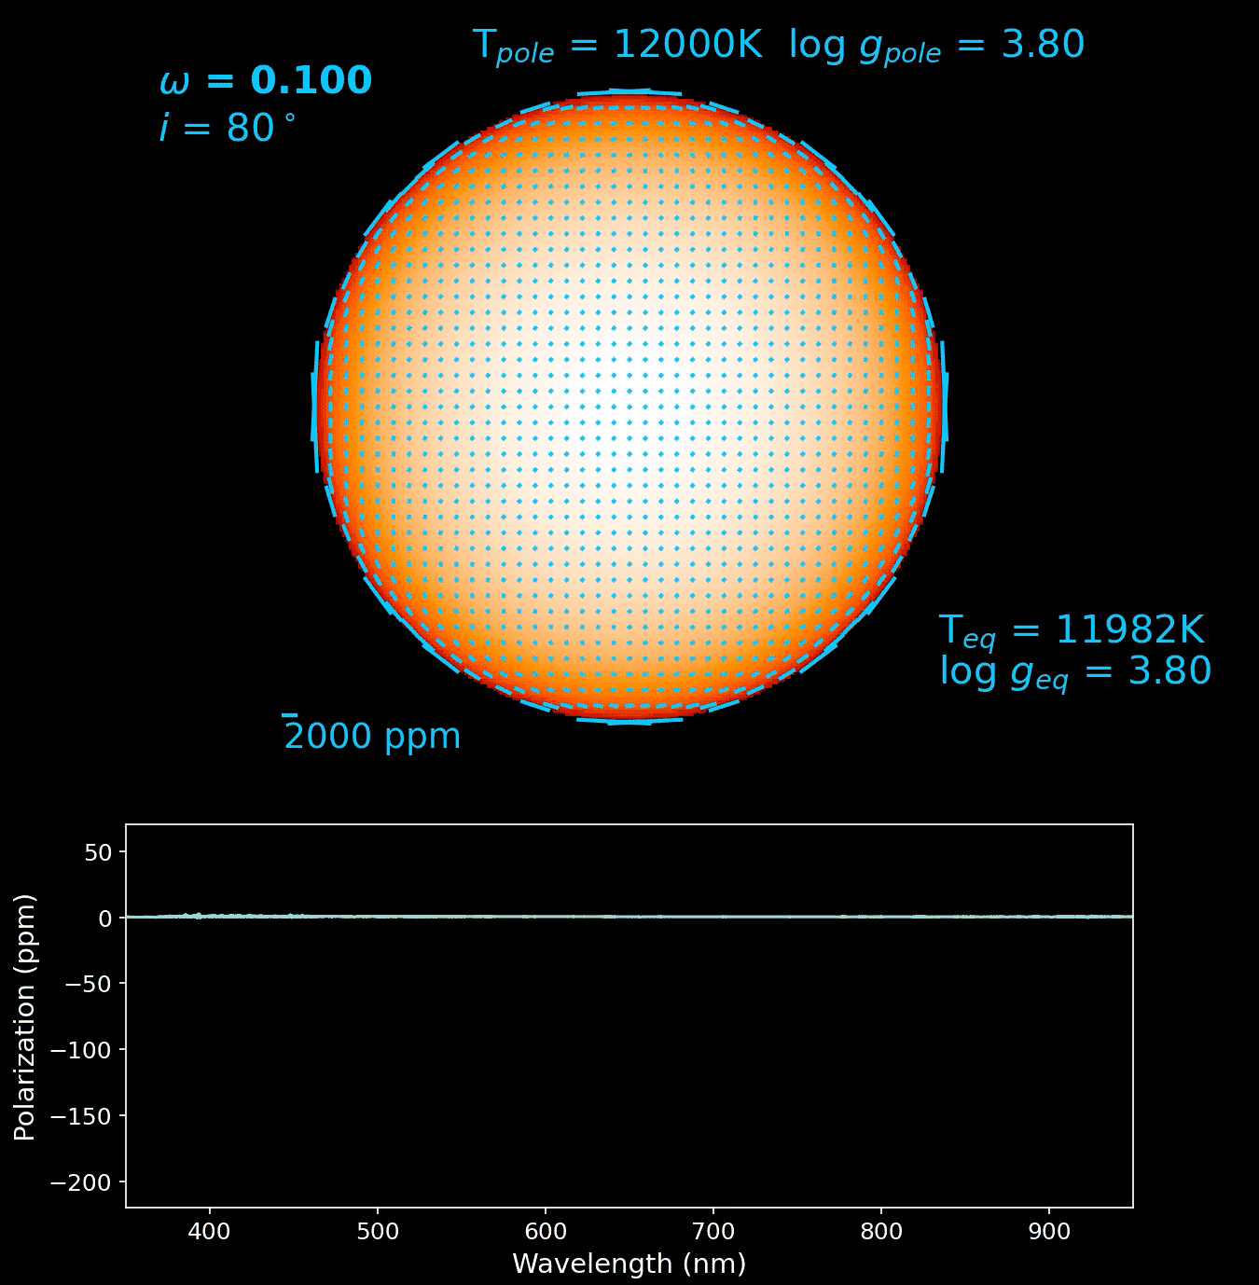
Models of Rotating Stars
Fixed T_{pole} and g_{pole}
Varying rotation
Use a grid of ATLAS9 stellar atmosphere models calculated for each latitude of star.
Use SYNSPEC/VLIDORT to determine intensity and polarization for each model.
Interpolate between models to determine values for each pixel of the star.
Sum over pixels to get integrated intensity and polarization.

Slide 21
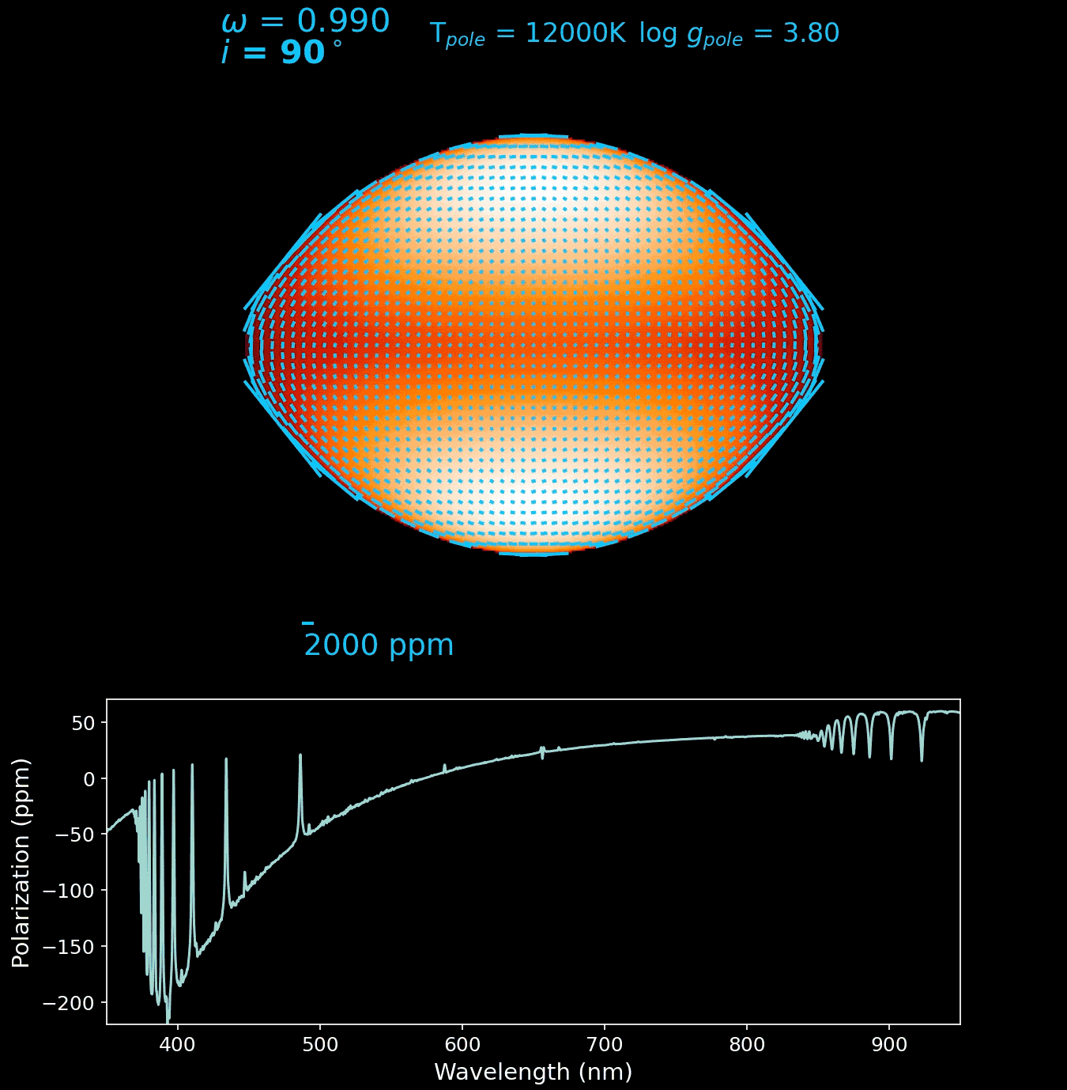

Slide 22
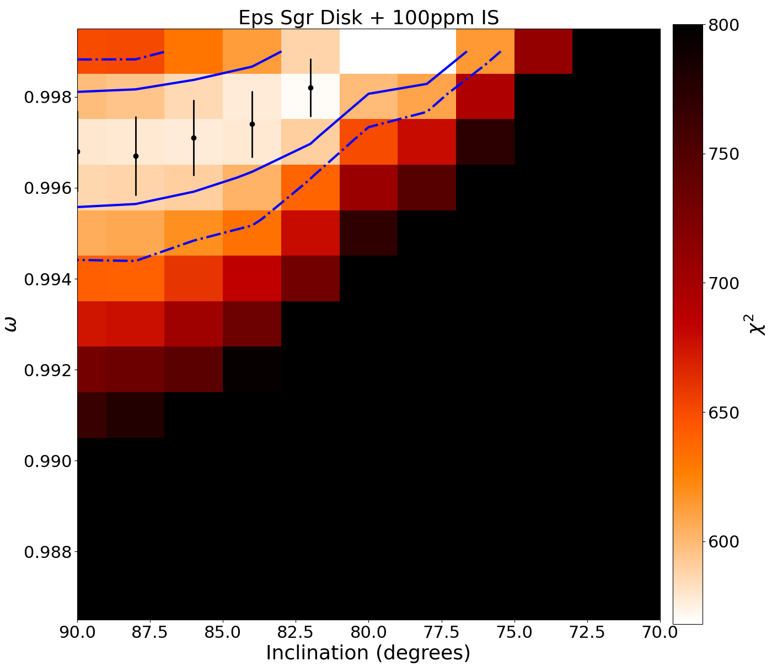
Rotational Polarization
Rotation produces polarization with a distinctive wavelength dependence and dependent on:
  Rotation (𝜔/𝜔_{crit})
  Inclination (i)
  Polar gravity (log g_{p})
  Polar Temperature (T_{p})
To model polarization observations we have to add additional constraints (flux in visible and UV, v sini).
Each point in the grid corresponds to a set of stellar parameters that fit the flux and v sini. The image shows how well each fit the polarization data.

Slide 23
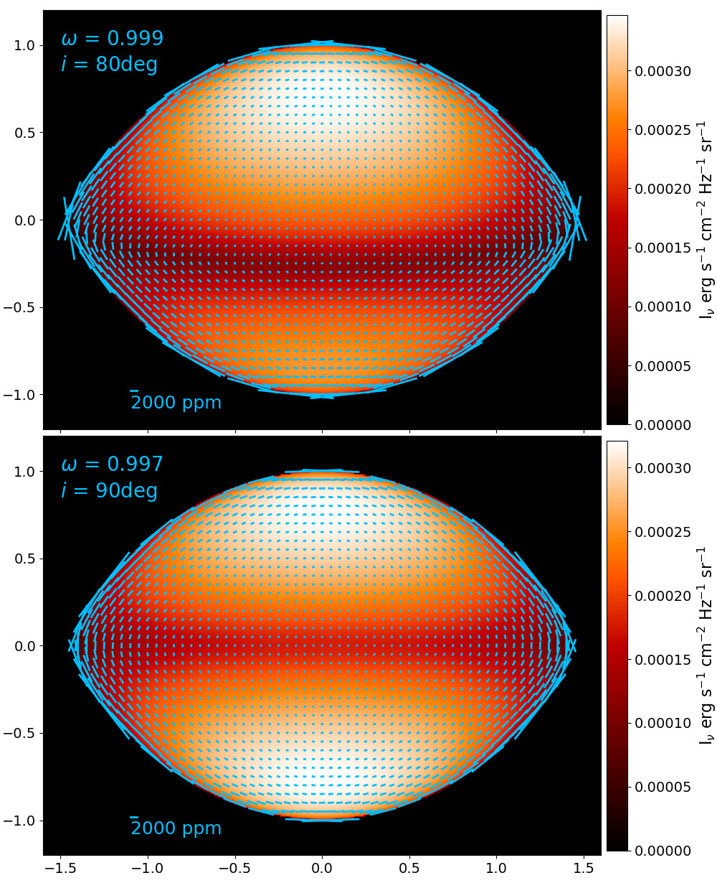
Epsilon Sagitarii — An extreme rapid rotator
We recently measured the bright A0 star 𝜀 Sgr (V = 1.85) to have an angular rotation rate of 𝜔/𝜔_{crit} > 0.995, the highest yet measured in our Galaxy. (Bailey et al., 2024, ApJ, 972,103).

Slide 24
Spherical Star
Physical parameters:
  Radius R
  Gravity log g
  Effective Temperature T_{eff}
  Mass M
Can be determined with conventional observations
  Fit a stellar atmosphere/spectral-synthesis model to spectrum to determine T_{eff} and log g.
  Use measured Flux + distance and T_{eff} to determine R.
  Compare observations with evolutionary model tracks on HR diagram to determine M (and Age).

Slide 25
Rotating Star
Physical parameters:
  Rotation (𝜔 or v/v_{crit}) — determines shape
  Inclination of rotation axis i
  Radius R_{pole} (R_{eq})
  Gravity log g_{pole} (log g_{eq})
  Effective Temperature T_{pole} (T_{eq}, T_{eff})
  Mass M
Cannot be determined with conventional observations
  Spectroscopy cannot determine rotation and inclination — can measure v sini, but this is not sufficient.
  Can only measure some average of R, T and log g — Don’t know what part of star is observed.
  Mass determined from spherical star evolutionary tracks will likely be wrong.
So - Spherical star model gets fitted to all stars.

Slide 26
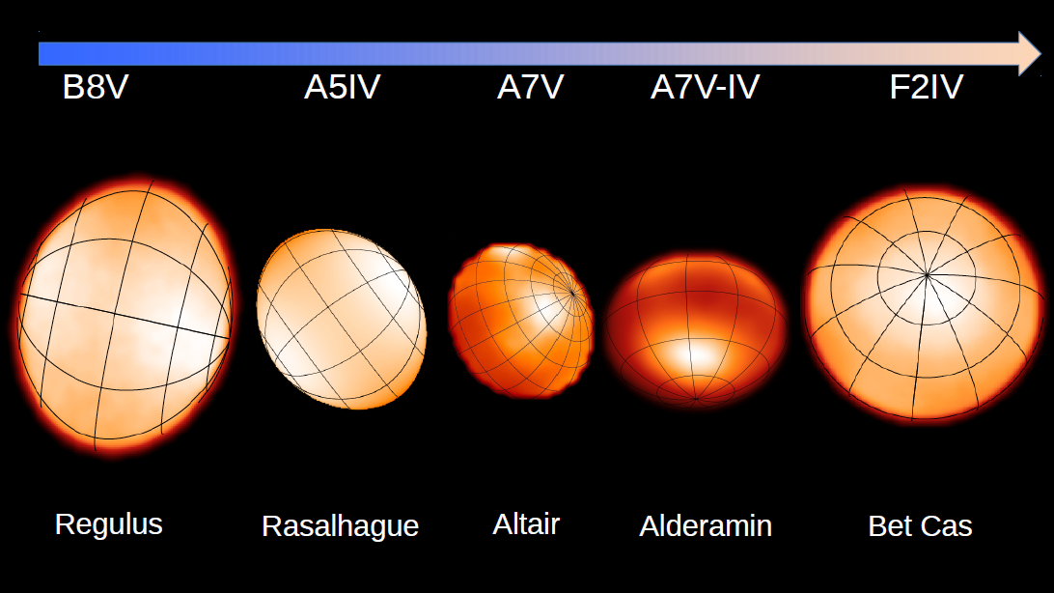
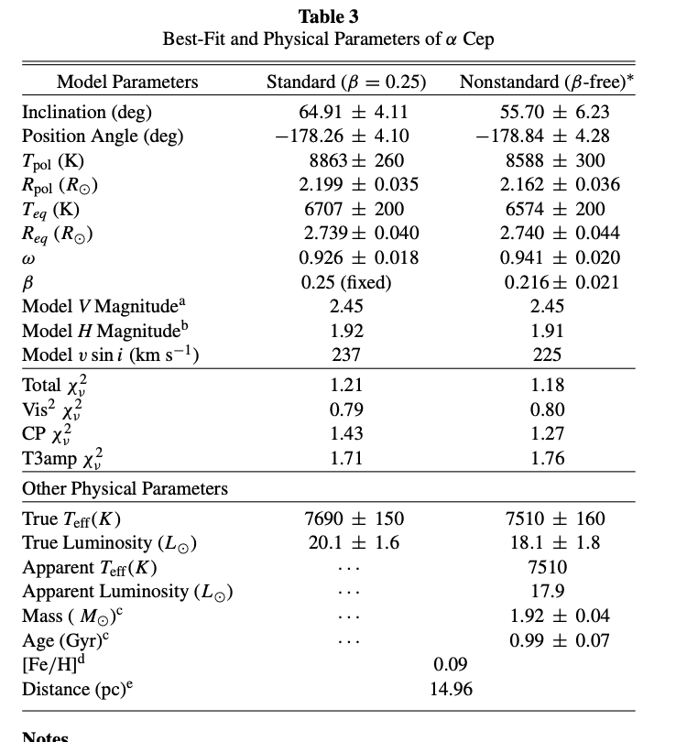
Interferometry
Stars imaged with CHARA array
Interferometry allows determinations of full set of parameters for a rotating star.

Slide 27
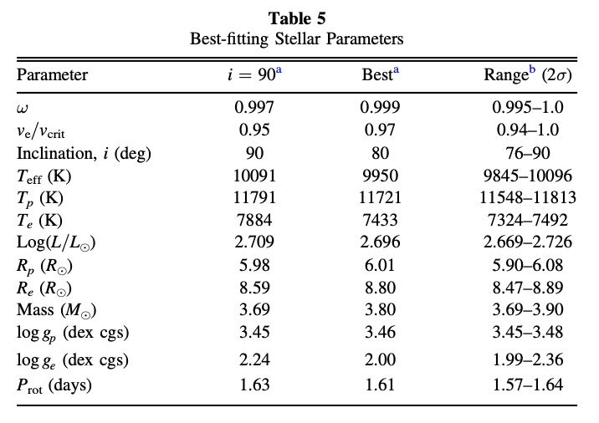
Polarimetry
Polarimetry, combined with additional constraints from flux, and v sini enables determination of a full set of stellar parameters for a rotating star.
Includes a mass estimate which is not based on evolutionary assumptions.
BUT there are less than 20 total measurements from interferometry or polarimetry methods.
𝜀 Sgr parameters

Slide 28

How Common are Rapidly Rotating Stars?
Using Wikipedia!
There are three main sequence AB stars among the ten brightest stars:
  Sirius (A1V), Vega (A0V), Achernar (B3V)
“As of 2015, Achernar was the least spherical star known in the Milky Way.^{[26]} It spins so rapidly that it has assumed the shape of an oblate spheroid with an equatorial diameter 35% greater than its polar diameter.”
The rotation of Vega “is 88% of the speed that would cause the star to start breaking up from centrifugal effects.^{[60]} This rapid rotation of Vega produces a pronounced equatorial bulge, so the radius of the equator is 19% larger than the polar radius”
Sirius is a relatively slow rotator.
Extreme rotation speed has flattened Achernar.
According to Wikipedia:
The brightest main sequence B star in the sky is the most rapidly rotating star we know!!!

Slide 29
How Common are Rapidly Rotating Stars?
According to Wikipedia:
The brightest main sequence B star in the sky is the most rapidly rotating star we know!!!
This strongly suggests:
Rapidly rotating stars (𝜔 >~ 0.9) cannot be rare, and must be common.
We have very few good measurements of stellar rotation.

Slide 30
How Common are Rapidly Rotating Stars?
To improve the statistics we are currently doing a small polarimetric survey of bright stars:
Covers B8-A8 main sequence stars
Brighter than V = 4
v sin i > 170 km s^{–1}
Survey is incomplete. There are more stars to be observed, and analysis is still in progress on existing observations.

Slide 31
Very Preliminary Survey Results
In range B8-A8 (v < 3.5) we have found the following:
Our published results: Regulus (ω = 0.96), 𝛼 Oph (𝜔 > 0.83), 𝜁 Aql (𝜔 = 0.95), 𝜀 Sgr (𝜔 > 0.995).
Under analysis (preliminary results): 𝛼 Pic (𝜔 > 0.94), 𝛽 Lib (𝜔 > 0.95), 𝛾 TrA (𝜔 > 0.87), 𝛿 Her (𝜔 > 0.97).
2 other stars with promising polarization signals.
That makes 10 stars out of 44 (~23%) with 𝜔 >~ 0.85.
BUT – we are not sensitive to the low inclination objects (i < 60).
AND – we are not sensitive to early main sequence stars.
Data could be consistent with almost all stars in this range being born with near-critical rotation.

Slide 32
Important Questions
What fraction of A stars are rapidly rotating?
  Our current survey will begin to address this.
Do hotter stars (B and O) have similar rapid-rotator frequencies?
  This is harder – our techniques are difficult to apply because these stars commonly have circumstellar gas (disks and winds) that dominates polarization.
What causes rapid rotation?
  Are stars born spinning rapidly, or are they spun-up in binary interactions?
Are rotation properties seen in nearby bright stars representative of the Galaxy as a whole?

Slide 33
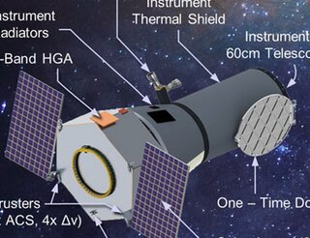
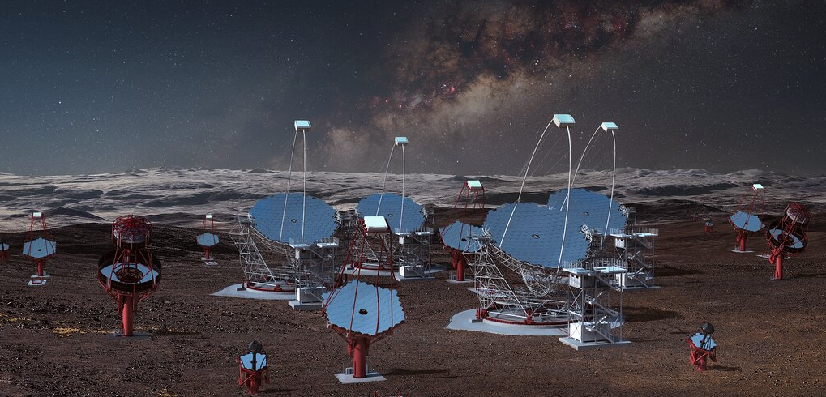
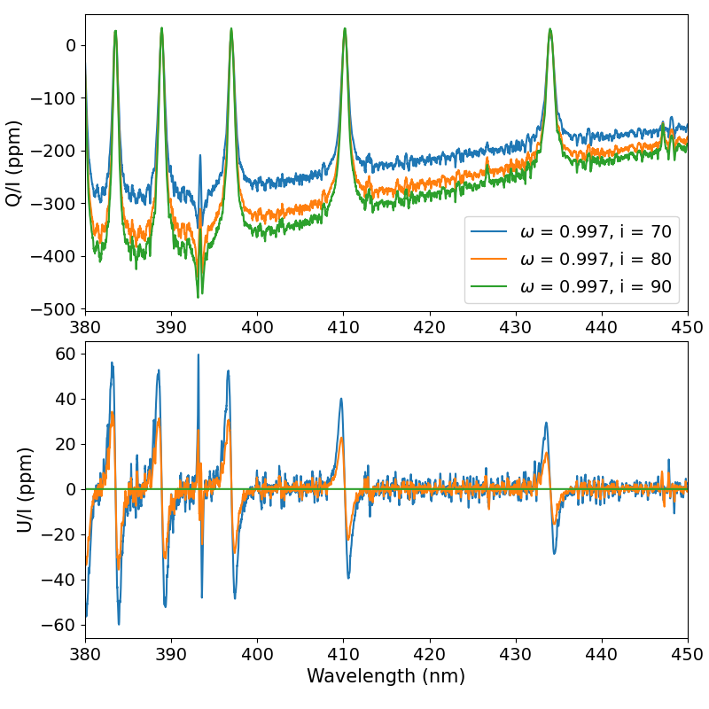
Future Capabilities
UV Polarimetry — Rotational polarization is much larger in UV (~200 nm) — proposed NASA PolStar SMEX mission.
Cerenkov Telescope Array (CTA) can be used as an intensity interferometer. (like the Hanbury-Brown instrument from the 1960s). Ideal for imaging hot stars.
The Ohman Effect (predicted in 1946 but never observed) is the rotational polarization effect across a spectral line. Requires high-precision high-resolution spectropolarimetry.

Slide 34
Conclusions
HIPPI-2 Observations have detected the polarization from stellar photospheres predicted by Chandrasekhar.
The results indicate how bright stars depart from sphericity due to:
  Rotational Distortion
  Non-Radial Pulsations
  Reflection and Tidal Distortion in Binary Systems.
Only Polarimetry (and Interferometry) allow a full determination of the physical parameters of rotating stars.
Rapid rotation is common in hot stars — analysis methods that assume stars are spherical may give misleading results.

