Slide 1
Evolution of the AAO Instrumentation software
From the AAT and around the world.
My thoughts on how and why it happened.
Tony Farrell, AAO MQ.
Notes:
Background – aat19_10

Slide 2
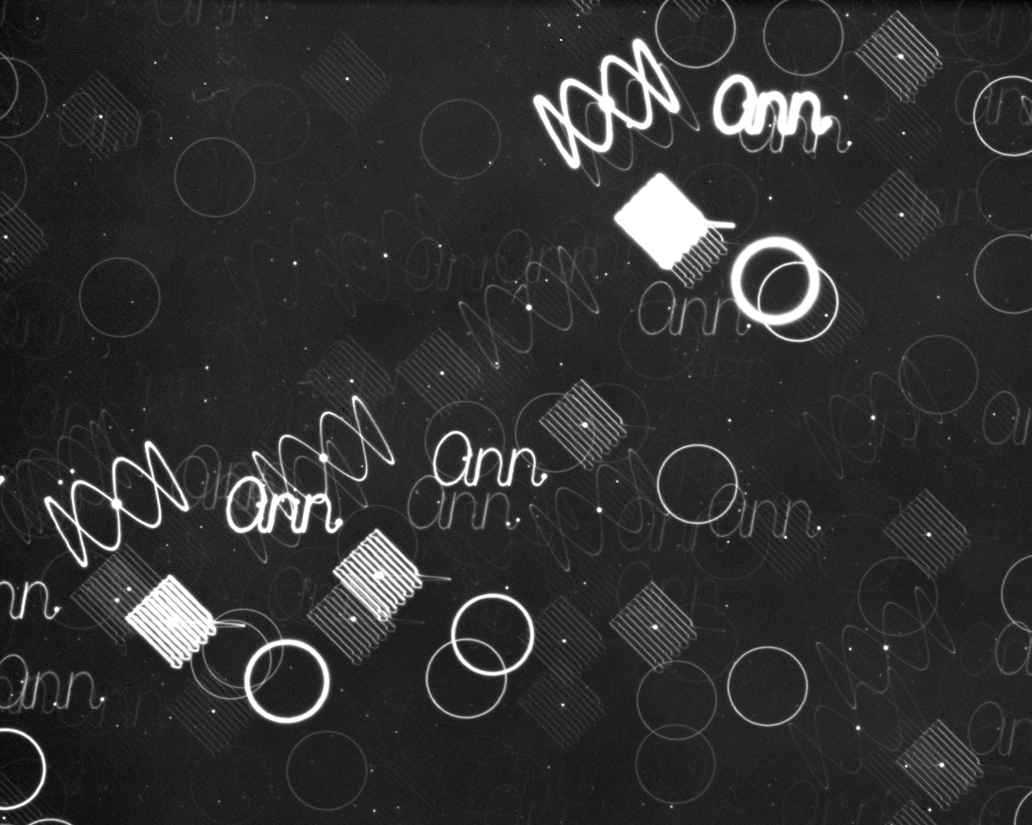
First impact The ANN plate
A long time ago…
In a conference at MIT (1975)
Various scan patterns
This worked so well due to the underlying tracking of the telescope being so very good
Both the hardware and the software were great
Notes:
After giving his talk, Pat Wallace remarked to Graham Bothwell: “it didn’t seem to go down so well, no response at all”. Graham replied: ”You left them dumbfounded, speechless – and they are still in a state of shock”
Refence “Creation of the AAO, pages 180,181.
Pat Wallace and John Strade

Slide 3
Notes:
1985. 3 exposures 15, 15 and 20 minutes. Plus time to change the filter.

Slide 4
Started to spread around.
SLA (library).
Written for Interdata Model 70, Fortran IV.
Later: Fortran 77, C, C++, Pascal versions
In many/most large telescope systems.
But there is totally open source alterative now.
TPOINT pointing analysis software
The tool for pointing analysis - Keck, GBT, Gemini, ALMA, AAT, ARC, WIYN, WHT, UKIRT, JBO, IRTF, NSST, ESO, CTIO, SOAR, MMT, Magellan, LBT and others)

Slide 5
Later
Figaro.
Came to AAO from Caltex with Keith Shortridge, but was supported & enchanced by him from the AAO, was later merged into the Starlink Software Collection.
DRAMA
Has turned up in various places
WHT, INT, UKIRT, JCMT, Mayall, Blanco
Will soon go to India (DOT Telescope) (after a few earlier attempts) and KASI/KMTnet.
Components of DRAMA were (are) used in the Gemini DHS.
Components of DRAMA are used on the VLT (Flames/FP).
Some of these are AAO’s doing, but many are not.

Slide 6
PTCS
UKIRT, JCMT (both prior to the AAT).
UKIRT PTCS was upgraded last year to track fast moving objects of interest to the USNO.
AAO CANopen libraries – Gemini.
Various smaller things – e.g.
Fibre spectrograph focusing tool, Gemini (GHOST).
Fibre Instrument Optical Modeling tool – VLT (Flames), Subaru (FMOS)

Slide 7
Why
”Get good people and point them in the right direction”
Keith Shortridge.
Give them interesting work
Keep them close to the people who can tell them what is really needed
Send them out to tell people what they are doing
And find out what others are doing.
Allow them to advance internally.

Slide 8
TCS and Telescope
No specification on the required performance.
Just the feeling that optical telescopes could be better
Not sure what these computer things could do – suspect they were not trusted!
My impressions from past conversations
Time with the telescope
A determination to perfect it
Wanted to understand the physical nature of the telescope
Pat and John were not “software only” people.
Working closely with people like Peter Gillingham and Graham Bothwell to understand the telescope.

Slide 9
And from there.
The engineers were allowed to travel.
To MIT in 1975. A big commitment at that time!
Talking to others
The TPOINT manual example is the UKST pointing.
Clearly the AAT team were talking to the UKST team
I suspect that working on the UKST allowed Pat to start the move to a general solution.
You need to test on more then one telescope.

Slide 10
Post TCS
Keith Shortridge, William Lupton.
And when William left, we got Jeremy.
Moved to working on the instrumentation
AAO Morning/Afternoon tea tradition.
Engineering groups, Admin group, Astronomy group
We could ask the possibly silly question
Find out what is working/not working.
Inclusive organization.
S/N 1978A -> All staff at Marsfield were briefed.

Slide 11
Sent the Engineers out to talk (and listen)
ADAM Workshops.
ADASS Conferences
SPIE Conferences
DRAMA courses
Lew and John Barton’s round the world CCD controller study trip.
If you were going close to another group – then you would drop in
Advancing Internally.
Many organizations insist on people changing jobs to advance.
AAO allowed the employees to show what they were capable of and then advanced them internally.
Keeps good people around and interested.

Slide 12
So yes
”Get good people and point them in the right direction”
Give them interesting work
Keep them close to the people who can tell them what is really needed
Send them out to tell people what they are doing
And find out what others are doing.
Allow them to advance internally.

Slide 13
And the result is
Other people were interested in what we were doing.
The were happy to work with us, use our code, take our advice.
And then build instruments for them.
And we got a lot back.
We saw our ideas being used in different ways.
Giving us new ideas.
Bug fixes came back.
And some of our people went on to big things.

