Slide 1
Some ruminations on making a Great Observatory out of a Good Telescope
(Emeritus) Prof. Chris Tinney, UNSW Sydney
Notes:
The Emeritus is deliberately parenthesized – I think of myself as “retired from teaching” rather than retired.
It turns out I joined AAO almost exactly 30 years ago in October 1994 – though my connection goes back a little further to 1985-1987, when I spent time as an undergraduate research assistant (along with a few other people in this audience) – measuring filter profiles for the AAT’s filters, testing optical fibre image slicers for Peter Gray, and eventually working on some actual data on eta Carinae with the late David Allen.
David organized my first trip to SSO in 1987, gave me a tour around the AAT, and answered ne of the most pressing questions in my mind at the time. University of Sydney’s School of Physics had both a Dept of Astronomy and a Ddept of Astrophysics. So I asked David what the difference was between an astronomer and an astrophysicist? To which he answerd “An astrophysicist is just a more prtetentious astronomer.” A joke/sledge I’ve been using ever since.
When asked to give a talk at this meeting (presumably because I’d reached the target weight and age), I wasn’t actually given any hints on what they wanted me to talk about. I’m guessing they were thinking “talk about exoplanets at the AAT. Or brown dwarfs. Or astrometry.”
But to be honest, I’ve reached the career stage where shameless self-promotion of my research, or the general area, is sort of losing its appeal. It’s certau8bly not going to help me into the next job!
So instead I wanted to try and think about what it is that’s made the AAO a successful organisition. That is, the sort of pontificating I have reached the right weight and age for. So …

Slide 2
Part I – Bloviating
Notes:
If I get through this too fast, then maybe I’ll slot some science in at the end.
In 1994, the AAT

Slide 3
In 1994, the AAT was still a front-rank telescope (just).
By the 00’s it was definitely in the second rank.
Despite which the AAO (and indeed the AAT) remained both high-profile & incredibly productive.
What’s can we learn from its success?
Notes:
In 1994, the AAT was still a front-rank telescope (just).
By the 00’s it was definitely in the second rank.
Despite which (I think, and demonstrably by the metrics Chris Lidman will show tomorrow for some time to come) the AAO (and indeed the AAT) remained both high profile & incredibly productive.
I’ve been spending more and more time on Boards - what can we learn for future facility organisations that are starting from scratch?

Slide 4
Good Governance
AAT Board was an effective mix of senior astronomers and senior bureaucrats, who functioned as a meaningful governance body,
A truly functional Board acts in the best interests of “shareholders/stakeholders”, by acting in the best interests of the organisation. It is not a stakeholder representative body.
Notes:
I’ve been on a few Boards, and the ones I feel work best are the ones that combine science/technical background, with a real understanding of the importance of governance. Boards that are all astronomers don’t work. Board for astronomy institutions that are all bureacrats or managers don’t wortk. You need a combination.
The Board system at AAO up to its dissolution in 2010 was a great example. I remember AAO EO Joan Wilcox explaining it to me as follows “The Board *owns* the telescope”. That ownership meant that they had to oversee the management of the telescope, and they did so in a very effective manner.
I can tell you that AAO staff spent a LOT of time preparing for the multiple Board meeting every year. Edveru paper they received had to be “just so”. The Board did *not* just do whatever AAO management suggested.
There is always an active and creative tension in Boards between trying to be the management themselves, letting the management decide everything, and feeling the need to act as a “parliament” or set of shareholder representatives. Good Boards achieve that balance, and it always seemed to me the AAT Board did a good job.

Slide 5
Budget & Budget Stability
AAO was founded as “quango” - equally funded by Australia and the UK under a treaty-like agreement
They each put in half the money and got half the time. It was rare that both countries wanted to cut their funding at the same time. Which meant that neither country was really able to cut funding.
The stable budget included both operations costs for the telescope and Observatory, and a budget stream to re-instrument … this was incredibly important!
Notes:
… until the UK pulled out completely after joining ESO.
Contiually reinstrumenting means continually reinventing and remaining relevant, finding new niches and exploring and adopting new technologies,

Slide 6
An Effective Executive
The Observatory was fortunate in the series of excellent Directors it attracted.
It was also fortunate in the great series of Executive Officers it was able to recruit (Doug Cunliffe, Joan Wilcox, Neville Legge to name just the ones I worked under).
Notes:
Can’t help wondering if budget stability, ability to plan for future instruments, and organizational independence might not have been the reason we got such great Directors.
At least to my mind, the role has become less attractive and desirable in the years since 2010.
The executive officers presided over what I often think of the the acme of management/beuraucrcy

Slide 7
Lean Management
Being a quango, rather than part of a government department (in either nation!), or part of a University, gave the AAO an unprecedented flexibility in its management.
Joan Wilcox always liked to say “we will never ask you to fill in a form unless the information in it is absolutely critical.” As anyone who left the AAO for employment elsewhere after 2010 can attest … it was a lean organisation to work for.
Notes:
Can’t help wondering if budget stability, ability to plan for future instruments, and organizational independence might not have been the reason we got such great Directors.
At least to my mind, the role has become less attractive and desirable in the years since 2010.

Slide 8
A Scientific Lure
I have always been astounded by the calibre of the scientists I worked with at the AAO. For a 4m-class telescope at what’s probably the world’s worst Site, it sure had a great science team.
After my time at Caltech, and then ESO, (places for which the phrase “not invented here” might have indeed been invented), I never felt that working at the AAO was a compromise. AAO was a lure
I won’t try to name names (because I’ll screw up and miss someone!), you can look around this room right now and see that there are real world leaders in their fields here, who worked for some substantial period of their time at AAO.
Notes:
Can’t help wondering if budget stability, ability to plan for future instruments, and organizational independence might not have been the reason we got such great Directors.
At least to my mind, the role has become less attractive and desirable in the years since 2010.
At the AAO I was never the smartest person in the room – maybe in the top 2 or 3 for practicality – but never the smartest …

Slide 9
Culture of Service
But despite all these people who were all the smartest people in every room they were in, there was a culture of AAO people working together to deliver the best quality telescope functionality, and the highest quality scientific data … a real culture of working together to deliver for our Australian and UK astronomical communities.
This in turn (plus leadership from Executive and Management telling us we had to) meant there was a real culture of reaching out to our astronomical communities, to find out what they wanted, and then try to give it to them.

Slide 10
Miscellaneous Things
A telescope close to somewhere people wanted to live
Focus on what the telescope is good at … and do that.
Be in a partnership with nearly equal-level partners.
Attract and retain good people.
Notes:
As some of the previous rambling might indicate … my thinking on all this is a bit inchoate. I;m sure there are many in the room who could put it more clearly.
But as part of trygint to distill out some meaning, there were a few thungs that didn’t fit any category …
Trees mean rain, which is bad for observing. But good for having good staff want to live nearby.

Slide 11
Miscellaneous Challenges
No astronomers go to a telescope any more. Keeping staff motivated is very hard. Training astronomers who know anything about hardware is even harder
Few astronomers understand instrumentation at the “whole of Observatory” level. So who writes the instrument specs for the next generation of instruments (you can’t do this without scientists who know what’s possible)?
Notes:
Recall tayyba’s images of the vicinity of Paranal. Or La Silla. EVERYONE commutes there.

Slide 12
Part II – Exoplanets at AAT
Notes:
If I get through this too fast, then maybe I’ll slot some science in at the end.
In 1994, the AAT

Slide 13
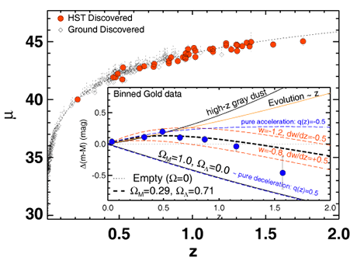
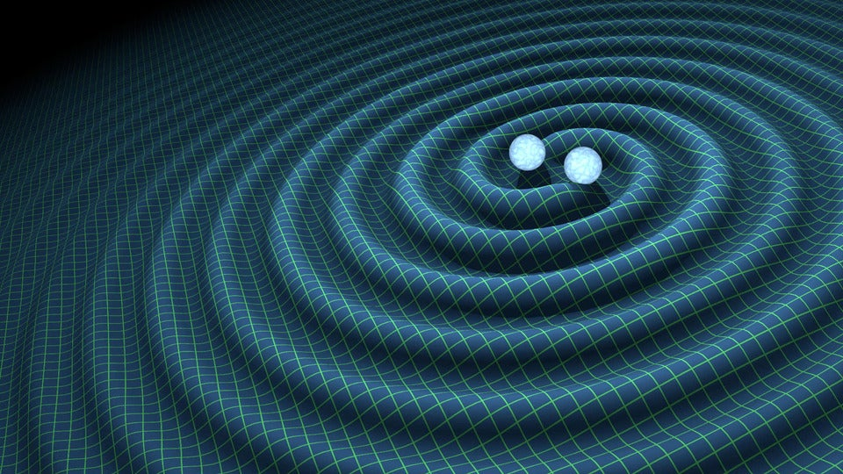
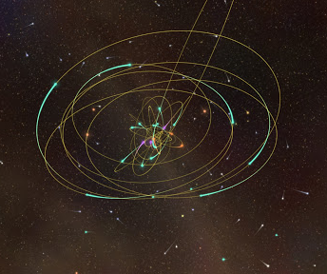
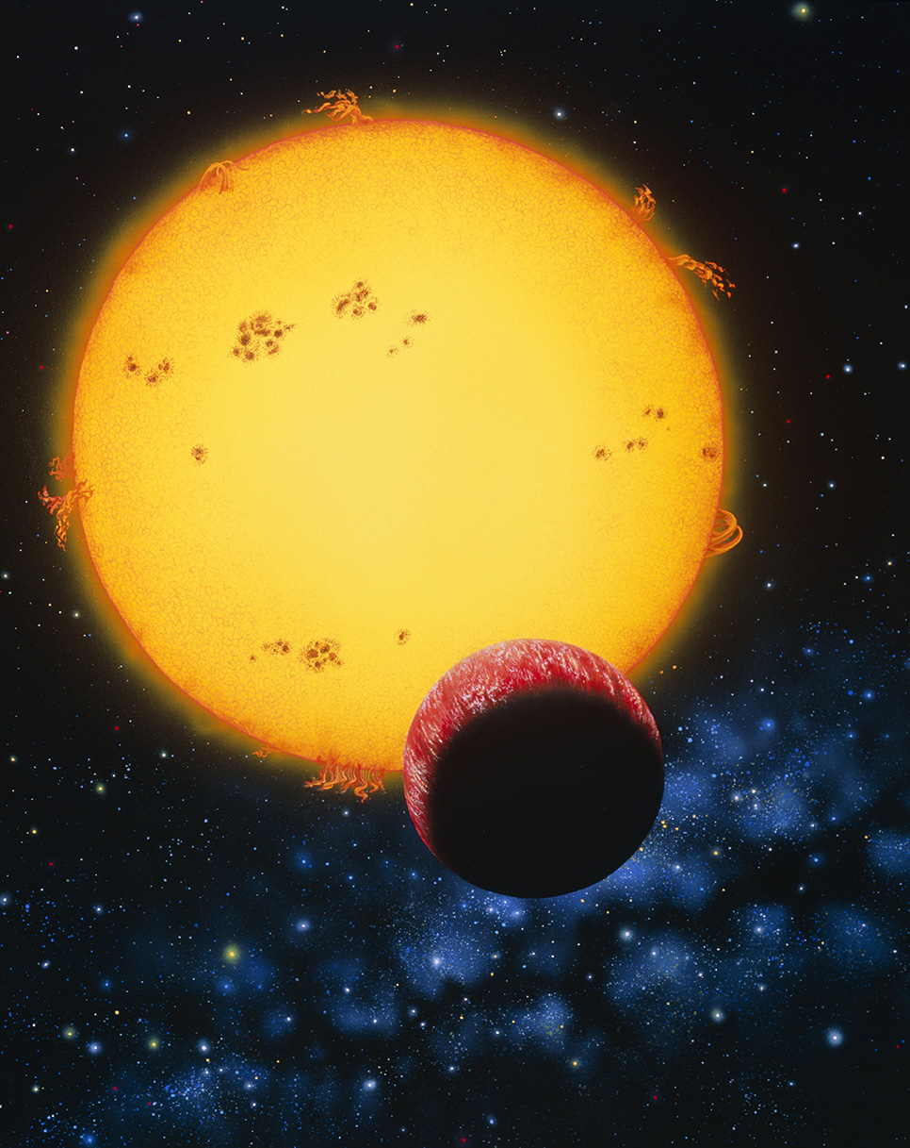
Discovery space
Big results usually come from big surveys, new techniques, or old techniques at extraordinary new precision.

Slide 14
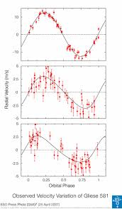
Exoplanet Science = Precision Science
½ smallest division?
Few m/s
1/10th line width?
1/200th seeing?
λ/Δλ=80,000 => 4000m/s resolution
Notes:
One of th things that always amazed me about the AAO, was that they allowed me to work there even thiugh I did almost none of the survey science the telescxope became famous for.
I’ve always had little interest in the science that comes from getting the same crappy redshifts for 100, or 10,000, or 500,000 galaxies.
My interest has always been in prevision measurements … how can we use the equipment we have. Or variations on it, to m=make measurements 10, or 100, or 1000 times better … and so open up new observational phase space.
What’s a precise measurement. For many astronnomers its ½ the smallest division - “I measured a 5-sigma blob to a position orecision of 0.5 pixels).
Or you dould do precise spectroscopy to 1/10th of a pixel. Or ground-based astrometry to 1/200th of the seeing,
In the exoplanet game, the stakes are much higher.

Slide 15
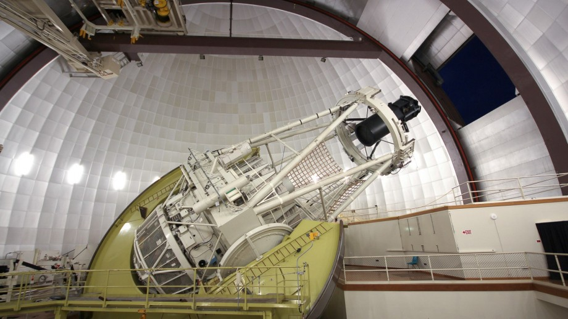
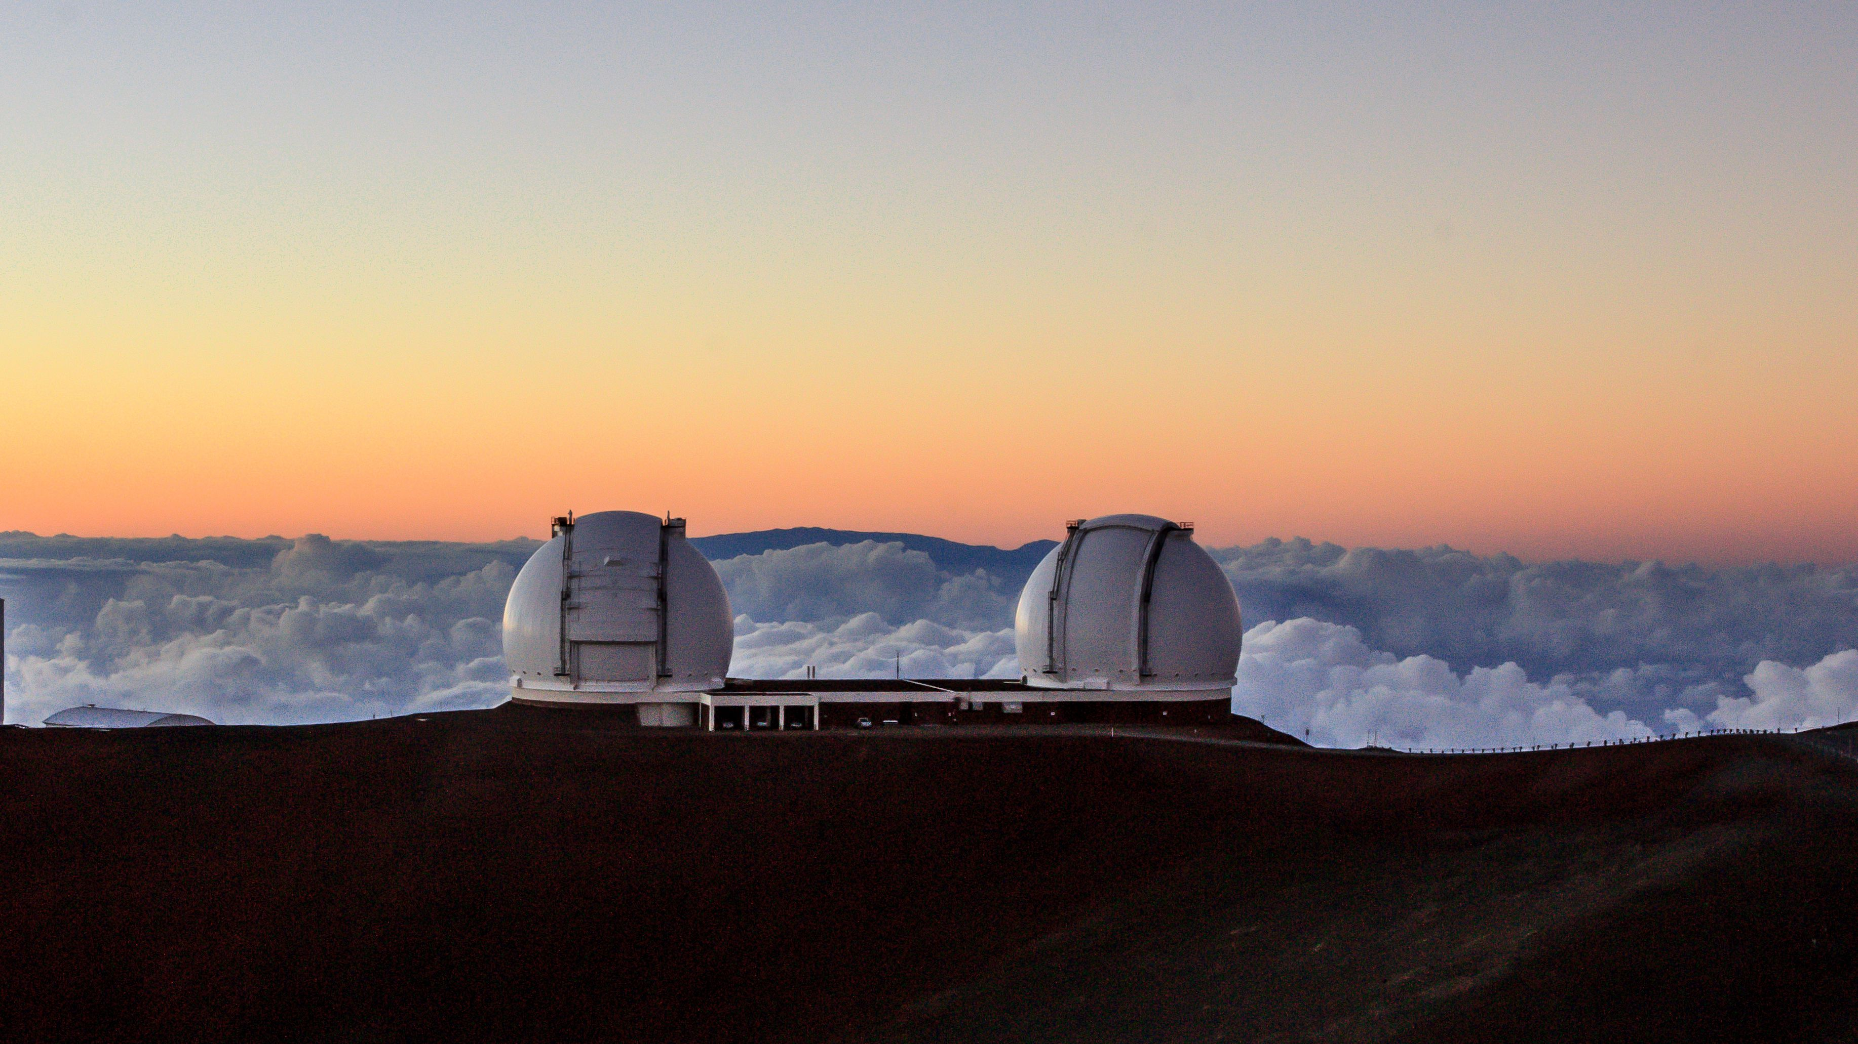
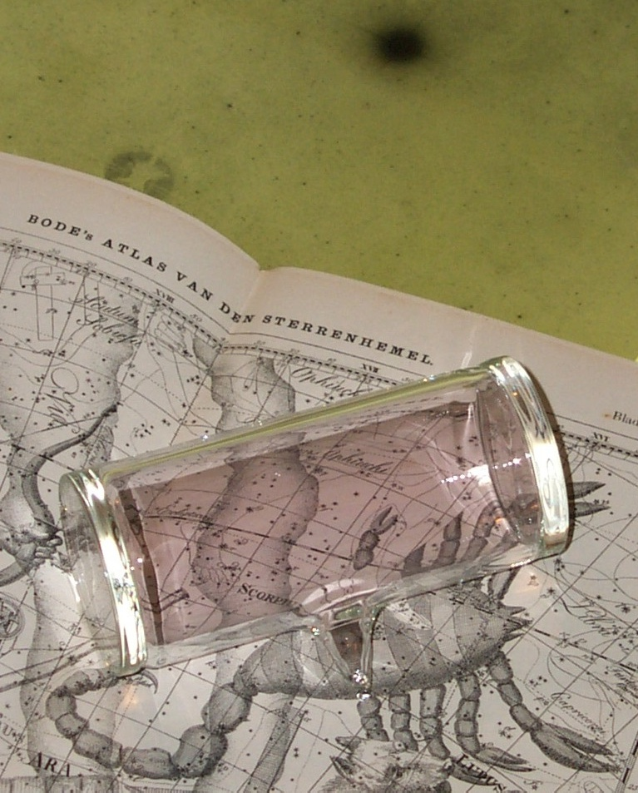
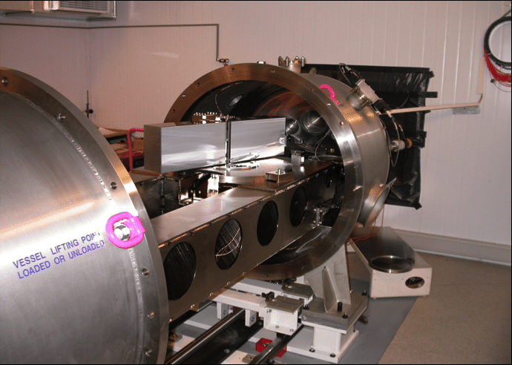
Successful approaches so far
Fundamental tool is the R~80,000-120,000 echelle spectrograph
Hyper-calibration (e.g. I2 cell)
This costs lots of photons
Hyper-stabilisation (nothing changes with time, systematics cancel)
This costs lots of $$

Slide 16
Echelle Spectrographs
A coarse diffraction grating (36l/mm) blazed at a large angle (76∘) and operated at high order (m=65-104) to deliver high-dispersion spectra in many short wavelength “chunks” in each order
plus
A low dispersion grating operating orthogonally to the echelle to “cross-disperse” the echelle output and deliver separated orders
We had one of those at the AAT (UCLES) and it did I2 cell absorption work from 1998-2015. It became obvious to me in ~2005 that the only way we’d do better was with a new facility
Notes:
Sadly the exoplanet community in Australia was so small, that was never going to get funded as part of the AAO instrumentation budget, which would always be spent in the next “400-at-a-time” widget … abd you can’t get Australian government grant money for a new instrument while at AAO. So I left to move to UNSW, where we have tried to solve that with Veloce.

Slide 17
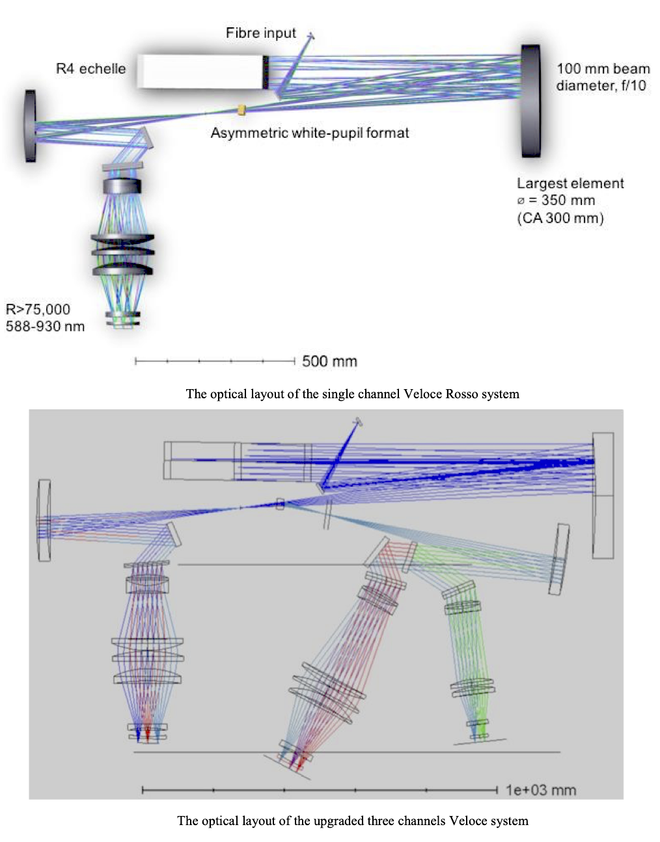
Veloce
Veloce project aims to give Australia capabilities for m/s Doppler science
But at a cost of ~$6m instead of >$20m.
This requires some compromises, some selected investment, and some application of intelligence (rather than brute force) to solve problems …
IFU. Laser comb. “Just-enough-stabilization”. 3 arms.
Notes:
What does Veloce stand for? Nothing! It’s a name.
The retro-fited acronym is the lowest form of wit.

Slide 18
Veloce’s Reddest Channel Echellogram Layout
m=65 m=104
High Dispersion
Orders

Slide 19
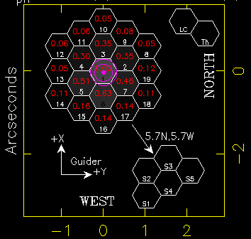
The Veloce feed
To save money on the spectrograph, we use optics fibres and a small IFU to “slice” the telescope focal plane into 19x0.5” smaller apertures, which are re-arranged into a pseudo-slit at the spectrograph entrance

Slide 20
Echellogram compression
The Veloce echellogram is compressed and under-sampled in X direction, so it fits. And in Y direction for the laser-comb source. But …
This leads to pixel-phase errors when we try to measure X,Y positions for the ‘lines’ of our LaserComb calibration source.
m=71, 0th iter

Slide 21
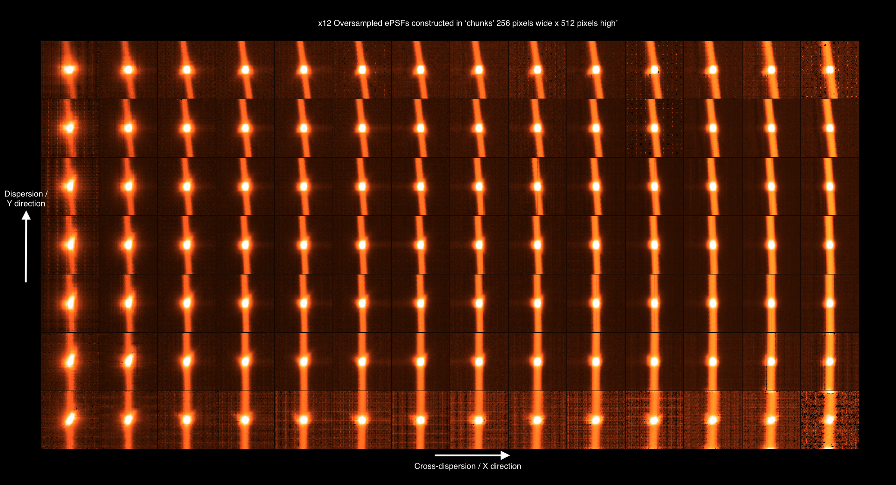
Fortunately that’s a Solved Problem
“Effective PSF” (ePSF) techniques developed for HST by Jay Anderson, work a treat …
m=71, 3rd iter, x12 sampling

Slide 22
Still to come
Replicate in the other 2 channels.
Then extend ePSF concept to the optimal extraction stage. Under-sampling means traditional extraction leaves few percent residuals when extracting the science fibres.
This is not a problem for 5-sigma lines at 0.5pix precision. But it kills precision Doppler work.
But the way ahead is clear. And now I’m “retired from teaching” its all I am working on …

Slide 23
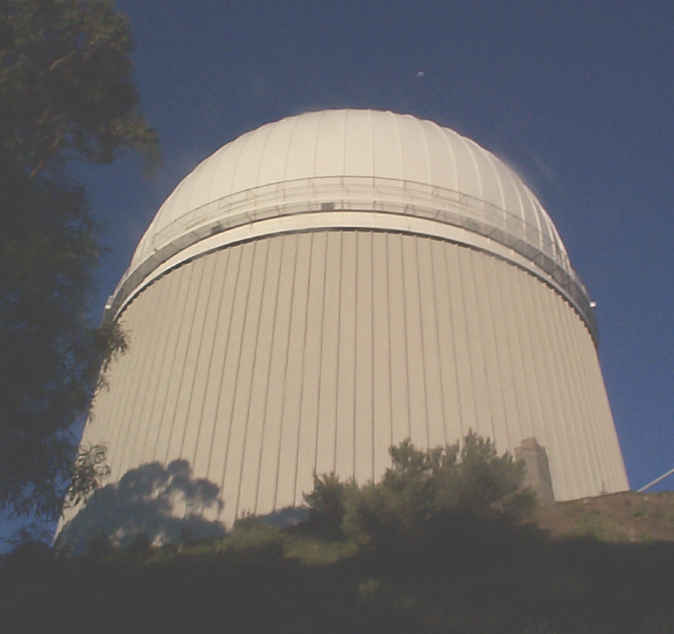
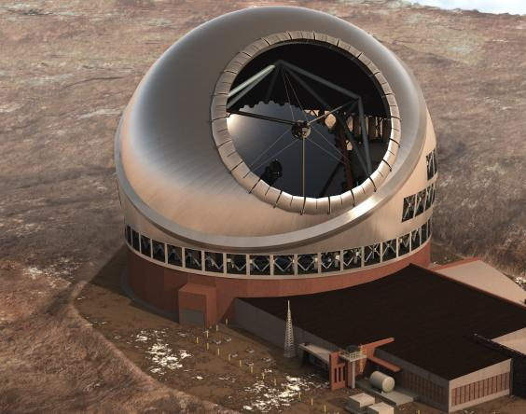
Obligatory pretty picture last slide.
I wish telescopes could last forever. Sadly AAO in its prime form cannot. But I do think its worth thinking about what made it work, and how we can factor that into brand new organsitions. Or even influencing existing ones.

