Slide 1
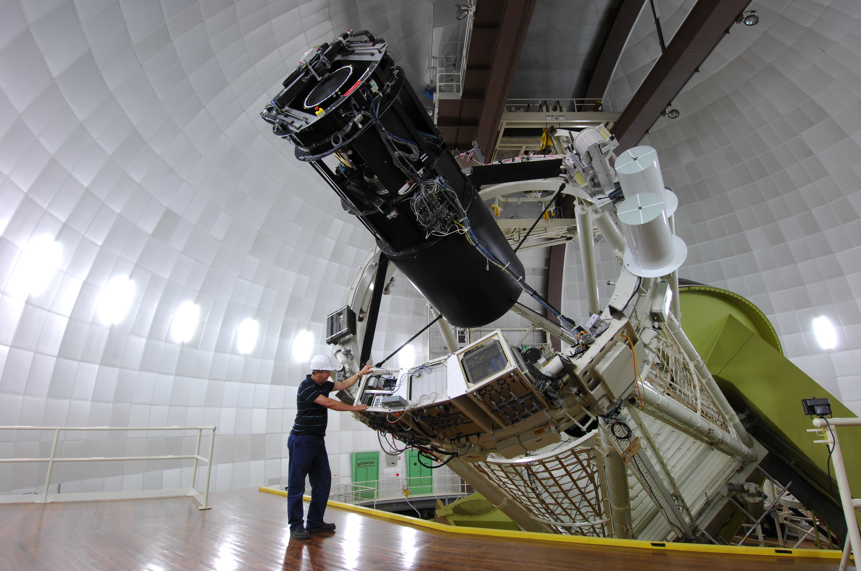
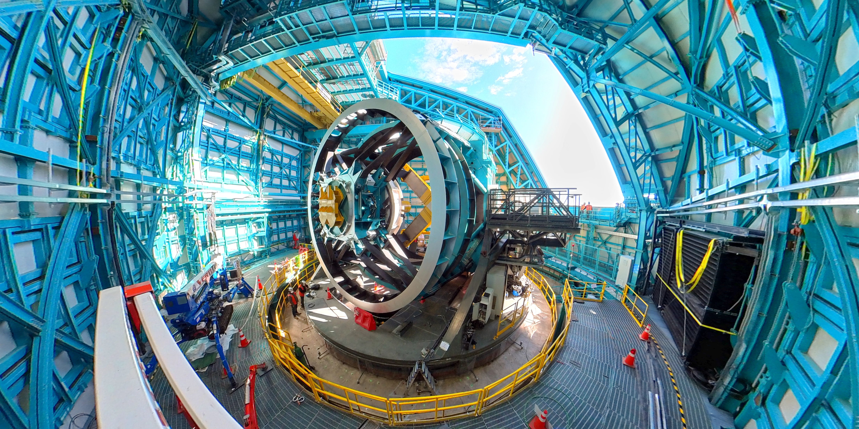
How the AAT led to Australia’s
membership of the Rubin Observatory’s LSST
Sarah Brough
Notes:
We’ve heard a lot about spectroscopic observations of galaxies … but I’d argue that each of those galaxies were originally selected from imaging surveys.
Until recently In the southern hemisphere we’ve often relied on limited imaging from the SDSS to undertake all of the amazing surveys you’ve seen to date.
LSST offers the opportunity for transformative change in the range of galaxies we can select as well as providing infinitely more information about each of those galaxies.

Slide 2
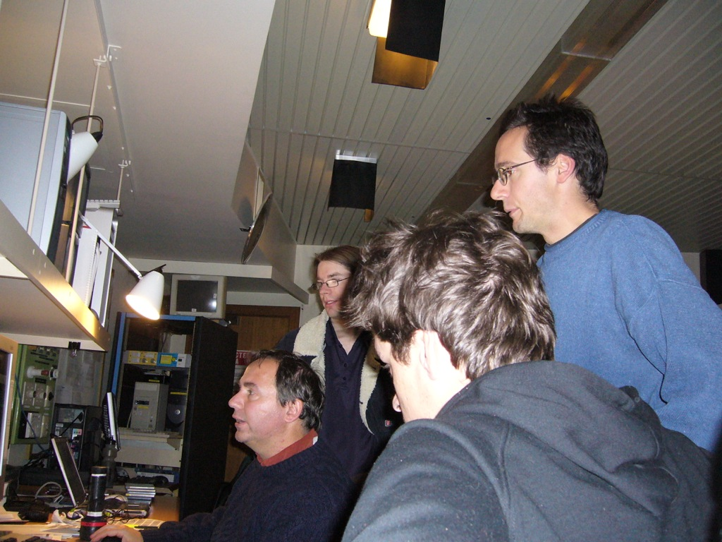
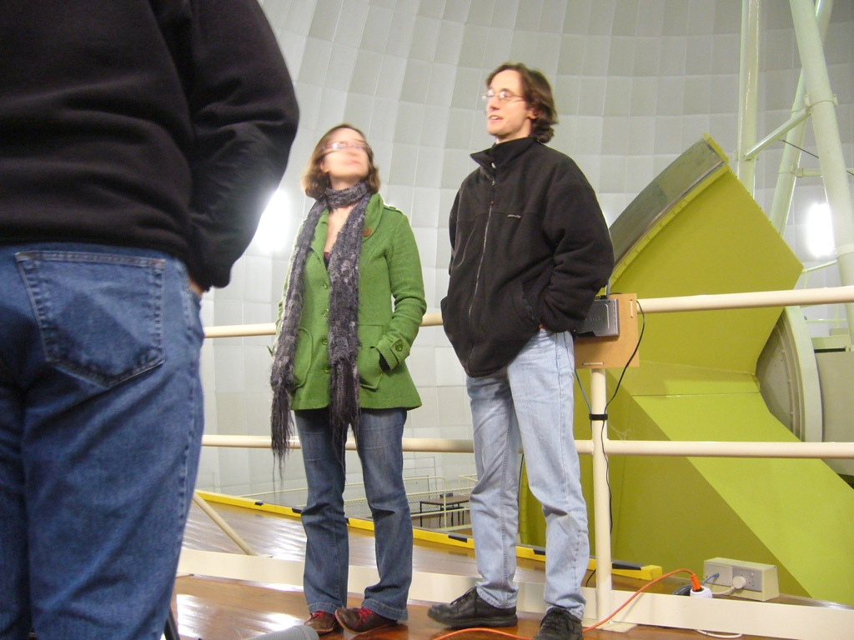
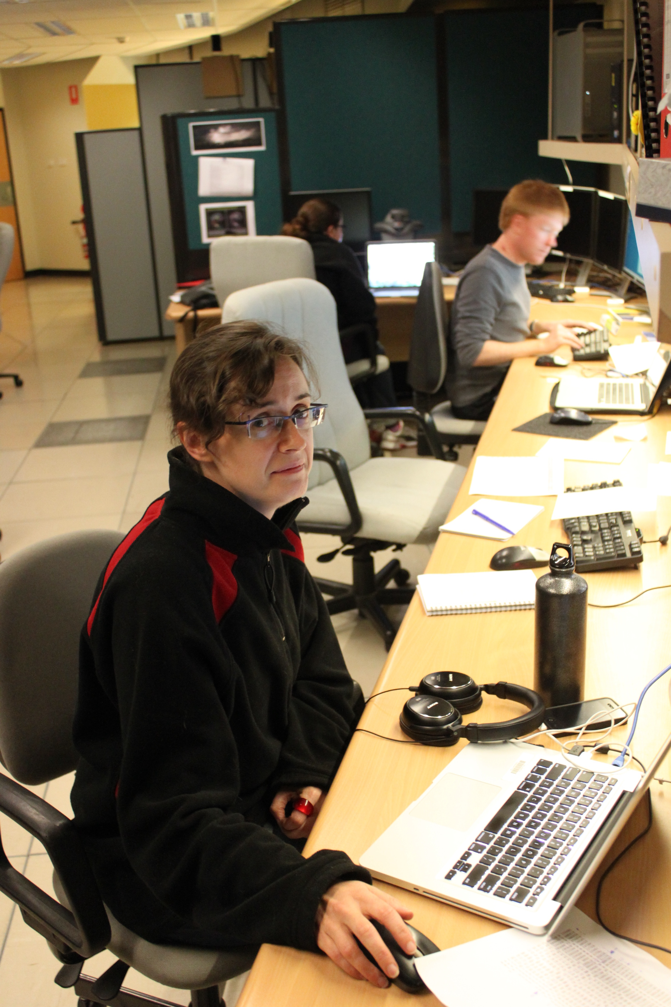
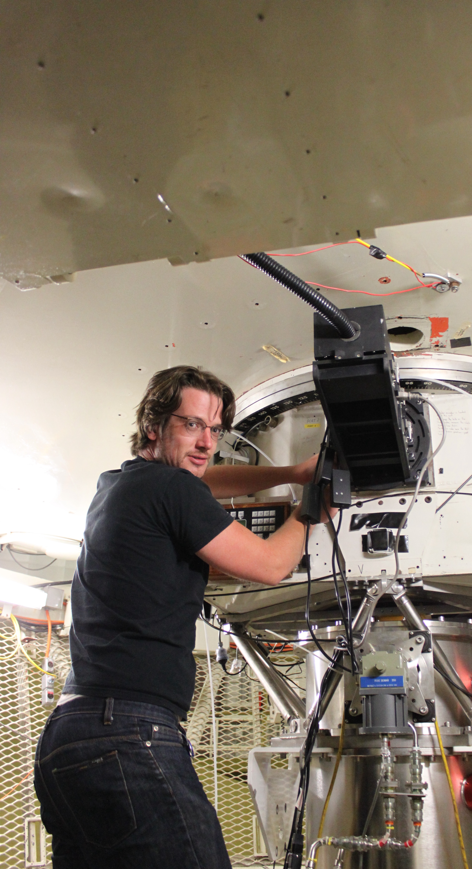
The AAO (2009-2017)
I was a member of the WiggleZ, GAMA and SAMI survey teams and the AAOmega Support Astronomer. I was at the AAT a lot…
These wide-field spectroscopic surveys of galaxies with the 2dF positioner, and then SAMI instrument, and the AAOmega spectrograph have been hugely scientifically important.
To undertake these surveys, galaxies had to be selected in the sky to be followed up spectroscopically. This was done from optical/nr-infrared images available for the Southern hemisphere.
At that time, this was very limited.

Slide 3
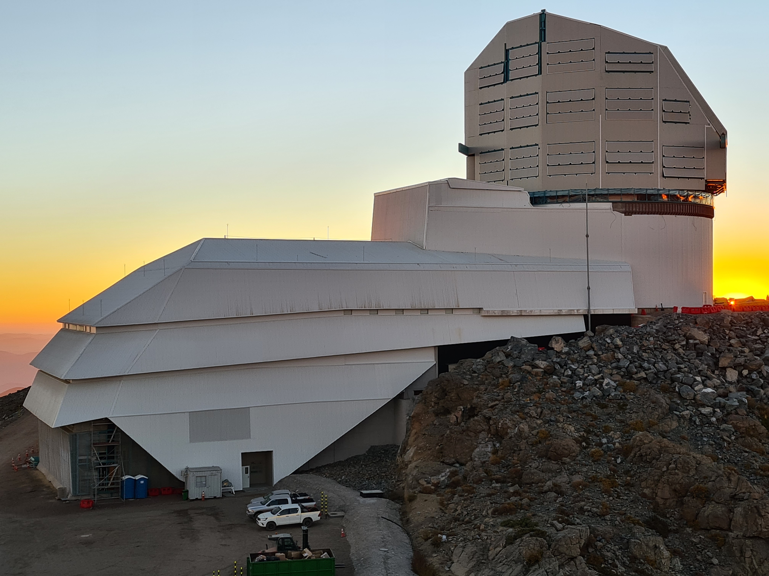
Decadal Plan Town Halls 2014
Vera C. Rubin Observatory’s Legacy Survey of Space and Time (LSST)
Being constructed in Chile.
Ranked #1 facility in USA’s 2010 Decadal Survey for Astronomy. Access recommended in 2020 mid-term review of AU Decadal Plan.
Images in 6 optical bands: ugrizy (320-1050nm).
10-year survey (2025-2035).
April 2021
Notes:
In the townhall at the AAO… someone mentioned the Vera C. Rubin Observatory’s Legacy Survey of Space and Time.

Slide 4
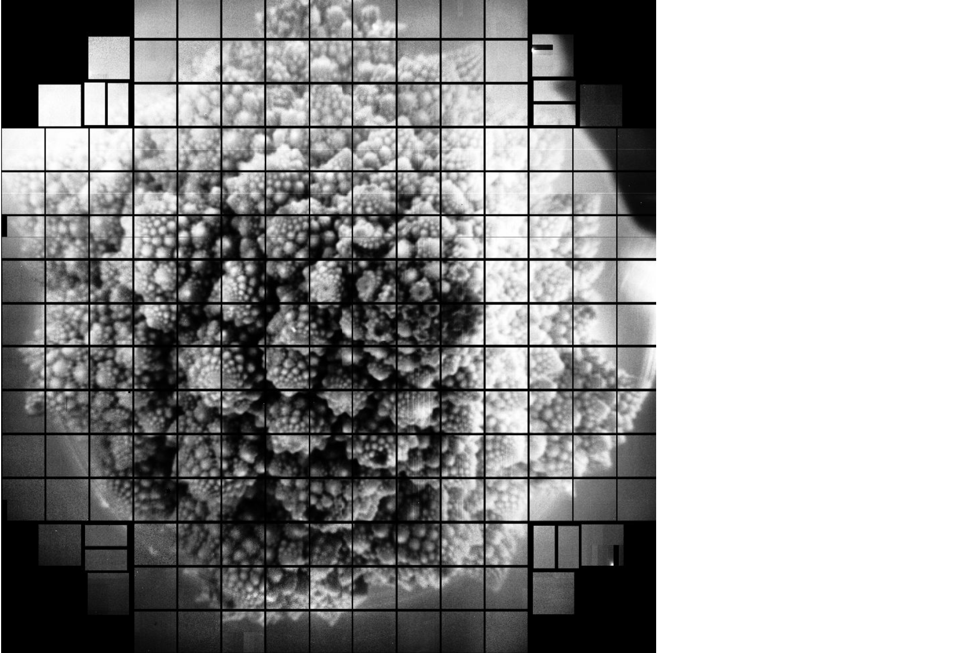
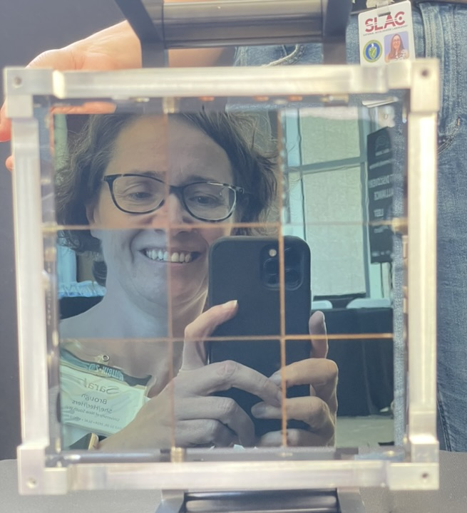
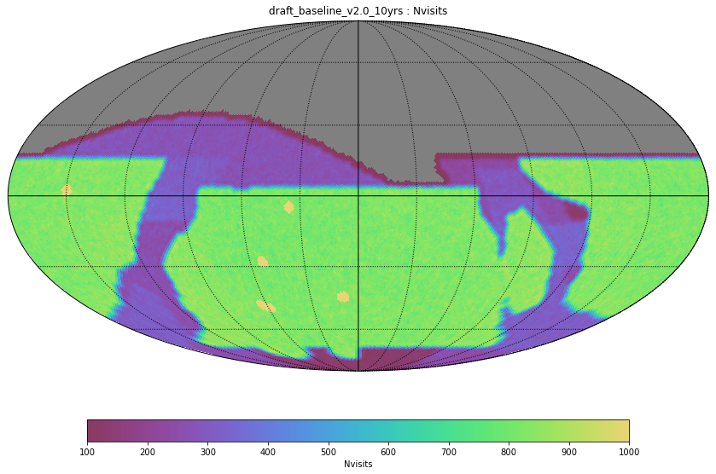
LSST
LSSTCamera has 189 detectors, covering 9.6deg² on sky.
Survey AREA: ~18,000deg²
Each region visited ~825x over survey. If you add visits you get SENSITIVITY!
Notes:
JWST 9arcmin2, factor 13M less.
When I first heard about this facility during process for last Au decadal super excited at prospect but we weren’t members.
I have led engagement over many years with community, Rubin, CoE, then AAL, to finally have membership. Funded by LIEF I led for next 3 years.

Slide 5
LSST
STATS:
2.7PB/year images alone
Deepest, highest-res, optical image of the Southern sky EVER
20 Billion Galaxies
17 Billion Stars
Notes:
is an increase of 100 times more galaxies, stars and solar system objects than any other survey.
The survey will have a transformative impact over nearly every area of astrophysics over the next 10 years. And 47PIs+JAs across Australia now have access to that.

Slide 6
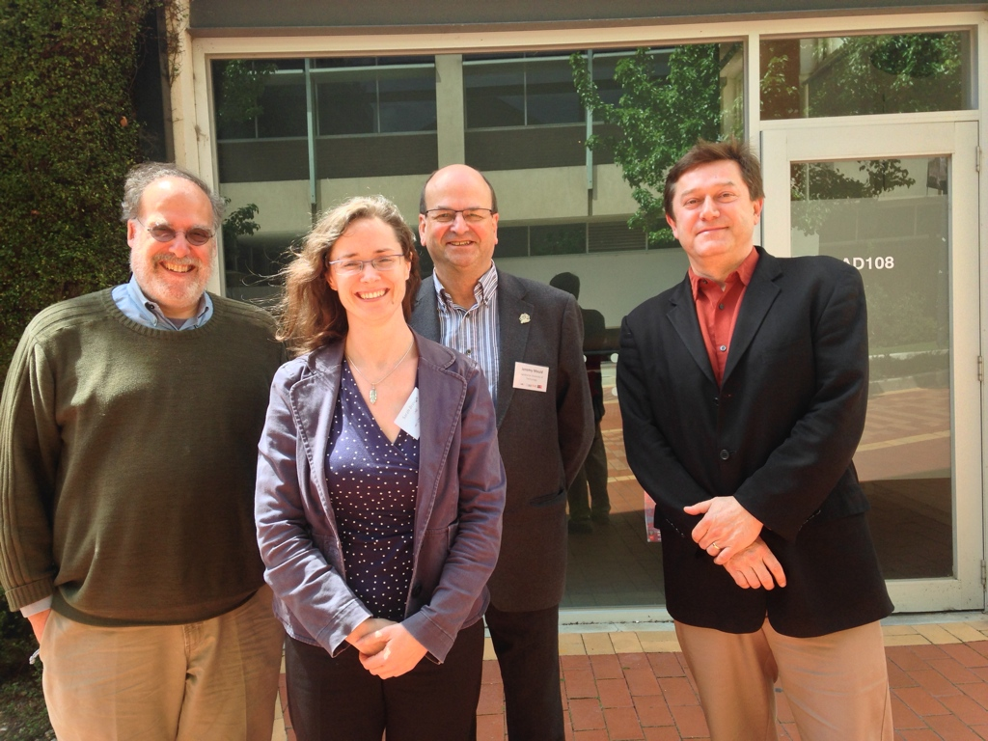
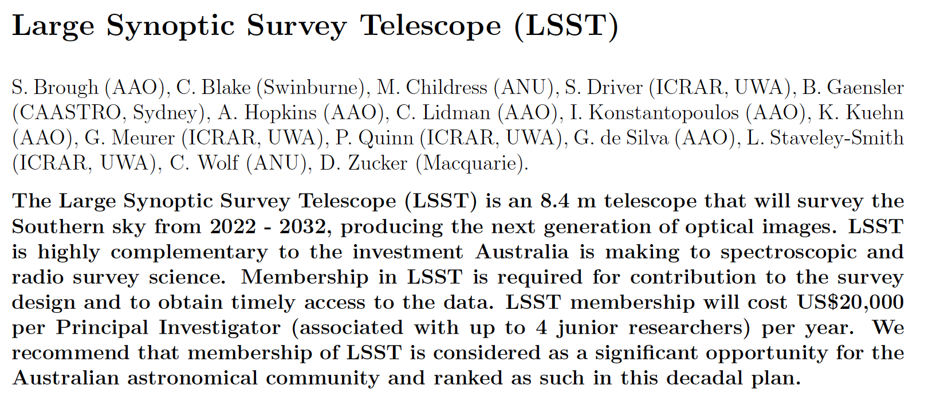
Decadal Planning 2014
I couldn’t understand why Australia wasn’t more interested? We relied on images like this in the Southern hemisphere to do our best science with the AAT. We needed this!
So I wrote a White Paper…
It turned out CAASTRO and ICRAR had already signed letters of intent with LSST - thanks to Bryan and Peter!
LSST Project Directors (Steve Kahn and Zjelko Ivezic) toured Australia in October 2014.

Slide 7
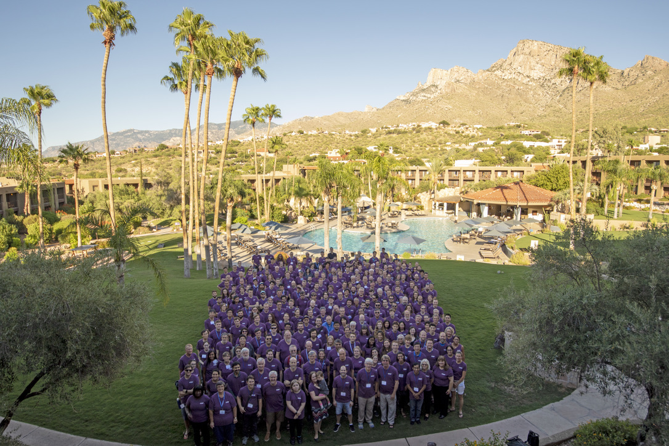
Next Steps 2015-2019
LSST was mentioned in the 2016-2025 Decadal Plan!
2015-2017 Supported by enthusiasm of Simon Driver, Karl Glazebrook, Kate Gunn, Rachel Webster, Chris Wolf - considering LIEF to pay access fee, and I raised community awareness*
2017++ Attended Rubin Project and Community Workshops
2018 Transfer of MOUs to Astronomy Australia Limited
Australian Science Lead
2019 LSST@Asia held at UNSW
Everything changed…
* gave 101 talks (possibly exaggerated)

Slide 8
2019++
Call for Letters Of Intent made by Rubin in October 2019
2019 Midterm review of 2016-2025 Decadal Plan recommends that Australia:
Despite discussions with community and Rubin regarding the value of AAT time, radio time, large datasets… The best return on investment was from our software expertise, as available through ADACS.
In 2021 finally in a good position to write a 3-year ARC LIEF bid to fund. Successful December 20th 2021. Initiated 1 July 2024.
LSST will have first light mid-next year with science verification data available ~6months later.

Slide 9
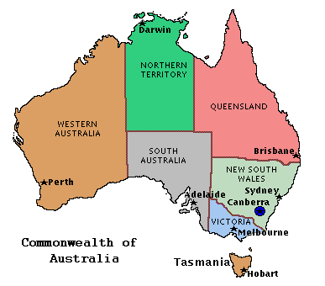
So HOW is Australia Involved?
We now have 47 Australian PI positions (Faculty members) and 4*47 = 188 Junior Associate (JA) positions.
Our In-Kind Proposal for LSST data access rights led by AAL and approved by Rubin Observatory, includes: - 3 FTE for directable software effort through ADACS/AAO Data Central - A “Lite” international Data Access Centre - 1 FTE for 1 year of non-directable software effort
The red items require funding. For 3 years this is supported by LIEF.
With AAL we have developed the LSST Consortium Agreement, which includes Terms of Reference for the AAL LSST Management Committee (ALManaC) and policies for new PIs and JAs to join.
From 2024 Prof Rachel Webster is the new Australian Science Lead for LSST with A/Prof Chris Wolf as Deputy.
Notes:
Two Items in red are LIEF funded. 14 institutions. 1 person per institution.

Slide 10
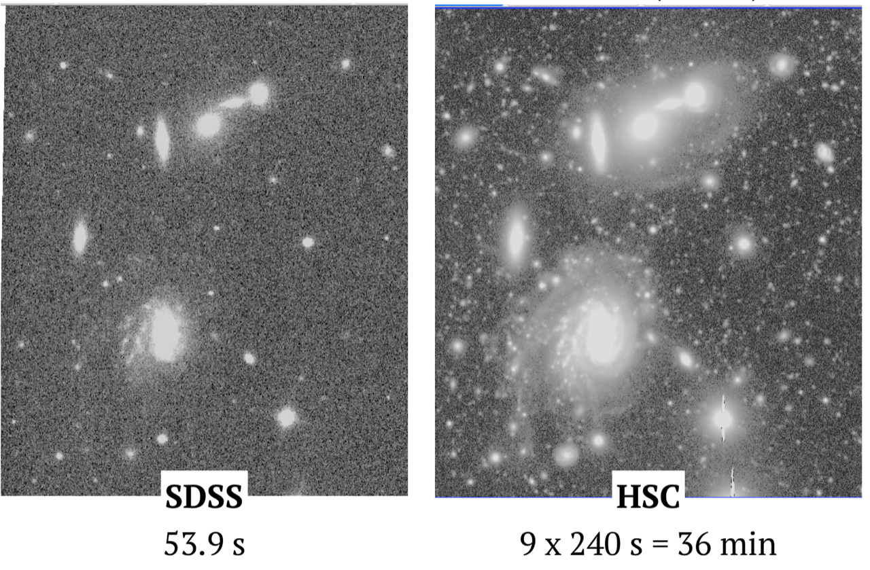
What do I want to do with LSST?
LSST’s sensitivity opens up a whole new parameter space in the Universe!
Surface brightness is the luminosity per unit area.
LSST will be even more sensitive than HSC.
It will find many more of the shell galaxies David Malin found with the AAT in the 80s.
Sloan Digital Sky Survey
2.5m Telescope, New Mexico
r~22.5 mag/arcsec Area~>10000deg²
Hyper Suprime-Cam
8m Telescope, Hawaii
r~29.8 mag/arcsec Area ~35deg²
Notes:
CFHT 4deg^2 best we had before 2017

Slide 11
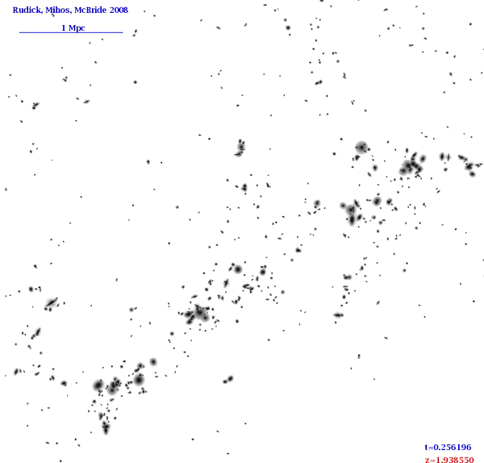
Intracluster Light (ICL)
Galaxies are often found bound together in massive dark matter haloes – galaxy clusters.
Galaxies merge in these haloes, but that process is not completely efficient.
The intracluster light (ICL) provides an important fossil record of these interactions.
To understand galaxy evolution in clusters we need to answer the questions of WHEN and WHERE does intracluster light form and from WHICH galaxies?
Notes:
We can answer this by:
establishing the relationships that ICL holds with cluster mass (WHERE) and redshift (WHEN) and its colour (WHICH galaxies)
Determine whether consistent with simulations.
Why not answered yet? Very faint. Limited survey data – and observational hurdles

Slide 12
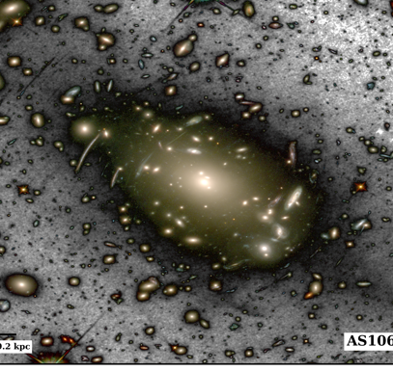
Intracluster Light (ICL)
I’m interested in how the most massive galaxies evolve but we’ve (nearly) reached the limit in doing that without understanding the faint fuzzy stellar light around those galaxies.
LSST will be able to SEE tidal features and Intracluster Light in statistical samples for the first time!
My team have been preparing to do this work with LSST and we are very excited by the prospect of science verification data!
Notes:
Why do I want LSST?

