Slide 1


How typical is the Local Group?
Dwarf galaxies in Local Group Analogues
Sarah Sweet
The University of Queensland
AAT 50th Anniversary Symposium 2024
With: Simon Deeley (UQ), Holger Baumgardt (UQ), Helmut Jerjen (ANU),
Chandrasekhar Murugeshan (CSIRO), Caroline Foster (UNSW),
Angel Lopez Sanchez (MQ), Adebusola Alabi (NWU)

Slide 2
This talk
Background: Is our Local Group of galaxies unique?
Motivation: The challenge of equitable comparison
Survey: Dwarf galaxies in Local Group Analogues
  Complete census
  Detailed demographics
  Family trees
Progress: First observations & forward look
Notes:
Motivate and describe the survey aims and methods. Show some very preliminary observations.
From ‘how typical is the MW?’ to ‘how typical is the LG?’

Slide 3
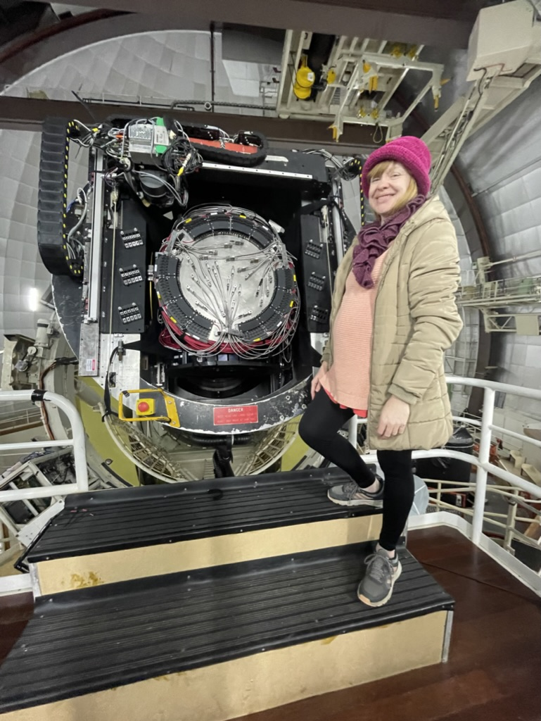
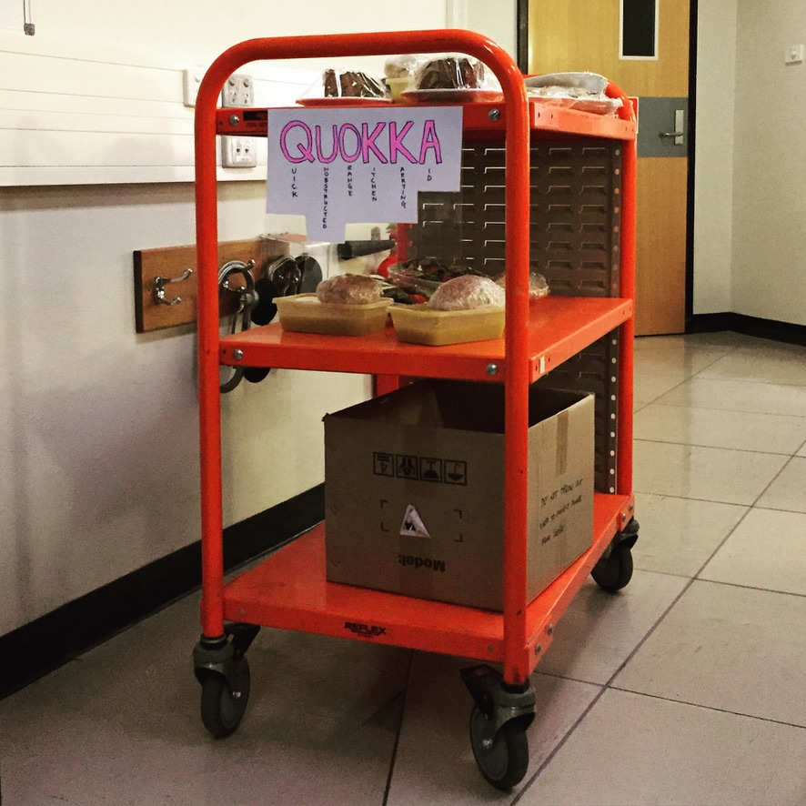
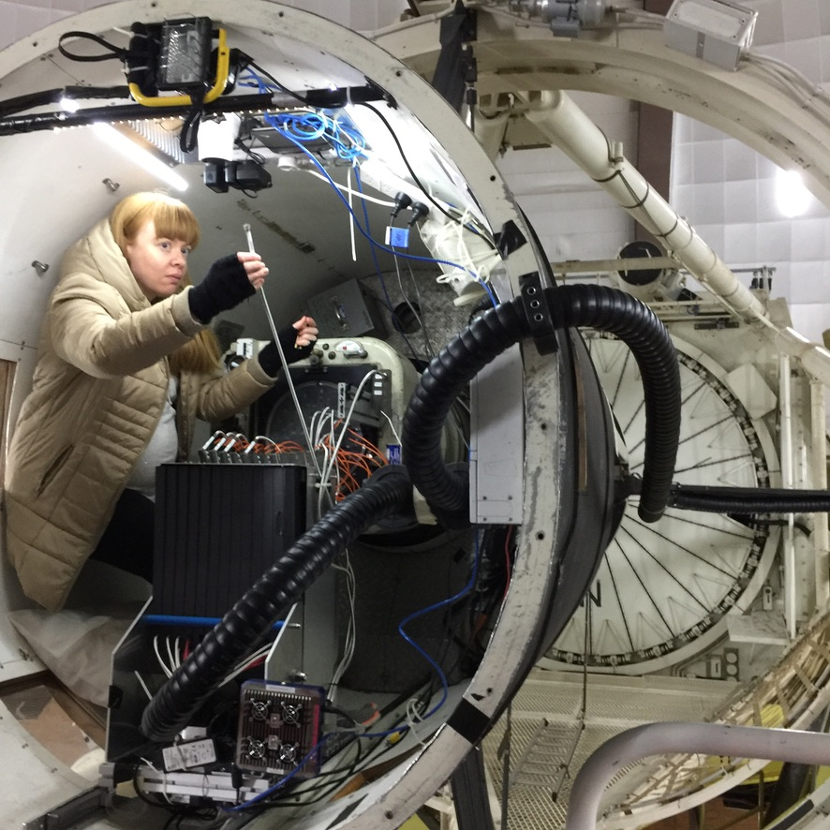
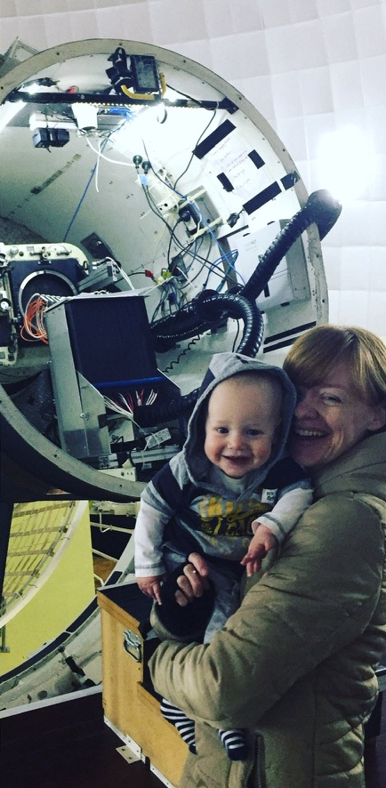
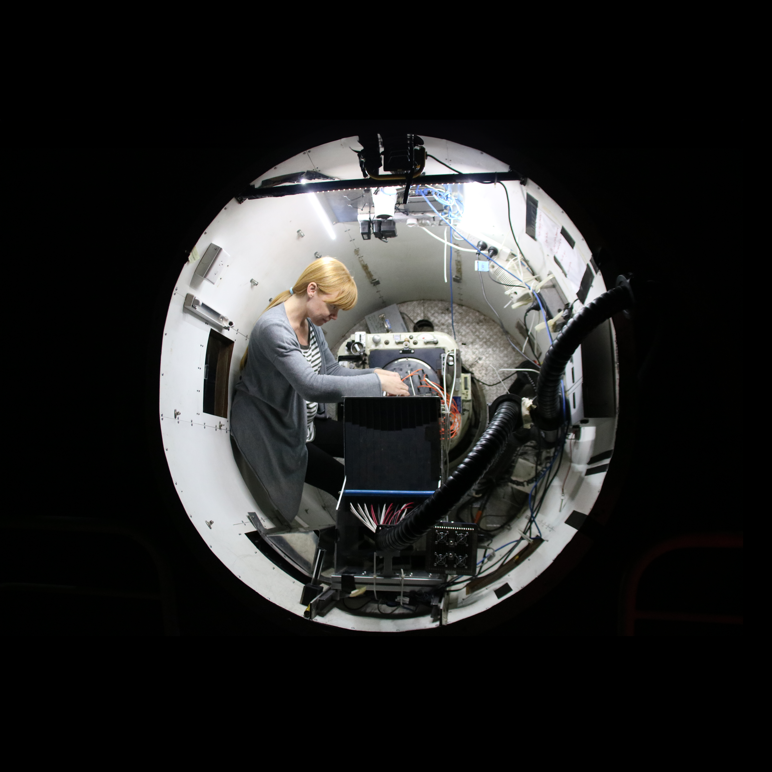
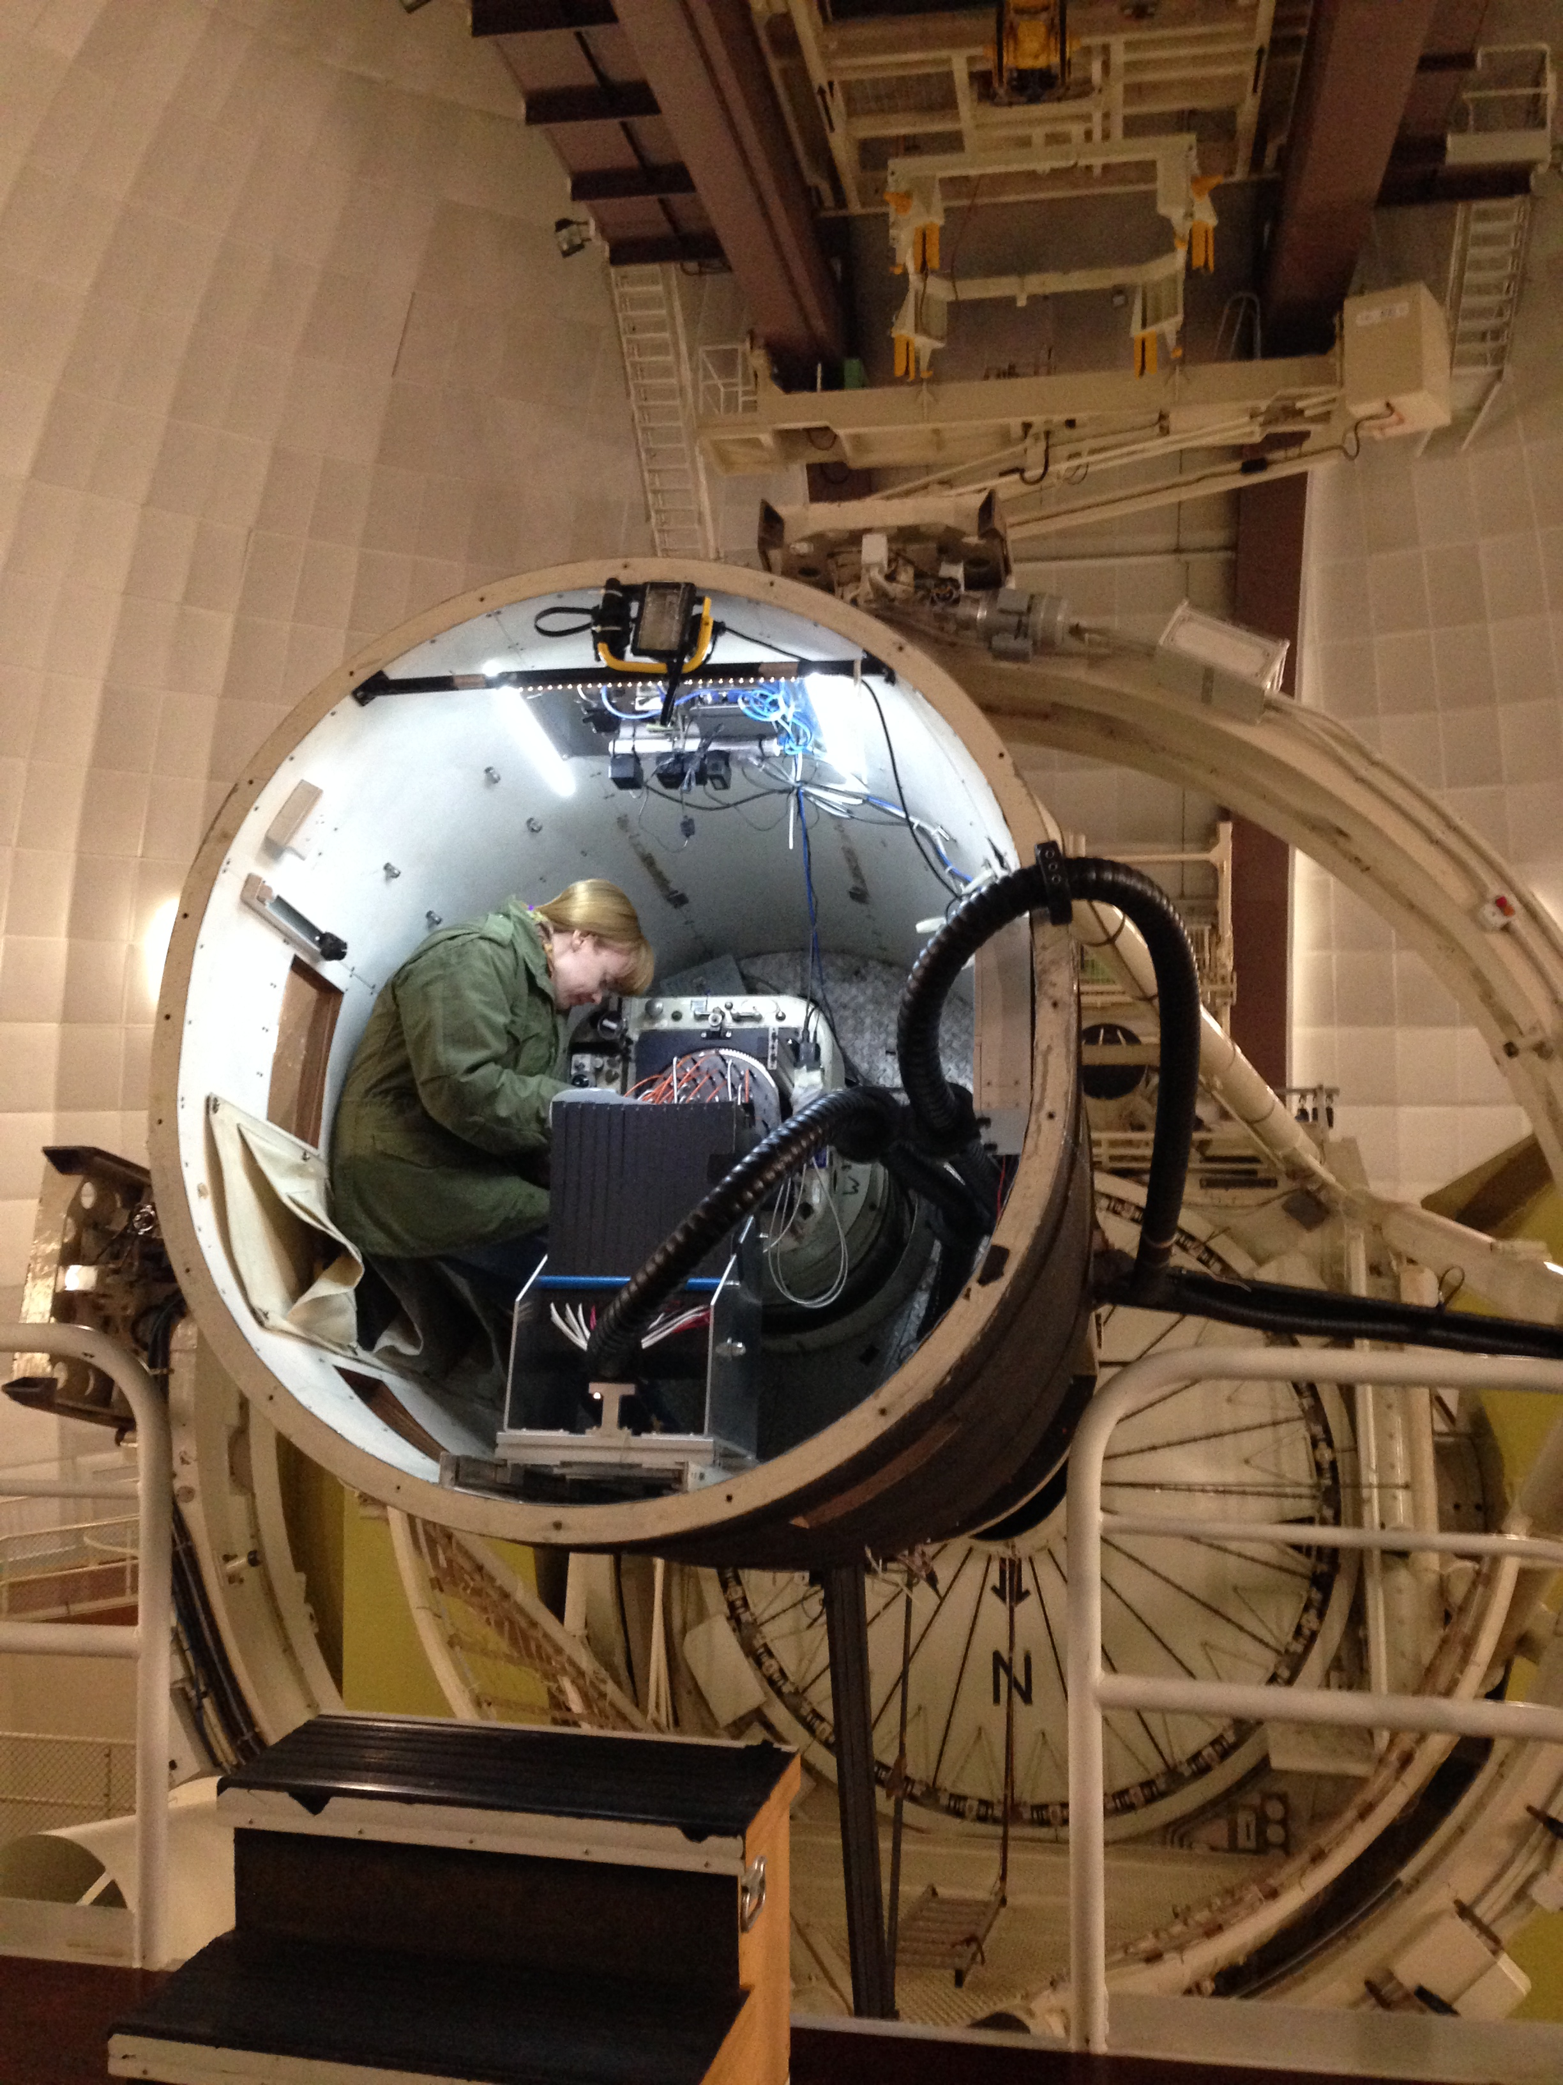
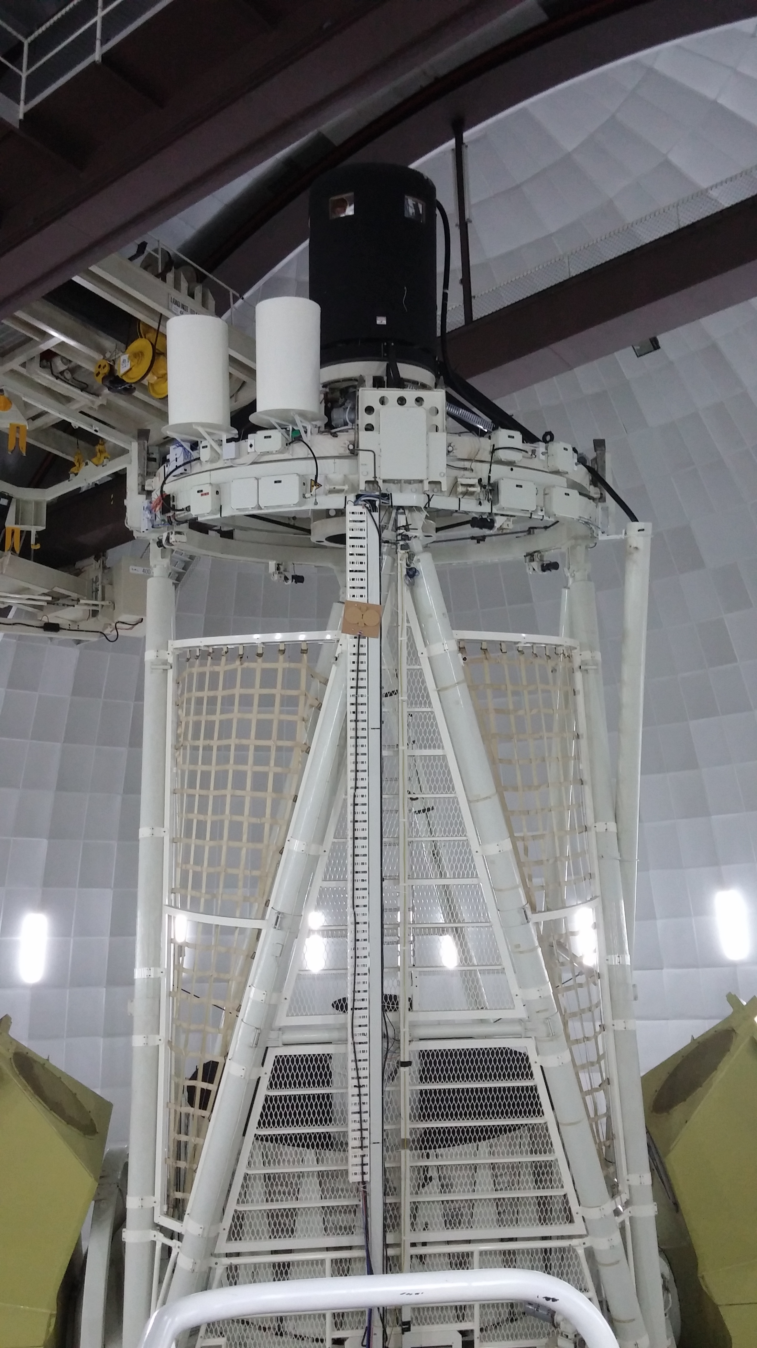
The AAT & Me
SAMI Galaxy Survey
(33 nights)
SAMI Zoom
(HII regions; 9 nights)
Hector (and 2dF)
(31* nights, incl. this week!)
KOALA (Local Group Analogues; 8* nights)

Slide 4
Background:
Is our Local Group of galaxies unique?
Detailed studies of our Local Group are foundational to galaxy evolution.
  Dwarfs are numerous, building blocks, trace DM, environment…
  Most galaxies are in groups.
MW & M31 and their respective retinues of dwarfs are well understood:
  Mass function
  Morphological type
  Kinematic structure
  Baryonic & DM profile
  Chemical evolution, age & SFH
Notes:
The accuracy of information we have about our place in the Universe rests heavily on detailed studies of our Local Group of galaxies (LG)–two host galaxies Milky Way and its neighbour Andromeda, and their respective retinues of dwarf satellite galaxies. The LG serves naturally as a unique laboratory for studying galaxy formation and evolution over cosmic times, offering a first-hand view of ways in which myriad types of dwarf galaxies gravitationally come together and form larger galaxies like our Milky Way.

Slide 5
Background:
Is our Local Group of galaxies unique?
Planes of satellites?
Diversity of dwarf types?
  Cores & cusps
  Morphologies: classical dwarfs, dSphs, dIrrs, dEs, BCDs, green peas, blueberries, UFDs, UCDs, UDGs, UFOs, UAVs, ...
  Kinematic profiles (rotation curves, and more)
  Ages & chemistry (stars, and gas)
Satellites of dwarfs?

Slide 6
Motivation:
The challenge of equitable comparison
Not straightforward to generalise beyond the LG.
Intrinsic diversity or measurement effects?
  Surface brightness detection limit?
  Spatial resolution?
  Aperture effects?
  Volume limitations?
Do we know too much?

Slide 7
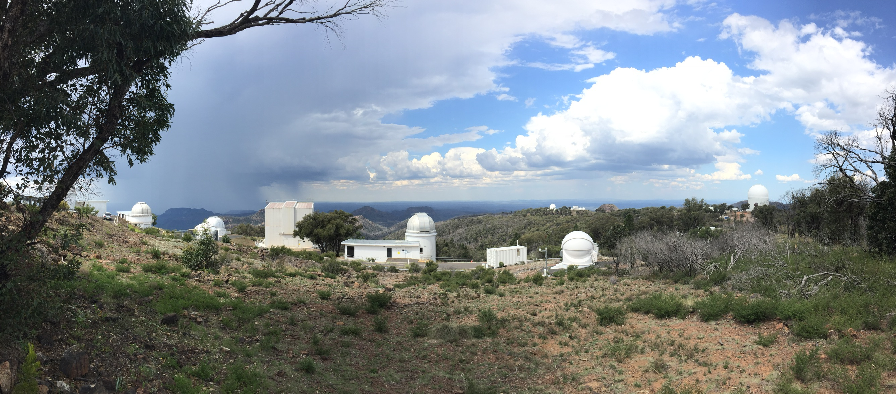
Near-field dwarf studies
1000+
resolved stars
CALIFA
100
semi-resolved
IFUs
Resolution elements per galaxy
10
Intermediate-z dwarfs
integrated
1
High-z dwarfs
stacked
Local Group
Local Volume
Low
Middle ages
Cosmic noon
Epoch of Reionization
z

Slide 8
Dwarf galaxies in Local Group Analogues
Developing equitable methods for direct comparison between LGAs, the LG and simulated LGs.
High-quality ‘semi-resolved’ observations of LGAs
Mock observations
  of Local Group members to mimic our LGA observations.
  of satellites around L* pairs in IllustrisTNG50 to compare like-for-like with our empirical optical & HI data.

Slide 9
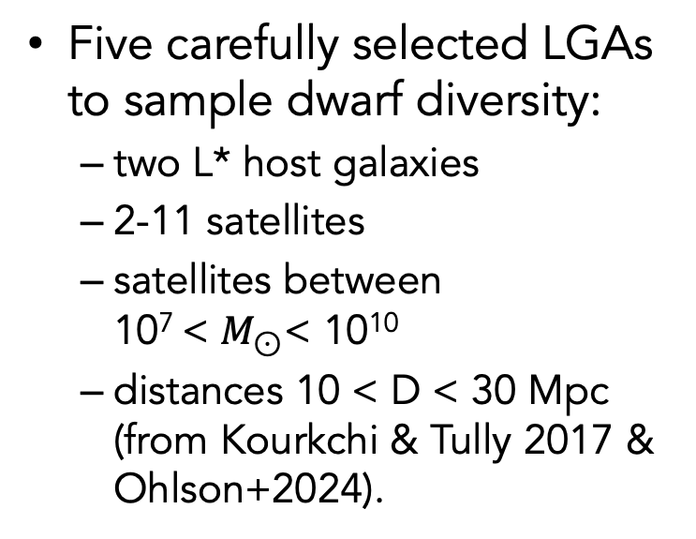
Dwarf galaxies in Local Group Analogues
Five carefully selected LGAs to sample dwarf diversity:
  two L* host galaxies
  2-11 satellites
  satellites between
  10⁷ < $M_{⊙}$< 10¹⁰
  distances 10 < D < 30 Mpc (from Kourkchi & Tully 2017 & Ohlson+2024).
Notes:
.
Blue = parent sample
Purple = mean + 1 std. dev.

Slide 10
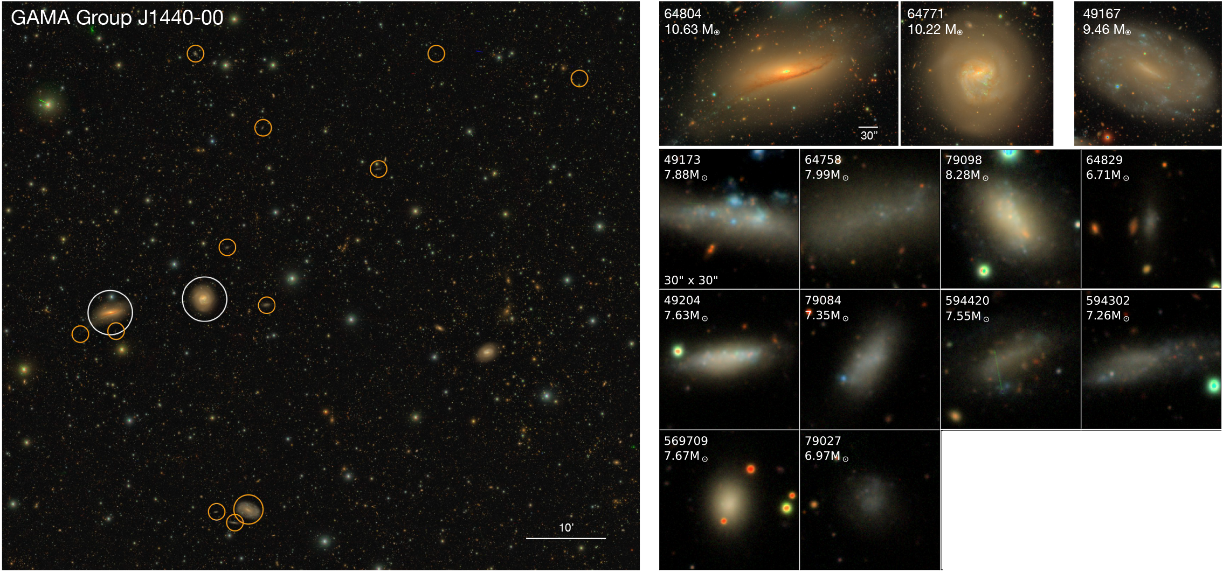
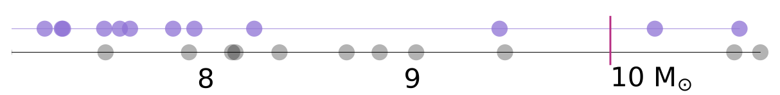
Dwarf galaxies in Local Group Analogues
‘Triangulum’
‘SMC’
Notes:
Example pics of groups,

Slide 11
Observations
Probing stellar, ionized gas & neutral gas physics at dwarf scales in the group environment:
  Optical integral field spectroscopy 3650 − 9600 Å
    AAT/KOALA R~2600-8800 @ 1.25”
    ANU/WiFeS R~3000-7000 @ 1”
  HI imaging (WALLABY, MeerKAT)

Slide 12
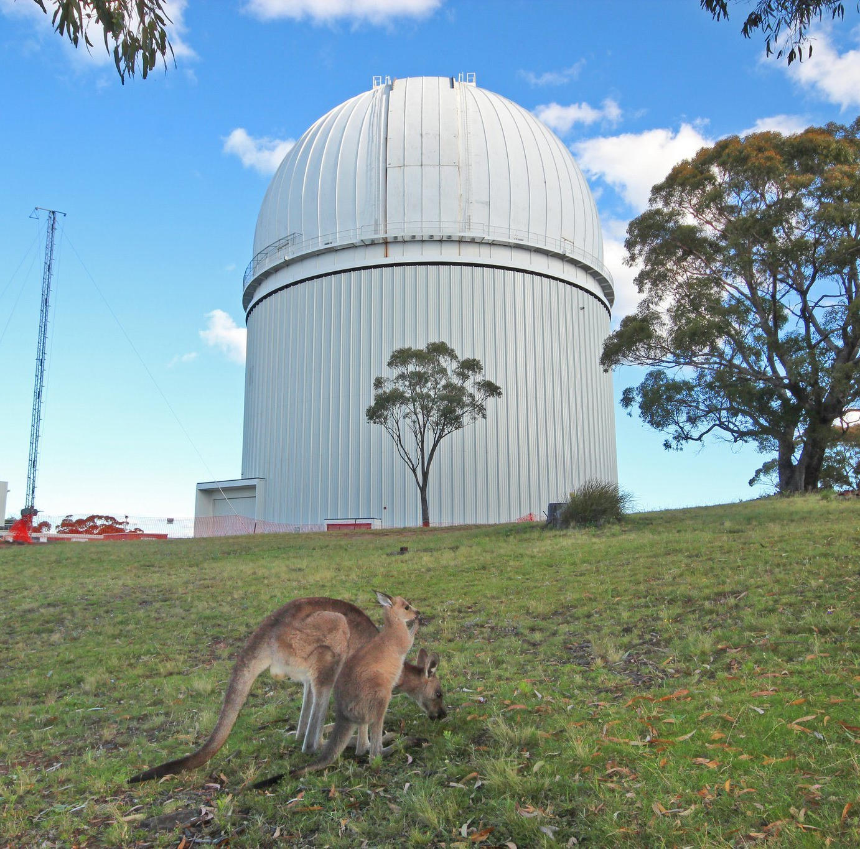

AAT 3.9m & ANU 2.3m at Siding Spring
Notes:
Picture of AAT (50th!) & 2.3m (MSO100th!) which is a long time in Aussie years.

Slide 13
Dwarfs in LGAs – complete census
Are the numbers, mass functions and spatial distributions of dwarf satellites in the LG typical when compared to LGAs? Do LGA satellites orbit their host galaxies in a plane, residing preferentially between the two giant galaxies as seen in the LG?
We will spectroscopically follow-up deep photometric data to confirm new dwarf galaxies in LGAs, and compare the numbers and distributions of dwarfs within LGSs in cosmological simulations, which appear to be in tension with observations of the LG.
Notes:
Flash up some high-level science questions to give a taste of our aims.

Slide 14
Dwarfs in LGAs – detailed demographics
What is the relationship between environment and dwarf galaxy evolution in LGAs? How do factors such as morphology, gas content, and kinematics vary with proximity to the central host galaxies? How do these influence the resulting variety of dwarf types?
We will analyse the dwarf galaxies’ distribution, age, chemical abundance and the kinematic properties of their constituent stars, ionized hydrogen, and neutral hydrogen, to study the interplay between angular momentum, morphology and environment, comparing between the LG, LGAs and LGSs.

Slide 15
Dwarfs in LGAs – family trees
What are the origins and evolutionary histories of dwarf galaxies in LGSs? How do these histories compare with our understanding of the LG dwarfs?
We will compare the formation and survival rates of dwarfs in LGSs with those in the LG, using simulations to uncover their assembly histories as they go on to contribute to the formation of larger systems like the Milky Way.

Slide 16

Progress
‘Triangulum’
KOALA*
‘SMC’ KOALA
KOALA*

Slide 17
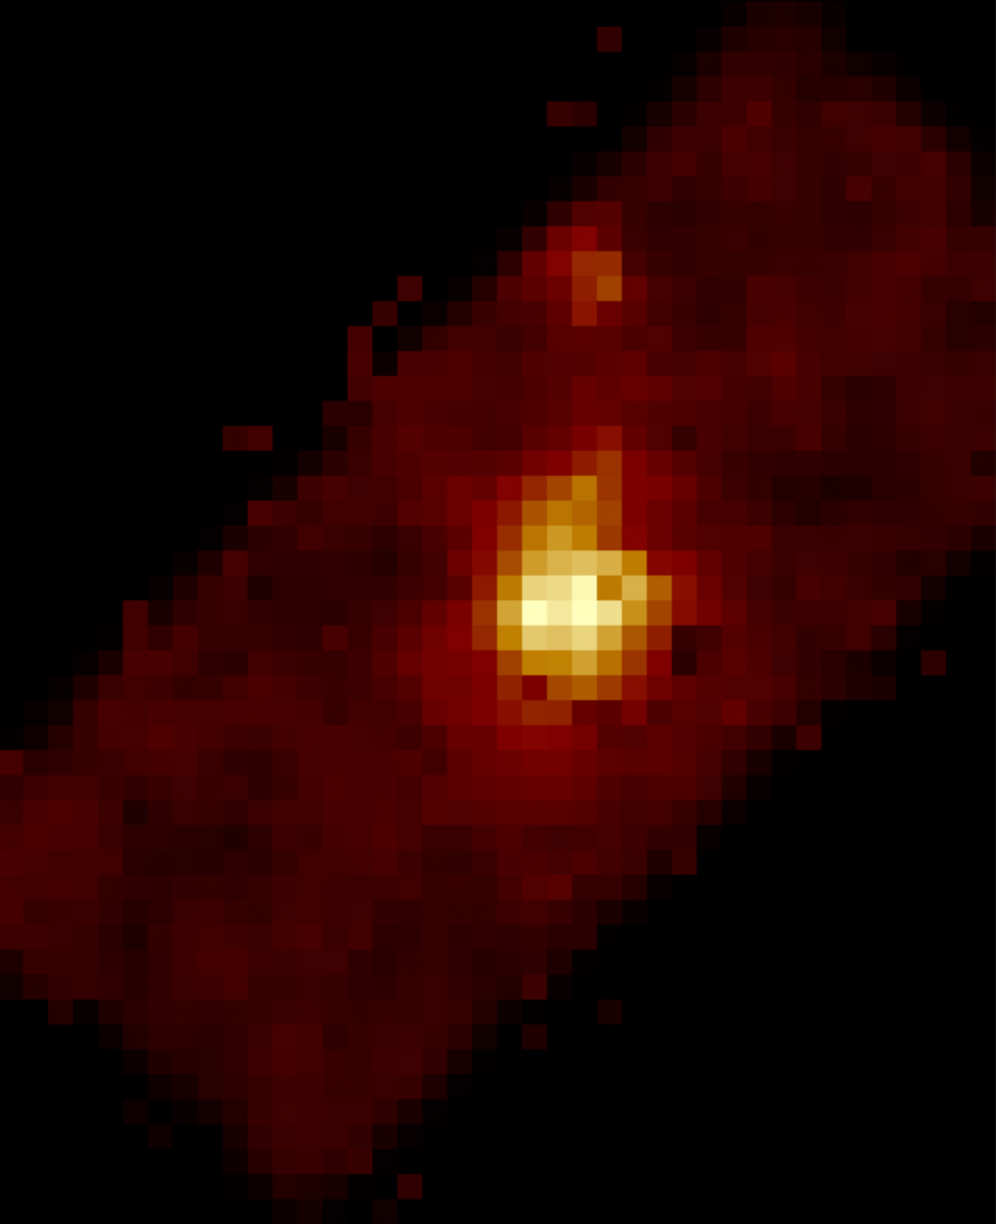
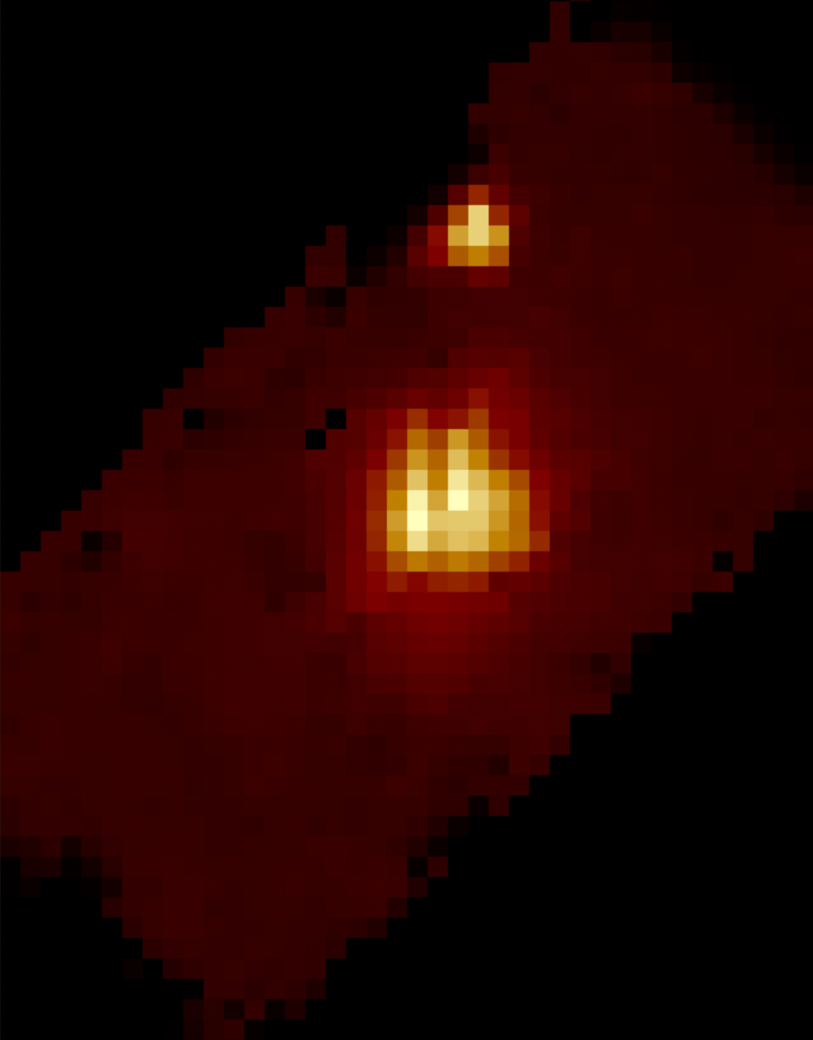
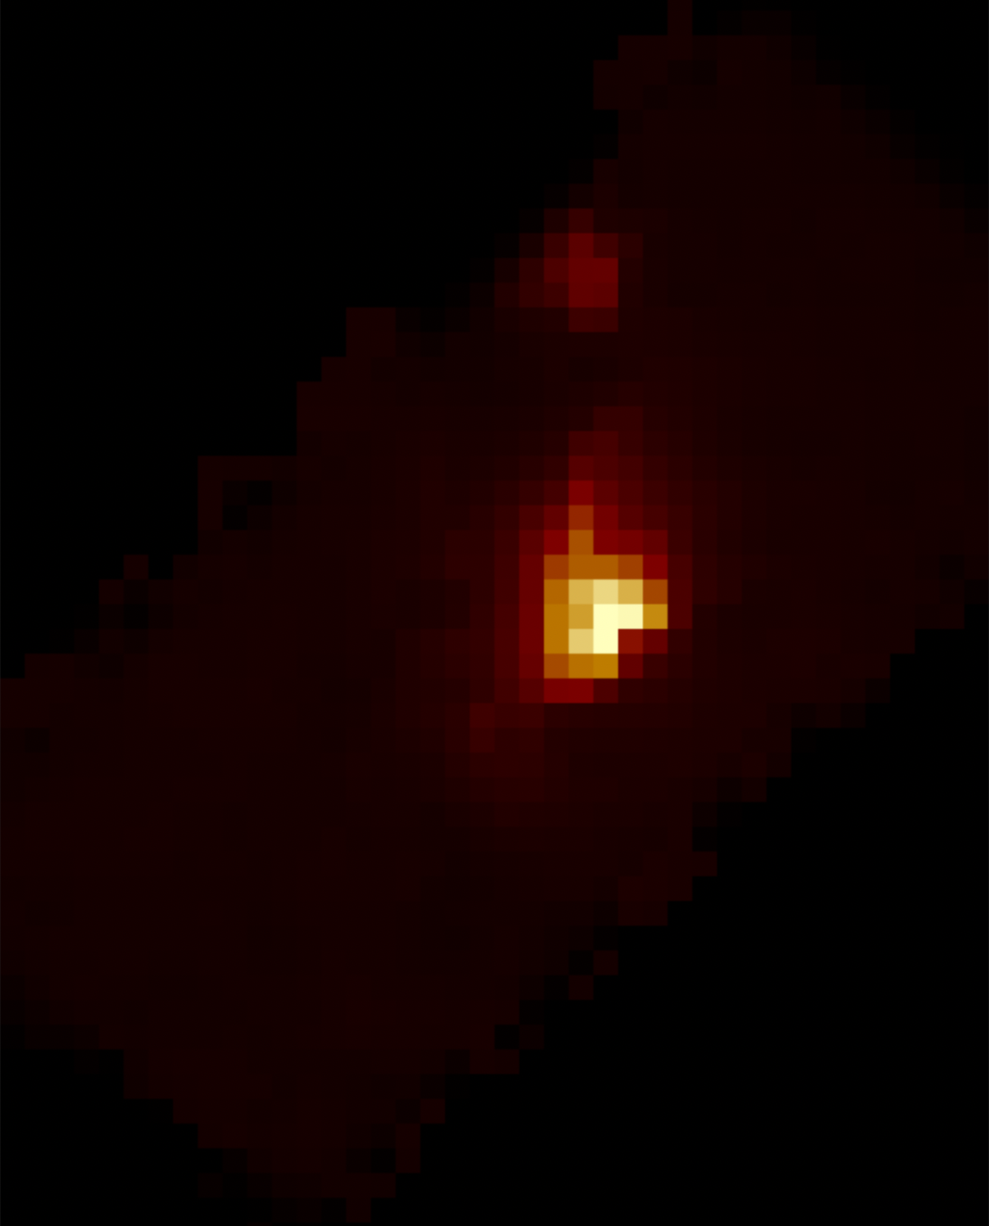
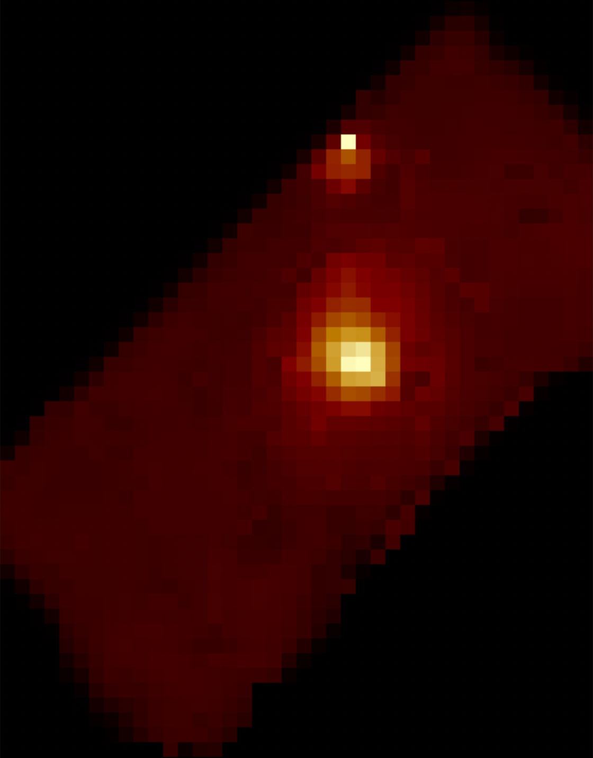
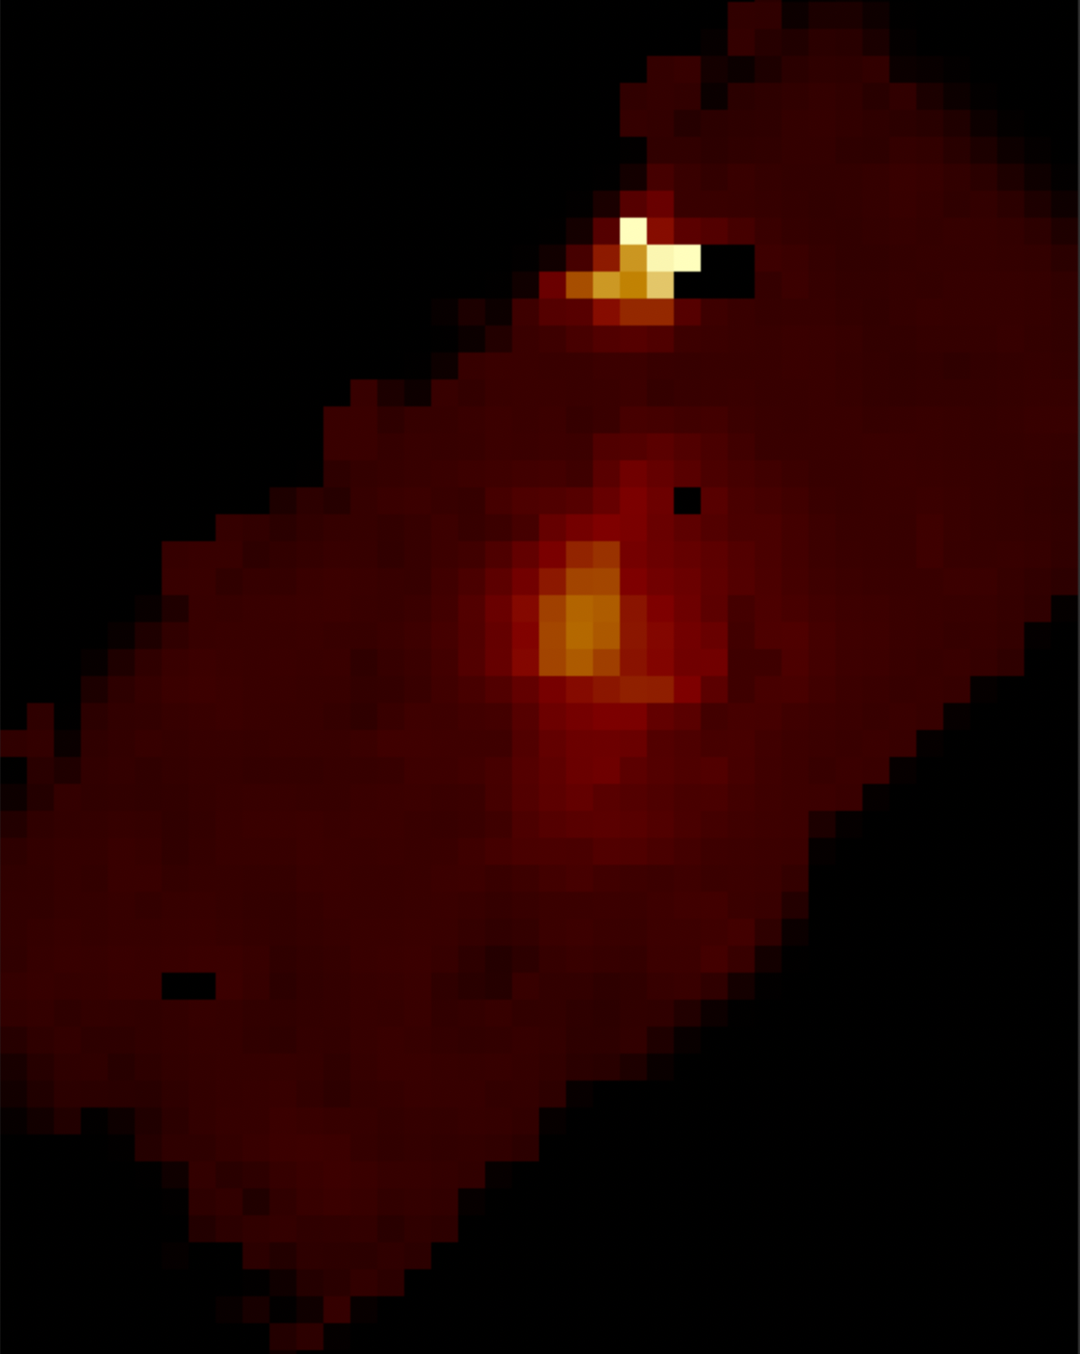
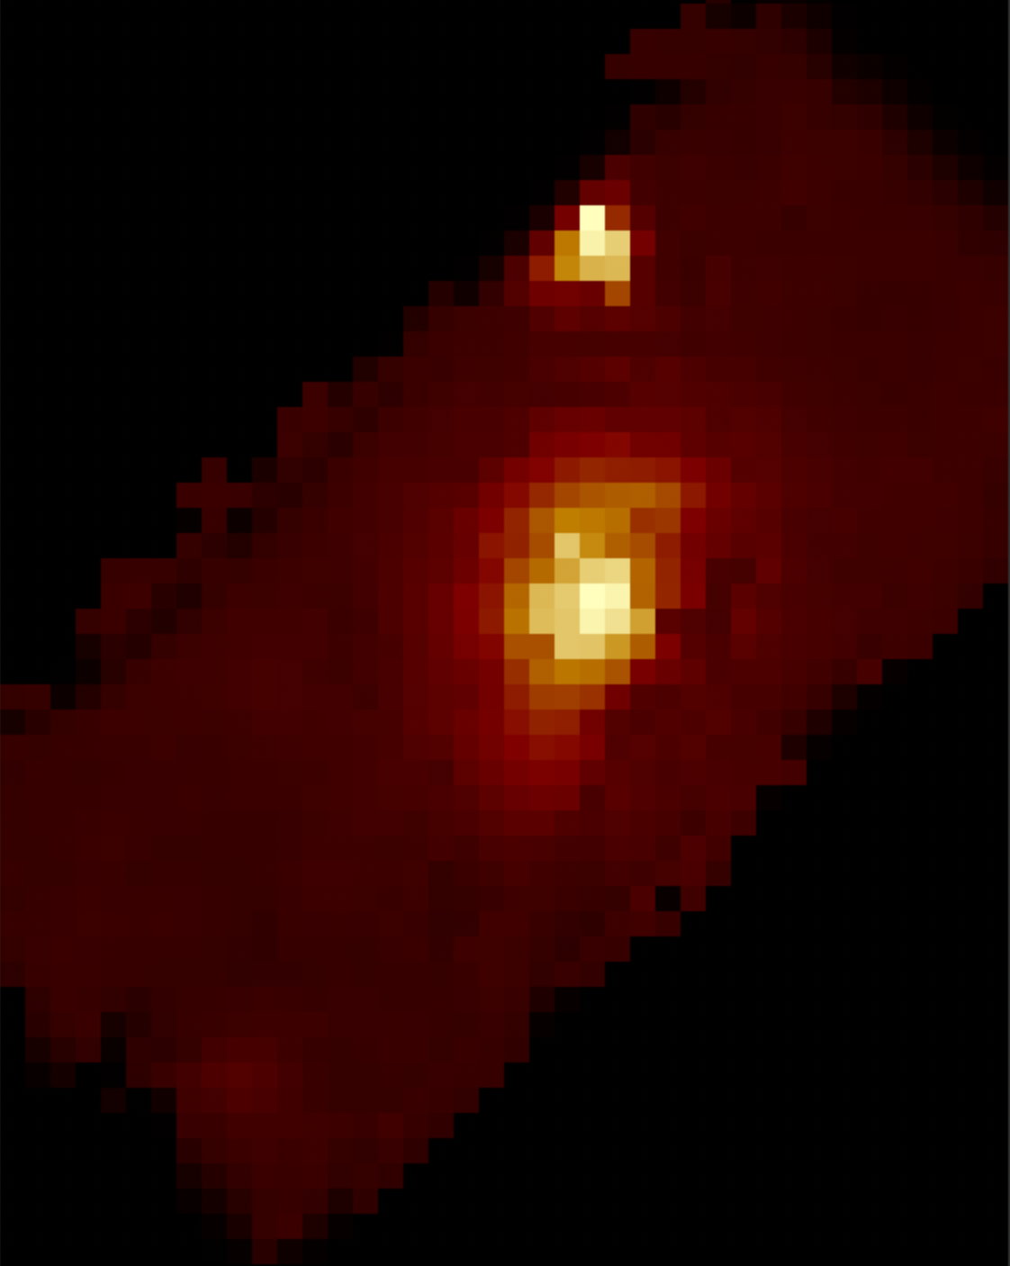


Preliminary maps
[OII]
H$β$
[OIII]
H$α$
[NII]
[SII]
Notes:
** map of 79098? **

Slide 18
Forward look
How, when and where do the myriad types of dwarfs form, and contribute to forming their L* host pairs?
Clearer definition of what is an LGA.
How typical is the Local Group?
Notes:
For more, see my talk at Small Galaxies, Cosmic Questions III…

Slide 19
Questions?

