Slide 1
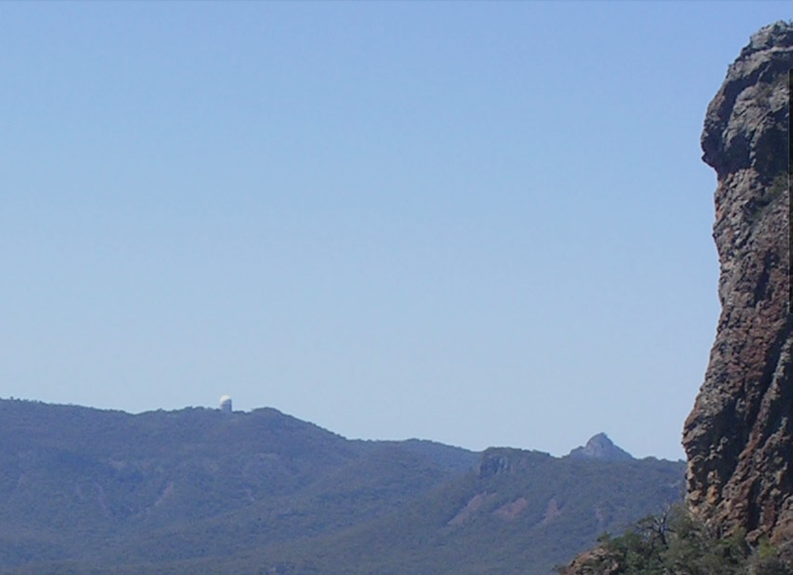
The Legacy of Mid-Infrared Astronomy at the AAT
Pat Roche, Oxford University
PDRA 1979-1981
SERC Fellow 1983-1985,
AATB 2002-2007

Slide 2
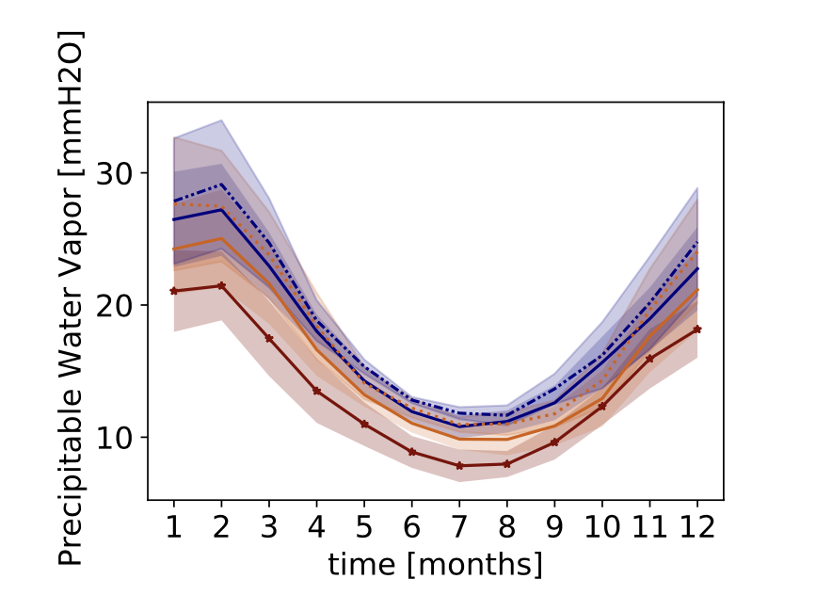
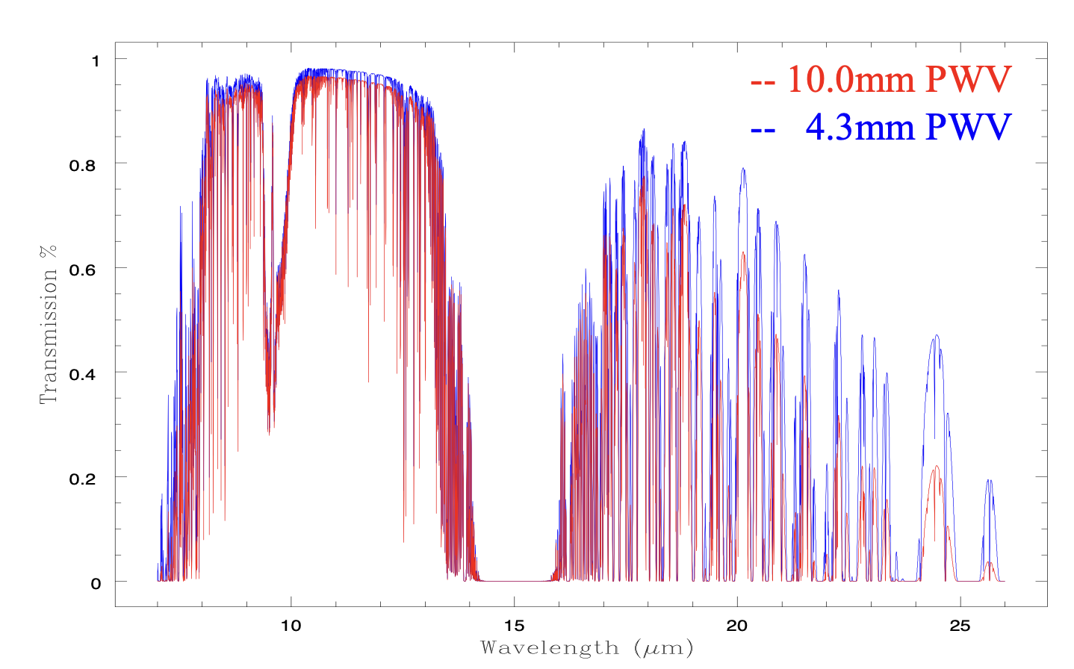
Mid-IR Astronomy in 1974
Was a new and relatively unexplored discipline ~10 years since first measurements with bolometers (e.g. F Low & H Johnson, 1964)
Instruments were built around Ge bolometers with single pixel detectors. Observations mostly made with 1.5m class telescopes e.g. Mt Lemmon & Tenerife with Photometers with broad or narrow band filters and some low-resolution spectroscopy with circular variable filters.
Challenging measurements because of high background from telescope and atmosphere, and variable atmospheric transmission. High dry and cold sites are preferred, as lower background and water vapour columns. IR transmission windows defined by atmospheric absorption by H₂O, CO₂, O₃ etc.
Observations confined to brightest objects, 2μm Sky Survey stars, AFGL sources and planets
Model from C. Haslebacher 2022
N band zenith atmospheric transmission for water columns of 10 and 4mm – which are probably at the lowest limit for Siding Spring

Slide 3
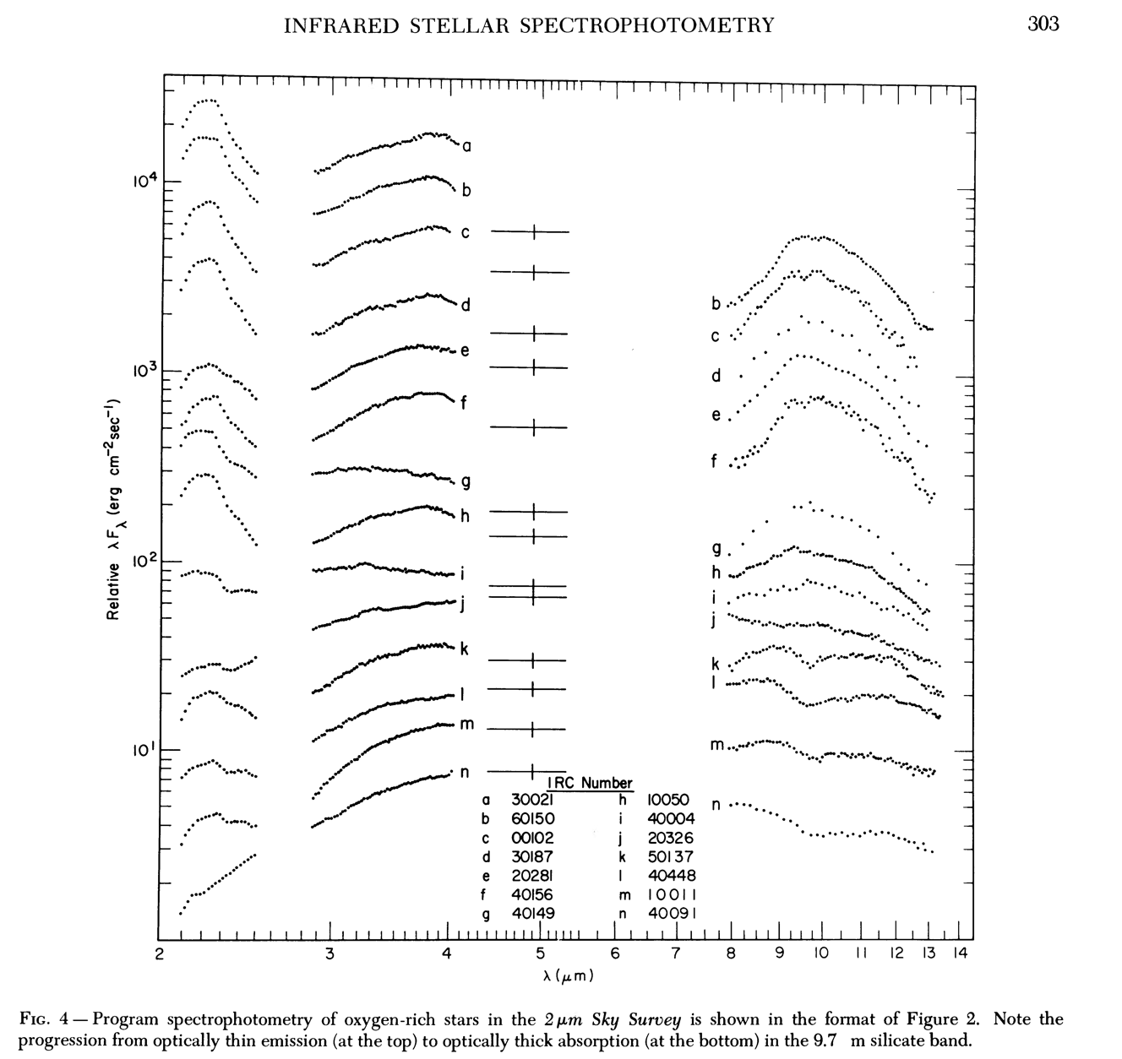
Spectrophotometry of bright 2μm Sky Survey stars obtained at Mt Lemmon.
Water bands are prominent in the near-IR and circumstellar dust with silicate emission in the mid-IR.
The silicate feature changes from emission to absorption as the optical depth increases.
Merrill & Stein 1976

Slide 4
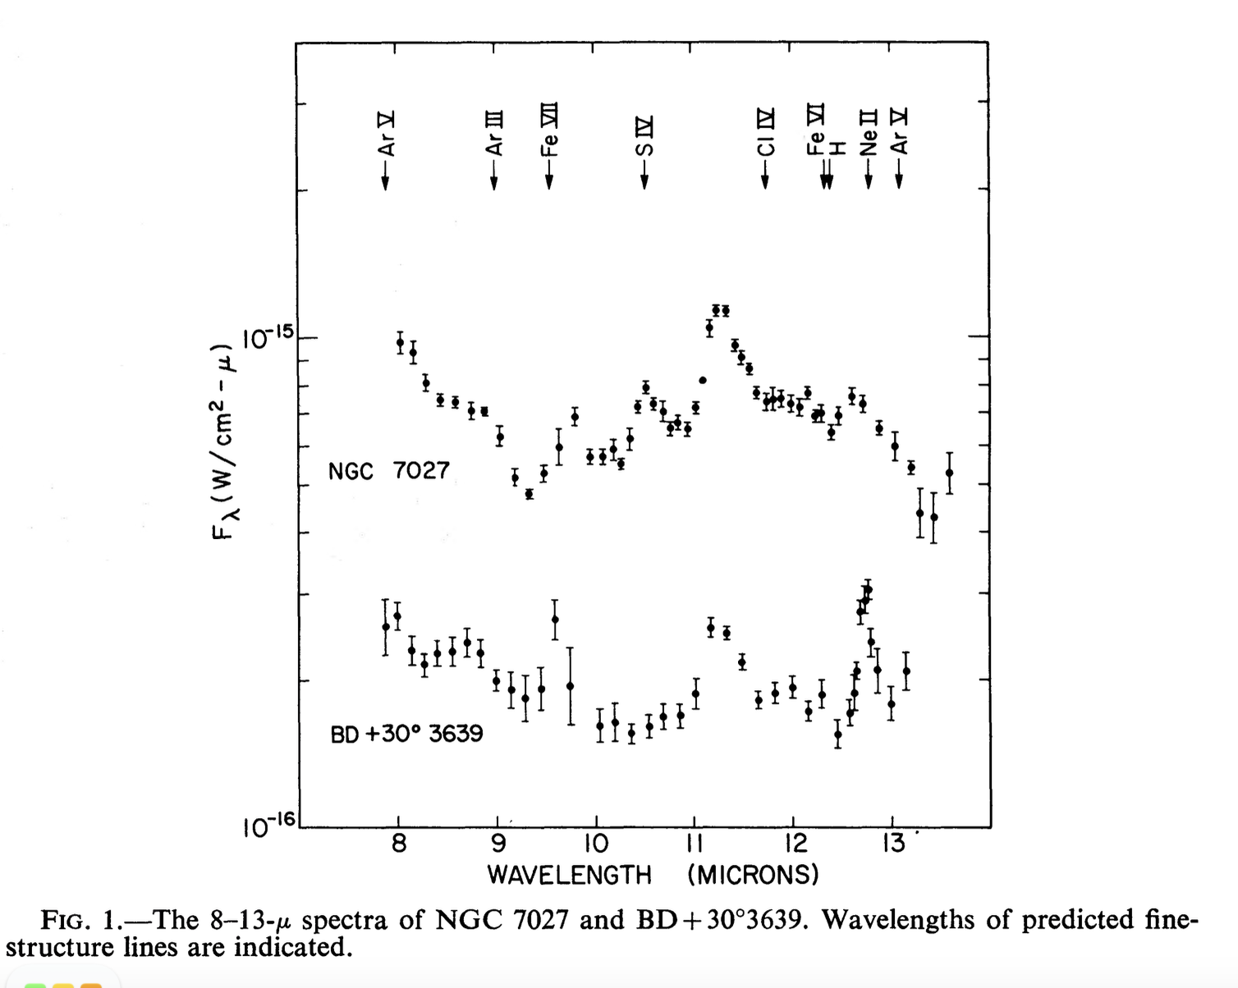
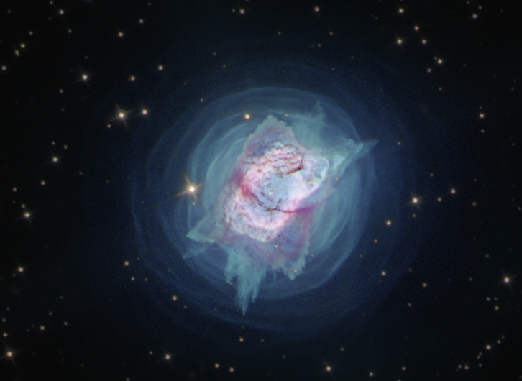
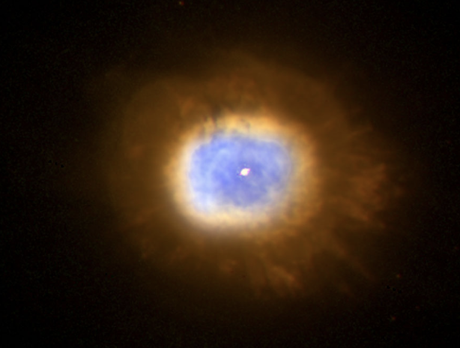
Mt Lemmon low-res spectrophotometry of bright bright planetary nebulae showing emission structure due to fine structure lines and dust. The 11.3μm band was initially proposed to arise from carbonates.
Gillett, Forest & Merrill 1973

Slide 5
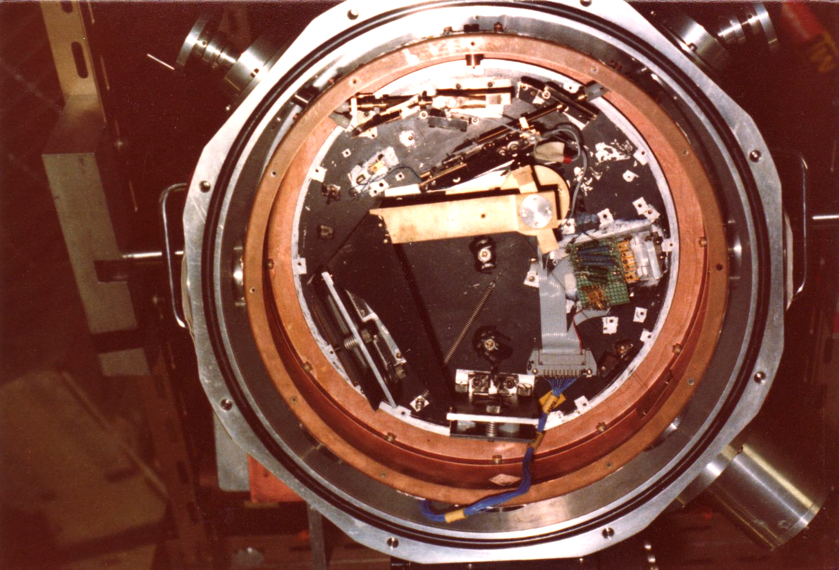
Thermal Infrared Observing
Very high and variable thermal background required differential measurements using sky chopping techniques – chopping secondary mirrors were developed in the US in the late 1960s and one was installed on the AAT in 1981.
The relatively warm temperatures and low altitude (1160m) of the AAT increases the thermal background relative to higher sites, but the large telescope diameter provided a smaller diffraction-limited image (0.6 arcsec at 10μm), which together with the excellent pointing and tracking, allowed small apertures to be used, rejecting more background and giving higher sensitivity and resolution.
The large dome and small aperture, shielded the telescope structure from sunlight, permitted extended daytime operations (4pm to 10am was the norm in the mid-infrared).
The telescope control system provided efficient, repeatable offset and nod operations, and the ability to make map scans with single aperture instruments.
First measurements by Harry Hyland, Dave Rank and Dave Aitken using bolometers.

Slide 6
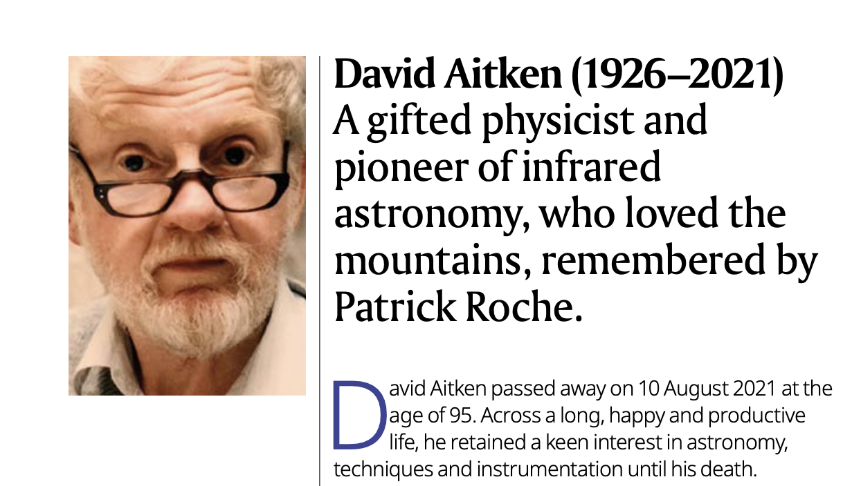
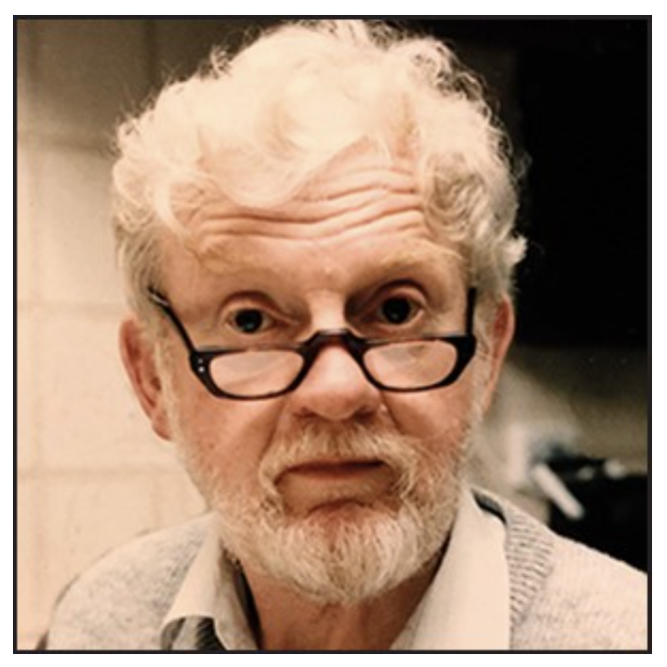
RAS A&G Feb 2022

Slide 7
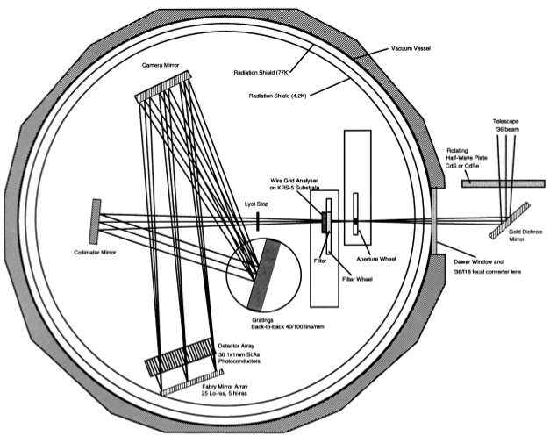
UCL Spectrometer
Liquid helium-cooled spectrometer with 10 and 20μm gratings, feeding an array of Rockwell Si:As detectors via Fabry mirrors.
Initially had 5 detectors, but upgraded to 30 in 1981 at the AAO with signal processing design by John Barton and support from Don Mayfield.
A low resolution mode that spanned the whole 8-13μm window was implemented in 1982, producing the most sensitive instrument of its kind.
It was used on the AAT from 1978 to 1994 and also on: UKIRT, IRTF, ANU 2.3-m, UH88”, Palomar…..
Over the following decade, spectra of HII regions, PN and emission line objects, Novae, Symbiotic stars, Wolf Rayet Stars and galaxy nuclei were measured.
A polarimetric mode was introduced in 1983.

Slide 8
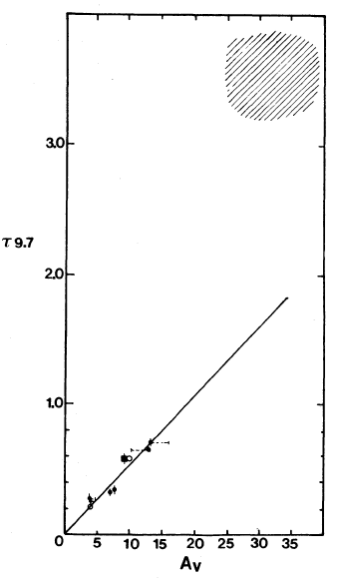
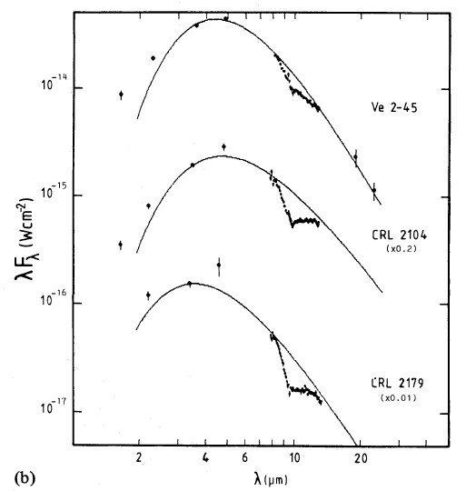
Extinction in the mid-infrared
Galactic Centre Objects
The depth of the silicate absorption was measured towards dusty late-type W-R stars which have carbon-rich circumstellar dust shells, and towards the Galactic Centre. This provided estimates of τ_{9.7μm} to A_{V} in the local neighbourhood and along the line of sight to the GC. A_{V} / τ_{9.7μm} ~ 15 in the former and ~8 towards the GC. The profile of the silicate band in the diffuse ISM is very similar to the dust around M supergiants.
WC and OB stars within 2 kpc
Roche & Aitken 1984, 85

Slide 9
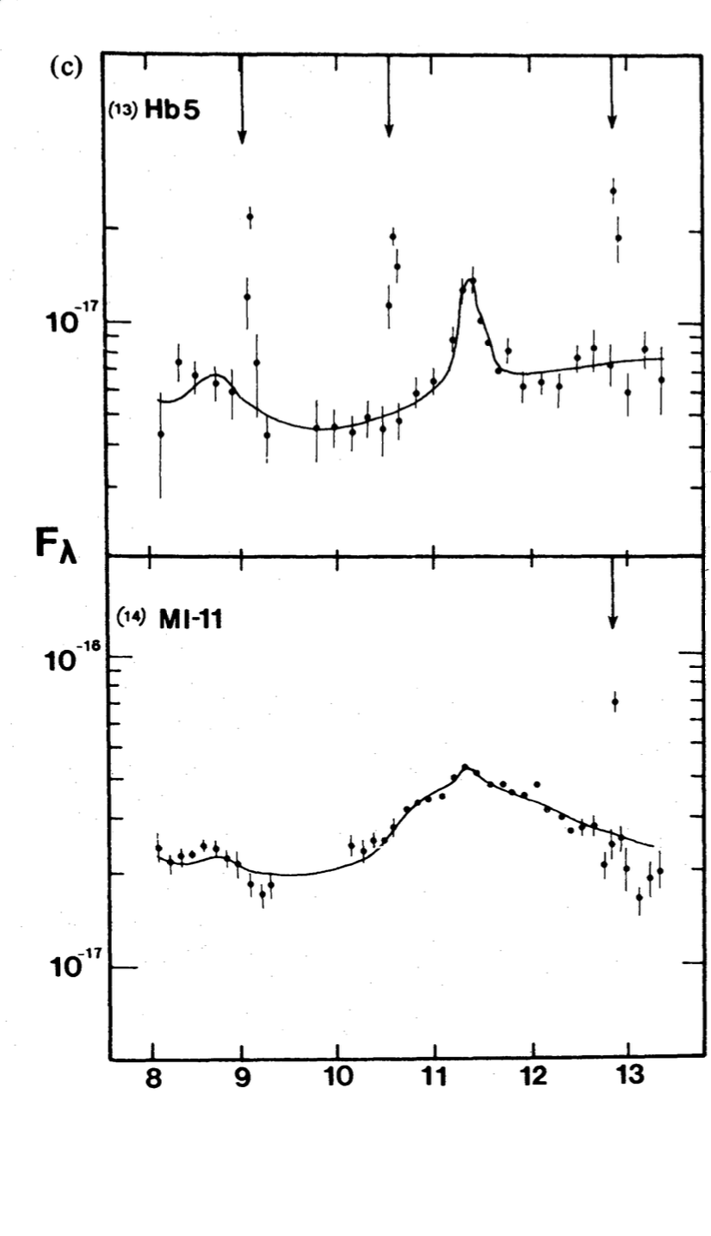
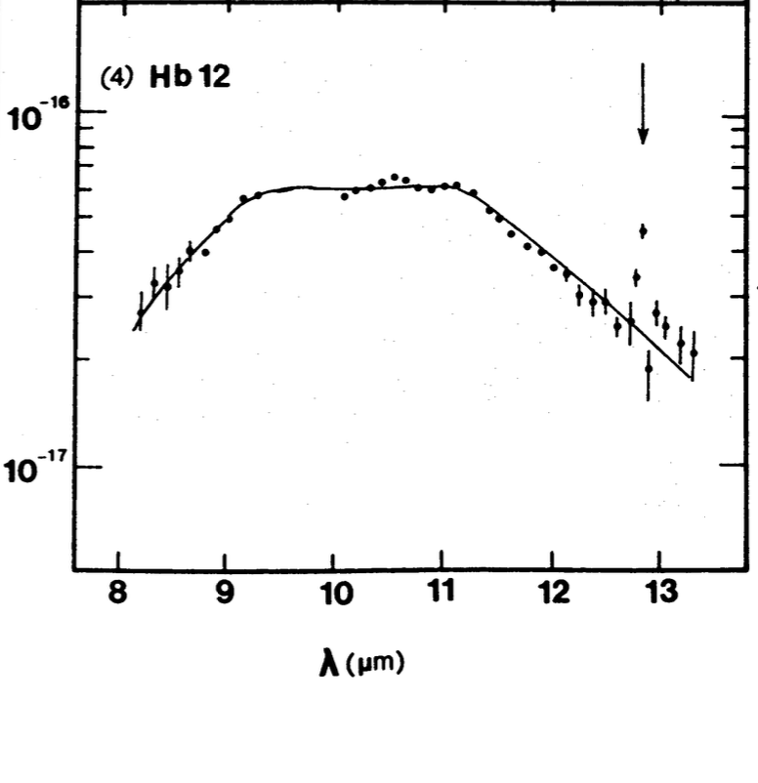
Planetary Nebulae
Observations between 1977 and 1990 showed the diversity of dust properties, with statistical analysis becoming possible as the sample of objects increased from ~5 to 50.
Silicate emission bands were not anticipated but were clearly detected in some compact and young PN.
The dust properties reflected the gas phase abundances derived from emission lines, with the 11μm silicon carbide emission band in objects with C/O close to or just greater than unity and the 11.3 μm and 8.6 μm narrow emission features more prominent in more C-rich objects.
Additional samples of PN towards the Galactic Centre suggested that the incidence of O-rich objects decreases outwards of the solar circle.
Aitken & Roche 1982

Slide 10
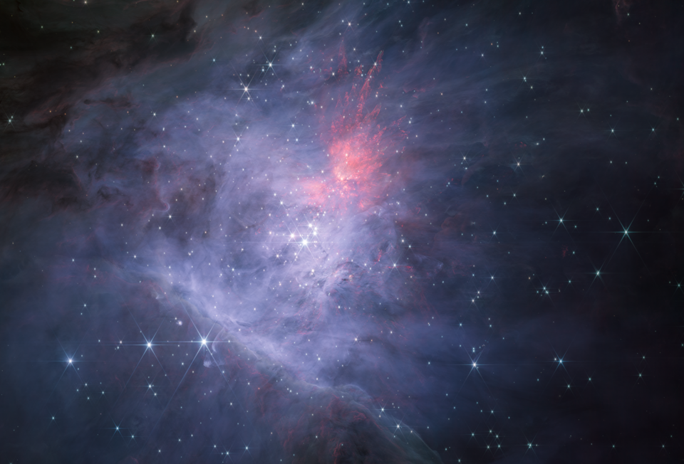
Orion JWST NIRCAM

Slide 11
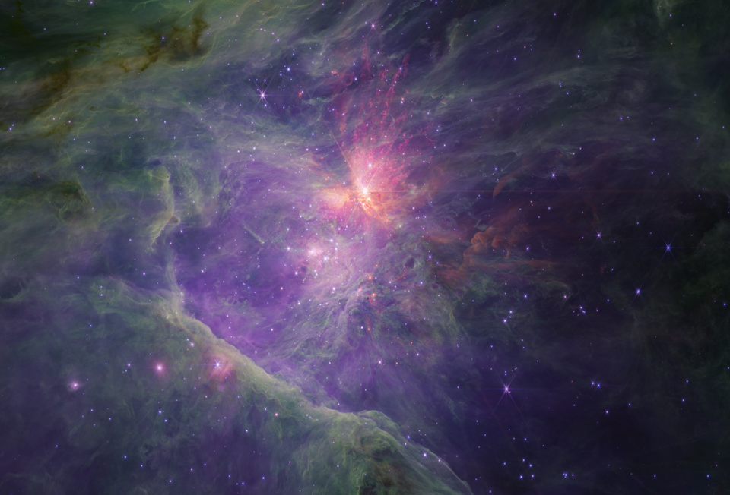
Orion JWST NIRCAM

Slide 12
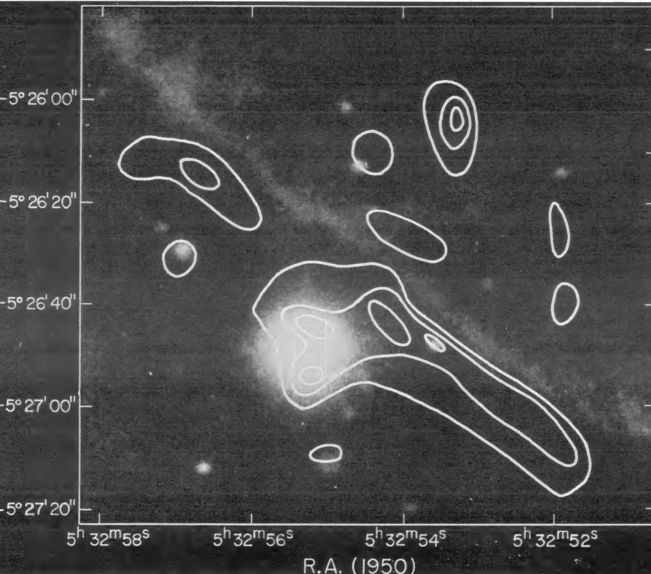
Orion NIRCAM+ Becklin 1976
Becklin et al 1976
Orion ionization front mapped at 10μm with the 5m Hale telescope. Dusty bar heated by the Trapezium stars

Slide 13
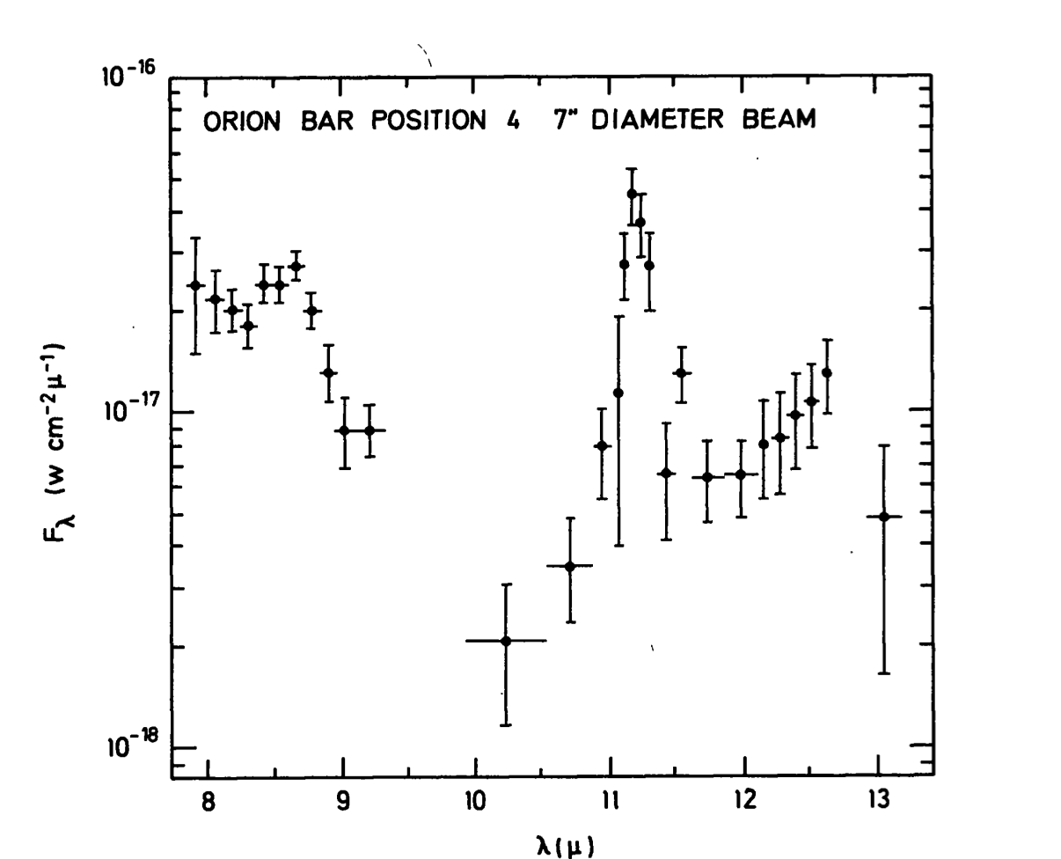
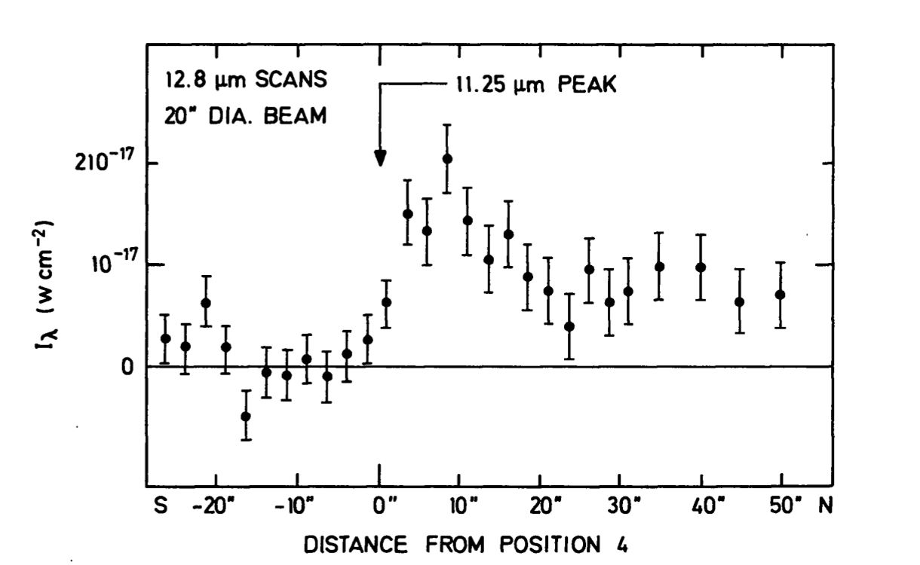
Spectroscopy from the AAT 1977
Spatial scan in the [Ne II] line across the Orion Bar
Dust emission dominated by narrow emission features at high contrast, peaking beyond the 12.8 μm [Ne II] line emission.
These observations, together with scans of NGC 7027 showed that the narrow emission bands peak outside the ionized region, suggesting that the carriers do not survive there.
Aitken, Roche, Spenser & Jones 1979

Slide 14
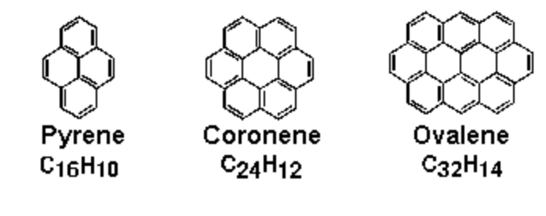
PAH Emission Bands
AAT observations provided important clues to the origin of the emission bands at 3.3, 5.2, 6.2, 7.7, 8.7, 11.3μm. They are not yet definitively identified but are generally attributed to polycyclic aromatic hydrocarbon molecules (Leger & Puget; Allamandola, Tielens and Barker 1985)
Small carbon-rich grains excited by single photons, which do not survive in ionized regions.
Emission bands coincident with hydrocarbon bending and stretching transitions
Now key diagnostics for many objects.

Slide 15
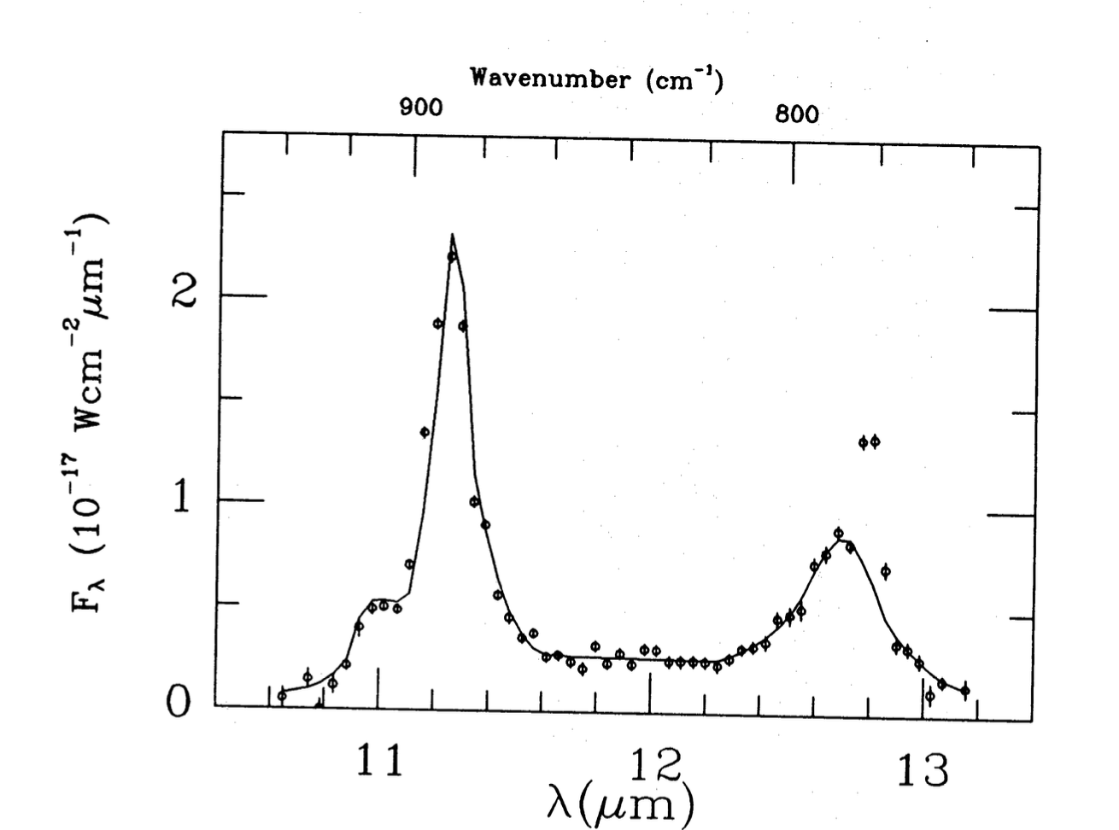
The shape of the emission bands
Observations of the Orion Bar with the upgraded detector array revealed more structure in the emission features and allowed the secure identification of a band at 12.7μm and a secondary peak at 11.05μm for the first time.
These structures give important clues to the emitting species. In PAHs, the precise wavelength of out-of-plane C-H transitions depends on the molecular structure, with solo C-H bonds contributing near 11.3μm and three adjacent C-H bonds near 12.7μm.
Orion Bar
Position 4
Roche, Aitken & Smith 1989

Slide 16
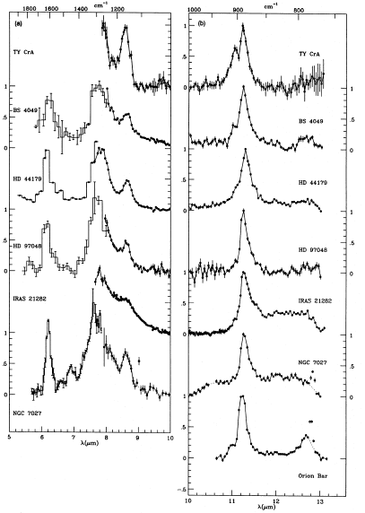
PAH emission features
AAT spectra were critical in establishing the properties of the UIR emission bands, their basic similarities and in elucidating the differences from object to object.
The correlation with C/O ratio in PN showed they were carbon-rich, while spatially resolved spectra showed that they peak strongly at the edge of ionized regions.
The red wing on the main 11.3μm feature may indicate anharmonicity while substructure may be due to a mix of PAHs
Now measured at high resolution and sensitivity by JWST and Spitzer
Roche, Aitken & Smith 1991

Slide 17
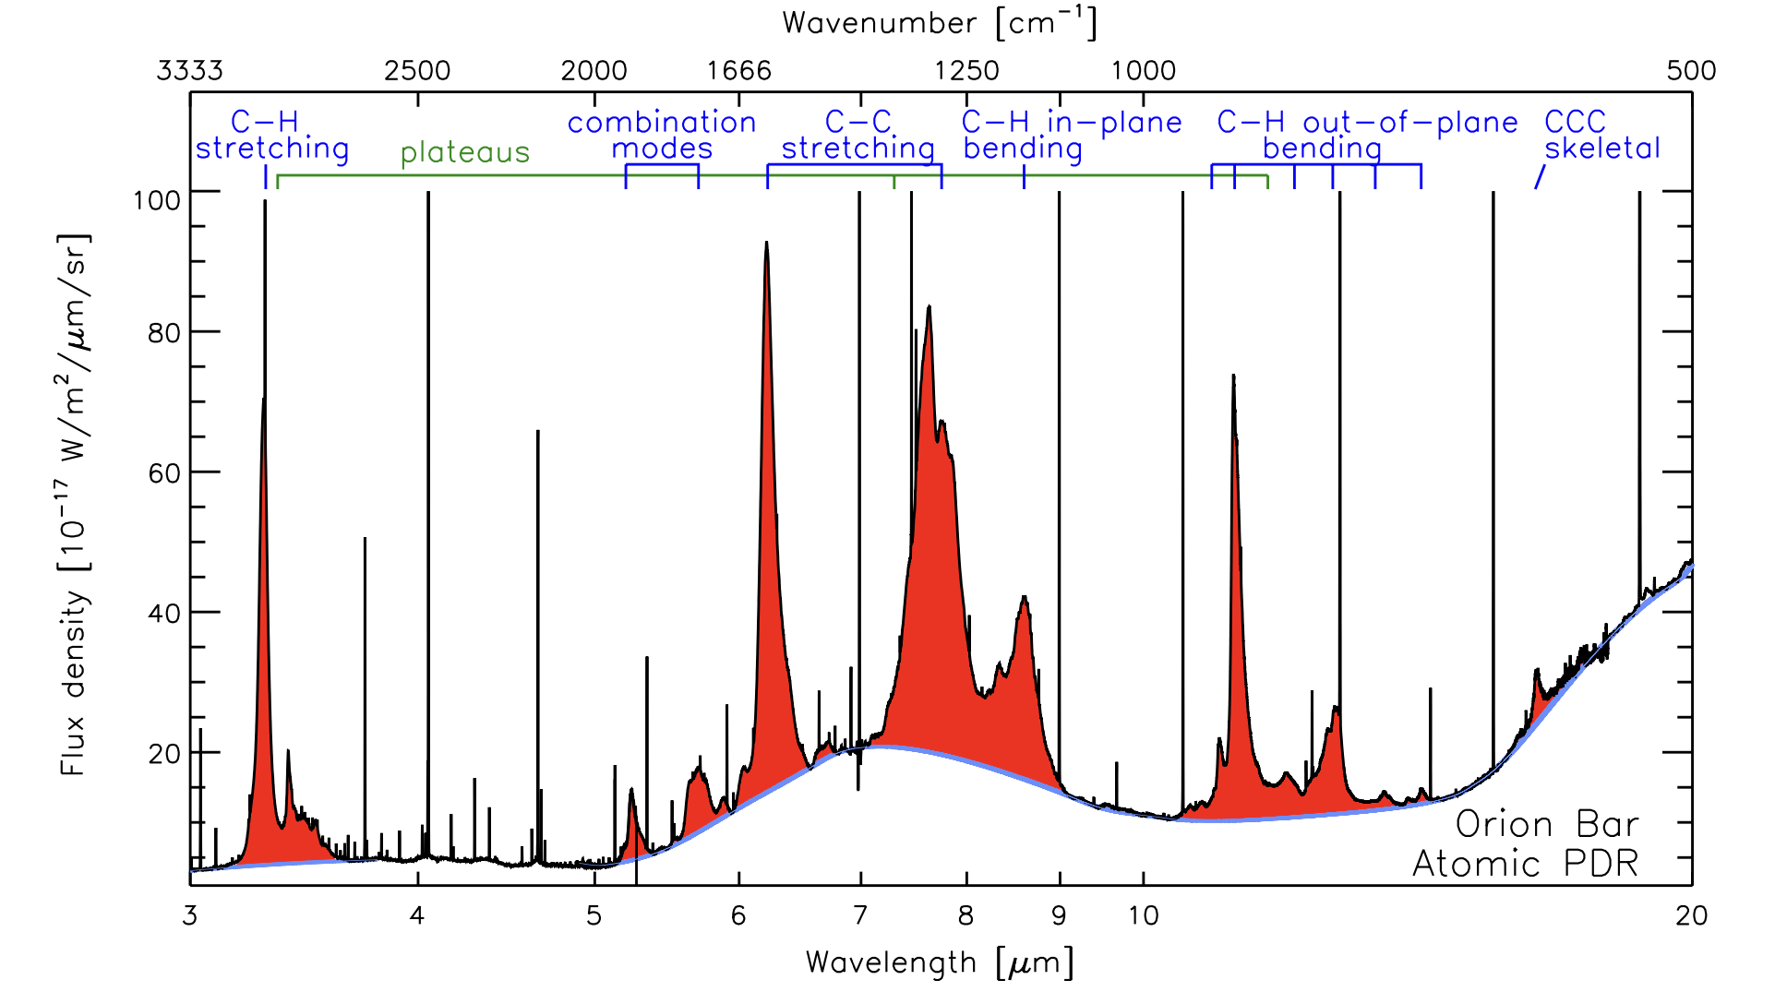
PAHs and JWST
JWST Orion Bar Spectrum. Red shaded regions show the emission bands on top of a blue continuum (Chown et al 2024; PDRS4ALL). Detailed profiles reveal substructures and spatial variations in several bands. The high spectral resolution reduces contamination by atomic lines.

Slide 18
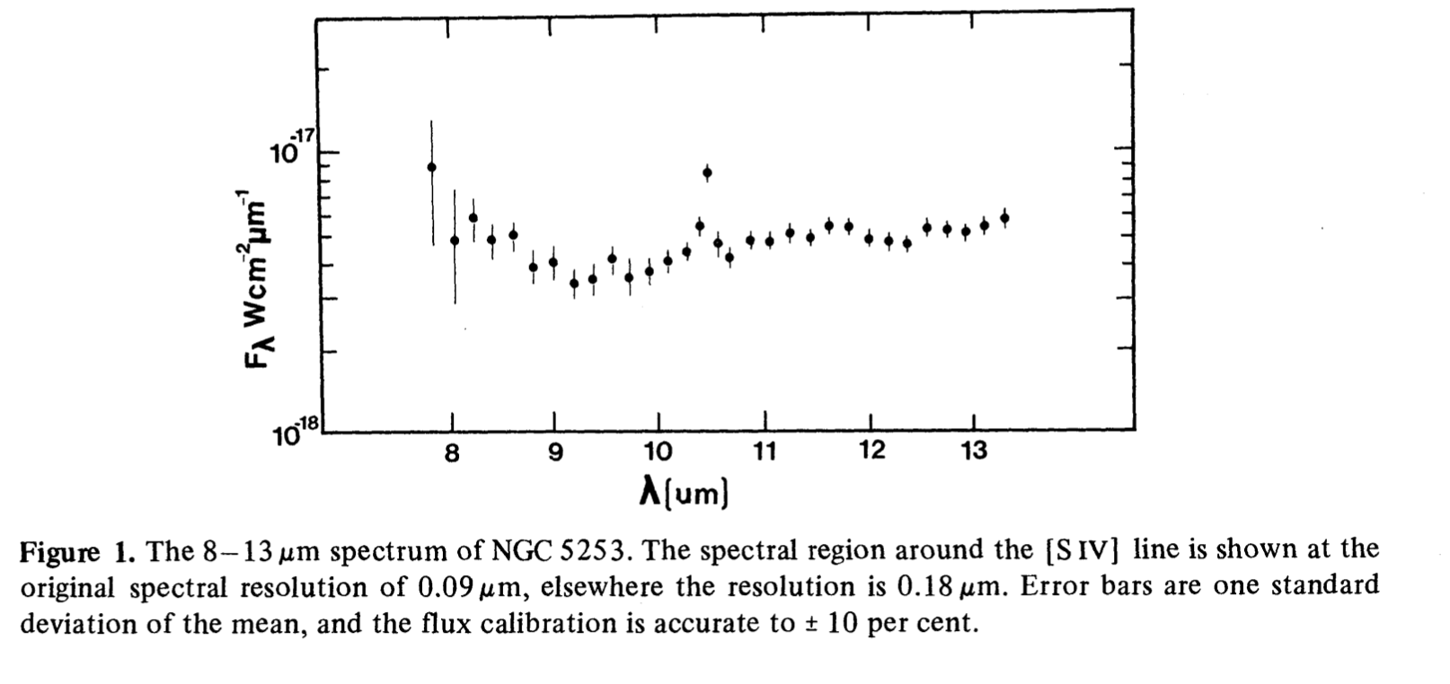
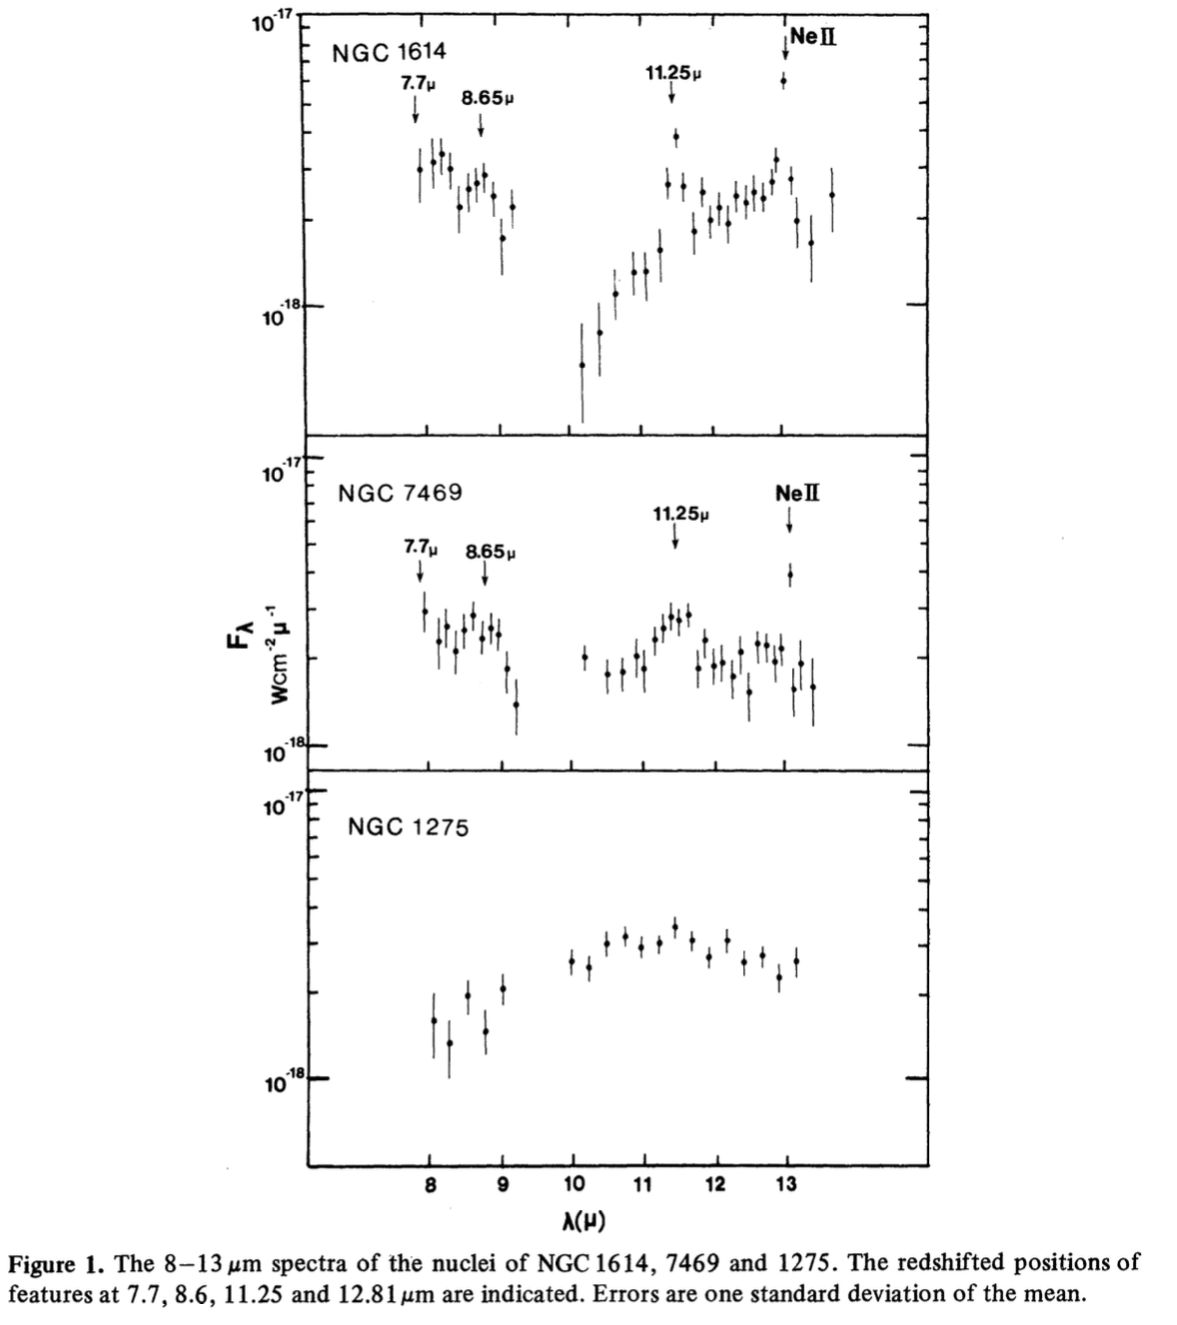
Galaxy Nuclei
Prior to 1980, 4 galaxies had been measured spectroscopically in the mid-IR. This was doubled by 1982 and increased to 60 by 1990, with the UCLS on the AAT, UKIRT, IRTF, Results were presented in a series of papers summarized in Roche et al 1991.
Silicate absorption is common in Seyfert 2 nuclei, confirming significant obscuration, but strong silicate emission is rare, though detected in a few objects including NGC 1275.
The diversity of mid-IR spectra was established with most HII region galaxies dominated by the narrow (PAH) emission bands, which are rare in AGN. It was proposed that the PAH molecules are destroyed by hard AGN photons
Aitken, Roche, & Allen1982
Aitken, Roche & Phillips 1981

Slide 19
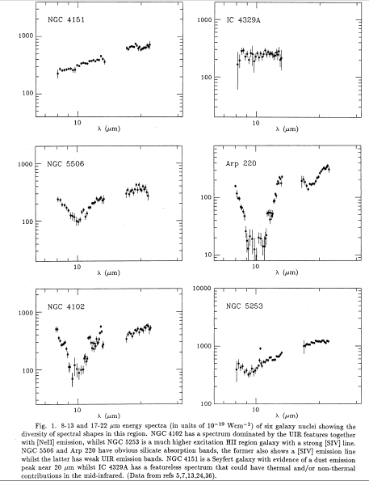
Galaxy Spectra
Most HII region galaxy spectra are dominated by the UIR emission bands, modulated by different silicate extinction depths, but they are weak in low metallicity / high excitation nuclei
The UIR bands are weak in AGN : Seyfert 2s have deeper silicate absorption than Seyfert 1s.
Silicate emission is weak
It was proposed that the carriers of the UIR emission bands are destroyed by hard AGN photons. This remains a hot topic.
The mid-IR spectrum is an excellent discriminator of the dominant nuclear energy source
Roche, Aitken, Smith, Ward 1991

Slide 20
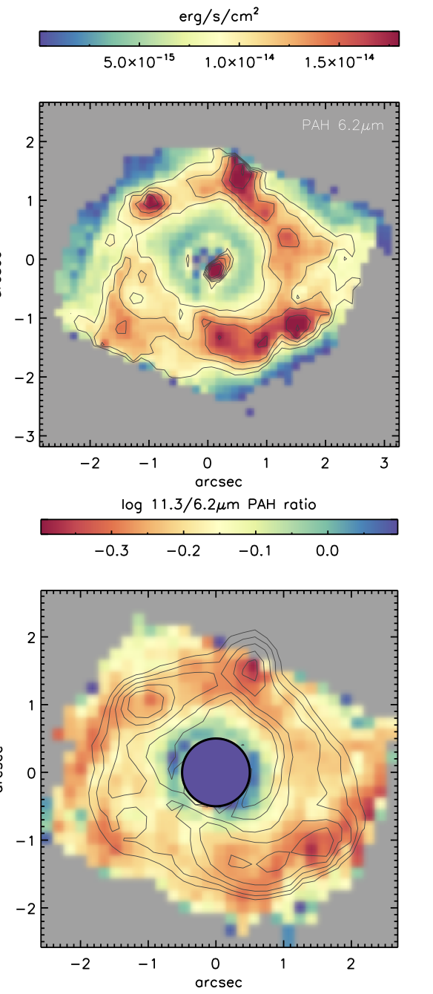
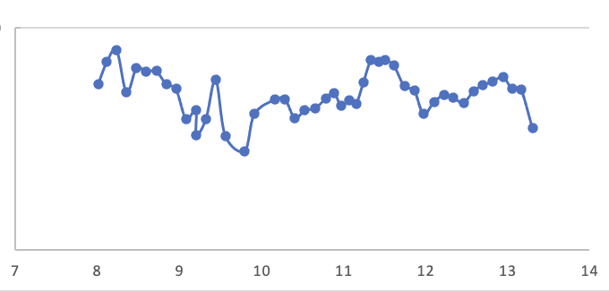
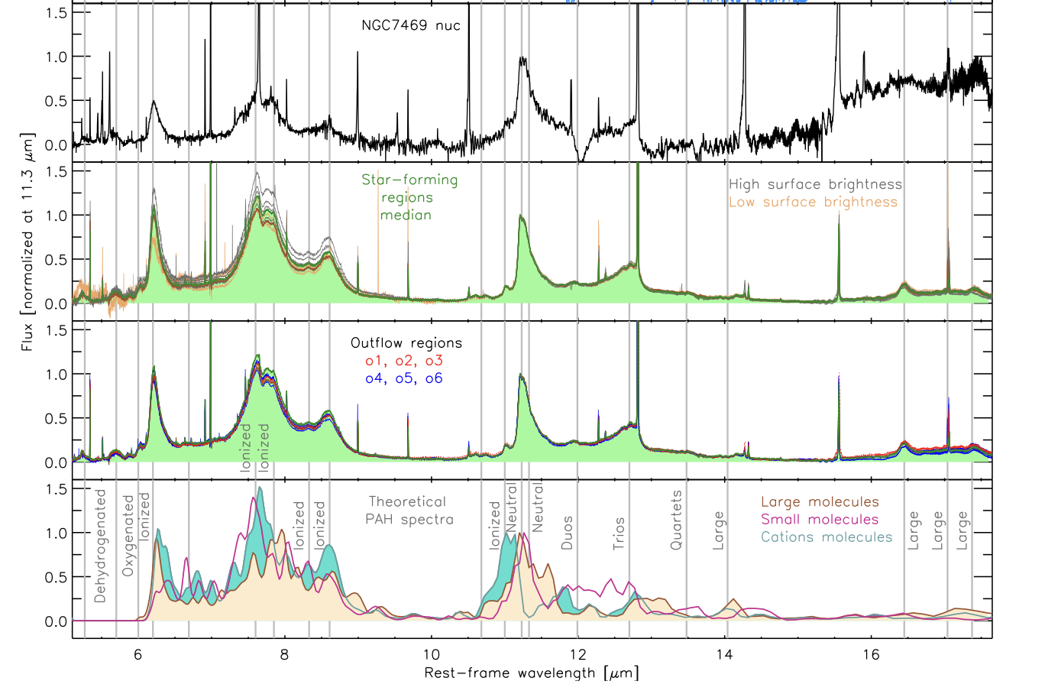
Top: AAT spectrum of nucleus of NGC 7469 in a 4.5 arcsec aperture (1980).
Right: JWST MRS IFU images of the intensity in the 6.2 μm PAH emission feature and the 11.3/6.2 ratio.
Bottom Left : Spectra of the nucleus, and positions in the circumnuclear ring. (Garcia-Bernete et al 2022).

Slide 21
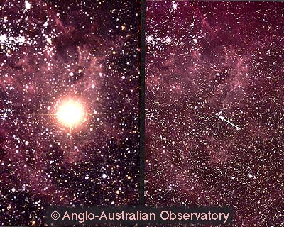
Supernova 1987A
Exploded in the Large Magellanic Cloud in February 1987
It was monitored at 10μm for 2.5 years with 9 observing runs at the AAT and 3 at the ANU 2.3-m, until the emission was no longer detectable.
We measured the emergence of emission lines of Cobalt and Nickel, emission from SiO molecules
and the onset of dust formation.

Slide 22
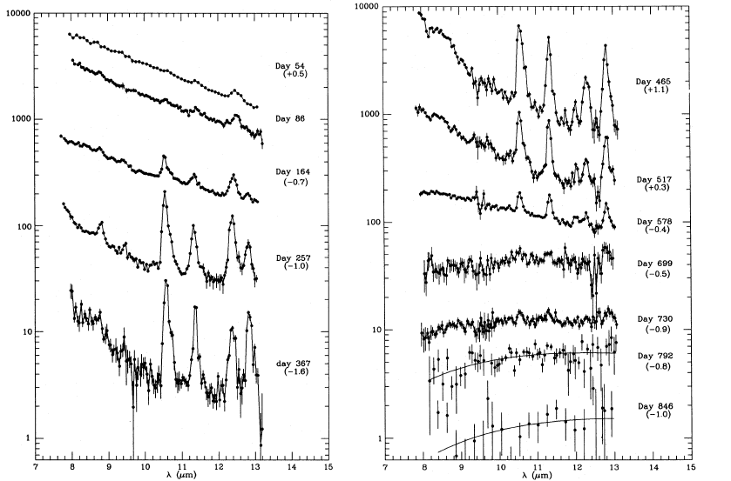
Hydrogen
SiO
Cobalt
Neon
Spectra of SN1987A showing the development of emission lines of hydrogen, neon, nickel, chlorine, the change in ionization as the ejecta expand and cool, and the radioactive decay of Cobalt as well as the formation of silicon monoxide and dust
Roche et al 1993
Roche, Aitken & Smith 1993

Slide 23
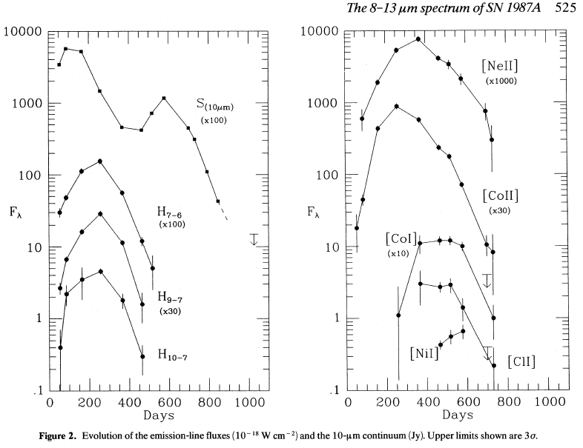

Slide 24
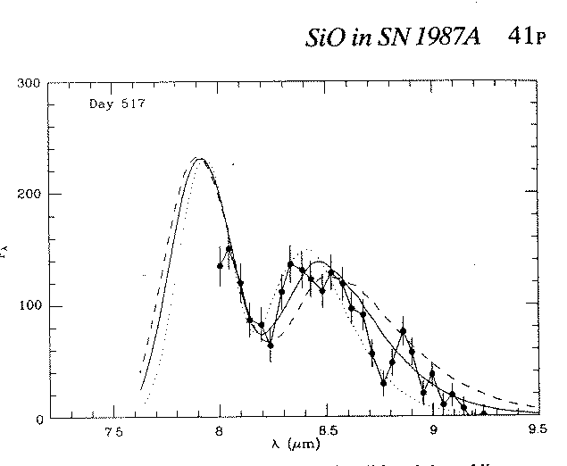
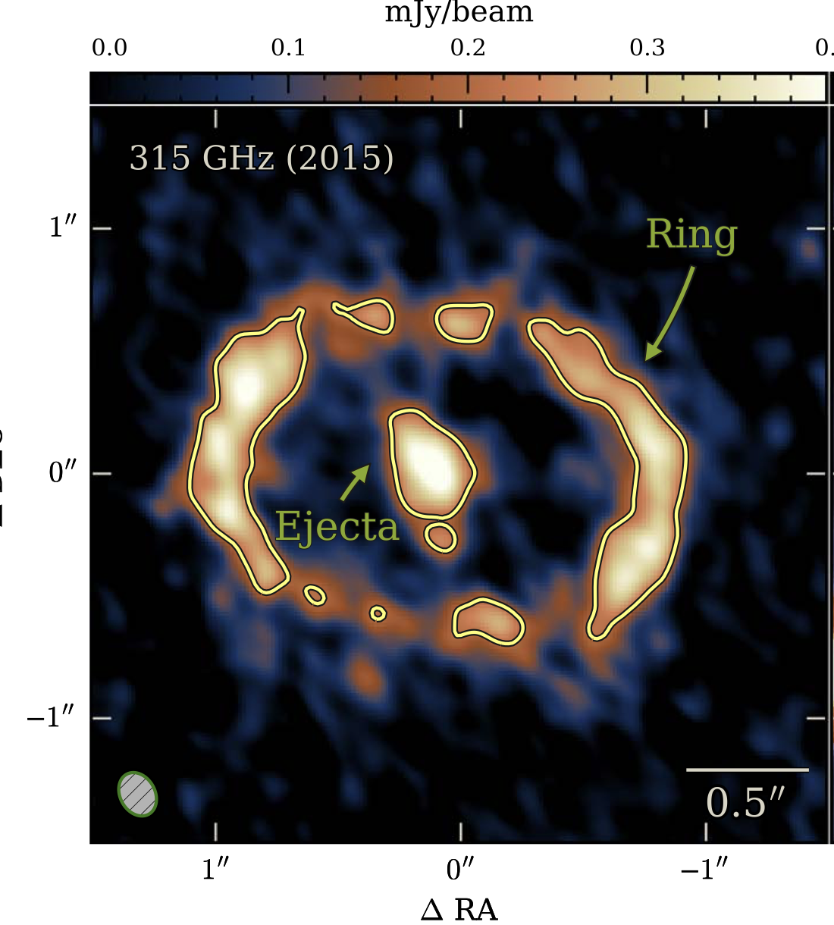
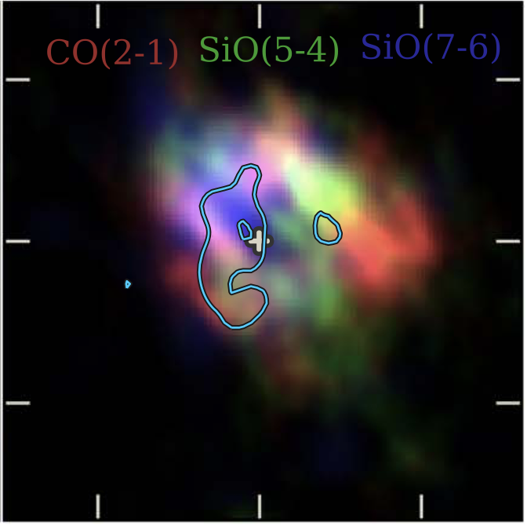
Evolution of SN1987A
Roche, Aitken & Smith 1991
The data obtained show directly the decay of radioactive Cobalt and confirm that 0.07M_{O} of Ni were formed in the explosion.
Detection of SiO may have been a precursor of dust formation, with ~10⁻⁵ M_{o} formed in the first 2 years. Emission from dust started around day 400 and at the peak of dust emission on day 578, the dust mass was ~10⁻⁴ M_{o} at T~500K
The spectra have provided templates for more distant Supernovae detected by Spitzer and JWST.
ALMA has measured the rotational lines of SiO and CO finding that they peak in different regions of the ejecta. About 0.4 M_{o} of dust had condensed in the ejecta by 2013, T_{dust}~20K and is too cool to emit in the mid-IR
The AAT spectra provide important baselines for understanding the formation and evolution of molecules and dust in supernovae.
The day 517 spectrum overlaid by model 8.1μm Δν=1 SiO fundamental vibrational-rotational band emission.
Cigan et al 2019

Slide 25
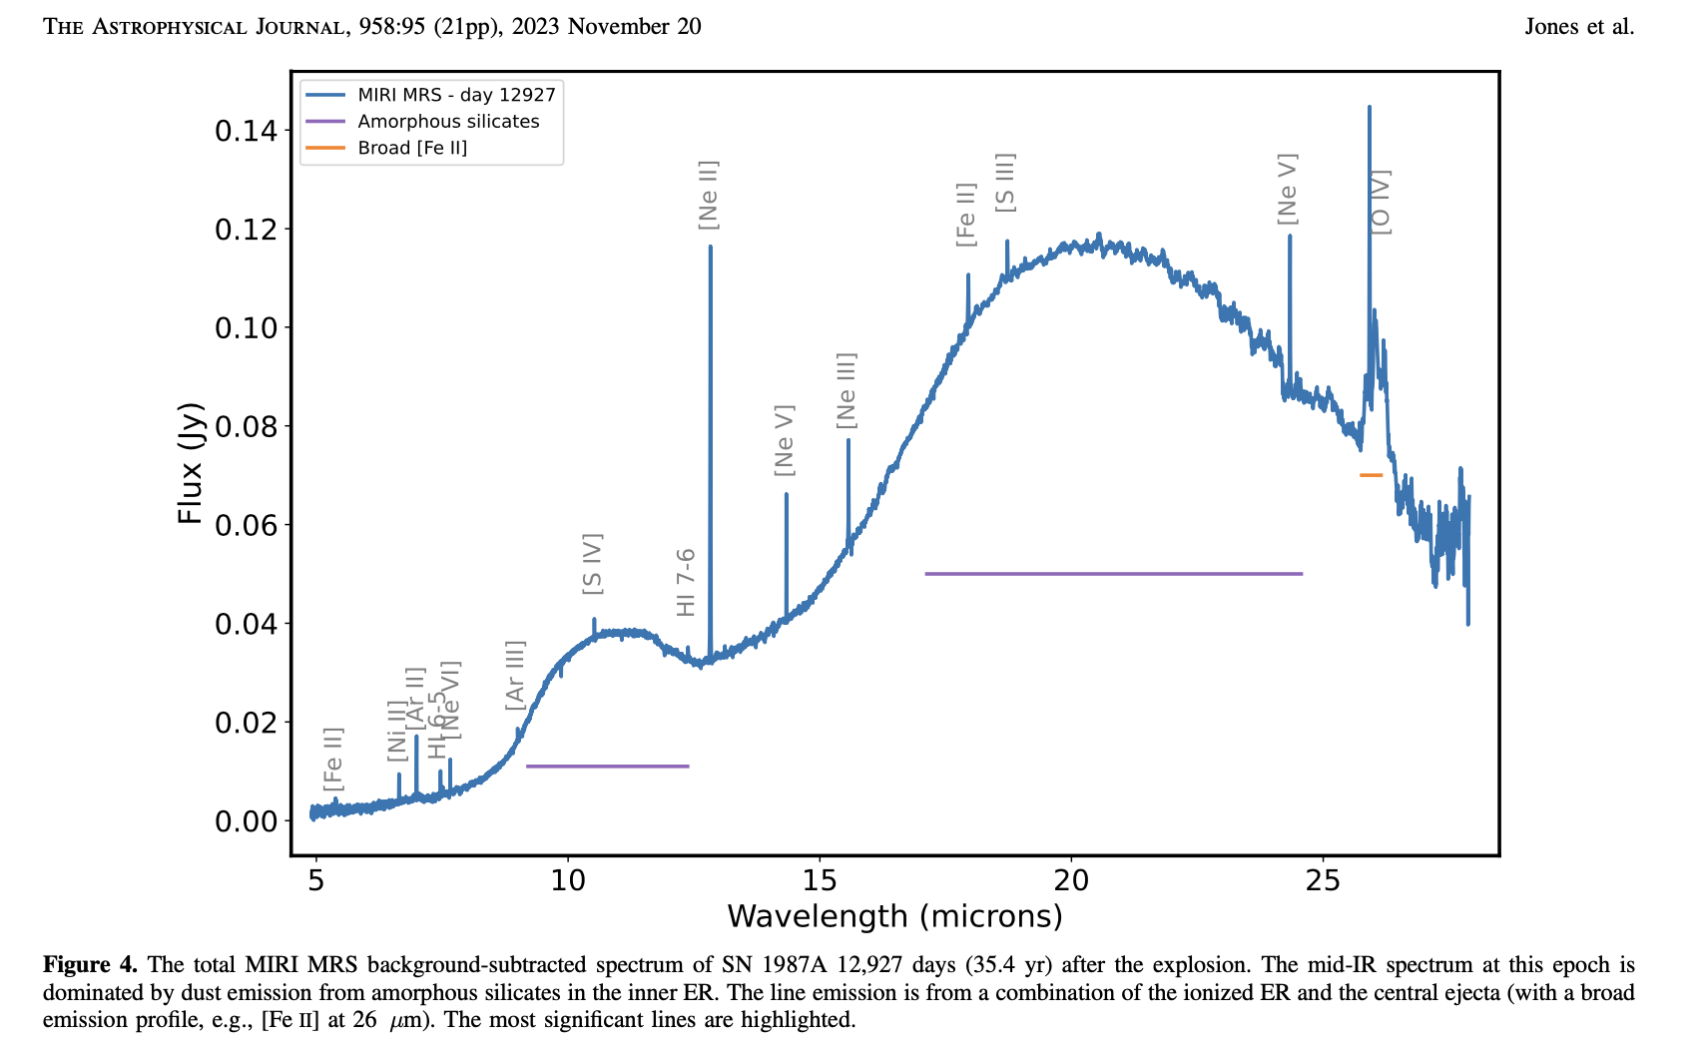
Jones et al 2023
JWST spectra show silicate emission arising from the equatorial ring along with a number of high and low-excitation emission lines. Warm dust emission was not detected in the central ejecta, and the dust emitting here was probably formed in a pre-supernova evolutionary phase. It is ~1000x fainter than the ejecta emission at day 578.

Slide 26
Mid-IR polarimetry
Spectropolarimetry with UCLS using a wire grid analyser and CdS and CdSe waveplates rotated above the dichroic.
Polarization spectra :
Show silicate grains are non-spherical and aligned
Suggest toroidal fields in YSOs.
Can differentiate between polarization through absorption or emission which have very different signatures
Once the polarization mechanism is known, the magnetic field directions in the plane of the sky can be inferred
Bright, compact objects including YSOs, HII regions and stars were observed, summarized by Smith et al 2000. A total of 55 objects are presented.
Apart from early work by Capps & Dyck, and a couple of measurements with Timmi2 or Canaricam, this still accounts for the great majority of mid-IR polarimetry available to date. The observations place important constraints on grain properties.

Slide 27
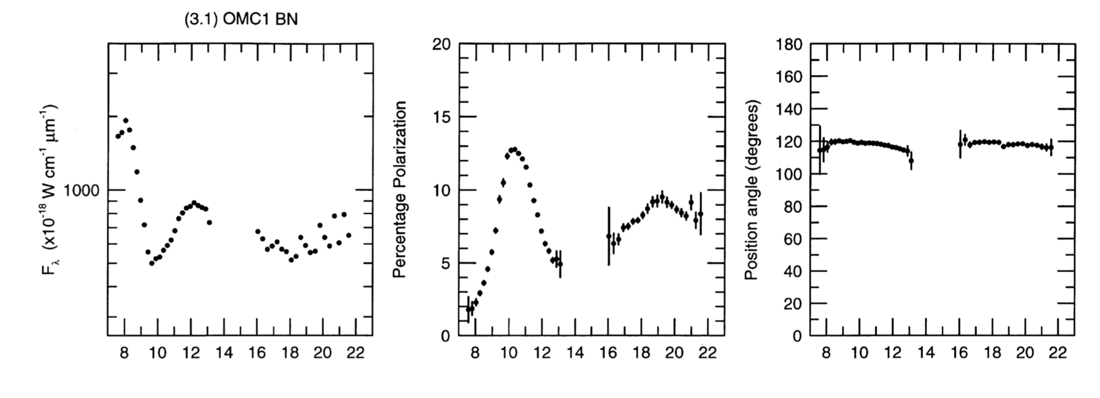
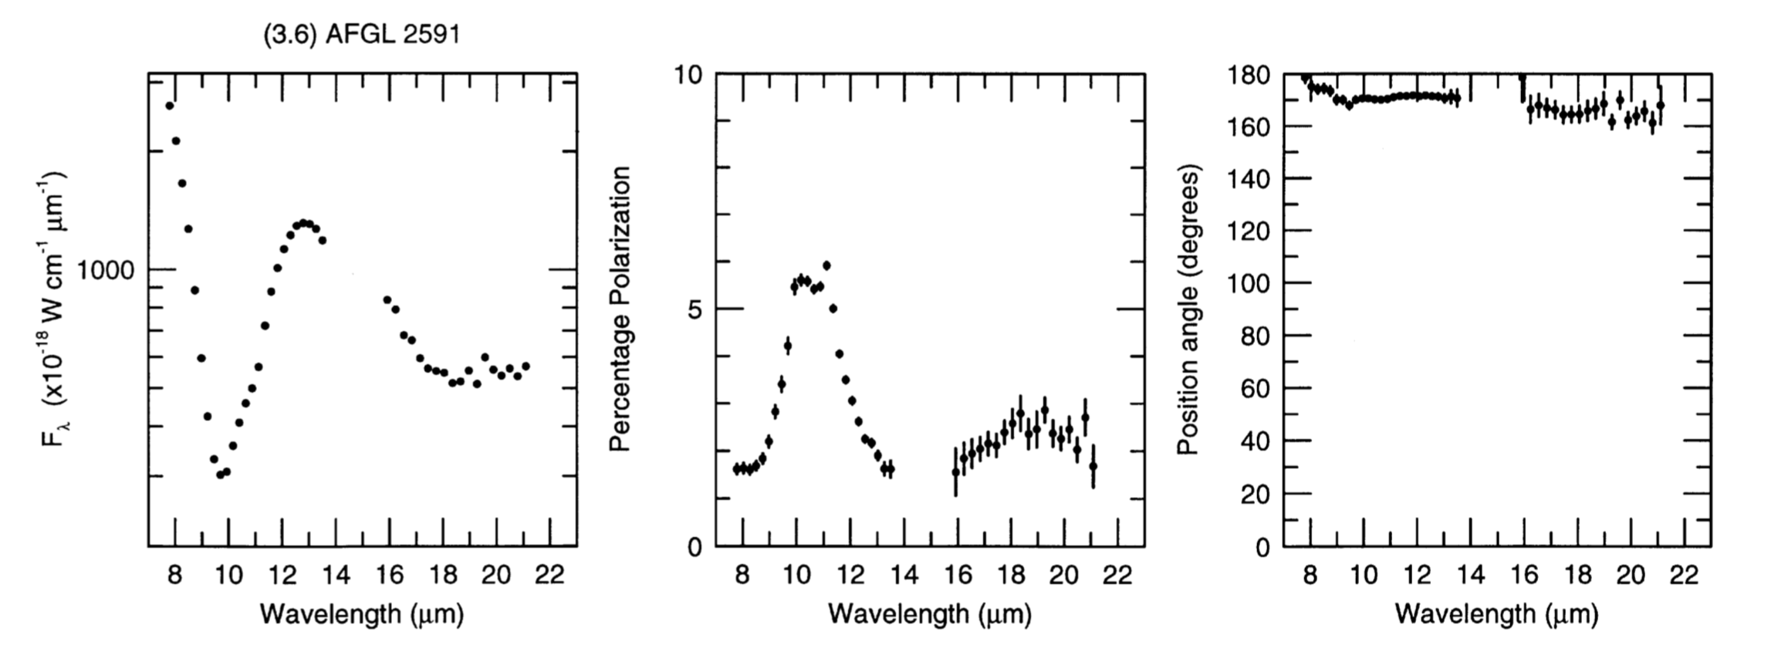

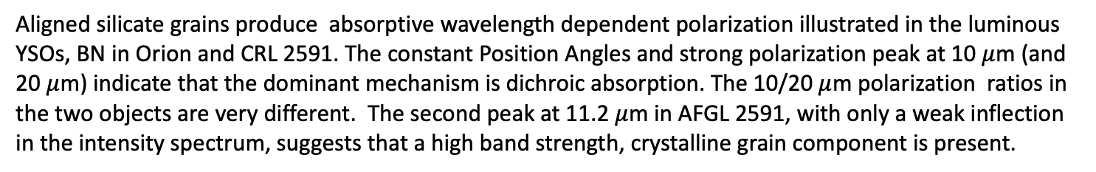
8-22$μ$m Absorptive Polarization
C Smith et al 2000
BN OMC1
AFGL 2591
Aligned silicate grains produce absorptive wavelength dependent polarization illustrated in the luminous YSOs, BN in Orion and CRL 2591. The constant Position Angles and strong polarization peak at 10 $μ$m (and 20 $μ$m) indicate that the dominant mechanism is dichroic absorption. The 10/20 $μ$m polarization ratios in the two objects are very different. The second peak at 11.2 $μ$m in AFGL 2591, with only a weak inflection in the intensity spectrum, suggests that a high band strength, crystalline grain component is present.

Slide 28
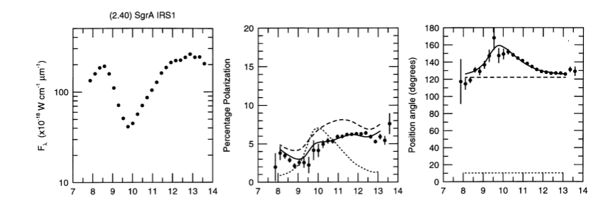
Galactic Centre SgrA IRS1
Unlike BN and CRL2591, the PA towards SgrA IRS1 is wavelength dependent. Spectropolarimetry across the silicate feature can separate a warm emissive component at θ= 120º (dashed line) overlaid by absorption by cold silicate grains at θ~ 10º (dotted line). Note that at 12μm, the emissive polarization is large and the IS absorptive component is low. [Aitken et al 1986]

Slide 29
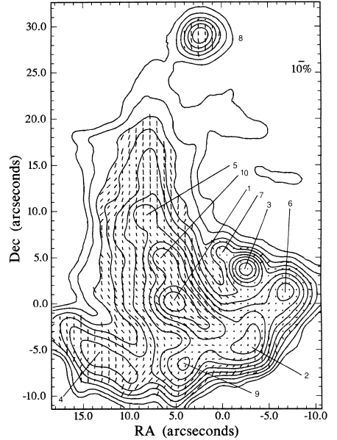
Imaging Polarimetry
Initial measurements were made by pointing at IR sources in the GC with UCLS, interpreted as intrinsic emissive polarization in the filaments overlaid by interstellar absorptive polarization. The first true imaging measurements were with the Goddard camera at UKIRT (1989), but were superseded by NIMPOL (1995),
The polarization vectors trace ordered magnetic fields in the Northern Arm leading to high degrees of polarization (<10%) with some distortions near the bright peaks. The alignment may be saturated, in which case the polarization levels indicate the orientation of the field to the plan of the sky.
Canaricam on GTC followed this up at higher spatial resolution.
Aitken, Smith, Moore, Roche 1998

Slide 30
Canaricam 12μm polarization vectors superimposed on a 1.3cm VLA image from Zhao 2009
Unlike the Northern Arm, the bright regions in the E-W bar have different polarization directions from the diffuse emission which lies along the bar and so are not embedded in it
Apparent helical structure west of IRS5 has some correspondence with polarization. Null points occur where filaments overlap.
Roche et al 2018

Slide 31
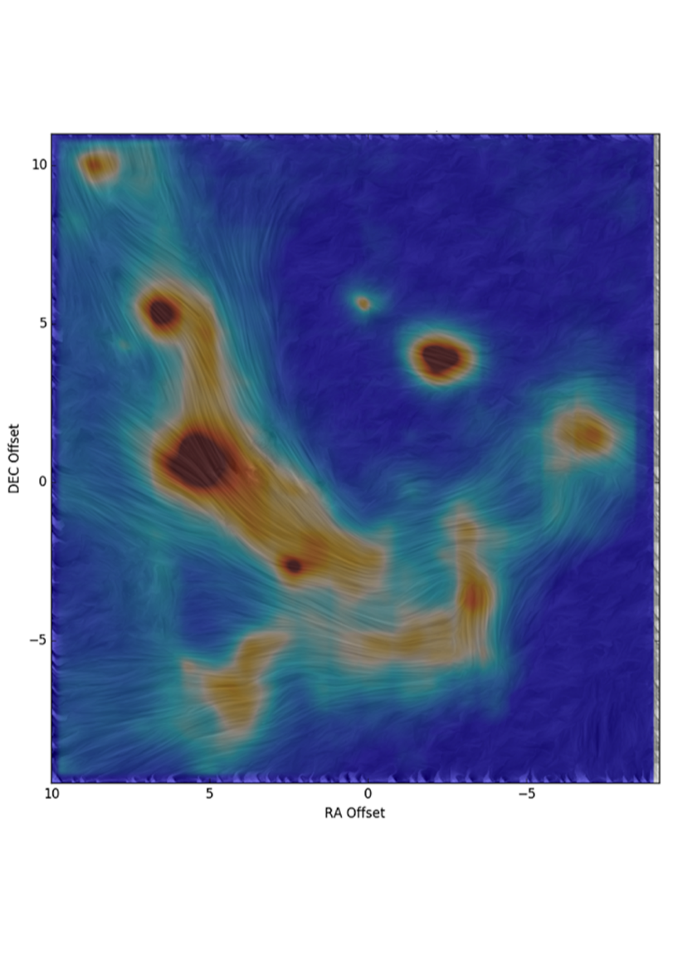
The B field in the central Parsec
The mid-IR polarization is a property of the diffuse emission rather than the compact, bright sources and suggests a B field strength ~2mGauss.
The compact objects do not perturb the inferred magnetic field directions or dilute the degree of polarization, suggesting that the stars are embedded within the field.
The brightest compact objects are linked by a coherent run of vectors suggesting that the field has been compressed and aligned to the sources by the stellar outflows.
The maximum polarization of 12% at 12.5 μm is found to the east of SgrA*. This may indicate that the filament lies in the plane of the sky and that the polarization is saturated here.

Slide 32
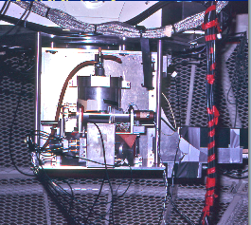
Conclusions
Mid-IR spectroscopy conducted with the UCLS at the AAT and UKIRT had a profound impact on our understanding of dust properties.
Spectroscopy of samples of planetary nebulae, galaxy nuclei, WR stars and other objects revealed environmental effects and dependencies on C/O ratios. These spectra informed requirements for space missions.
By 2000, new facilities and instruments including 8-m telescopes and space telescopes were largely superseding the capabilities on the AAT, which anyway were approaching the limit of what could be observed in a reasonable time.
The AAT was the right facility at the right time.

Slide 33
Reflections
Legacies continue, especially from variable objects including the unique data sets for SN1987A and in the techniques developed for interpreting the data.
25 years on, the mid-IR Polarimetric observations still largely represent the state of the art providing unique insights into grain alignment and properties and magnetic fields.
In my view a real strength of the AAT was the independence of the observatory and Director provided by the AAT Board. This allowed a great degree of autonomy and devolved decision making.
The observations were possible because of the exceptional support and can-do, willing help provided by the telescope and observatory staff and the fertile scientific and technical environment at the AAO
This work was done with Dave Aitken, Craig Smith, Chris Wright, Mike Barlow, Dave Allen and other collaborators

Slide 35
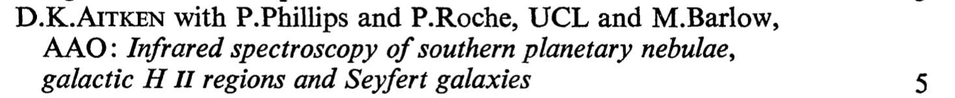
Mid-IR Spectroscopy
Regular Telescope Time awards for 8-13μm spectroscopy e.g. 1978 :
Over the following decade, spectra of HII regions, PN and emission line objects, Novae, Symbiotic stars, Wolf Rayet Stars and galaxy nuclei were measured. Properties of dust species and environmental dependence were investigated along with the spectral shape and strength of mid-IR extinction.
There were many discoveries and first measurements, defining the mid-IR spectral characteristics of classes of objects

Slide 36
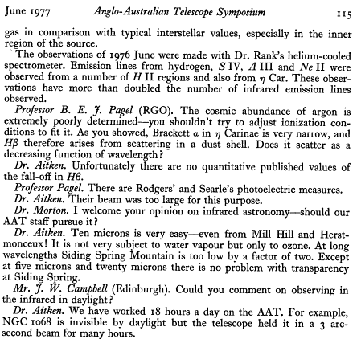
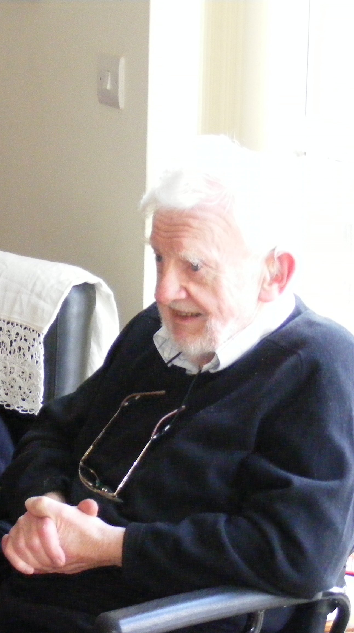
Mid-Infrared observing from the beginning
The Observatory 97, 114 (1977)

Slide 37
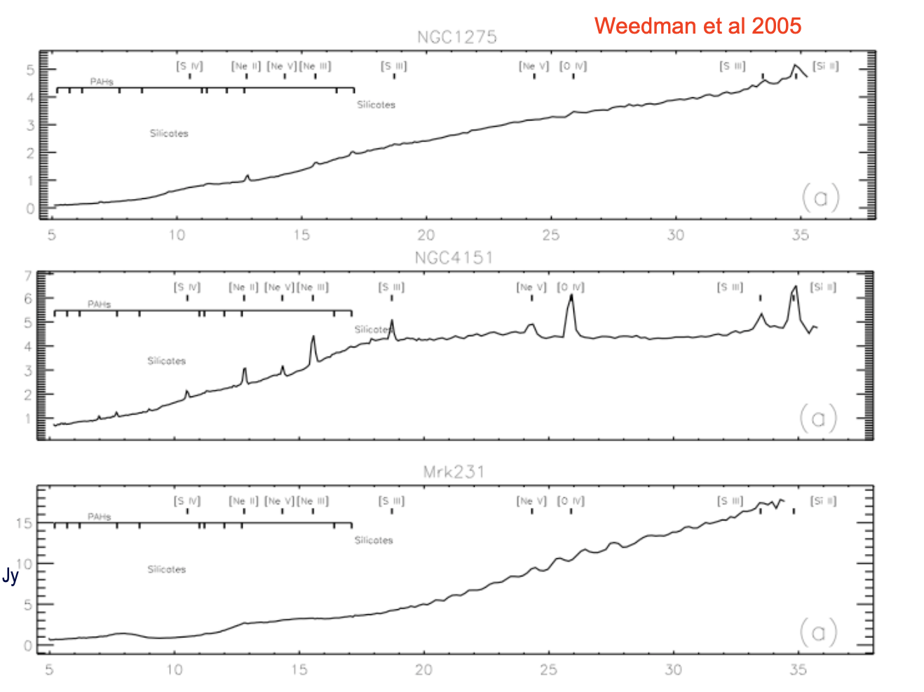
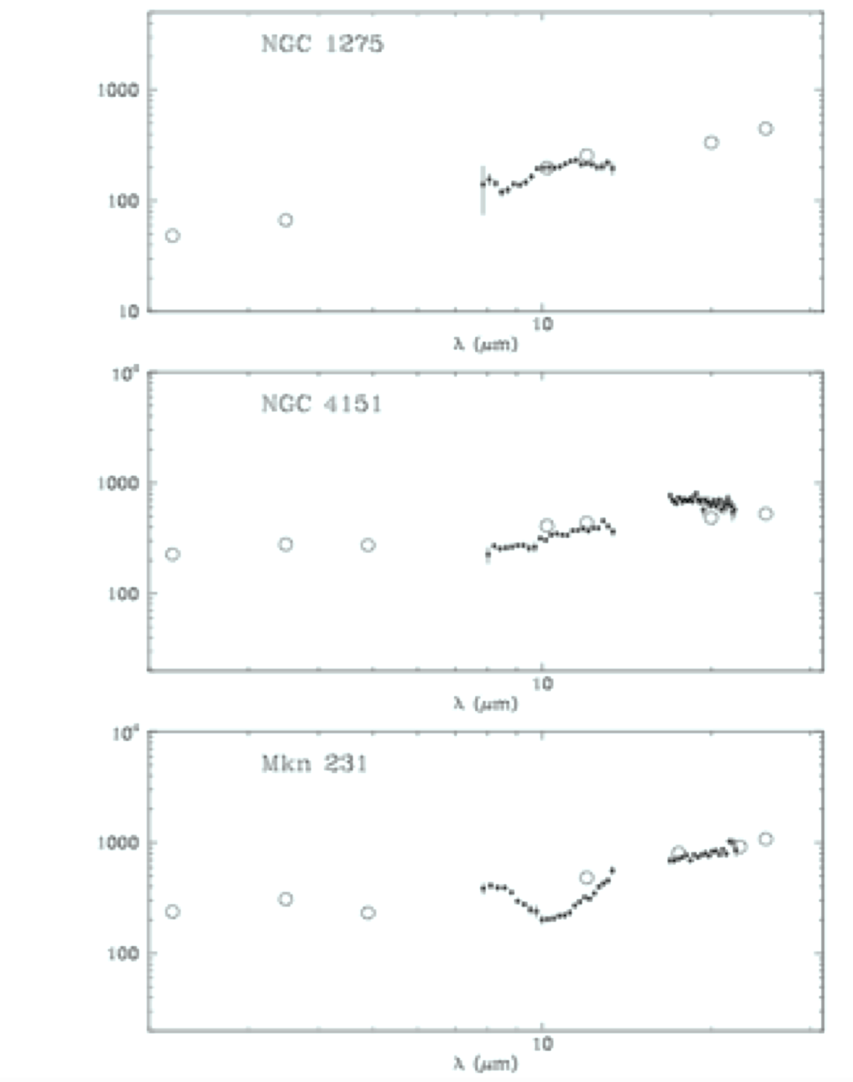
Comparison between UCLS spectra of bright AGN with Spitzer IRS spectra, which covered a larger wavelength range at higher sensitivity.

Slide 38
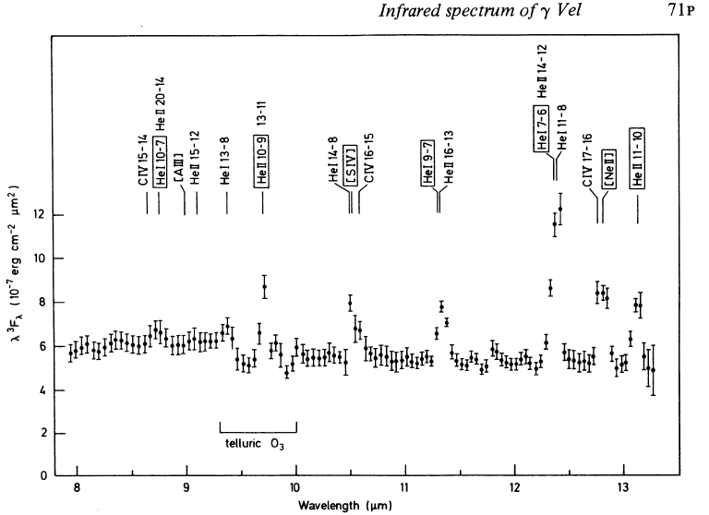

Wolf-Rayet Stars
Aitken, Roche & Allen 1982
Spectra of early type WR stars are dominated by He and C or N lines together with S IV and Ne II fine-structure lines
These give information on the element abundances and wind density structure and can be used as tracers of the terminal velocity as the lines peak in regions where the density is close to the critical density.
Analysis methods have been applied to ISO and Spitzer spectra which also cover [Ne III] to give the total neon abundance..
Barlow,Roche Aitken1988

Slide 39

Probing Stellar Winds
IR continuum from optically-thick free-free emission
Recombination lines of He, C dominate the spectrum
Fine-structure lines of [Ne II] and [S IV] have maximum emissivity near the critical density of ~ 10⁵ cm⁻³ and probe the outer wind
Spatially resolved observations with Gemini provide information on the wind structure and support moderate clumping
The outflow from the WR star gamma Velorum
Roche, Colling & Barlow 2013

