Slide 1
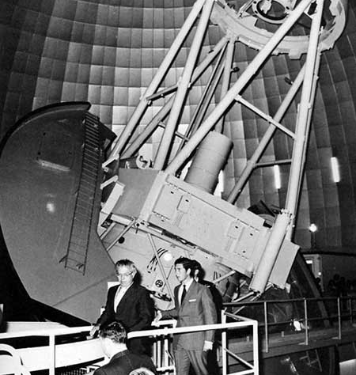
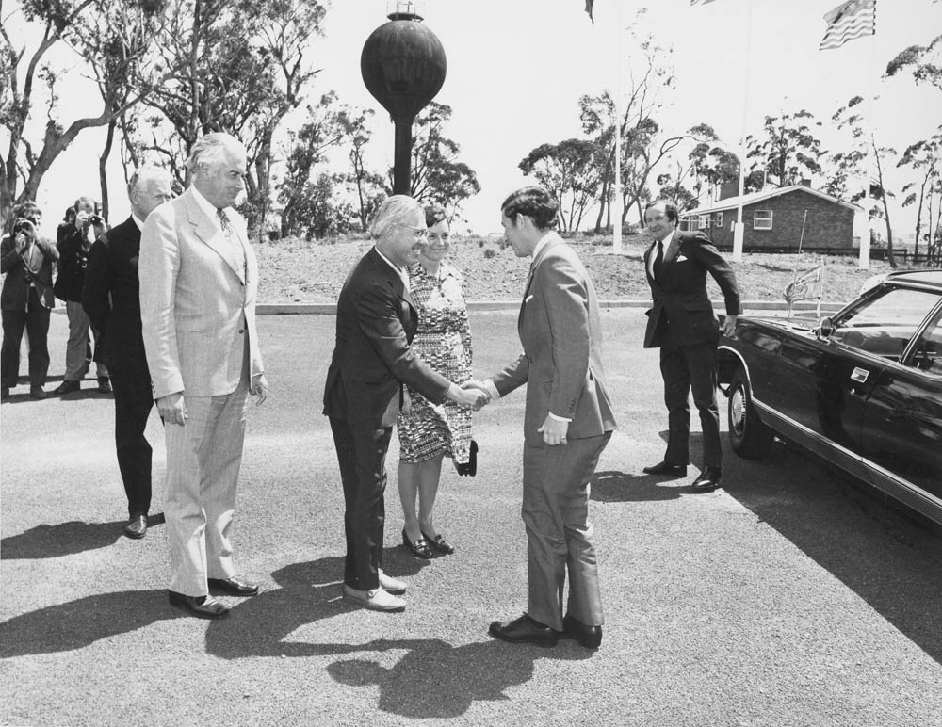
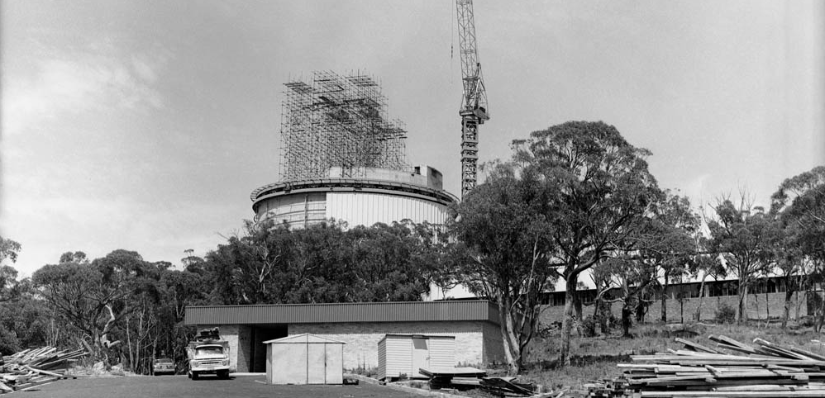
Notes:
https://aat.anu.edu.au/public/HRH-The-Prince-of-Wales-commemorates-AAT-40th
https://history.aip.org/exhibits/cosmology/ideas/larger-image-pages/pic-bigbang-hoyle.htm
https://aat.anu.edu.au/files/711202_site_constr_28_GS_sm.jpg
https://aat.anu.edu.au/public/images/aat-construction-photos-twitter-aat40

Slide 2
Instrumentation Legacy of the Anglo-Australian Observatory: Securing the Next 50 Years
Professor Richard McDermid
Interim Director, Australian Astronomical Optics (AAO)
Macquarie University

Slide 3
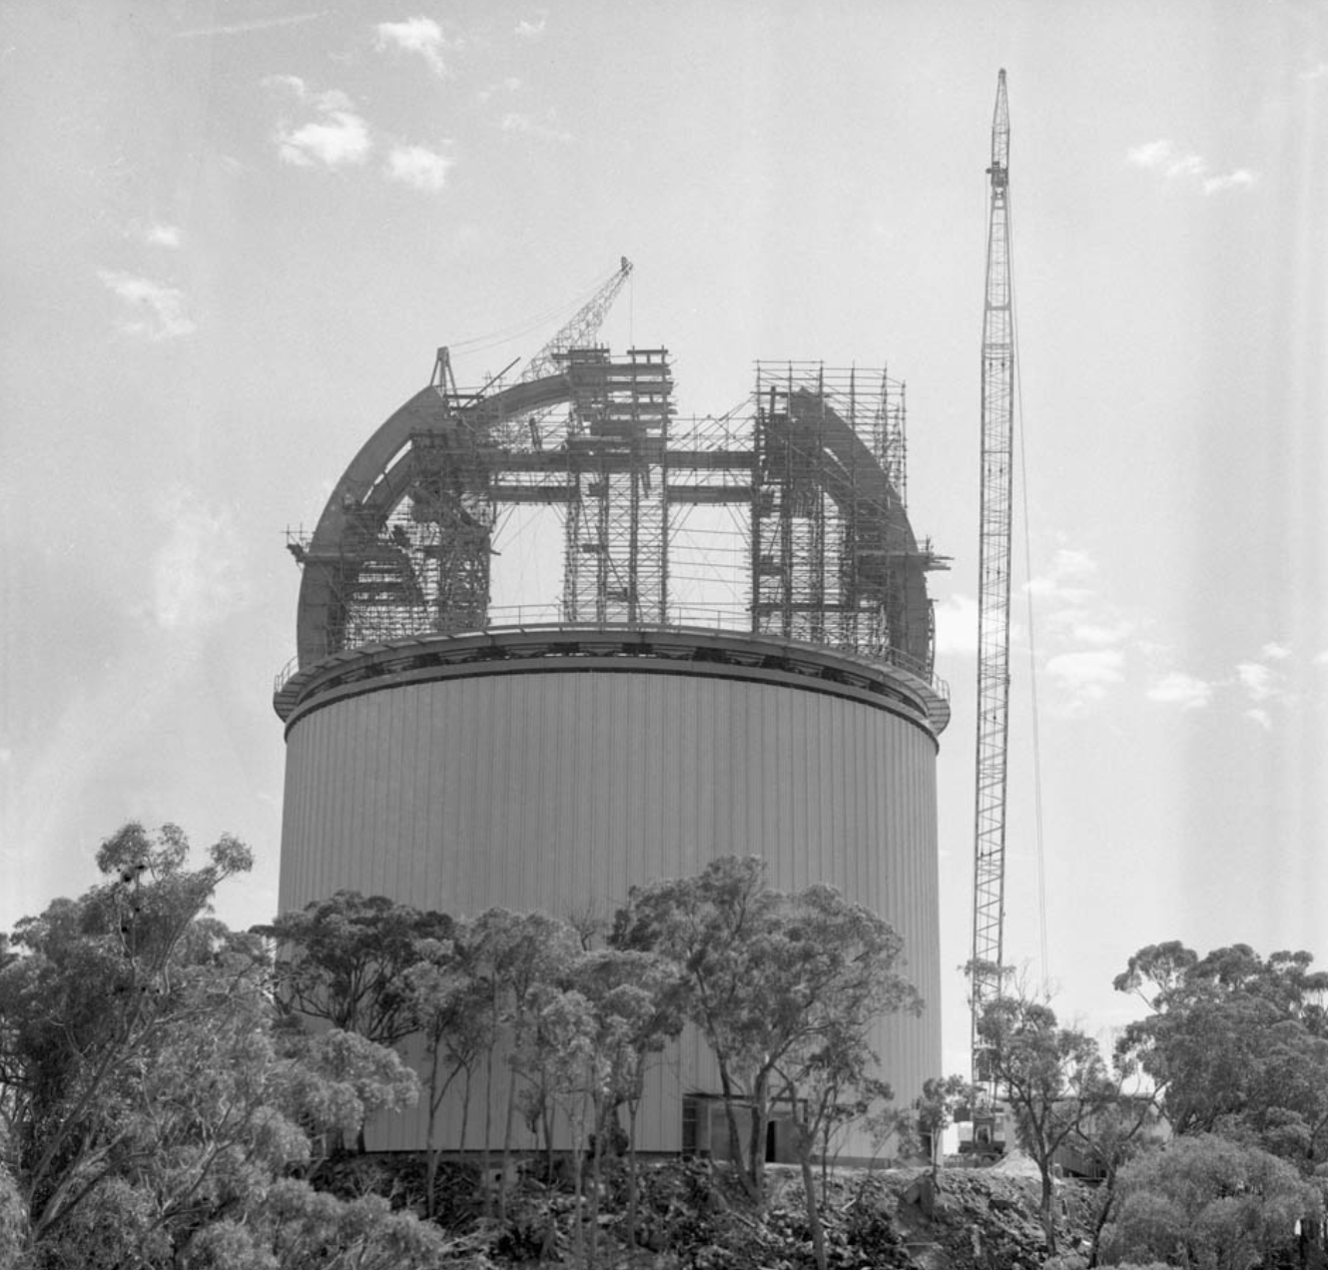



Evolution of the “AAO”
1969-1974
UK & Australia agree to build AAT
AAT Board forms the Anglo-Australian Observatory
2010
UK involvement ceases
Australian Astronomical Observatory
2018
Australia begins 10-year ESO Strategic Partnership
Australian Astronomical Optics joins Macquarie University

Slide 4
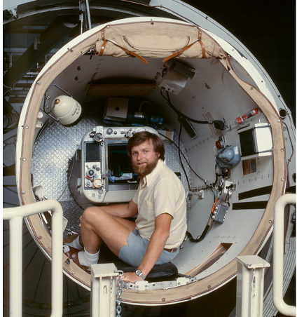
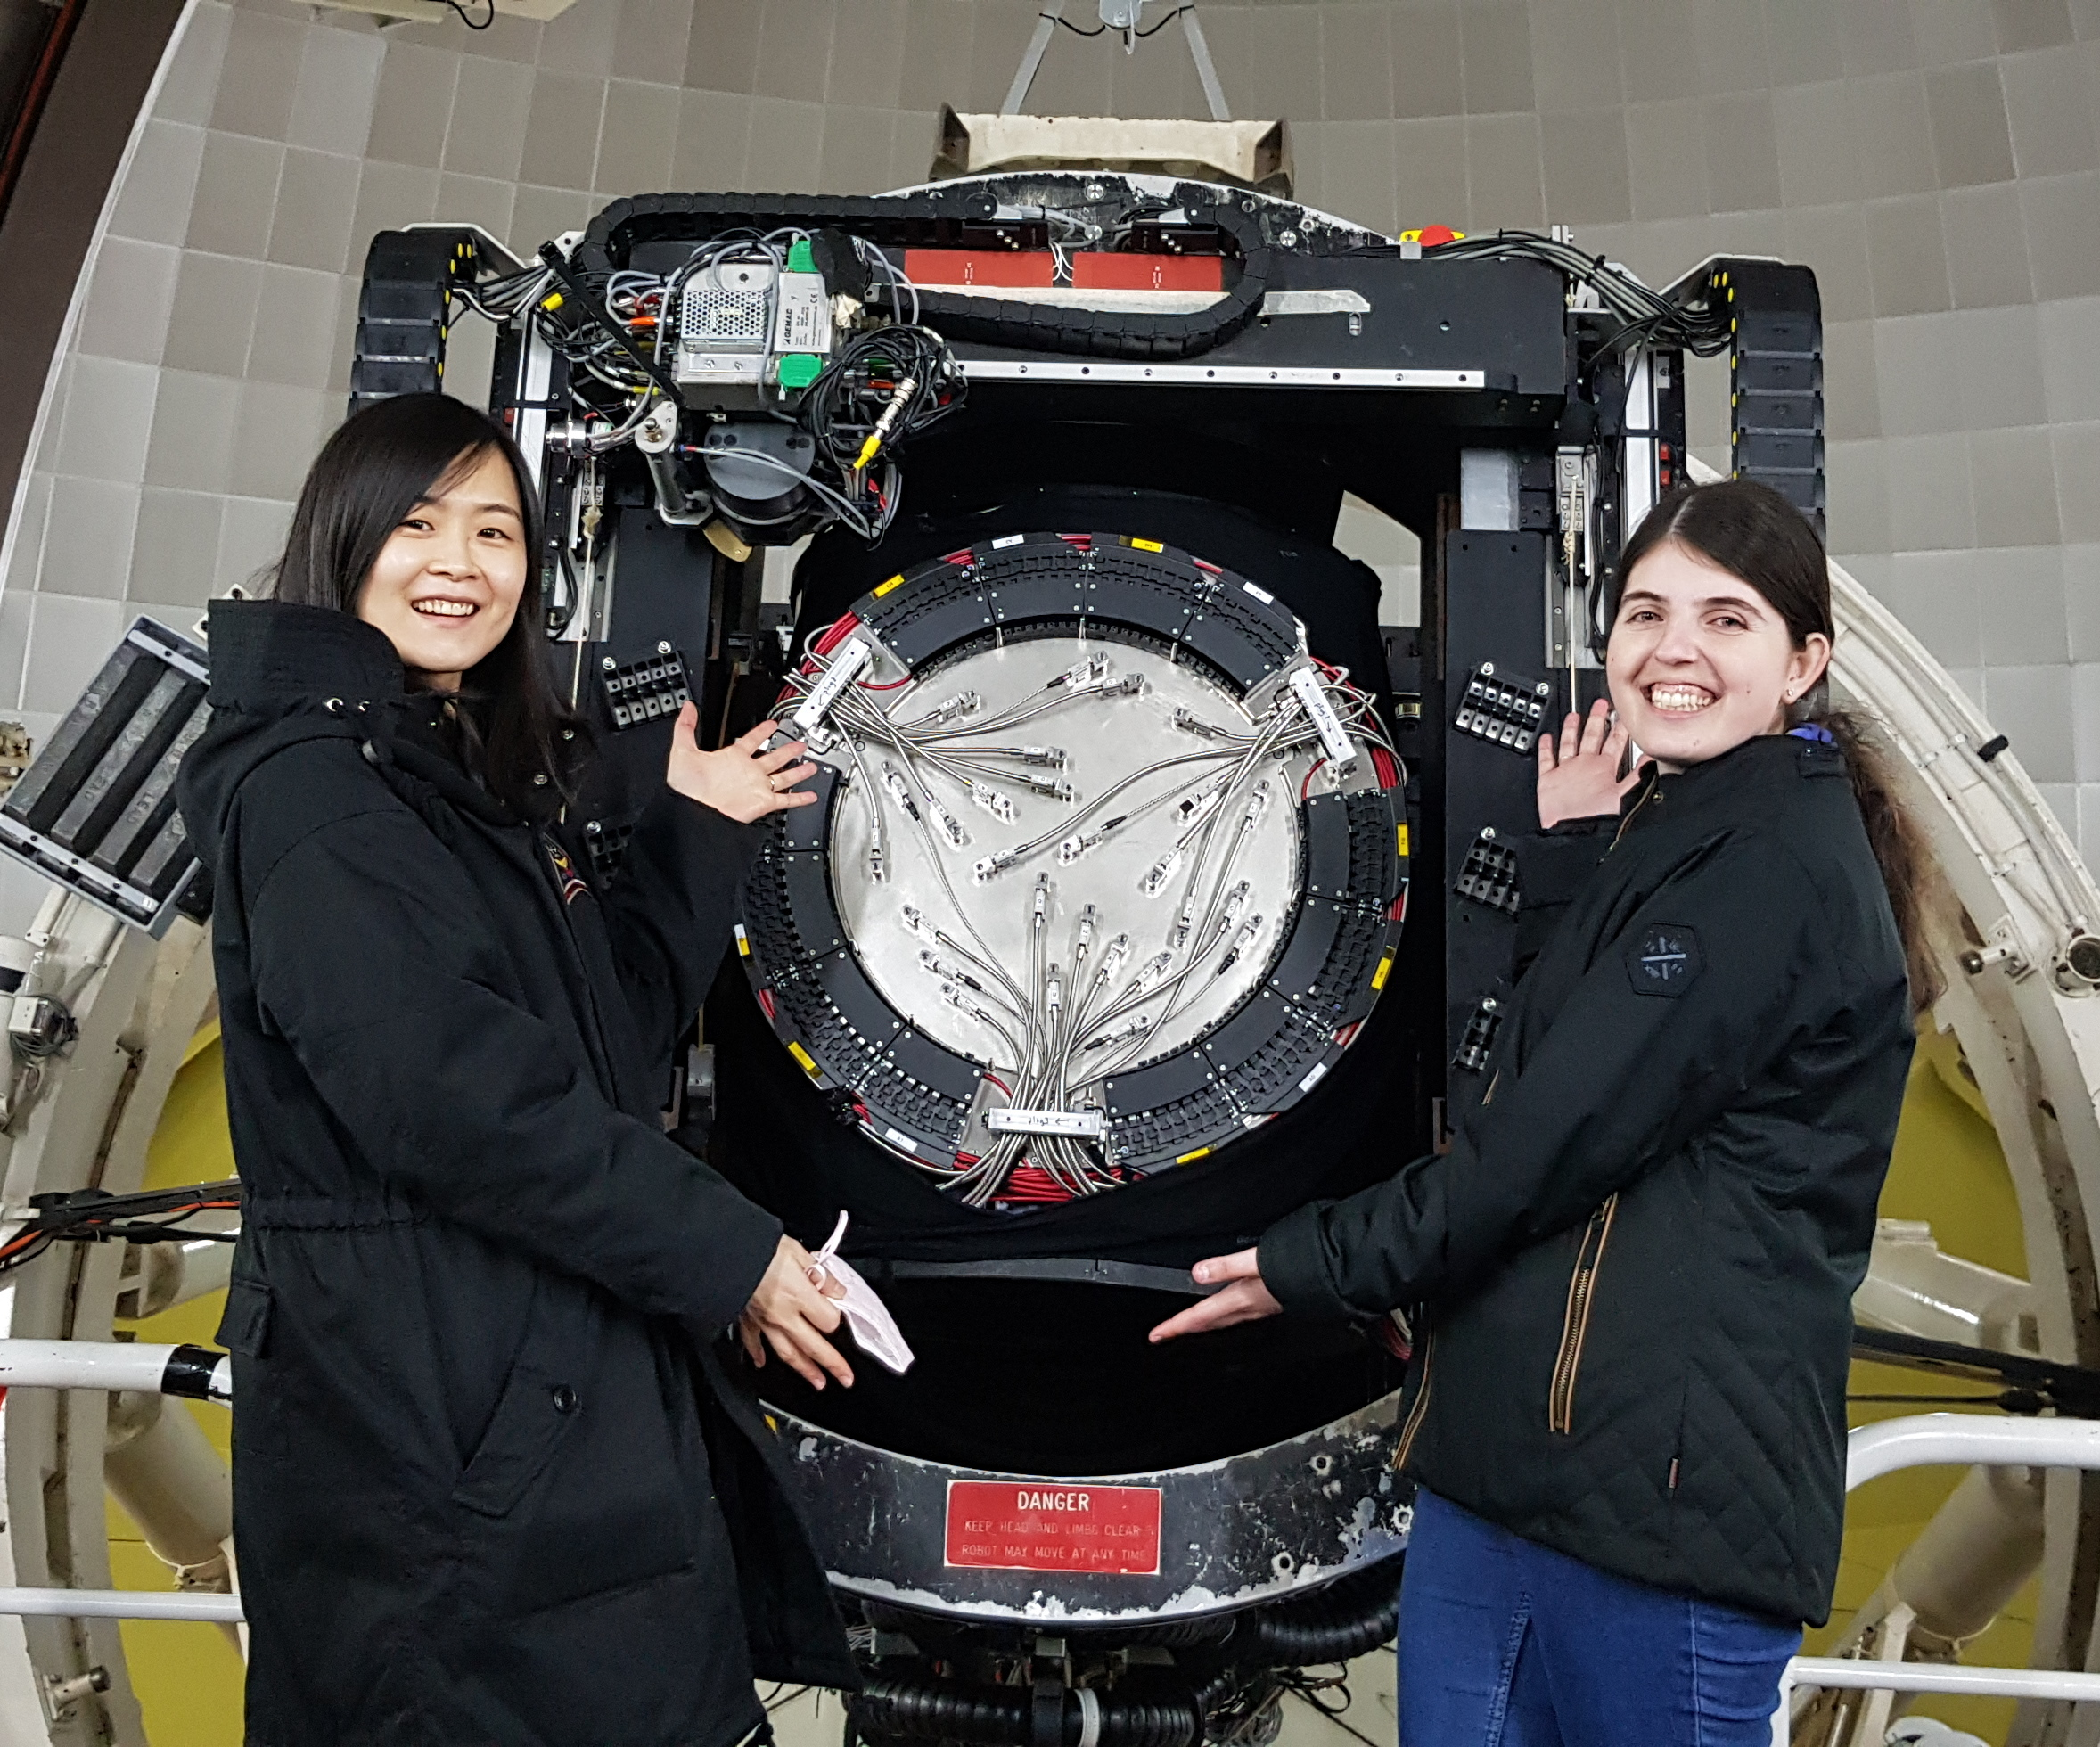
Evolution of AAO Instrumentation
David Malin, circa. 1980s
Mina Pak, Gabriella Quattropani and Hector, 2024

Slide 5
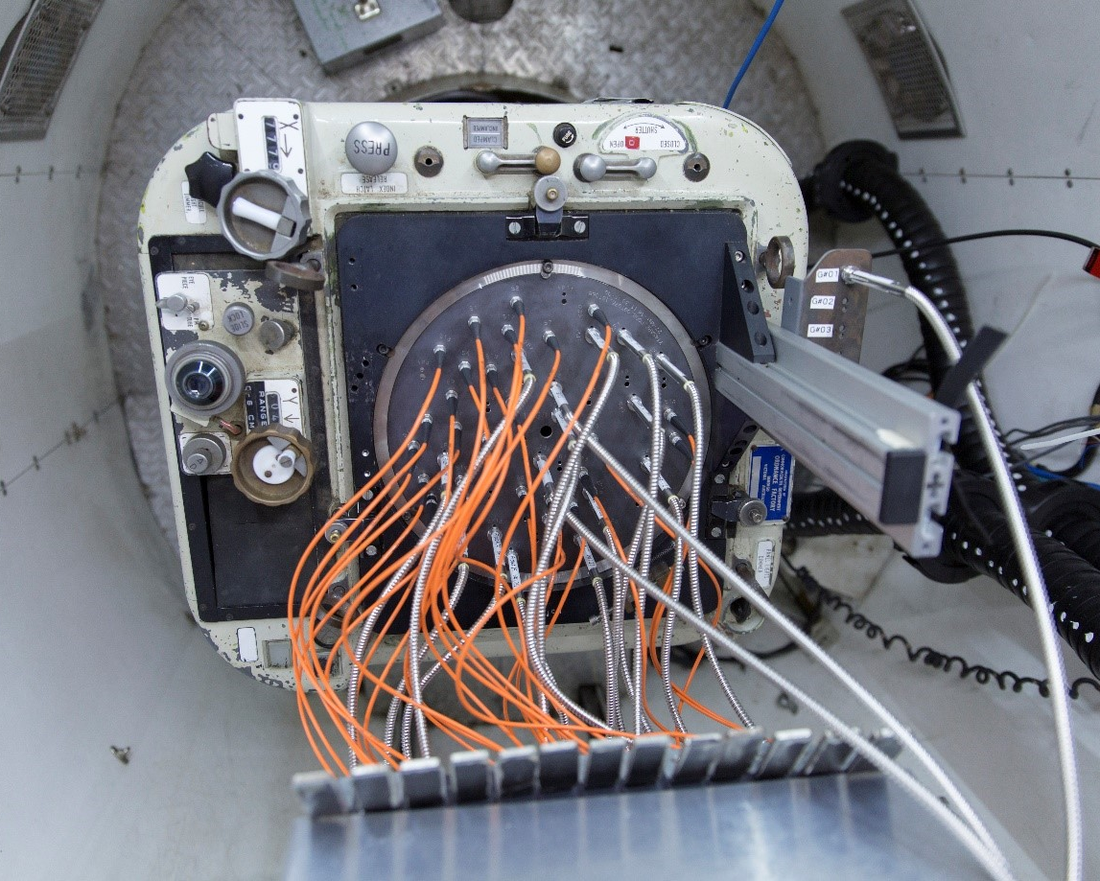
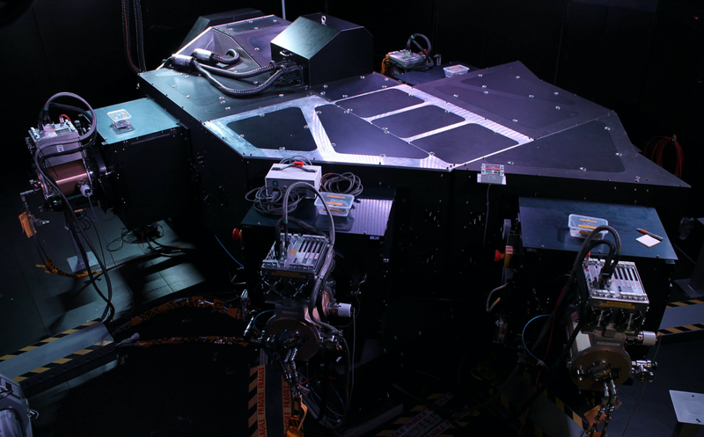
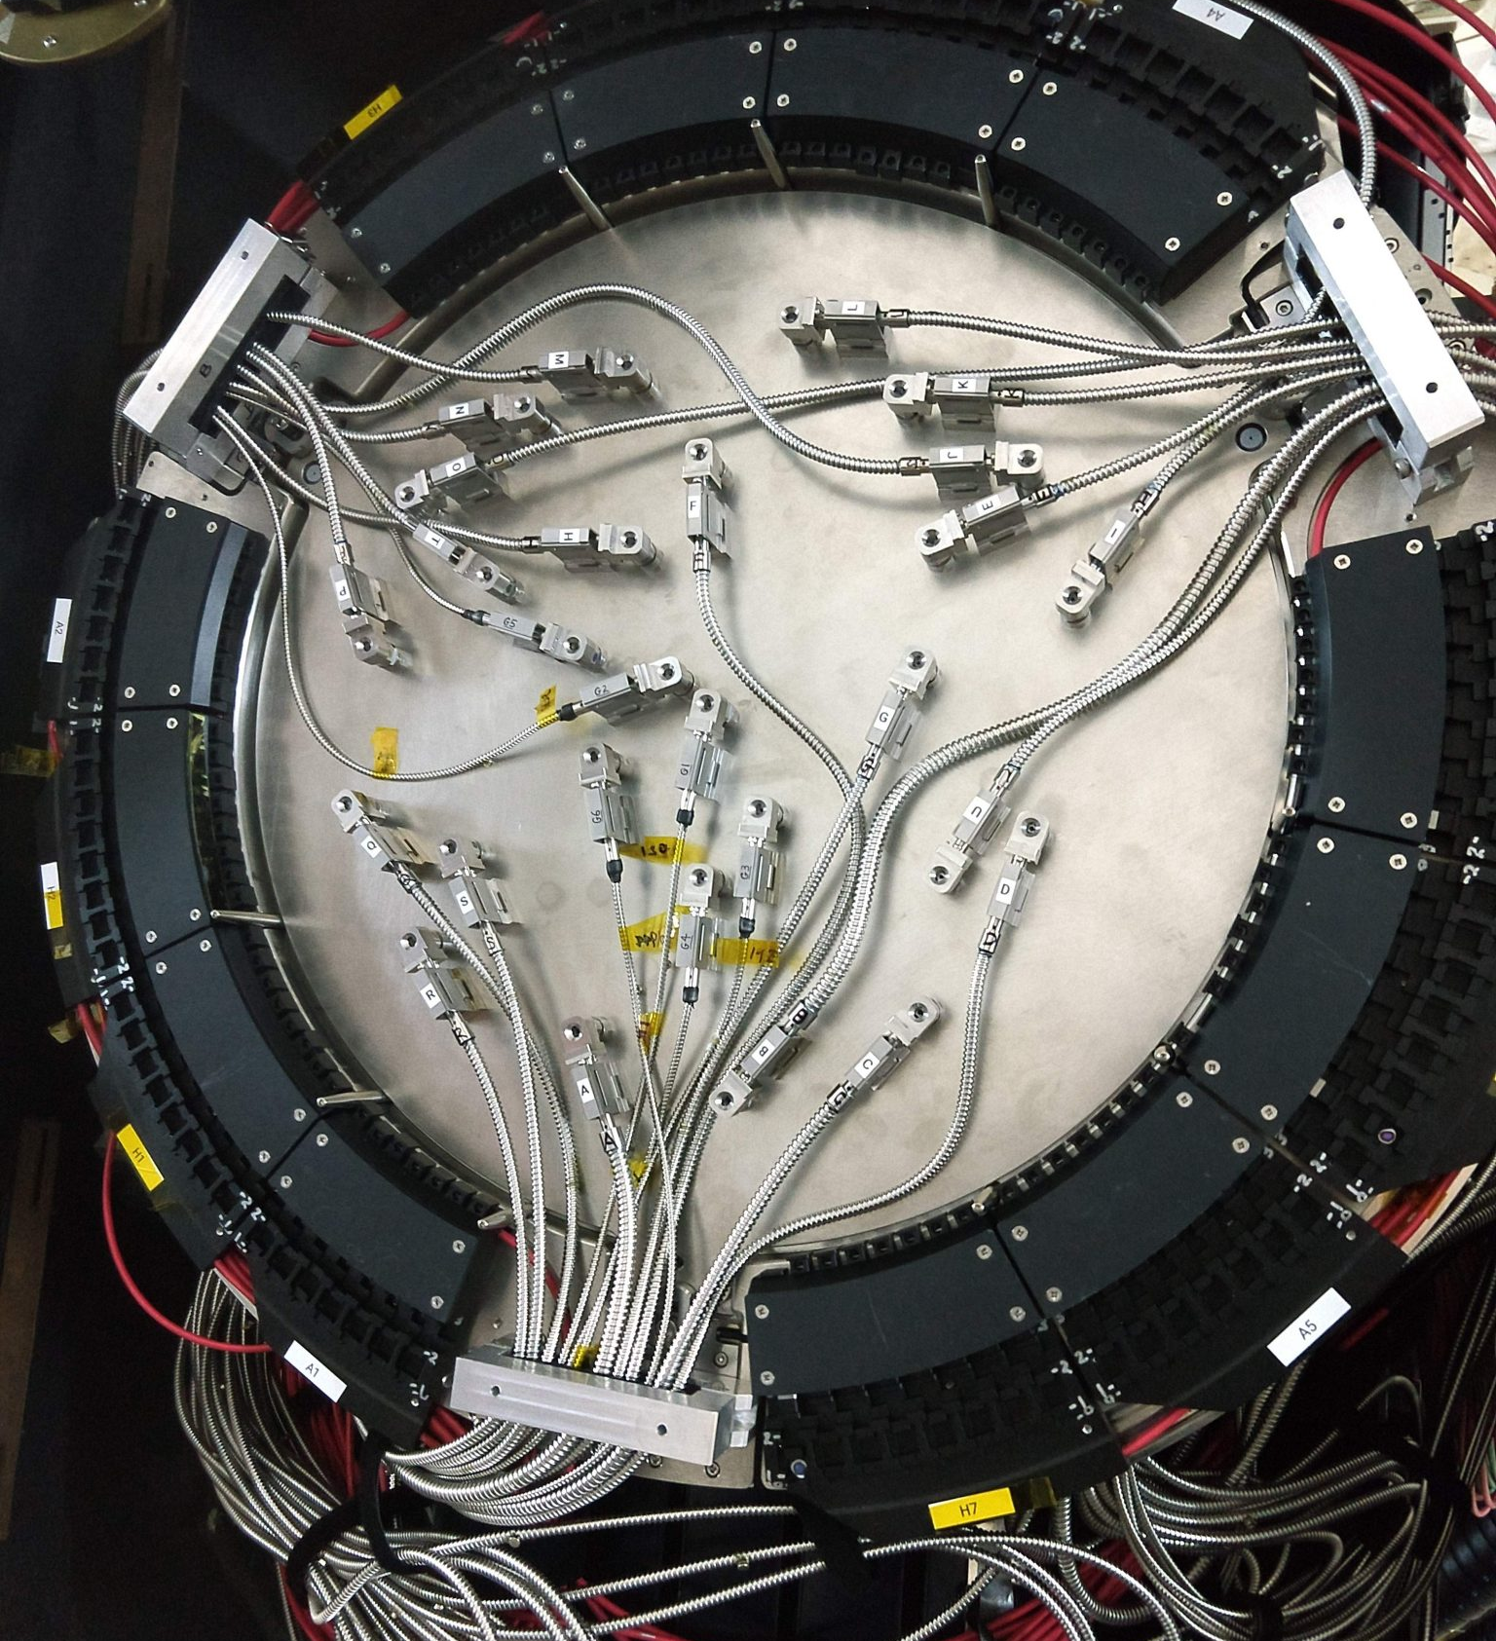
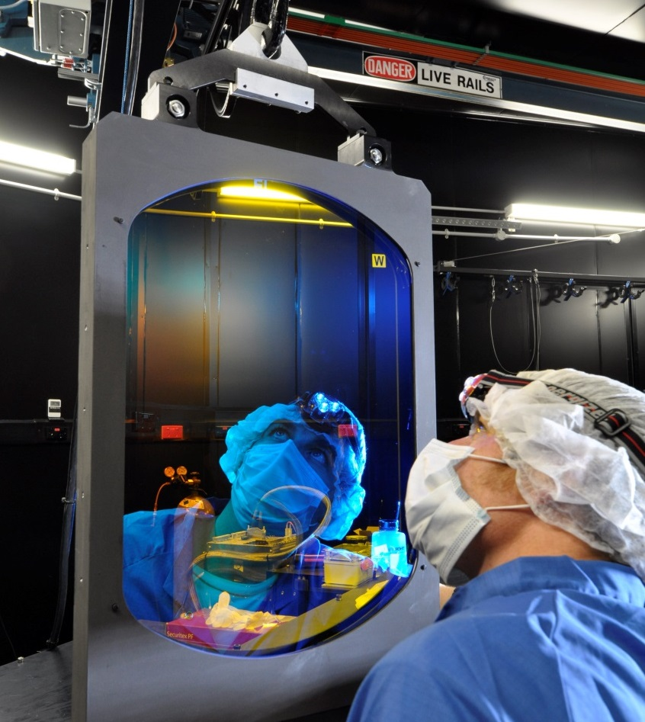
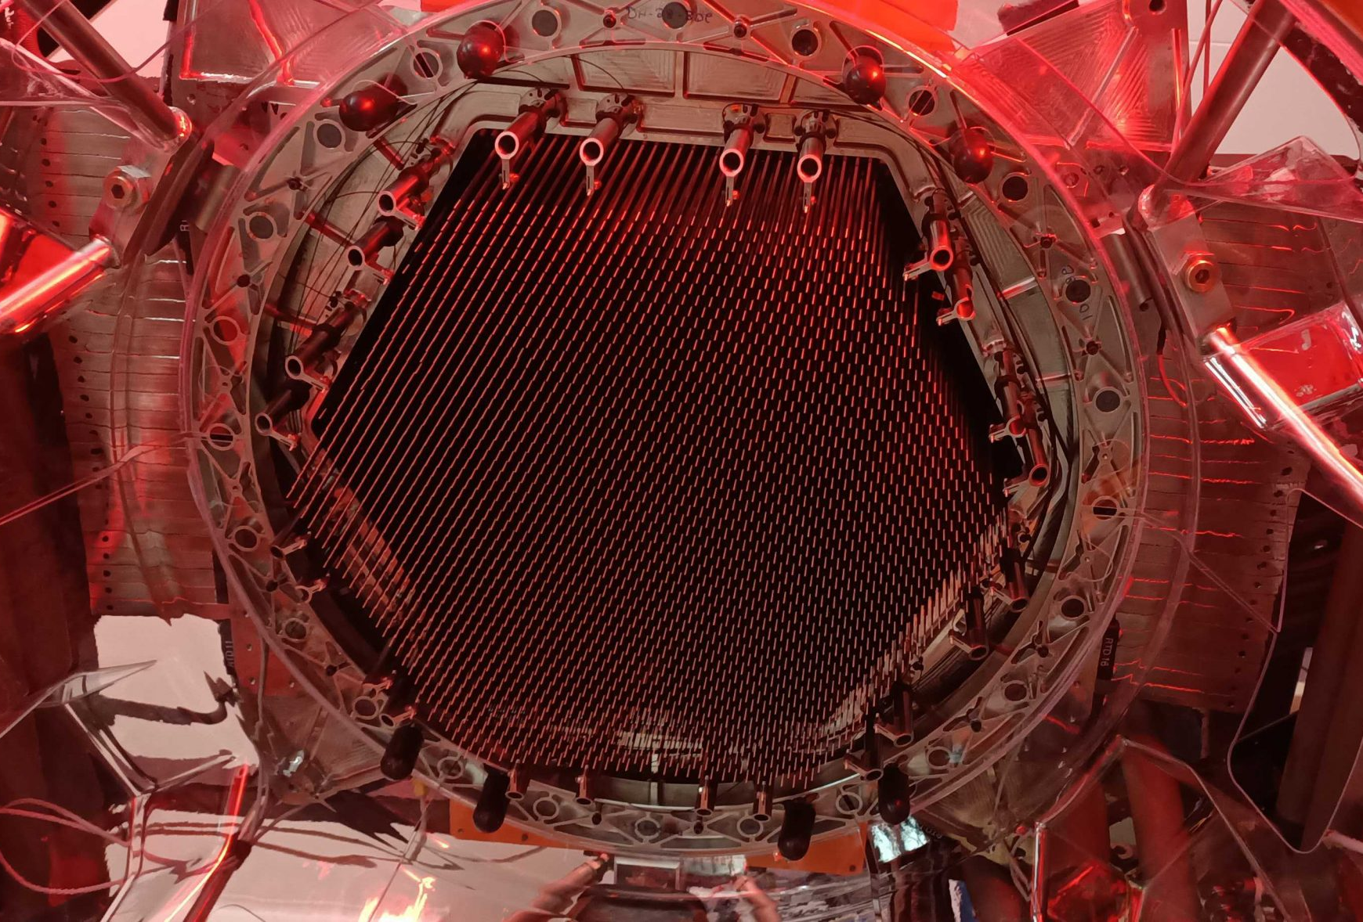
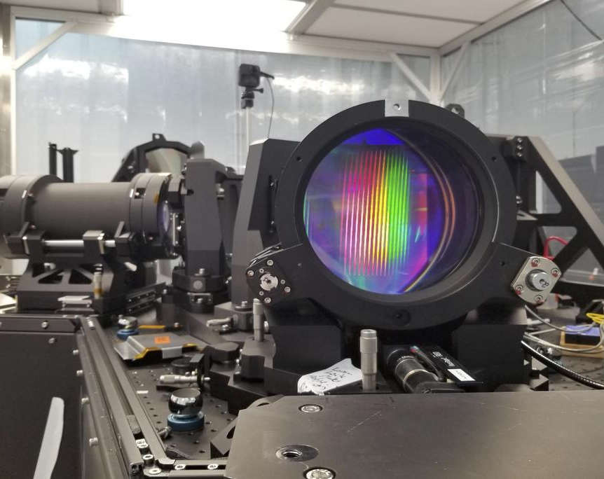
AAO – Completed Instrument Projects
RGO - long-slit moderate resolution optical spectrograph for the AAT – Pre-1981
FOCAP - fibre plug-plate feed for the RGO spectrograph at the AAT - Pre-1981
Auxiliary CCD camera - narrow field of view optical camera for the AAT – Pre-1981
IRIS - near infrared camera/spectrograph for the AAT – Pre-1981
Taurus - a Fabry-Perot tunable filter for the AAT – 1981
FORS - faint object red spectrograph for the AAT – 1984
Autofib - 64 fibre positioner for the RGO spectrograph at the AAT – 1987
LDSS - low dispersion spectrograph for the AAT – 1988
UCLES - high resolution optical Echelle spectrograph for the AAT – 1988
FLAIR-II - multi-object fibre spectrograph and positioner for the UKST - 1992
UHRF - ultra-high resolution optical spectrograph for the AAT – 1993
UNSWIRF - narrow band infrared tunable Fabry-Perot filter – 1996
2df - 2 degree field corrector and 400 fibre positioner for the AAT – 1997
2df spectrograph - two fibre-fed optical spectrographs for the AAT – 1997
SPIRAL-A - a fibre IFU and spectrograph for the AAT – 1997
Taurus II - a Fabry-Perot tunable filter for the AAT – 1997
LDSS++ - a multi-slit optical spectrograph for the AAT – 1998
UKS-TCS - telescope control system upgrade for the UKST – 2000
SPIRAL-B - fibre-IFU and spectrograph for the AAT – 2000
SOAR-IFU - prototype fibre-IFU for the SOAR(link is external) telescope – 2000
Taurus Polarimeter - imaging polarimetry mode for Taurus – 2000
MAPPIT 2 - high resolution interferometer for the AAT – 2000
PFU - prime focus unit for the AAT – 2000
WFI - wide field optical imager for the AAT – 2000
6dF - 150-fibre positioning robot for the UKST – 2001
IRIS2 - near-infrared slit-mask spectrograph and imager for the AAT – 2002
DAZLE - near infrared narrow-band imager for the VLT(link is external) – 2003
OzPoz - fibre positioning robot for the VLT(link is external) – 2003
AAOmega - optical multi-object spectrograph for the AAT – 2006
SPIRAL - upgrade to SPIRAL-B for use with AAOmega at the AAT – 2006
FMOS/Echidna - fibre positioning robot for Subaru(link is external) – 2007
AAT-TCS - telescope control system upgrade for the UKST – 2008
APT camera - wide-field optical camera for the APT – 2008
CYCLOPS - fibre image slicer for UCLES at the AAT – 2010
SAMI prototype - multi-IFU hexabundle fibre feed for the AAT – 2011
CURE - Cassegrain calibration and guide unit at the AAT – 2012
GNOSIS - OH suppression fibre feed for IRIS2 at the AAT – 2012
CYCLOPS2 - fibre image slicer for UCLES at the AAT – 2012
SAMI -multi-IFU hexabundle fibre feed for the AAT – 2013
KOALA - 500 element fibre-IFU for the AAT – 2014
HERMES - moderate resolution optical spectrograph for the AAT – 2014
AAOmega upgrade - new CCDs for the AAOmega instrument at the AAT – 2014
GHOST – High resolution echelle spectrograph for Gemini – 2016
TAIPAN – Starbugs MOS for UKST - 2019
HECTOR – Multi-IFU fibre feed and double-arm spectrograph for AAT – 2022
DIRAC – Cryogenic IR imager for Eastern Anatolia Observatory, Turkey – 2024
Malya payload for Gilmour Space - 2024

Slide 6
Astralis

Slide 7
Astralis

Slide 8
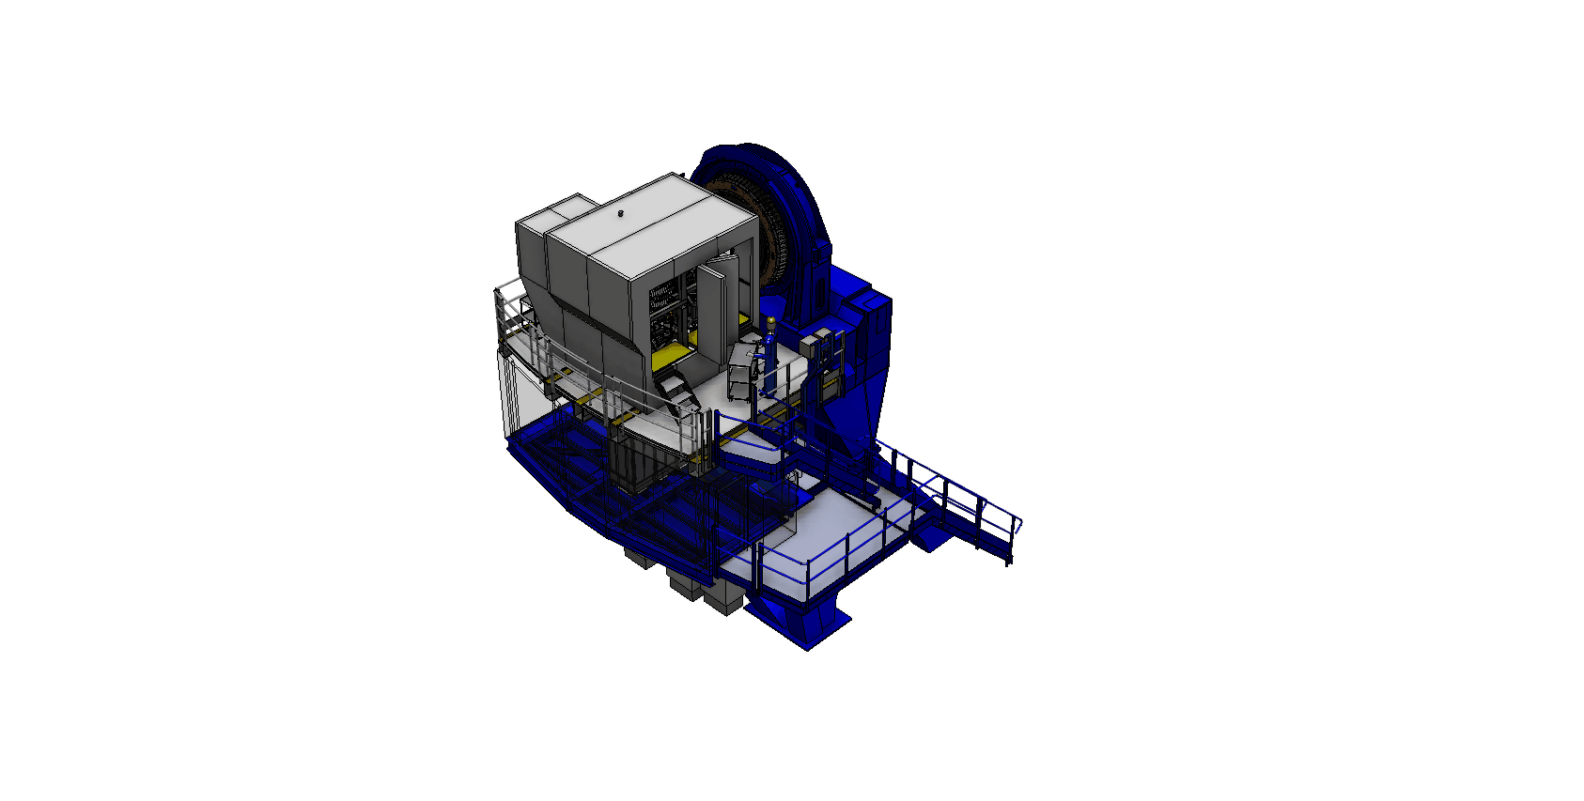
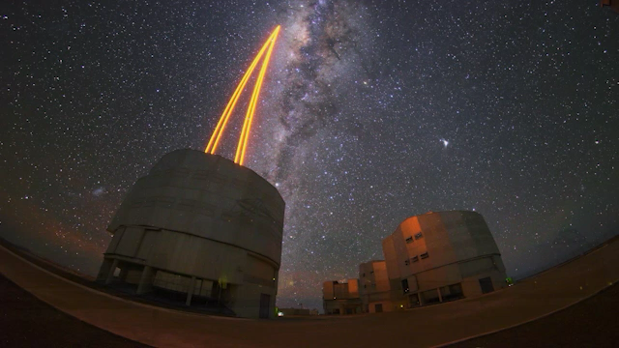
AAO looking to the future: MAVIS
Multi-conjugate Adaptive Optics system for correction in the visible
  complete with a 30”x30” imager @ 7.3mas pixels
  and an IFU w/ 4 spectral resolution modes (4-12k),
  + 2 spatial modes (3x3” 25mas, 6x6” 50mas)
Expecting ≈ 10% Strehl (goal 15%) at V band
50% sky coverage @ South GP for 15% encircled energy in 50 mas spaxel
Imager 5-sigma limiting mag in 1 hour V ≈ 29.5
Tight Consortium: ASTRALIS (lead) / INAF / LAM / ESO
Passed phase B April 2023, first light expected 2030
For the ESO VLT AOF (UT4)
  4x2 Laser Guide Stars;
  3 Near-IR NGS Wavefront Sensors (using SAPHIRA);
  3 Deformable mirrors (DSM + 2 post focal DMs);
A brilliant community-driven science case:
(https://arxiv.org/abs/2009.09242)

Slide 9
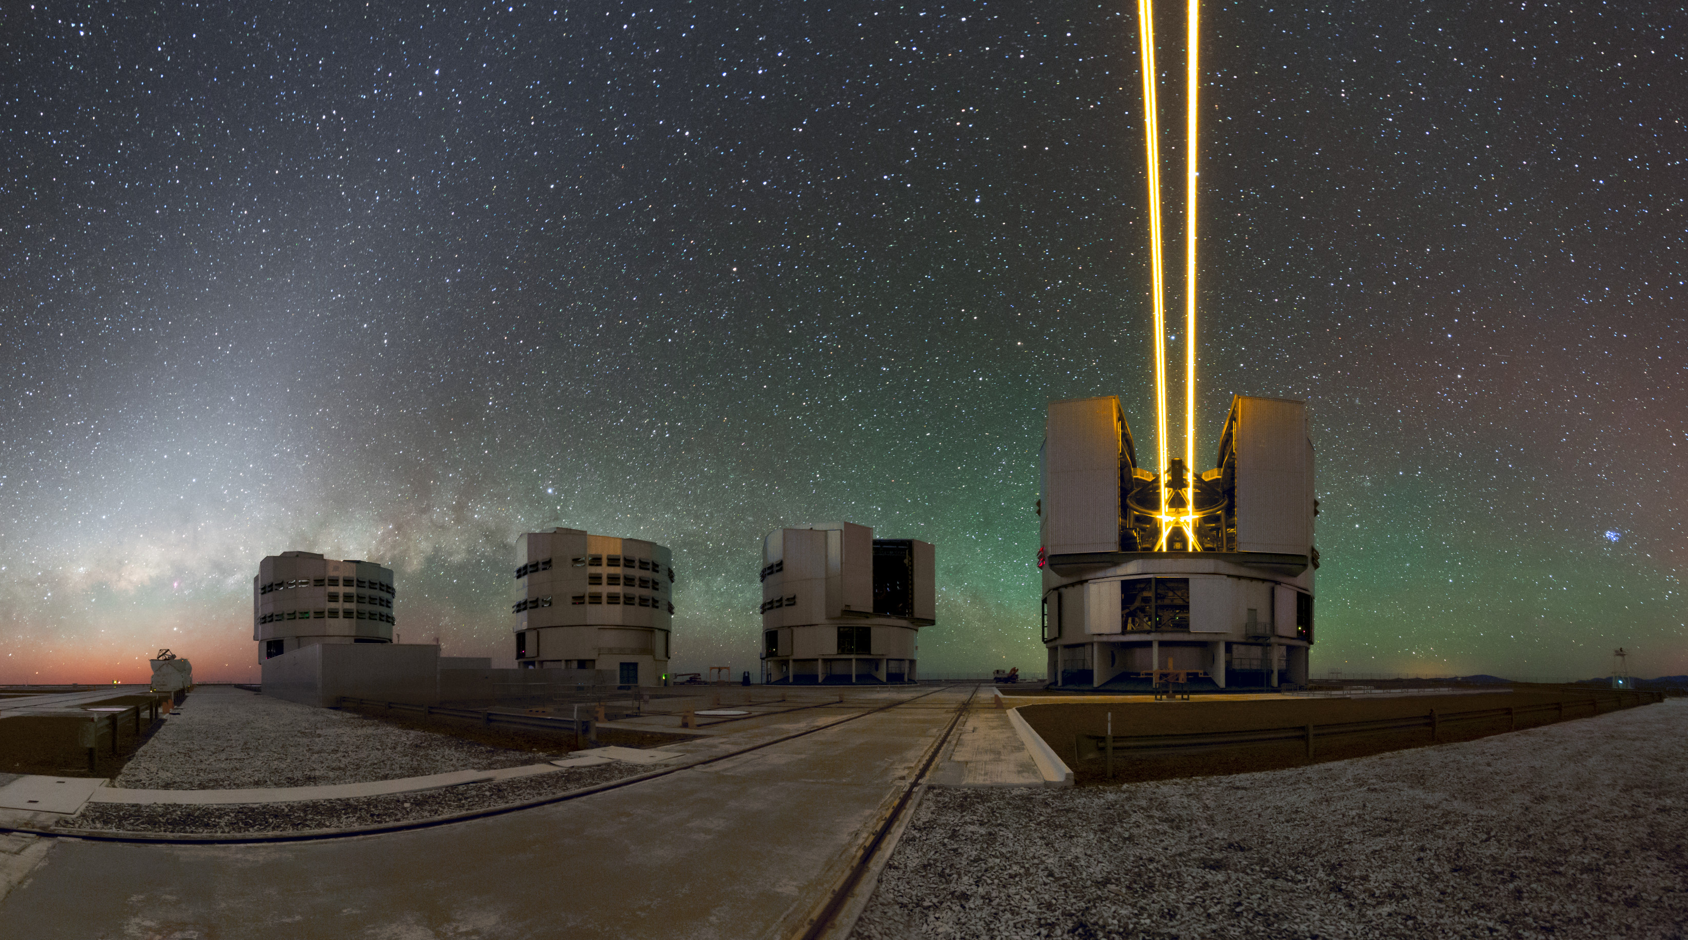
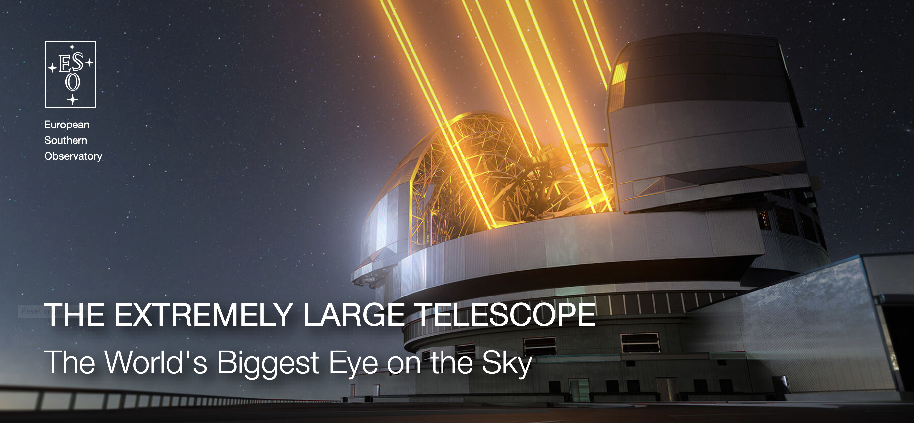
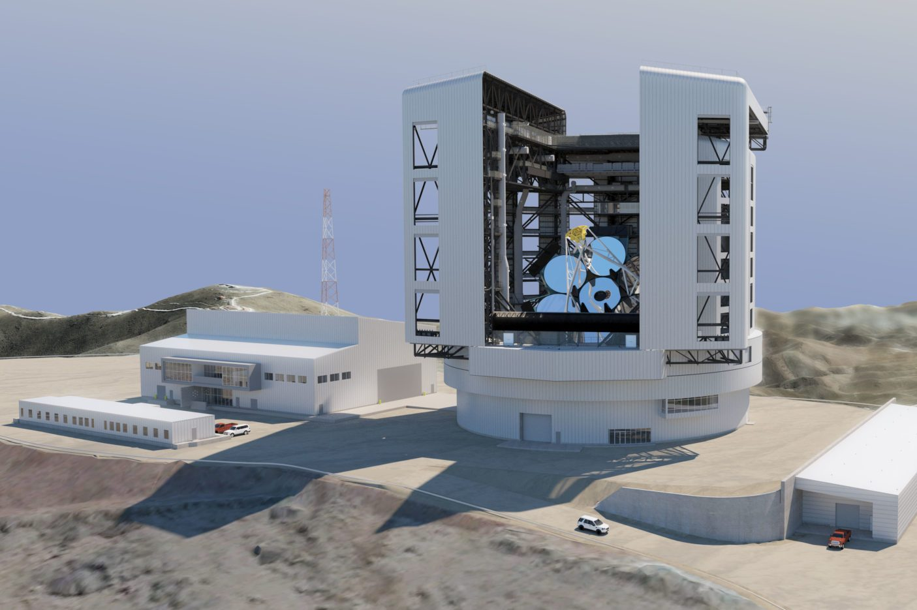
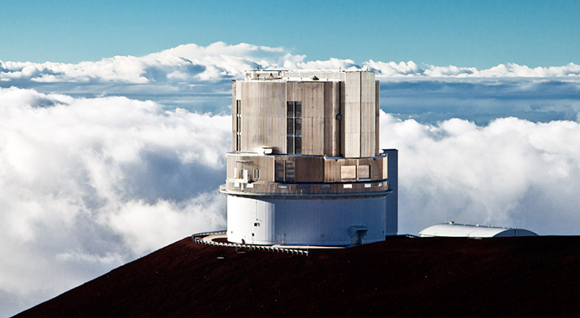
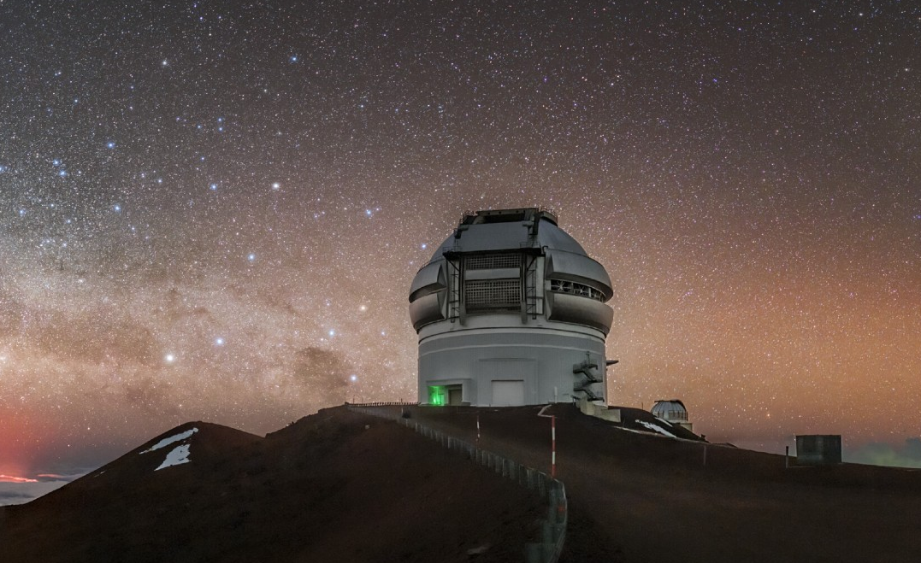
AAO looking to the future: International
European Southern Observatory (ESO) – Chile/Europe
Giant Magellan Telescope (GMT) – USA/Chile
Subaru Observatory – Japan
Gemini Observatory – USA/Chile

Slide 10
AAO looking to the future: International
European Southern Observatory (ESO) – Chile/Europe
Multiple projects ongoing:
MAVIS final design review Q2-2025
AESOP/4MOST being integrated
BlueMUSE design well advanced
WST European funding success
Giant Magellan Telescope (GMT) – USA/Chile
Subaru Observatory – Japan
Gemini Observatory – USA/Chile

Slide 11
AAO looking to the future: International
European Southern Observatory (ESO) – Chile/Europe
Multiple projects ongoing:
MAVIS final design review Q2-2025
AESOP/4MOST being integrated
BlueMUSE design well advanced
WST European funding success
Giant Magellan Telescope (GMT) – USA/Chile
Subaru Observatory – Japan
Gemini Observatory – USA/Chile
ULTIMATE Subaru:
Building on past AAT-Subaru partnership
AO, imager, m-IFU

Slide 12
AAO looking to the future: International
European Southern Observatory (ESO) – Chile/Europe
Multiple projects ongoing:
MAVIS final design review Q2-2025
AESOP/4MOST being integrated
BlueMUSE design well advanced
WST European funding success
Giant Magellan Telescope (GMT) – USA/Chile
Subaru Observatory – Japan
Gemini Observatory – USA/Chile
ULTIMATE Subaru:
Building on past AAT-Subaru partnership
AO, imager, m-IFU
Adaptive Optics project:
Conceptual design review October 2024

Slide 13
AAO looking to the future: International
European Southern Observatory (ESO) – Chile/Europe
Multiple projects ongoing:
MAVIS final design review Q2-2025
AESOP/4MOST being integrated
BlueMUSE design well advanced
WST European funding success
Giant Magellan Telescope (GMT) – USA/Chile
Subaru Observatory – Japan
Gemini Observatory – USA/Chile
ULTIMATE Subaru:
Building on past AAT-Subaru partnership
AO, imager, m-IFU
Adaptive Optics project:
Conceptual design review October 2024
MANIFEST:
Multi-fibre positioner
Technology design review early 2025

Slide 14
AAO looking to the future: International
European Southern Observatory (ESO) – Chile/Europe
Multiple projects ongoing:
MAVIS final design review Q2-2025
AESOP/4MOST being integrated
BlueMUSE design well advanced
WST European funding success
HARMONI:
AAO+Astralis solicited for expertise contributions (funding dependent)
Giant Magellan Telescope (GMT) – USA/Chile
Subaru Observatory – Japan
Gemini Observatory – USA/Chile
ULTIMATE Subaru:
Building on past AAT-Subaru partnership
AO, imager, m-IFU
Adaptive Optics project:
Conceptual design review October 2024
MANIFEST:
Multi-fibre positioner
Technology design review early 2025

Slide 15
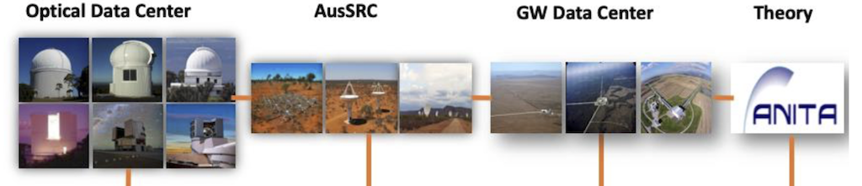


AAO looking to the future: Data & Software
Australian Astronomical Data Landscape
More than data archiving and distribution:
ESO Software Pipelines (2018 – 2023)
2.3m telescope Automation (Siding Spring Observatory)
ADACS (NCRIS-funded Astronomy Data and Computing Services)
Diversification into other research data (e.g. health, fieldwork data collection)

Slide 16

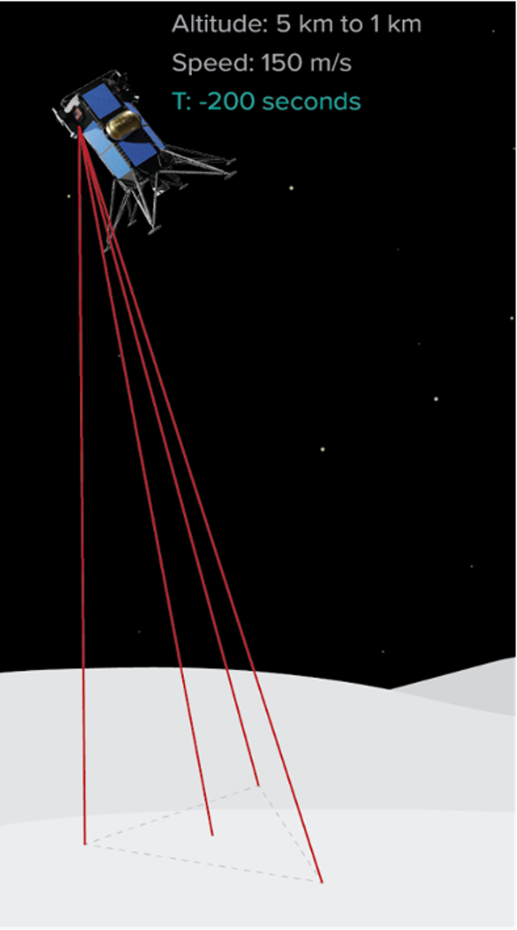
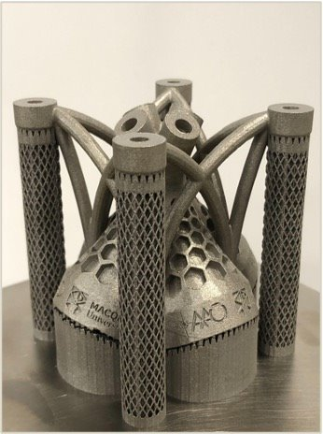
AAO looking to the future: Space + Industry
Designed by AAO
3D printed in metal at Macquarie​
Fine machined at NHMicro​
Delivered to Adanced Navigation​
Ranging system for lunar lander, part of Australia's Moon to Mars initiative​

Slide 17

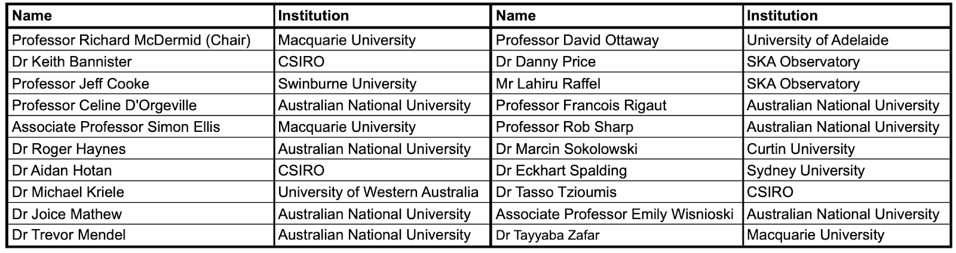
Decadal Plan - Instrumentation Working Group
Optical, Near-Infrared, Radio, Gravitational Waves
Research and Development Activity
Industry Engagement and Commercialization
Funding
Instrumentation Workforce
Future Trends and Opportunities

Slide 18
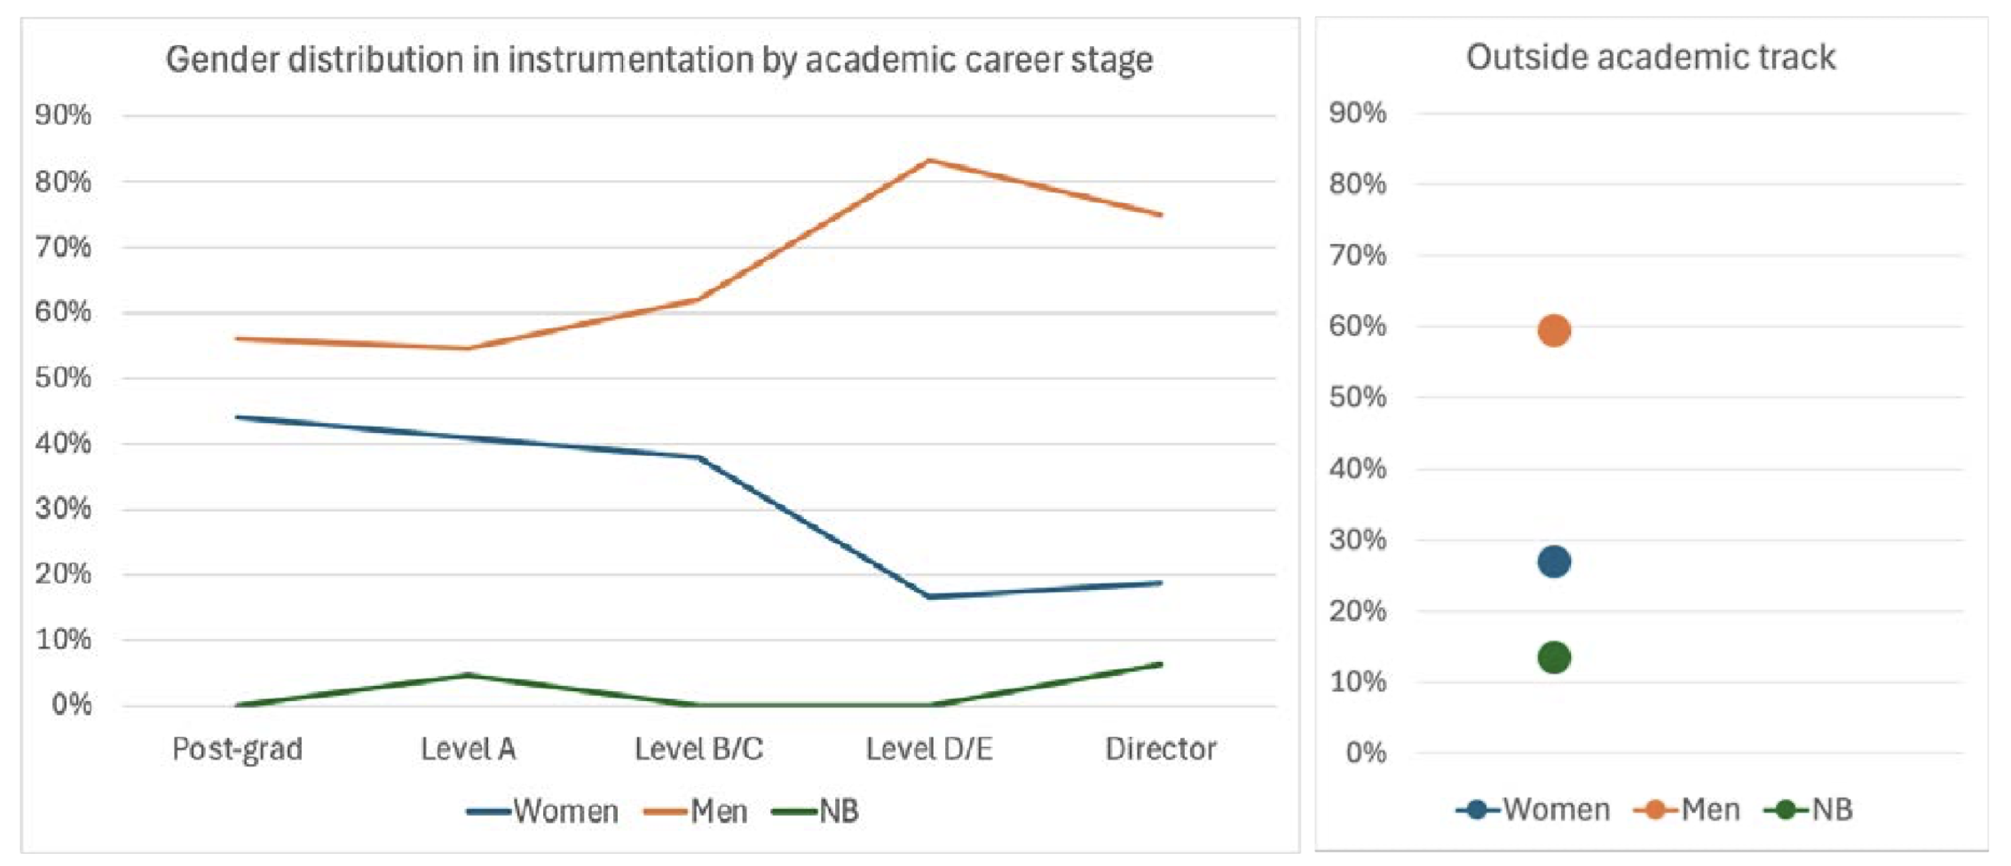
Instrumentation White Paper: Workforce
n ≈ 117
n ≈ 56
“Compared with the 2014 survey, instrumentation as a whole has increased in research effort from 13% to 21%, overtaking ‘Extragalactic Astronomy’ as the most popular area of astronomy research.”

Slide 19
Instrumentation White Paper : Key Findings
Finding 1: Instrumentation is a priority for Australian astronomy
  ● Australia has an internationally valued track record and capacity for innovation in astronomical instrumentation, with a skilled workforce decades in the making.
  ● Through the co-development of science and instrument research, this capability enables Australian scientific leadership in the technology-driven research field of astrophysics and space science.
  ● Building instruments for observatories can enable dedicated access to those facilities, while at the same time developing national capacity in associated technical areas, such as optics, electronics, software and data.
  Recommendation: Continue to ensure Australian instrumentation excellence is enabling world-class science in astronomy.

Slide 20
Instrumentation White Paper : Key Findings
Finding 2: Stable funding is needed to support core groups with key expertise
  ● Astronomical instrumentation is a specialised area. Growing and maintaining instrumentation groups requires long-term development of the relevant expertise, drawing from a small pool.
  ● Funding for individual instrumentation projects tends to be stochastic, and varied in scale, inhibiting strategic investment, planning, and recruitment of young talent.
  ● Project funding does not fund development of emerging technologies for future instrumentation.
  Recommendation: Secure stable, dedicated base funding for national-scale instrumentation programs (including those of Astralis and CSIRO) for the next decade.

Slide 21
Instrumentation White Paper : Key Findings
Finding 3: Astronomy instrumentation should be aligned, where possible, with major facility investments
● Alignment of instrumentation activities with major facilities builds the engagement of Australian astronomers with Australian instrumentation, maximising the science return of both investments.
● In-kind instrumentation contributions can offset partnership costs to international facilities, reducing the off-shore spend, and increasing return on investment in national instrumentation programs.
● Major facility partnerships typically run over many years, ensuring long-term engagement (scientifically, and financially) well-suited to typical instrumentation projects.
Recommendation: Align national-scale instrumentation program funding with the community’s long-term major facility investments, potentially via in-kind arrangements or partnership agreements.

Slide 22
Instrumentation White Paper : Key Findings
Finding 4: Large, long-term funding mechanisms are needed to engage in next generation instrumentation projects
  ● Taking a leading or major role in new instruments for next-generation astronomical facilities (e.g. ELT, GMT, or SKA) requires a scale and duration of funding currently not catered for by any national competitive grant scheme.
  ● Australia has the internationally-competitive workforce and facilities to lead and deliver such projects, but lacks the long-term funding mechanisms to secure them.
  Recommendation: Enable access to stable, mid-level ($5-10M p.a.) funding over 5-10 year periods that permits full engagement and leadership of major instrumentation projects for world-class astronomy facilities.

Slide 23
Instrumentation White Paper : Key Findings
Finding 5: Instrumentation groups, especially in academic institutions, should better support and cater for the diversity of career paths in instrumentation
  ● The vast majority of the astronomical instrumentation workforce are non-academic technical professionals and engineers with little or no background in astronomy.
  ● Outside of CSIRO, astronomical instrumentation activity largely happens within University-based groups, supported through limited-term project-based funding.
  ● Universities generally have limited mechanisms for supporting long-term career development and substantive employment for non-academic staff.
  ● Limited career stability and progression makes recruitment and retention of highly-trained technical professionals a major challenge.
  ● Academic careers emphasise a ‘publish or perish’ pathway that is not well suited to high-risk, high-reward research into new instrumentation, inhibiting the growth of technical research academics within University groups.
  Recommendation: Establish sustainable and rewarding career paths within the sector for instrumentation professionals from academic and non-academic/industry backgrounds.

Slide 24
Summary
As part of the AAO national observatory, AAT has been, and continues to be, a nexus for Australian optical instrumentation development
“AAO” continues to evolve, from national observatory, to international collaborator of choice, based at Macquarie University
The Astralis consortium marks a fundamental shift in Australian optical instrumentation, creating a powerful national capability with expanding engagement with industry, training, and diversified research
The Decadal Plan highlights both the value, and fragility, of Australia’s hard-fought instrumentation asset, the need for stable funding, and the opportunity to add value to infrastructure investments (AAT, ESO, GMT)

Slide 25
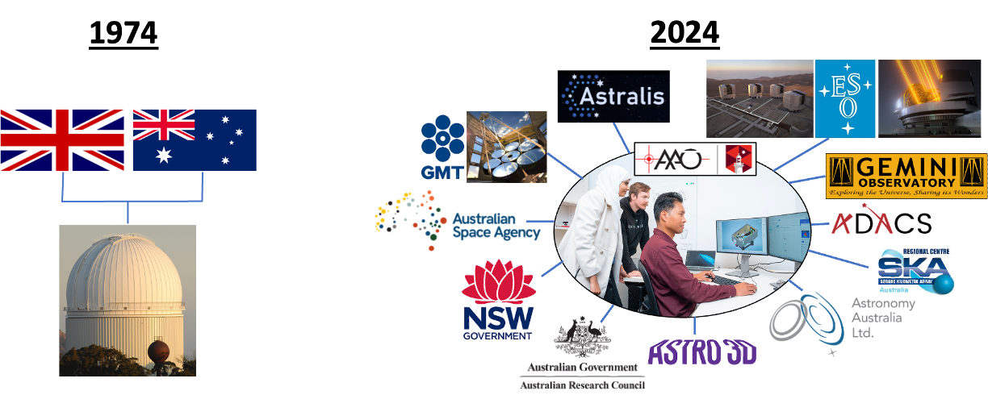
AAO: An ongoing story…
Evolving from a
national observatory history …
… to an interconnected, people-led future.

