Slide 1









The GC – Galaxy Connection
and The Origin of Ultra Diffuse Galaxies
North American Collaborators
Aaron Romanowsky, Yimeng Zang
Roberto Abraham, Pieter van Dokkum, Shany Danieli
Swinburne Collaborators
Duncan Forbes
Warrick Couch
Jonah Gannon
Joel Pfeffer
Anna Ferrè-Mateu
Luisa Buzzo
Lydia Haake
Steve Janssens
Jean Brodie

Slide 2
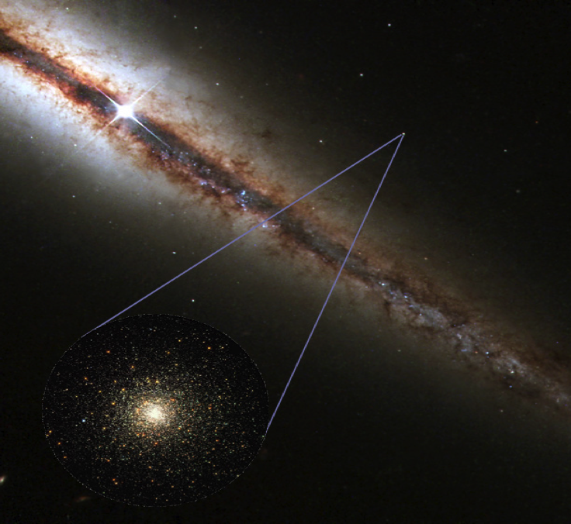
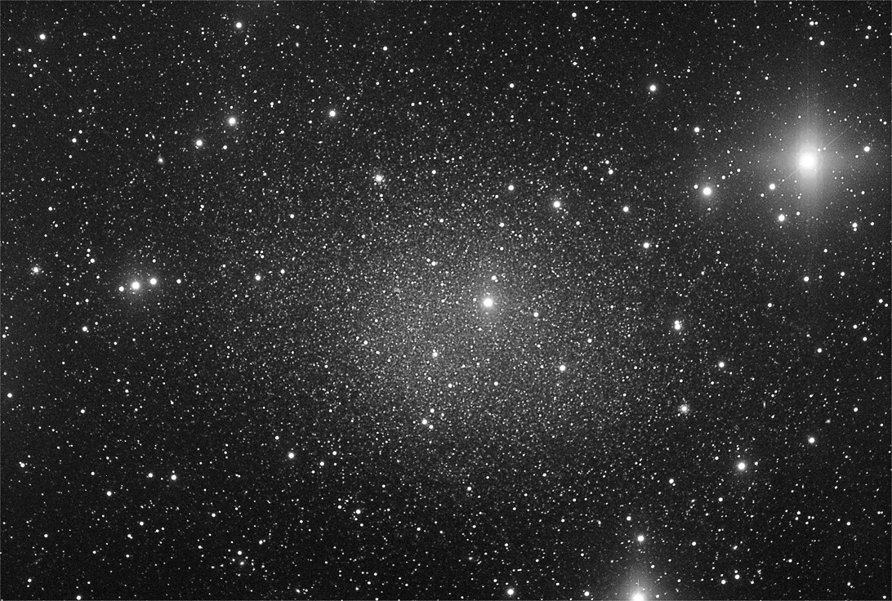
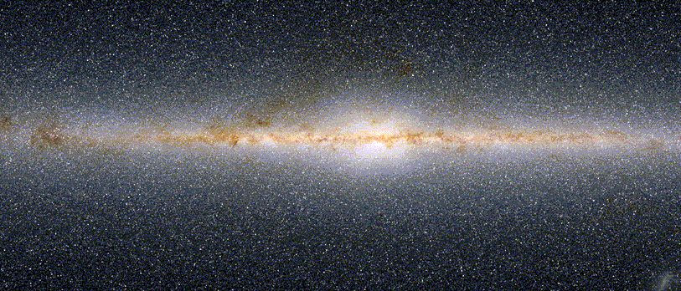
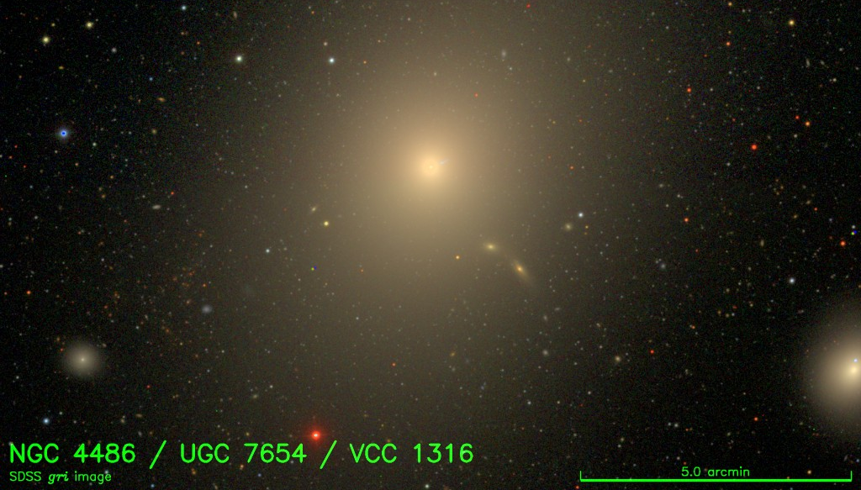
Globular Clusters
Spherical aggregates of stars
(10⁵­−10⁶ M☉)
Almost all galaxies
(>10⁹ M☉) host GC systems
GC formation accompanies all major star formation
Vast majority are old
Bright fossil tracers of galaxy formation
Spectroscopy feasible to
~ 50 Mpc
Dwarfs: 0 to 10s
Spirals: 10s to 100s
Ellipticals: 100s to10,000+
Notes:
Almost all galaxies >10⁹ M☉ host GC systems
GC formation accompanies all major star formation
Bright (10⁵­10⁶ M☉) fossils
Spectroscopy feasible to ~ 50 Mpc

Slide 3
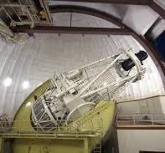
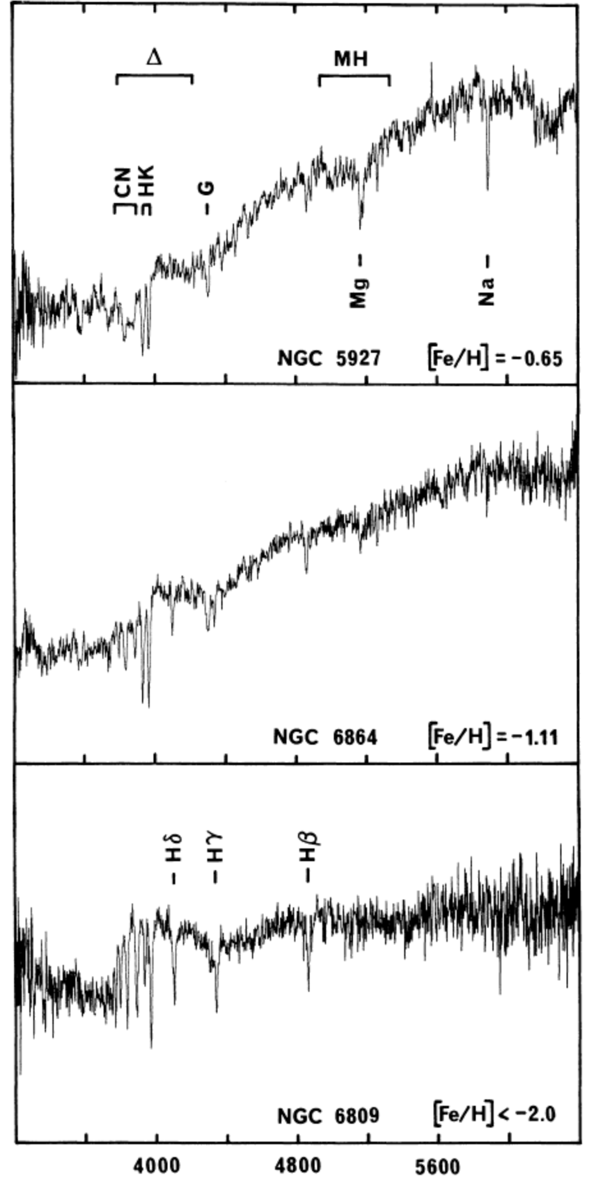
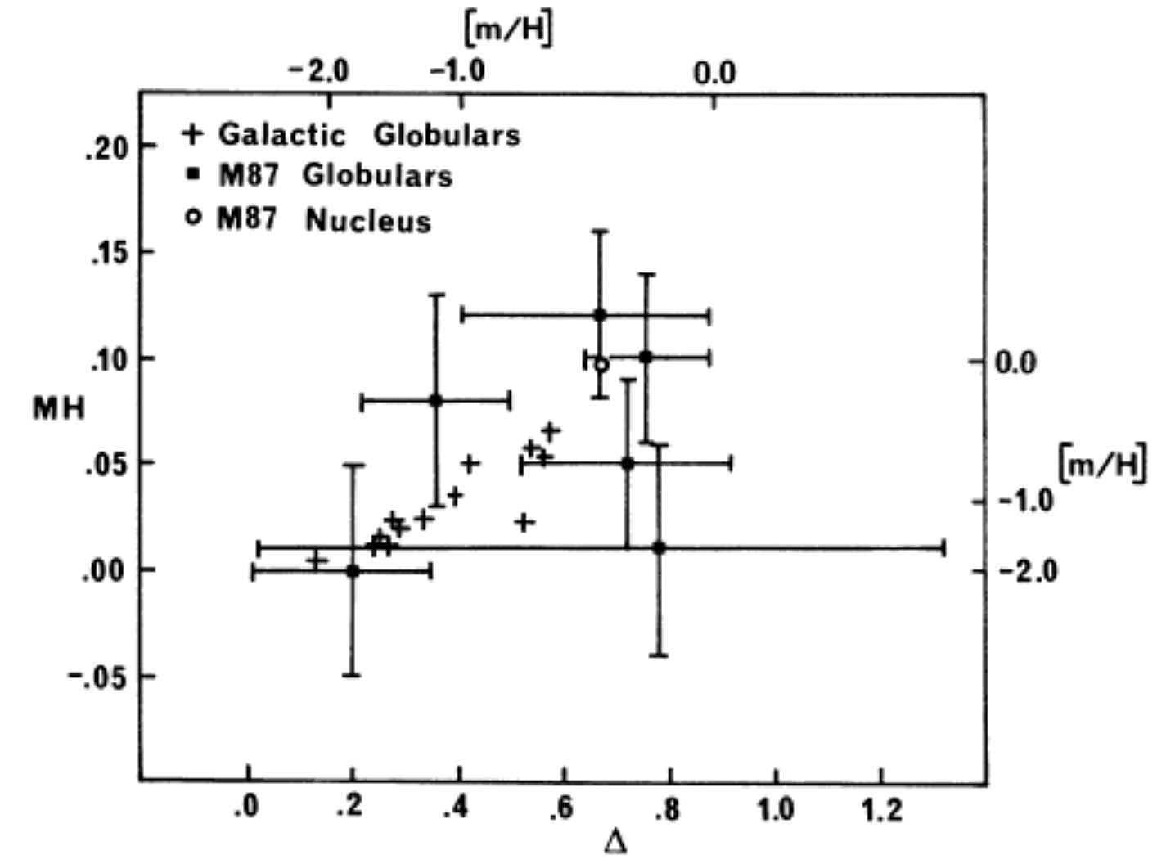
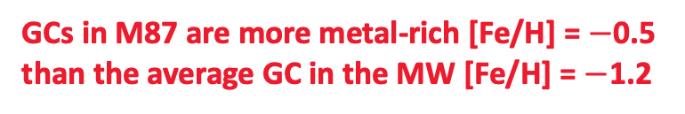

The Globular Cluster – Galaxy Connection
From Ancient History to Unique Constraints
My PhD observations of M87 were made with the AAT !!
Brodie & Hanes 1986
Hanes & Brodie 1986
Defined and calibrated 16
metallicity indices from 36 MW GCs
Derived metallicities for 6 galaxies
6 GCs in M87 w/IPCS
Minimum zenith distances of $\sim$43 degrees !!
Integration times 50 min to 2.5 hrs
GCs in M87 are more metal-rich [Fe/H] = $−$0.5
than the average GC in the MW [Fe/H] = $−$1.2
Notes:
Modelled differential refraction
6 indices, 36 MW GCs, 6 galaxies, spirals point down, ellipticals point up.

Slide 4
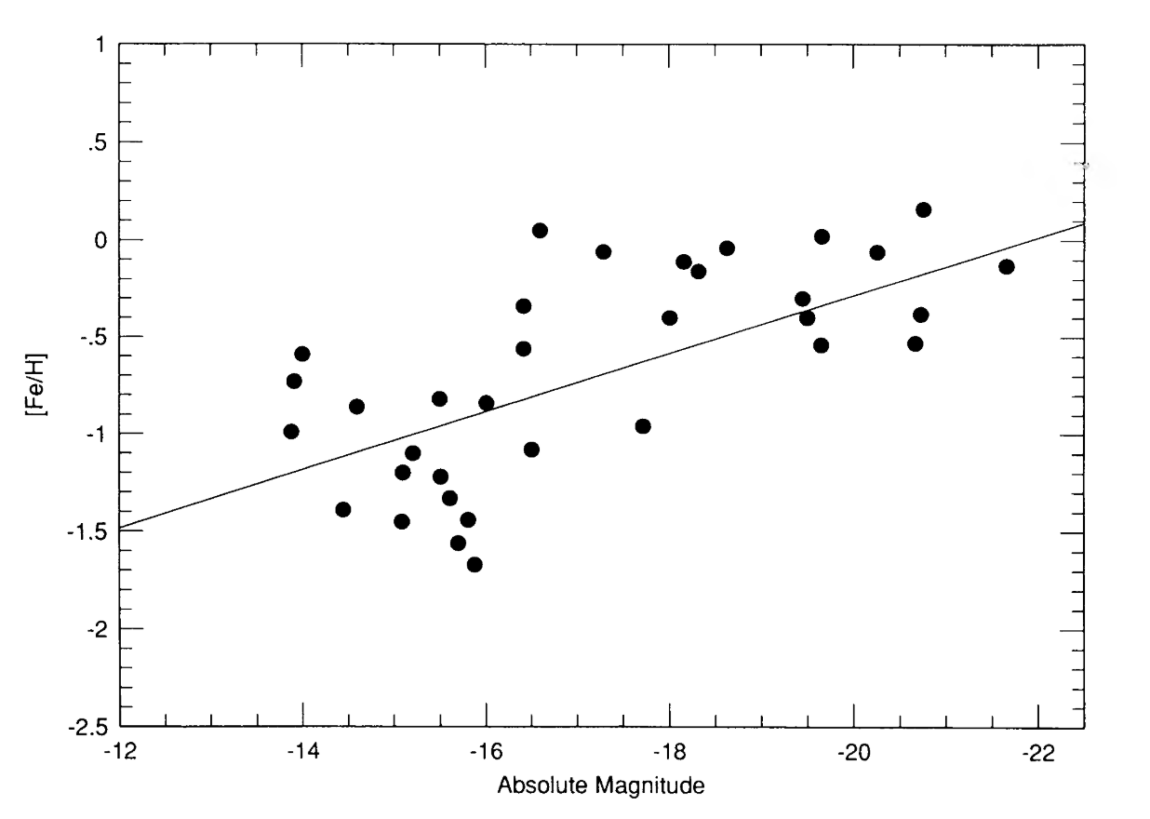
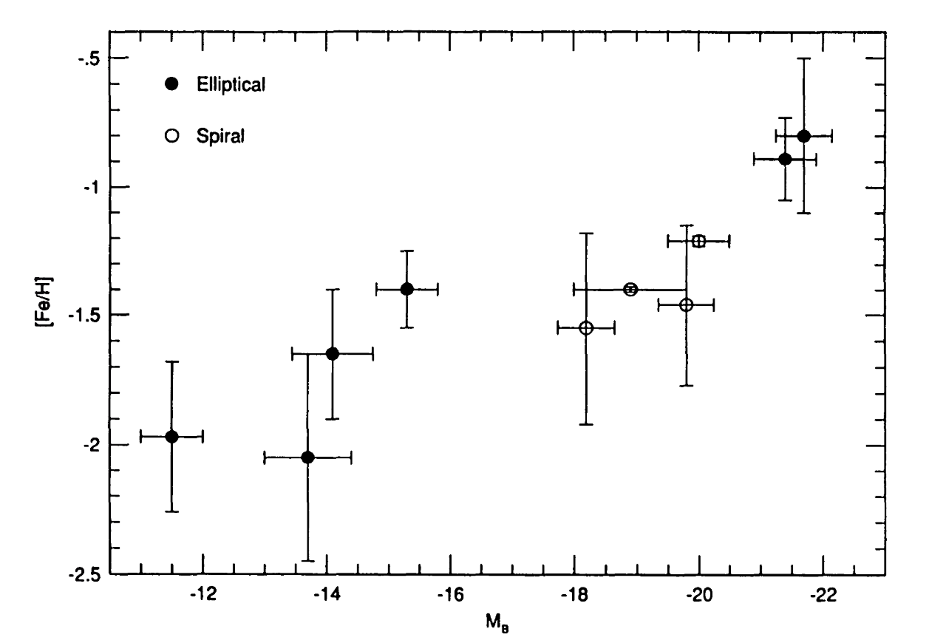
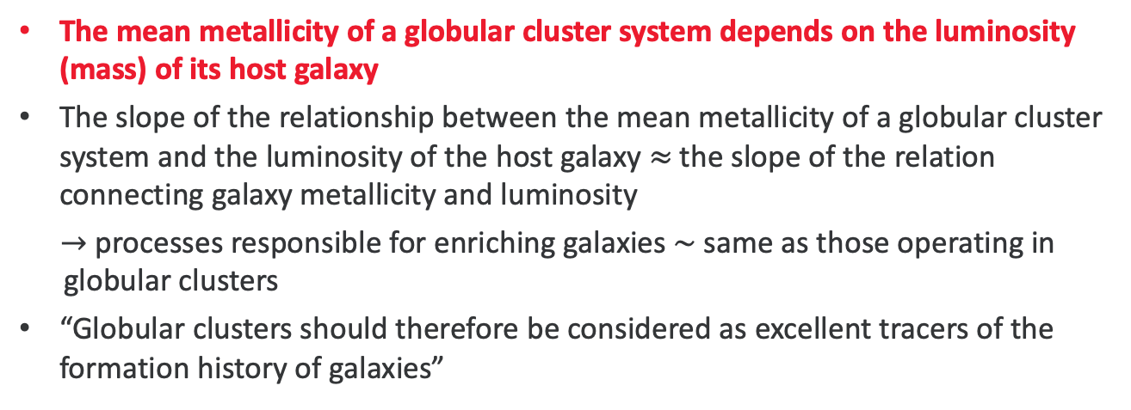
Revealing the fundamental connection between GCs and Galaxies
The mean metallicity of a globular cluster system depends on the luminosity (mass) of its host galaxy
The slope of the relationship between the mean metallicity of a globular cluster system and the luminosity of the host galaxy $≈$the slope of the relation connecting galaxy metallicity and luminosity
$→$processes responsible for enriching galaxies $\sim$same as those operating in
globular clusters
“Globular clusters should therefore be considered as excellent tracers of the formation history of galaxies”
Brodie & Huchra 1990, 1991
GC mean metallicity
Galaxy metallicity
Host Galaxy Luminosity
Galaxy Luminosity
Notes:
There is an offset in the relations, in the sense that clusters are more metal poor than the galaxies at a given luminosity.

Slide 5
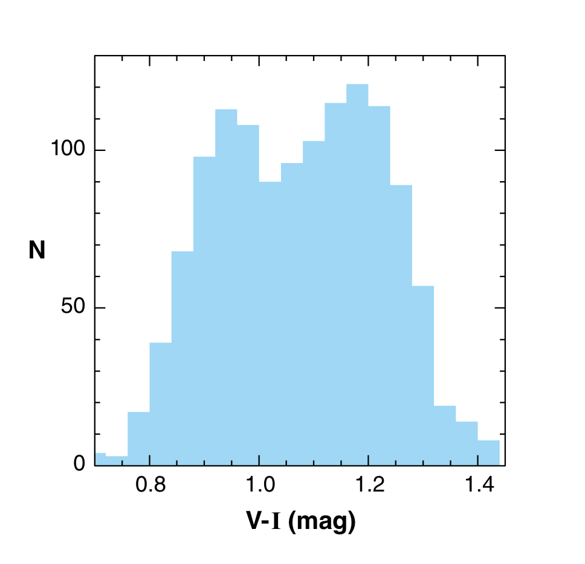
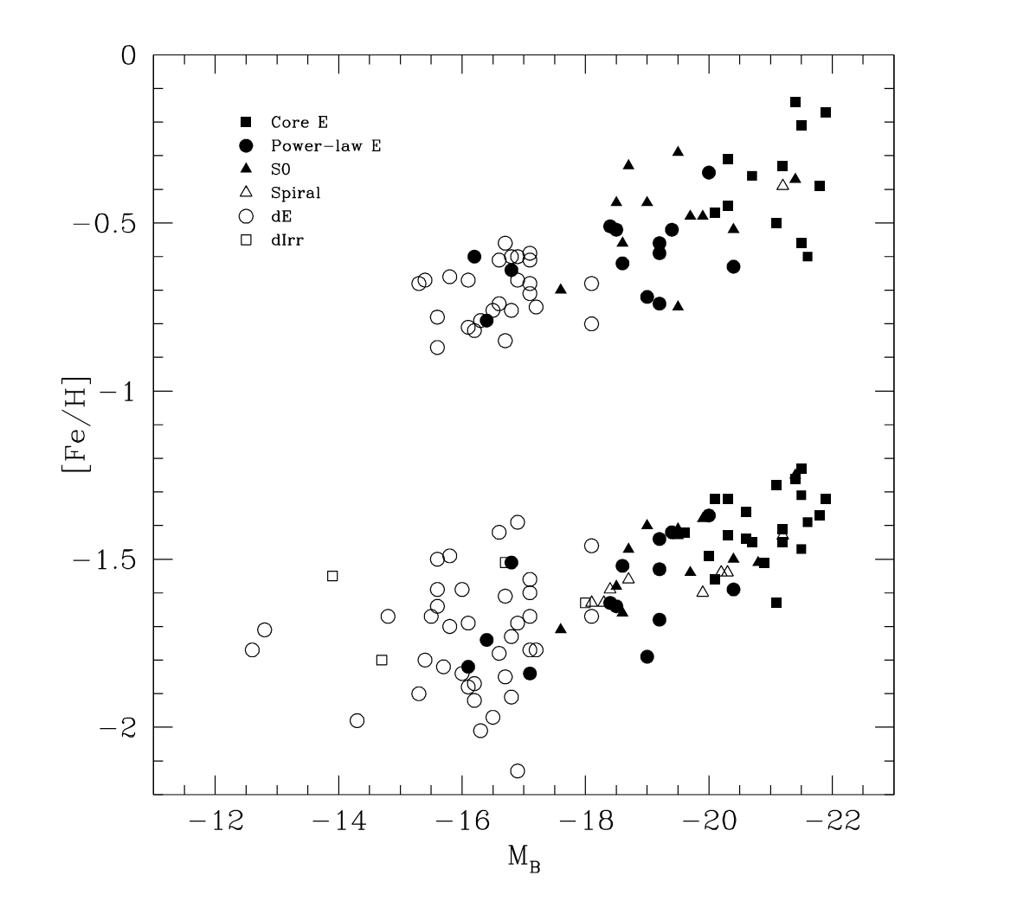
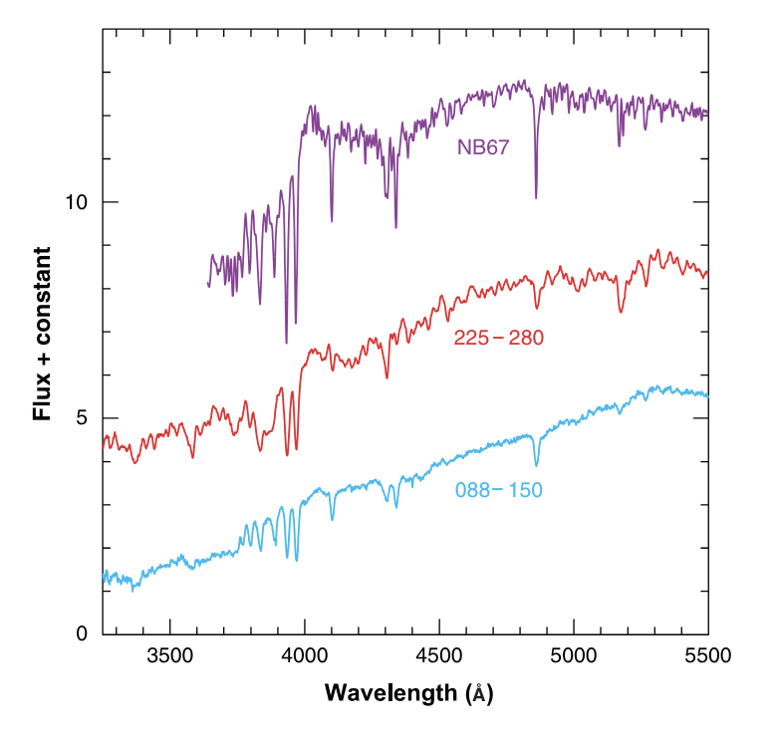
Applies to both MR and MP subpopulations
Larsen, Brodie, + 2001
Brodie & Strader 2006
GC peak metallicity
Galaxy luminosity
Keck/LRIS Integration times ~5 mins

Slide 6
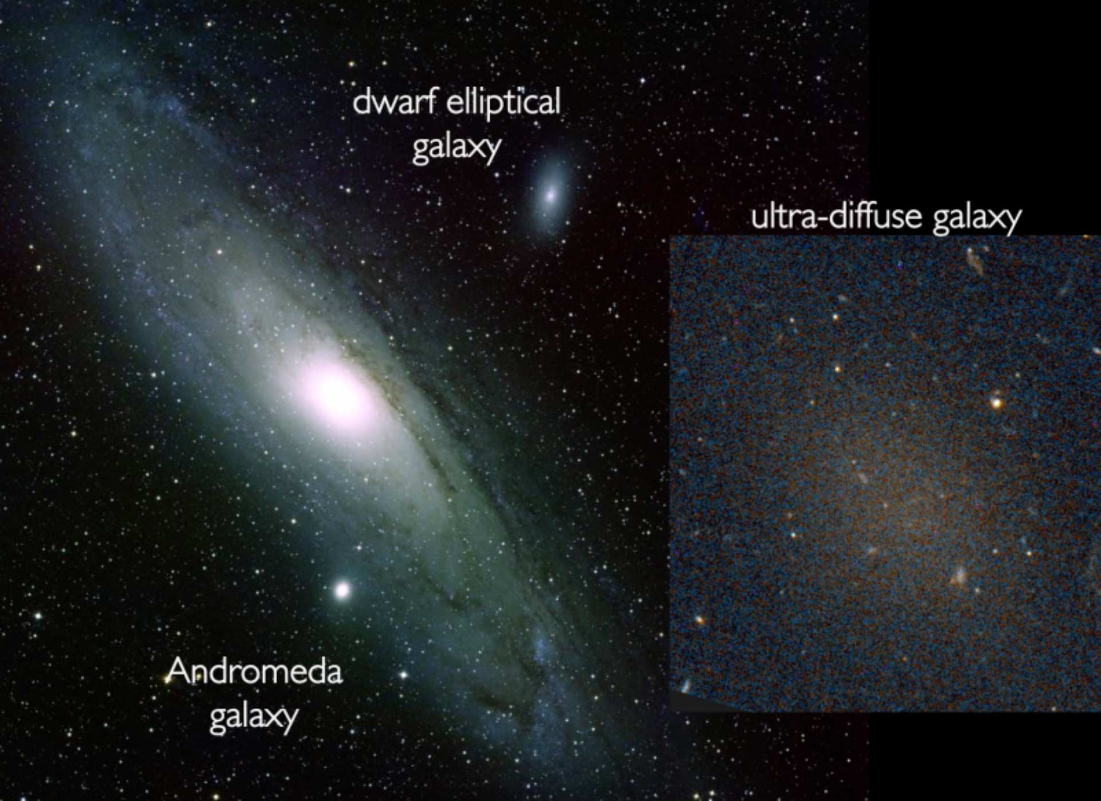
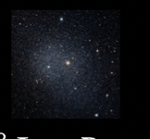
Ultra Diffuse Galaxies (UDGs)
dwarf spheroidal
galaxy
Images to scale
Working definition:
UDGs are LSB galaxies (𝜇>24 m/arcsec²), sizes Re > 1.5 kpc
Notes:
What are ultra diffuse galaxies

Slide 7
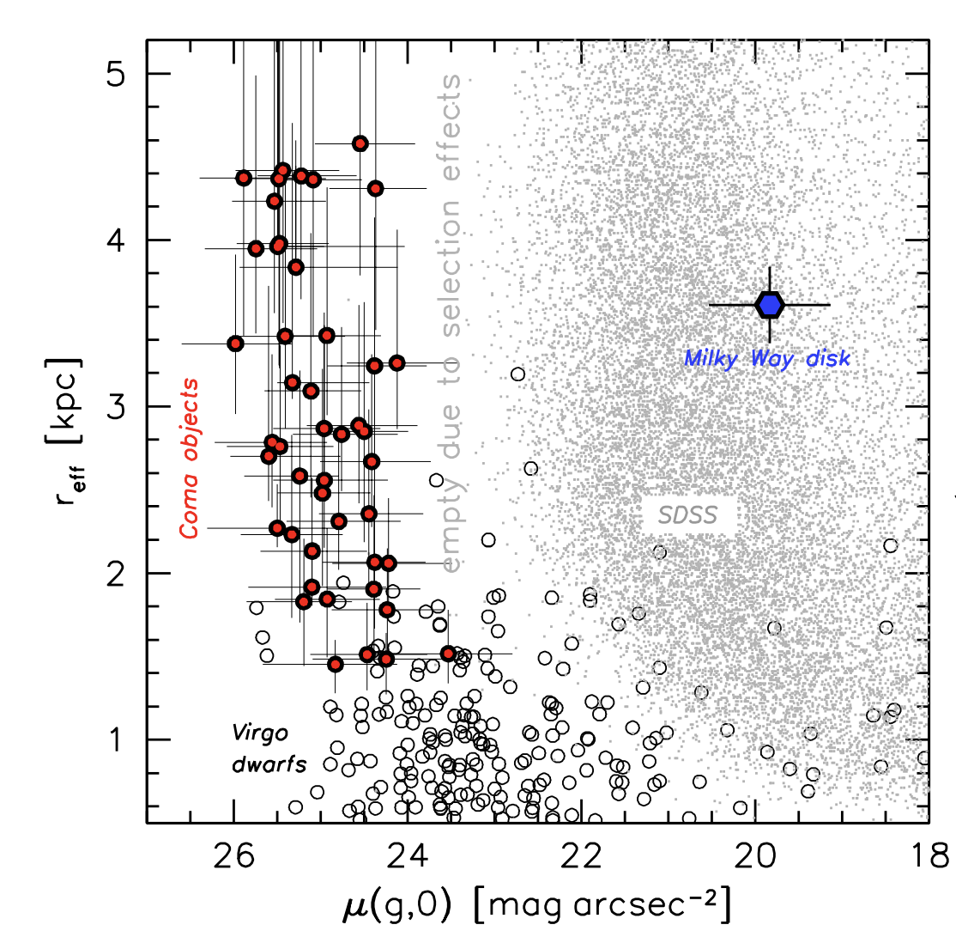
Another bit of history
Low Surface Brightness galaxies with UDG properties are not new
Handful discovered much earlier
Impey+ 1988, Bothun+ 1991, Dalcanton+ 1997
Identified in large numbers, originally in Coma, and recognized as a new class
of galaxy, van Dokkum+ 2015
van Dokkum+2015
Then found in groups and the field
e.g., Martinez-Delgado 2016, Roman & Trujillo 2017,
Leisman+ 2017

Slide 8
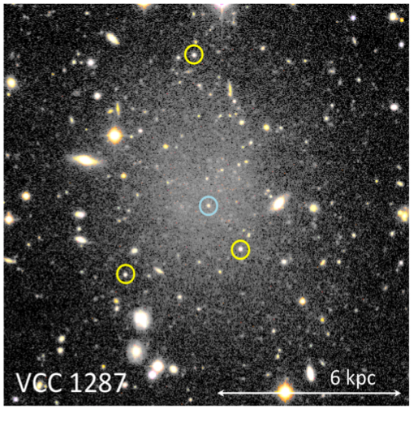
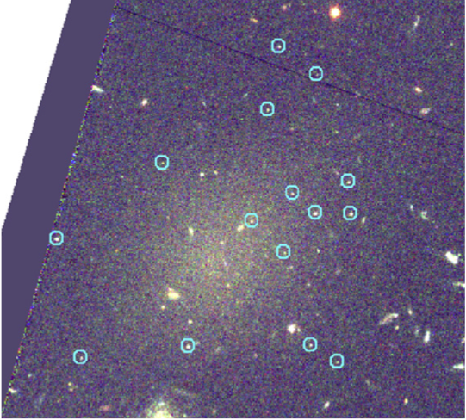
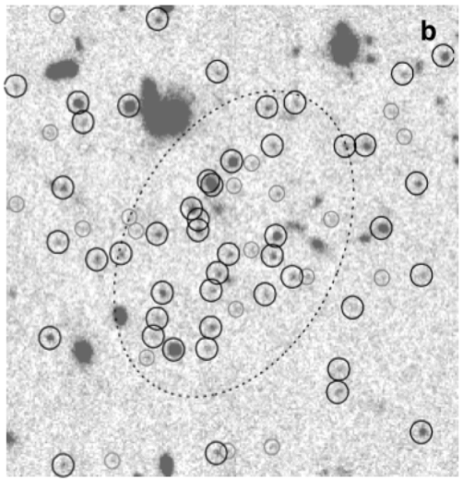
Globular clusters in ultra diffuse galaxies
DF17
DF44
How do we measure the mass of a UDG?mass:
Estimate from stellar velocity dispersion (extremely telescope time intensive)
Weak lensing (few results, stacking, only limits)
X-rays/UV – no detections
GC dynamics
Count number of GCs (mass in GCs)
Notes:
GM/R ~ sigma^2

Slide 9
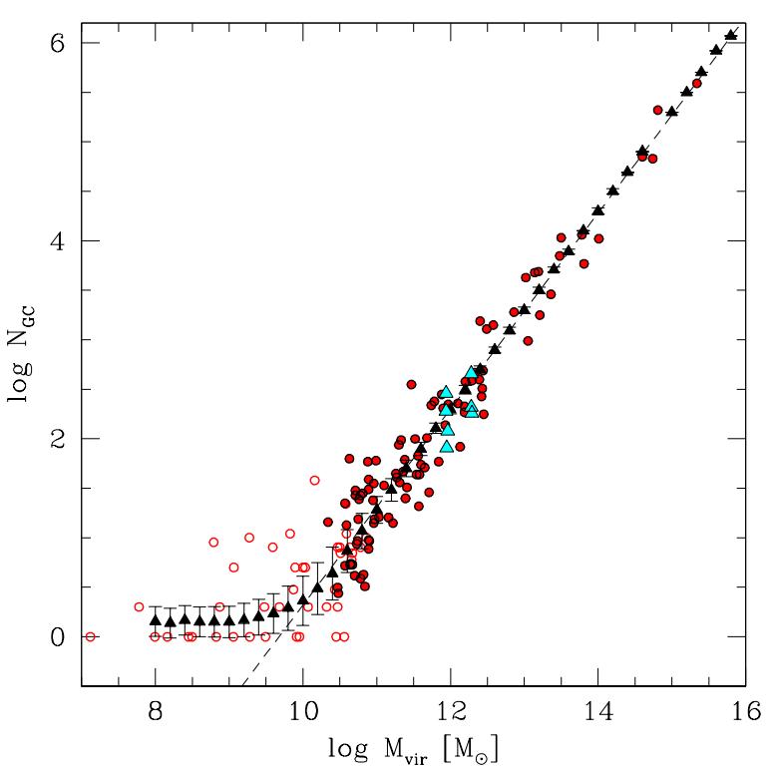

Globular Clusters Indicate Halo Mass
$M_{Halo}=5 ×{10}^{9} M_{ʘ}{ N}_{GC}$
Globular Cluster Number
Tested for
Dragonfly 44
[van Dokkum+ 2019]
Halo Mass
Burkert & Forbes (2020)
Notes:
Just mention that the masses come from variety of sources but you don’t need to care about where

Slide 10
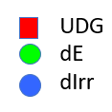
Observations
Forbes et al. (2020)

Slide 11
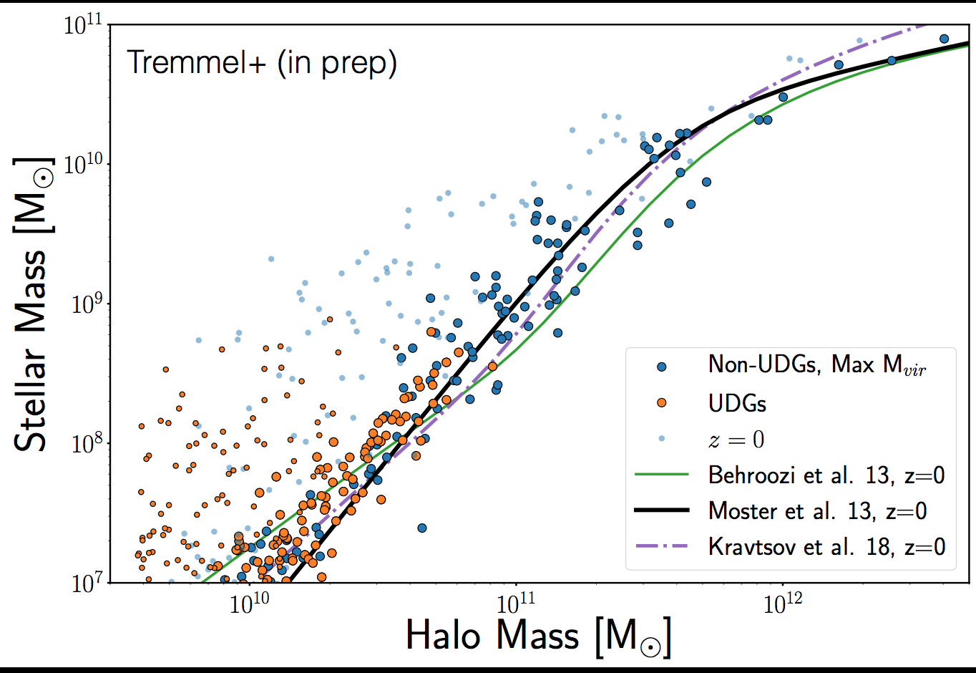
Simulations
Romulus-C cosmological hydrodynamical simulation
2020
Gannon+ 2020

Slide 12
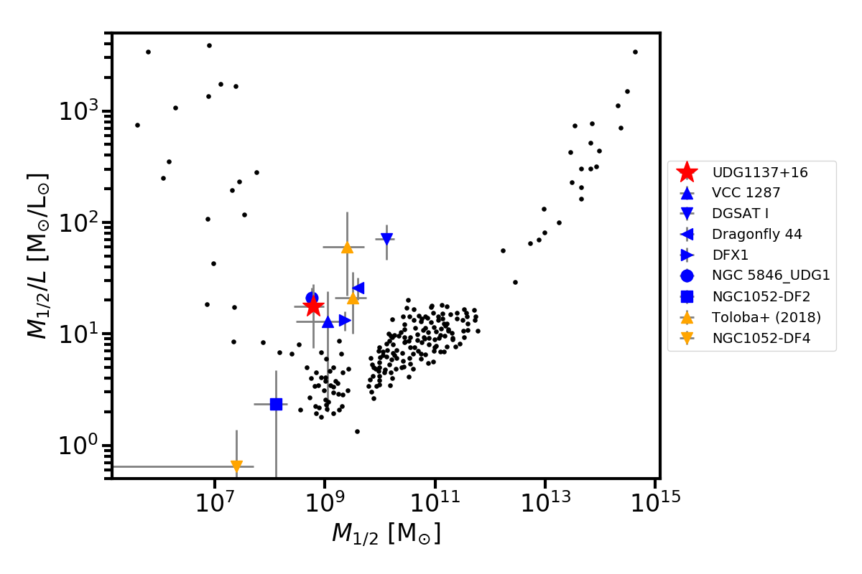
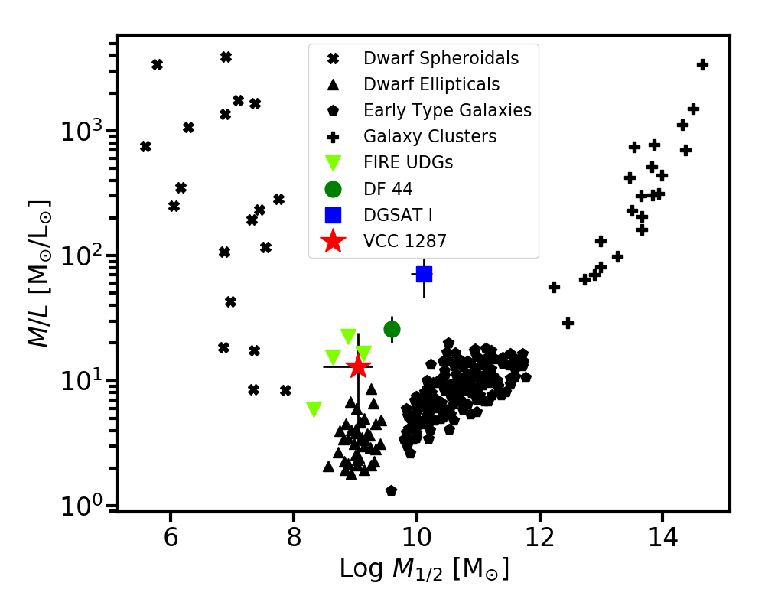
Mass to Light
Gannon+ 2020
Extreme variations in UDG M/L ratios
Mass-to-light ratio with half-light radius
GCs Stars
Dynamical mass within half-light radius
FIRE cosmological simulations of dwarf galaxy formation
can reproduce some UDGs, but not all, and GCs remain tbd
Notes:
FIRE cosmological simulations of dwarf galaxy formation
can reproduce some UDGs, but not all, and GCs remain tbd

Slide 13
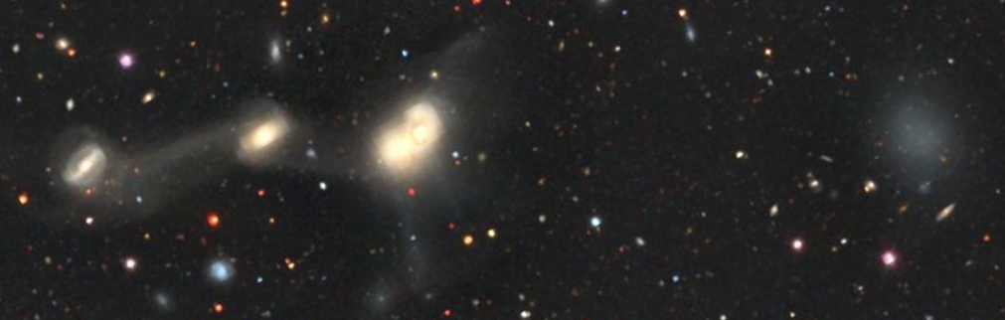
3 UDG TYPES
Old, gas poor
Puffy Dwarfs
Dwarf galaxies that were puffed-up and made “ultra diffuse”
Candidate processes: tidal interactions; high spin; strong feedback
Expect modest halo mass, low velocity dispersion, few GCs
Failed Galaxies
Dark matter halo ~ 10¹¹ solar masses
Formed stars at an early epoch but ceased subsequent star formation
Candidate processes: tidal heating, ram pressure stripping;
violent, early massive star cluster formation → gas ejection
Expect high halo mass, high velocity dispersion, many GCs
Dark Matter Free
Not expected!
Notes:
It is this “Puffy Dwarf” type of UDG that has been successfully simulated
Failed giants, by some, as yet unknown, mechanism ceased subsequent star formation.
Failed galaxies lie above the SMHM relation for normal galaxies
DM Free – not initially expected

Slide 14
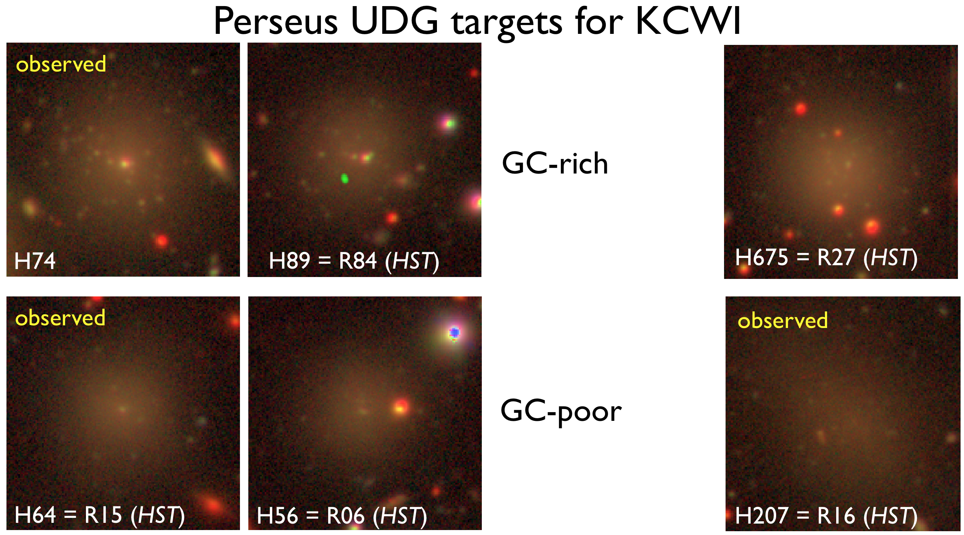
GC rich – failed galaxies?
GC poor – puffed up dwarfs?
Globular Cluster Rich Globular Cluster Poor
Both types in all environments
Many UDGs have remarkably rich GC systems
Notes:
Many UDGs have remarkably high specific frequencies

Slide 15
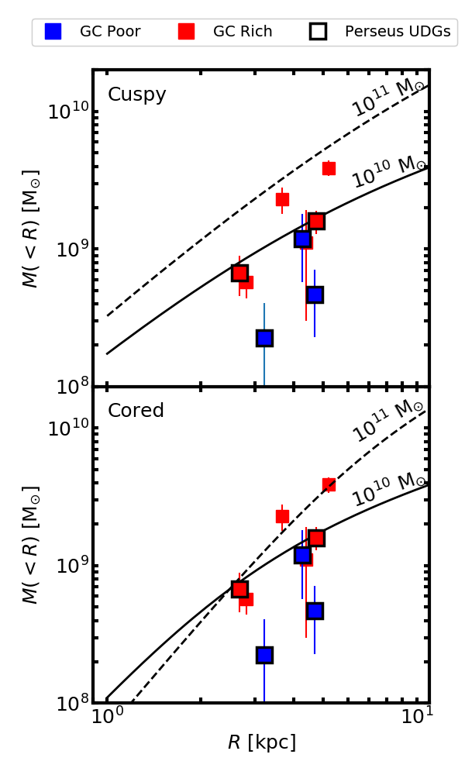
GC poor UDGs in lower mass halos
GC-poor UDGs live in "under-massive" haloes
Galaxies formed at earlier redshifts expected to have more GCs
Mistani+2016; Bastian, Pfeffer+2020, Carleton 2021
At higher redshifts, haloes are more compact and core mass is higher
(LCDM prediction)
Expect a correlation between GC richness and enclosed mass
Gannon+ 2022
Notes:
At higher redshifts, haloes are more compact and core mass is higher
(LCDM prediction)
→ Expect a correlation between GC richness and enclosed mass
(As a side note about halo "compactness" in case this comes up: In the usual NFW definition of concentration [c=r_200/r_s], at a fixed mass high redshift haloes are *less* concentrated than at present day. But the haloes are more compact because r_200 is smaller. Because scale radius r_s is about constant, the "core mass" [mass within r_s] is larger at high redshift.)

Slide 16
E-MOSAICS
Simulating Globular Cluster Formation
Sub-grid, on the fly modeling
Schaye+ 15
Crain+ 15
Kruijssen+ 11
Pfeffer+ 18
Notes:
Mosaics is a sub-grid model for cluster formation and evolution
On-the-fly modelling (timestep level)
Each star particle hosts its own (sub-grid) cluster population based on local properties
Cluster formation physics based on young star clusters
Cluster formation efficiency, Γ
Exponential truncation to mass function, M_{c,*}
Model recovers relations of observed clusters (Pfeffer+ 19)

Slide 17
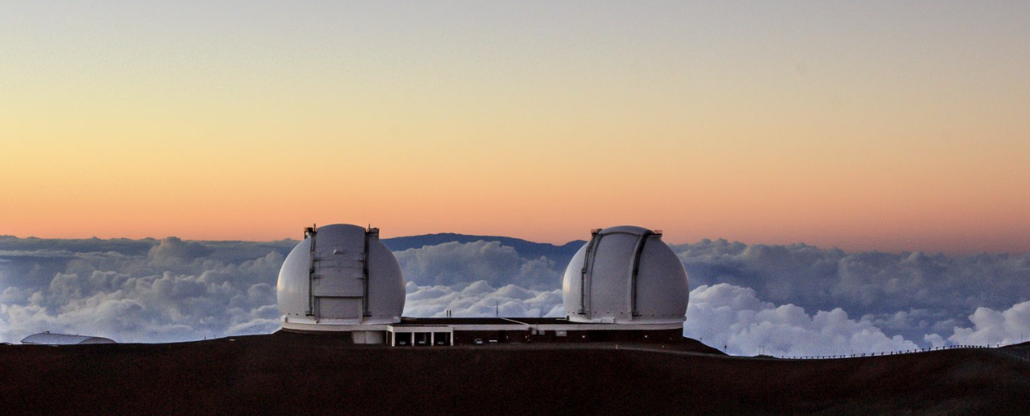
Testable Predictions
E-MOSAICS SIMULATIONS
Pfeffer+ 2023, 2024
Establishing UDG properties directly too telescope time intensive
Understanding GC formation in UDGs is essential
Natal gas pressure determines GC richness
More rotation in GC poor UDGs
GC rich UDGs should have rounder shapes on
average than GC poor ones
Pfeffer+ 2023
Notes:
GC formation needs to be explicitly simulated
Mosaics is a sub-grid model for cluster formation and evolution
On-the-fly modelling (timestep level)
Each star particle hosts its own (sub-grid) cluster population based on local properties
Cluster formation physics based on young star clusters
Cluster formation efficiency, Γ
Exponential truncation to mass function, M_{c,*}
Model recovers relations of observed clusters (Pfeffer+ 19)

Slide 18
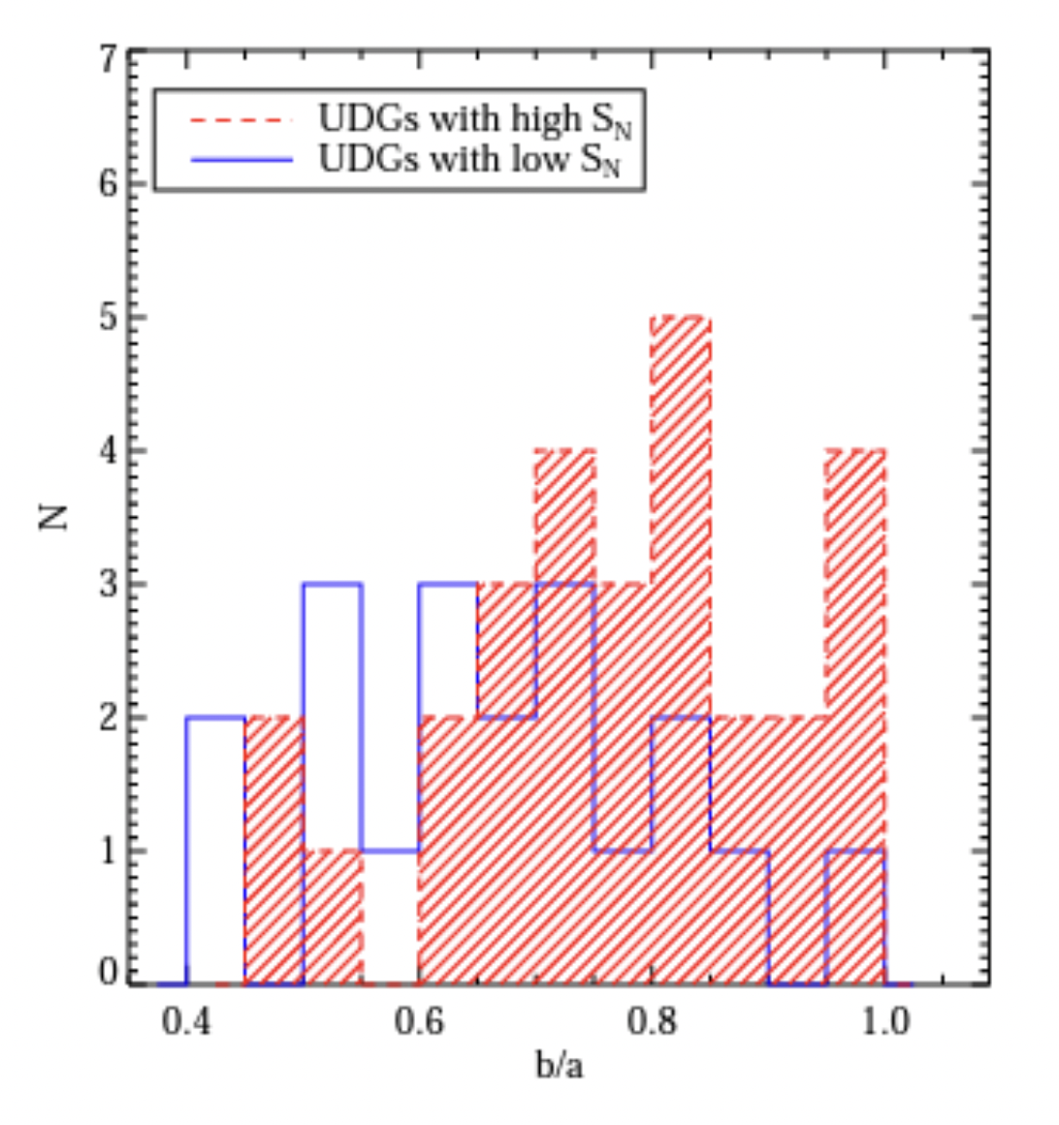
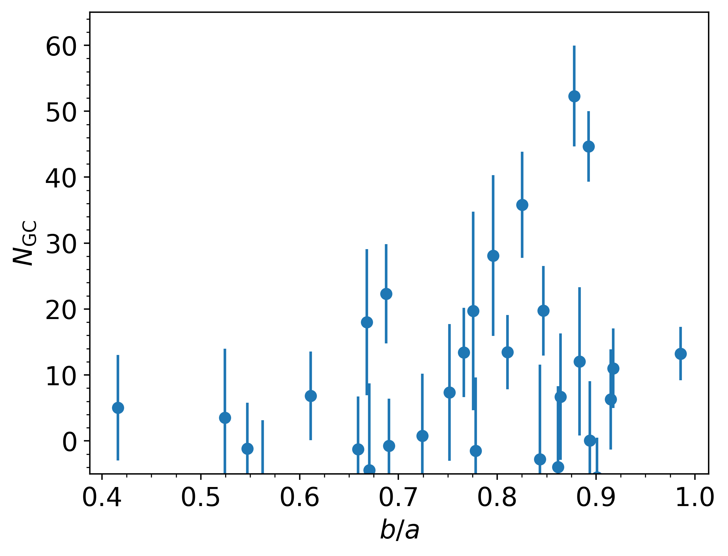
Evidence that GC Poor UDGs are Diskier
What Do We Know About UDG Rotation?
Very few rotation measurements in quiescent UDGs, especially GC poor ones
DF44 not rotating, GC rich ✓
Lim+ 2018 found low S_{N} UDGs in Coma to be more elongated
Perseus results from HST imaging
Janssens+ 2024 submitted
High S_{N} UDGs all round
Elongated UDGs have low S_{N}
Notes:
The b/a values are from van Dokkum et al. (2015) and
van Dokkum et al. (2017).
The blue solid open histogram
shows the distribution for UDGs with S_N values similar to
classical dwarf galaxies. The red dashed histogram shows
the distribution for UDGs with high S values.
A KS test
for these two distributions yields a K-S statistic of 0.40 and
probability of 0.038, indicating that the distributions differ
at high confidence.

Slide 19
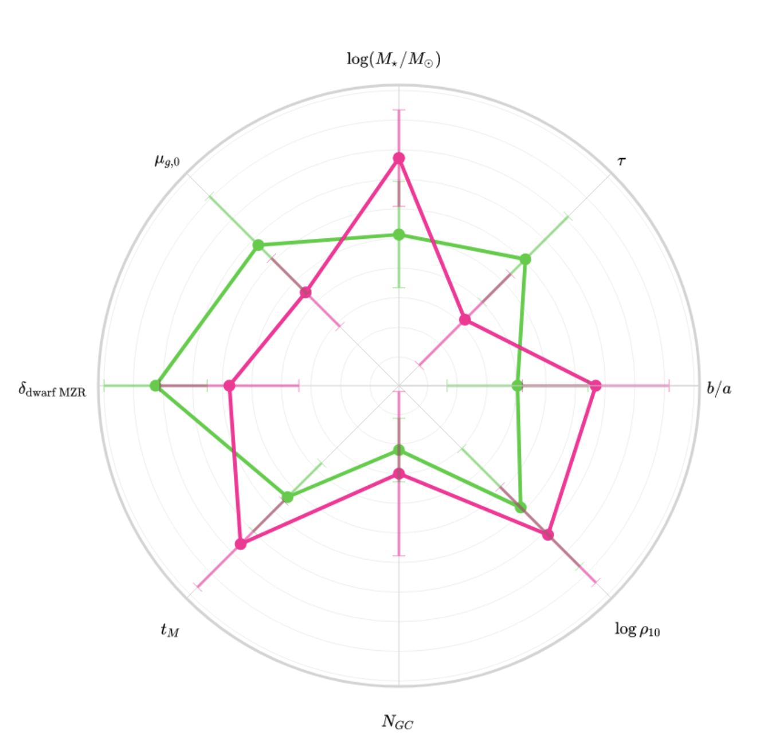
UDGs separate into two sub-classes: puffy dwarfs & failed galaxies
Based on SED Fitting
37 UDGs with N_{GC}
KMeans grouping algorithm → clear separation into 2 classes
Lower stellar mass, more metal rich, prolonged SF, more elongated, in less dense environments, lower N_{GC}, younger, fainter, smaller, follow classical dwarf MZR
More massive, metal poor, quick SFHs , rounder, in the densest environments, richest GC systems, older, brighter, largest sizes, fit the evolving MZR at 𝑧 = 2.2, i.e., consistent with early-quenching.
Buzzo+ 2024
Notes:
less massive, more metal rich, have higher 𝜏 values (i.e., prolonged SFHs), have smaller axis ratios (i.e., elongated), live in less dense environments, have a small number of GCs, are younger, fainter, have smaller physical sizes, and are all well within the classical dwarf MZR.
more massive, metal poor, have smaller 𝜏 values (i.e., quick SFHs), have higher axis ratios (i.e., rounder), live in the densest environments, host the richest GC systems, are older, brighter, have the largest physical sizes, and are better explained by the evolving MZR at a redshift of 𝑧 = 2.2, i.e., consistent with early-quenching.

Slide 20
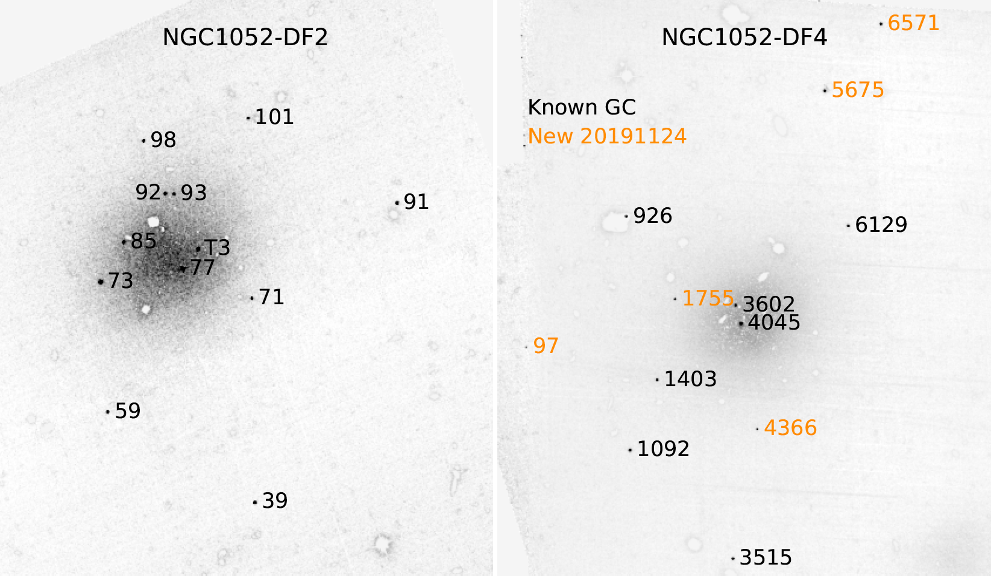
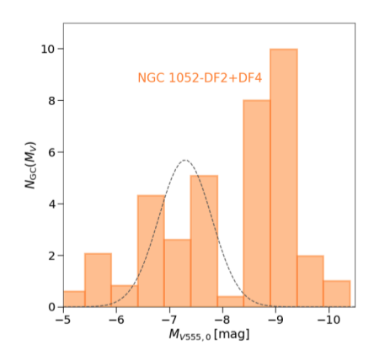
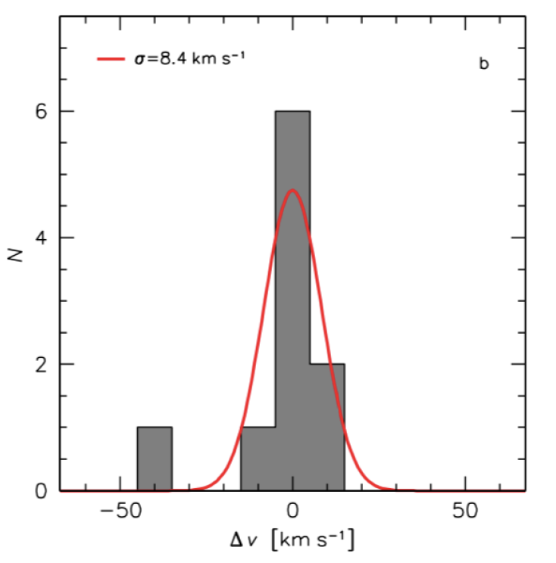
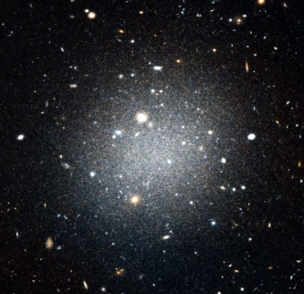
UCDs in UDGs lacking DM
🤨
Population of luminous, extended, flattened star clusters => UCDs
van Dokkum+ 2018, 2019 Shen+ 2020
DF2
M★ = 2 x 10⁸ M⦿
Mhalo < 3.4 x 10⁸ M⦿
Mhalo/M★ ~ 1 consistent with zero dark matter
DF2
Expected Mhalo is 400 times higher than our upper limit
Notes:
With the revised distance, all of the GCs in NGC 1052–DF2 are 0.2 mag more luminous than previously reported. The GC luminosity function now peaks at Mv ≈ −9.3, even further from the canonical value of −7.5 (see Rejkuba 2012).

Slide 21
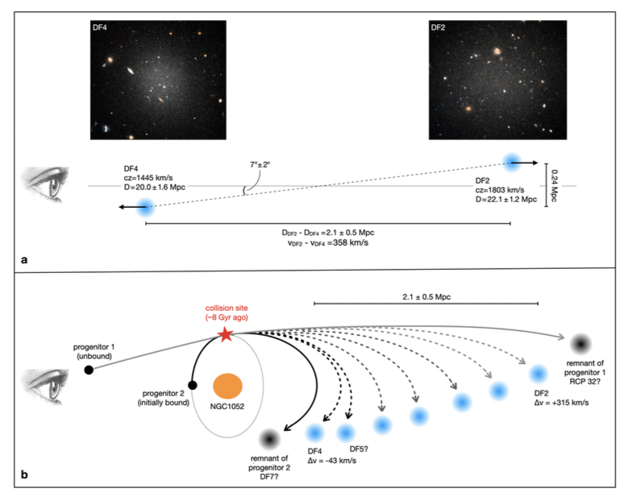
Bullet formation scenario
NGC 1052 group
van Dokkum+ 2022 Nature
Two gas rich galaxies collide
Creates trail of UDGs
stripped of DM
Also creates massive star clusters & feedback expands UDGs
Stellar pops are key:
DF2 and DF4 same metallicities & ages
[Fe/H] -1.35, ~8 Gyr, consistent with model
DF5? Similar but fainter
Notes:
Self-interaction cross section for DM
Search for other examples – simulations suggest 8 within 20Mpc
Star cluster ages in DF2 ≳ 8 Gyr,
[Fe/H] ≅ –1.35

Slide 22
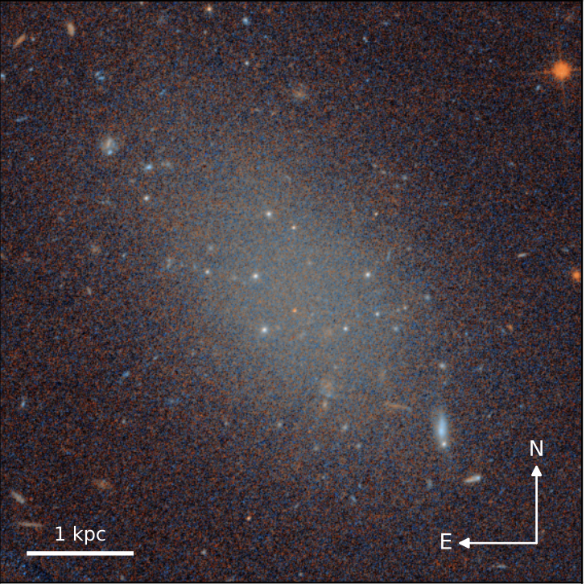
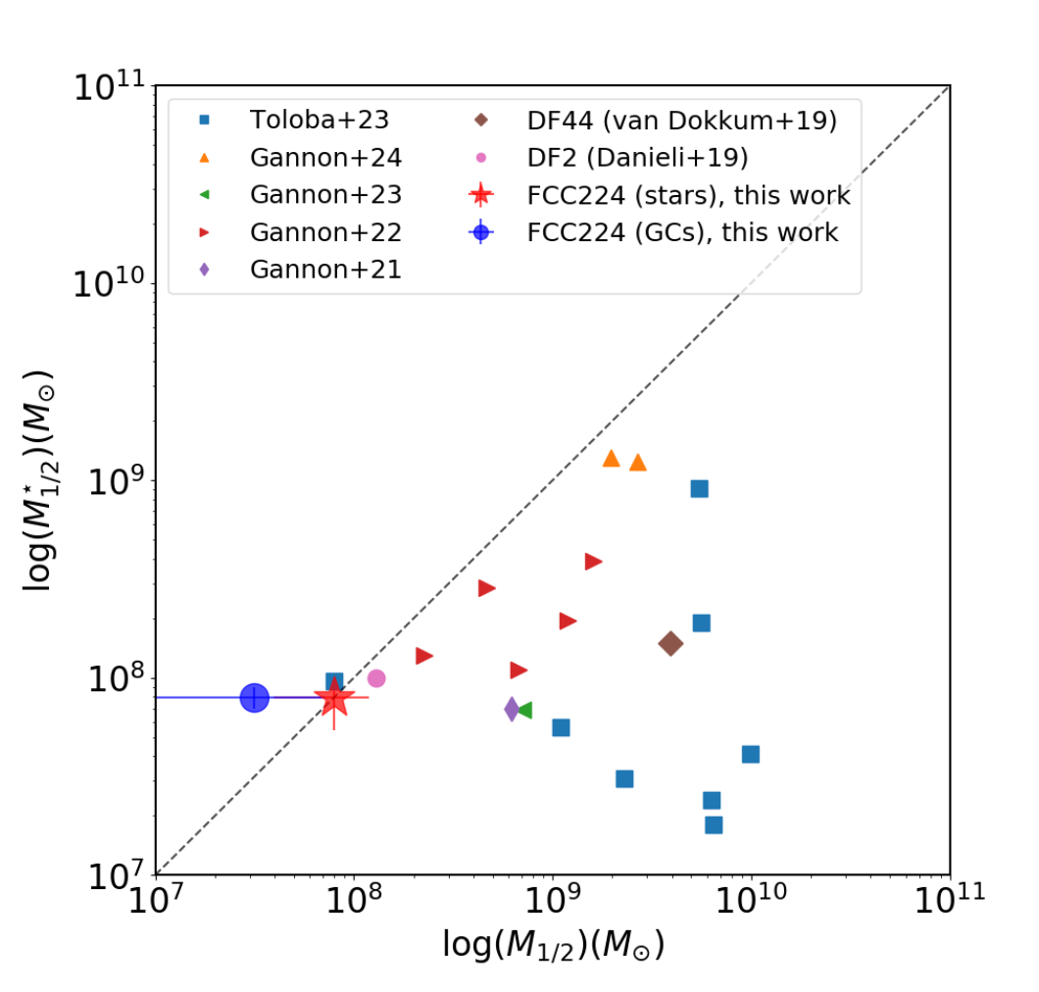
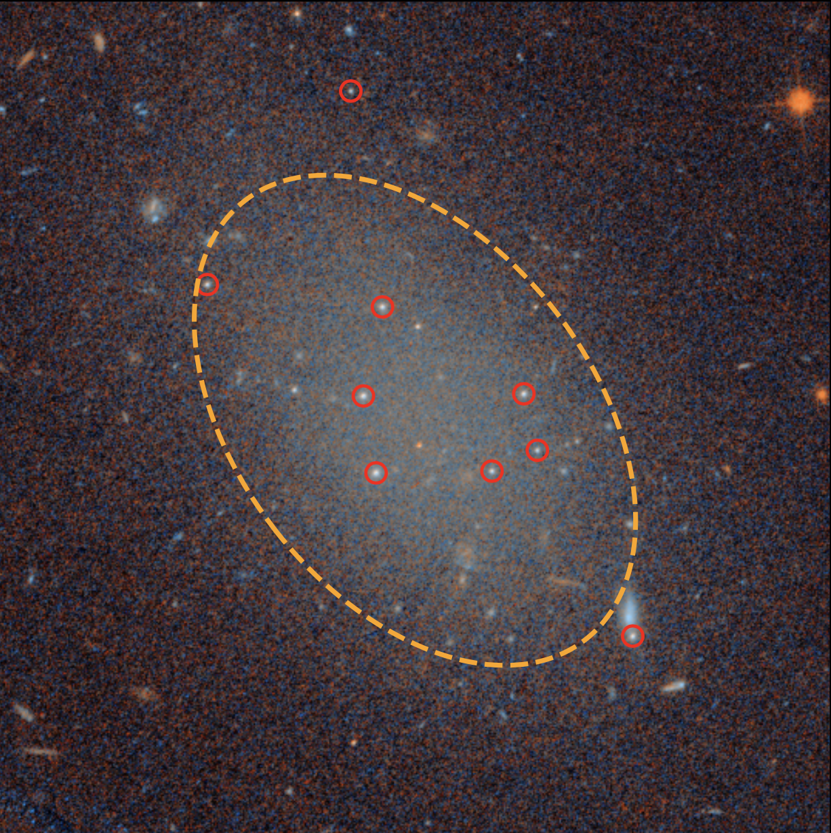
Another DM – free UDG
FCC 224 (Romanowsky+ 2024, Tang+ submitted, Buzzo+ in prep)
DECaLS, HST, KCWI
Quiescent UDG in Fornax at ~18 Mpc, age 10 Gyr, [m/H] -1.3
6 confirmed GCs, homogenous colours
& very similar to the galaxy starlight
Single burst formation for galaxy and GCs
Top-heavy GCLF
Sigma (stars and GCs) consistent with no DM
Differences c.f. DF2/4
Compact GCs distribution
(r_{1/2 Ngc} = 0.55 r_{e,gal})
GCs are not extended
No massive galaxy nearby
Bullet scenario is still best bet
Notes:
At the 3D deprojected half light radius

Slide 23
Summary
3 distinct types of old, relatively metal poor UDGs
Puffed up dwarfs (GC poor), Failed galaxies (GC rich), DM free galaxies (GCs and UCDs)
Some UDGs are DM dominated based on: NGC, GC dynamics, stellar velocity dispersion
Simulations do best with Puffy Dwarfs (e.g., FIRE)
No simulations reproduce all the observed characteristics of UDGs
SED fitting provides ages, metallicities, SFHs, for large samples as a function of environment
E-MOSAICS simulations & observations point to a scenario in which
GC rich UDGs form early & fast, lower metallicities, pressure supported
GC poor UDGs extended/recent star formation, higher metallicities, diskier

