Slide 1
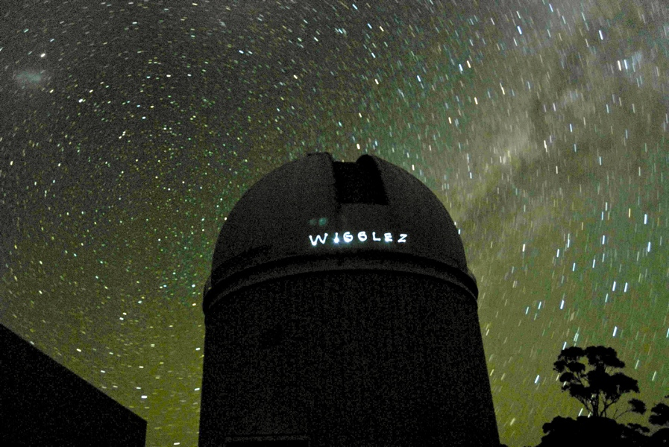
The Australian WiggleZ Dark Energy Survey 2007–2011: 2dF’s second major cosmology survey
Karl Glazebrook

Slide 2
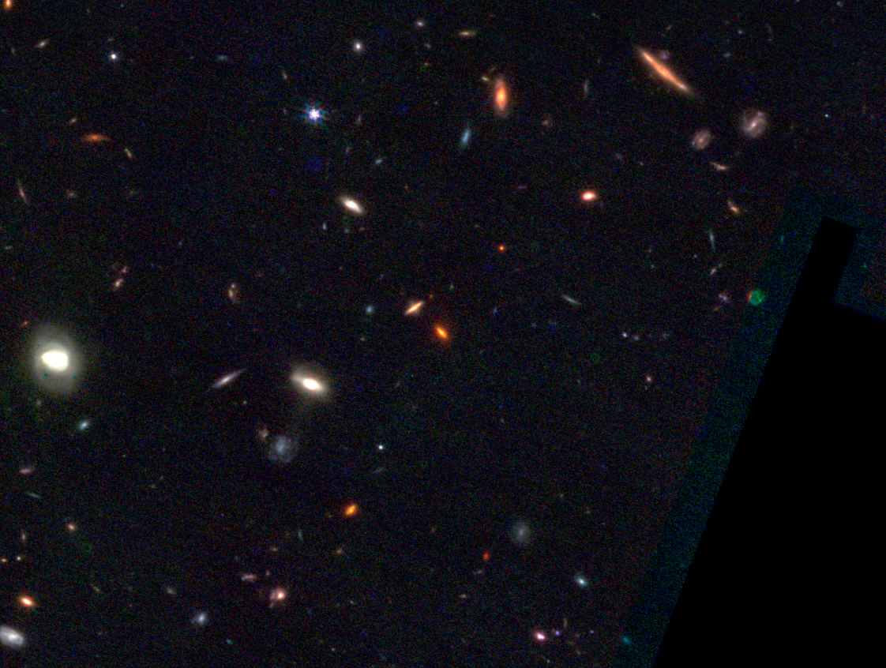
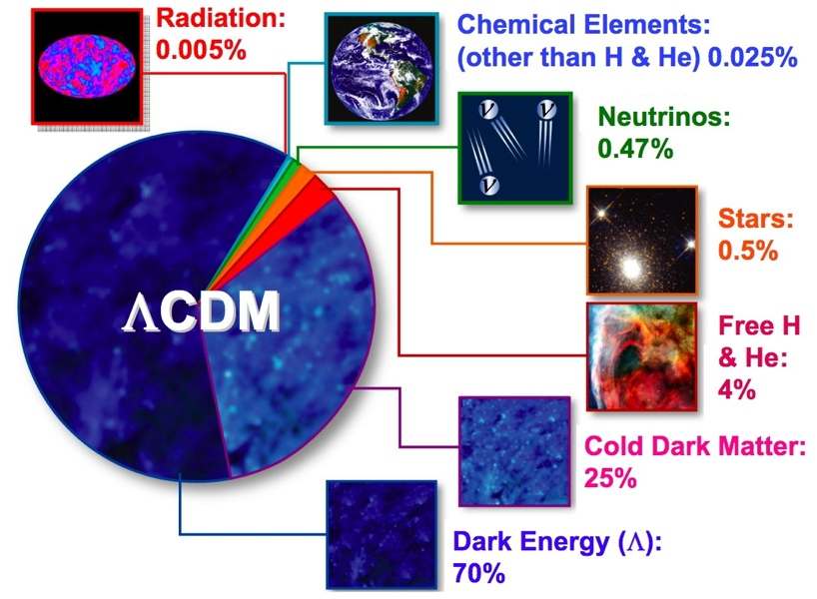
Cosmology in the early 2000s

Slide 3
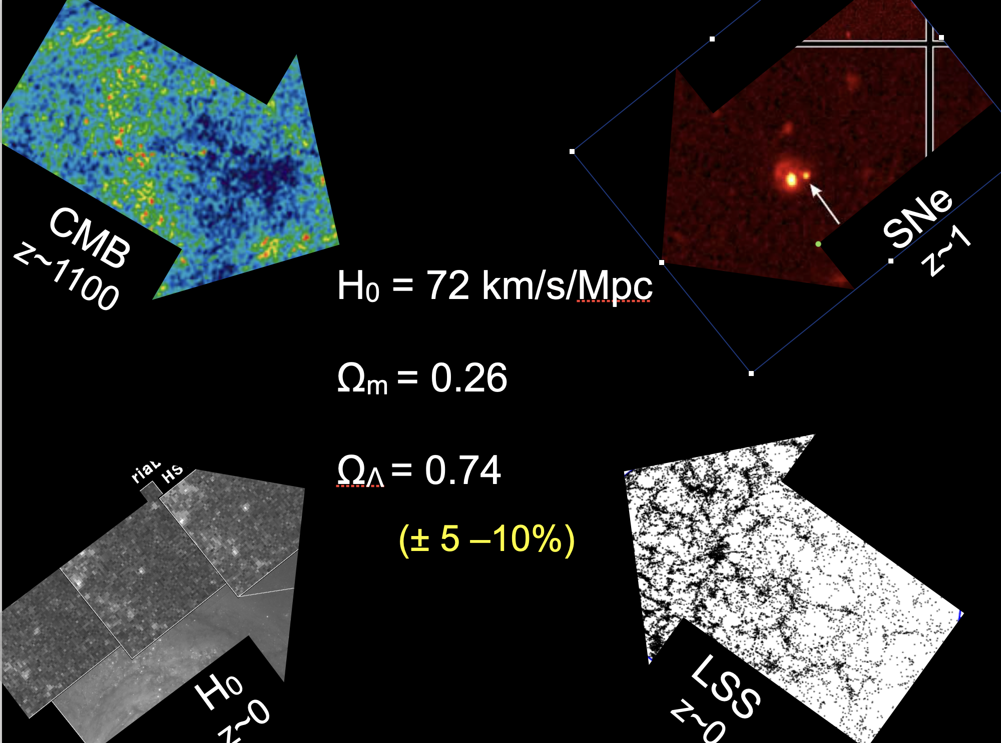
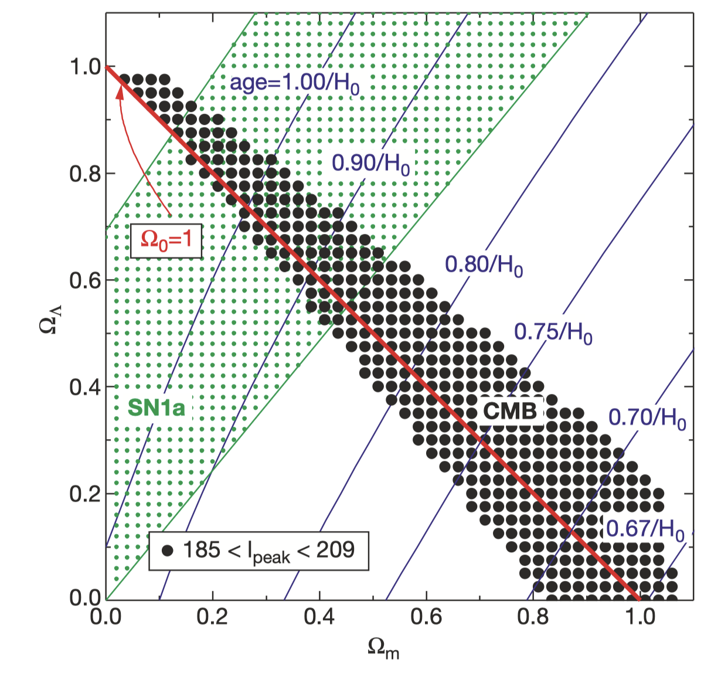
De Bernadis et al. (2001)

Slide 4
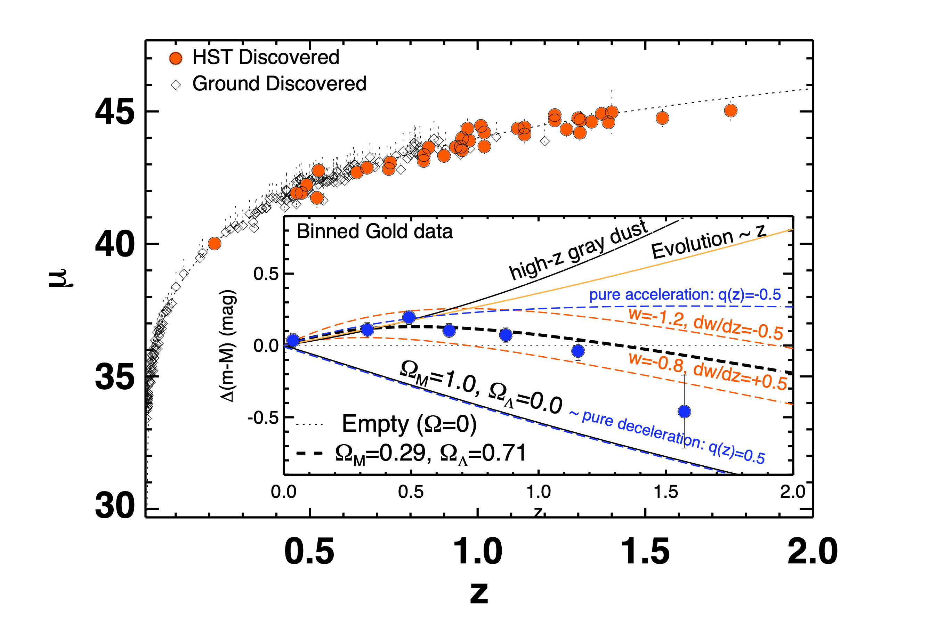
Supernovae cosmology
Riess et al. 2006
µ(z) = m–M = 4 log DL(z)
Evolution of progenitors?
Host galaxy environments?
Dust?
Non-linear modeling? Explosions not understood
Calibration: Now limited by this (>1%)

Slide 5
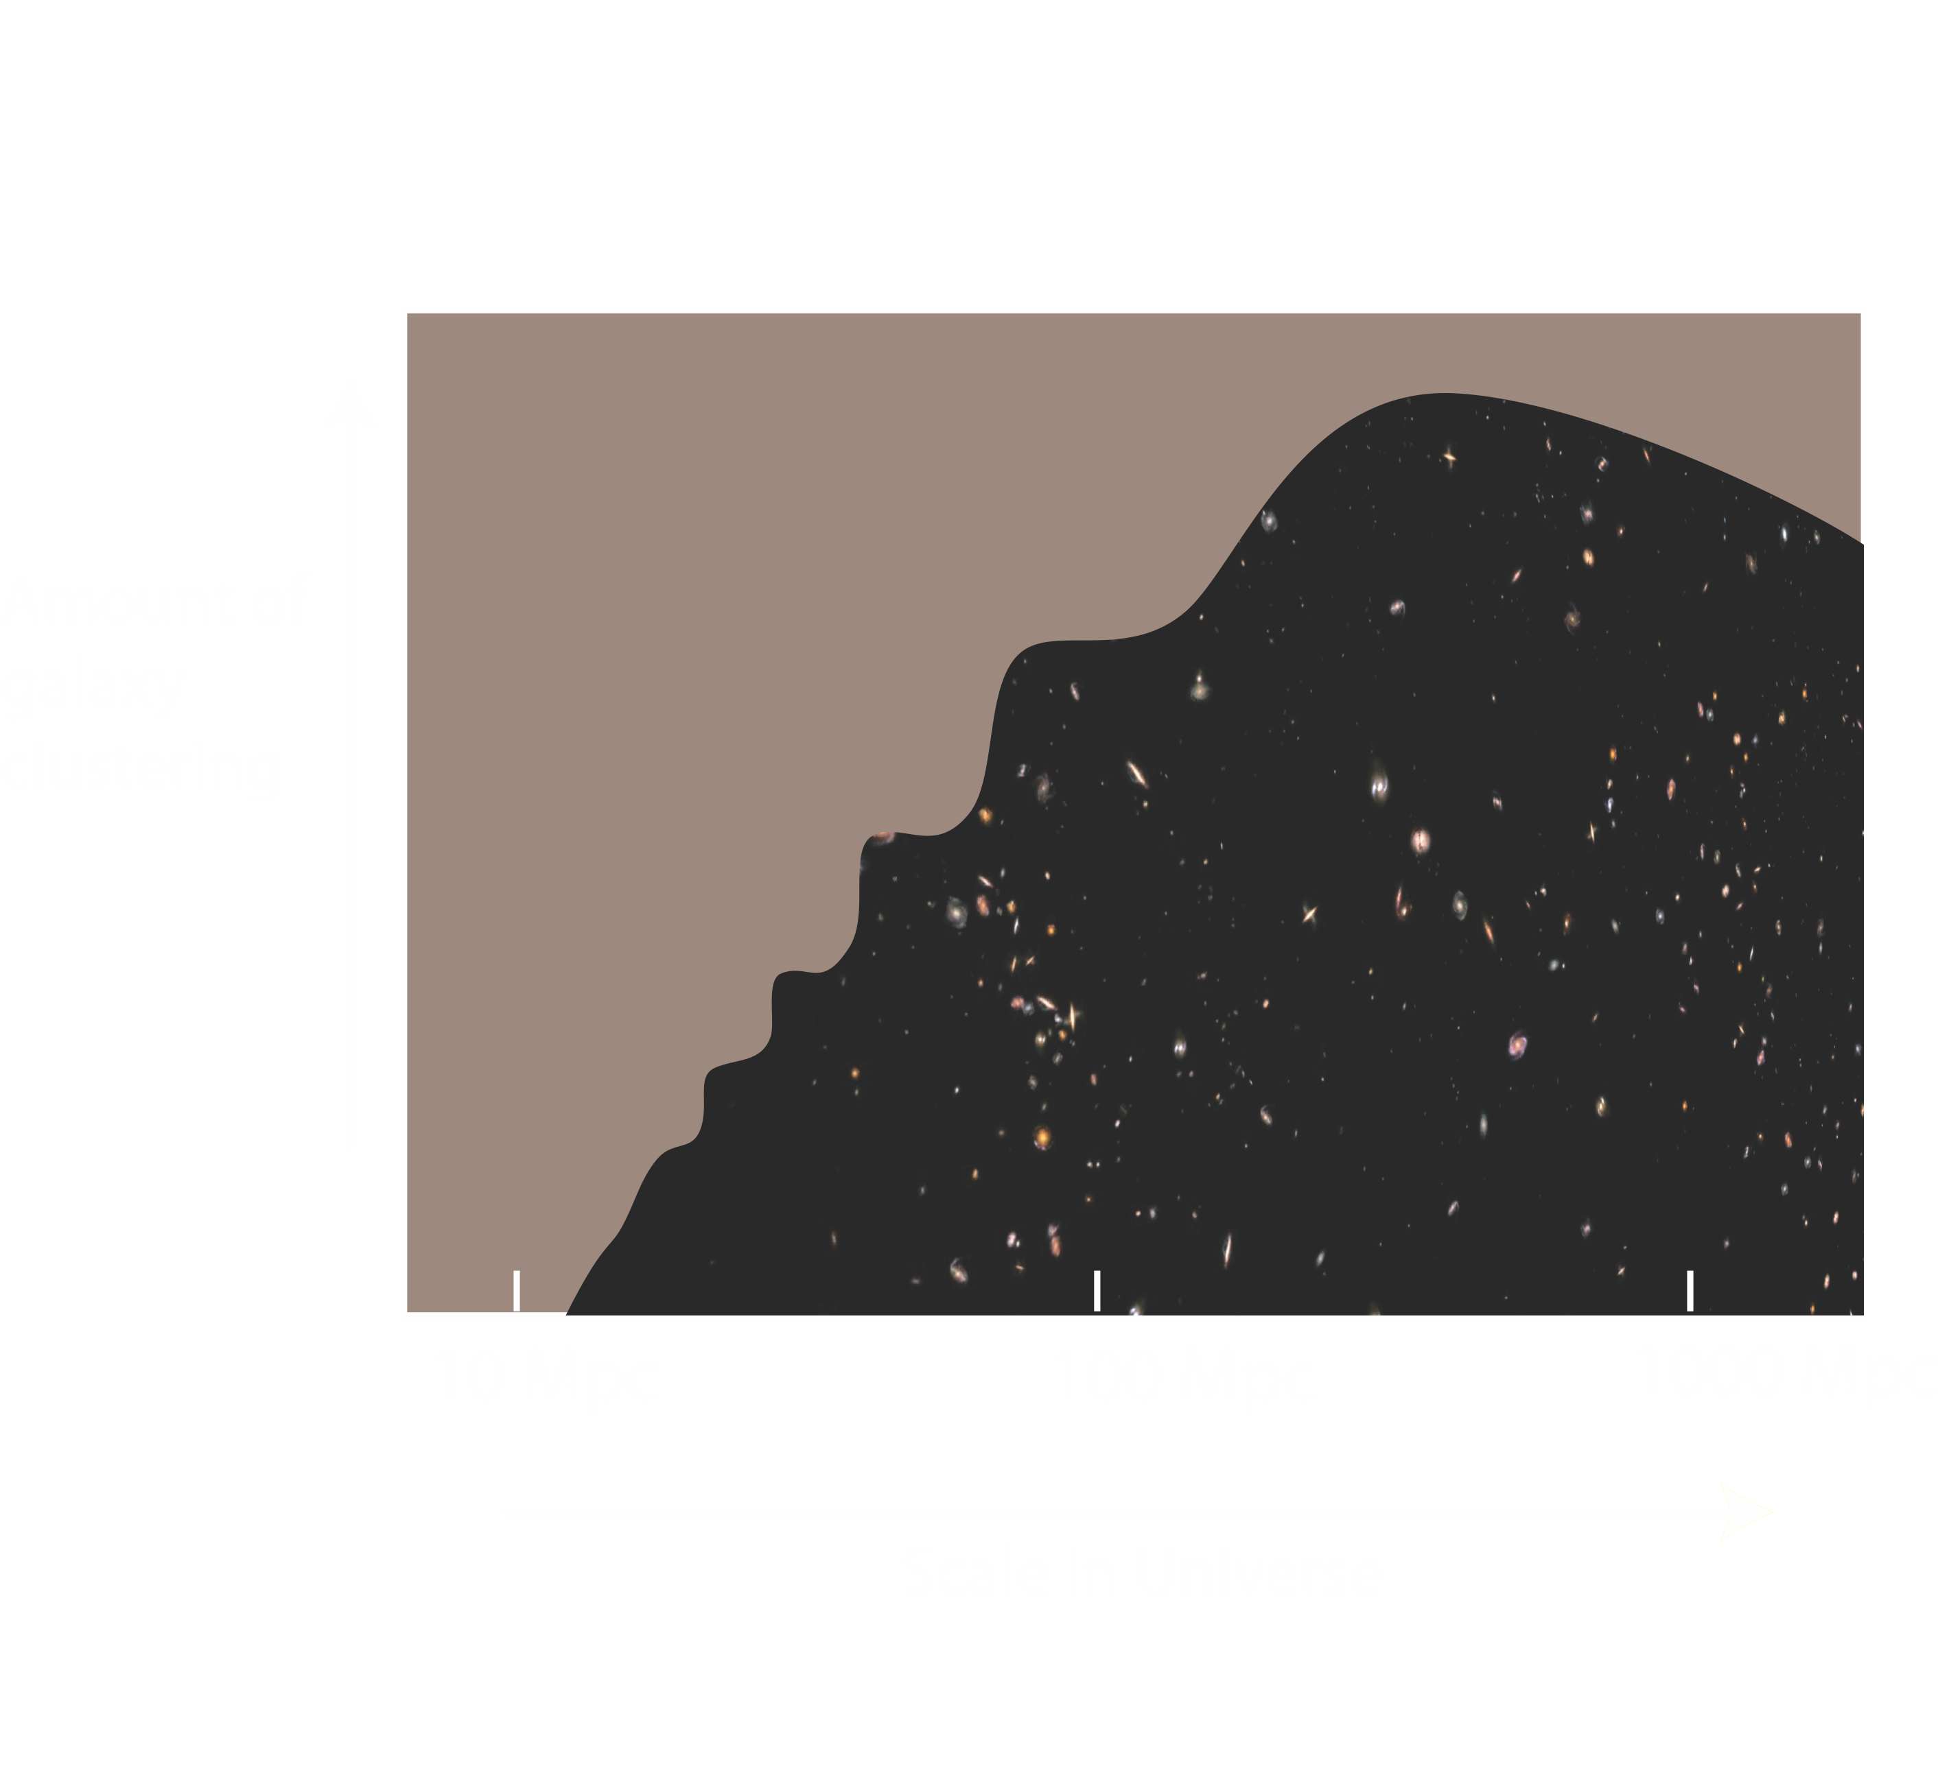
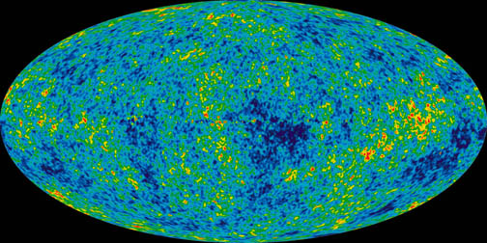
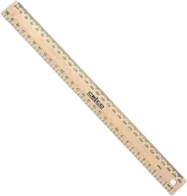
Alternative: a standard ruler in the ‘Matter Power Spectrum’
‘Shape’
‘Turnover’
‘Baryonic Acoustic Oscillations’ on 100 Mpc scales imprint of CMB epoch
‘Baryon Wiggles’
Non-linear scales

Slide 6
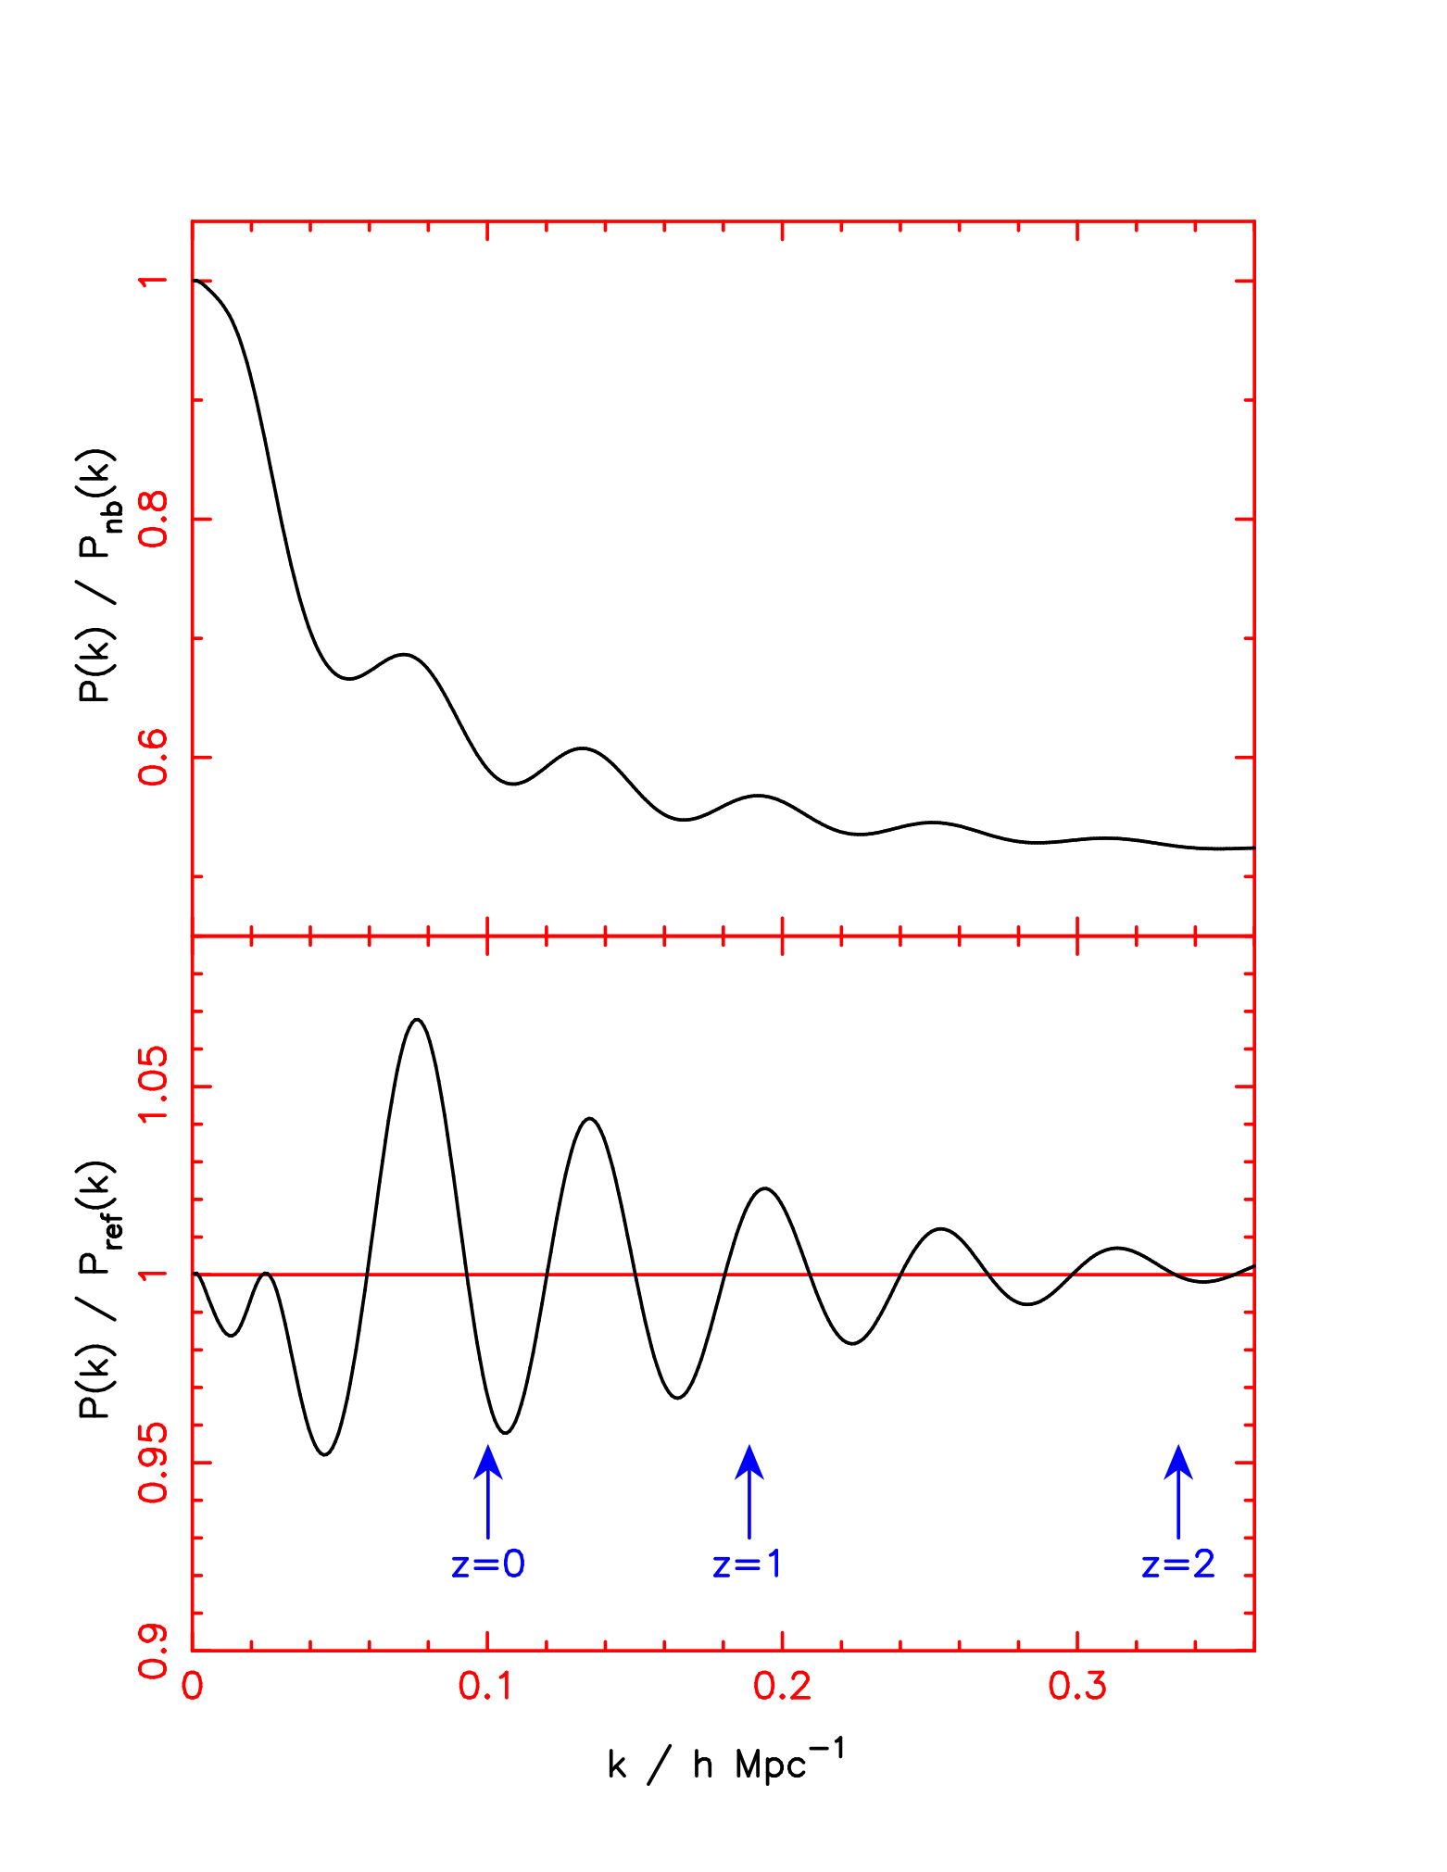
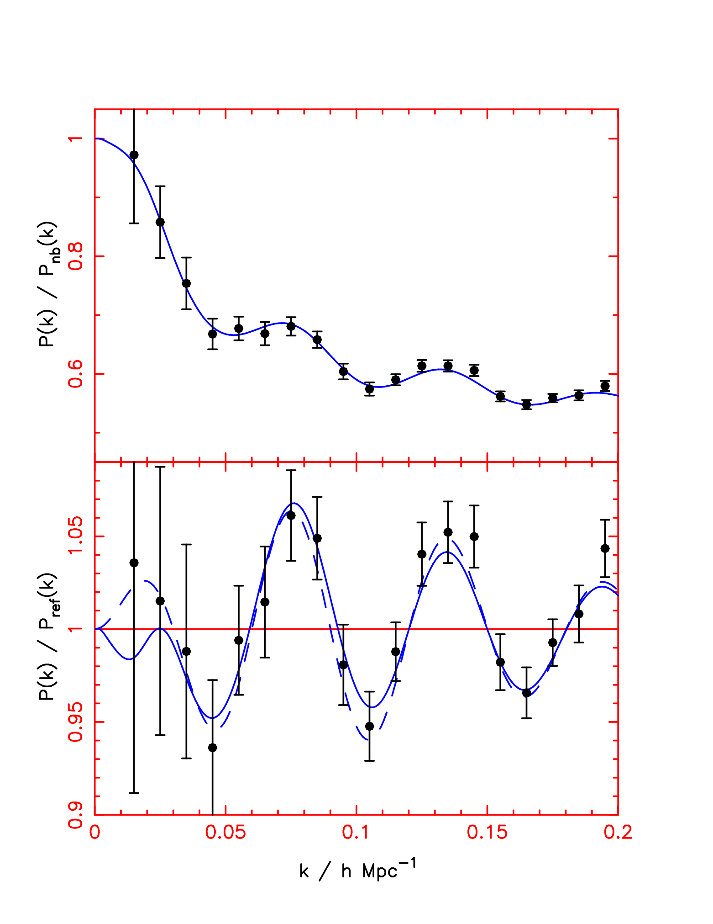
Baryon oscillations in matter
Imprint of acoustic waves before recombination in matter distribution
GALAXIES trace these but need >10⁵ over > 1 h^{–3} Gpc³
LINEAR Features in galaxy clustering
Show up in large scale galaxy P(k)
Acc. Std. ruler
Blake & Glazebrook (2003)
÷ by zero baryons
0.5<z<1.3
2×10⁶ galaxies
6 V_{sloan}
(~1 Gpc³)
600 deg²
÷ by smooth fit

Slide 7
The Challenge
AAOmega Spectrograph
Need ten times the volume of 2dF Galaxy Redshift Survey
Need to go ~7x higher redshift
Could use ‘bright tracers’ of large scale structure
Could we use existing telescopes?
CFHT MegaCam
GALEX UV survey

Slide 8
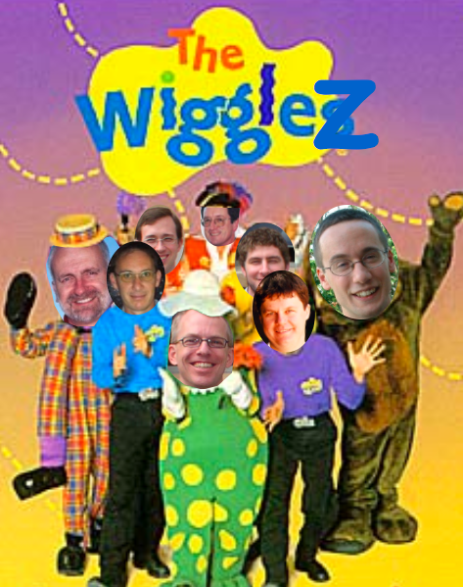
The WiggleZ team
Warrick Couch, Karl Glazebrook, Chris Blake, Sarah Brough, Greg Poole, Darren Croton, Mike Pracy, Duncan Forbes, Nick Jones, Tornado Li (Swinburne)
Michael Drinkwater, Russell Jurek, Kevin Pimbblet, Tamara Davis (UQ)
Matthew Colless, Rob Sharp (AAO)
Scott Croom, Ben Jelliffe (Sydney)
David Woods (UBC)
CIT/GALEX: Chris Martin, Barry Madore, Karl Foster, Todd Small, Ted Wyder
RCS2: Howard Yee, David Gilbank, Mike Gladders
+ students & associate members

Slide 9
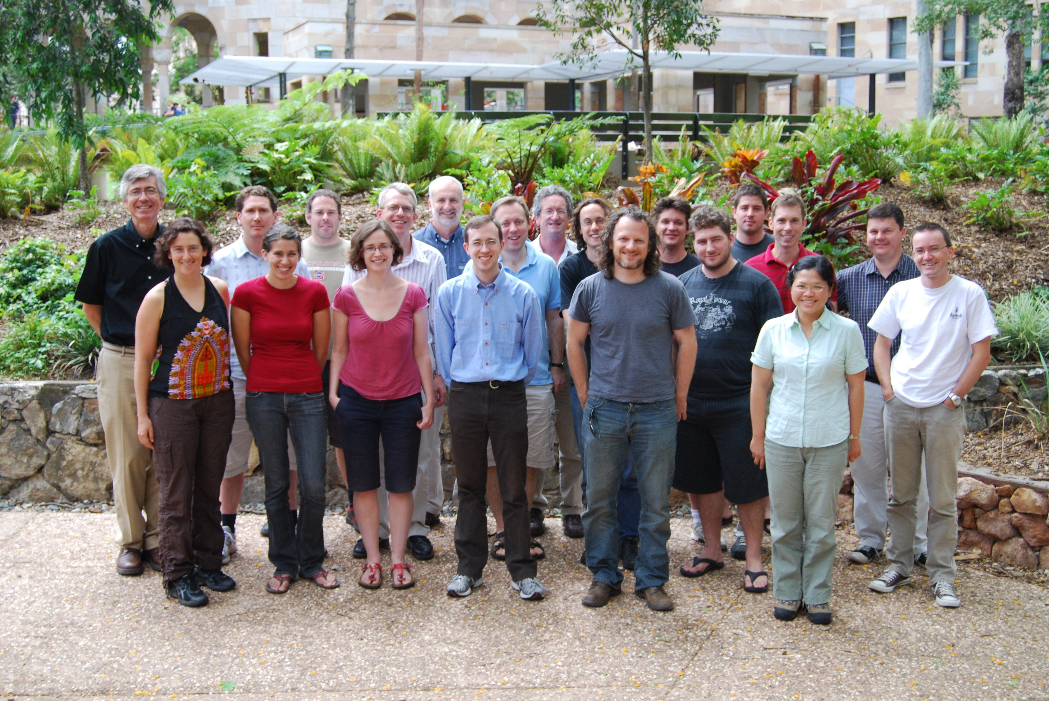
ANU Prof.
GMTIFS instrument scientist
ANU Prof.
ex-RSAA Director
UQ Prof. (Retd.)
SUT Dist. Prof.
SUT Prof/Pawsey Medal
Syd Data Scientist
Caltech Dist. Prof.
SUT Prof.
Syd Prof.
SUT Dist. Prof/Laureate Fellow
UNSW Prof/HoS
SUT ADACS data scientist
ANU A/Prof
U. Hull Prof.
UQ Prof/Laureate Fellow

Slide 10
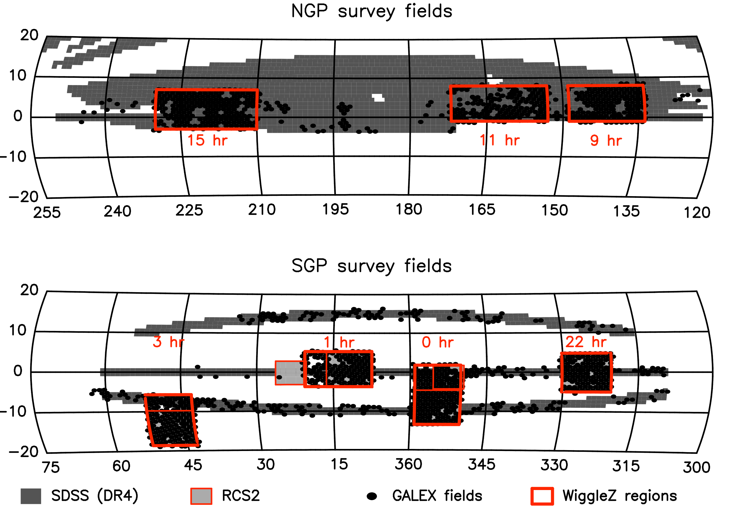
Fields
240,000 redshifts
Drinkwater et al. 2009

Slide 11
Notes:
Last redshift measured by WiggleZ! By Rob Sharp on Jan 17th 2011!

Slide 12
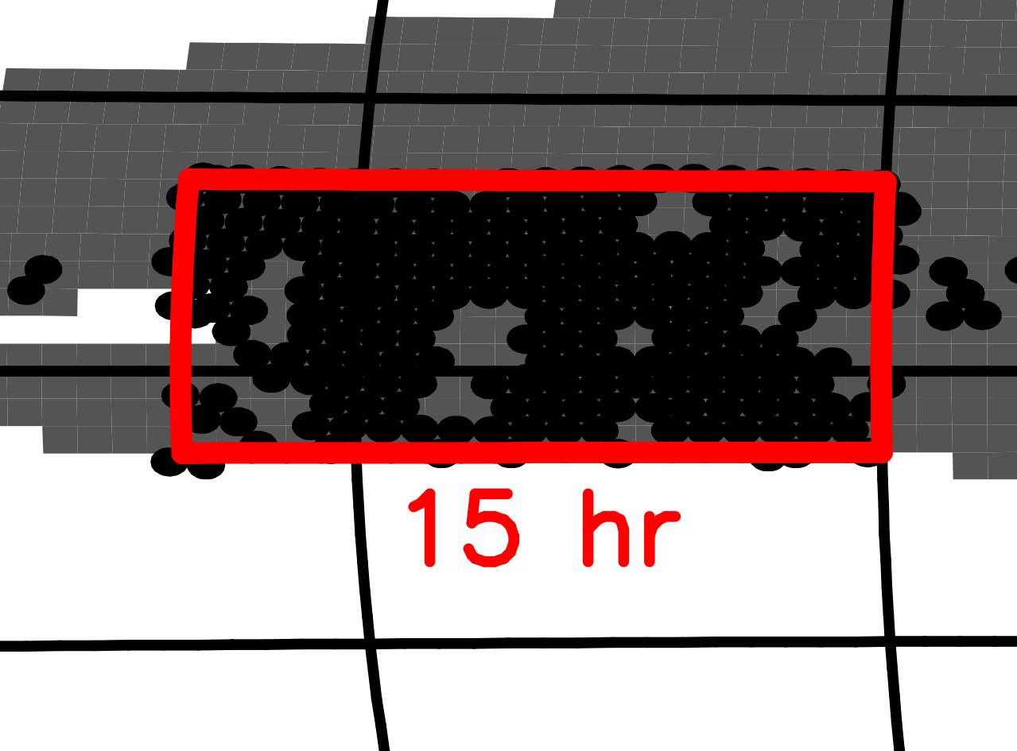
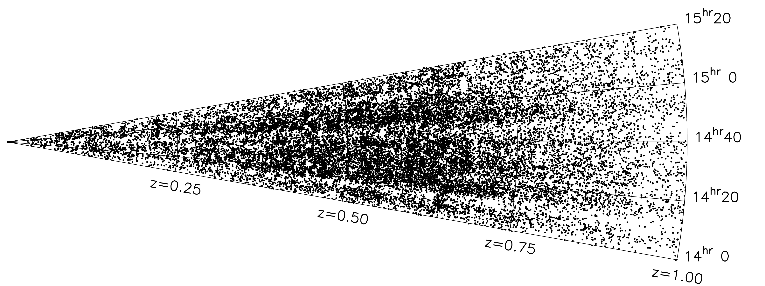
Drinkwater et al. 2009

Slide 13
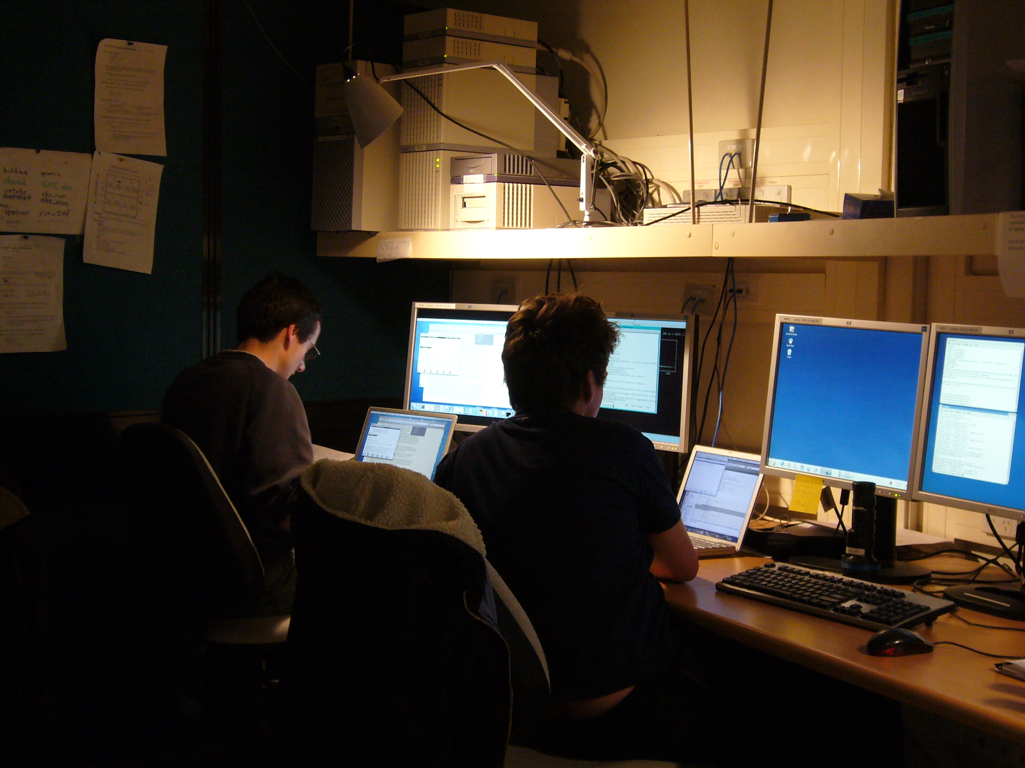
Did it work?
220 nights and 240,000 redshifts later…

Slide 14
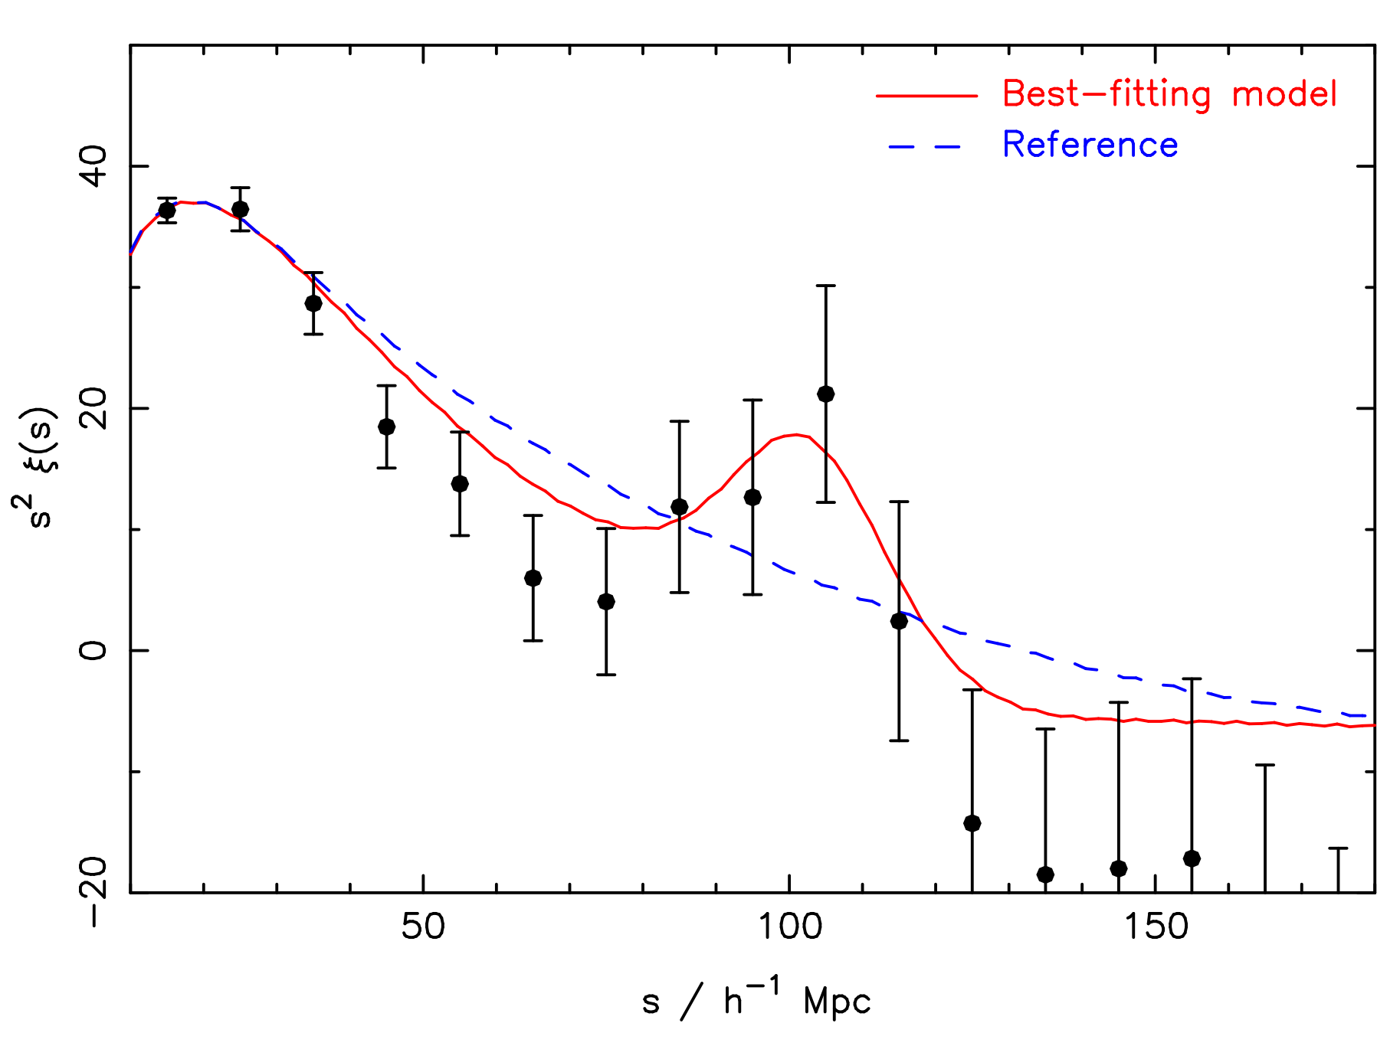
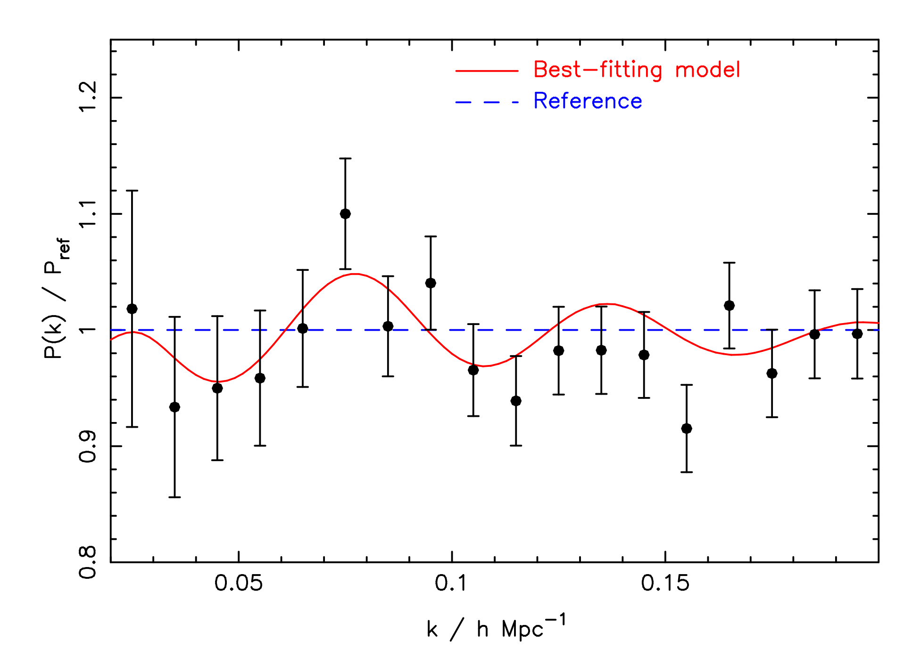
BAO (angle-averaged)
Blake et al. 2011
Correlation function
Power spectrum

Slide 15
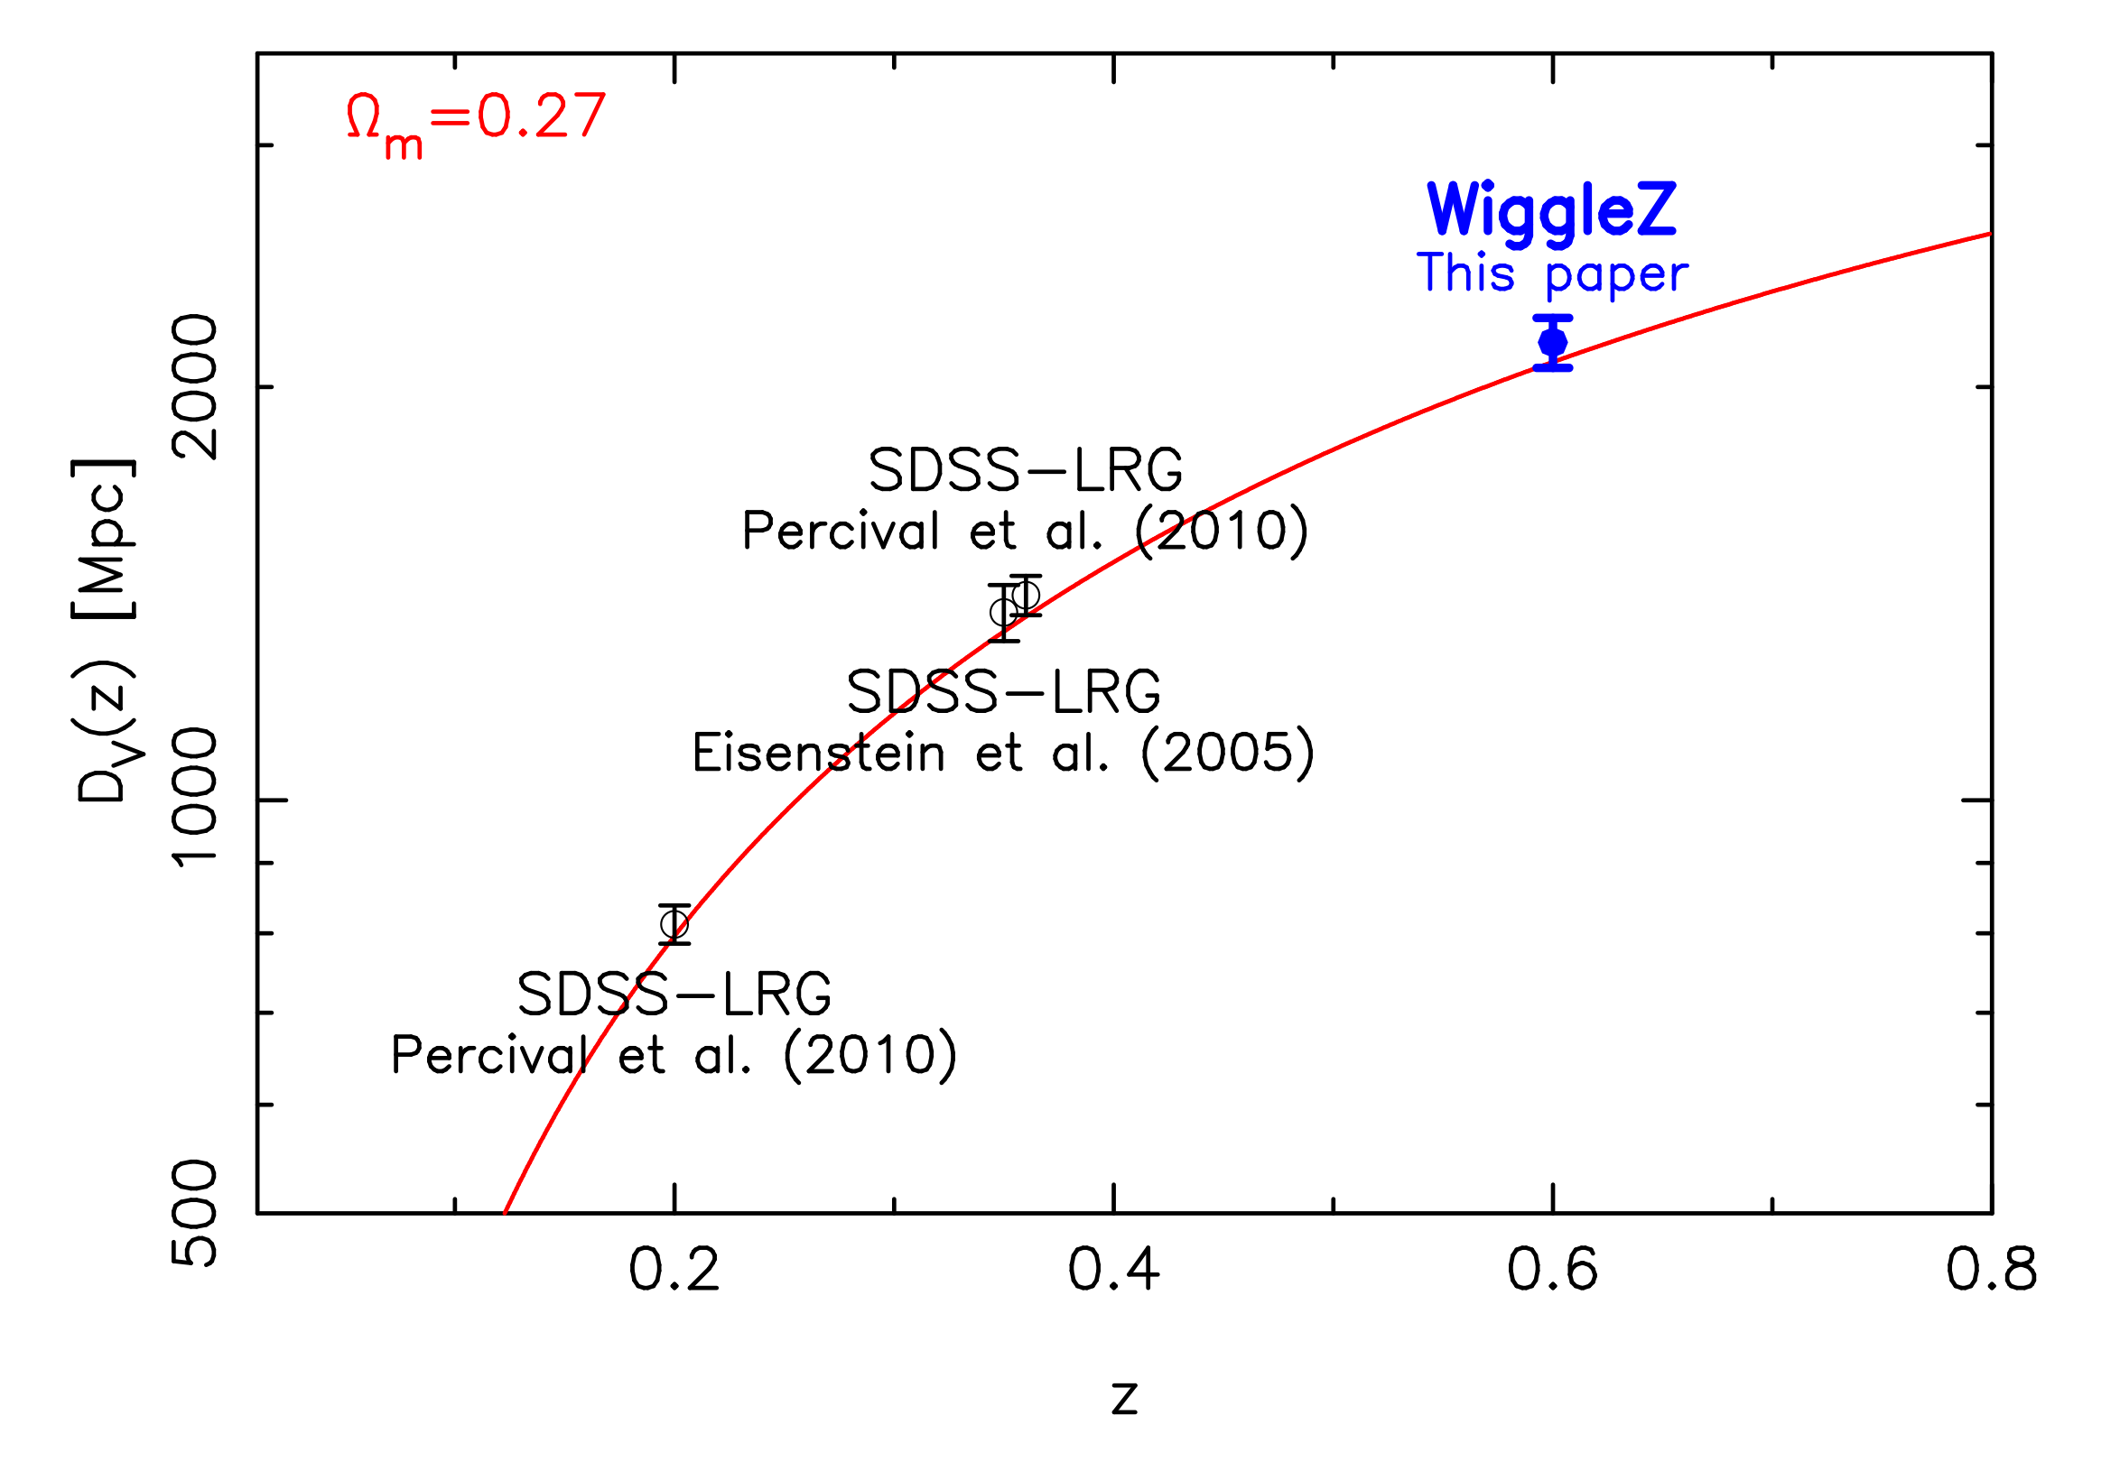
BAO distance scale
Blake et al. 2011

Slide 16
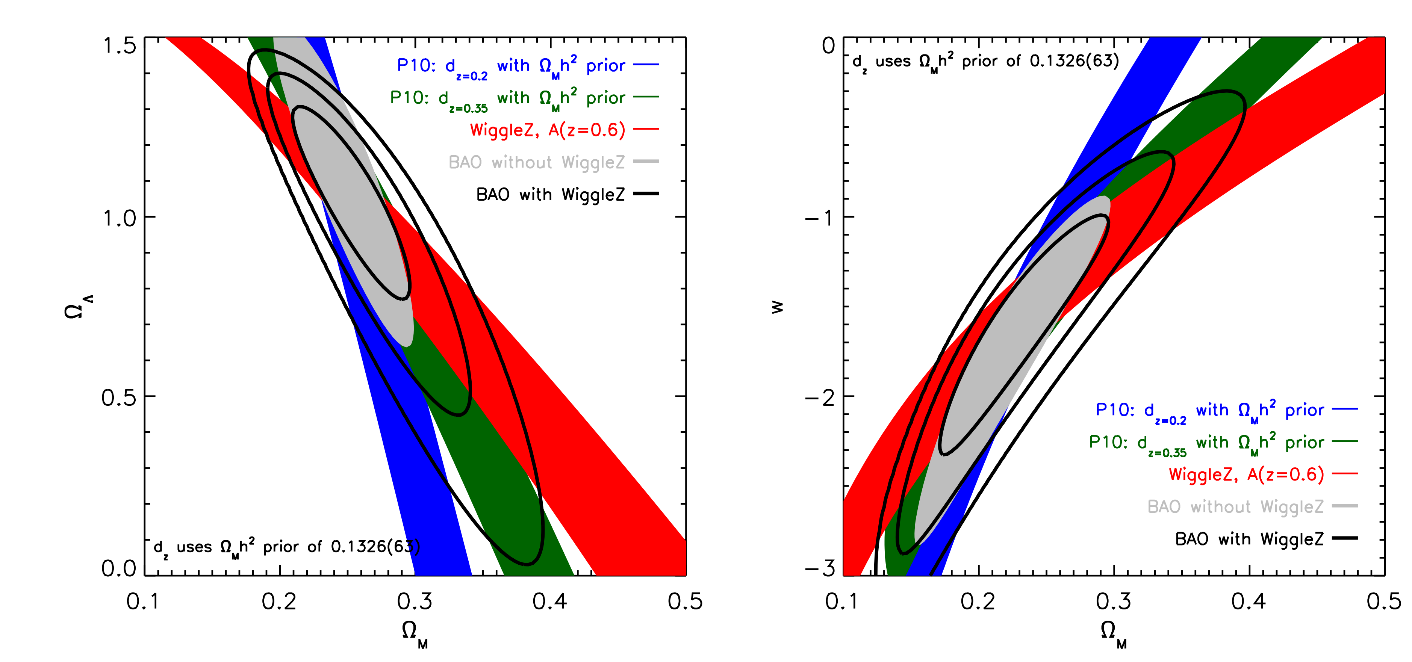
Cosmology banana plot
Blake et al. 2011
Notes:
Uses BAO and CMB prior on Om h^2 - no SNe!

Slide 17
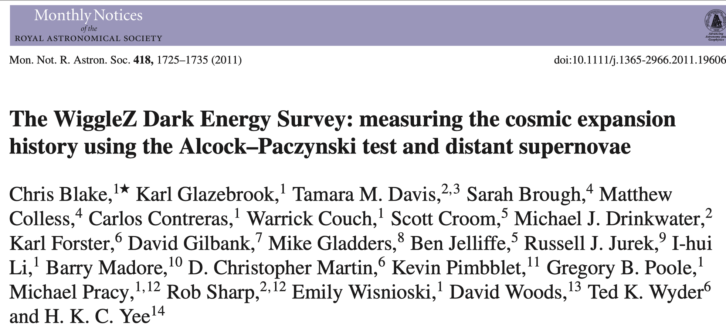
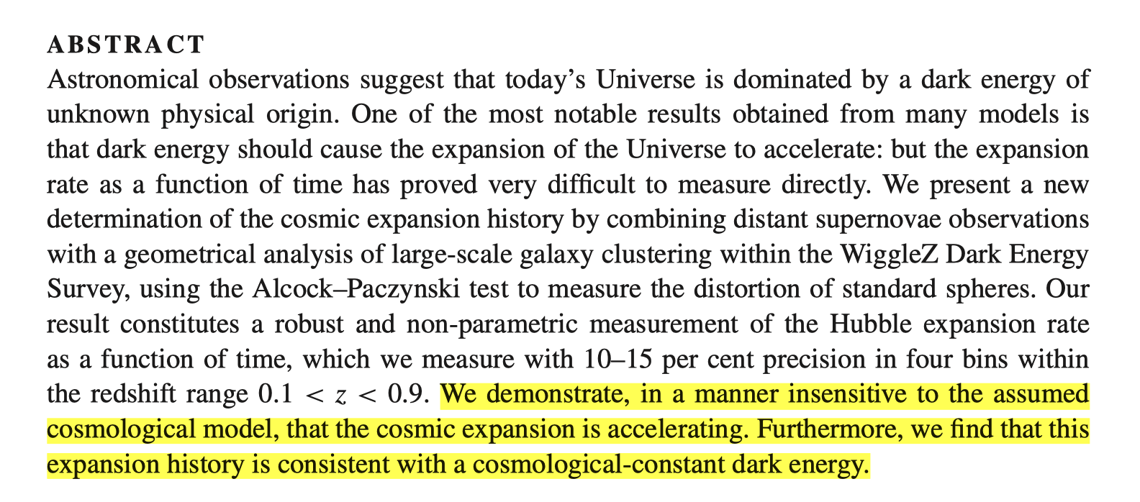
My favourite idea: a direct test for cosmic acceleration
Sphericalness of galaxy clustering in a redshift bin measures (Alcock-Paczyński ) measures DA(z) H(z)
SNe measure DL(z) H0
Ratio mesures H(z) / H0 ➩ da(z)/dt / a0 (where a(z) is th cosmic scale factor)
Direct measure of cosmic expansion rate da/dt independent of major assumptions on energy fields

Slide 18
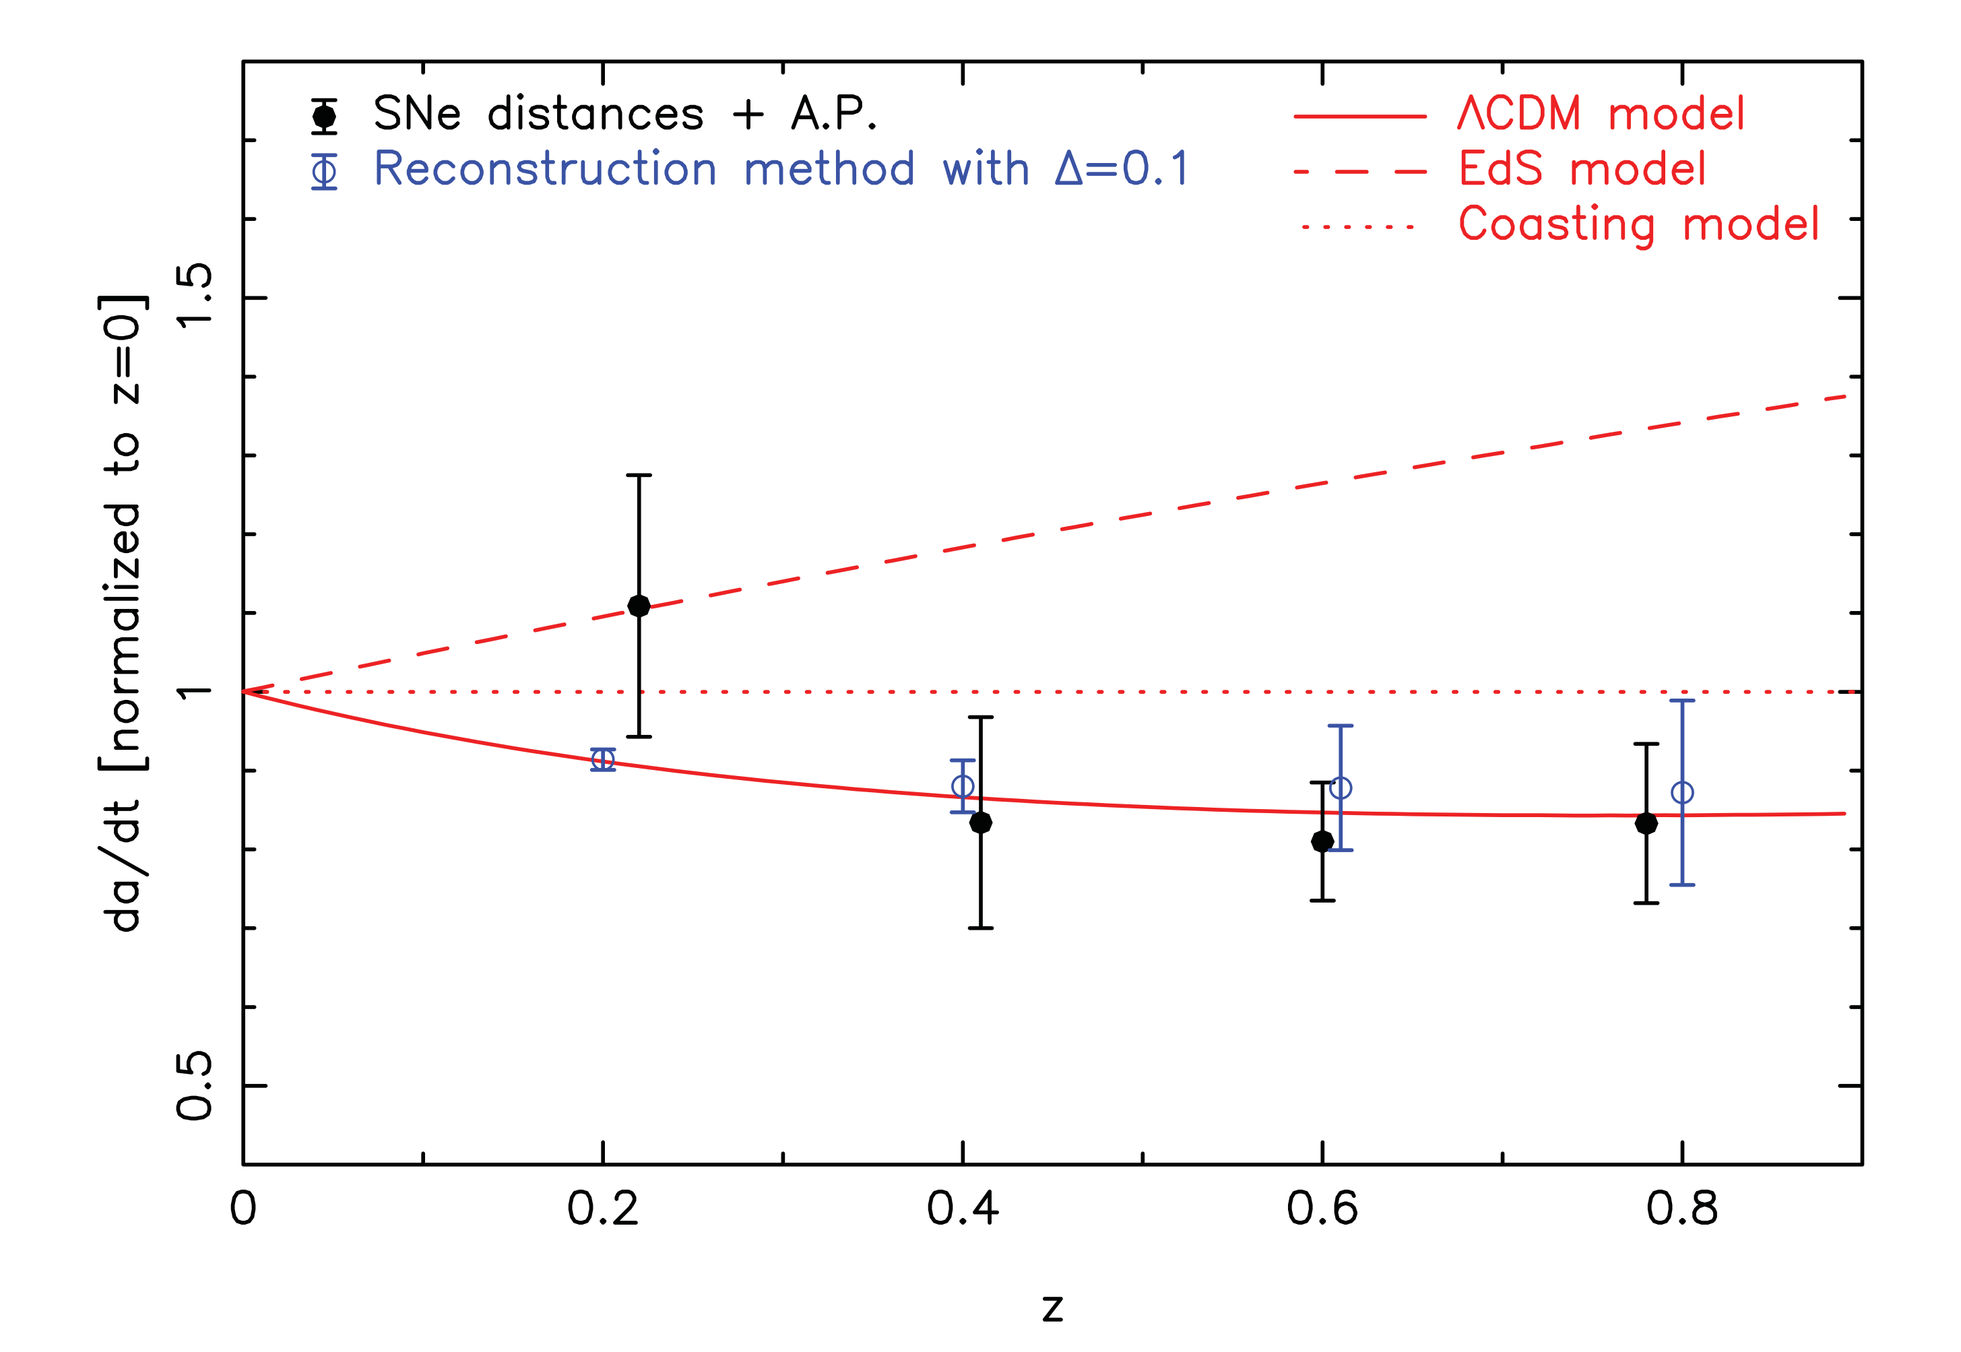
Cosmic expansion
Blake, Glazebrook et al. 2011

Slide 19
Summary
WiggleZ was a major advance for cosmology
Direct measure of distances to z~1 independent of SNe calibrations or evolution
First model-independent demonstration of accelerating expansion with direct H(z) measurements
Pathfinder for modern cosmology surveys: ELG selection, high-z (e.g. DESI which does WiggleZ every 2 nights!
Tons of other stuff: galaxy evolution, rare galaxies, morphological evolution…

