Slide 1
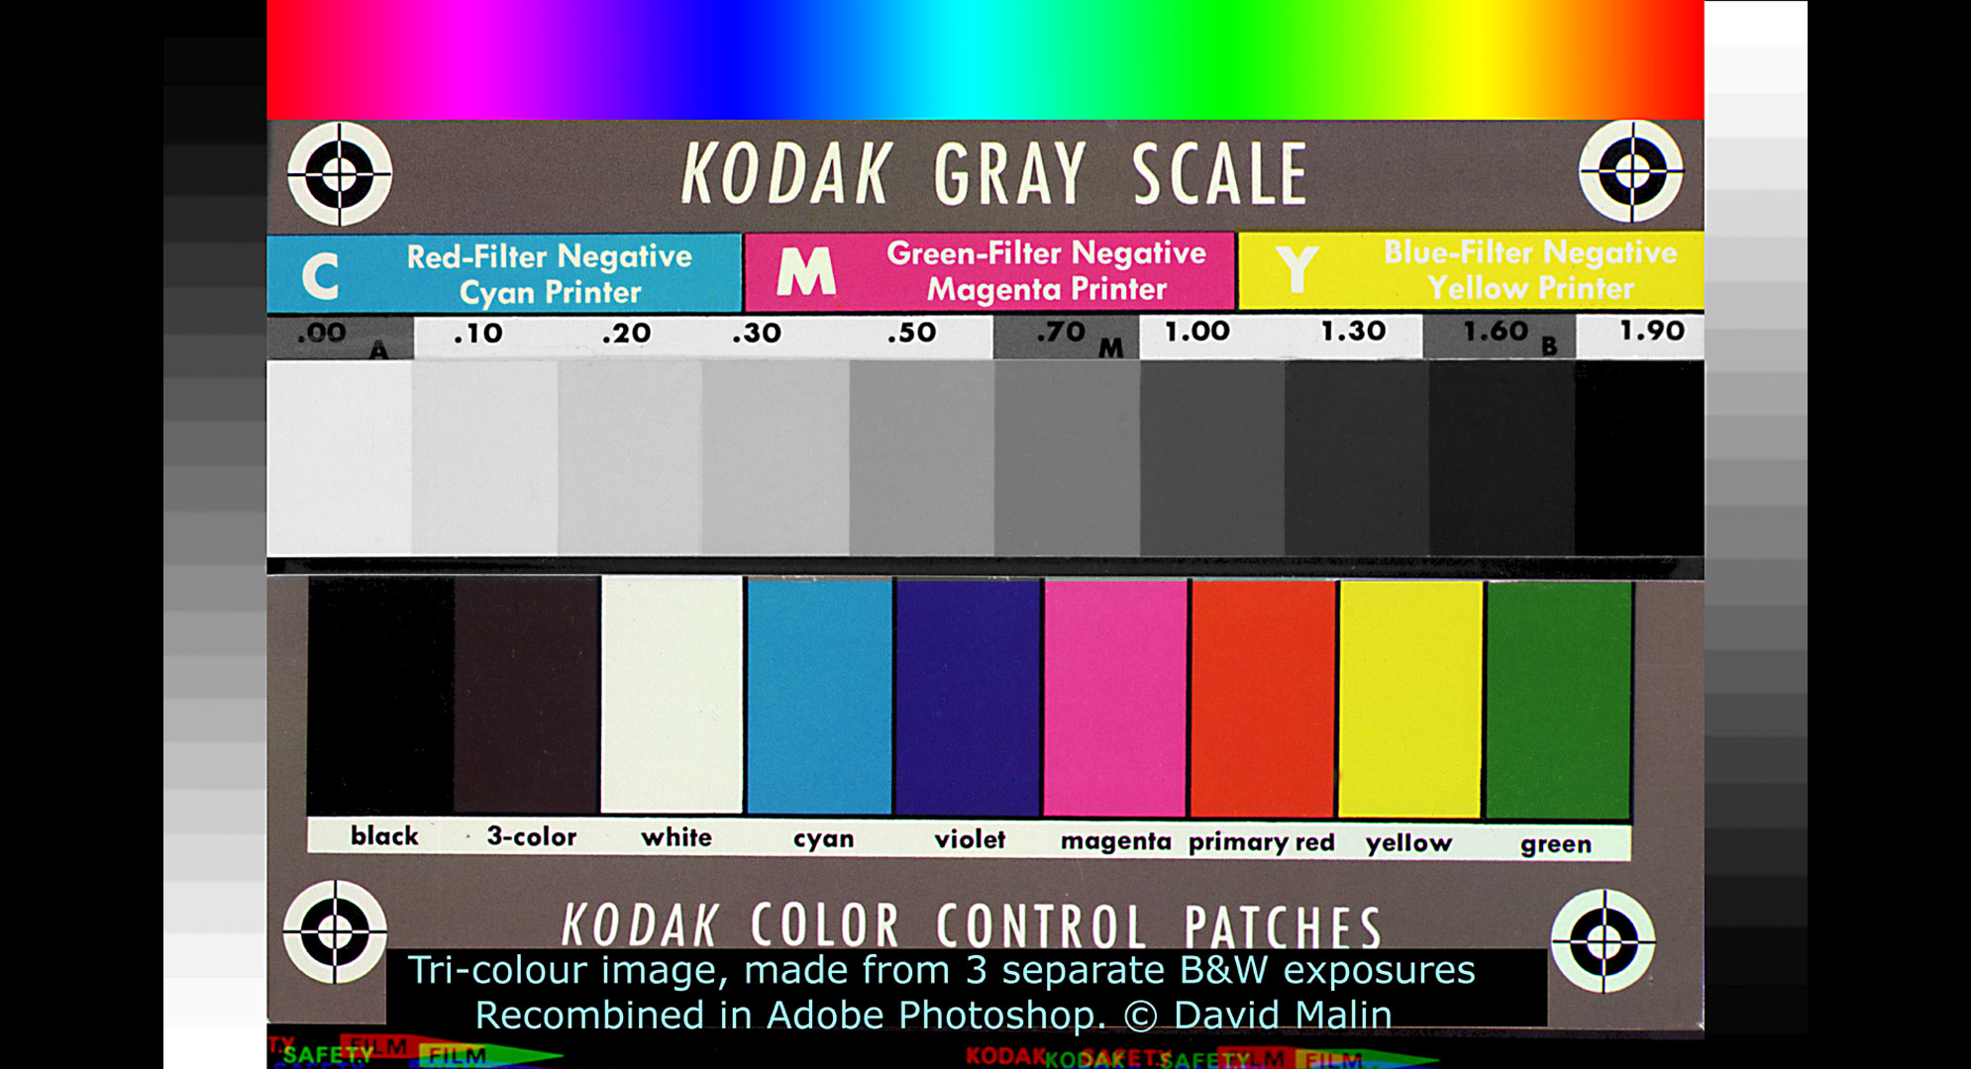

Slide 2
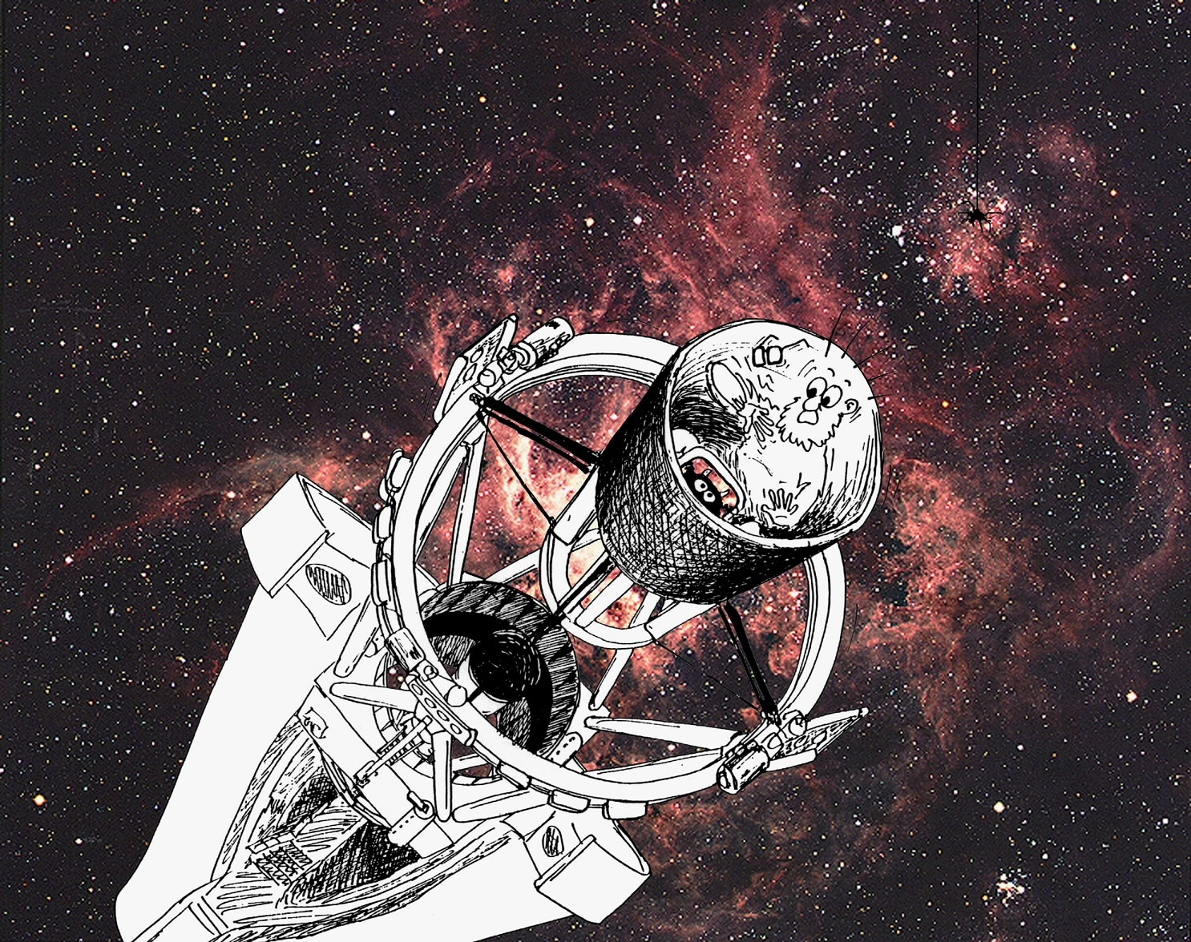
Jonathan Pogson

Slide 3
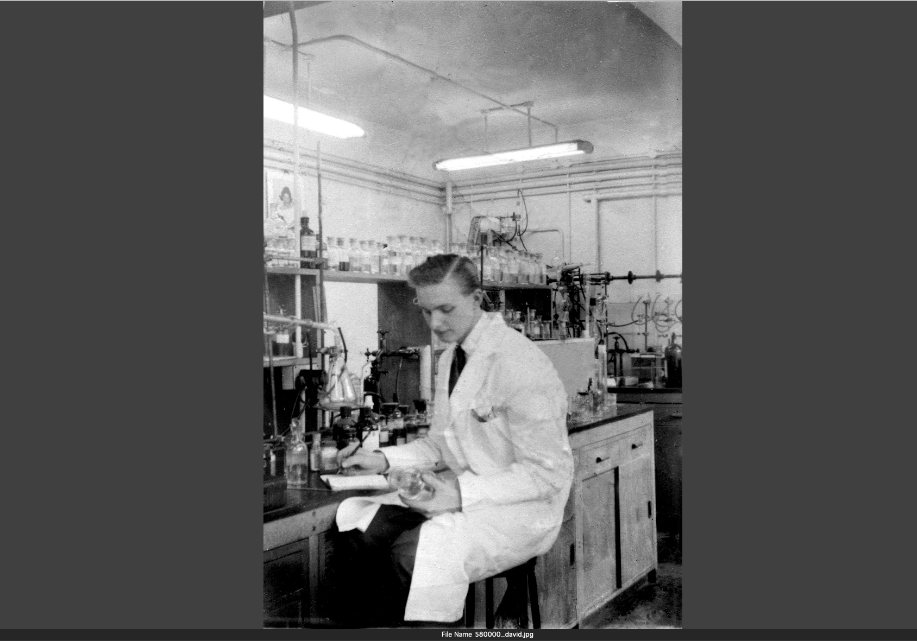
David Malin in the
Ciba-Geigy
Pesticides Lab
1957

Slide 4
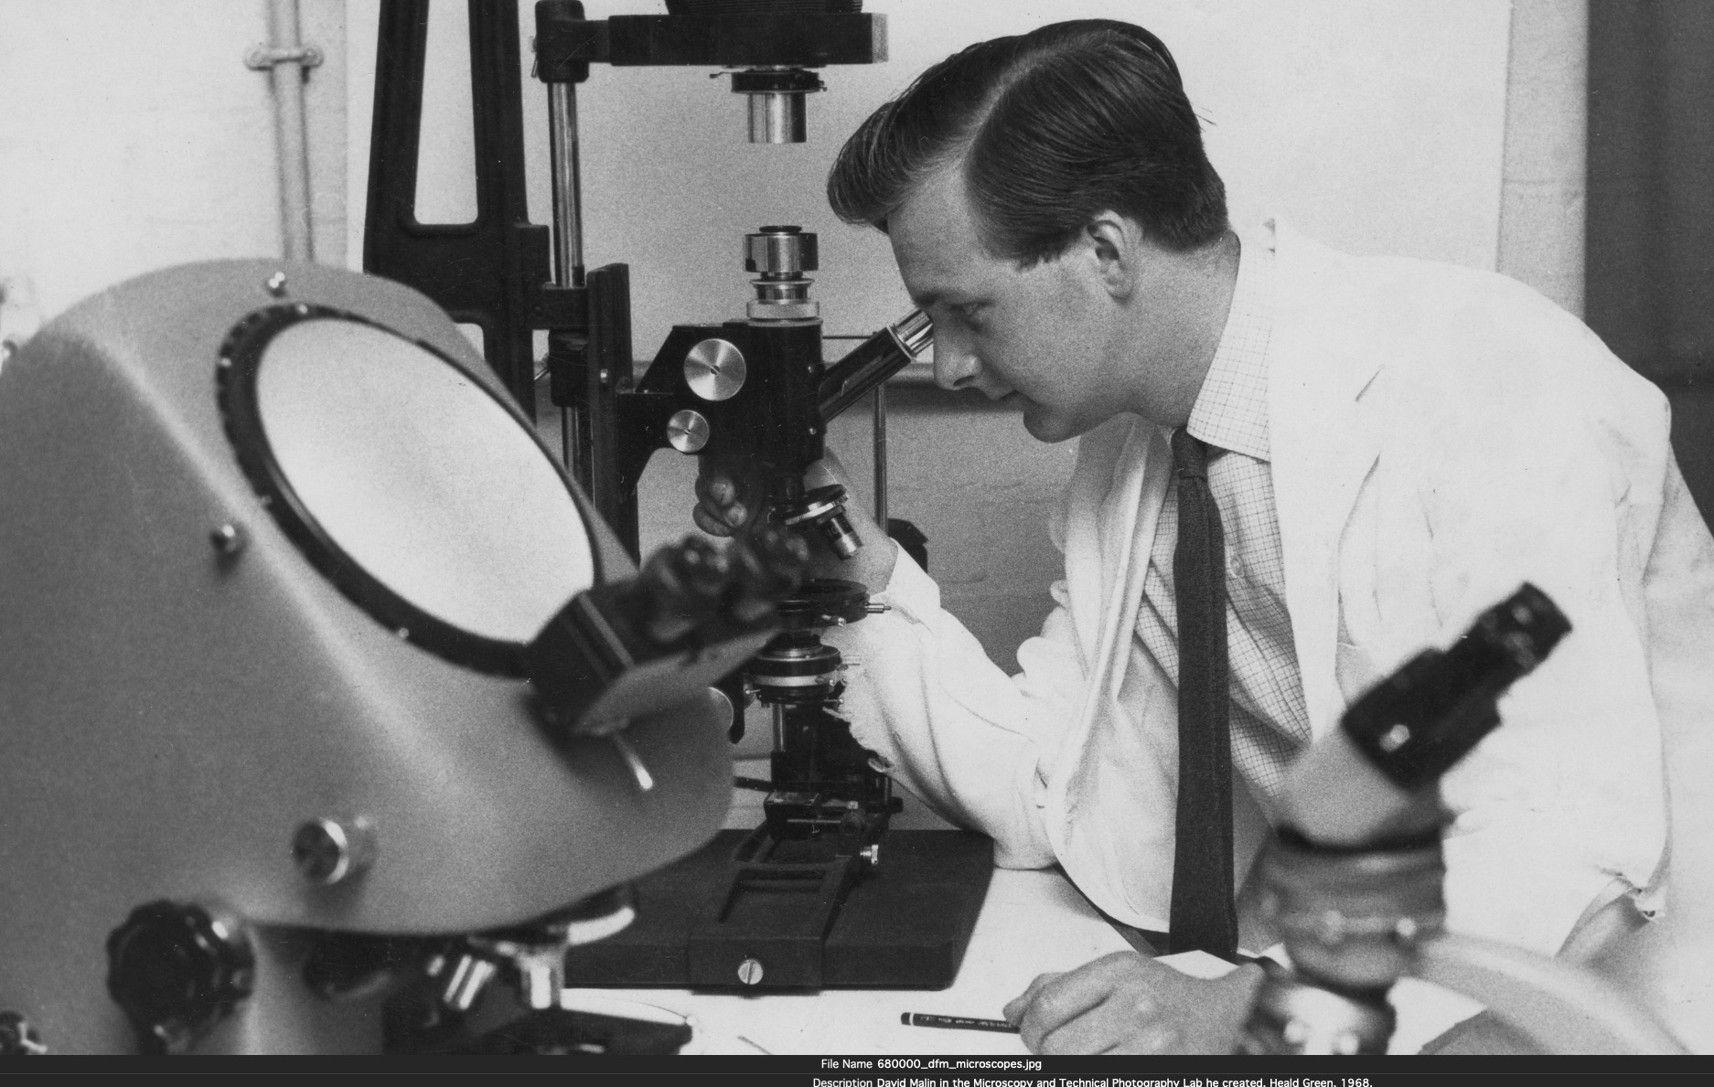
Microscopy Lab, 1968
Ciba-Geigy

Slide 5
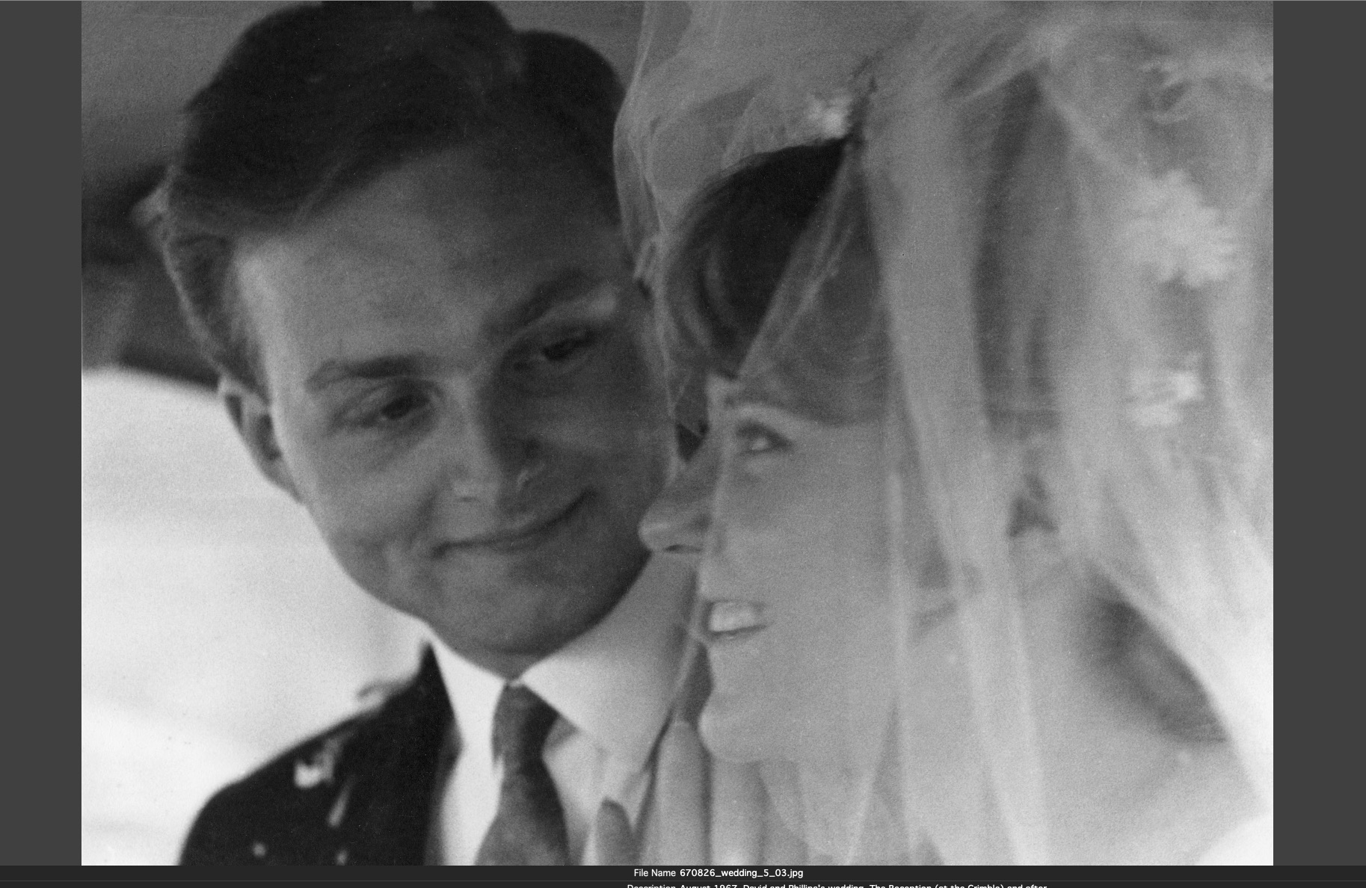
Wedding day
August, 1967

Slide 6
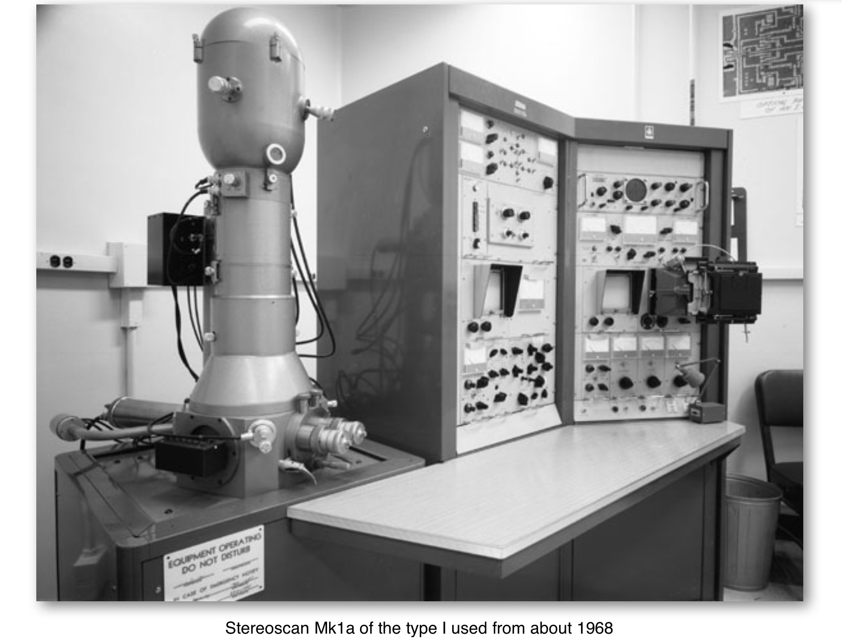
Ciba-Geigy
Stereoscan electron microscope (SEM) October 1974
Ciba-Geigy

Slide 7
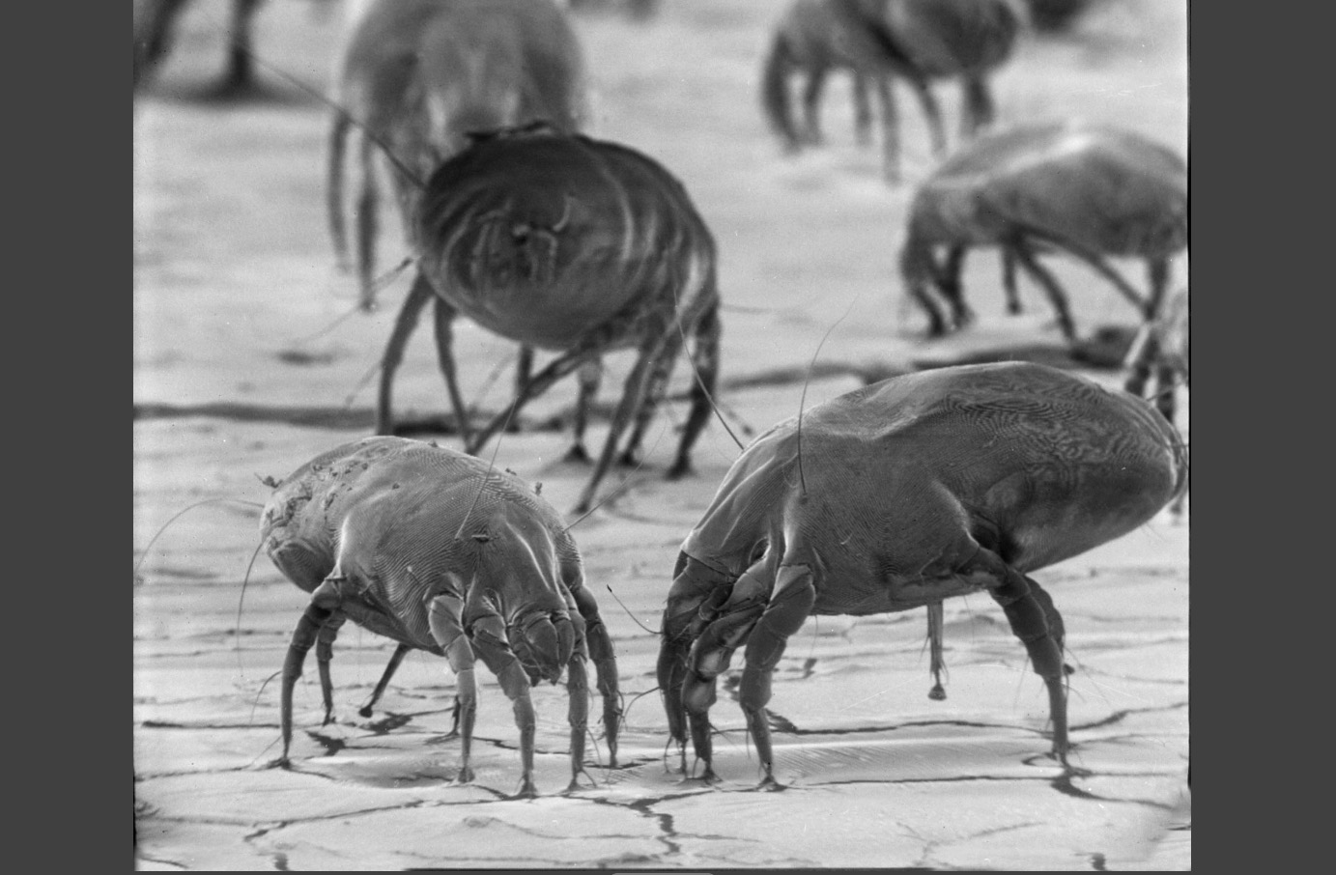
Where’s all the dust gone?
March 2017, David’s birthday
with Brian Cox
Interstellar
SEM image of house dustmites 1968

Slide 8
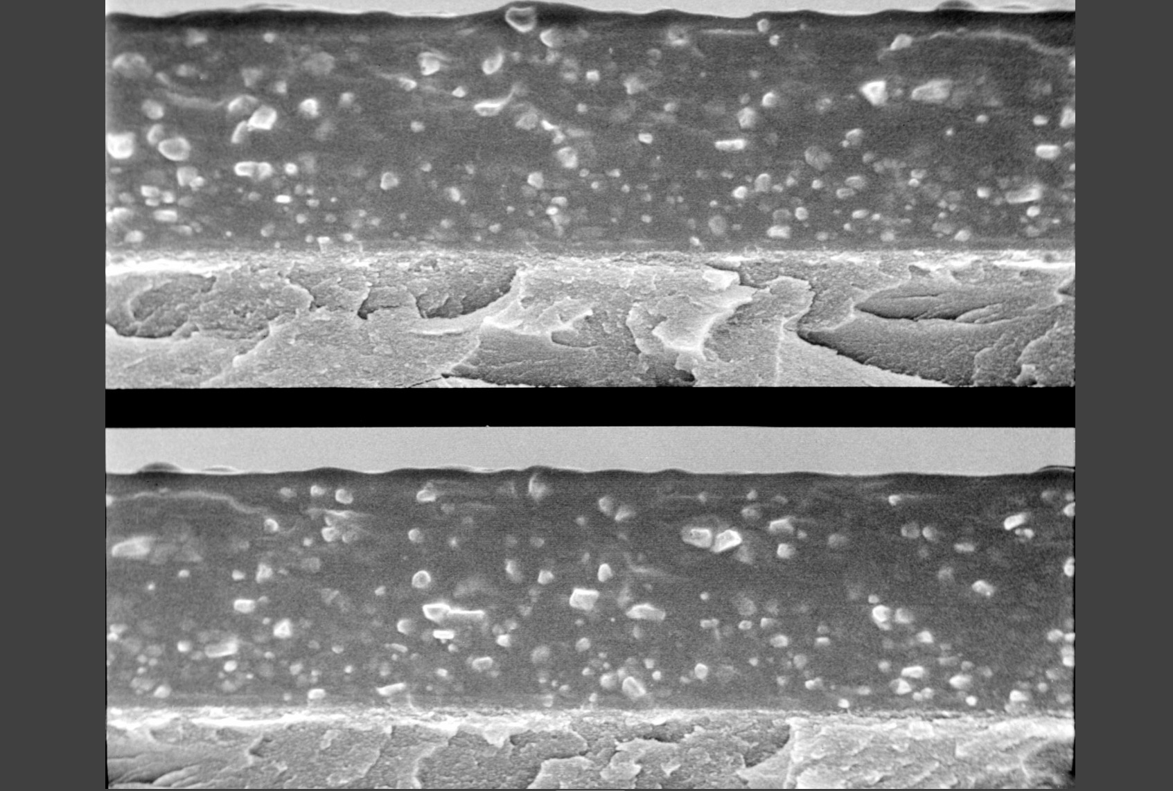
SEM cross-section of B&W Tri-X Pan Kodak film, 1968

Slide 9
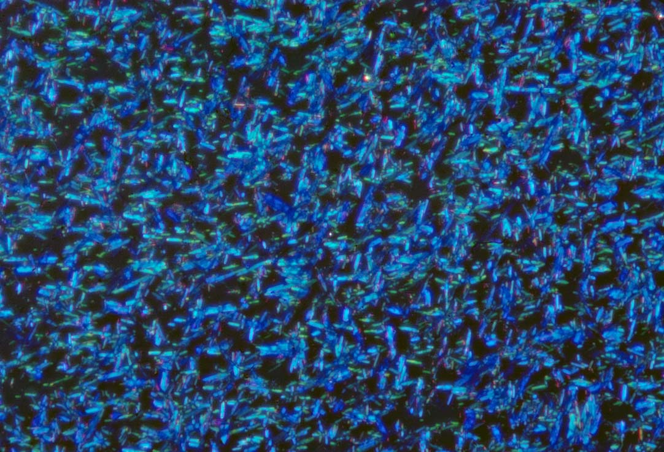
Phthalocyanine pigment, crossed polars, birefringent colours

Slide 10
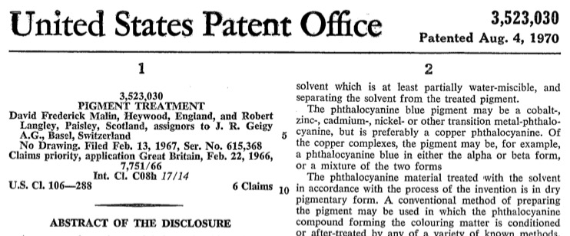
Phthalocyanine pigment, crossed polars, birefringent colours

Slide 11
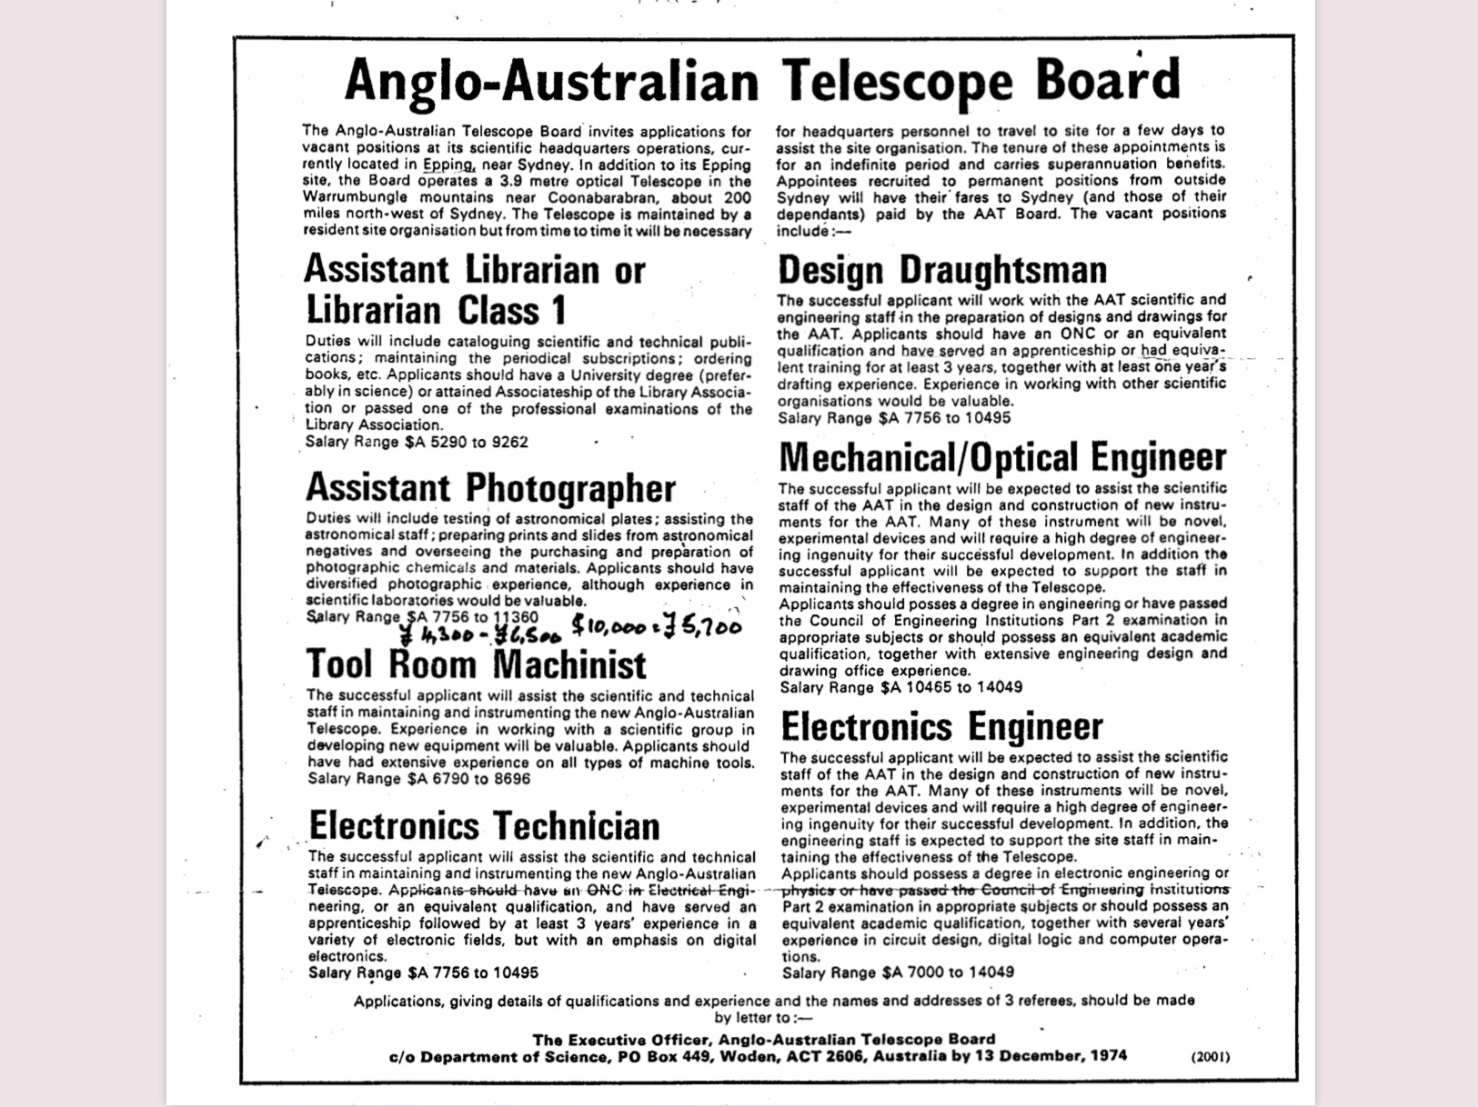
October
1974

Slide 12
October
1974

Slide 13
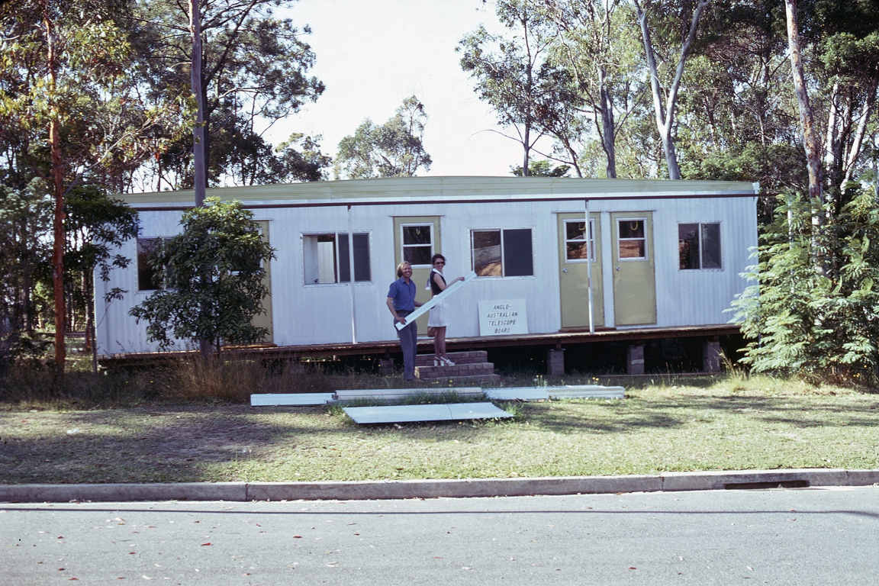
Joe Wampler and Cheryl Christiansen building the AAO office, Epping, late 1974

Slide 14
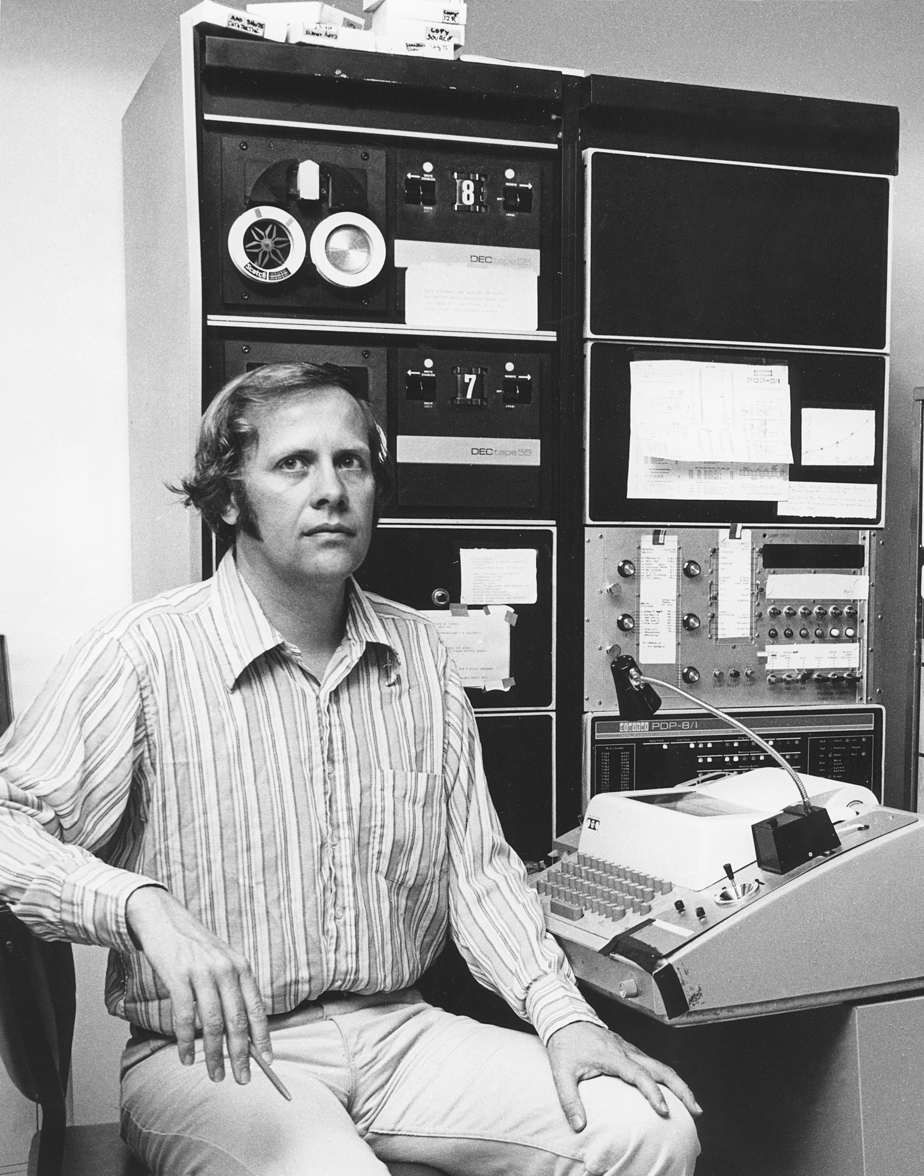
Joe Wampler
1975

Slide 15
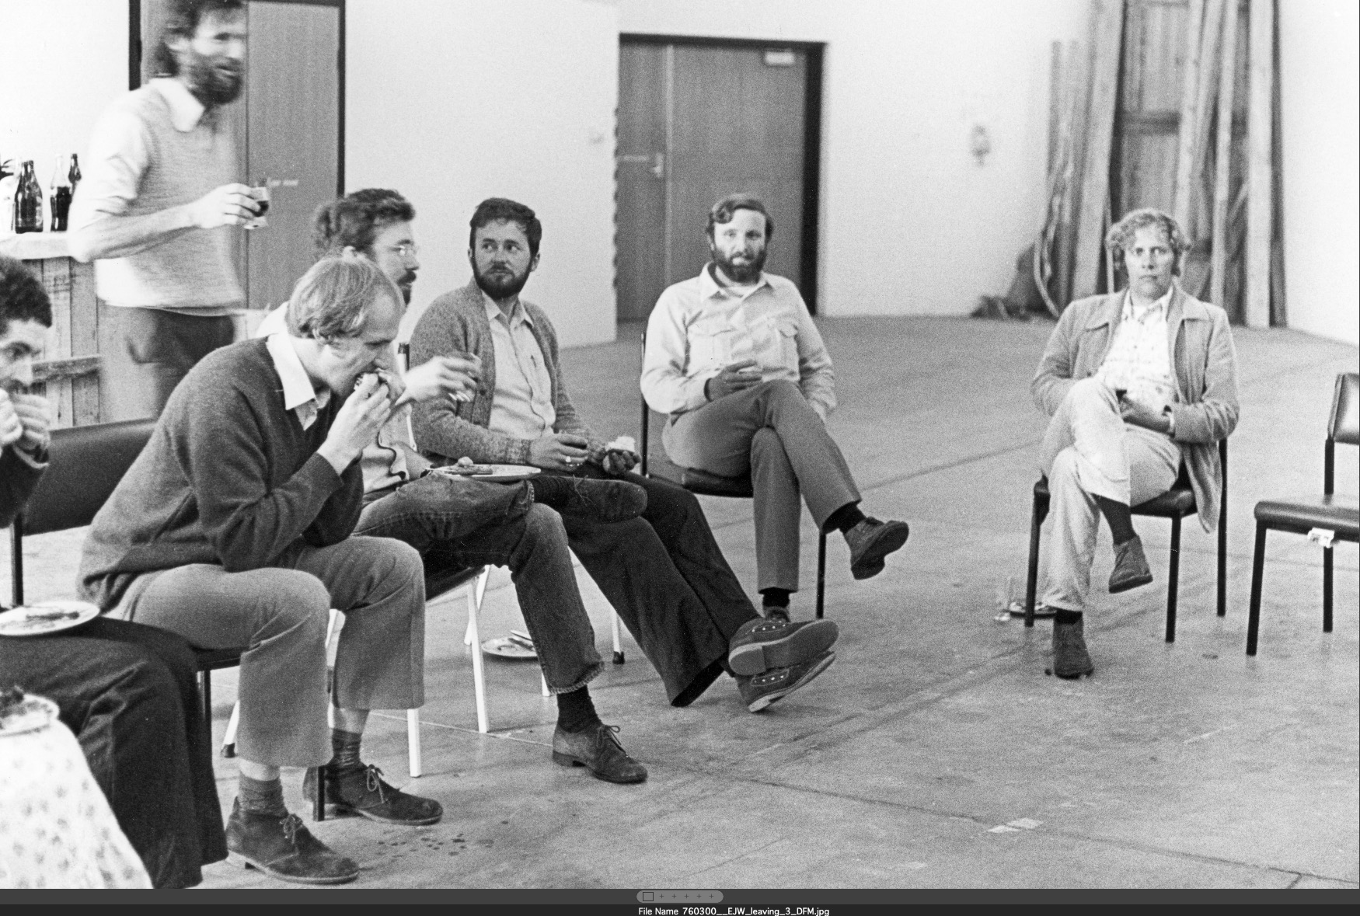
Joe Wampler’s leaving ‘party’ March 1976

Slide 16
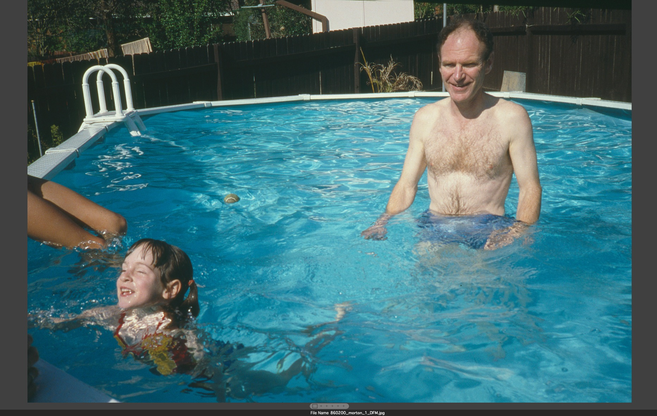
Don and Christine Morton
in Ken Gorham’s swimming pool
mid-1970s

Slide 17
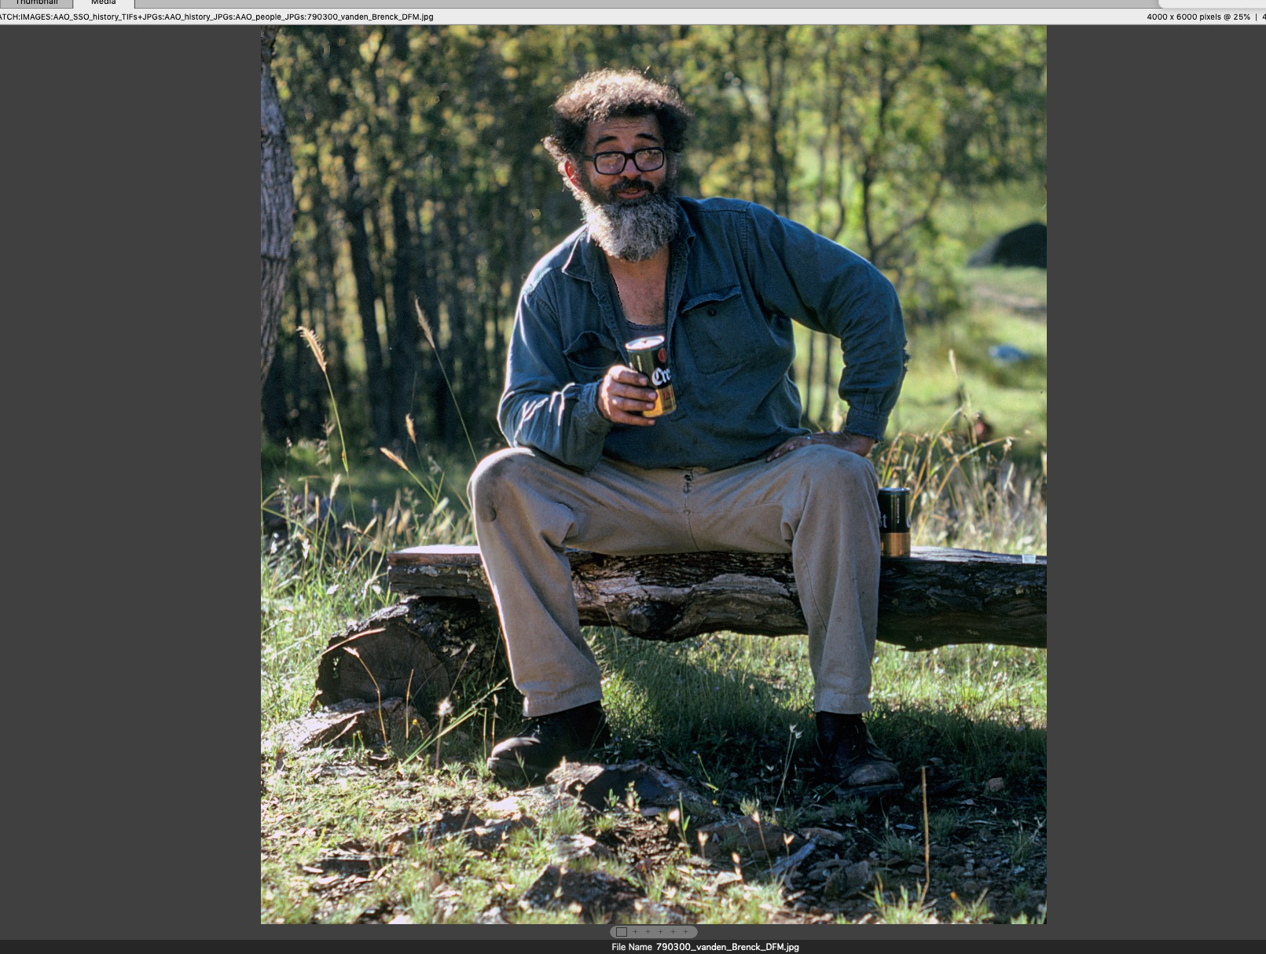
John van den Brenk
March 1976

Slide 18
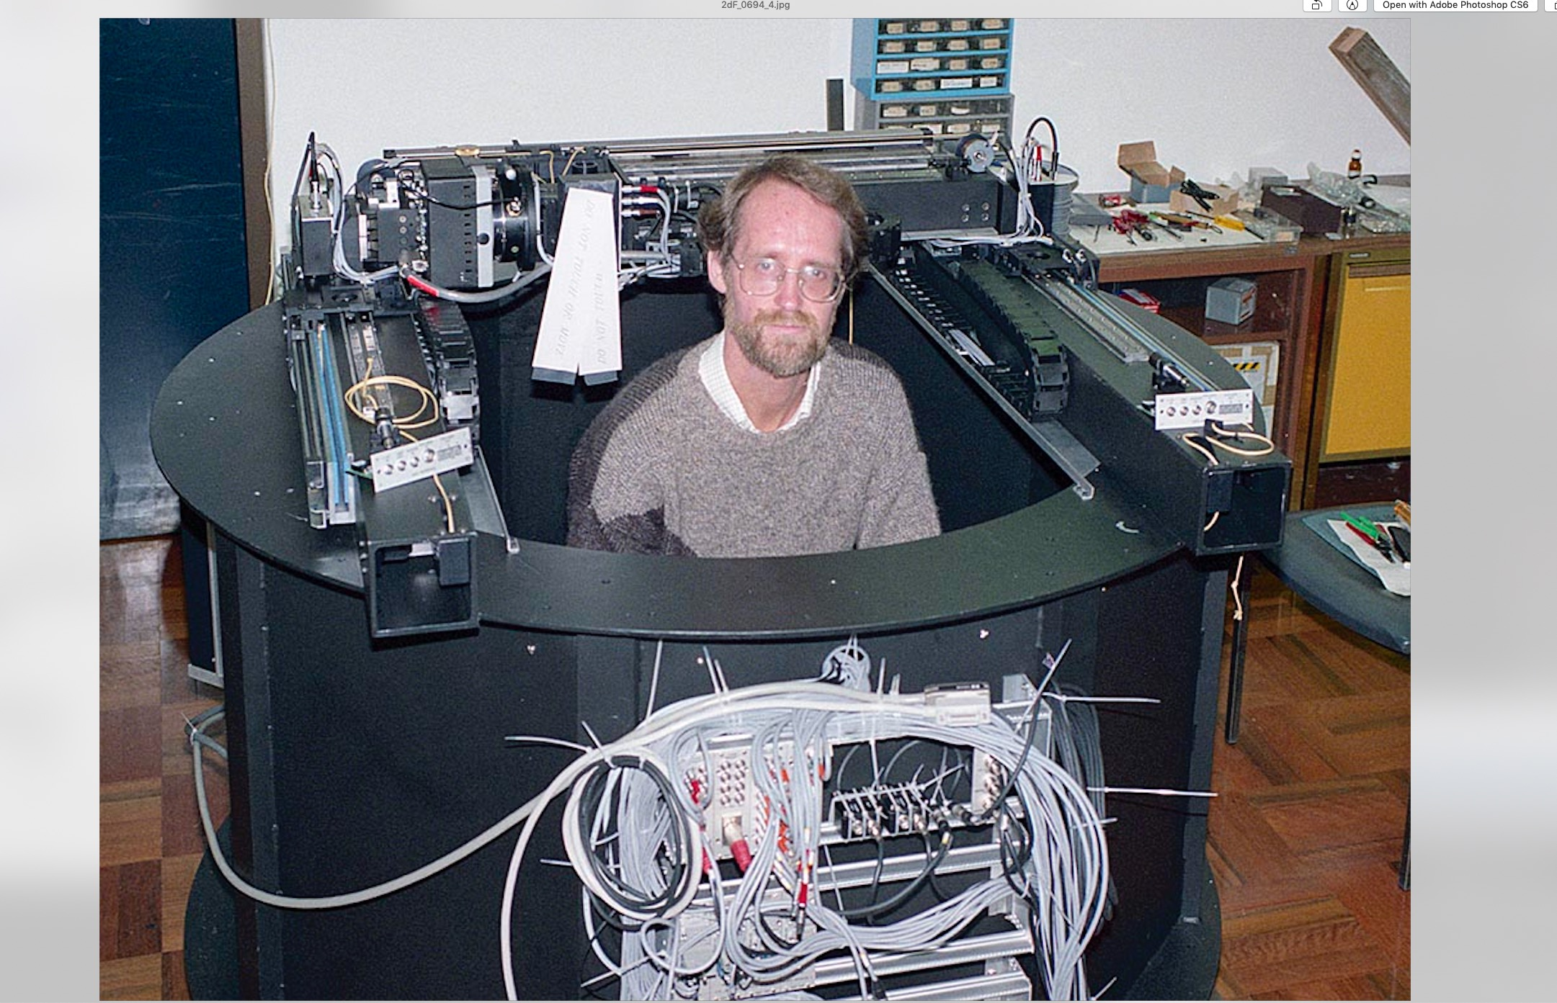
Get me out of here!

Slide 19
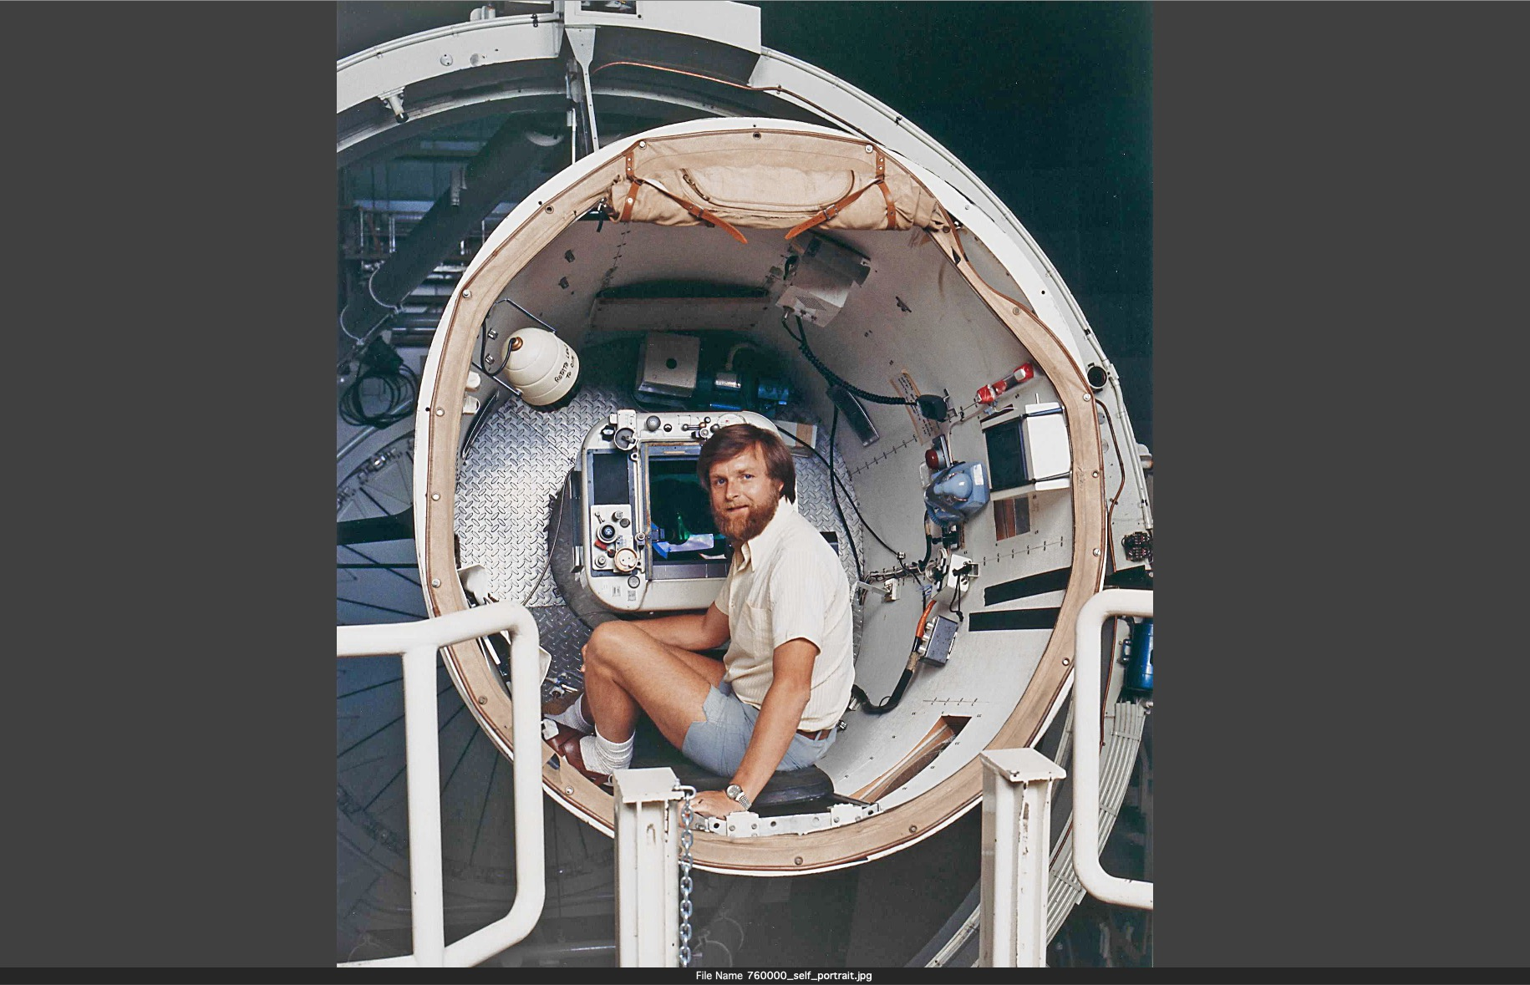
At the AAT
early 1976

Slide 20
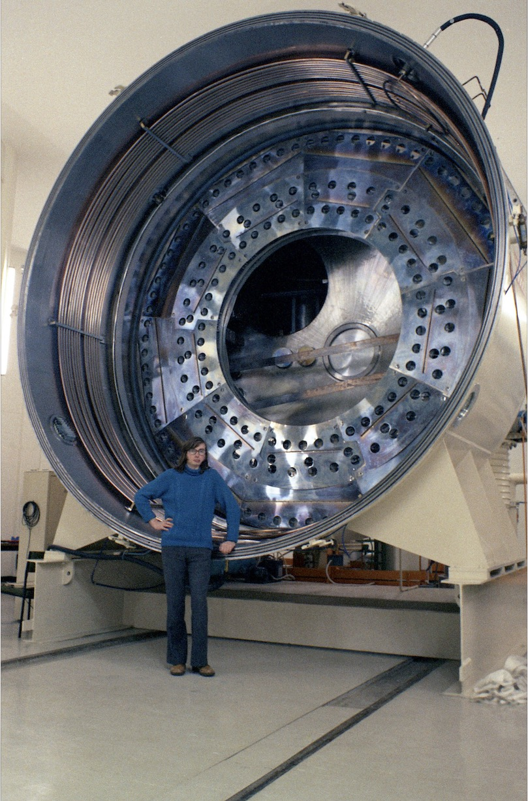
Pat Wallace, 1975

Slide 21
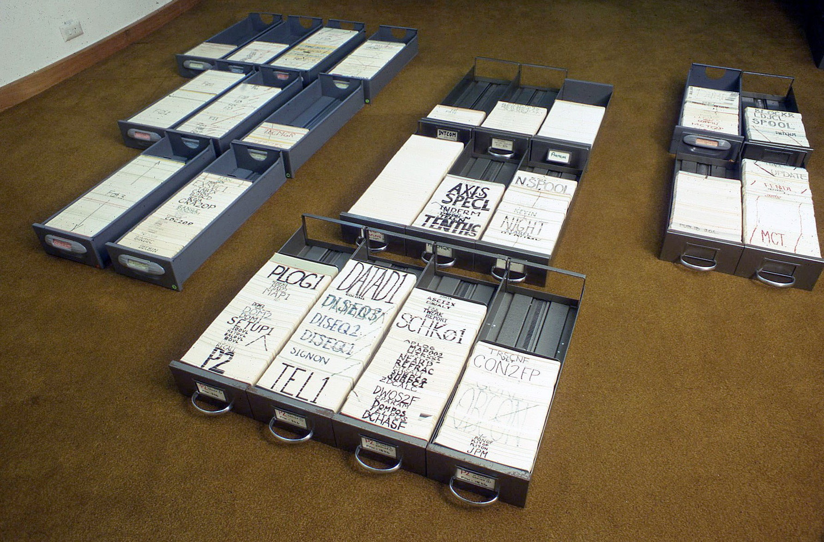
Punched cards, late 1970s

Slide 22
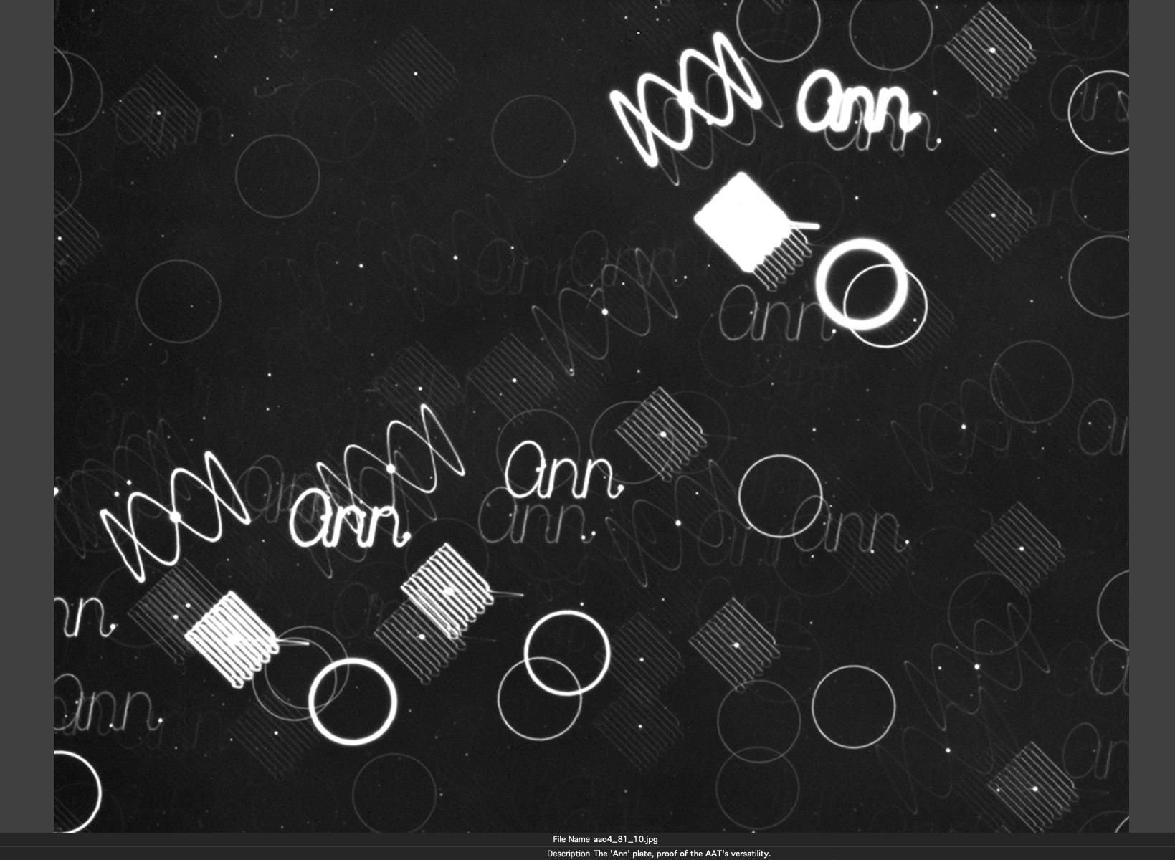
The ‘Ann’ plate March 1976.
Raster scans separated by 10 arc sec.

Slide 23
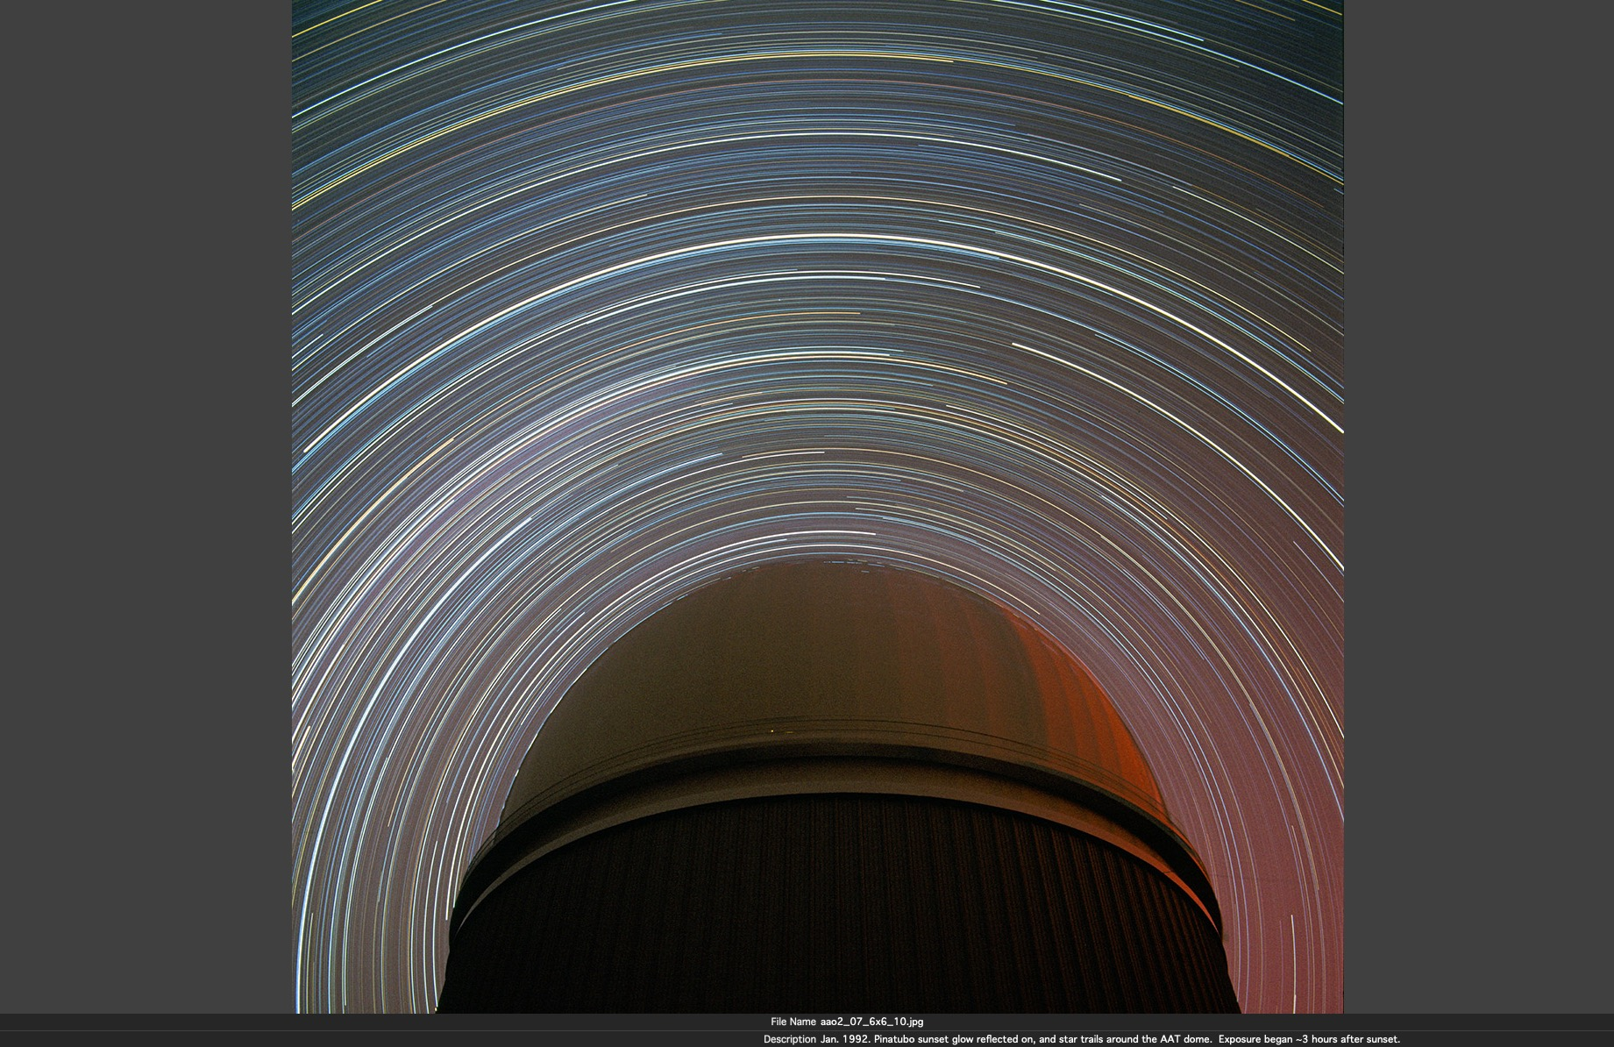
Pinatubo sky, 3 hours after sunset, January, 1992

Slide 24
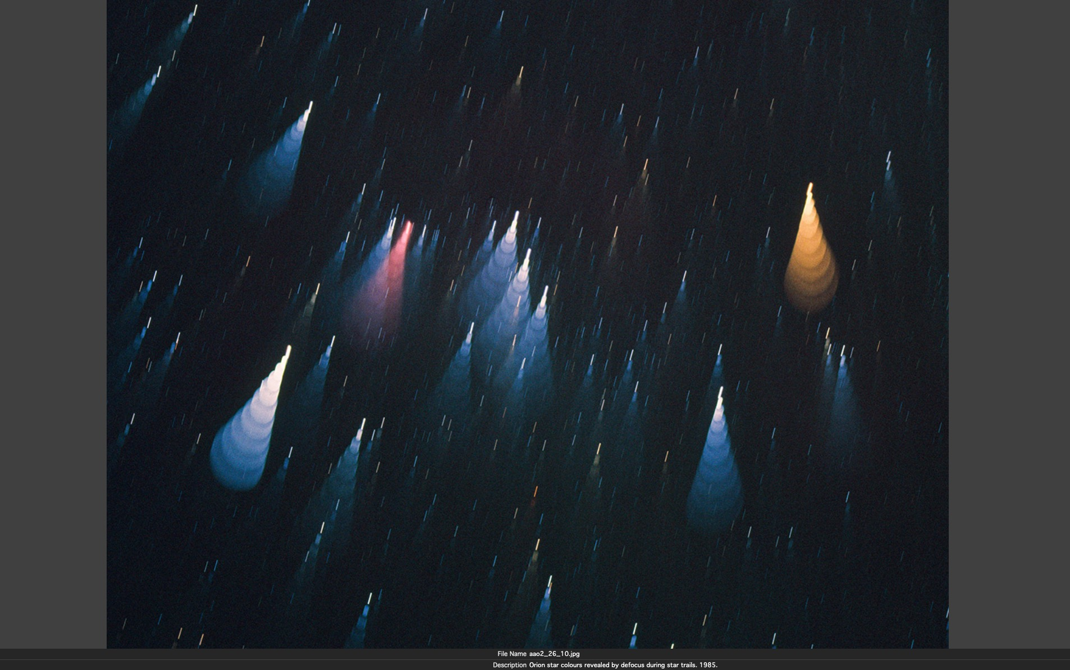
Defocused star trails in Orion, revealing colour.

Slide 25
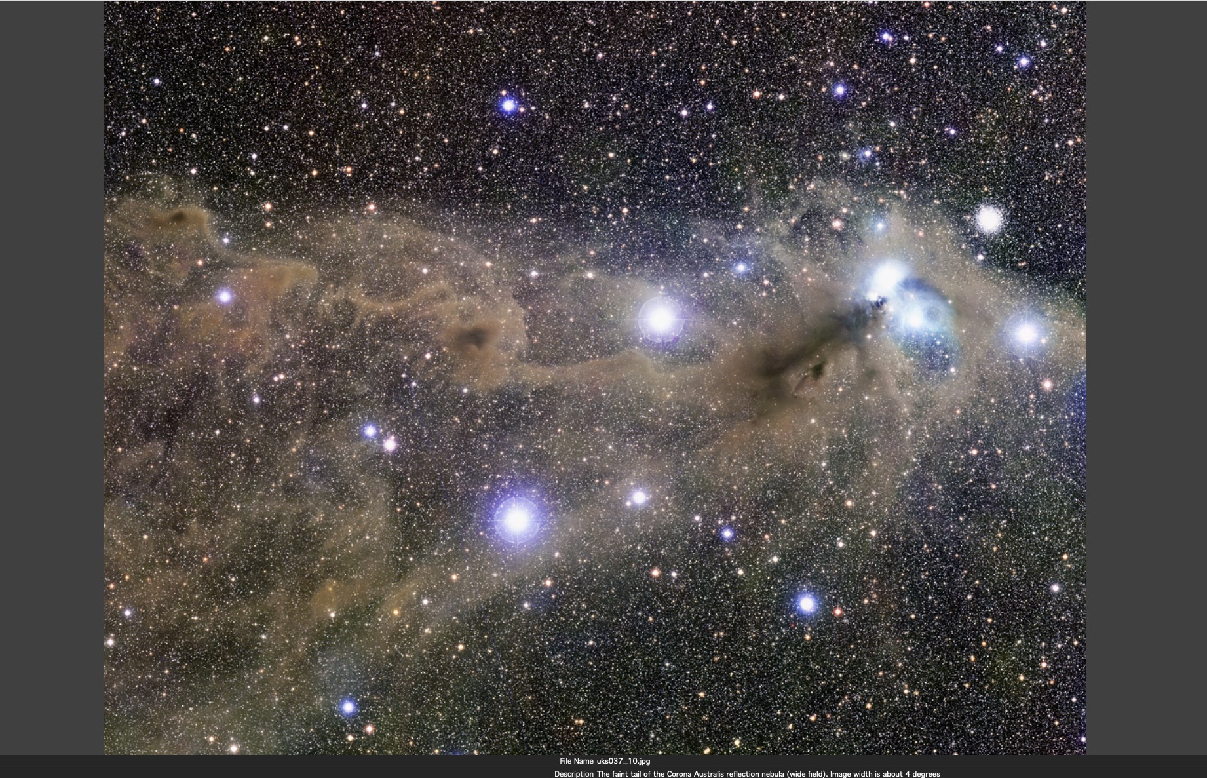
Dust colours in the Corona Australis reflection nebula (UKST)

Slide 26
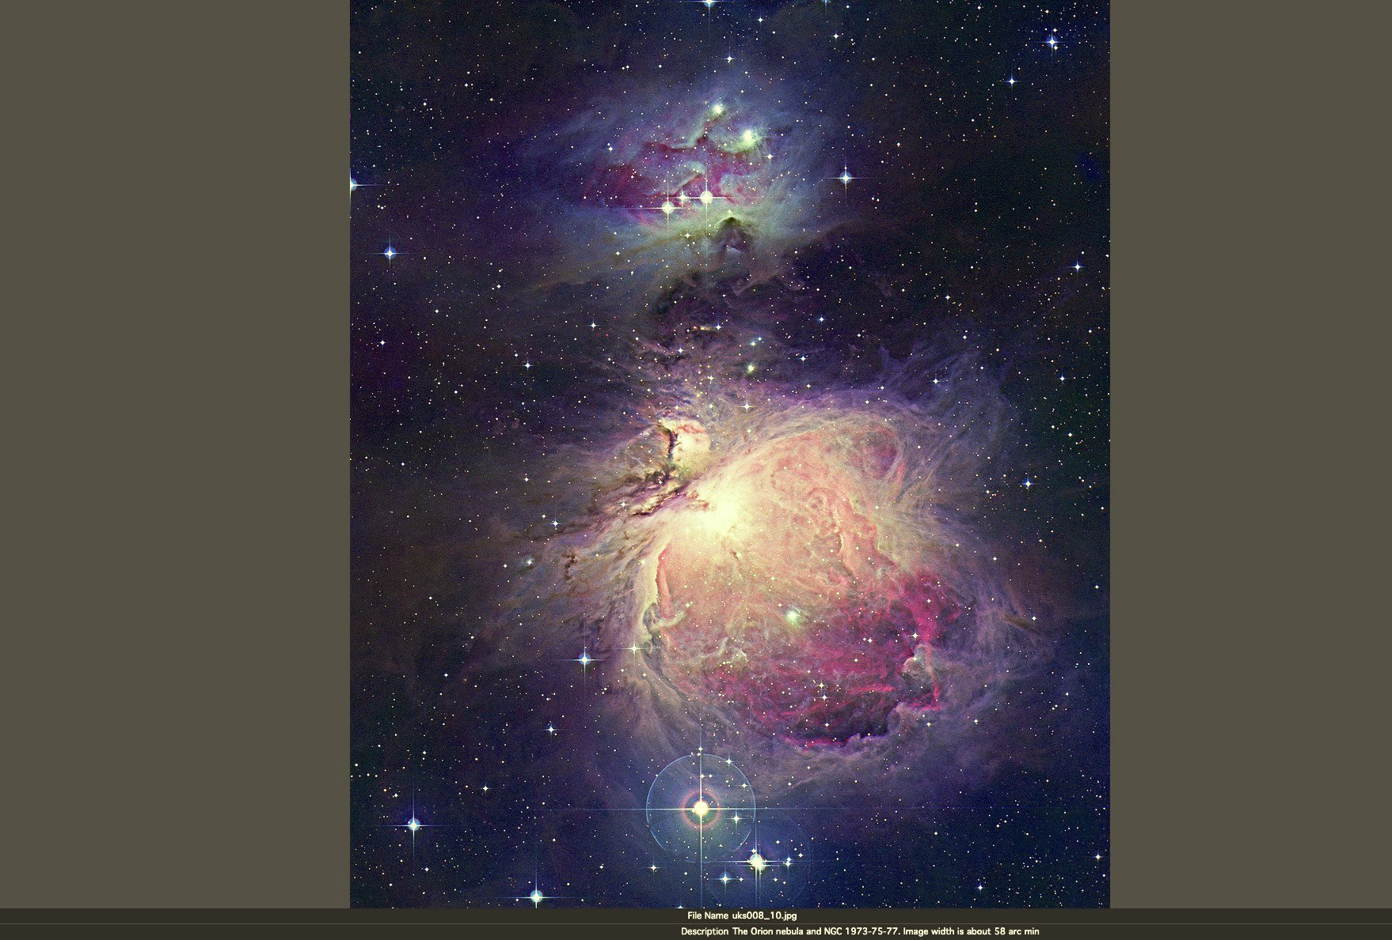
The Orion Nebula
from UKST plates.

Slide 27
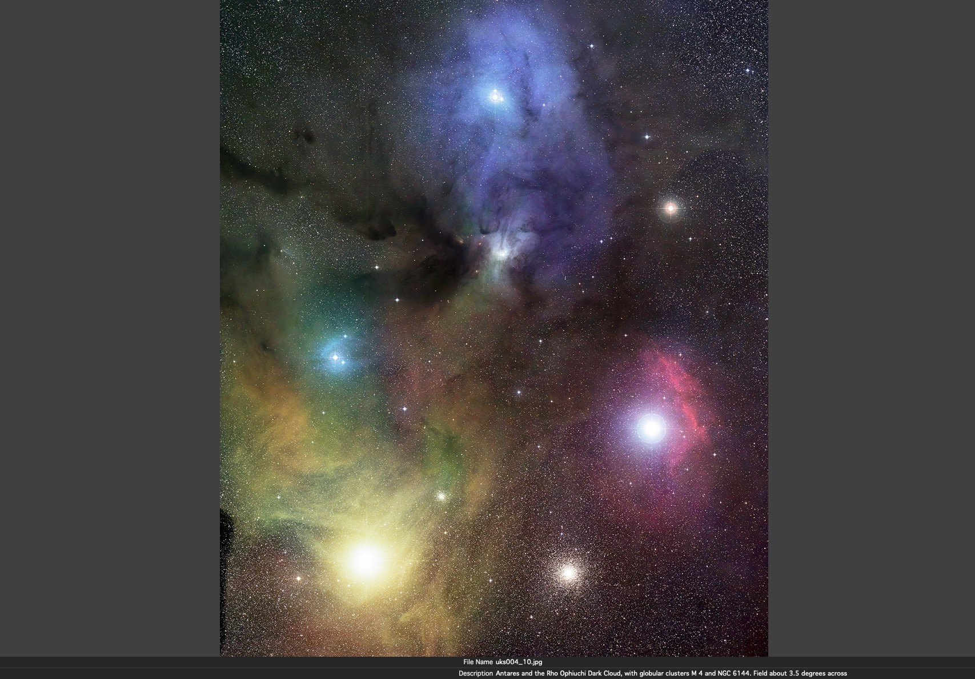
Rho Ophiuchi
Nebula
(UKST plates).

Slide 28
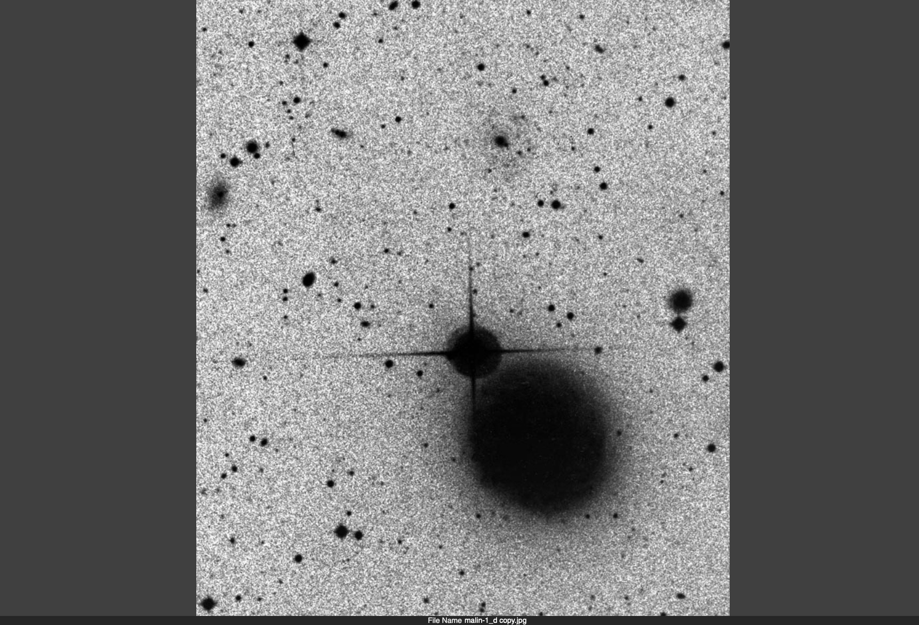
Malin-1
discovery
image
(UKST plate, 1986)

Slide 29
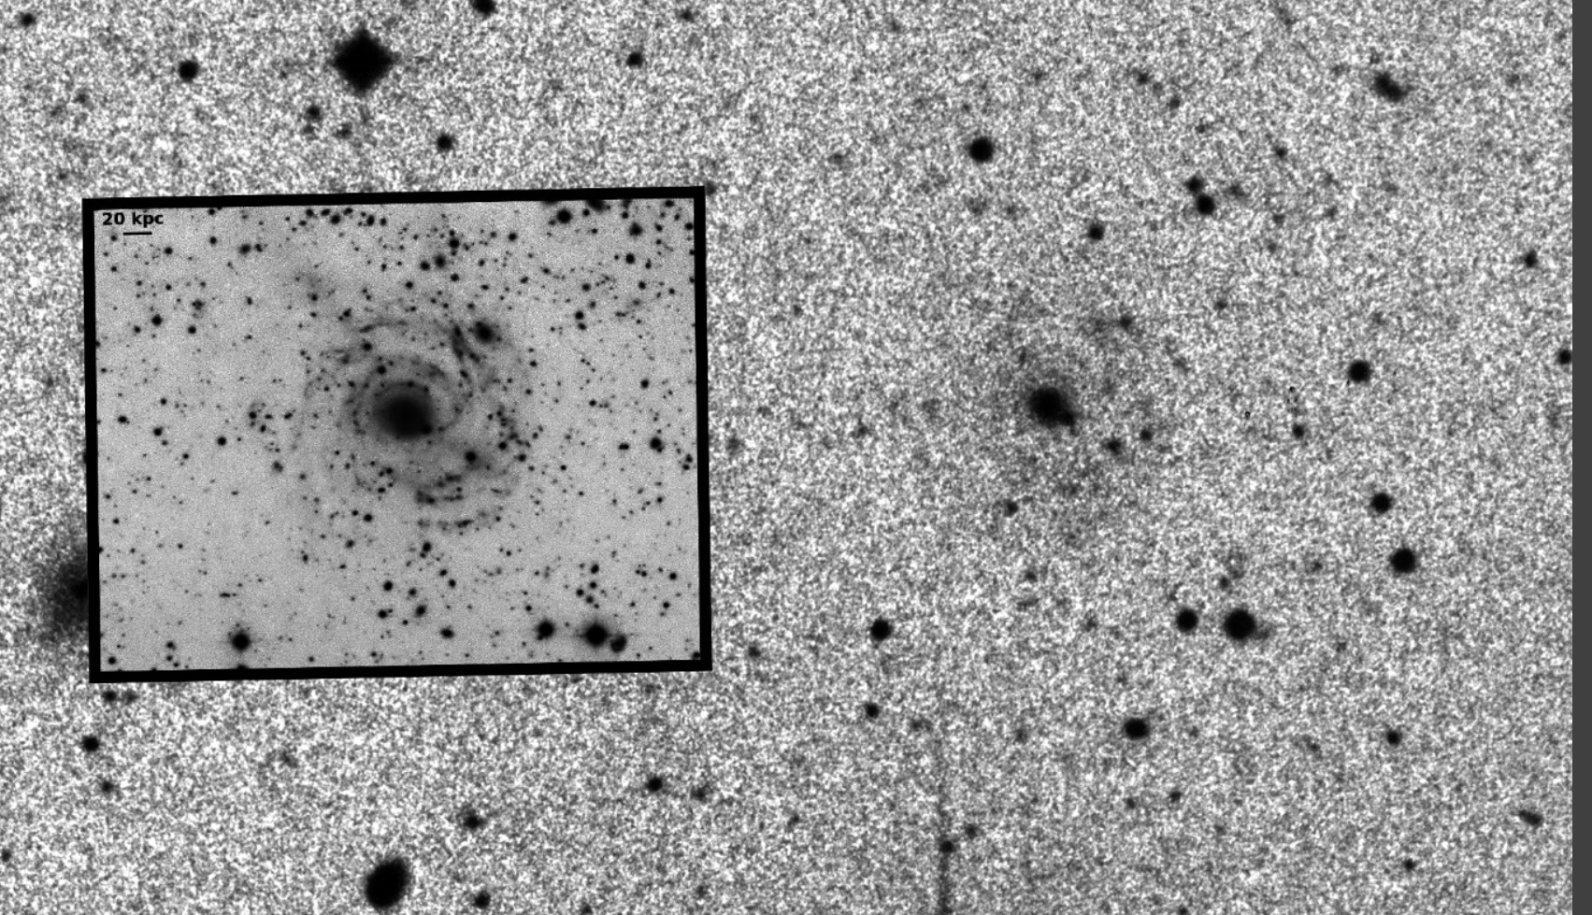
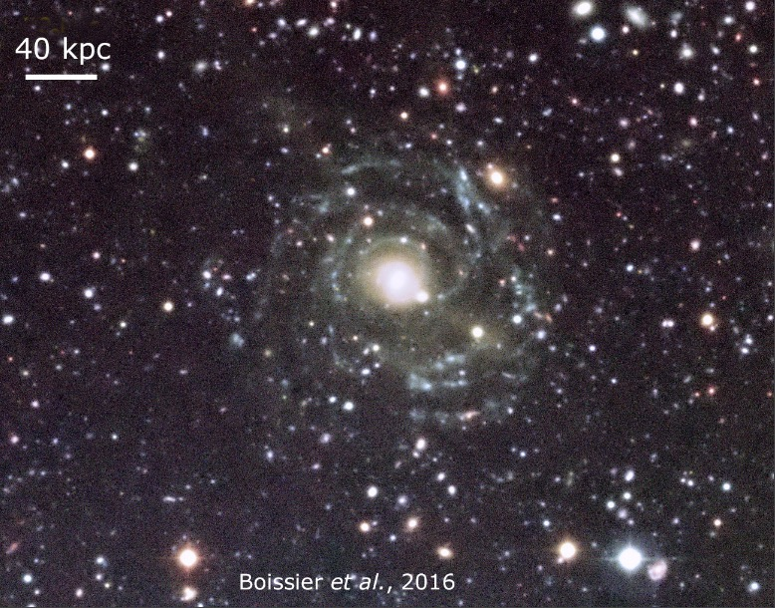
Malin-1 in colour, 30 years later
“ ..... the largest barred spiral galaxy ever to have been observed.” (Wikipedia)

Slide 30
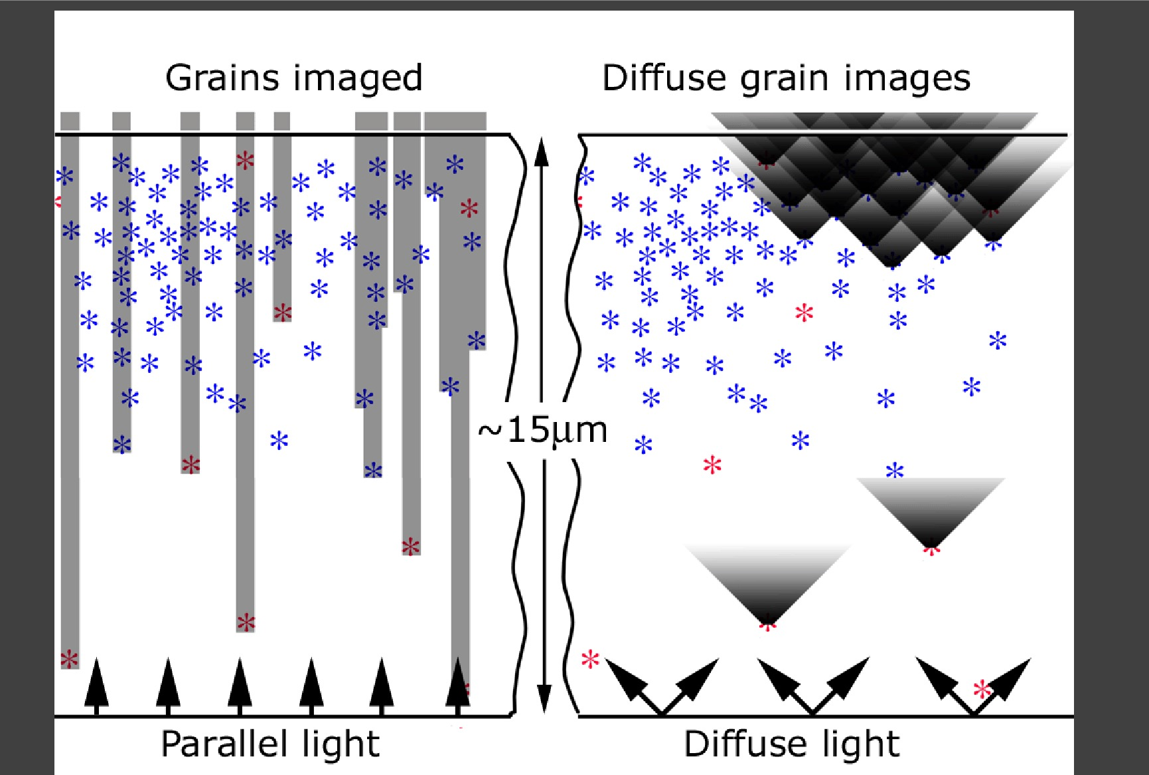

Slide 31
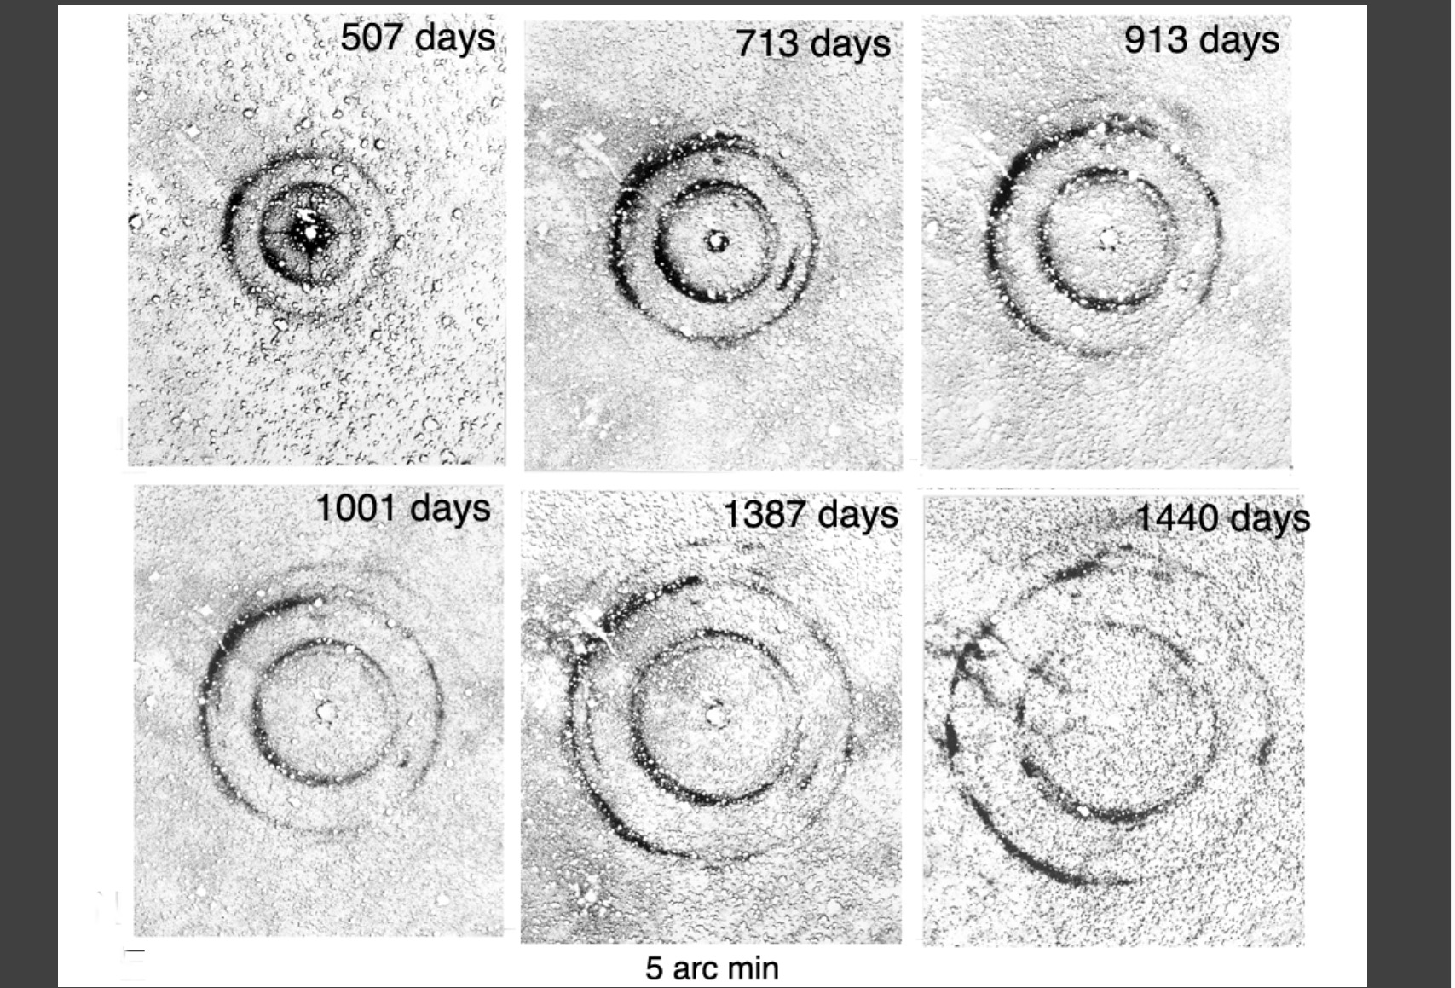
The expansion of the light echo of SN1987a to July 1989. (NB reflection nebula)

Slide 32
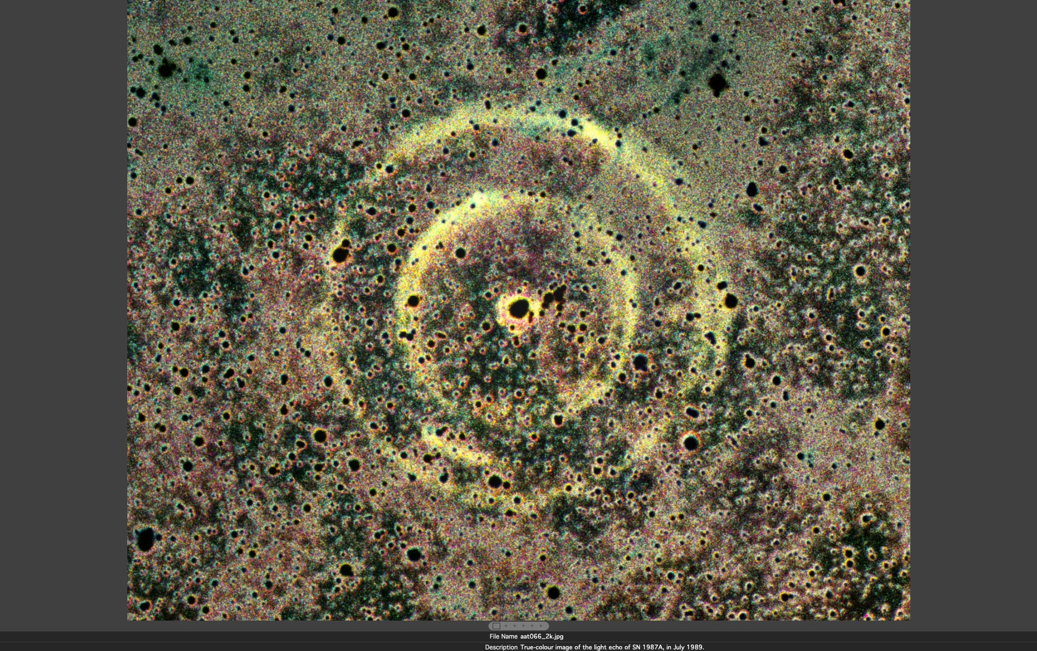
The colour of light echo of SN1987a

Slide 33
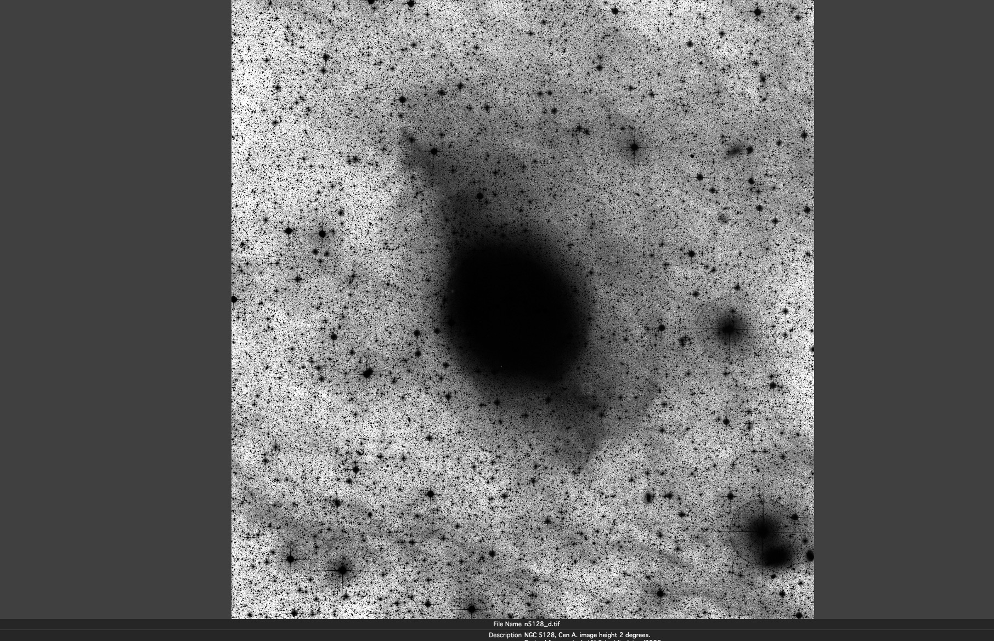
ß
Deep image
of Cen A.
UKST plate

Slide 34
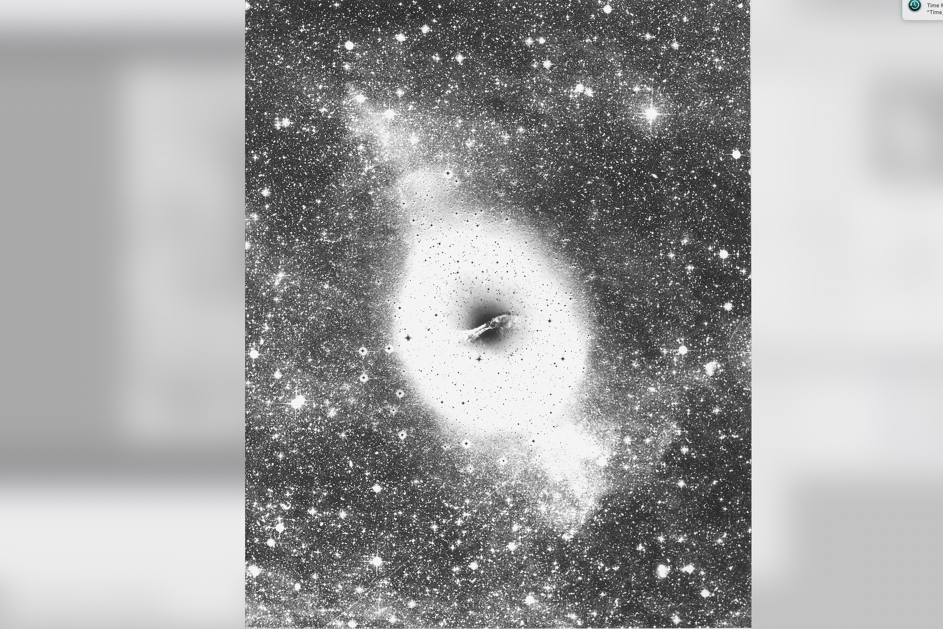
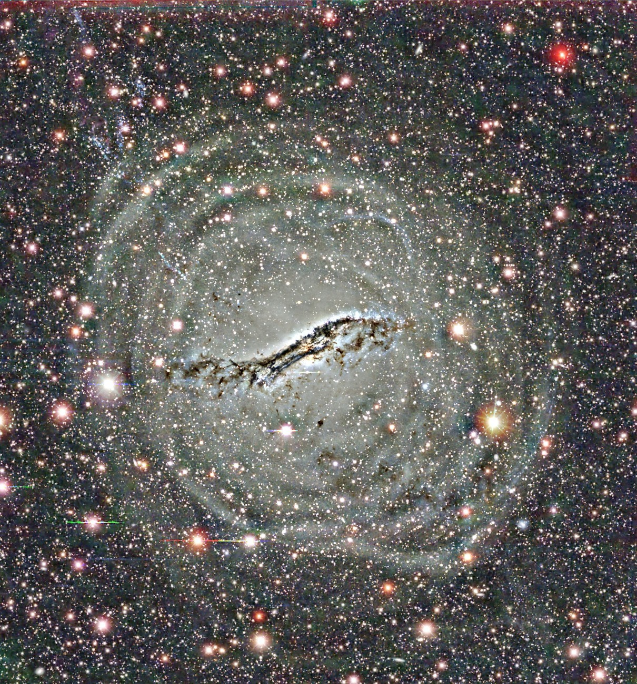
Deep image
of Cen A
UKST plate
plus
AAT overlay

Slide 35
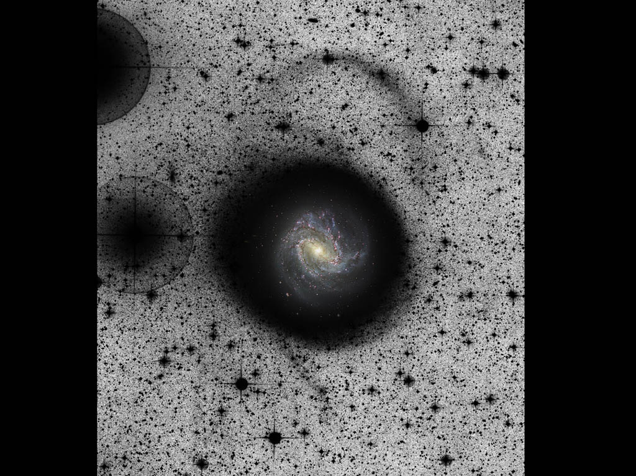
M83.
Deep UKST
image
and AAT colour

Slide 36
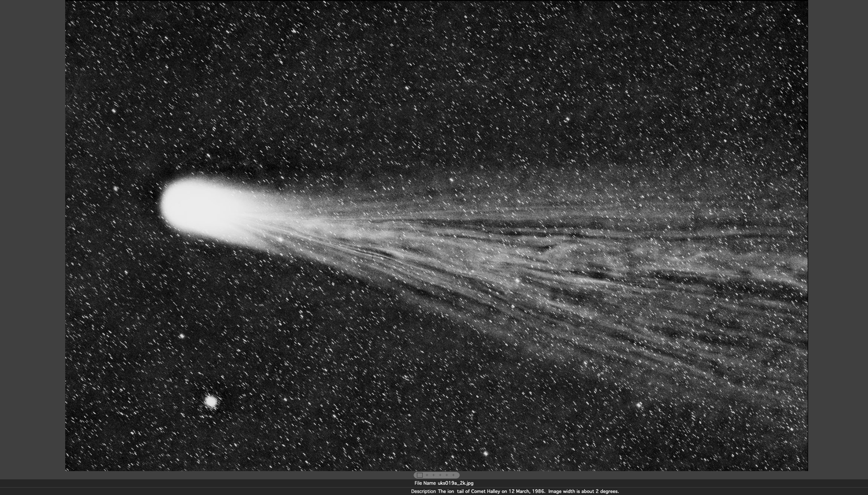
The ion tail of Comet Halley, March, 1986

Slide 37
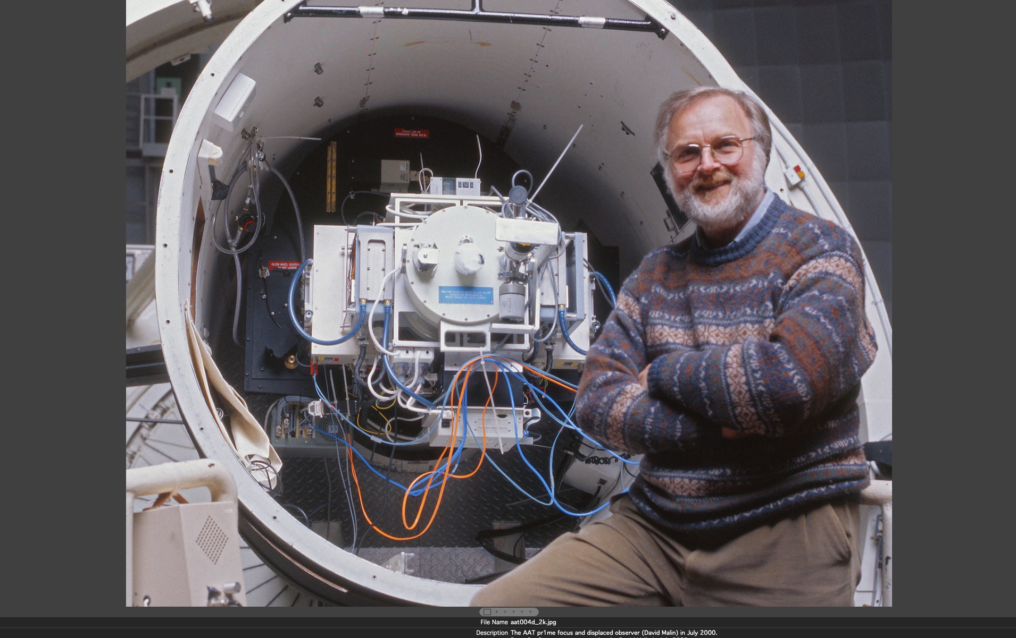
July 2000, my last imaging session on the AAT

Slide 38
David Allen
Russell Cannon
Dave Carter
Ben Gascoigne
Dave Hanes
Dave Jauncey
Steve Lee
Bruce Peterson
Paul Murdin
Gordon Robertson
Jason Spyromilio
John Storey
Keith and Sue Tritton
Louise Turtle (neé Webster)
Pat Wallace
Fred Watson .... etc.
With much help from
my
many mentors
(and some
tormentors)

