Slide 1
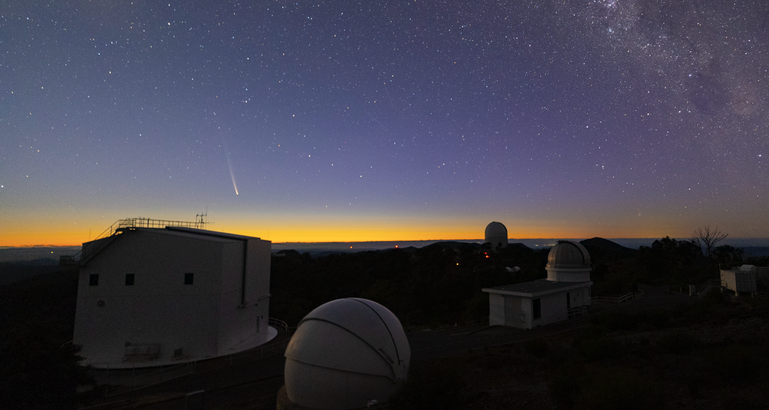
Anglo-Australian Telescope
Chris Lidman
(Australian National University)
The Transition
Governance
Funding
Performance
Operations 2025-2028
Beyond 2028
Comet Tsuchinshan-ATLAS
Photo credit: Blake Estes

Slide 2
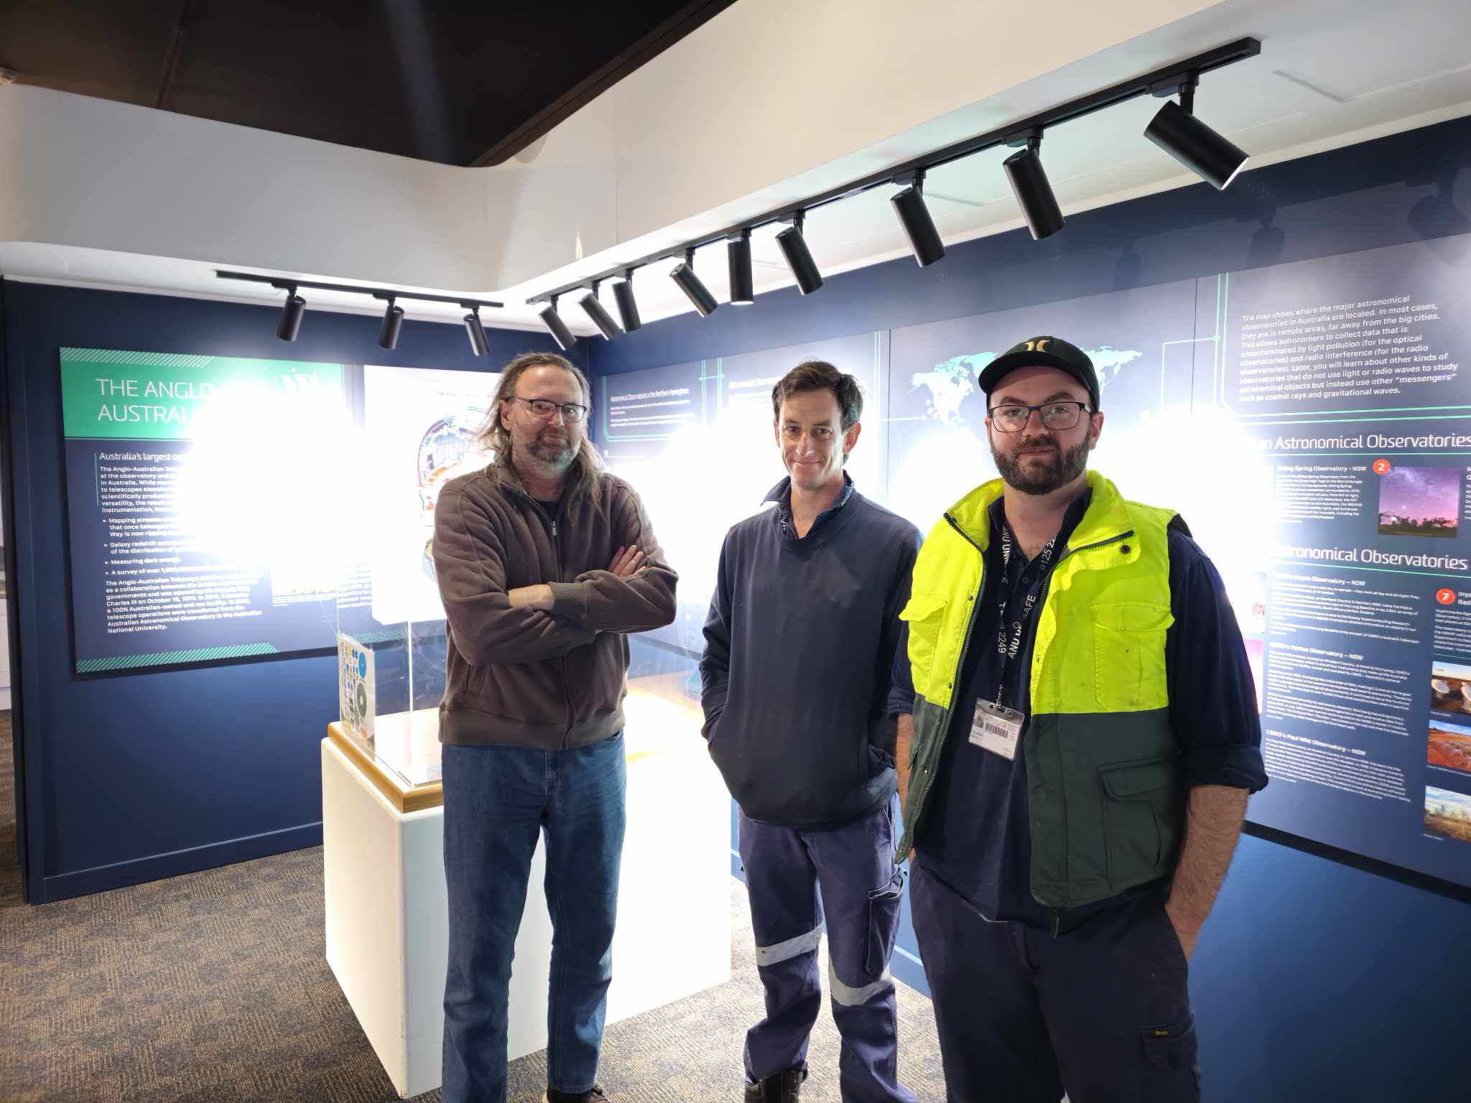
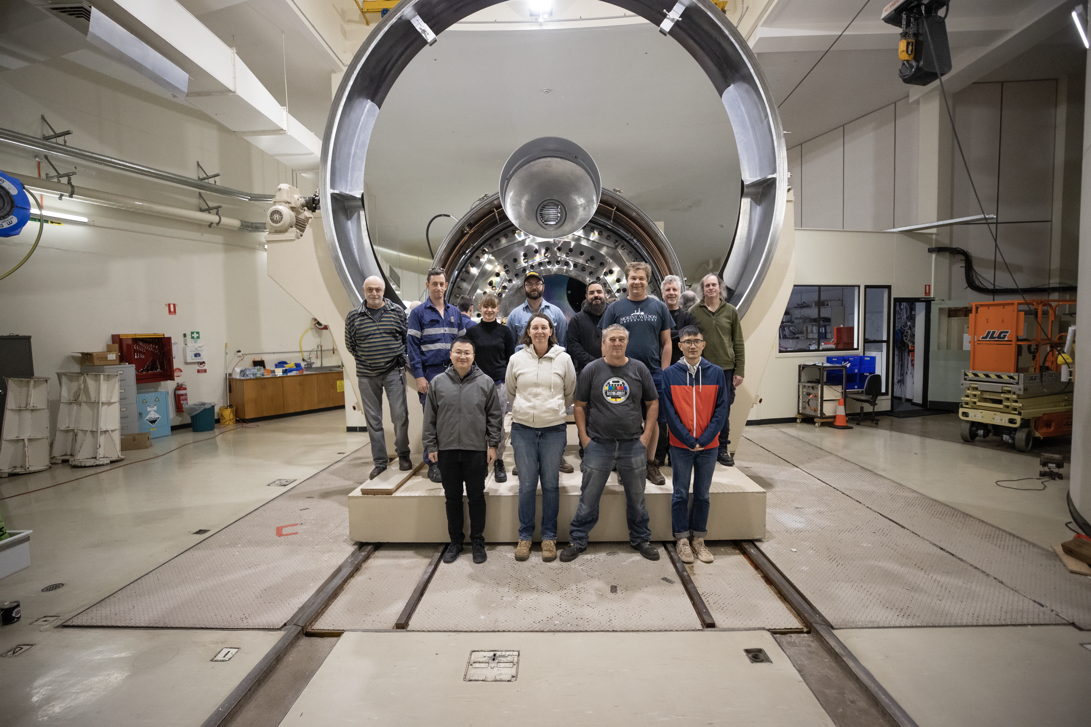
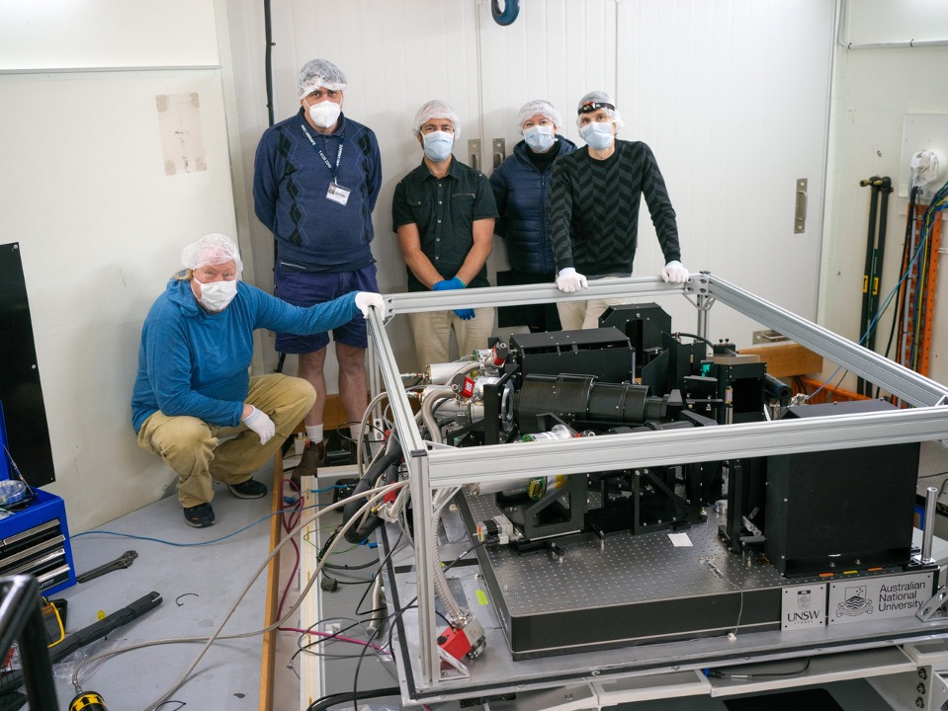
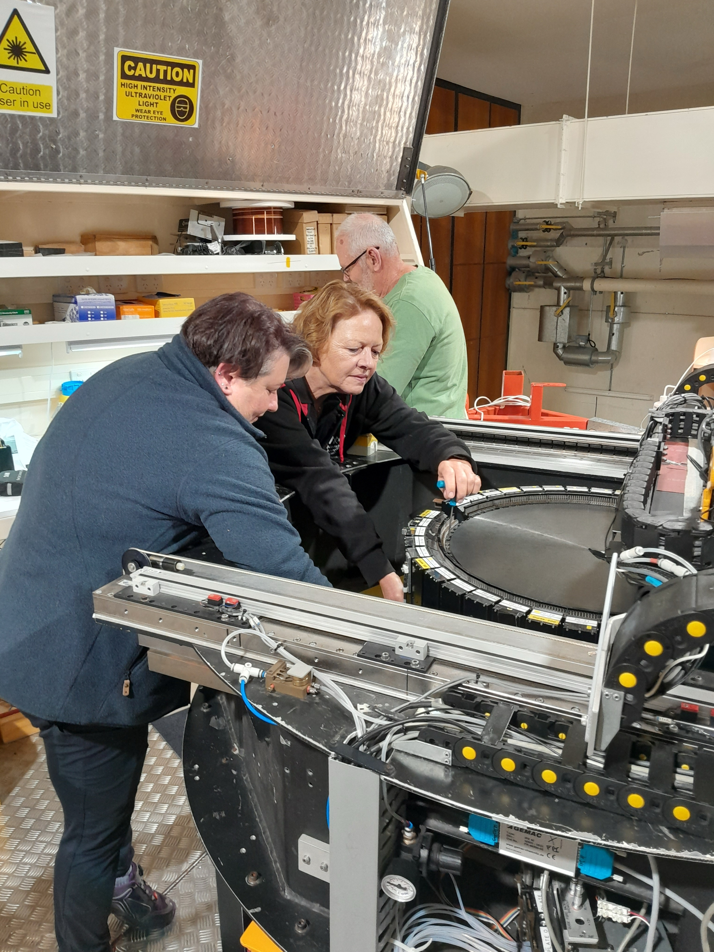
Staff @ SSO

Slide 3
The transition in 2018
01 July 2018
The former AAO was split into two – AAT and AAO (MQ)
AAT funded and run by university sector
Funding became short term - 7 (4+3) years
Staff were moved to fixed term contracts
External engineering support – AITC, AAO (MQ)
Astronomical support provided by the community
Photo Credit: Steve Chapman

Slide 4
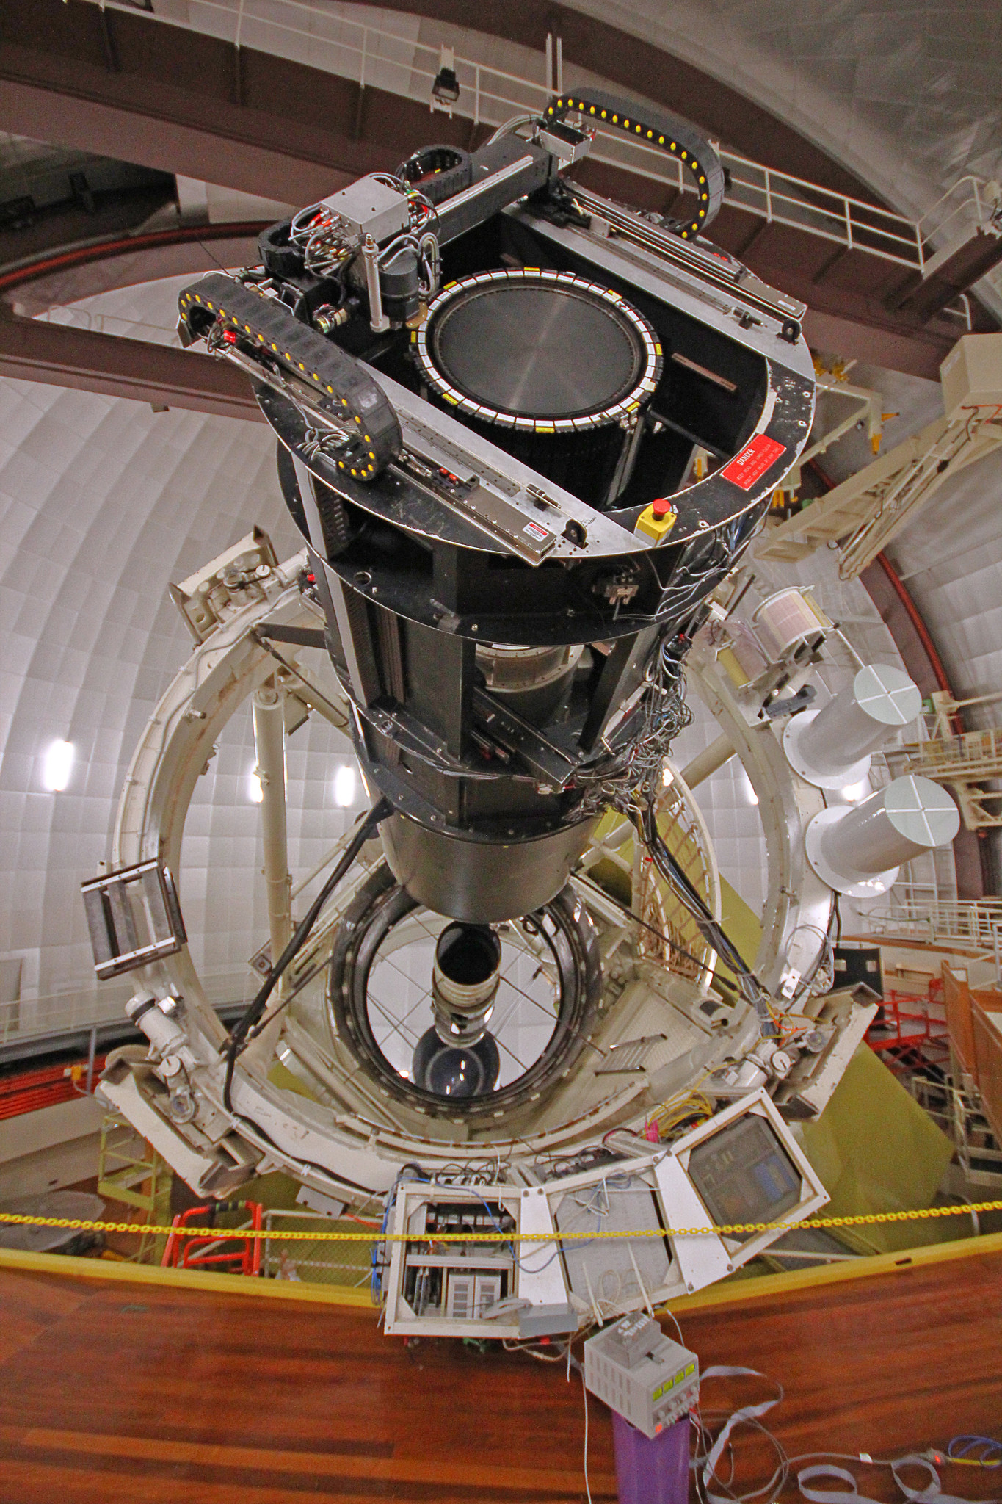
Governance
AAT Consortium
11 Australian universities +
AAL (Manager)
The AAT Consortium Agreement
The Commonwealth
The owners of AAT
Research Services
Agreement
Use
Agreement
ANU
The operator

Slide 5
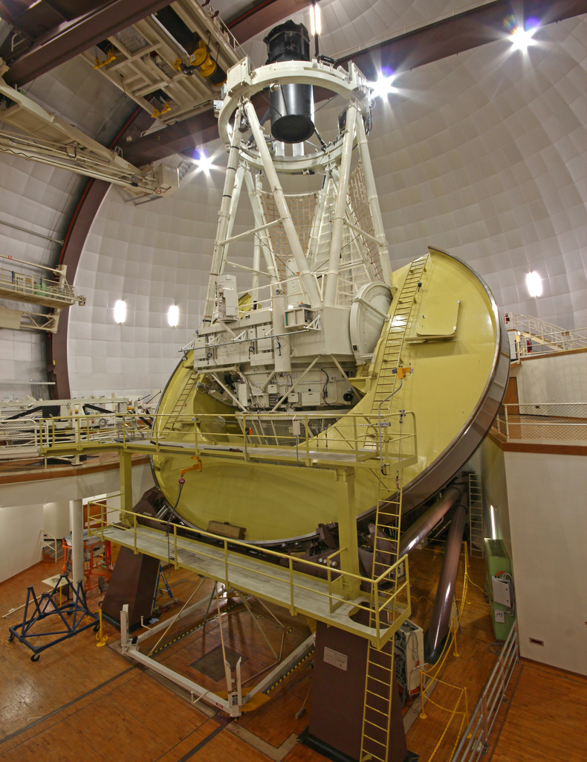
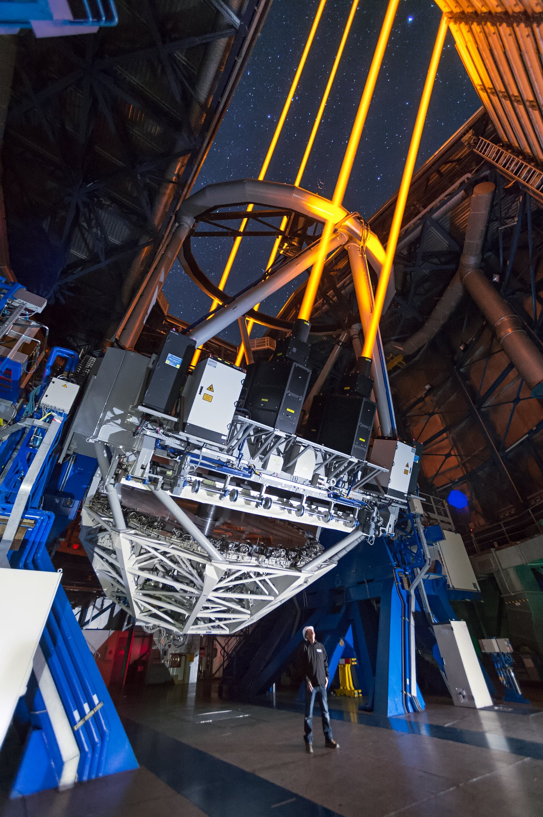
Approximate operating costs
(per night)
ANU 2.3m
AAT
VLT Unit Telescope
$1,000
$10,000
$100,000

Slide 6
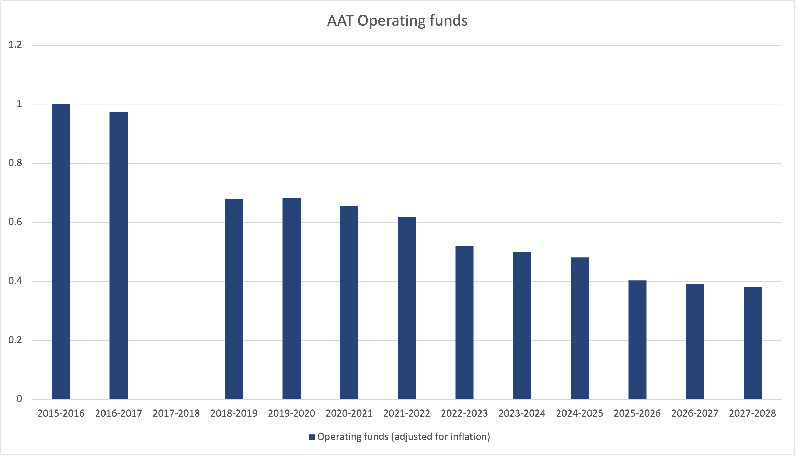
AAT Budget
“In conclusion, the AAT appears run fairly lean operations compared to other observatories of similar size and age …” - Source: Review conducted in 2017
Transition
Today
DISR
AAT Consortium
#1
AAT Consortium
#2
AAT Consortium
#3
Amounts corrected for
Inflation

Slide 7
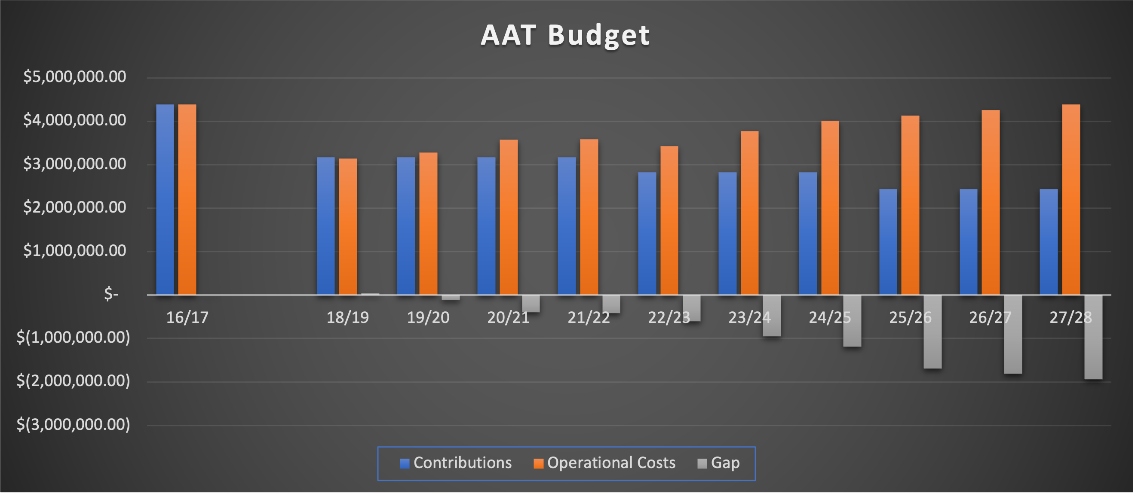
AAT Budget
DISR
AAT Cons. #1
AAT Cons. #2
AAT Cons. #3
Gap funded by selling time
Gap funded
by selling time
and …
Amounts not corrected for
Inflation

Slide 8
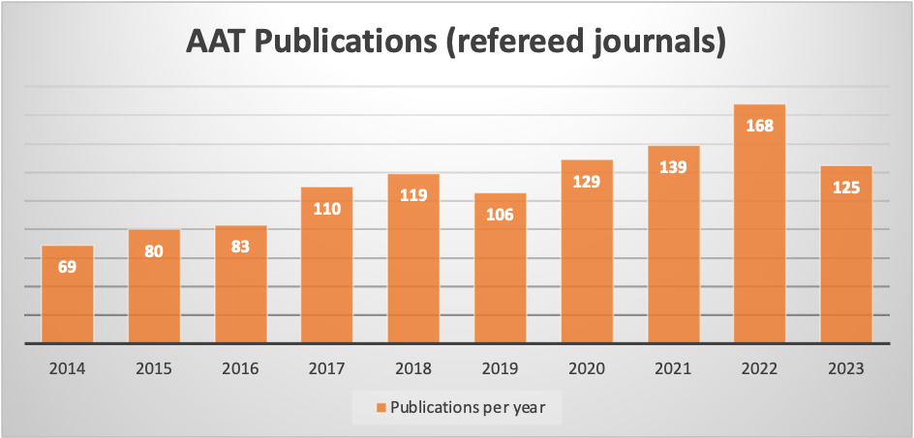
Performance Metrics - I
Publications
In ten years, the number of papers have doubled. Most are from large programs (SAMI, GALAH, GAMA, OzDES)

Slide 9
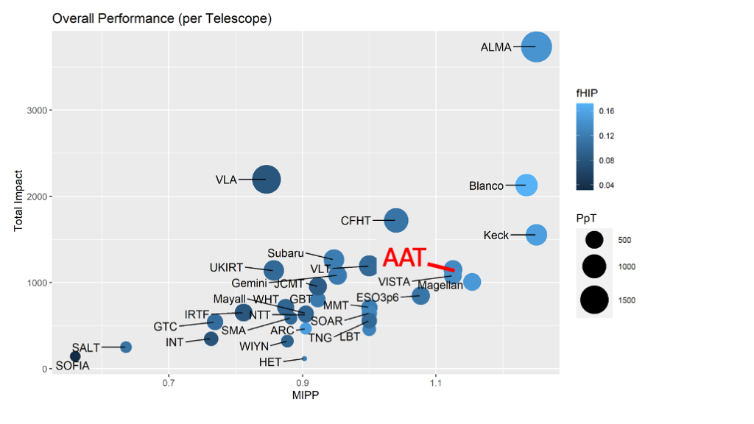
Performance Metrics - II
Relative Ranking

Slide 10
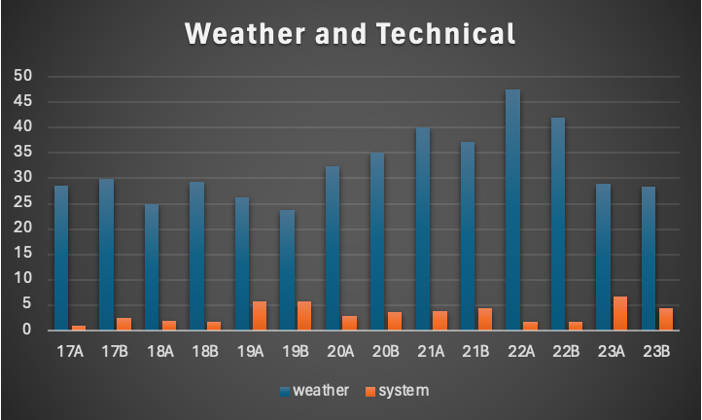
Performance Metrics - III
Weather Loss and Technical Downtime
DISR
AAT Consortium #1
AAT Consortium #2
Downtime generally remains below the 5% threshold
On average, one-third of time is lost to weather

Slide 11
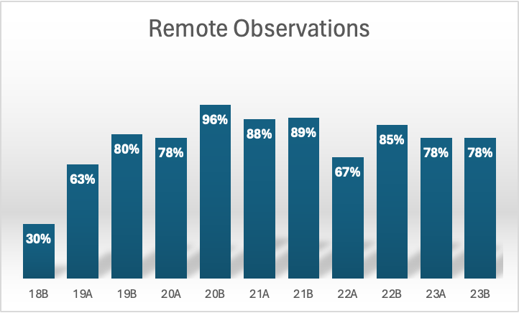
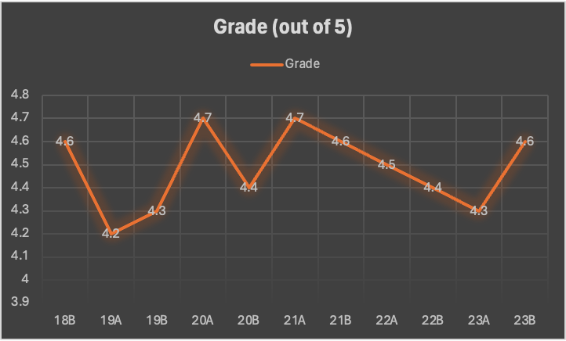
Performance Metrics - IV
COVID19 restrictions in
2020A and 2020B
User satisfaction
Steady over past five years

Slide 12
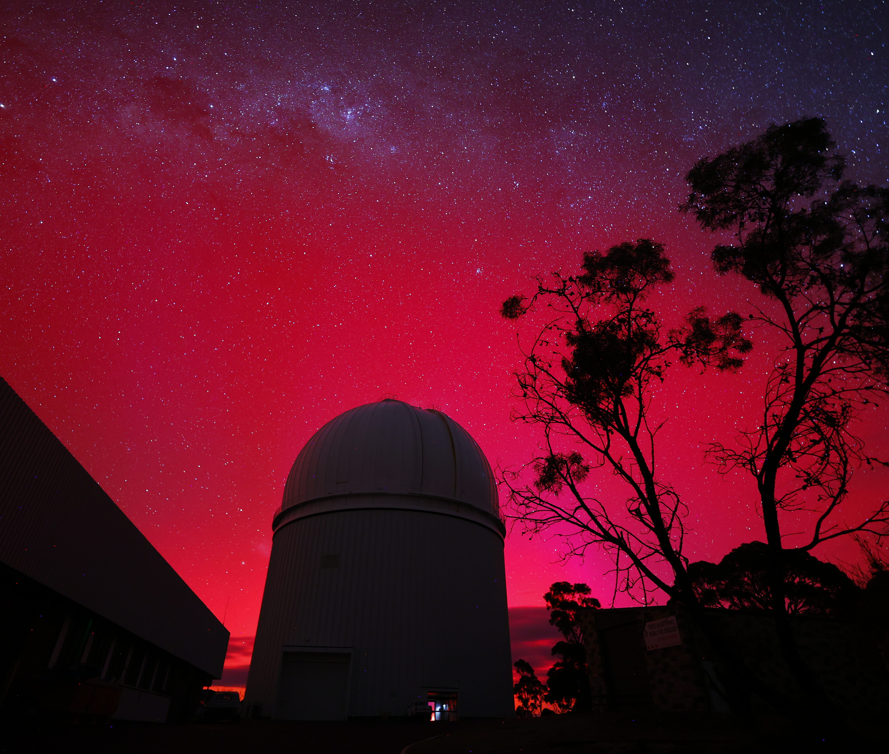
Operations (July 2025 to Dec 2028)
If further funding can be secured
Key Project Time
Approximately 230 nights per year to four key projects. Assessed by ATAC
Open Time
Approximately 90 nights per year. Assessed by ATAC
All Australian-based astronomers can apply for time.
Paid Time
Approximately 20 nights per year.
Photo Credit: Blake Estes

Slide 13
Beyond 2028 – the challenges
Short term funding
Incompatible with the long lead time for major
instruments. Hector and Veloce were discussed at an
AAO Symposium back in 2011
High staff turnover and loss of knowledge
2. The age of the telescope.
Maintenance costs increasing
Broad community support to ensure funding.
A single instrument/top-end will reduce operating costs, but at the risk of thinning out community support.

