Slide 1
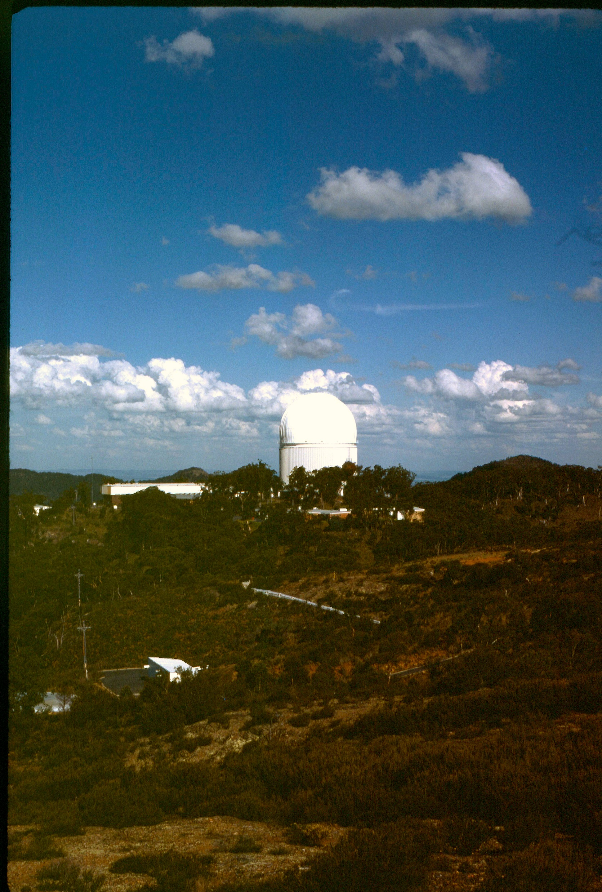
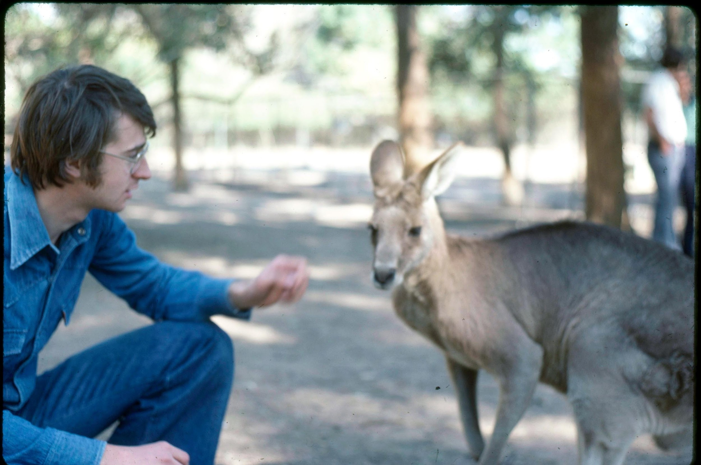
Siding Spring 1977
Galaxy dynamics & stellar populations from IPCS to SAMI.
Roger Davies,
Emeritus Professor University of Oxford & Christ Church
RLD 1977

Slide 2
Outline
Stellar populations & dynamics ~1970-80
Early results from the IPCS
Fundamental Plane
IFU surveys - SAURON
The SAMI survey: the FP today.
Reflections

Slide 3
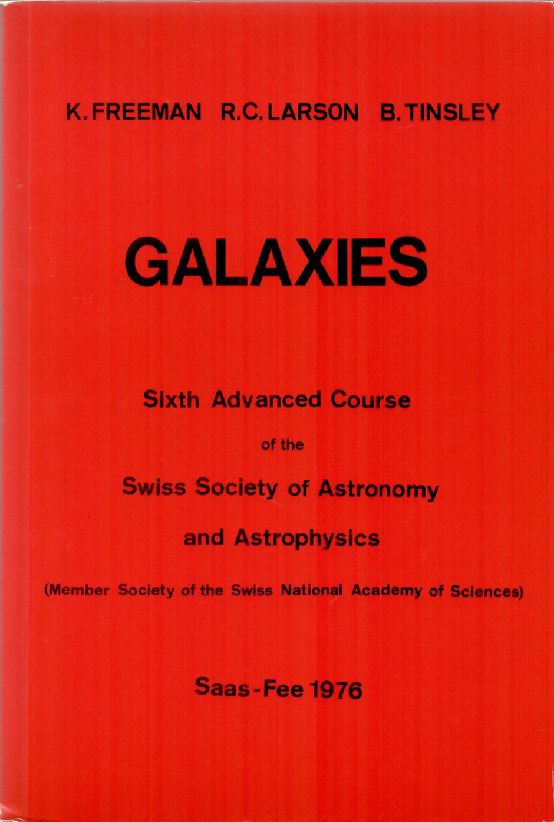
Thanks to Ken Freeman
Saas Fee lecturer 1976

Slide 4
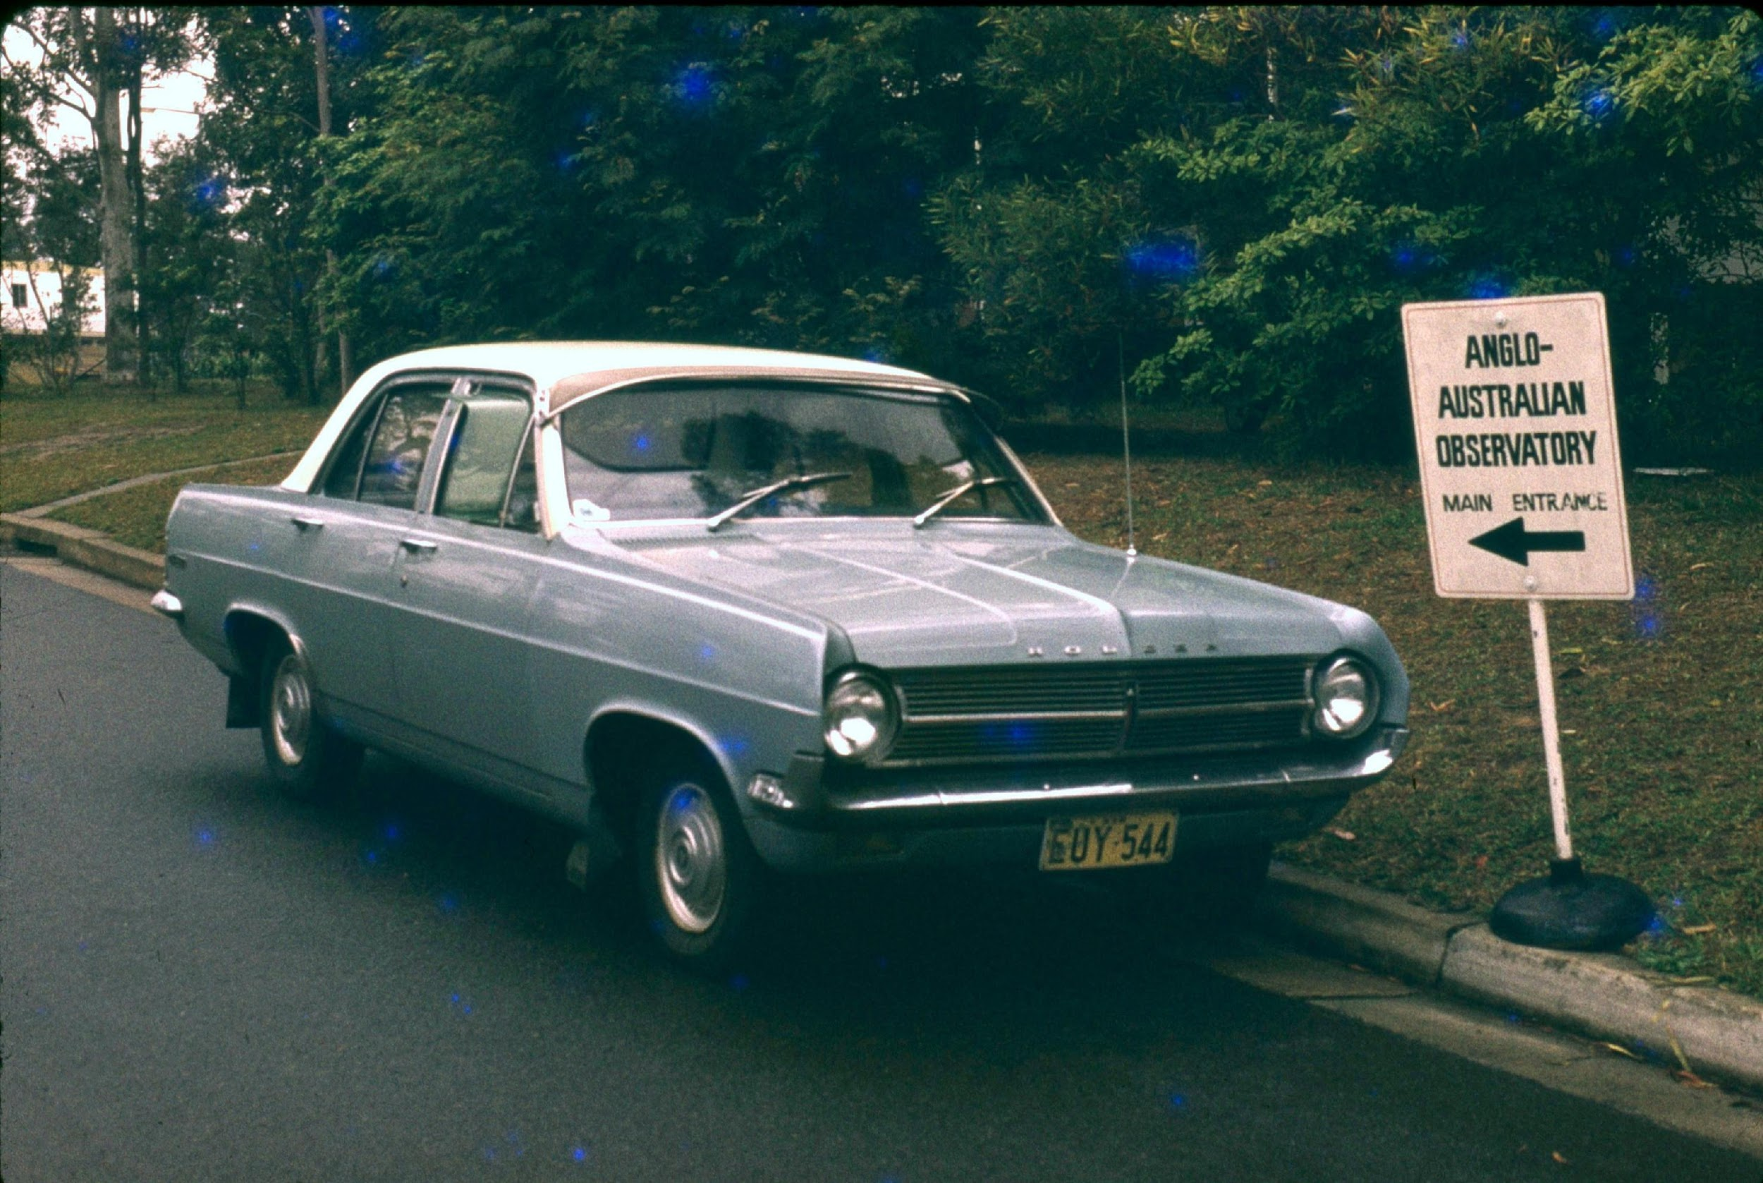
Thanks to Don Morton
AAO Director
(and to Doug Cunliffe, Exec Officer)
……for the opportunity
………..for the car
………….& so much more.

Slide 5
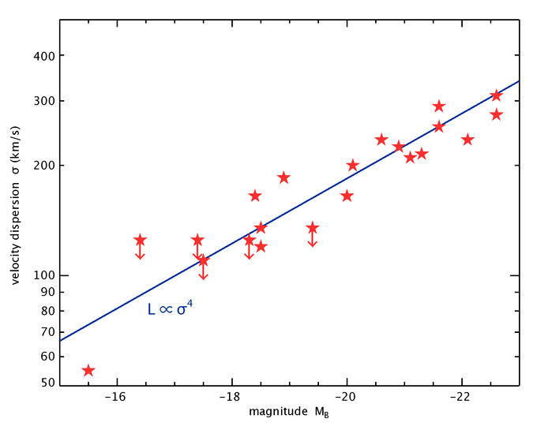
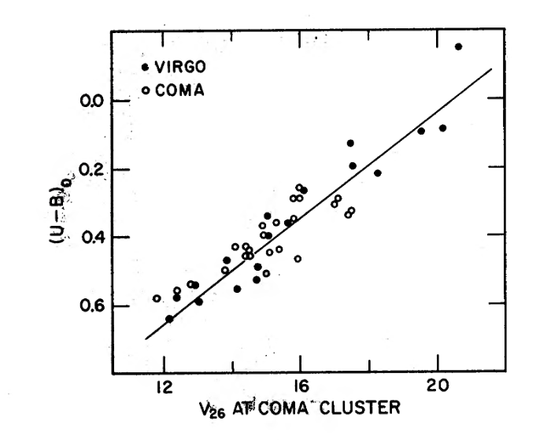
Stellar pops & dynamics ~ 1970-80
Colour-magnitude diagram,
Sandage 1972
Faber & Jackson 1976

Slide 6
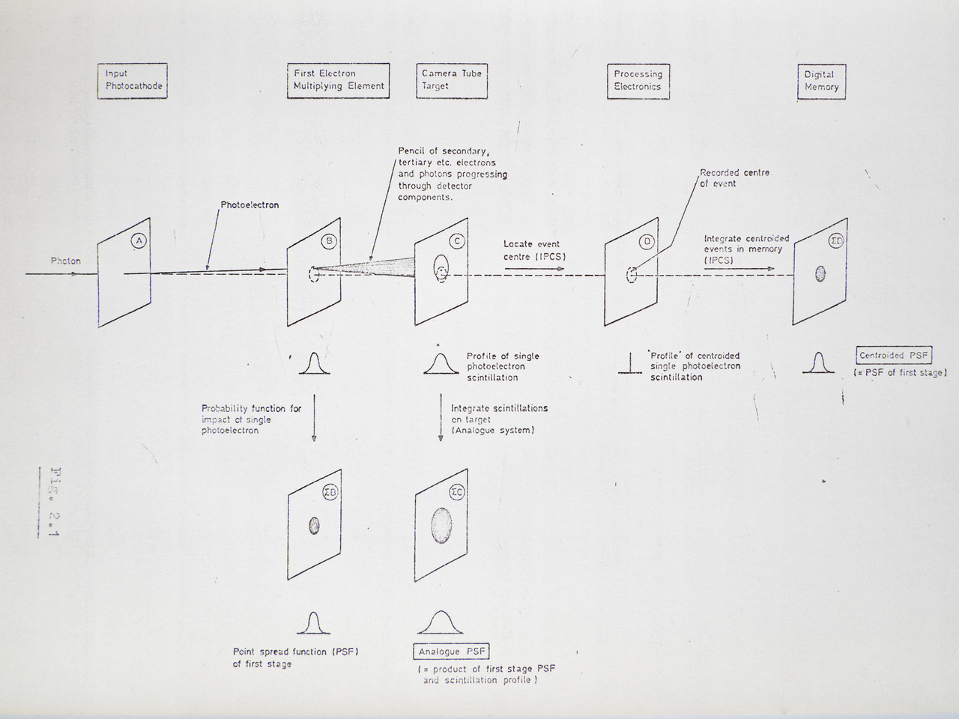
Image Photon Counting System: IPCS: Boksenberg & Burgess 1972
flopometer

Slide 7
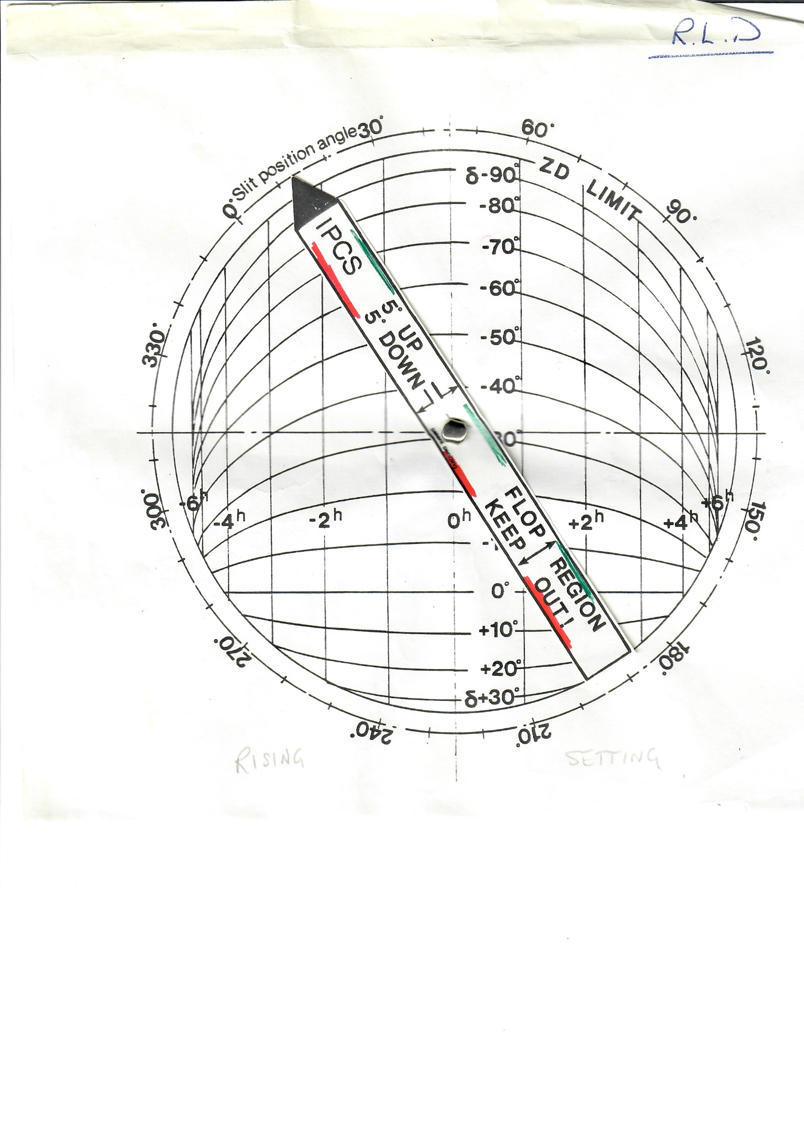
Image Photon Counting System: IPCS: Boksenberg & Burgess 1972
Flopometer

Slide 8
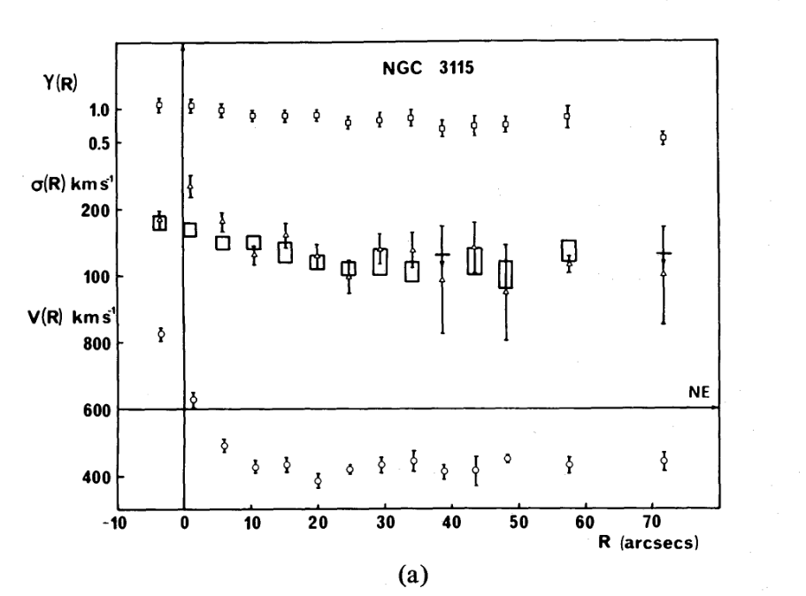
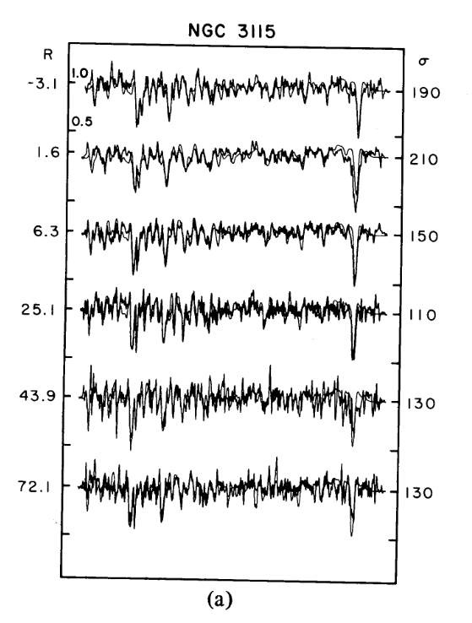
Long slit spectroscopy with RGO spgh & IPCS

Slide 9
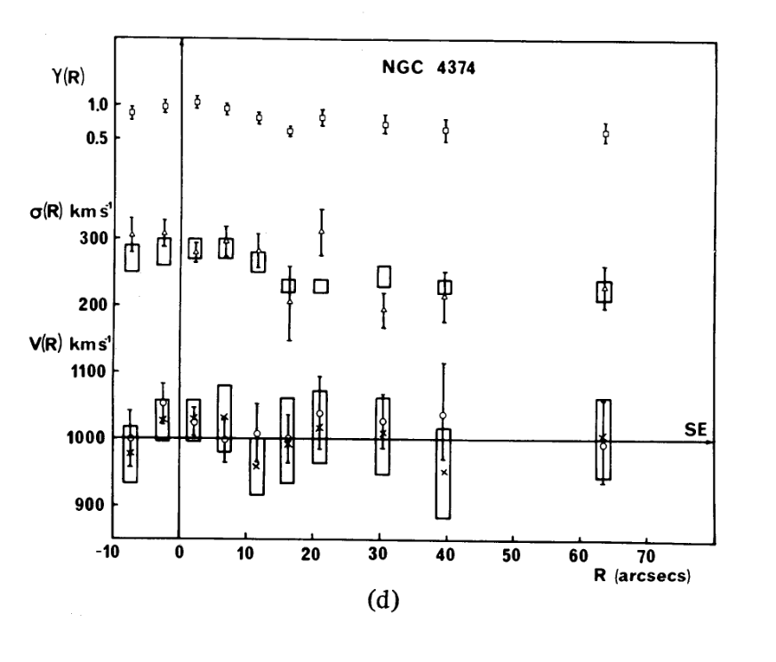
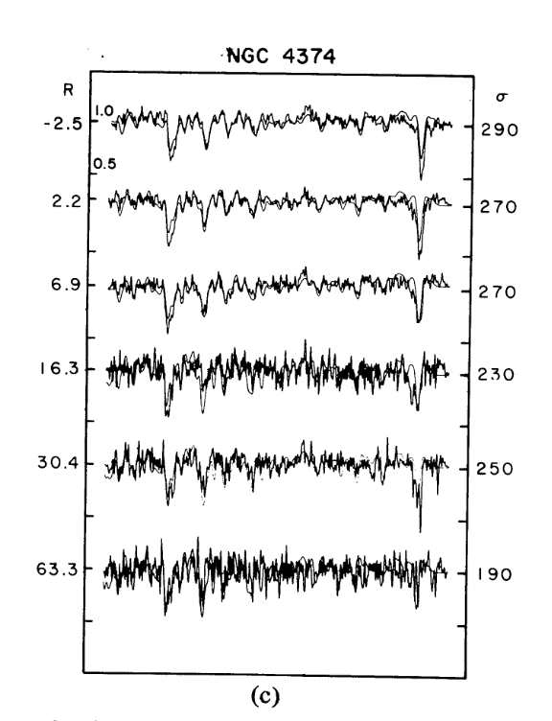
Long slit spectroscopy with RGO spgh IPCS

Slide 10
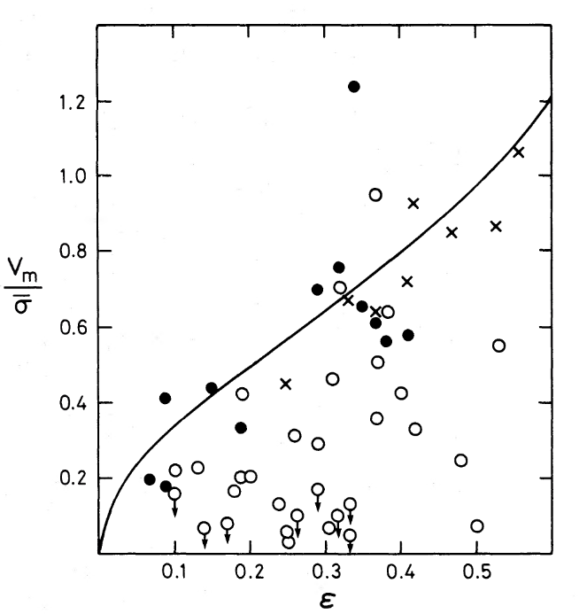
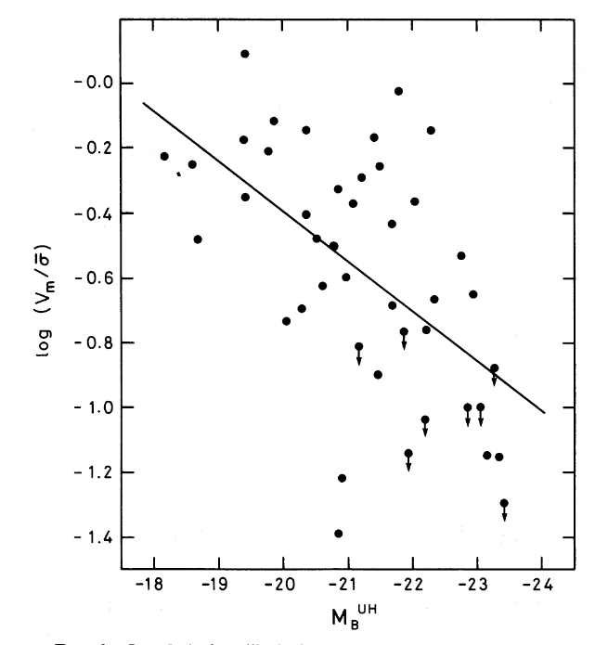
Galaxy Rotation
DEFIS 1983: 11 + 7 Es observed with AAT IPCS & KPNO HGVS.
+ compilation of 58 galaxies from the literature.

Slide 11
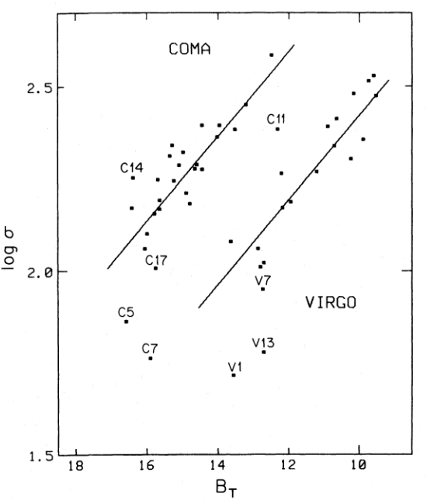
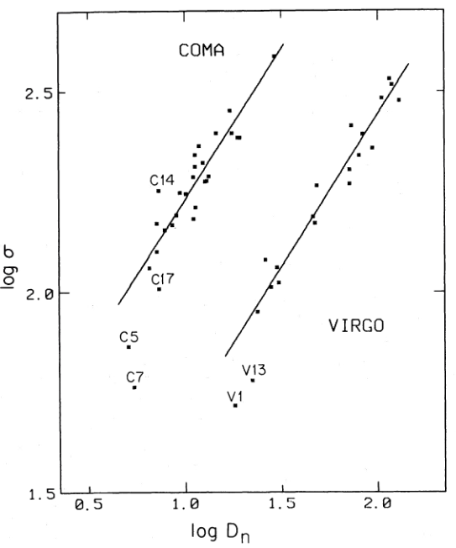
Seven Samauri spectroscopy
Four AAT runs in Jan & August 1980 & 1981.
Dressler et al 1987
The scatter in logD_{n} was found to be ~ ±0.07 dex, half that in FJ relation.
Surface brightness is the second parameter in the FJ relation.
or
FJ relation D_{n} - σ relation
…….. meanwhile.

Slide 12
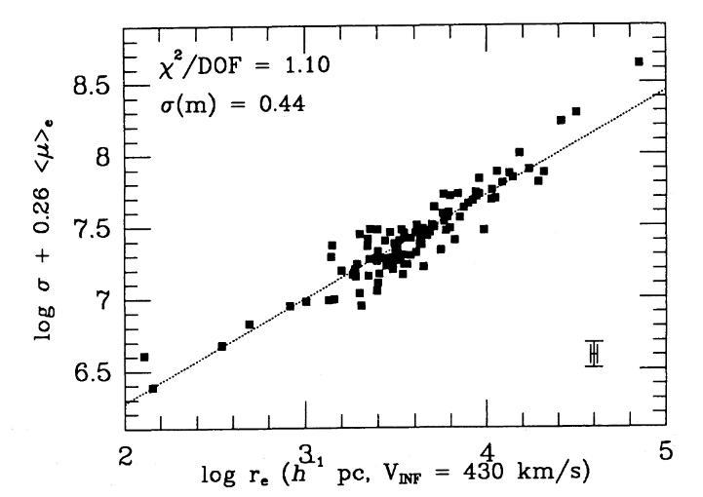
Fundamental Plane
Djorgovski & Davis, 1987
AAT IPCS + RGO spgh played an important part in the discovery and initial exploitation of the Fundamental Plane to measure distances and thus galaxy peculiar motions.

Slide 13
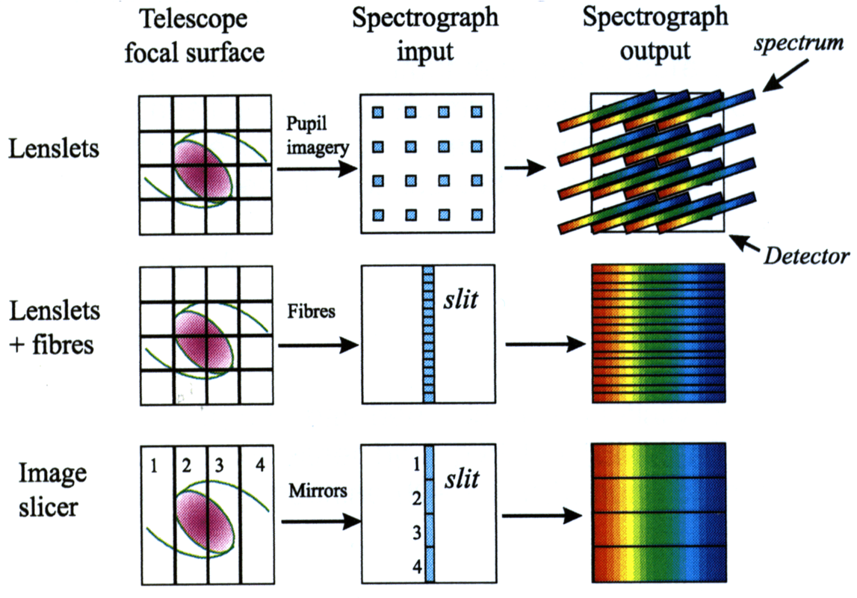
Integral Field Spectrographs.

Slide 14
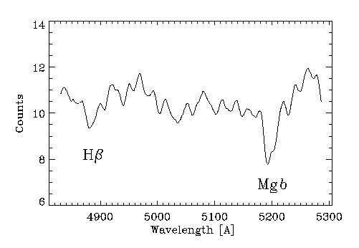
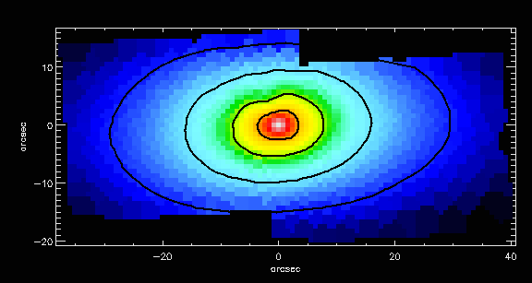
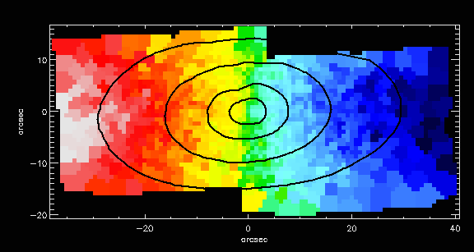
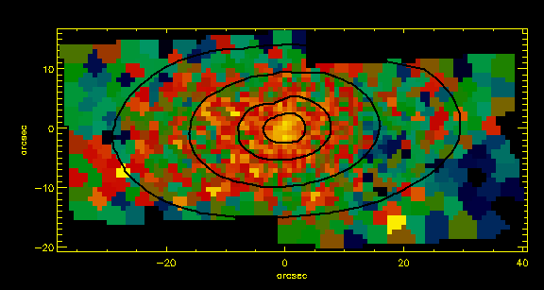
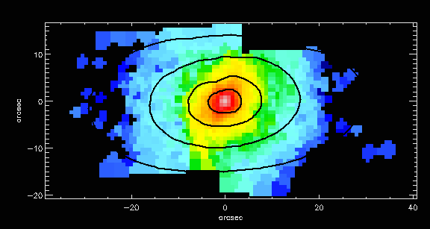
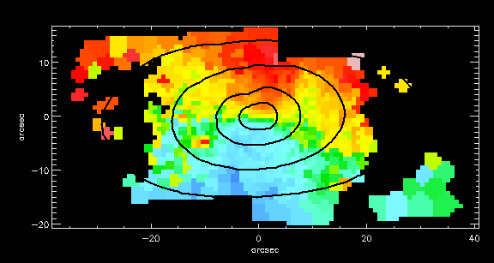
IFS: What do you get?
(with particular reference to SAURON)
Total flux
Morphology, photometry
Absorption lines
Stellar kinematics
LOSVD (V,σ,h3,h4)
Line strength index
Hβ, Mgb, Fe5015, Fe5270
Emission lines
Gas distribution
Hβ, [OIII], [NI]
Line ratios
Gas kinematics
V(Hβ), V([OIII]), FWHM(Hβ), FWHM([OIII])
Gas velocity map
[OIII] line intensity
Reconstructed image
Mgb line index
Stellar velocity map

Slide 15
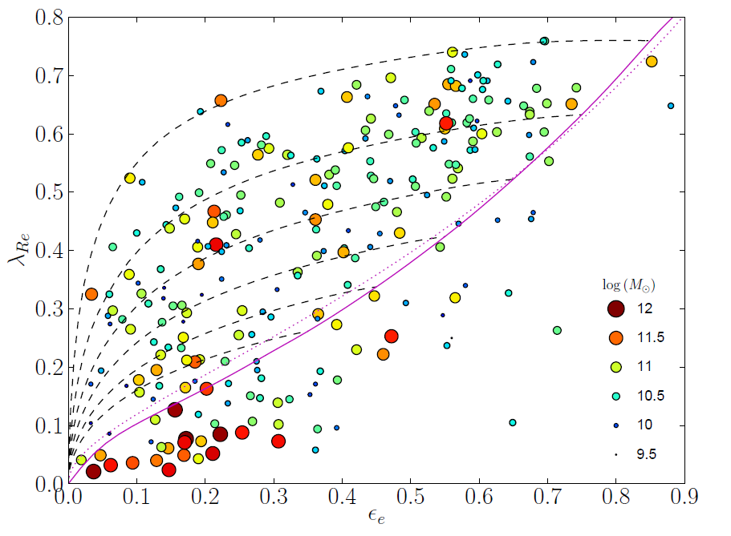
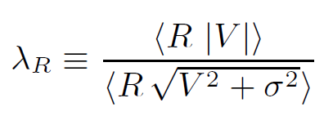
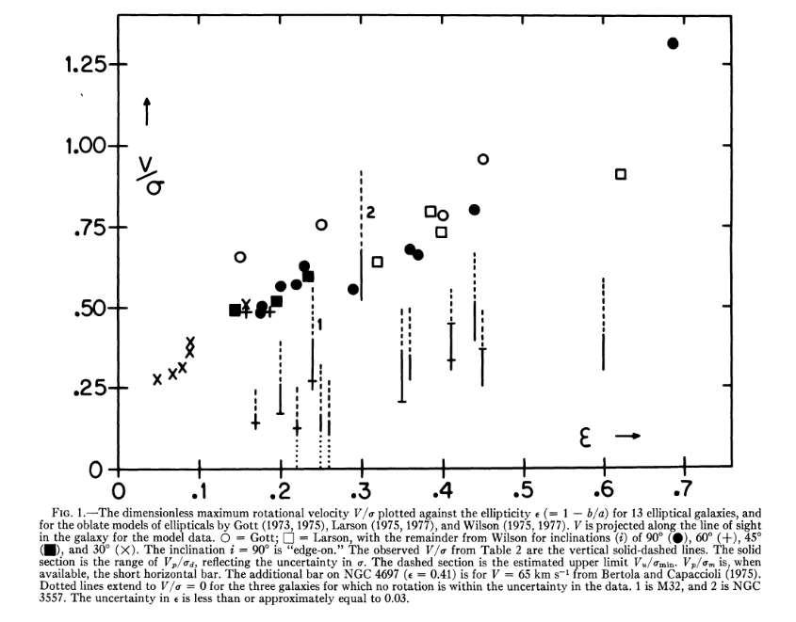
SAURON version
2011 Emsellem et al version:
Illingworth 1977
version
1983 DEFIS version

Slide 16
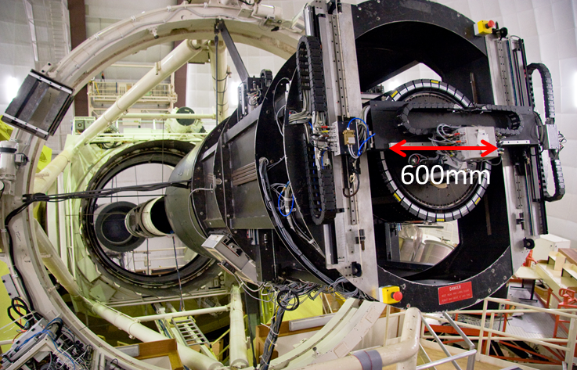
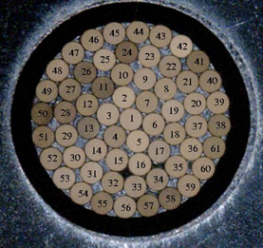
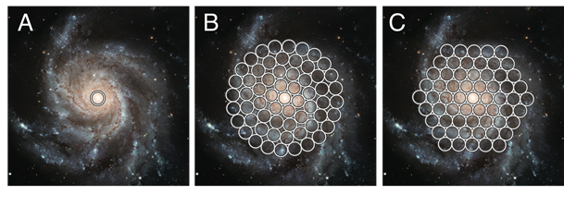
The Sydney-AAO Multi-object Integral field spgh (Croom et al. 2012).
1 degree diameter field-of-view.
13 x 61 fibre IFUs using hexabundles Bland-Hawthorn et al. 2011; Bryant et al. 2014. Each has 15 arcsec diameter.
Survey observations completed in 2018.
3068 unique galaxies observed.
Primary fields selected using GAMA Driver et al. 2010.
8 clusters targeted ~800 gals,
Owers et al. 2017.

Slide 17
Data
Imaging: GAMA survey gives morphology plus:
L, R_{e}, ε_{e}, & concentration index , n
IFU spectroscopy with SAMI instrument spectra give: v, σ_{e}, & line strengths

Slide 18
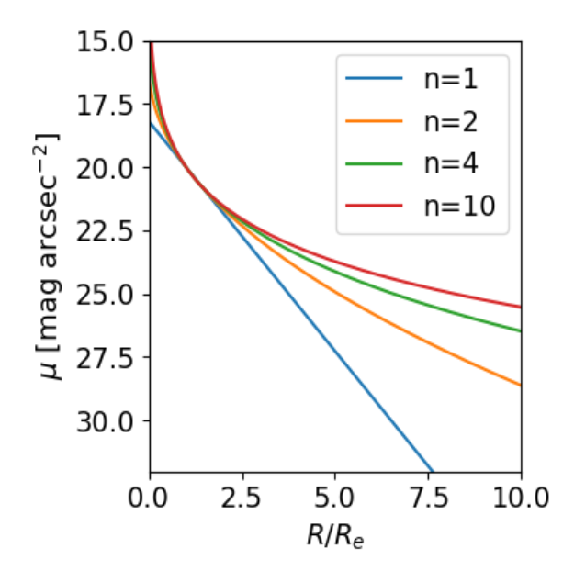
GAMA imaging: luminosity, size, shape & `Sersic index’
GAMA survey: CCD imaging from SDSS & VST ATLAS.
Fit a 2D Sersic model:
to give morphology, L, R_{e}, ε_{e}, & n where the subscript `e’ refers to values determined within a radius Re containing half the light.

Slide 19
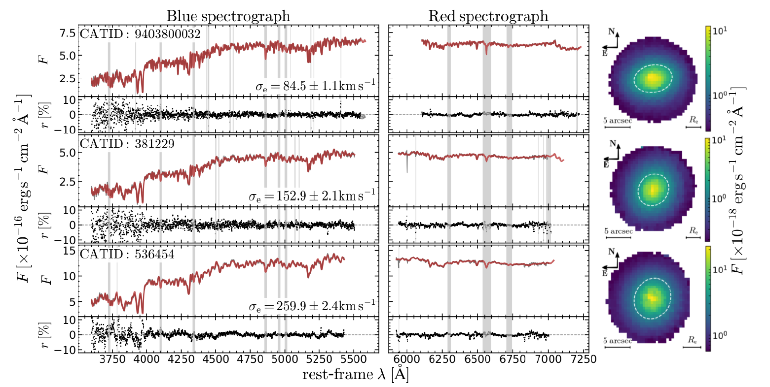
The SAMI survey: dynamics
The velocity, v & velocity dispersion, σ_{e} are determined by fitting a a library of stellar spectra (MILES, Sanchez-Blazquez et al. 2014) using pPXF (Cappellari, 2017).

Slide 20
The SAMI survey: stellar populations
The stellar population parameters age, [Z/H], [α/Fe] are determined by measuring 20 absorption line strengths and fitting them to stellar population models of Schiavon (2007) & Thomas etal. (2010) and inferring stellar mass-to-light ratio, ϒ*, from Maraston (2005).

Slide 21
M/R (= potential depth, Φ or V_{esc}) is the best predictor of metallicity
Barone et al 2018 ApJ 856 64
Dynamical mass
Z/H
Stellar mass
Log M Log M/R Log M/R²

Slide 22
M/R² ⁽= surface density, Σ) is the best predictor of stellar population age.
Barone et al 2018 ApJ 856 64
Dynamical mass
Age
Stellar mass
Log M Log M/R Log M/R²

Slide 23
What can we learn about galaxies from the FP?
Consider a galaxy in its dark halo:
virial mass, M_{vir} α σ²R/G
where R is the radius & σ is the velocity dispersion of a tracer population. So:
κ is a parameter describing the the distribution of mass f(r) that varies from galaxy to galaxy.
This is a plane in the M_{vir,}σ_{e}, R_{e} space

Slide 24
What can we learn about galaxies from the FP?
Transform from mass to light.
denote the stellar-to-total mass fraction as f*,
and the stellar mass-to-light ratio as ϒ*
Treating L as the dependent variable, fit to the L, σ, R plane and note how the coefficients of logσ & logR differ from the Virial values (known as the tilt of the FP) reveals how:
κ – the non-homology parameter
ϒ* - stellar population M/L &
f* - the stellar mass fraction
vary systematically with σ, R

Slide 25
Structural & dynamical properties
For 560 ETGs:

Slide 26
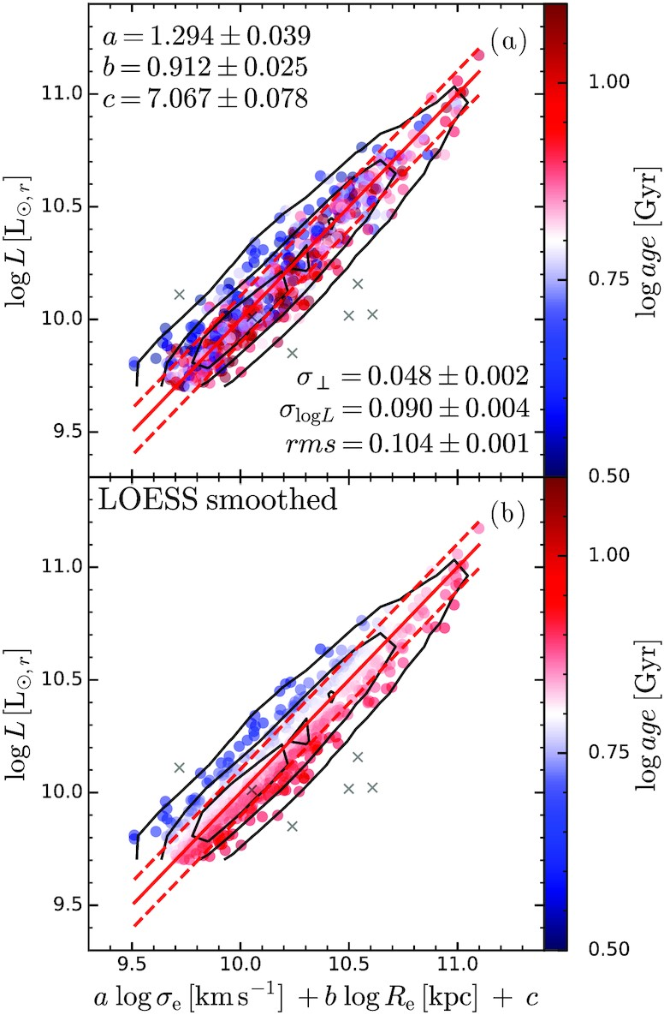
Results
The Fundamental Plane
The best fit parameters are different from Virial values:
1.294, 0.912.
Perpendicular scatter = 0.048
Locally estimated scatterplot smoothing
Clear gradient with age across the FP. Galaxies that are old for their dispersion & size sit below the FP.

Slide 27
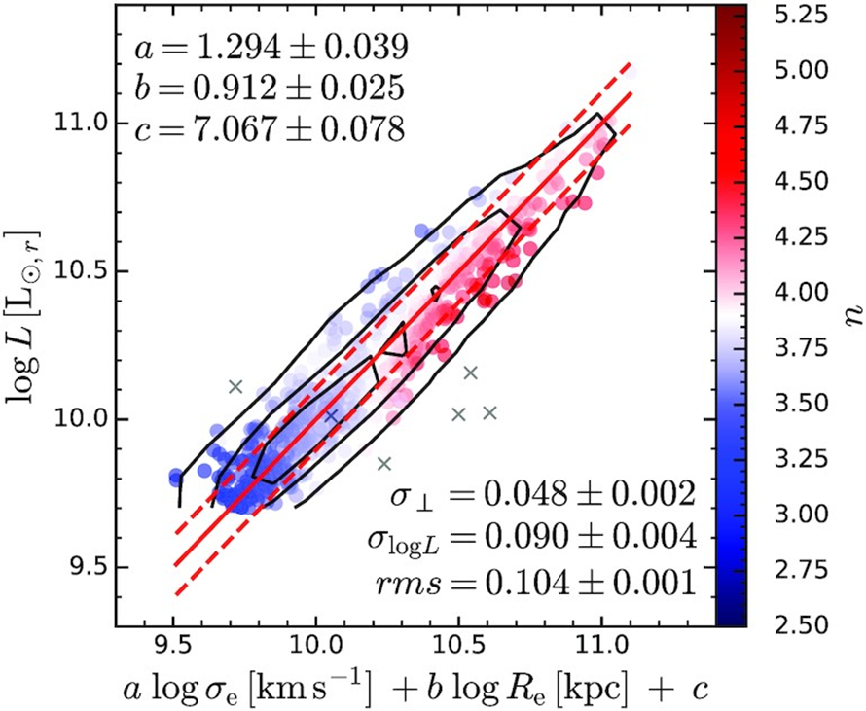
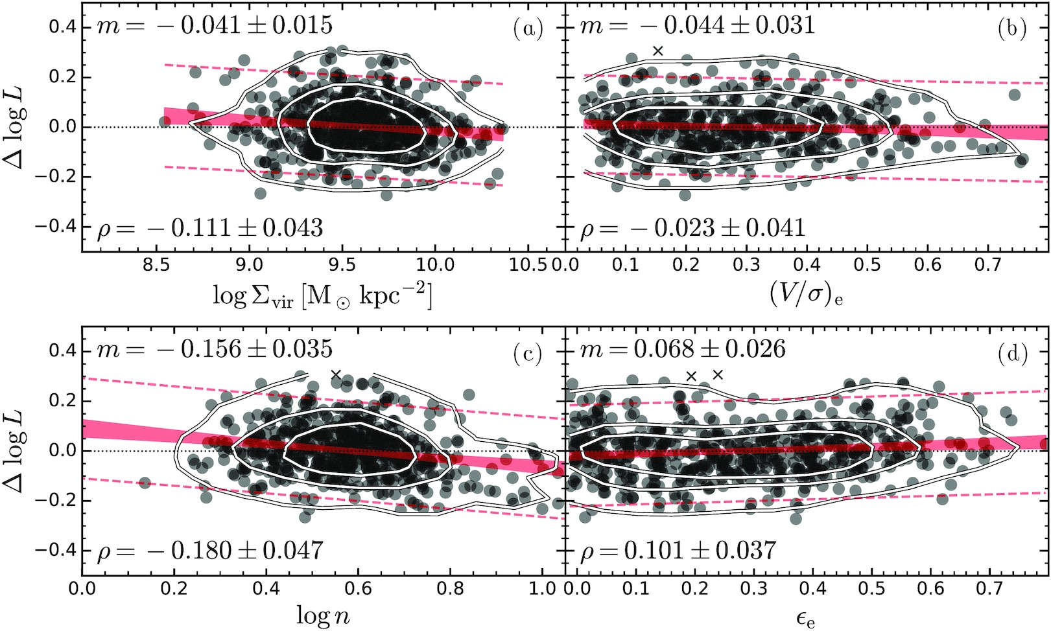
What drives this trend?
(i) Explore residuals, ΔL, with structural & dynamical parameters: surface density: Σ(=M/R²), rotational support (=v/σ), concentration, n and ellipticity ε.
The only 3σ trend is with Sersic index, n.

Slide 28
What drives this trend?
Explore residuals, ΔL, with structural parameters,
The only 3σ trend is with Sersic index, n.

Slide 29
ϒ* (=M/L) correlates with surface density Σ
Mass Potential Φ = M/R surface mass density Σ = M/R²
The scatter in the ϒ*, M & ϒ*, Φ diagrams arises from
residual trends with size. Smaller galaxies at fixed mass
have lower M/L (are older and more metal-rich as well)

Slide 30
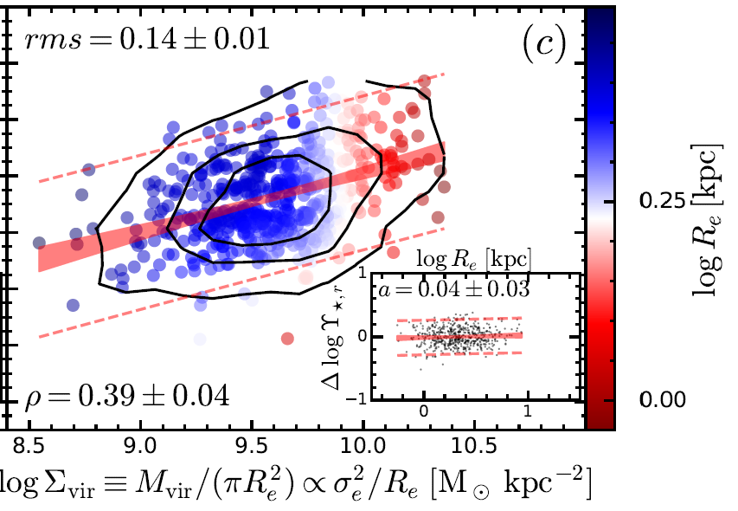
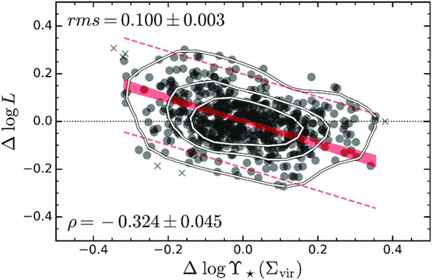
Surface mass density & ϒ*
At a fixed position on the FP galaxies lying above ϒ^{* -} Σ (or age-Σ) relation have higher M/L and lower mass. Older galaxies have higher surface mass density => Compact galaxies form earlier.

Slide 31
Conclusions from the SAMI FP
Scatter in the FP is dominated by stellar population variations (age, ϒ*) not structural parameters. Changes in ϒ* account for 75% of the scatter.
There is a strong anti-correlation between residuals in the FP and those in the ϒ*- Σ_{Vir} relation. Galaxies that are more luminous than the fiducial FP have lower surface mass density.
Taking into account stellar population effects accounts for ~75% of the FP tilt, but not all. The remaining tilt is likely due to changes in the dark matter fraction or IMF.

Slide 32
What comes next?

Slide 33
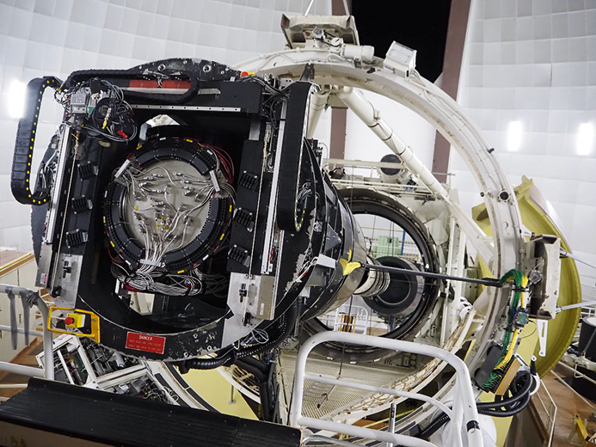
Hector
A survey of 15,000 galaxies at a redshift of z < 0.1.
Hector covers 372.7–776.1 nm with a spectral resolution of 1.3 Å, the highest of any galaxy-survey IFS instrument.
See talk by Julia Bryant!
The photograph shows the 2-degree field top end of the AAT with silver fibre cables terminated with bundles (21 hexabundles connected to floor-mounted spectrographs and 6 guide star bundles).

Slide 34
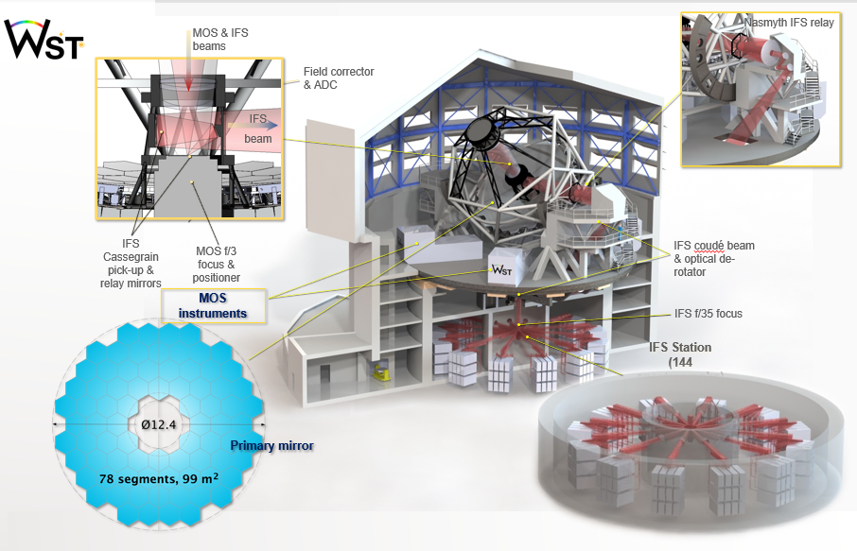
Wide-field Survey Telescope (taken from Roland Bacon)

Slide 35
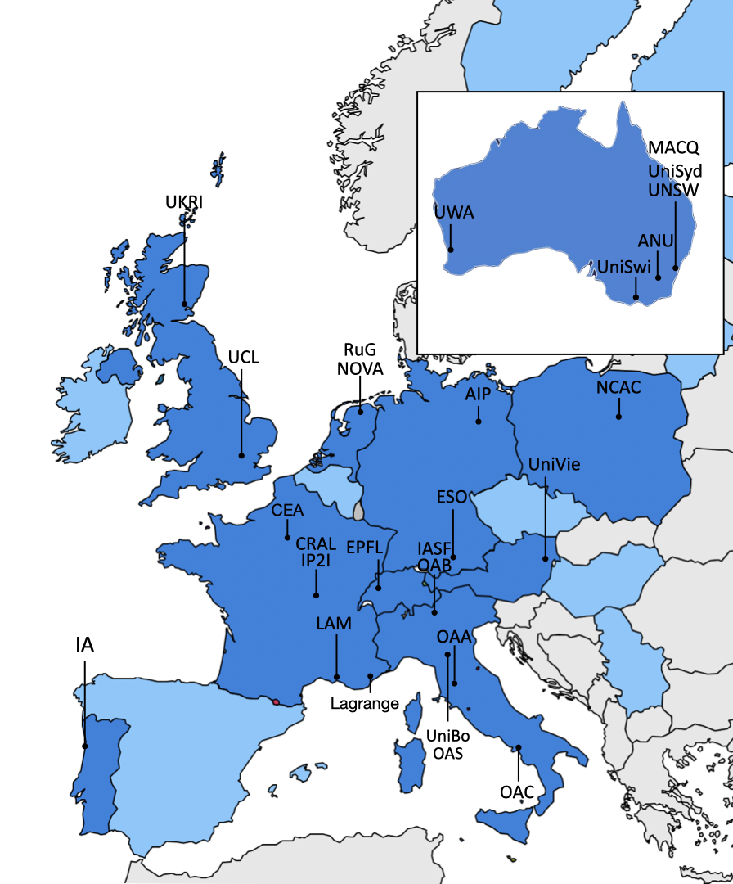
Wide-field Survey Telescope (taken from Roland Bacon)
12m spectroscopic survey telescope, seeing limited. Broad science case: galactic, resolved stellar pop, extragalactic, cosmology, time-domain served by 2 instruments:
A visible (0.37-1µ) MOS with 3.1 deg² FoV with 2 modes
LR mode R~3000, full simultaneous wavelength coverage, multiplex of 20,000
HR mode R~40,000, 3-4 wavelength windows, multiplex of 2,000
2. A visible (0.37-1µ) giant panoramic IFS with 9 arcmin² FoV, full simultaneous wavelength coverage, R~3000
Innovative & sustainable design, low risk, using existing technology (eg ELT segments), massive production of image slicers (140), spectrographs (200) & detectors (350)
Consortium
Breakthroughs:
MOS x20 FoV, x10 multiplex, IFS x9 FoV, high res MOS,
IFS & MOS in simultaneous operation
Strong synergy with existing and planned facilities: LSST, Euclid, ET, ELT, SKAO, …
Proposed to ESO as the next large program after the ELT.
Decision 2028, first light 2035-2040, estimated cost: 800 M€
Science Team
Australia

Slide 36
Reflections

Slide 37
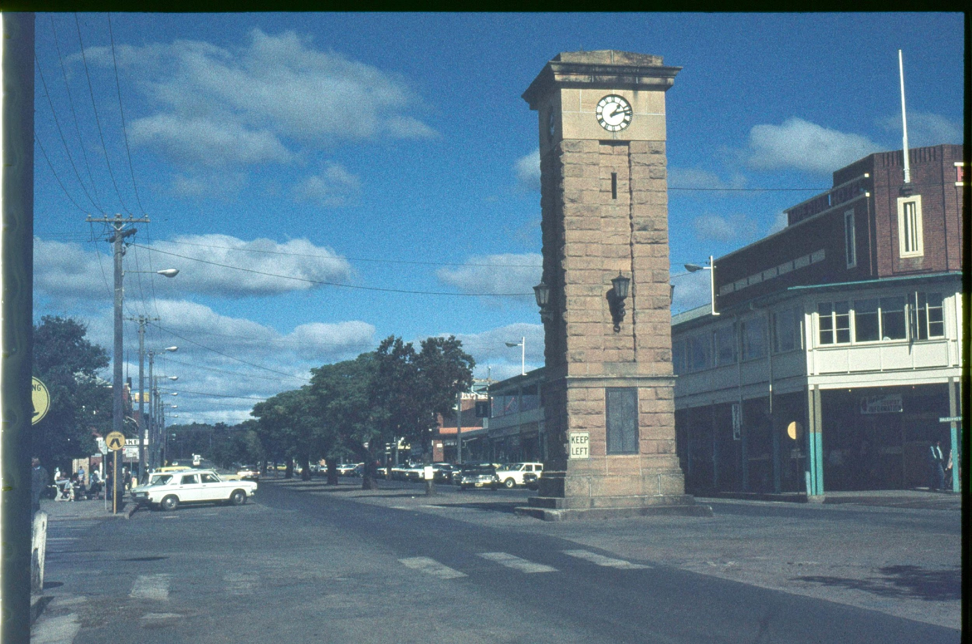
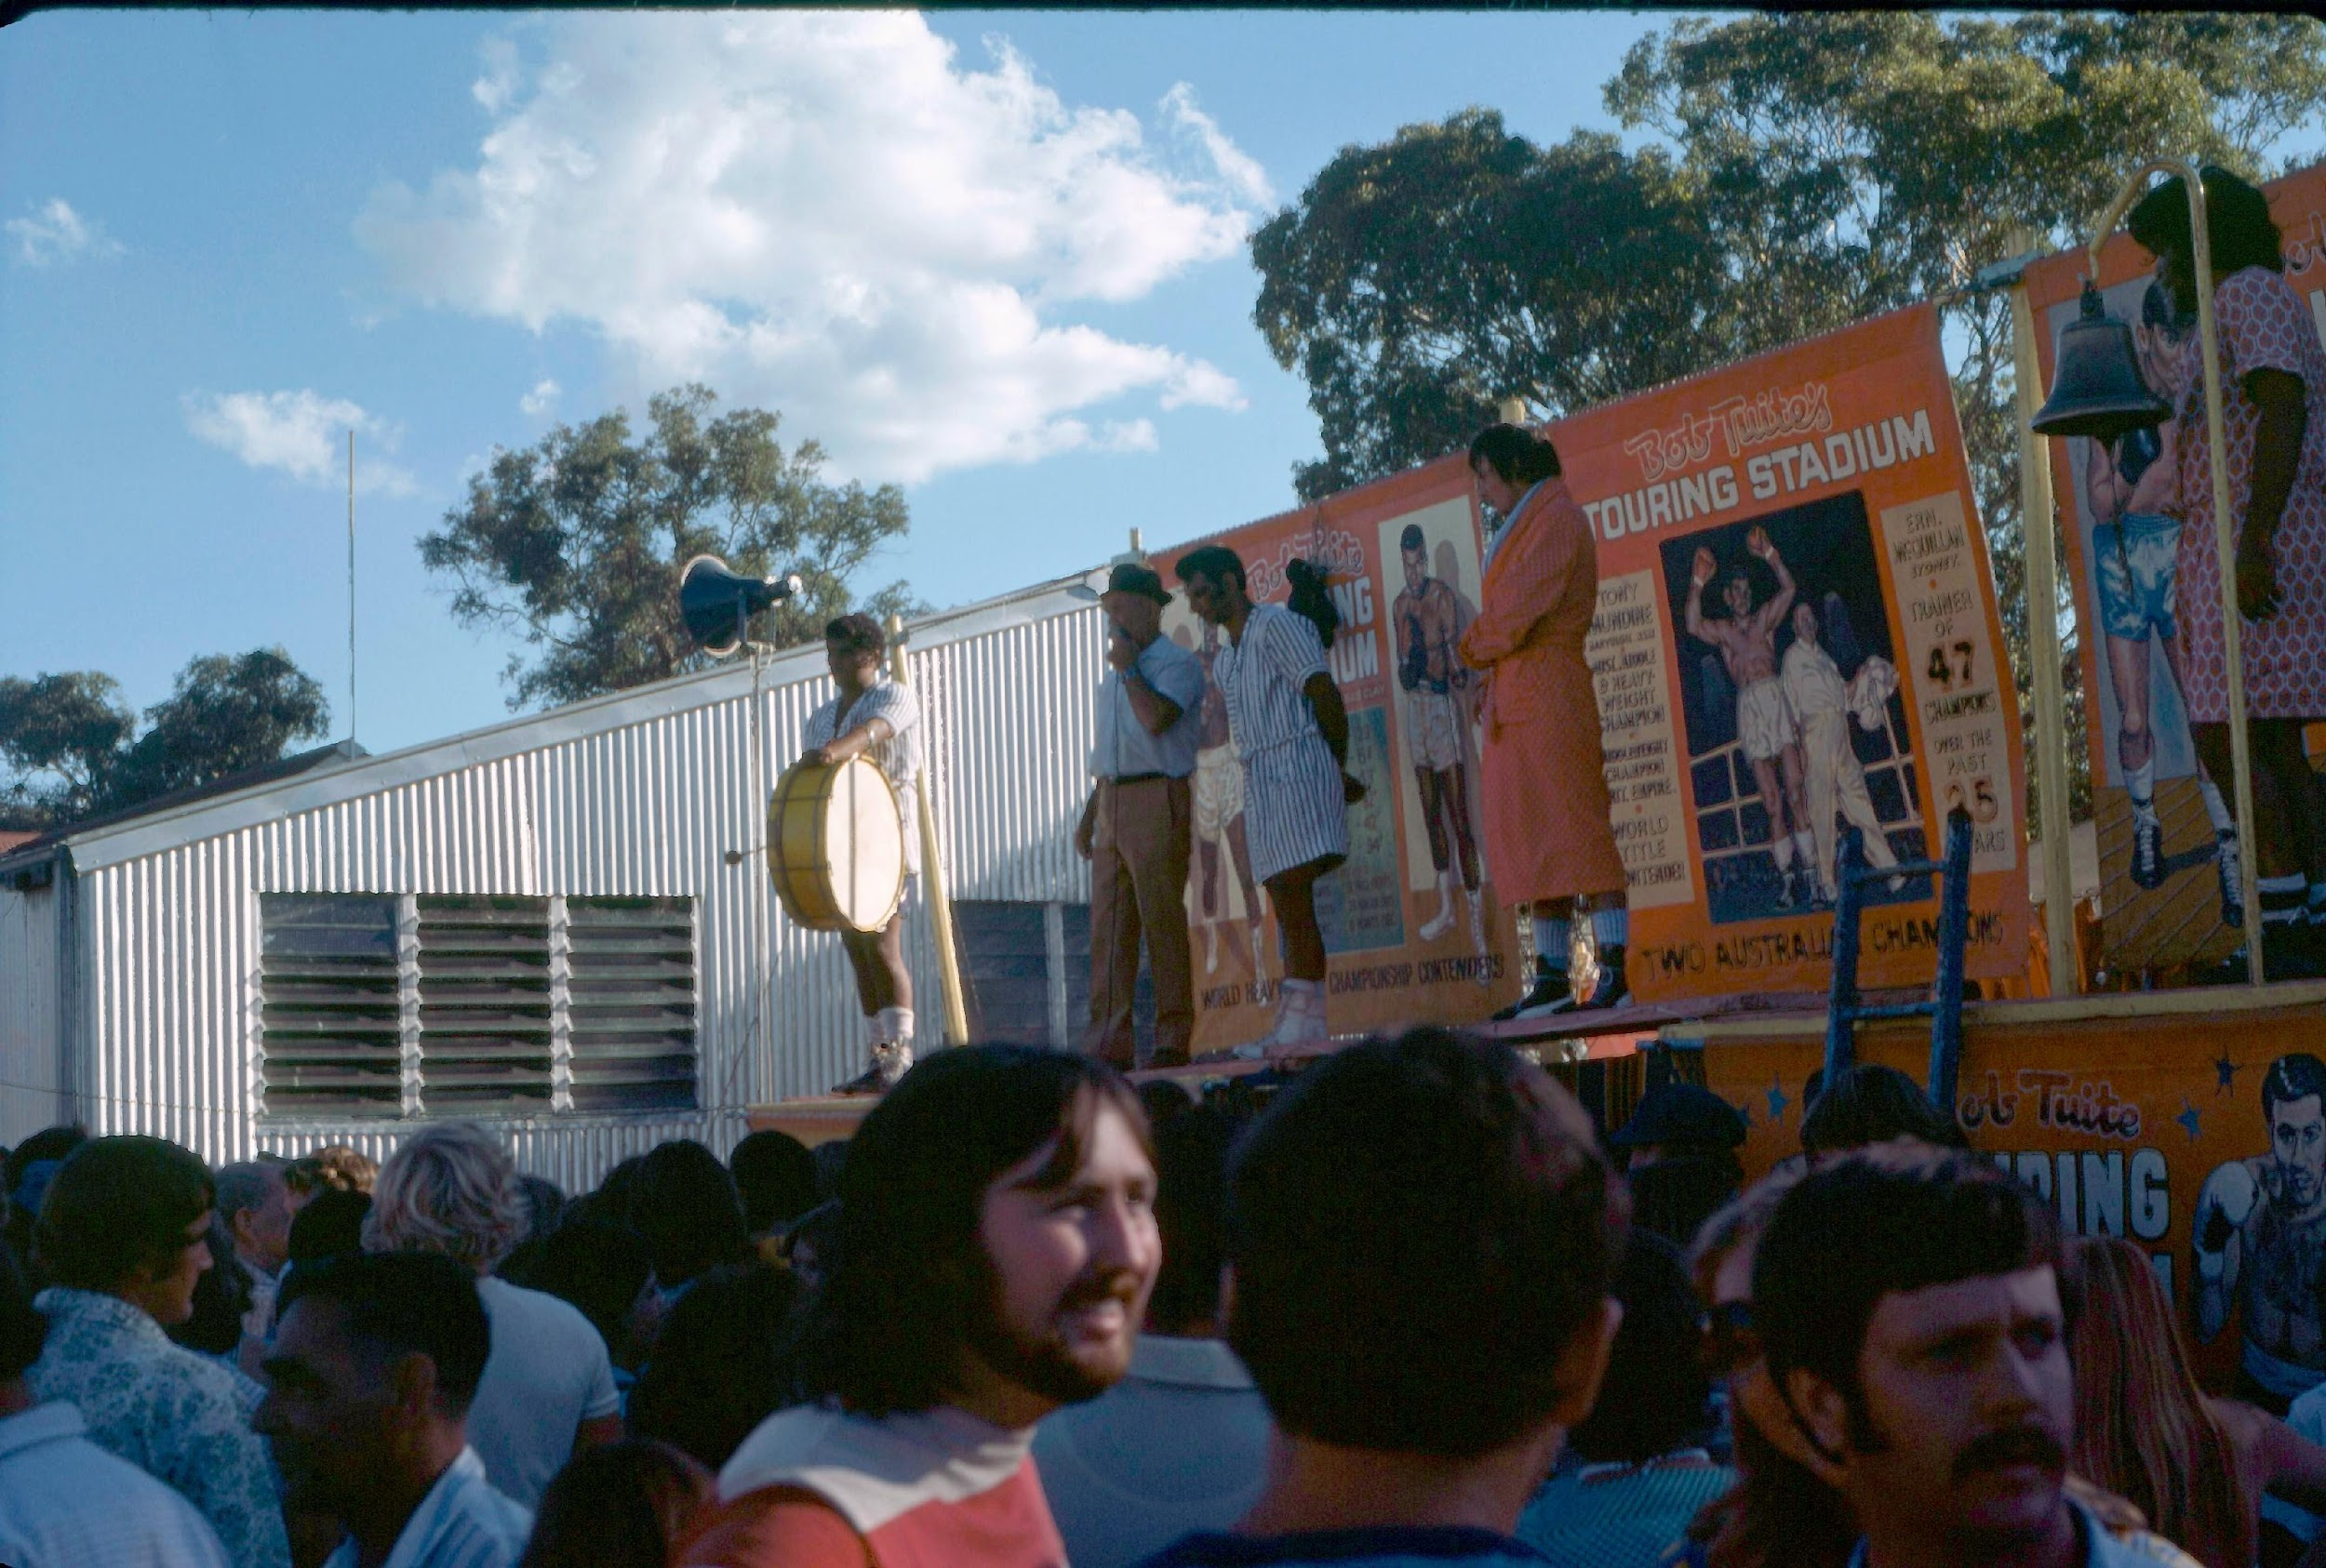
Coonarabran 1977
Clock tower
Coona Show

Slide 38
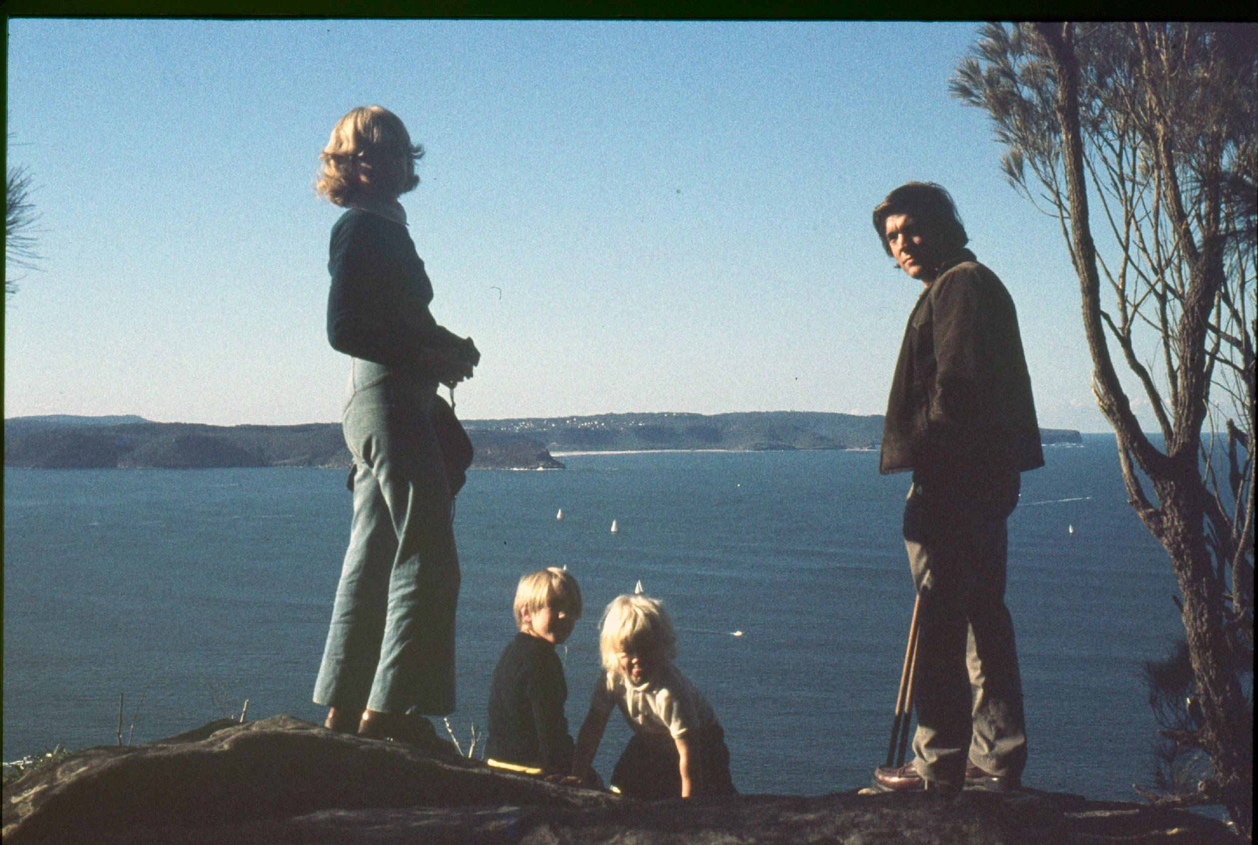
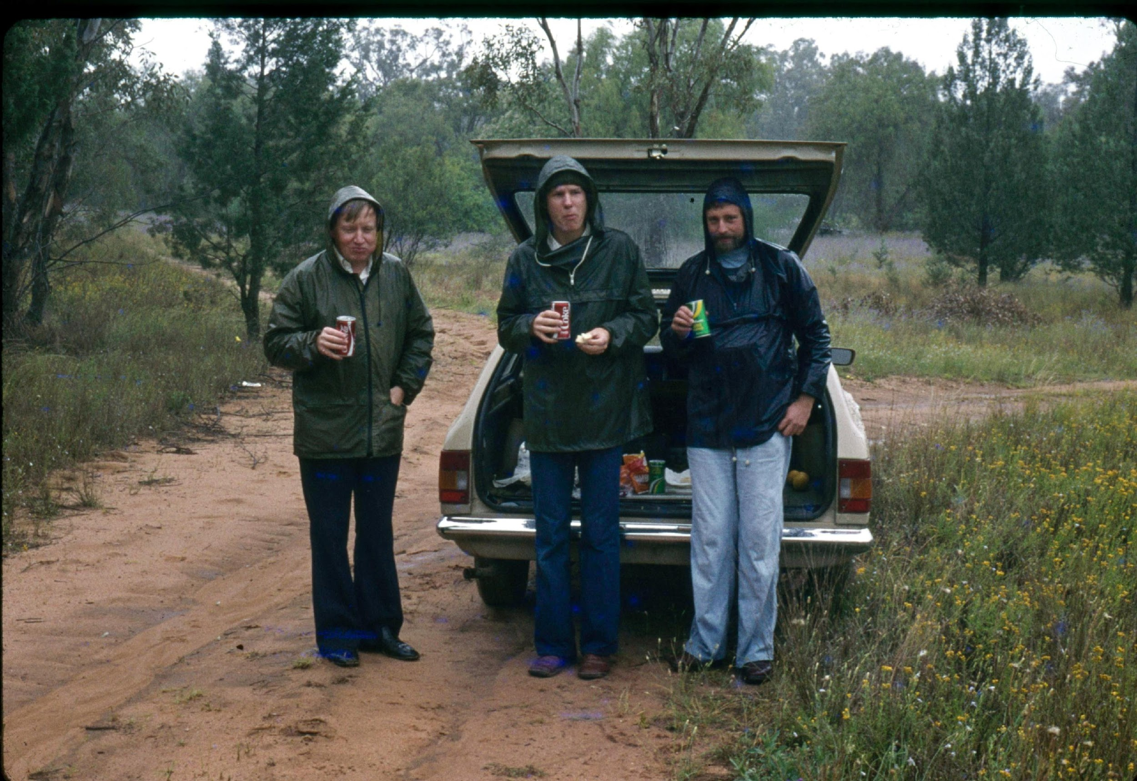
People from 1977…..

Slide 41
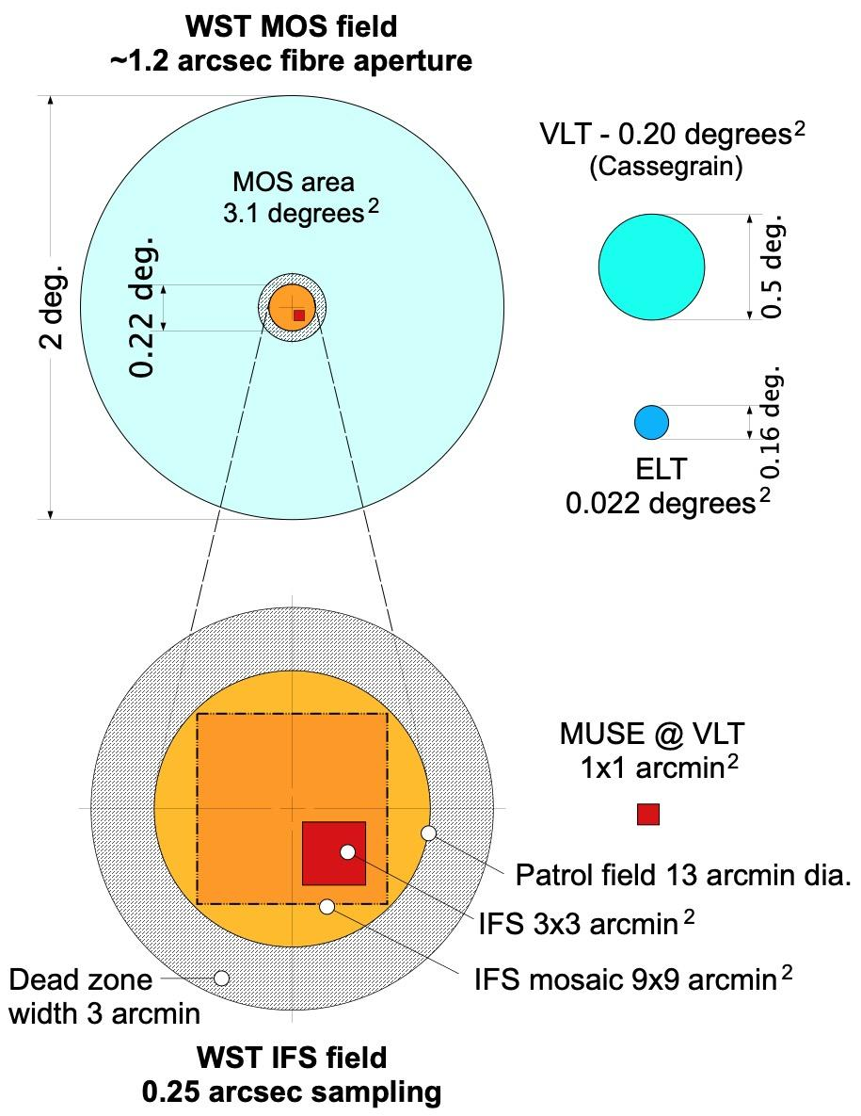
Top Level Requirements
Telescope Aperture | 12 m, seeing limited
Telescope FoV | 3.1 deg²
Tel. Spec Range | 0.35-1.6 μm
MOS LR Multiplex | 20,000
MOS LR Resolution | 3,000-4,000
MOS LR Spec Range | 370-970 nm (simultaneous)
MOS HR Multiplex | 2,000
MOS HR Resolution | 40,000
MOS HR Spec Range | 350-970 nm (3-4 regions)
IFS FoV | 3x3 arcmin²
IFS Resolution | 3,500
IFS Spec Range | 370-970 nm (simultaneous)
IFS Mosaic | 9x9 arcmin²
MOS & IFS simultaneous operation
ToO implemented at telescope and fibre level

Slide 42
Science Case
The WST science white paper v1, Mainieri et al, 2024, astro-ph
194 pages, 214 authors https://arxiv.org/abs/2403.05398
v2 foreseen in 2027-2028
Galactic
Resolved Stellar
Populations
Gaia,
LSST/Rubin,
Euclid,
SKAO,
Einstein Telescope,
ELT, …
MOS-LR
MOS-HR
Extragalactic
IFS
Cosmology
Time Domain
Register to become a science team member: www.wstelescope.com

Slide 43
What causes the scatter & tilt of the FP?
Make a mock FP using measured R_{e}, σ_{e} the measured M/L, ϒ*^{(measured)} to calculate a synthetic luminosity: L_{synth} ≡ M_{vir}/ϒ*^{(measured)}
We assume f*=1 & ignore non-homology and re-fit the FP eliminating the effect of changes in M/L.

Slide 44
What causes the scatter & tilt of the FP?
Make two mock FPs using measured R_{e}, σ_{e} &
the measured ϒ*^{(measured)} and
ϒ*^{(Σvir)} inferred from Σ_{vir}
to calculate a synthetic luminosity: L_{synth} ≡ M_{vir}/ϒ*
We assume f*=1 & ignore non-homology and re-fit the FP eliminating the effect of changes in M/L.
The mock FPs are found to be identical.

Slide 45
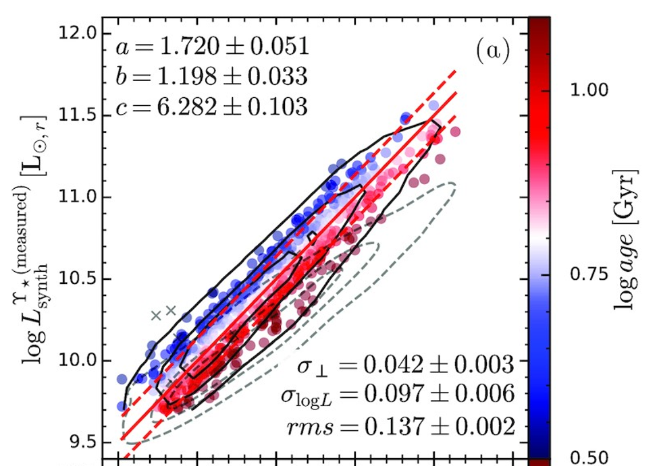
Mock FP cf. Observed FP
Scatter: the ┴ intrinsic scatter in the mock is only a little less than in the fiducial FP.
═> ~75% of the scatter in FP arises from variation of ϒ* at fixed R_{e} & σ_{e}
Mock Observed
Locally estimated scatterplot smoothing

Slide 46
Mock FP cf. Observed FP
2. Tilt:
on the logσ_{e} axis the mock is closer to the virial slope – the effect of ϒ* rotates the plane in the right direction but is insufficent to account for all the tilt.
on the logR_{e} axis the the effect of ϒ* rotates the plane beyond the FP further from the Virial slope.
Mock Observed
Locally estimated scatterplot smoothing
The remaining tilt (~40%) arises from either dark matter fraction or IMF or both!

Slide 47
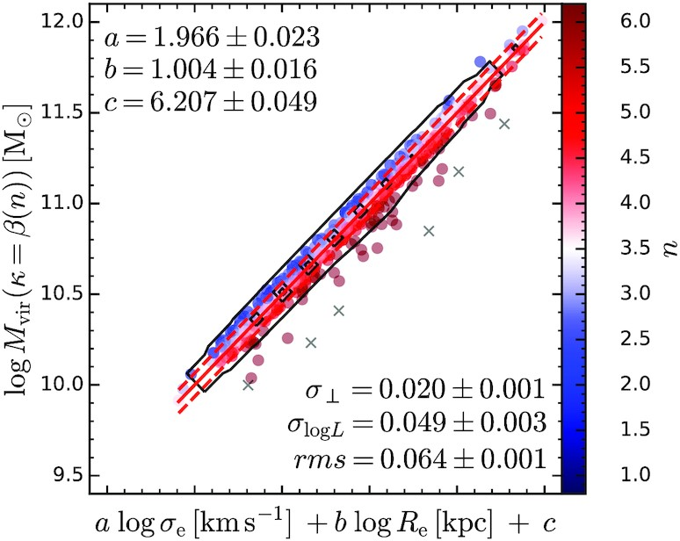
Mock FP cf. Observed FP
3. Non-homology : we can use the measured Sersic index, n, to calculaute M_{vir} in a similar way.
The range of n-values at fixed R_{e}, σ_{e} are much less than those caused by stellar population changes.

