Slide 1
AAO/AAT – an integrated culture of research, innovation & practice
Joss Bland-Hawthorn
University of Sydney

Slide 2
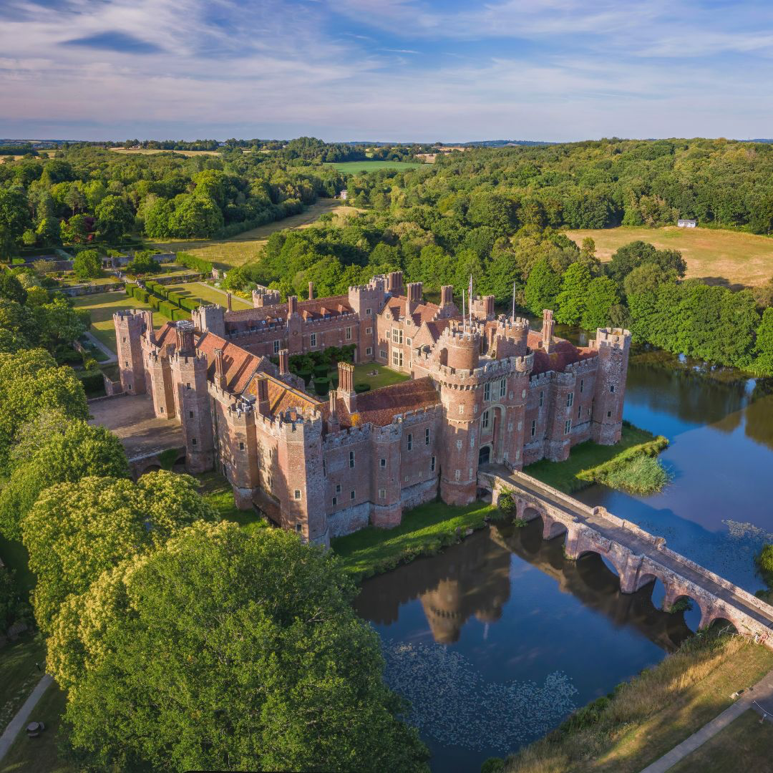
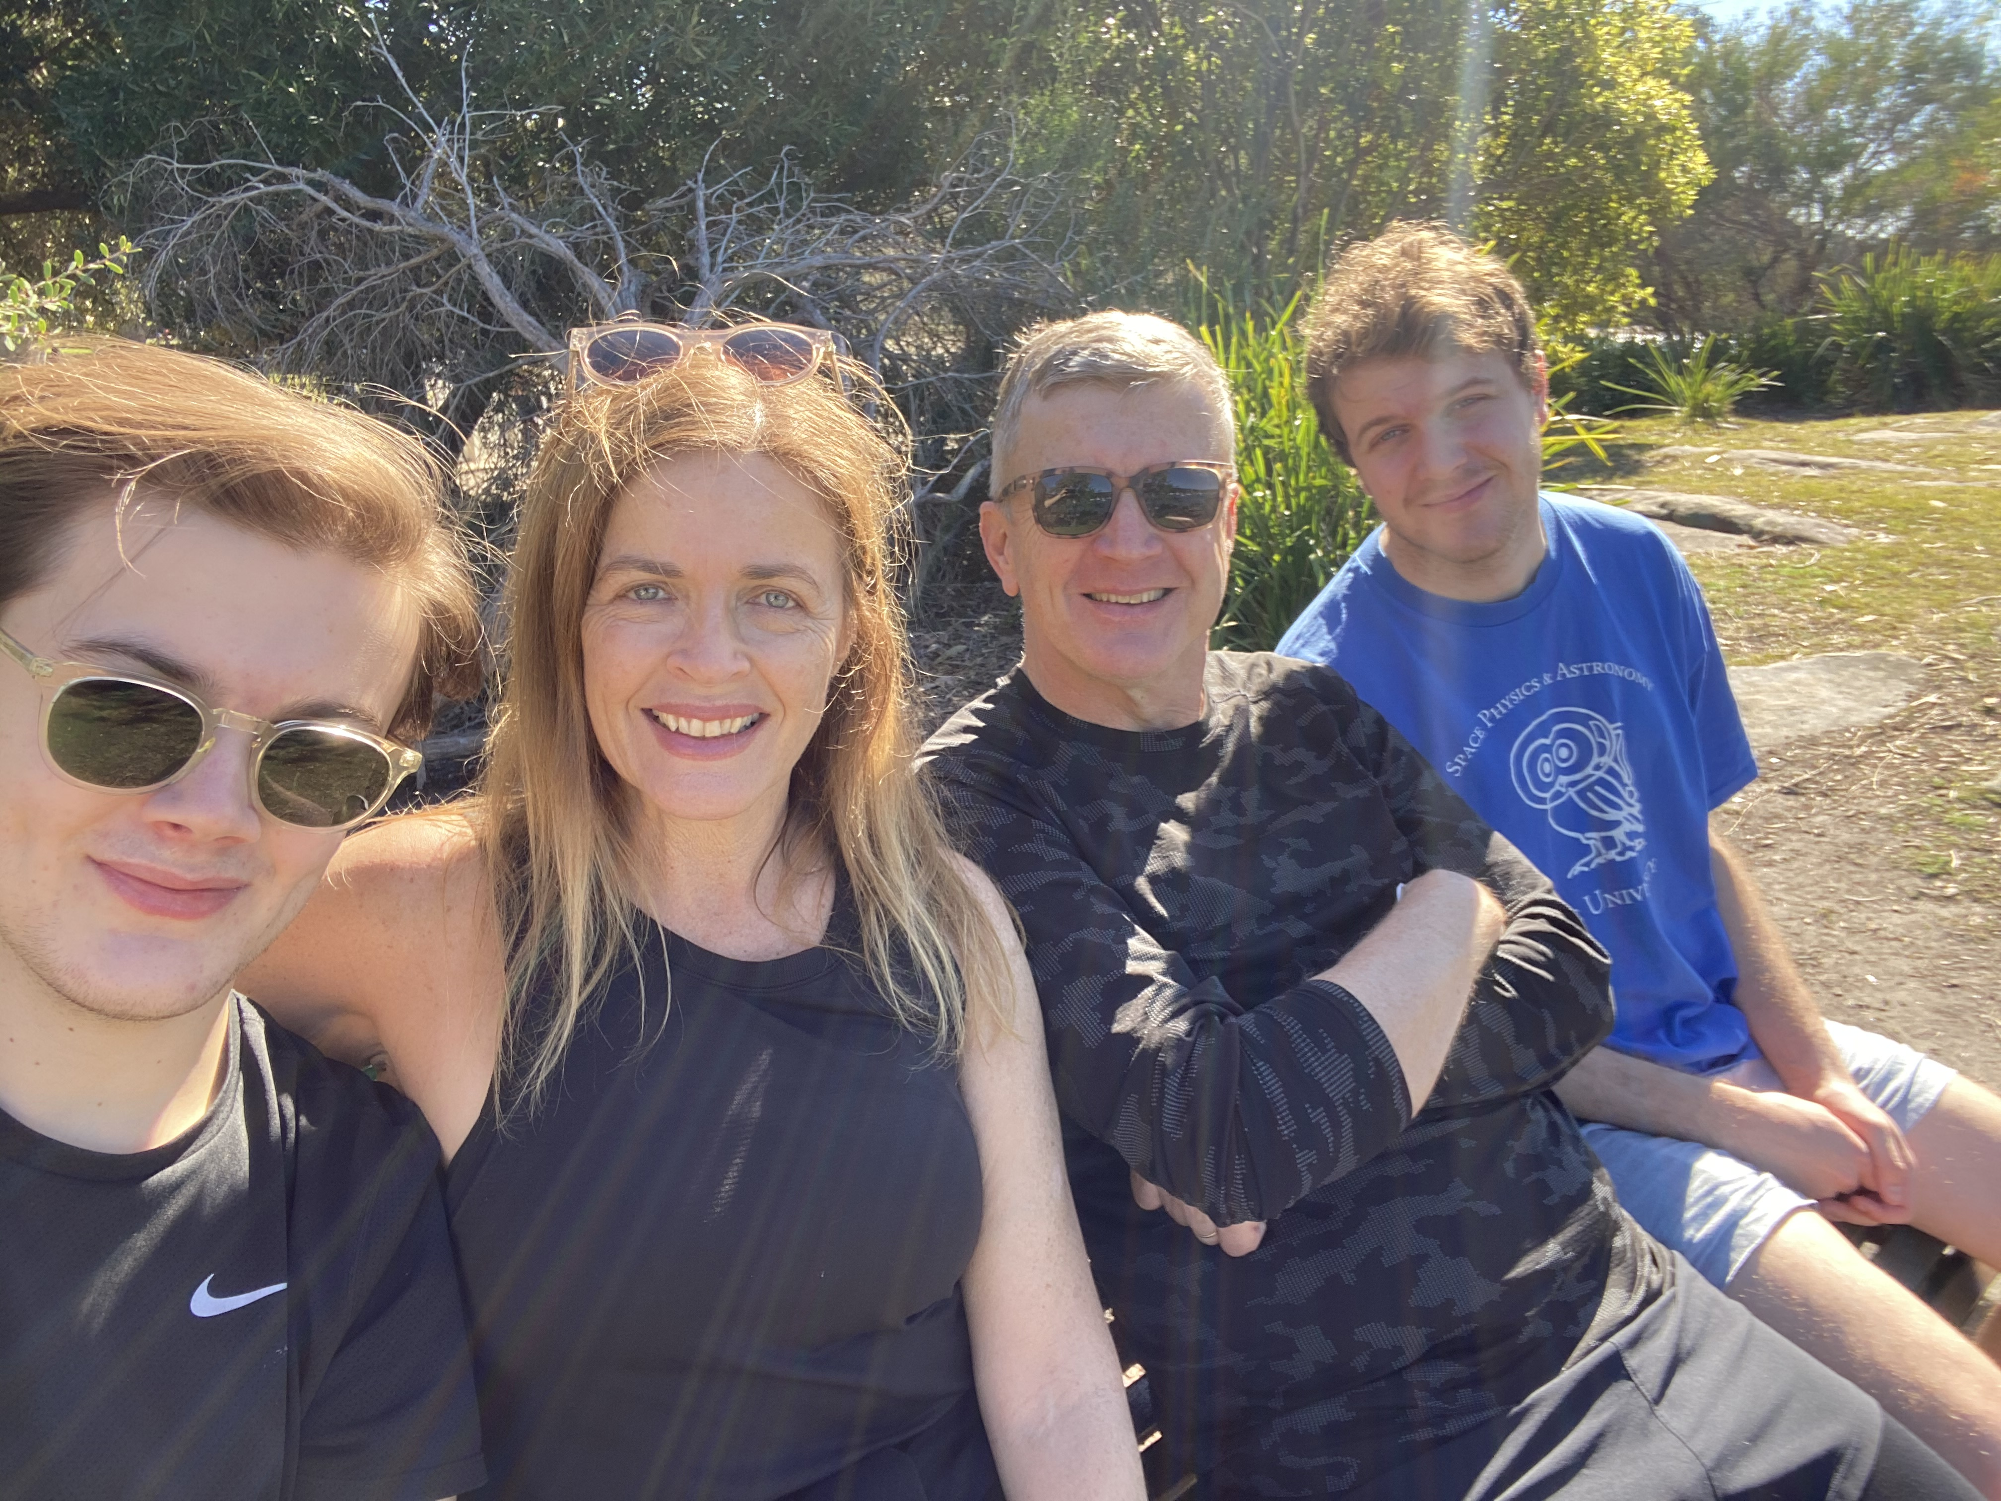
The AAO/AAT was inevitable....
1979: RGO studentship w/ astrometrist Andrew Murray to analyse UKST plates, code GALAXY machine
(Taylor, Fosbury, Penston², Jenkins, Pettini, Murdin, Worswick, Harmer, Nicholson, Pagel, Terlevich², Elmegreen², Wynne...)
1982: RGO spectrograph run – 4/4 spectacular nights
1982-5: PhD years with Taurus
1986: IRPS run with JAB – absolutely changed my life!
Christian
Luke
Sue
Notes:
spun off road

Slide 3
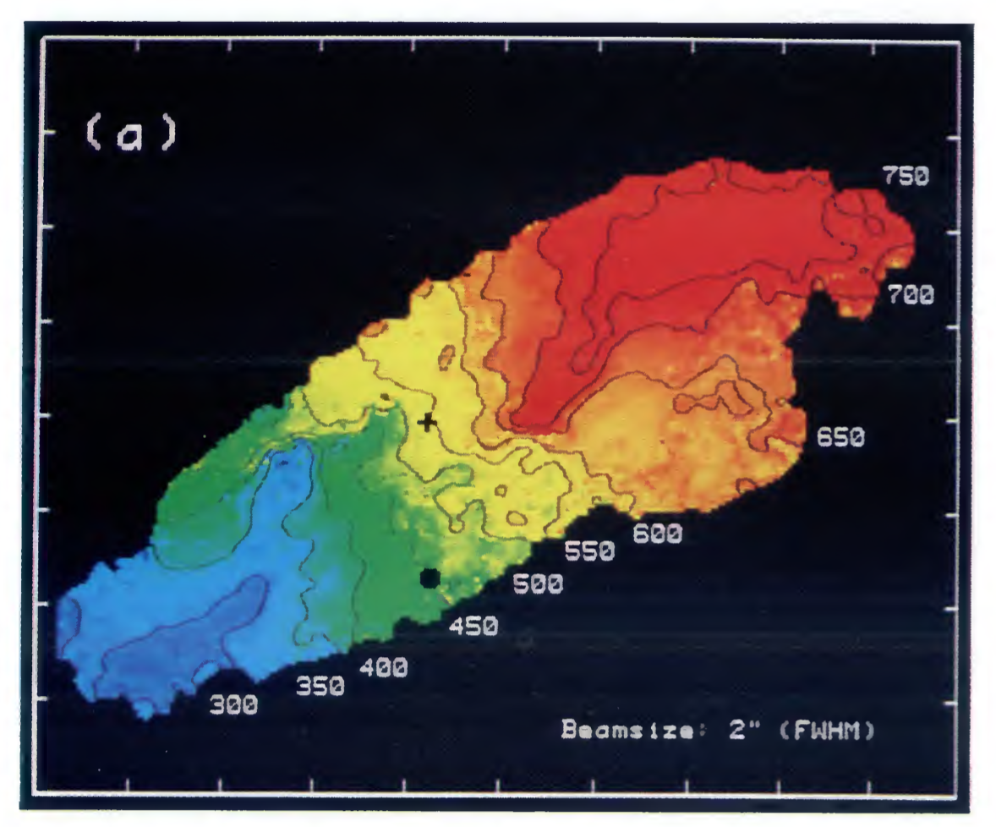
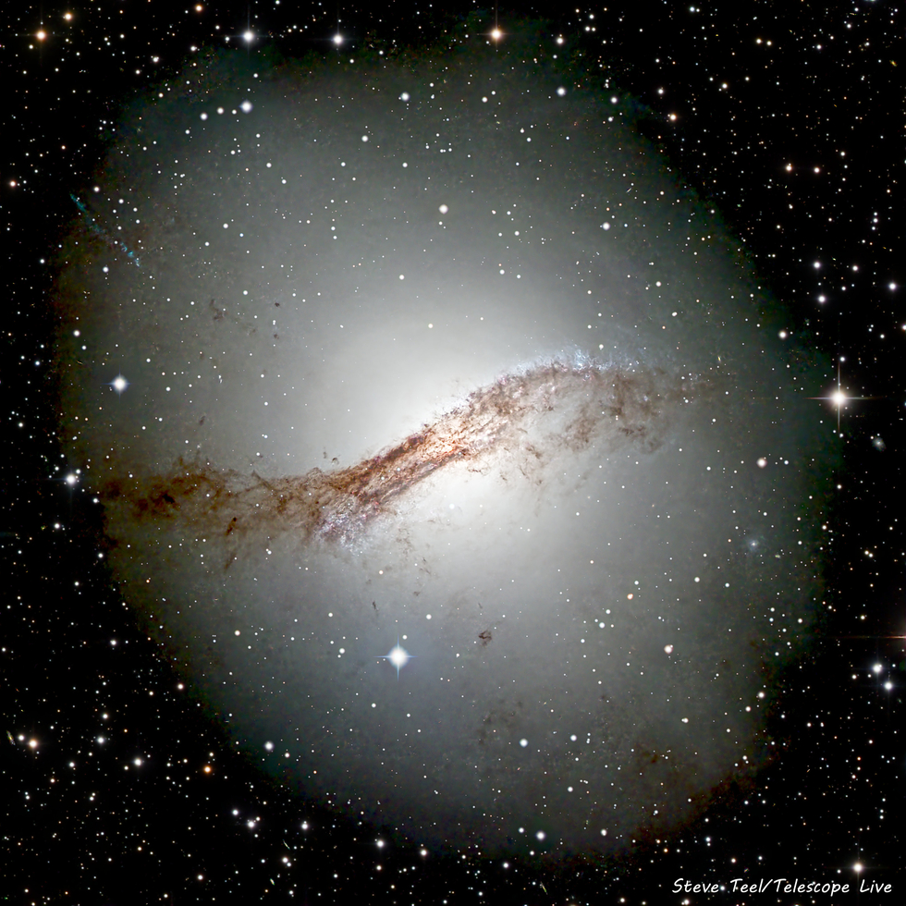
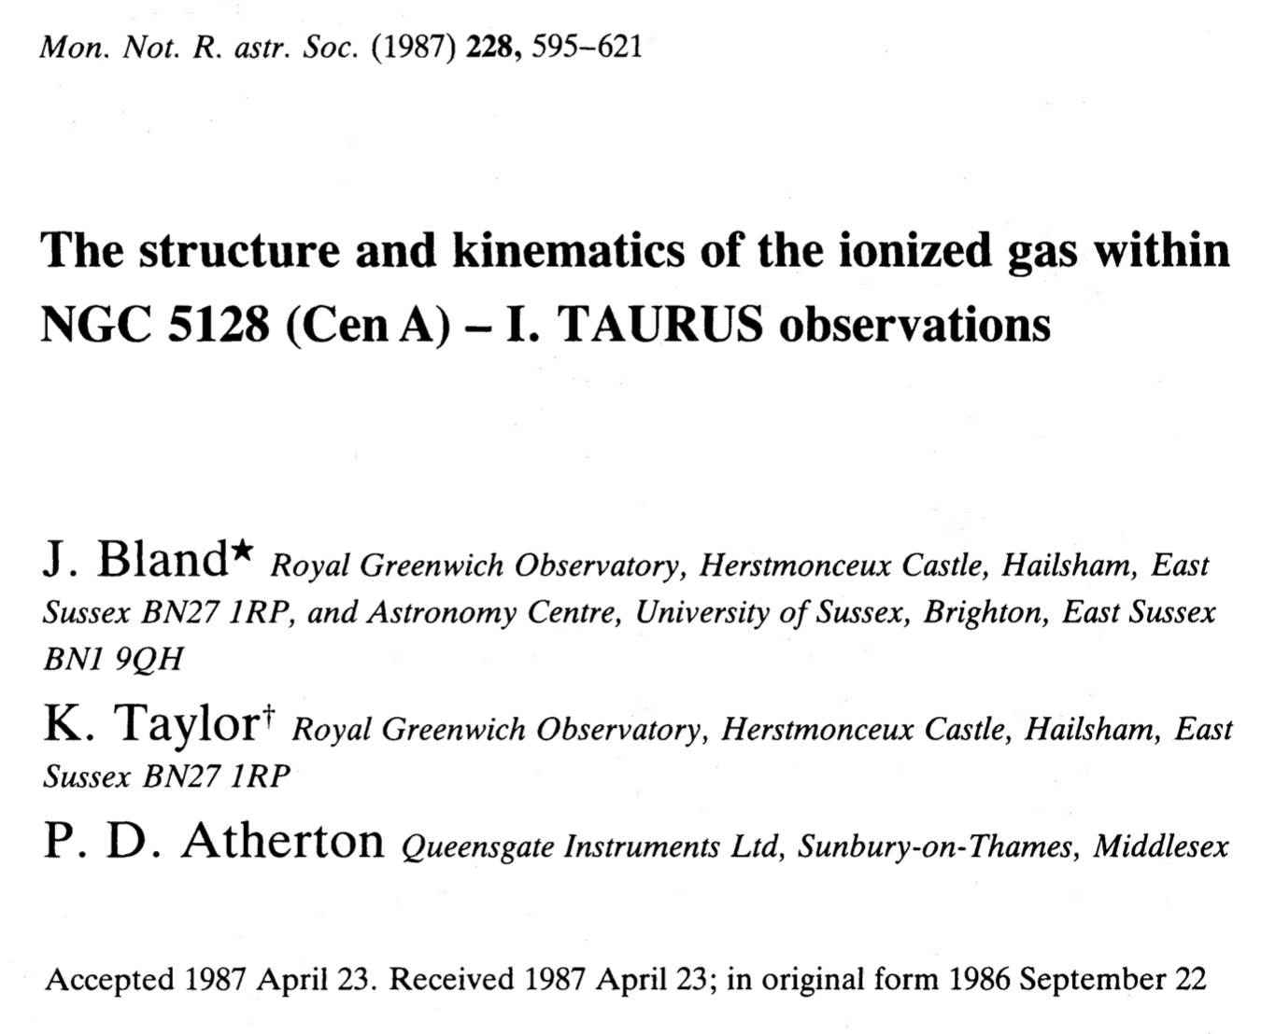
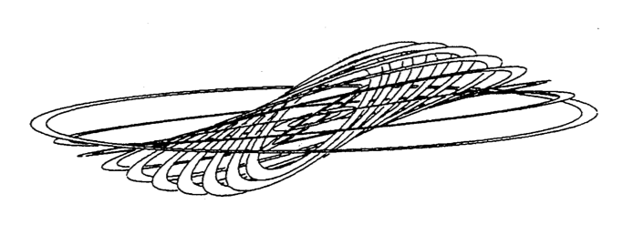
1997: ISO satellite
Notes:
need to mention TAURUS...

Slide 4
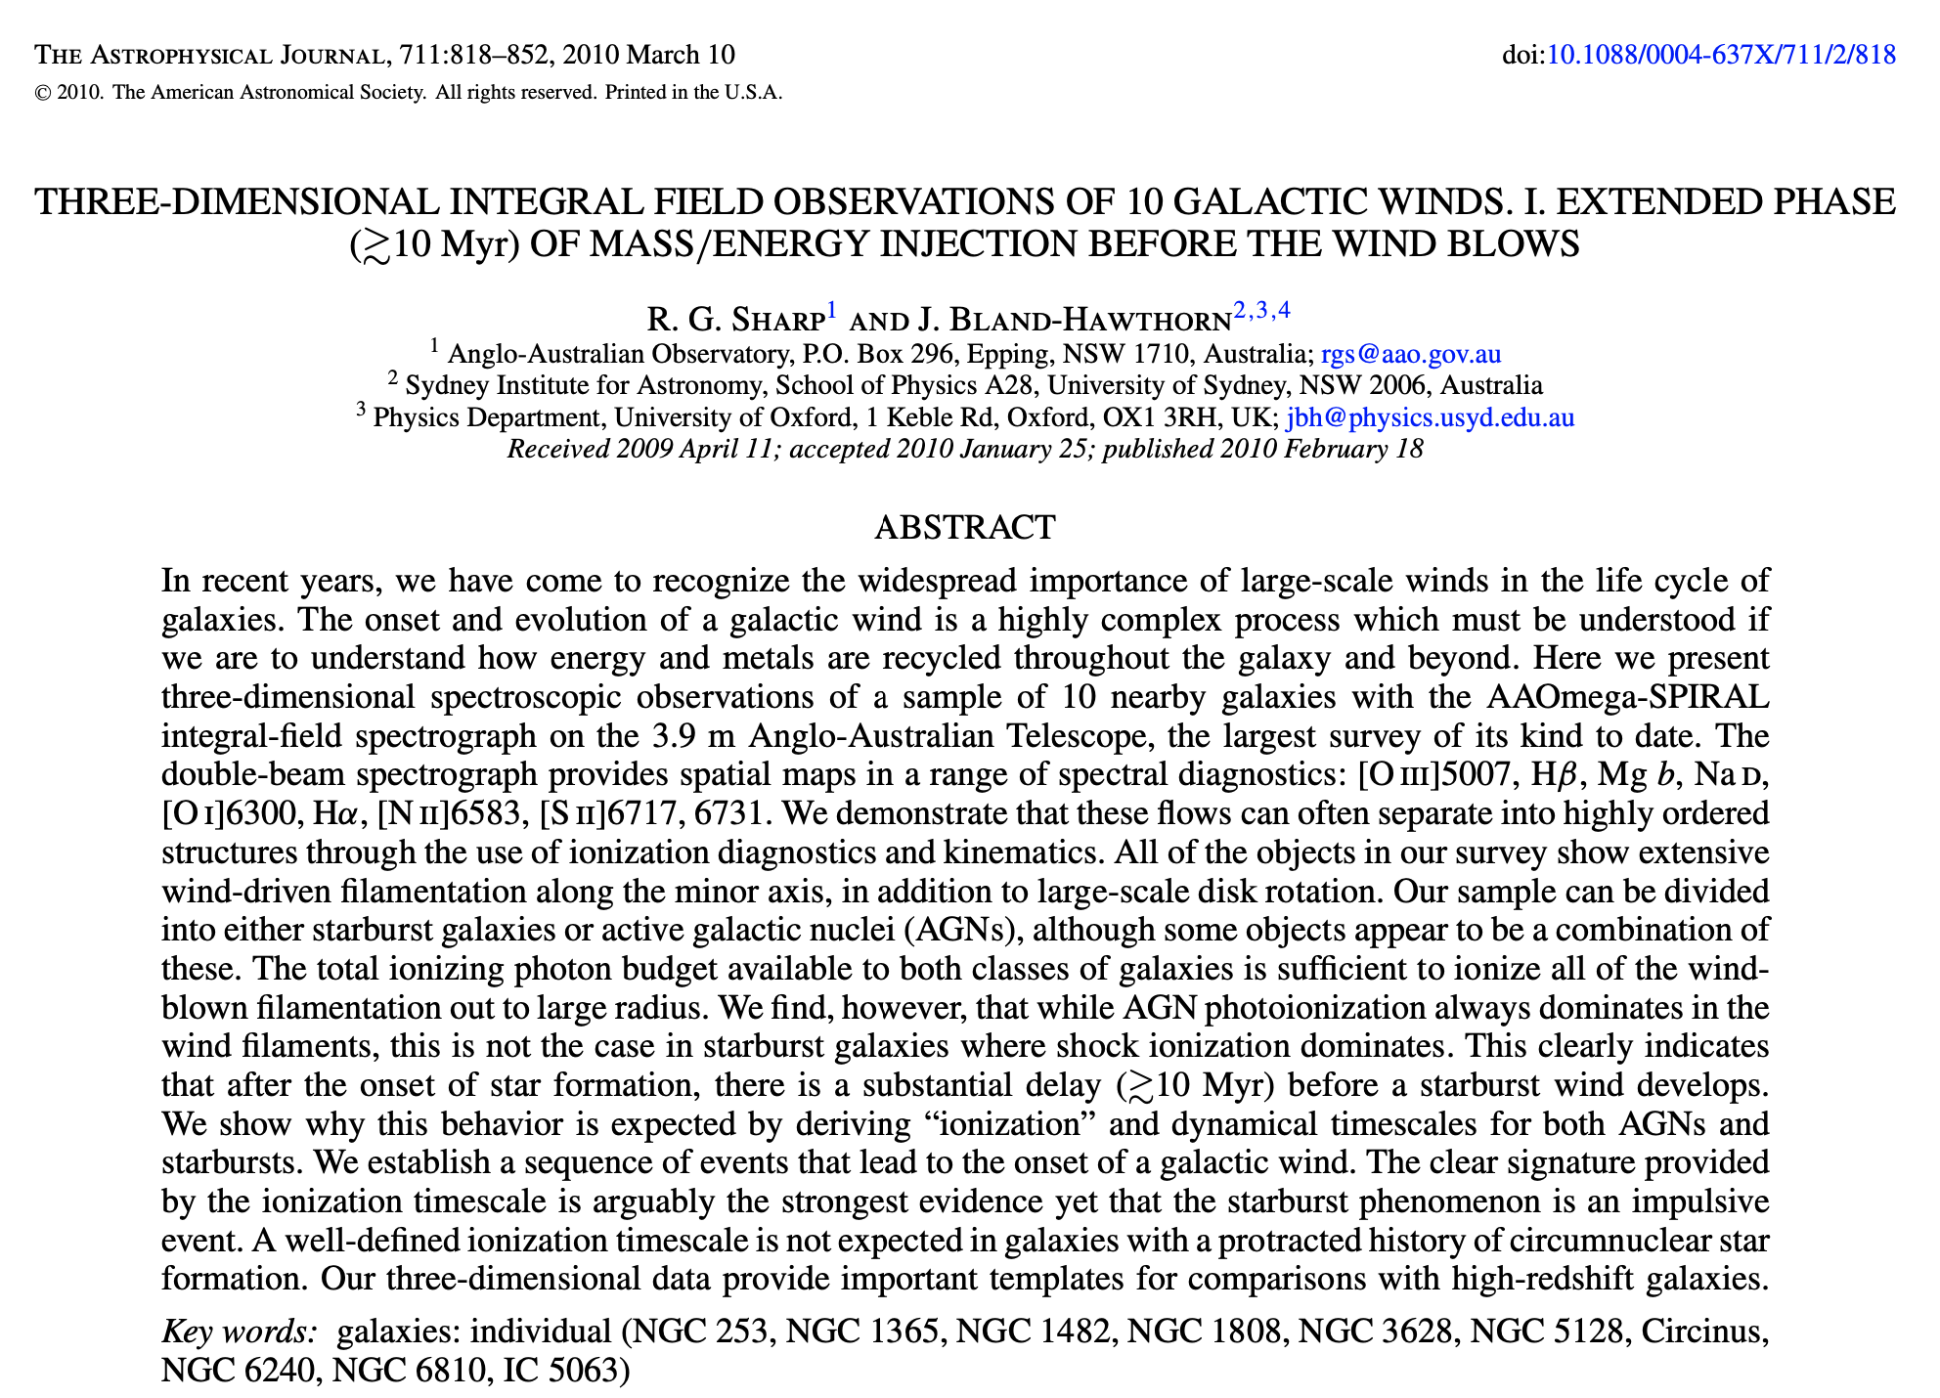
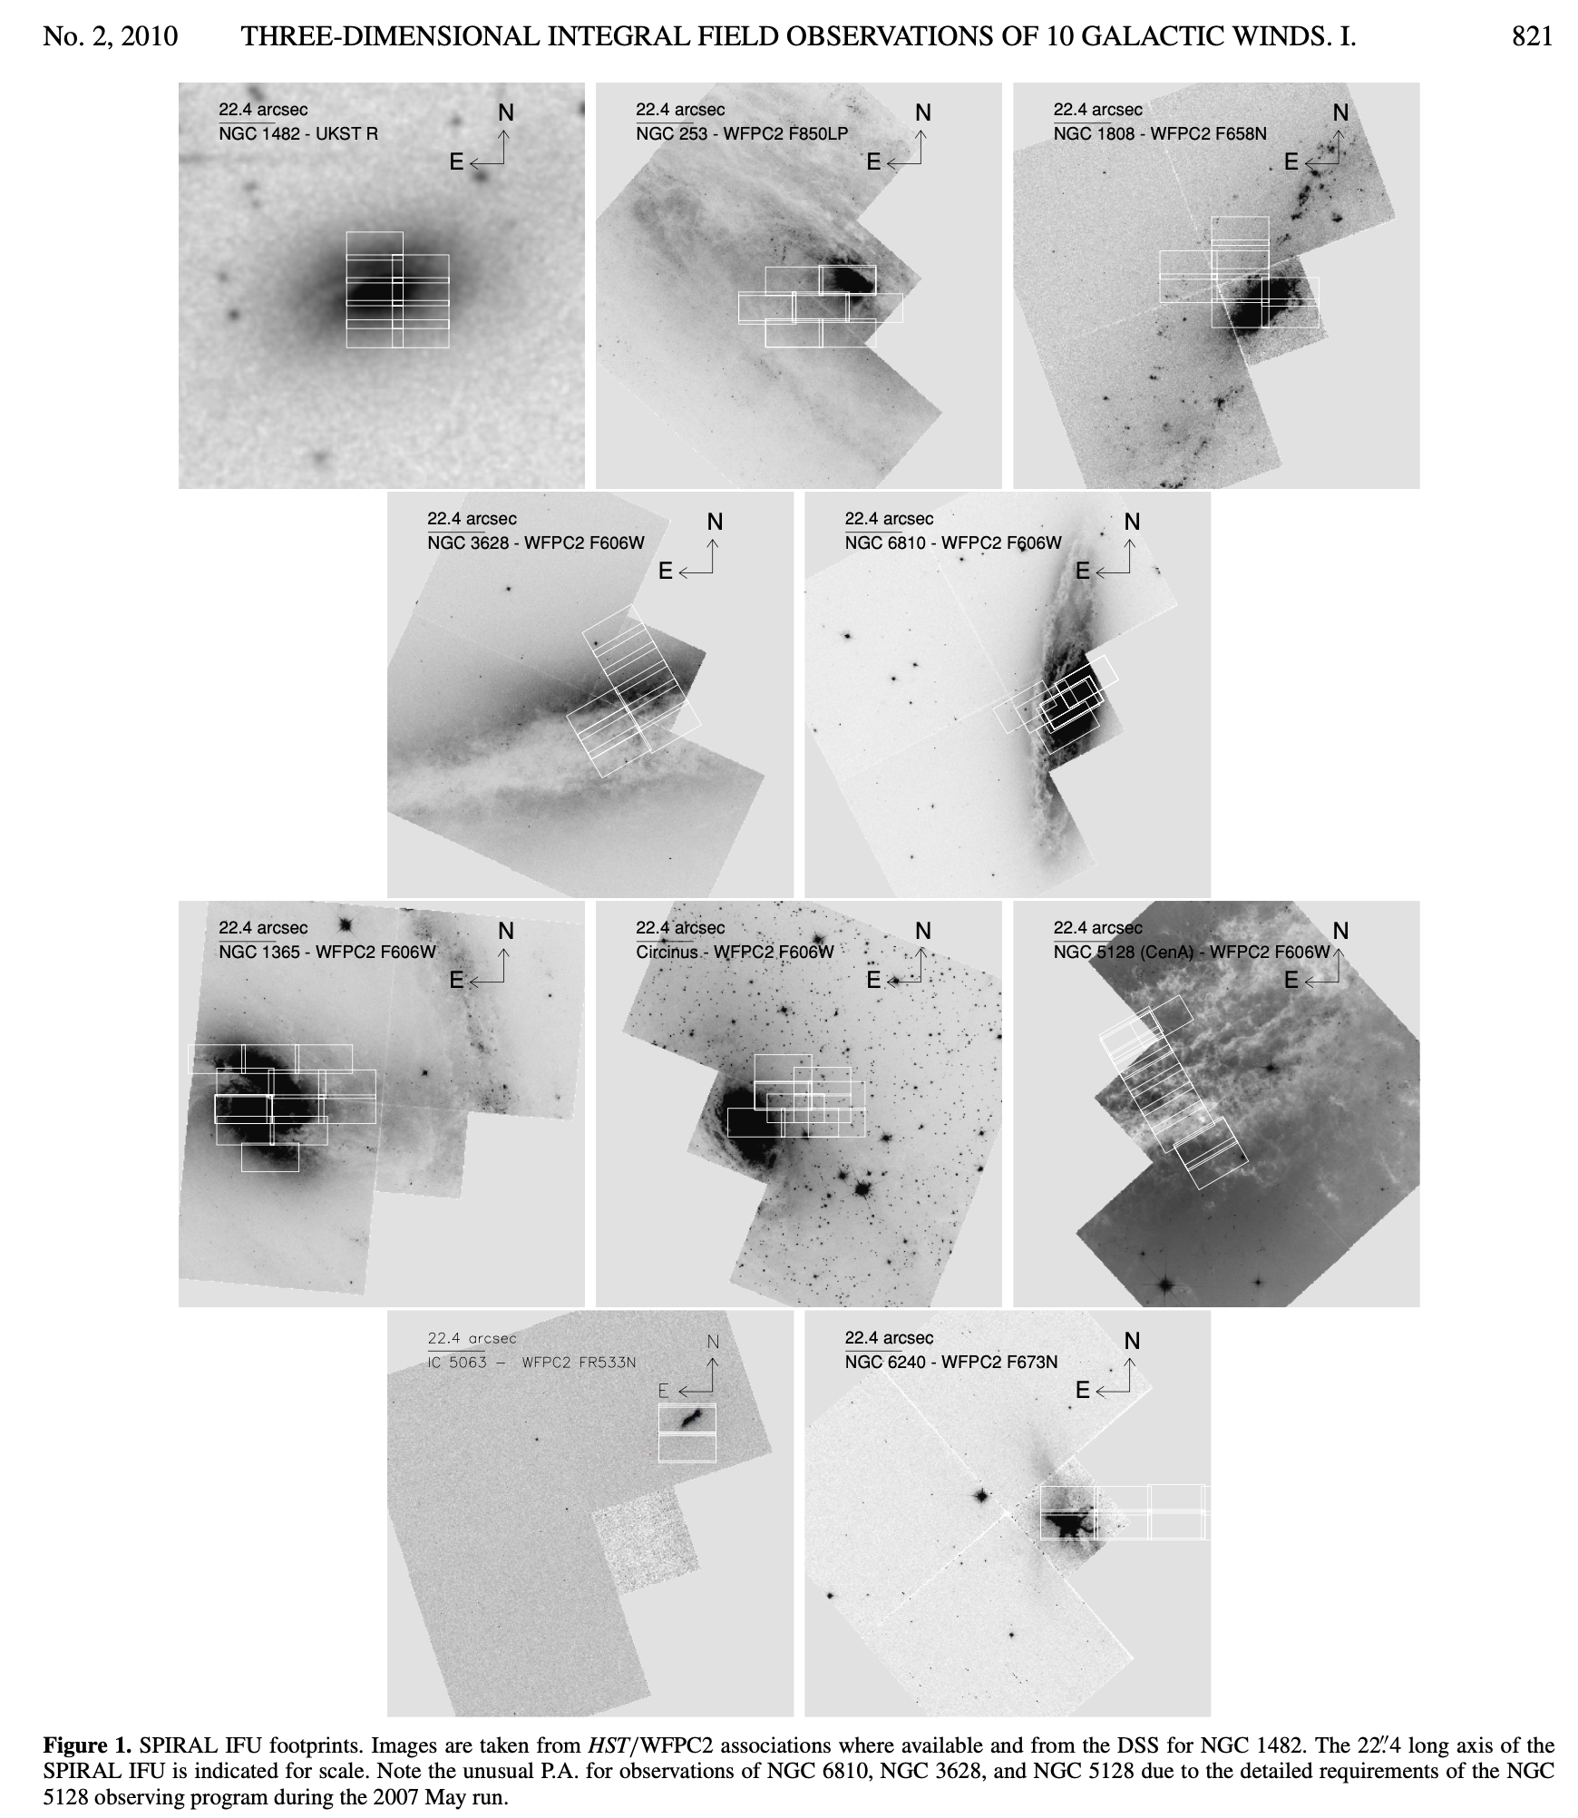
200+ ADS citations
This was made possible by Ian Parry & Keith Taylor (SPIRAL concept), Dave Lee (builder) and AAOmega DBS.
Notes:
let’s not forget SPIRAL, Rob’s nice work

Slide 5
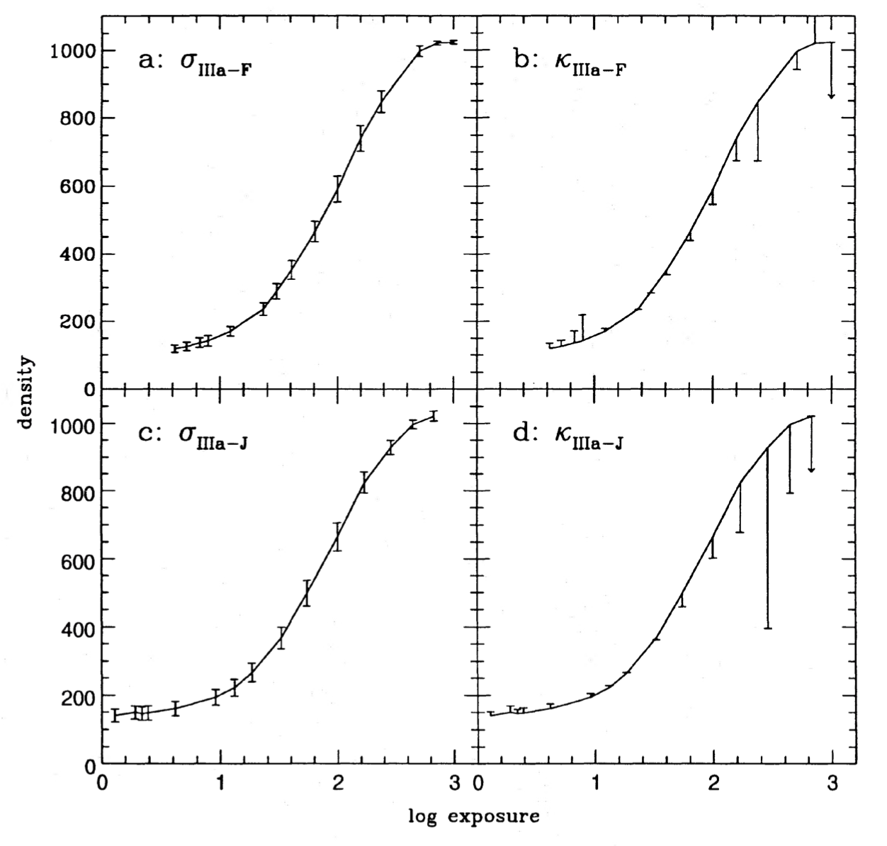
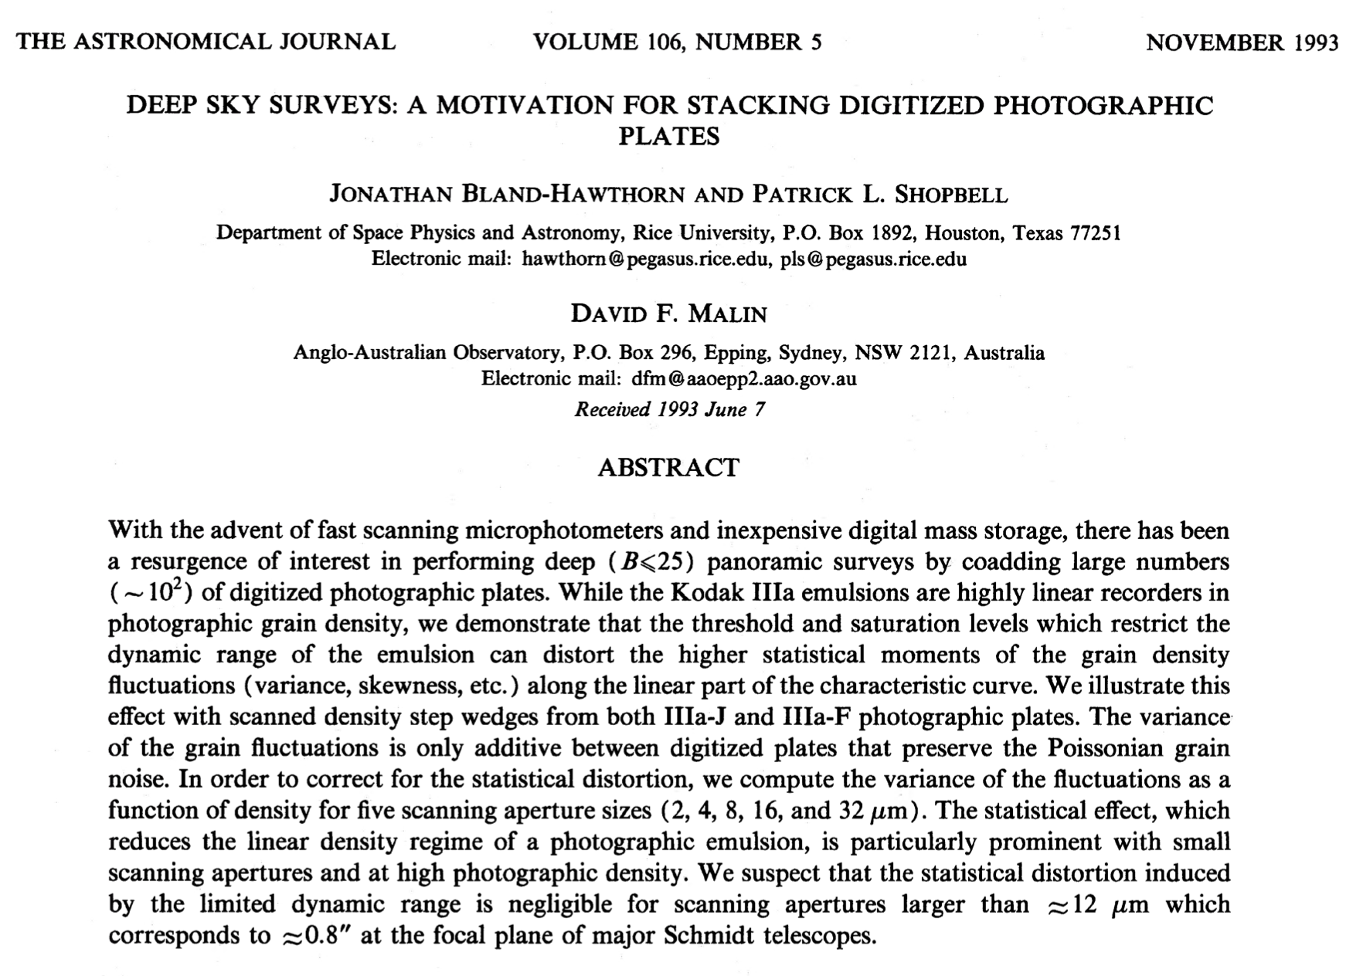
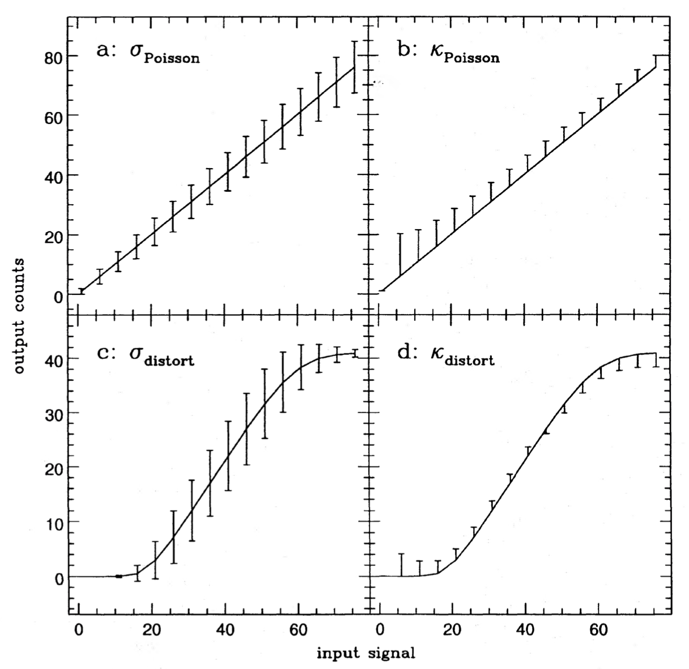
Notes:
KT plates, ADC working?

Slide 6
Given the short talk format, the focus here is on the experimentalists (1993-2007). But there were astronomers who made important contributions.

Slide 7
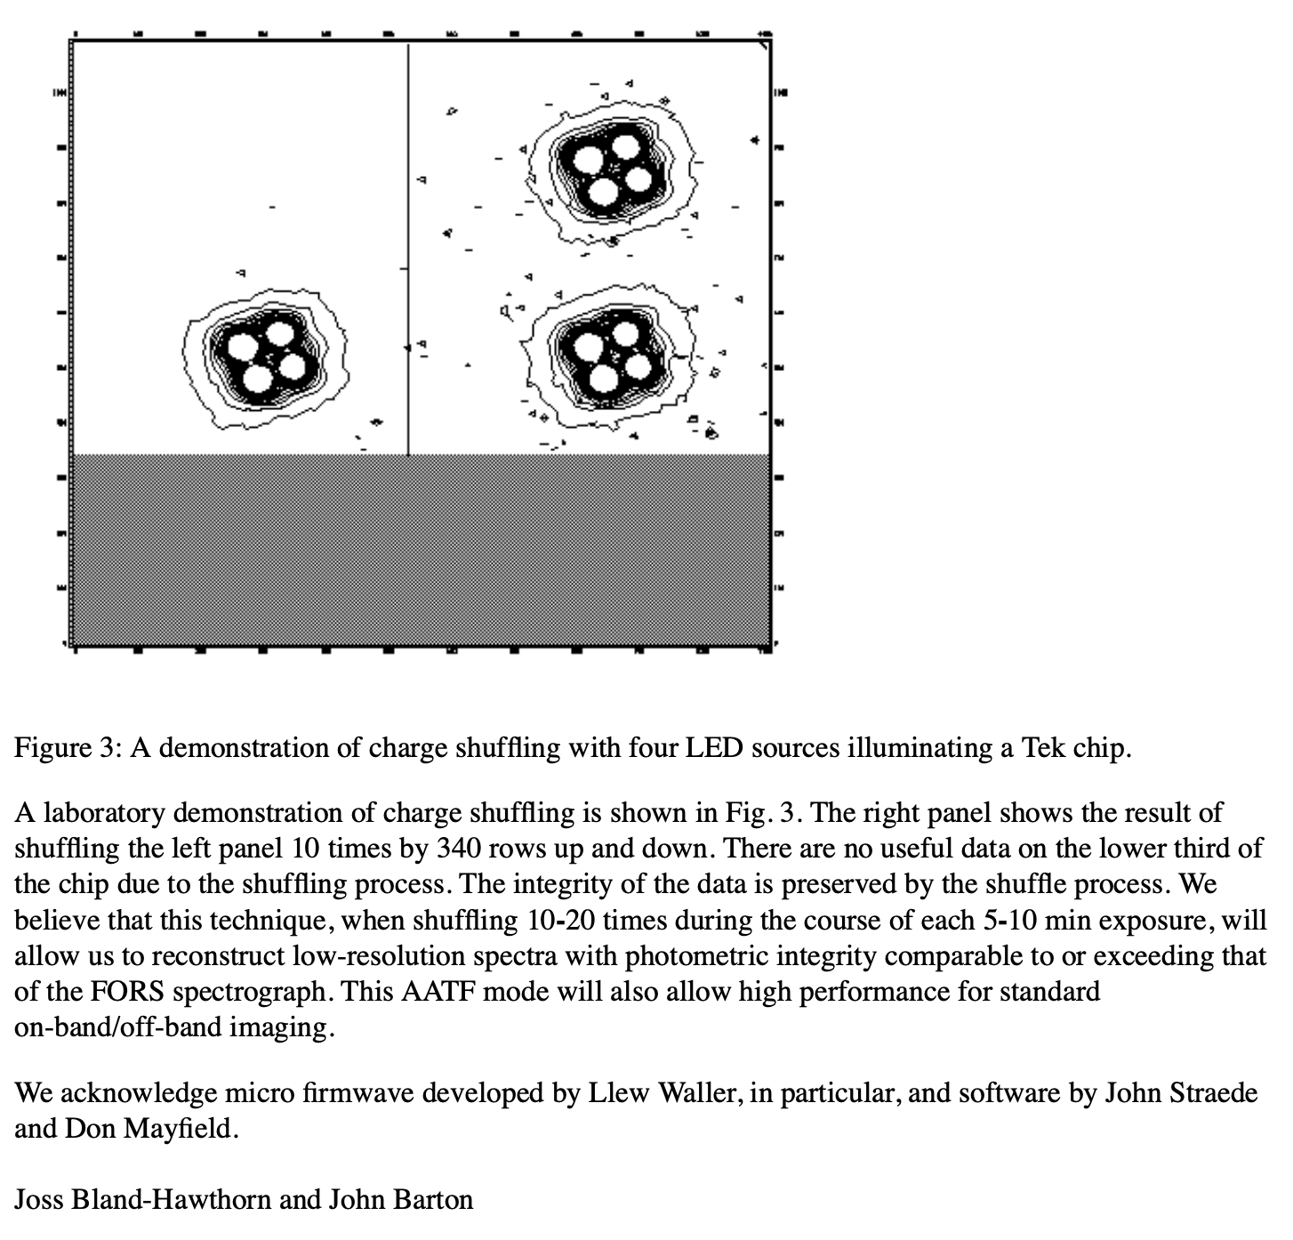
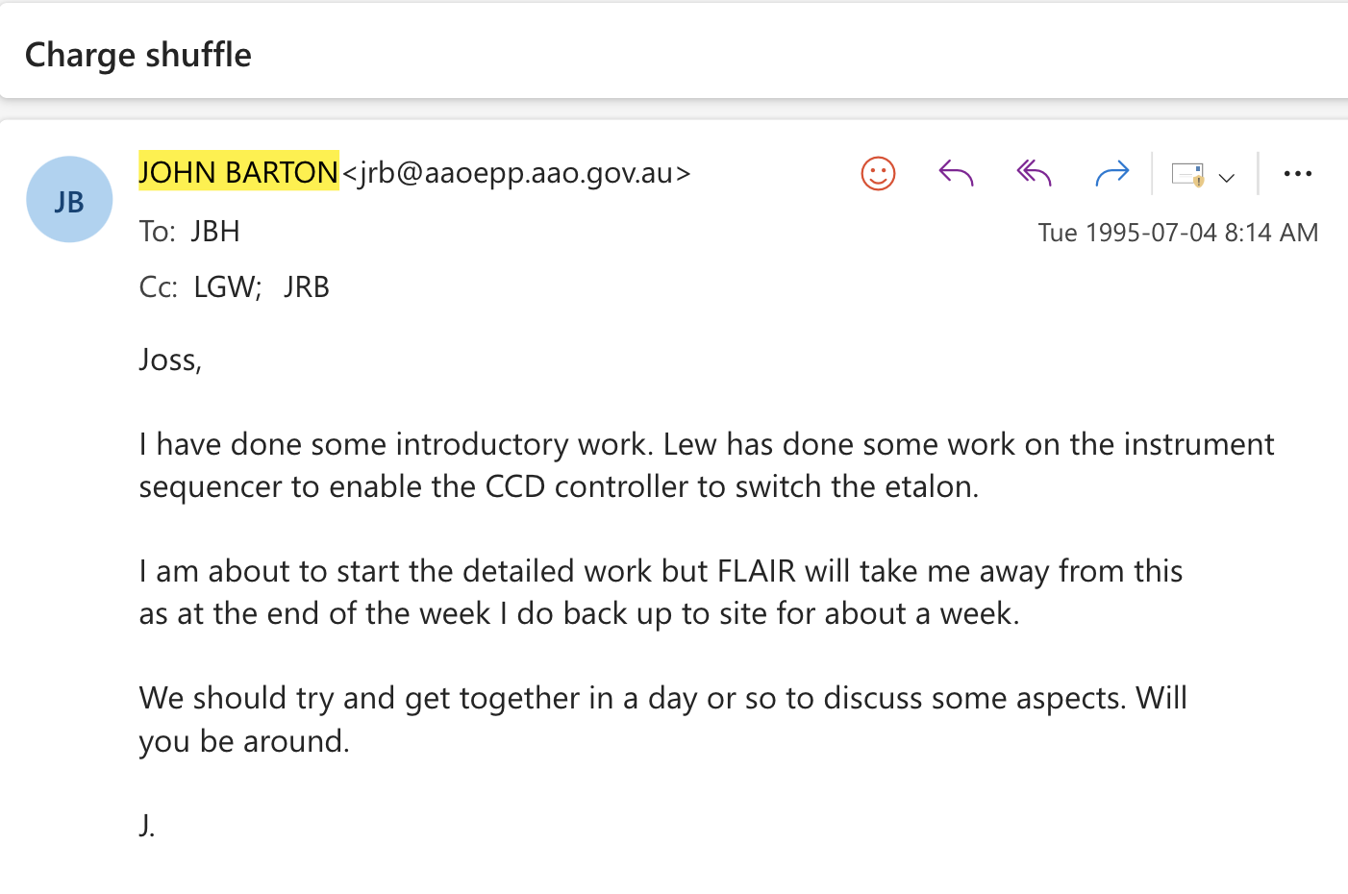
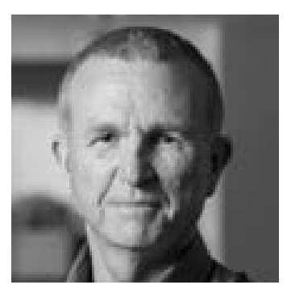
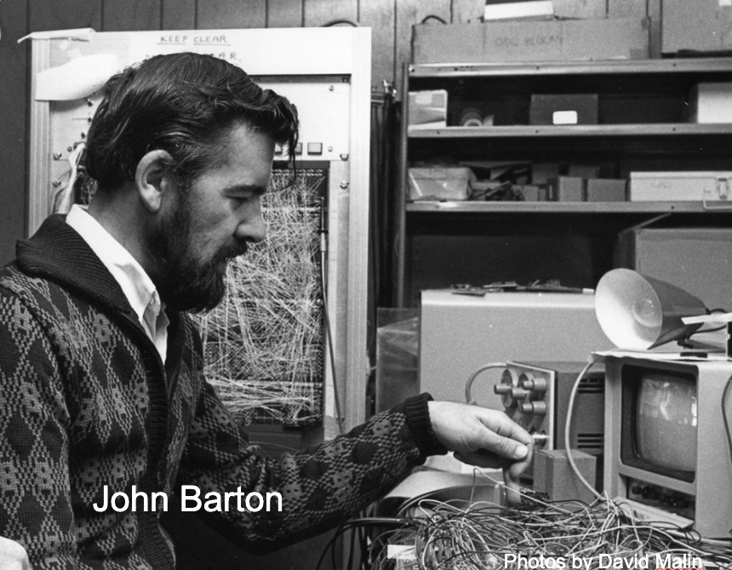
John Barton
Lew Waller
Nod & shuffle –
1994: first discussions
1995: first tests, AAO Newsletter
1996: RGO spectrograph, AAO Newsletter
1998: LDSS++ (*Glazebrook, PI)
2003: Gemini/GMOS (*Glazebrook, PI)
Biggest science gains –
Gemini Deep Deep Survey (Glazebrook+)
High redshift supernovae (Schmidt+)
*While not in Inst Sci group, he was an astronomer who made key technical contributions to several instrument projects during his AAO tenure.

Slide 8
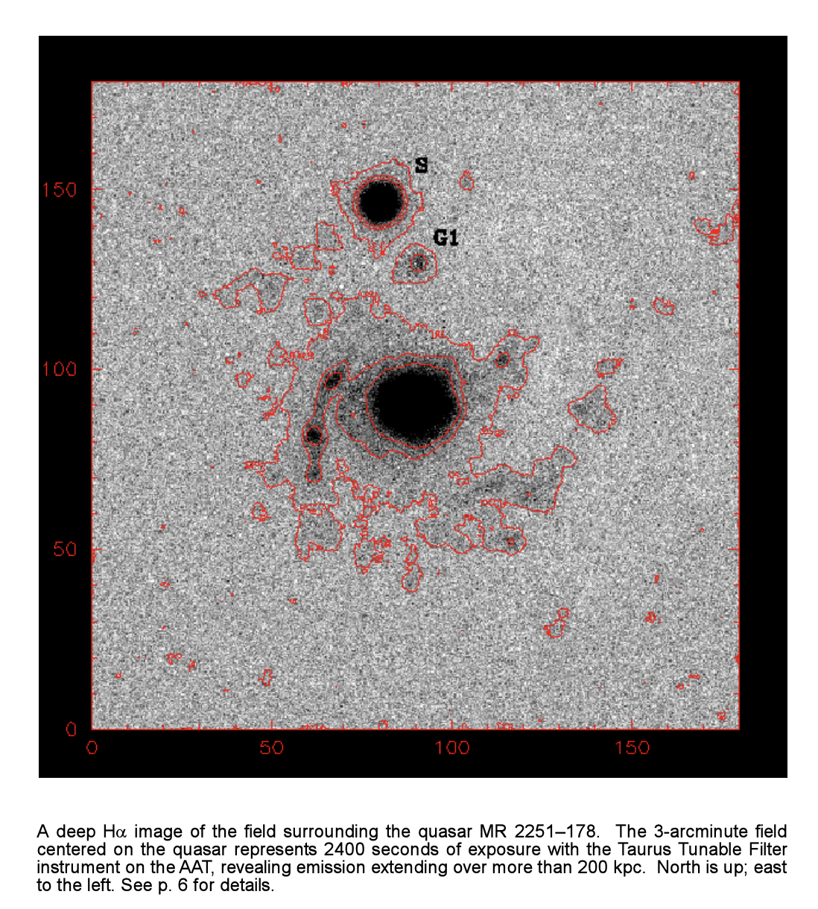
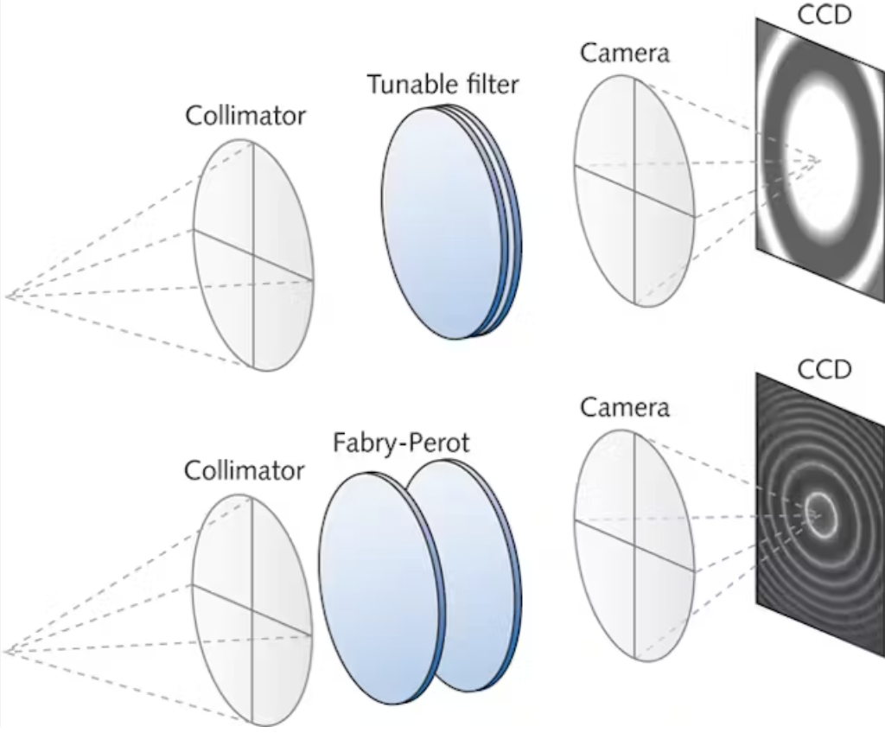
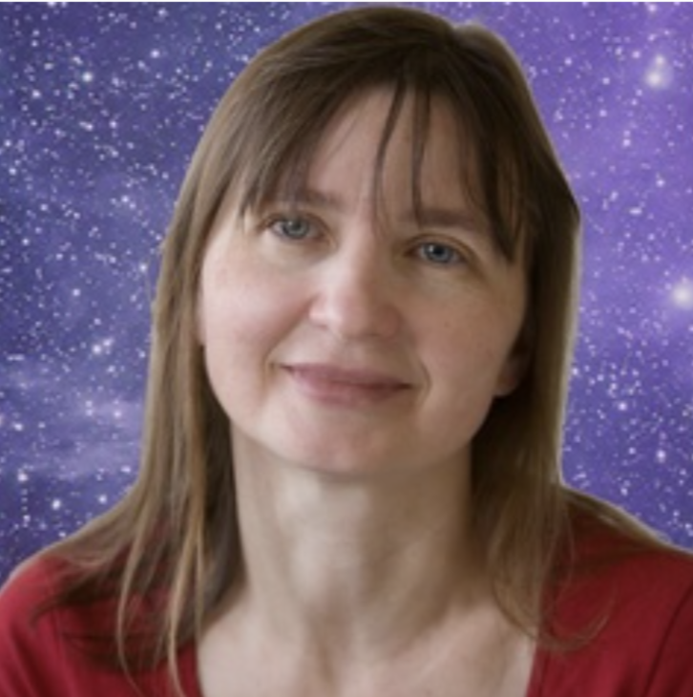
Lucyna Kedziora-Chudczer
TTF

Slide 9
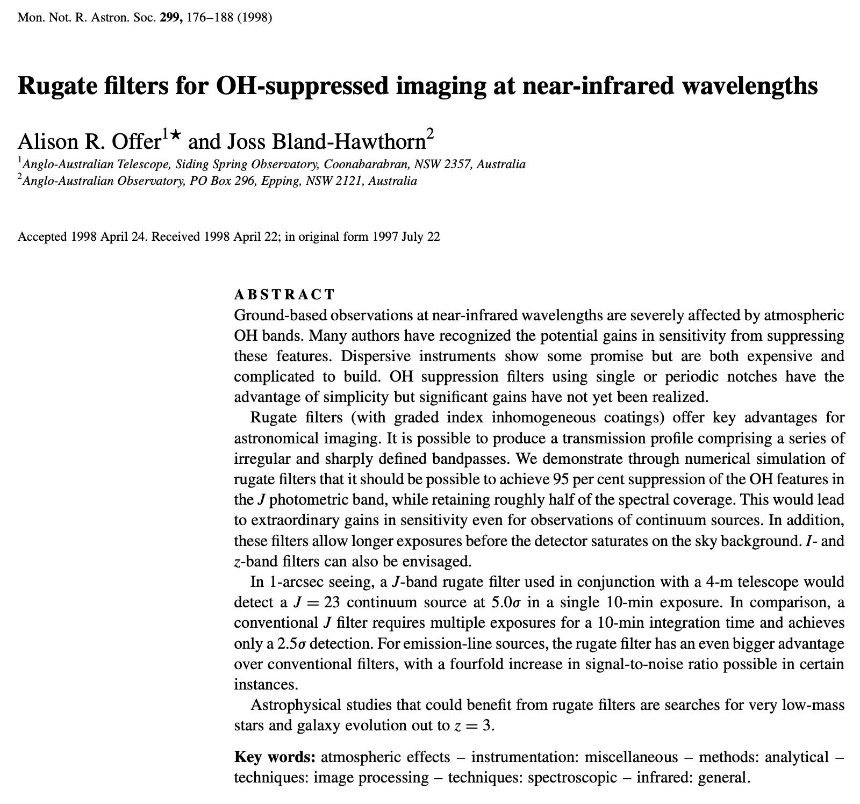
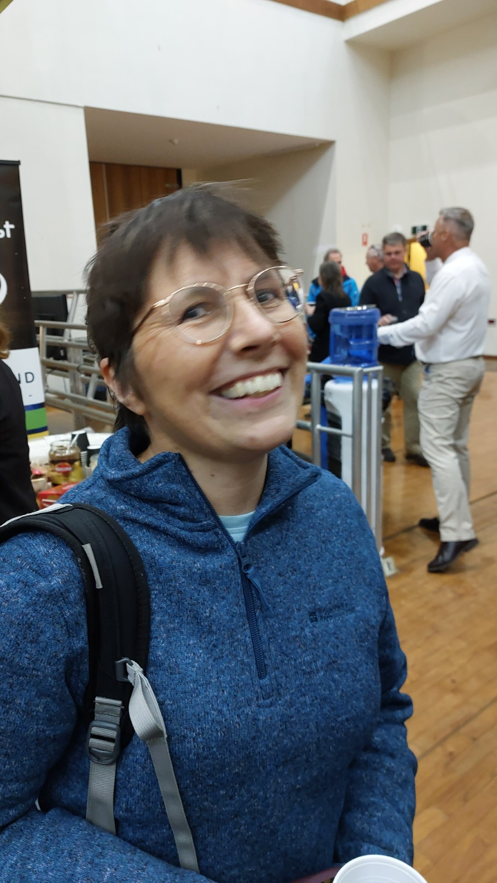
Alison Offer
This is the ultimate in strong grating technology; it can never solve the sky problem.
Notes:
led the way to FBGs, weak grating limit

Slide 10
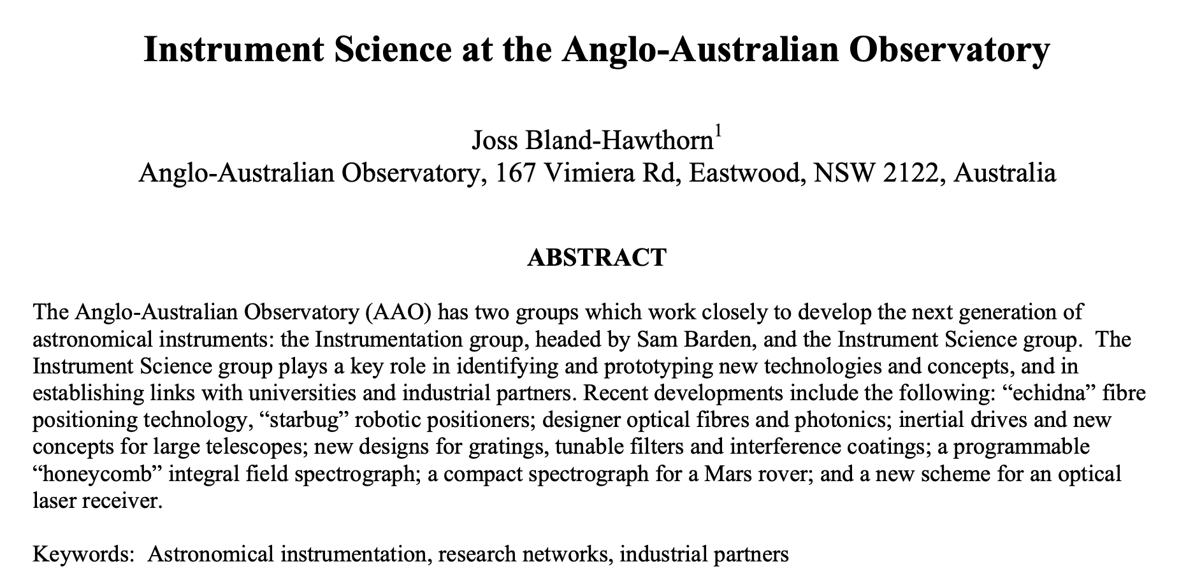
The IS group was the Board’s idea, not the Director’s.
“There is so much innovation under way, this should be the focus of a distinct group.”
SPIE 2004, Glasgow
14 of us went to sell our wares!

Slide 11
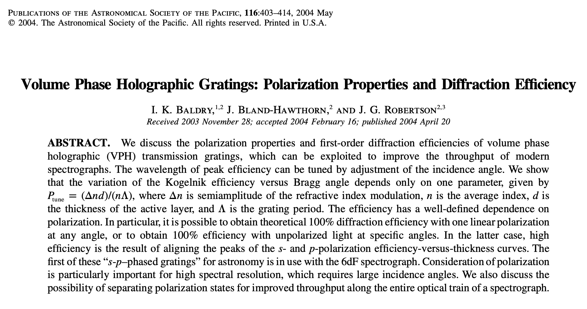
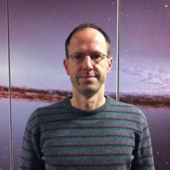
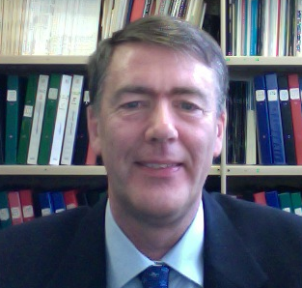
Ivan Baldry
Gordon Robertson
Sam Barden joined the staff. In earlier work, he promoted VPH gratings but told me that very little was known beyond the fact they work.
Ivan’s journey

Slide 12
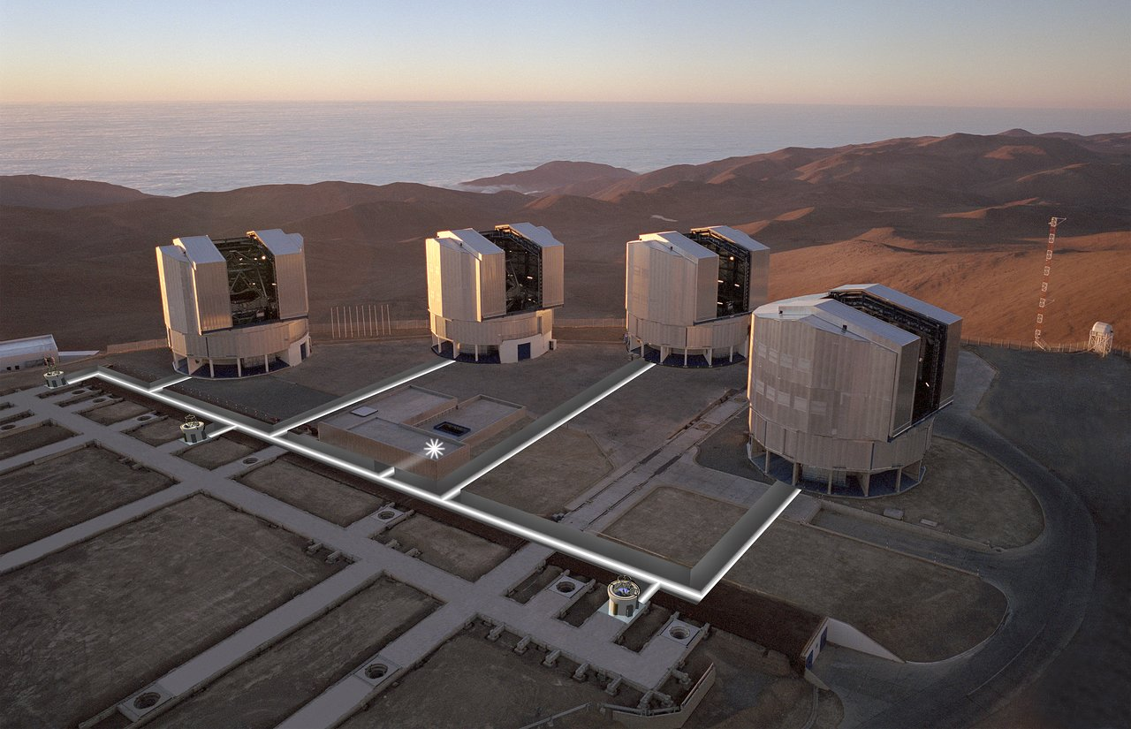
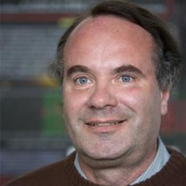
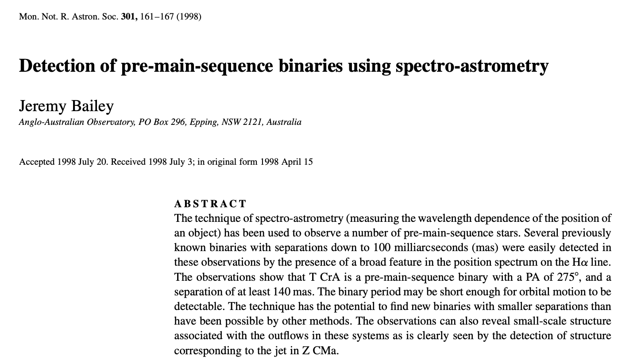
Jeremy Bailey
ESO Gravity
Notes:
on Gravity, Gravity+ review committees

Slide 13
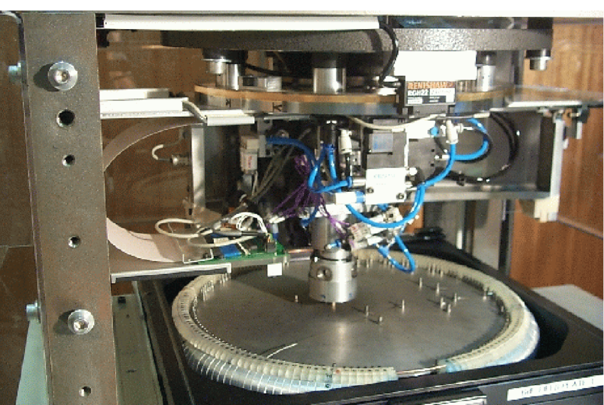
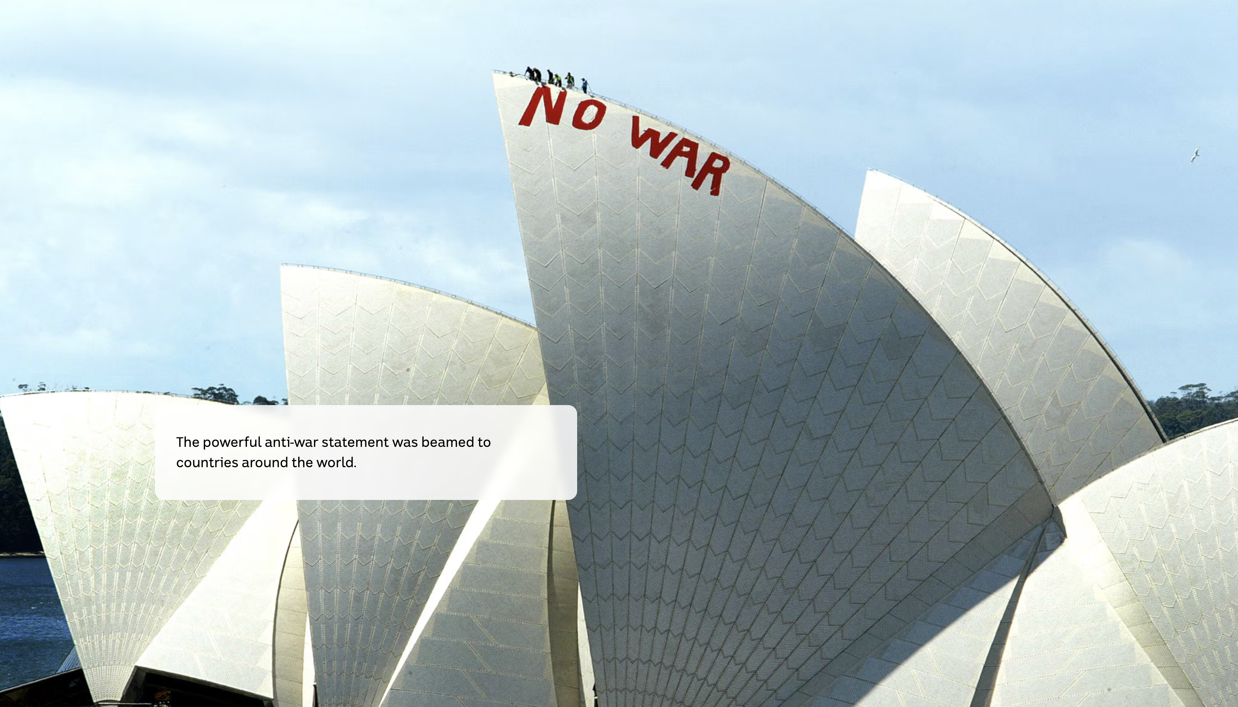
Will Saunders
Fred Watson
RAVE survey (7000 cites)
6dFGS survey (5000 cites)
Notes:
AAOmega – brillliant work, then 6dFGS, PILOT

Slide 14
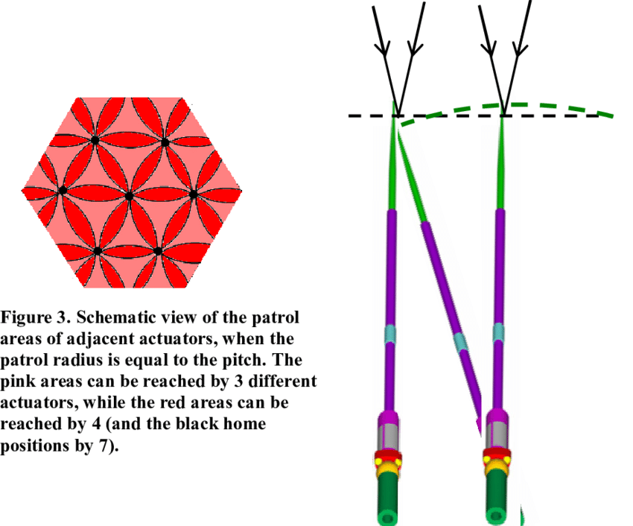
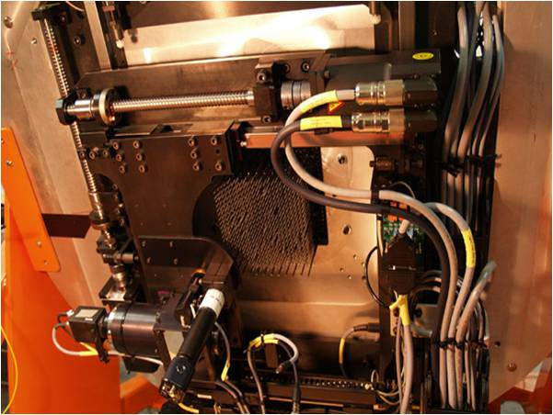
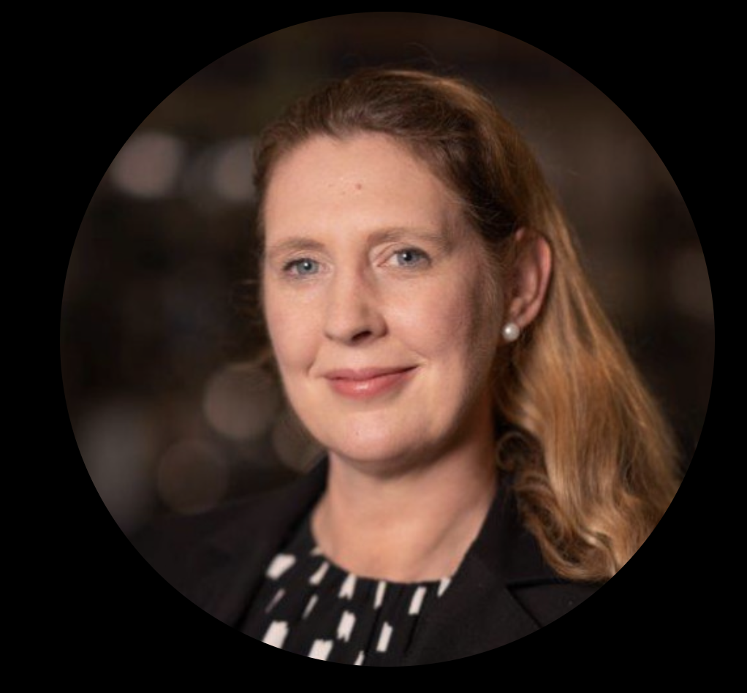
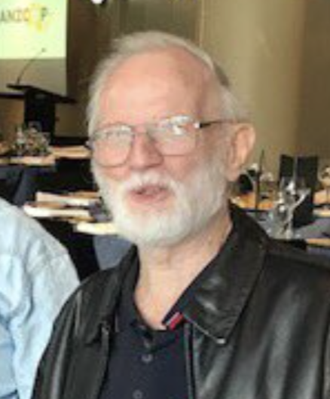
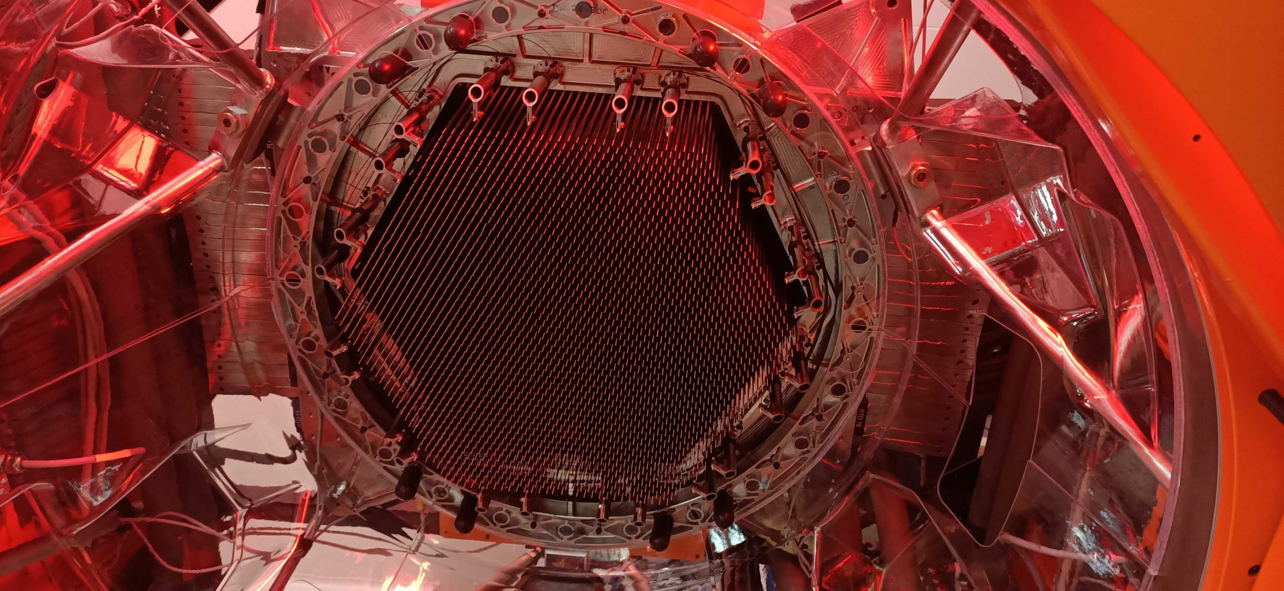
Anna Moore
Peter Gillingham
The role of industry
Notes:
FMOS/Subaru
4MOST/Aesop

Slide 15
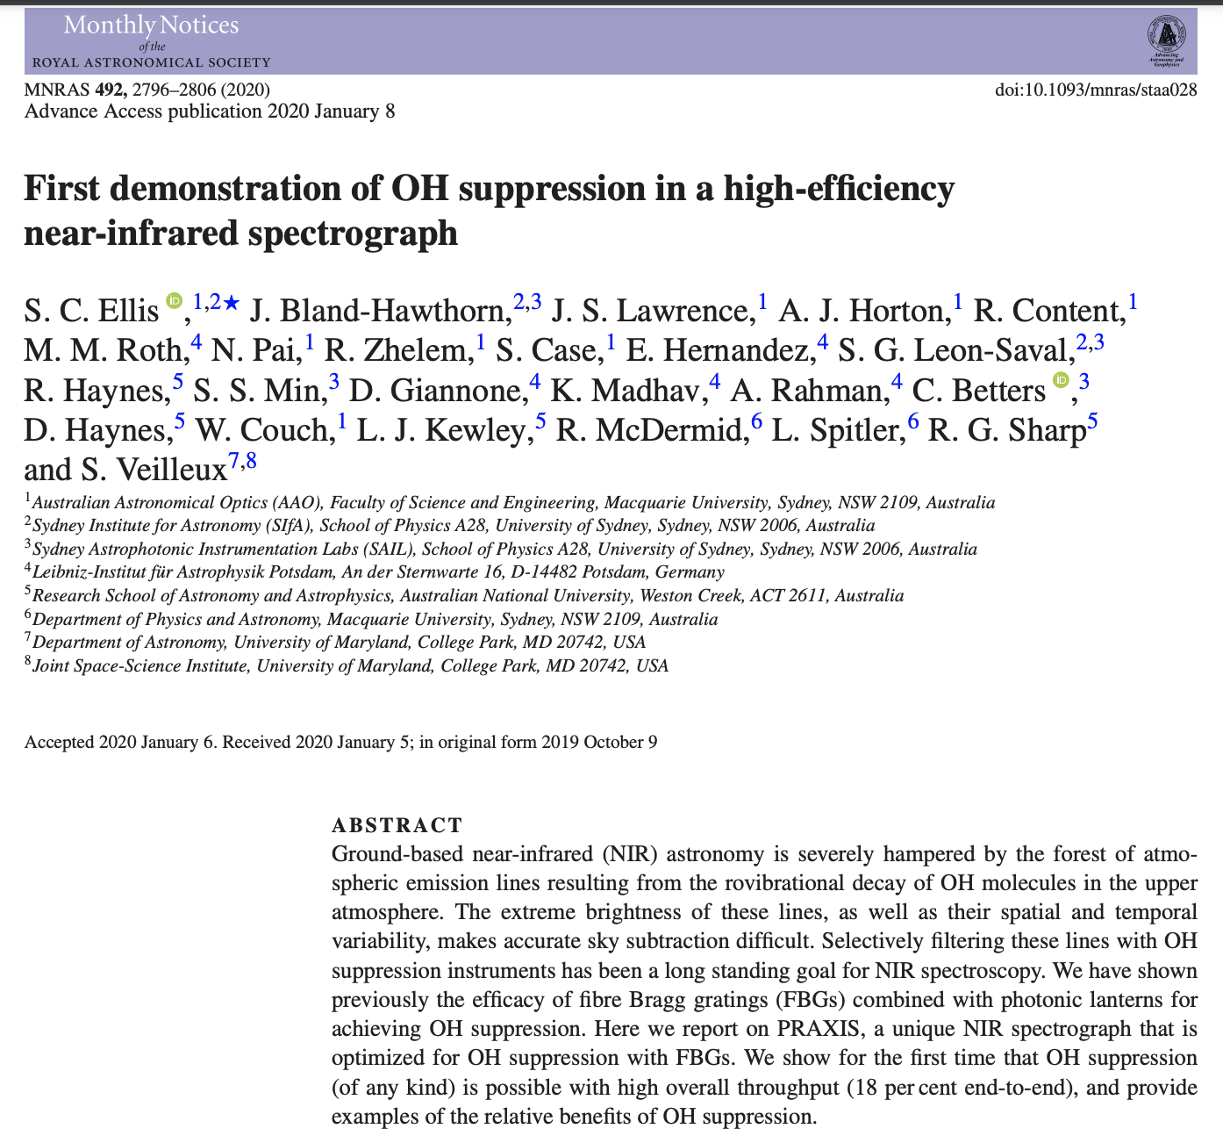
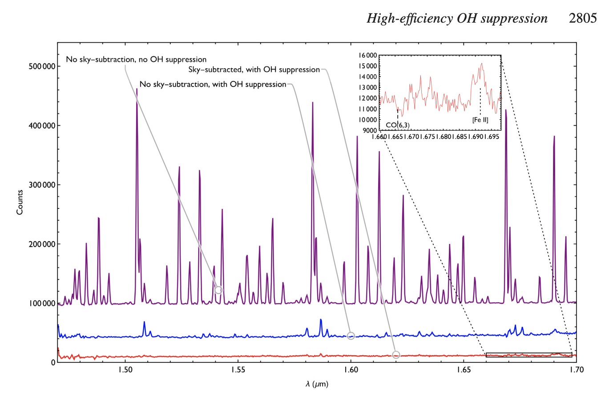
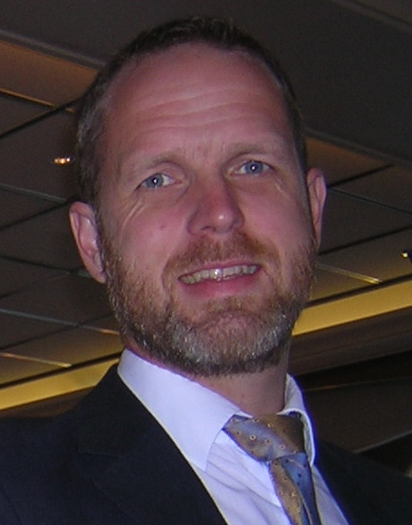
Simon Ellis
18% efficient end to end OH supp
now available for full J and H bands
Notes:
Install on ELTs

Slide 16
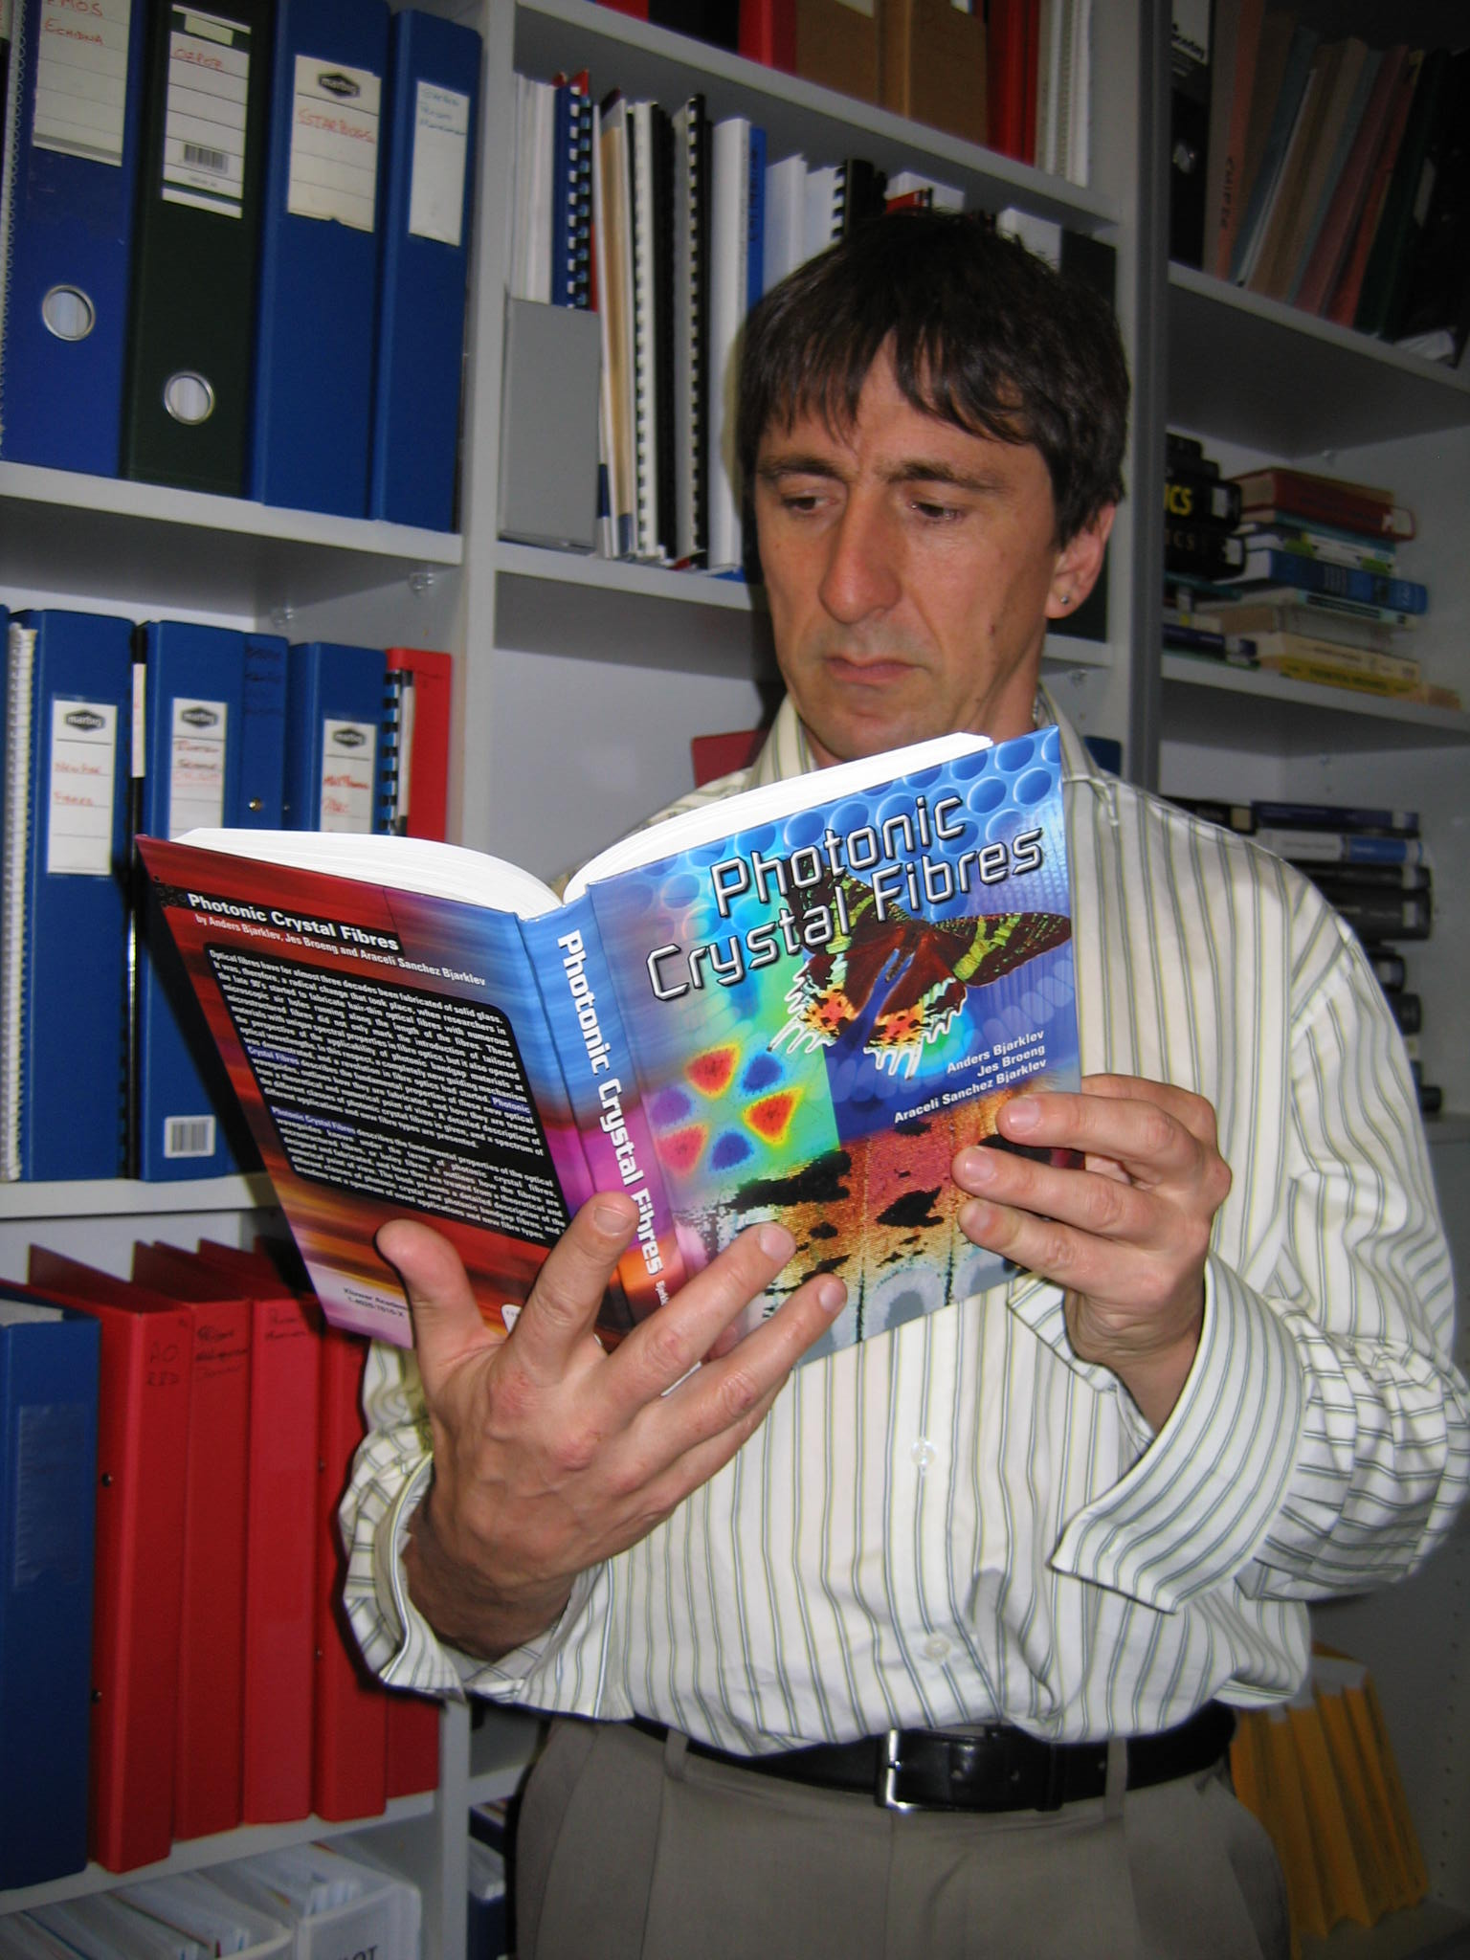
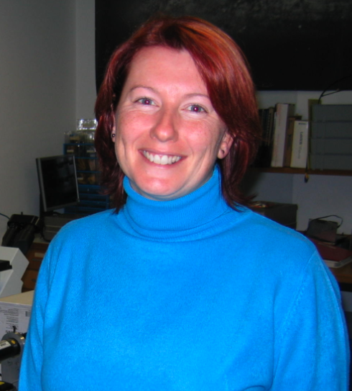
Dionne & Roger
There was only one year where Australia could apply for STFC funds – 2000/1.
Roger had the idea to incorporate Durham (RMS, JRAS), and we landed $1.3M for 3 years, one of the largest grants that year!
This was the birth of ASTROPHOTONICS, a neologism due to RMS.
1995: Fred Watson plays an important role as an early inspiration.

Slide 17
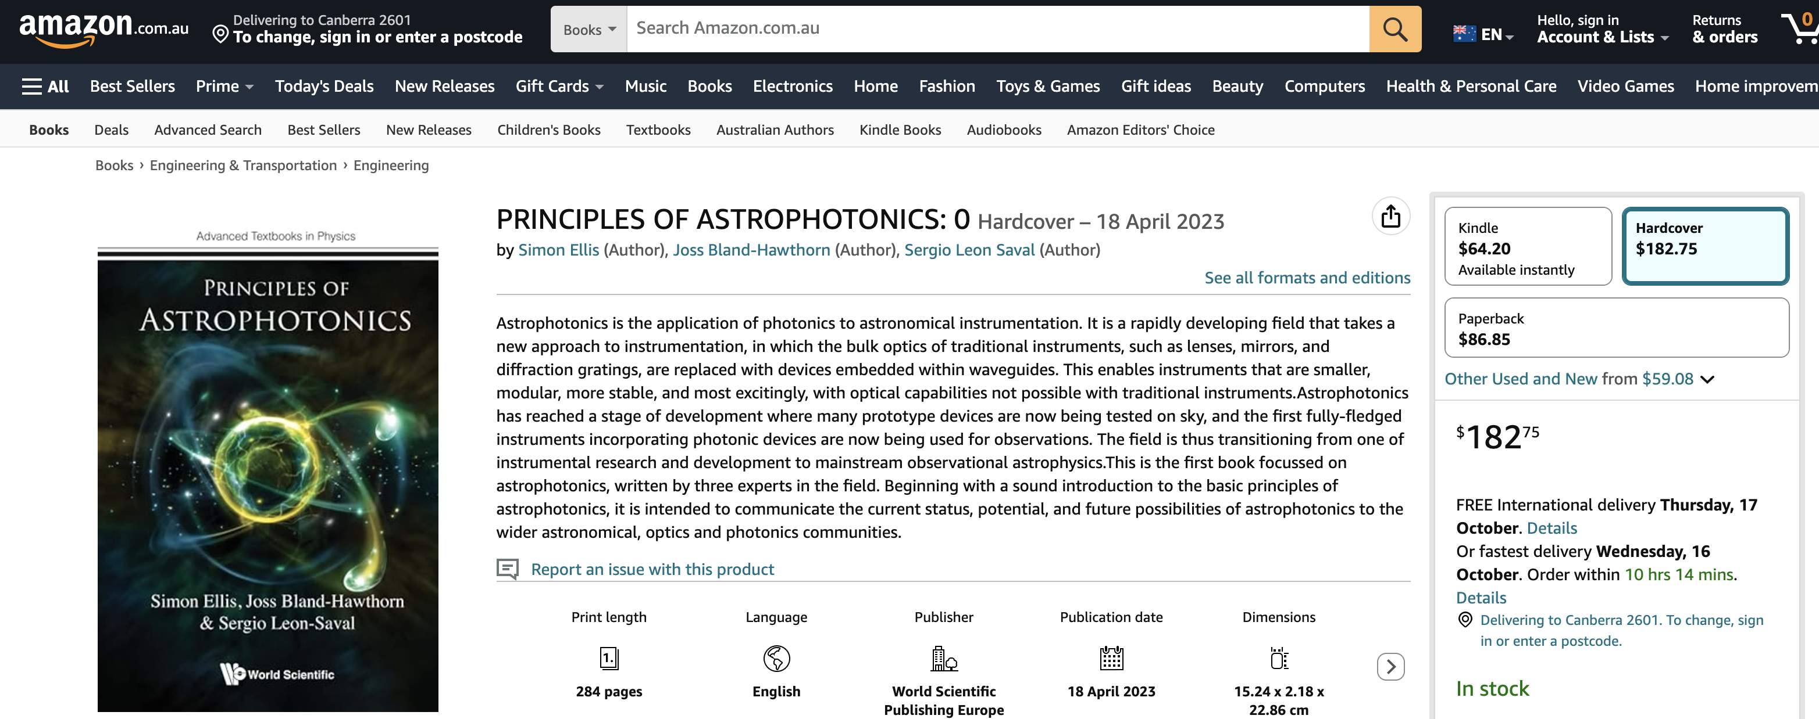

Slide 18
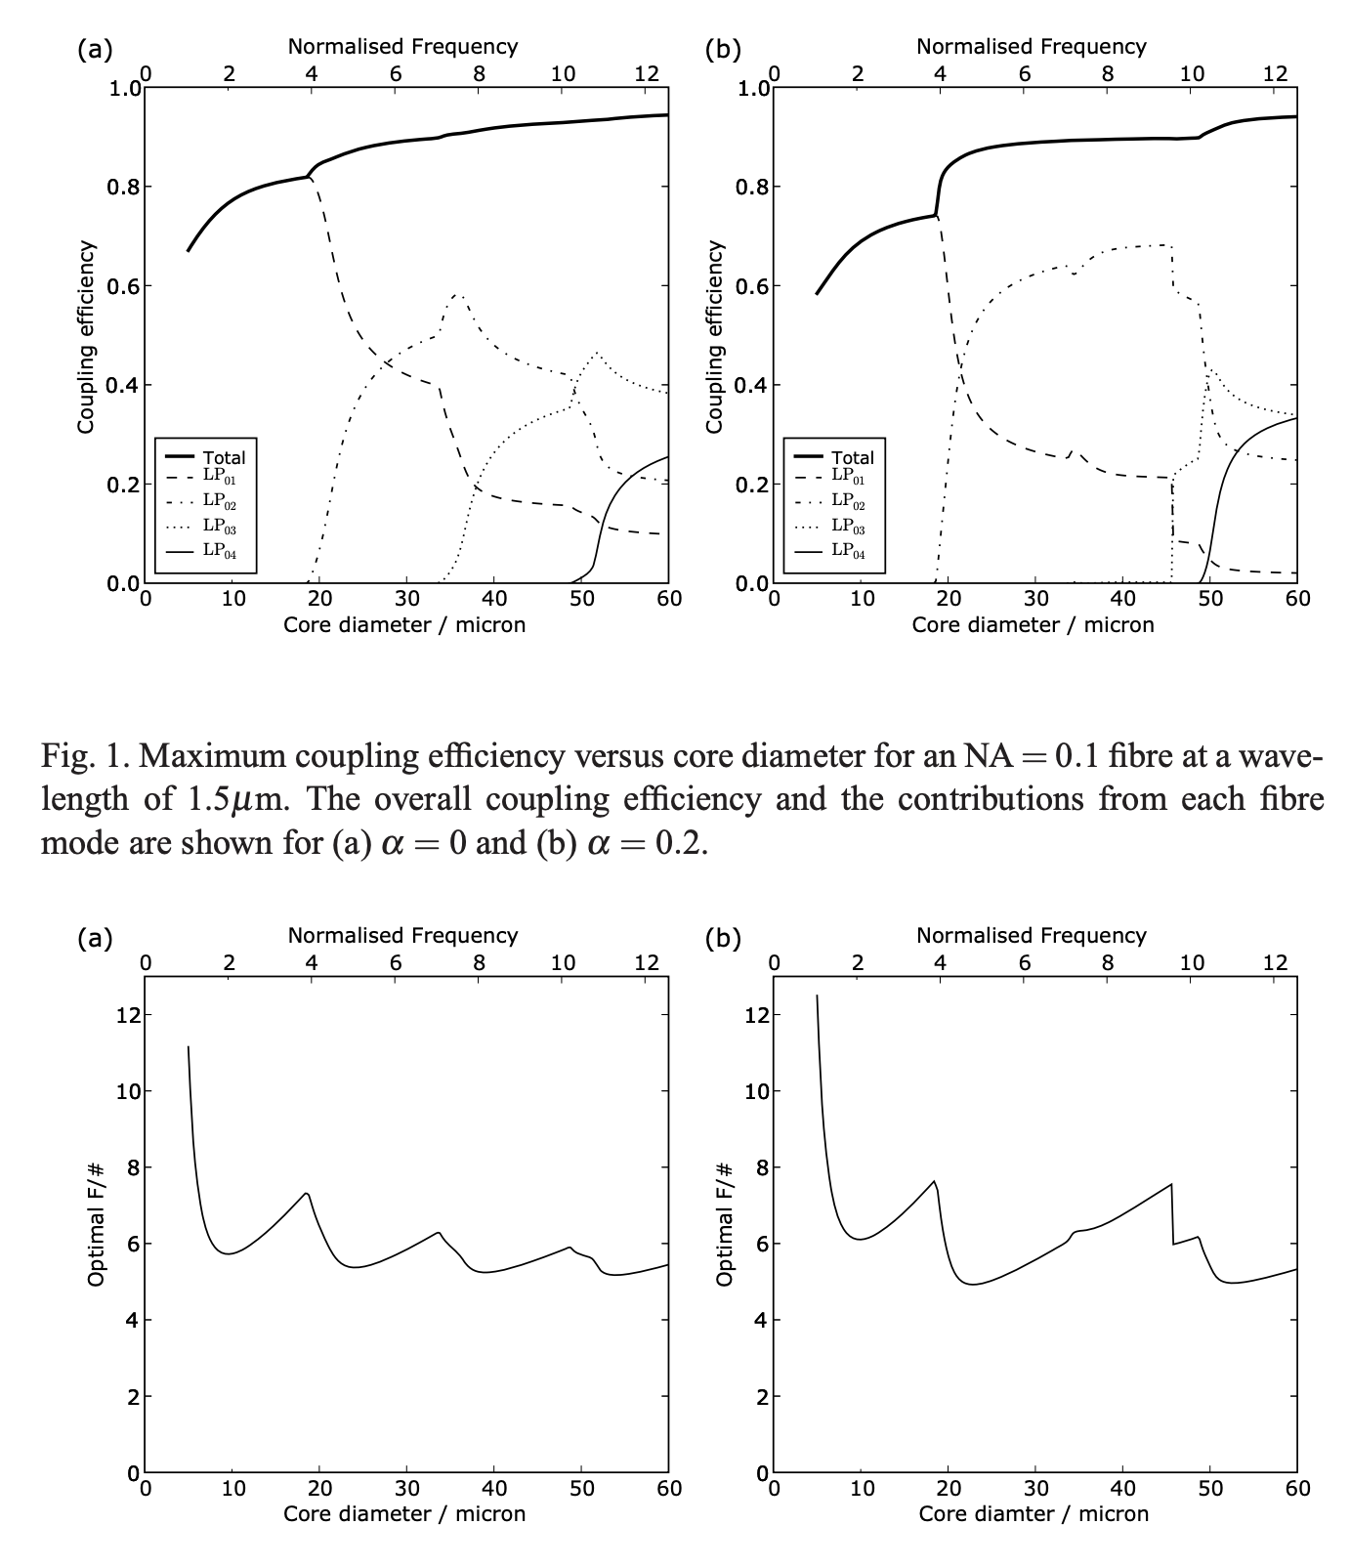
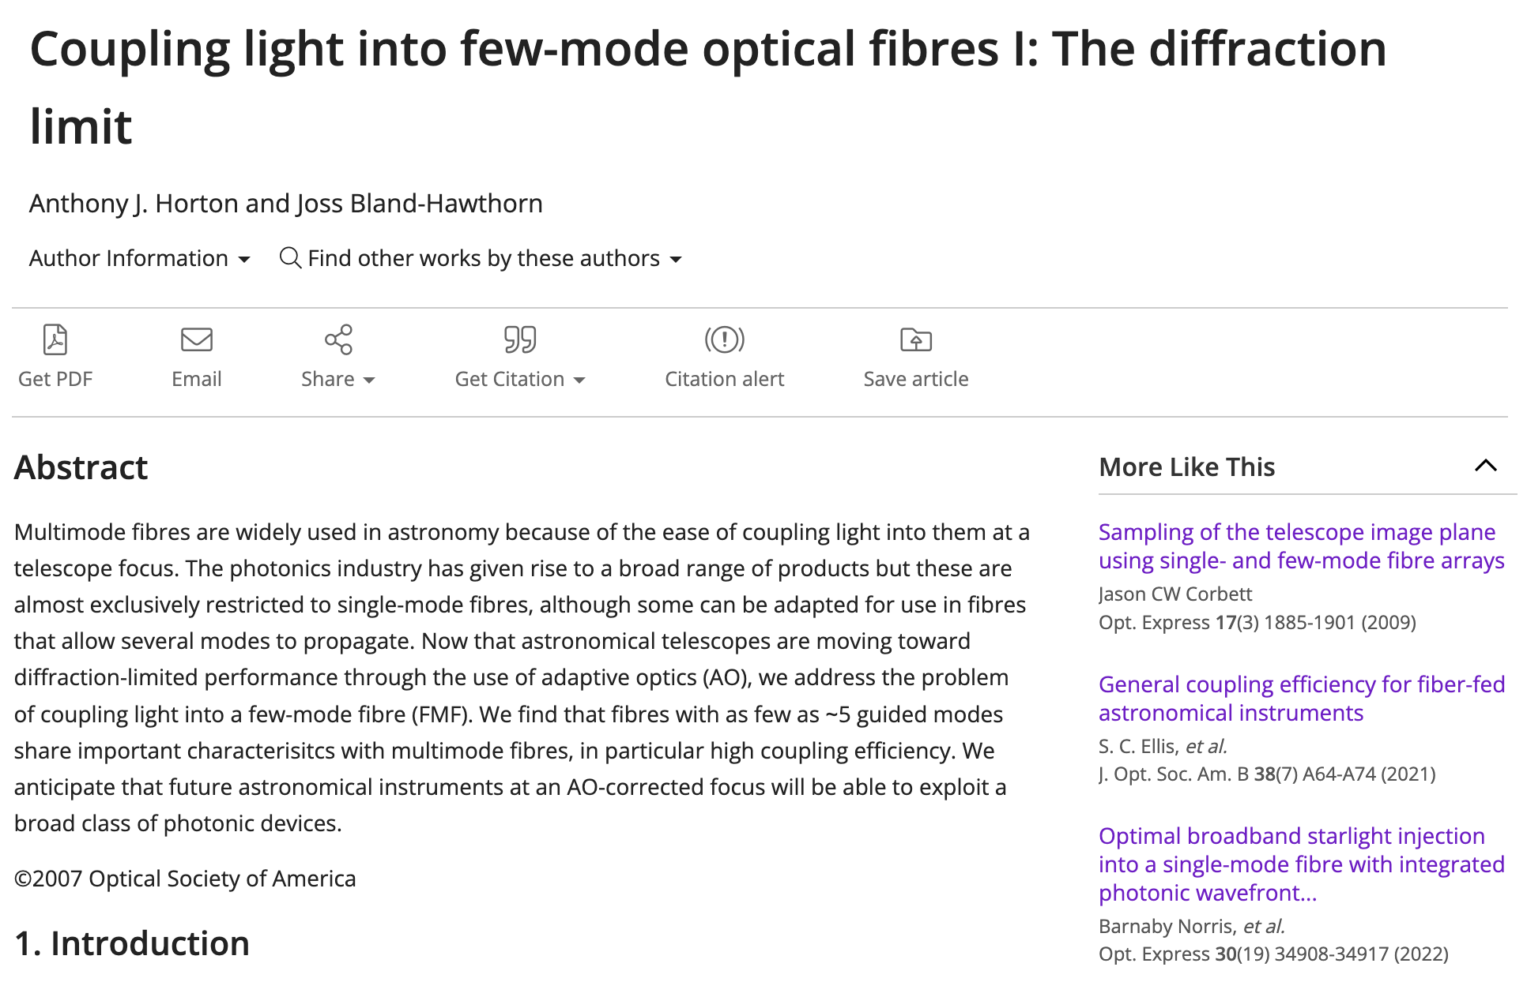
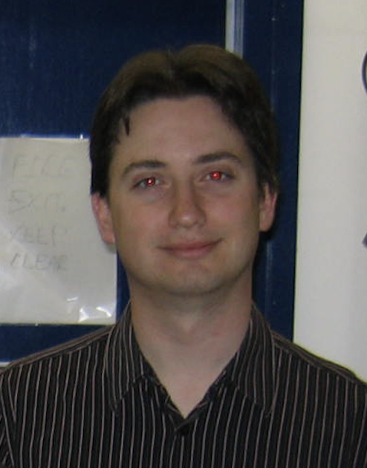
Anthony Horton

Slide 19
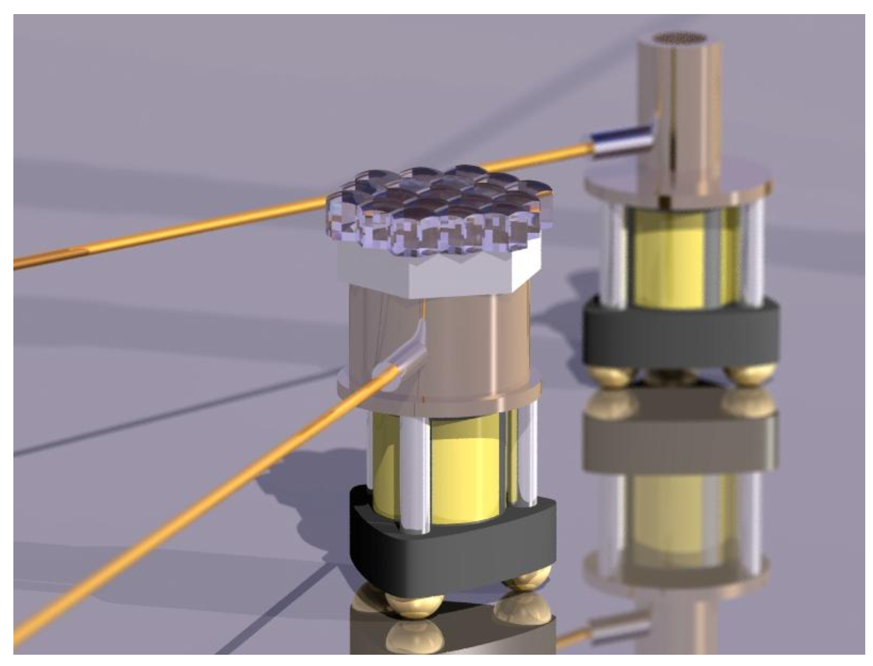
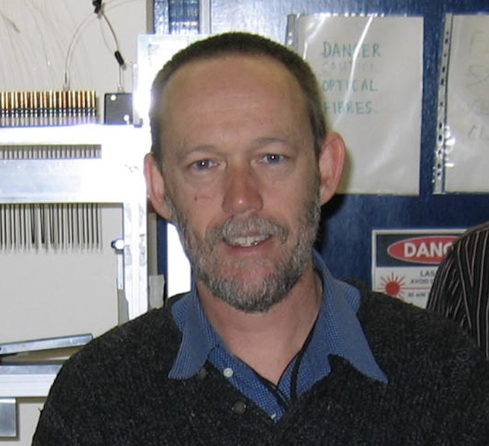
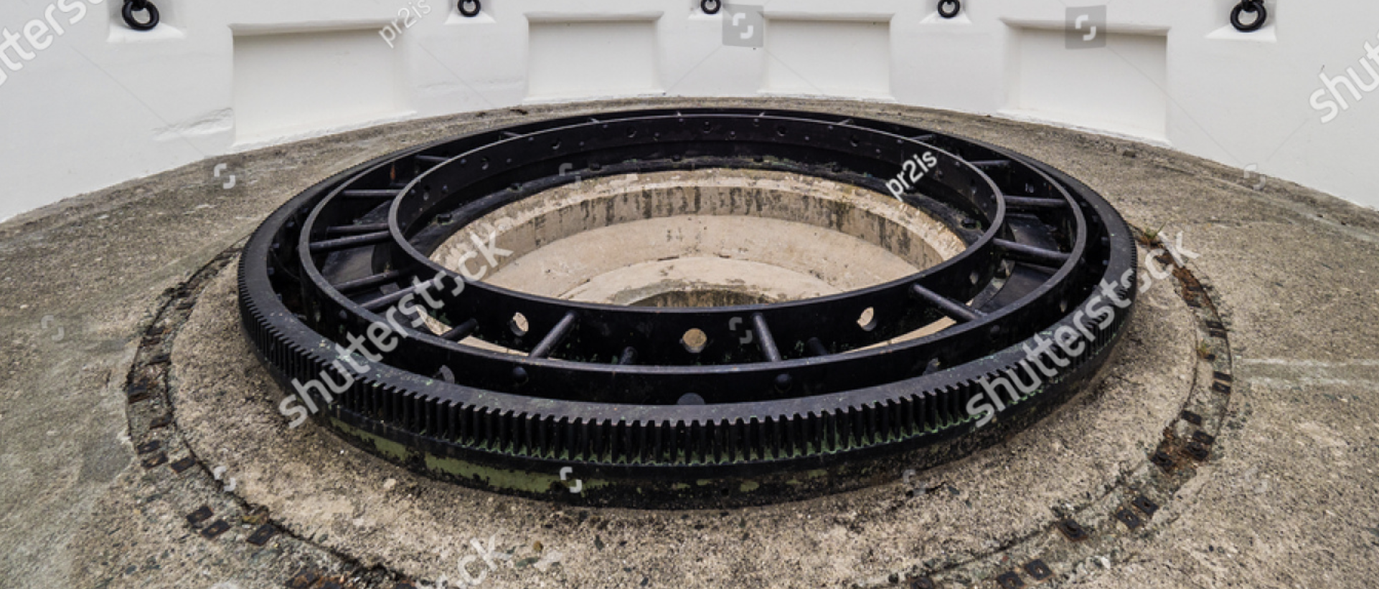
Andrew McGrath
He worked on the first “starbugs” and coined the name. These went through various permutations, with key contributions from the engineering staff before arriving at the MANIFEST concept, now sidelined in favour of a new approach.
Andrew’s awesome demo of a gun turret for AAOmega.

Slide 20
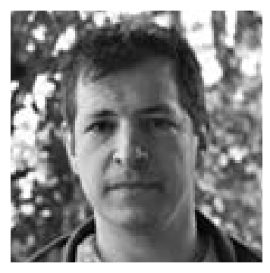
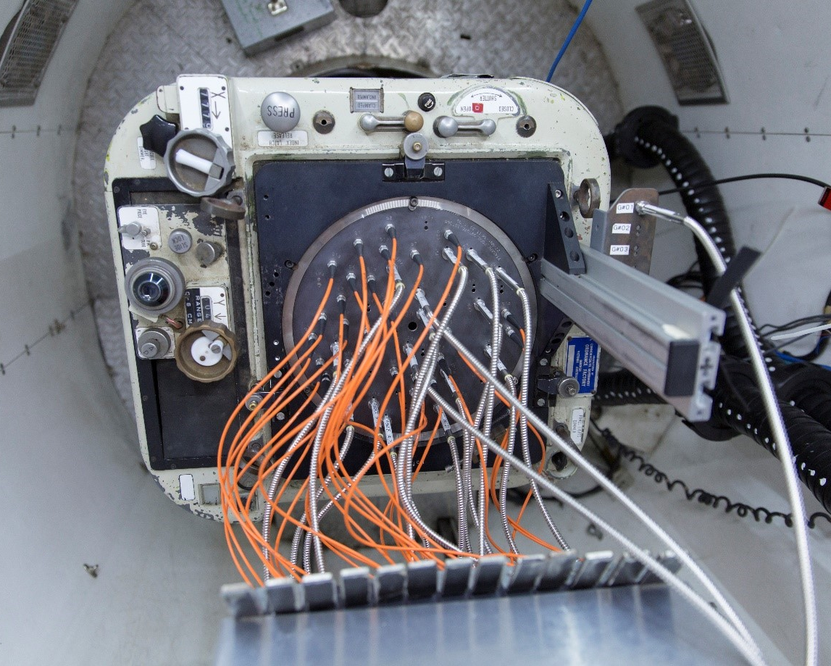
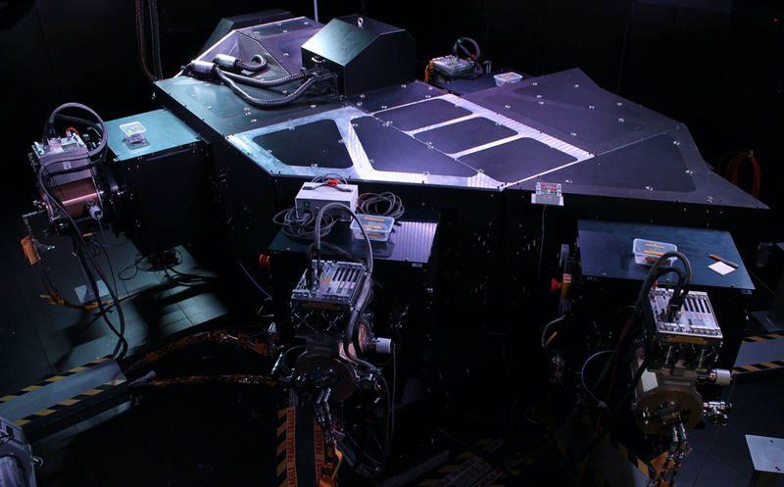
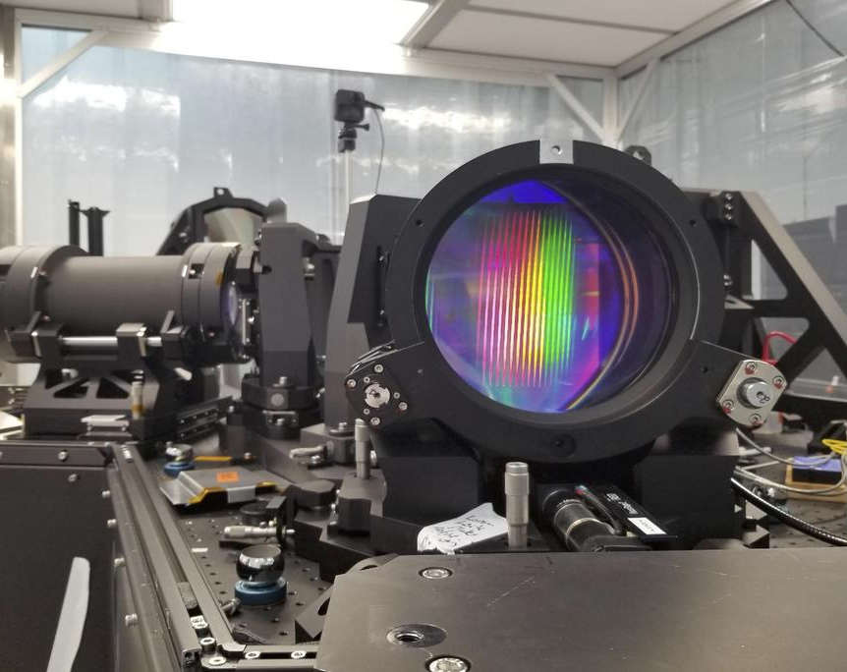
AAO – Completed Instrument Projects
RGO - long-slit moderate resolution optical spectrograph for the AAT – Pre-1981
FOCAP - fibre plug-plate feed for the RGO spectrograph at the AAT - Pre-1981
Auxiliary CCD camera - narrow field of view optical camera for the AAT – Pre-1981
IRIS - near infrared camera/spectrograph for the AAT – Pre-1981
Taurus - a Fabry-Perot tunable filter for the AAT – 1981
FORS - faint object red spectrograph for the AAT – 1984
Autofib - 64 fibre positioner for the RGO spectrograph at the AAT – 1987
LDSS - low dispersion spectrograph for the AAT – 1988
UCLES - high resolution optical Echelle spectrograph for the AAT – 1988
FLAIR-II - multi-object fibre spectrograph and positioner for the UKST - 1992
UHRF - ultra-high resolution optical spectrograph for the AAT – 1993
UNSWIRF - narrow band infrared tunable Fabry-Perot filter – 1996
2df - 2 degree field corrector and 400 fibre positioner for the AAT – 1997
2df spectrograph - two fibre-fed optical spectrographs for the AAT – 1997
SPIRAL-A - a fibre IFU and spectrograph for the AAT – 1997
Taurus II - a Fabry-Perot tunable filter for the AAT – 1997
LDSS++ - a multi-slit optical spectrograph for the AAT – 1998
UKS-TCS - telescope control system upgrade for the UKST – 2000
SPIRAL-B - fibre-IFU and spectrograph for the AAT – 2000
SOAR-IFU - prototype fibre-IFU for the SOAR(link is external) telescope – 2000
Taurus Polarimeter - imaging polarimetry mode for Taurus – 2000
MAPPIT 2 - high resolution interferometer for the AAT – 2000
PFU - prime focus unit for the AAT – 2000
WFI - wide field optical imager for the AAT – 2000
6dF - 150-fibre positioning robot for the UKST – 2001
IRIS2 - near-infrared slit-mask spectrograph and imager for the AAT – 2002
DAZLE - near infrared narrow-band imager for the VLT(link is external) – 2003
OzPoz - fibre positioning robot for the VLT(link is external) – 2003
AAOmega - optical multi-object spectrograph for the AAT – 2006
SPIRAL - upgrade to SPIRAL-B for use with AAOmega at the AAT – 2006
FMOS/Echidna - fibre positioning robot for Subaru(link is external) – 2007
AAT-TCS - telescope control system upgrade for the UKST – 2008
APT camera - wide-field optical camera for the APT – 2008
CYCLOPS - fibre image slicer for UCLES at the AAT – 2010
SAMI prototype - multi-IFU hexabundle fibre feed for the AAT – 2011
CURE - Cassegrain calibration and guide unit at the AAT – 2012
GNOSIS - OH suppression fibre feed for IRIS2 at the AAT – 2012
CYCLOPS2 - fibre image slicer for UCLES at the AAT – 2012
SAMI -multi-IFU hexabundle fibre feed for the AAT – 2013
KOALA - 500 element fibre-IFU for the AAT – 2014
HERMES - moderate resolution optical spectrograph for the AAT – 2014
AAOmega upgrade - new CCDs for the AAOmega instrument at the AAT – 2014
GHOST – High resolution echelle spectrograph for Gemini – 2016
VELOCE — fibre feed for the AAT - 2018 TAIPAN – Starbugs MOS for UKST – 2019
PRAXIS - OH suppression spectrograph for the AAT – 2018
HECTOR – Multi-IFU fibre feed and double-arm spectrograph for AAT – 2022
Huntsman - Telescope Array at Siding Spring Observatory - 2022
DIRAC – Cryogenic IR imager for Eastern Anatolia Observatory, Turkey – 2024
Malya payload for Gilmour Space - 2024

Slide 22
The legacy of the AAO days

