Slide 1
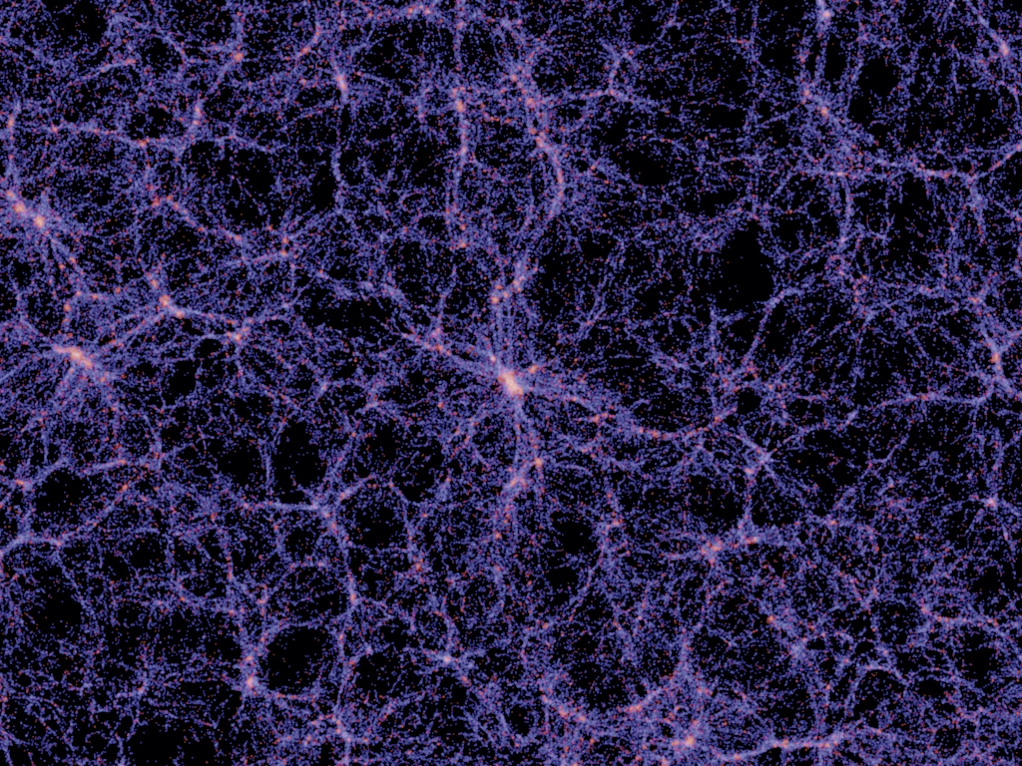
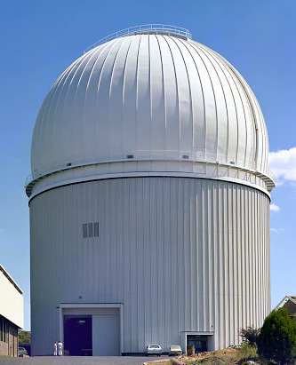

AAT 50th Anniversary Symposium
Clusters of Galaxies: what the AAT has taught us about environmentally-driven galaxy evolution
Warrick Couch
Swinburne University
Millennium Simulation (Springel et al 2005)
Australian Government, Department of Industry, Innovation & Science

Slide 2
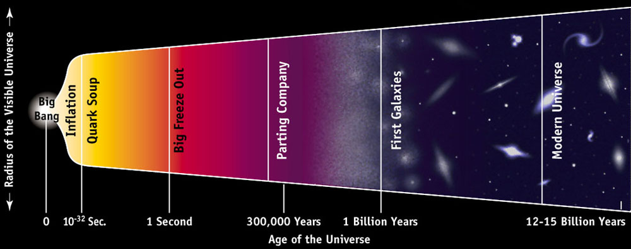
At the most fundamental level, galaxy evolution is a ‘nature vs nurture’ question
Or was it ‘environmental’ processes acting at subsequent times that were most important in determin-ing galaxies’ properties? (NURTURE) ”Phenotype”
Was it the conditions that prevailed at the time of birth that were most influential in determining galaxies’ properties? (NATURE) “Genotype”

Slide 3
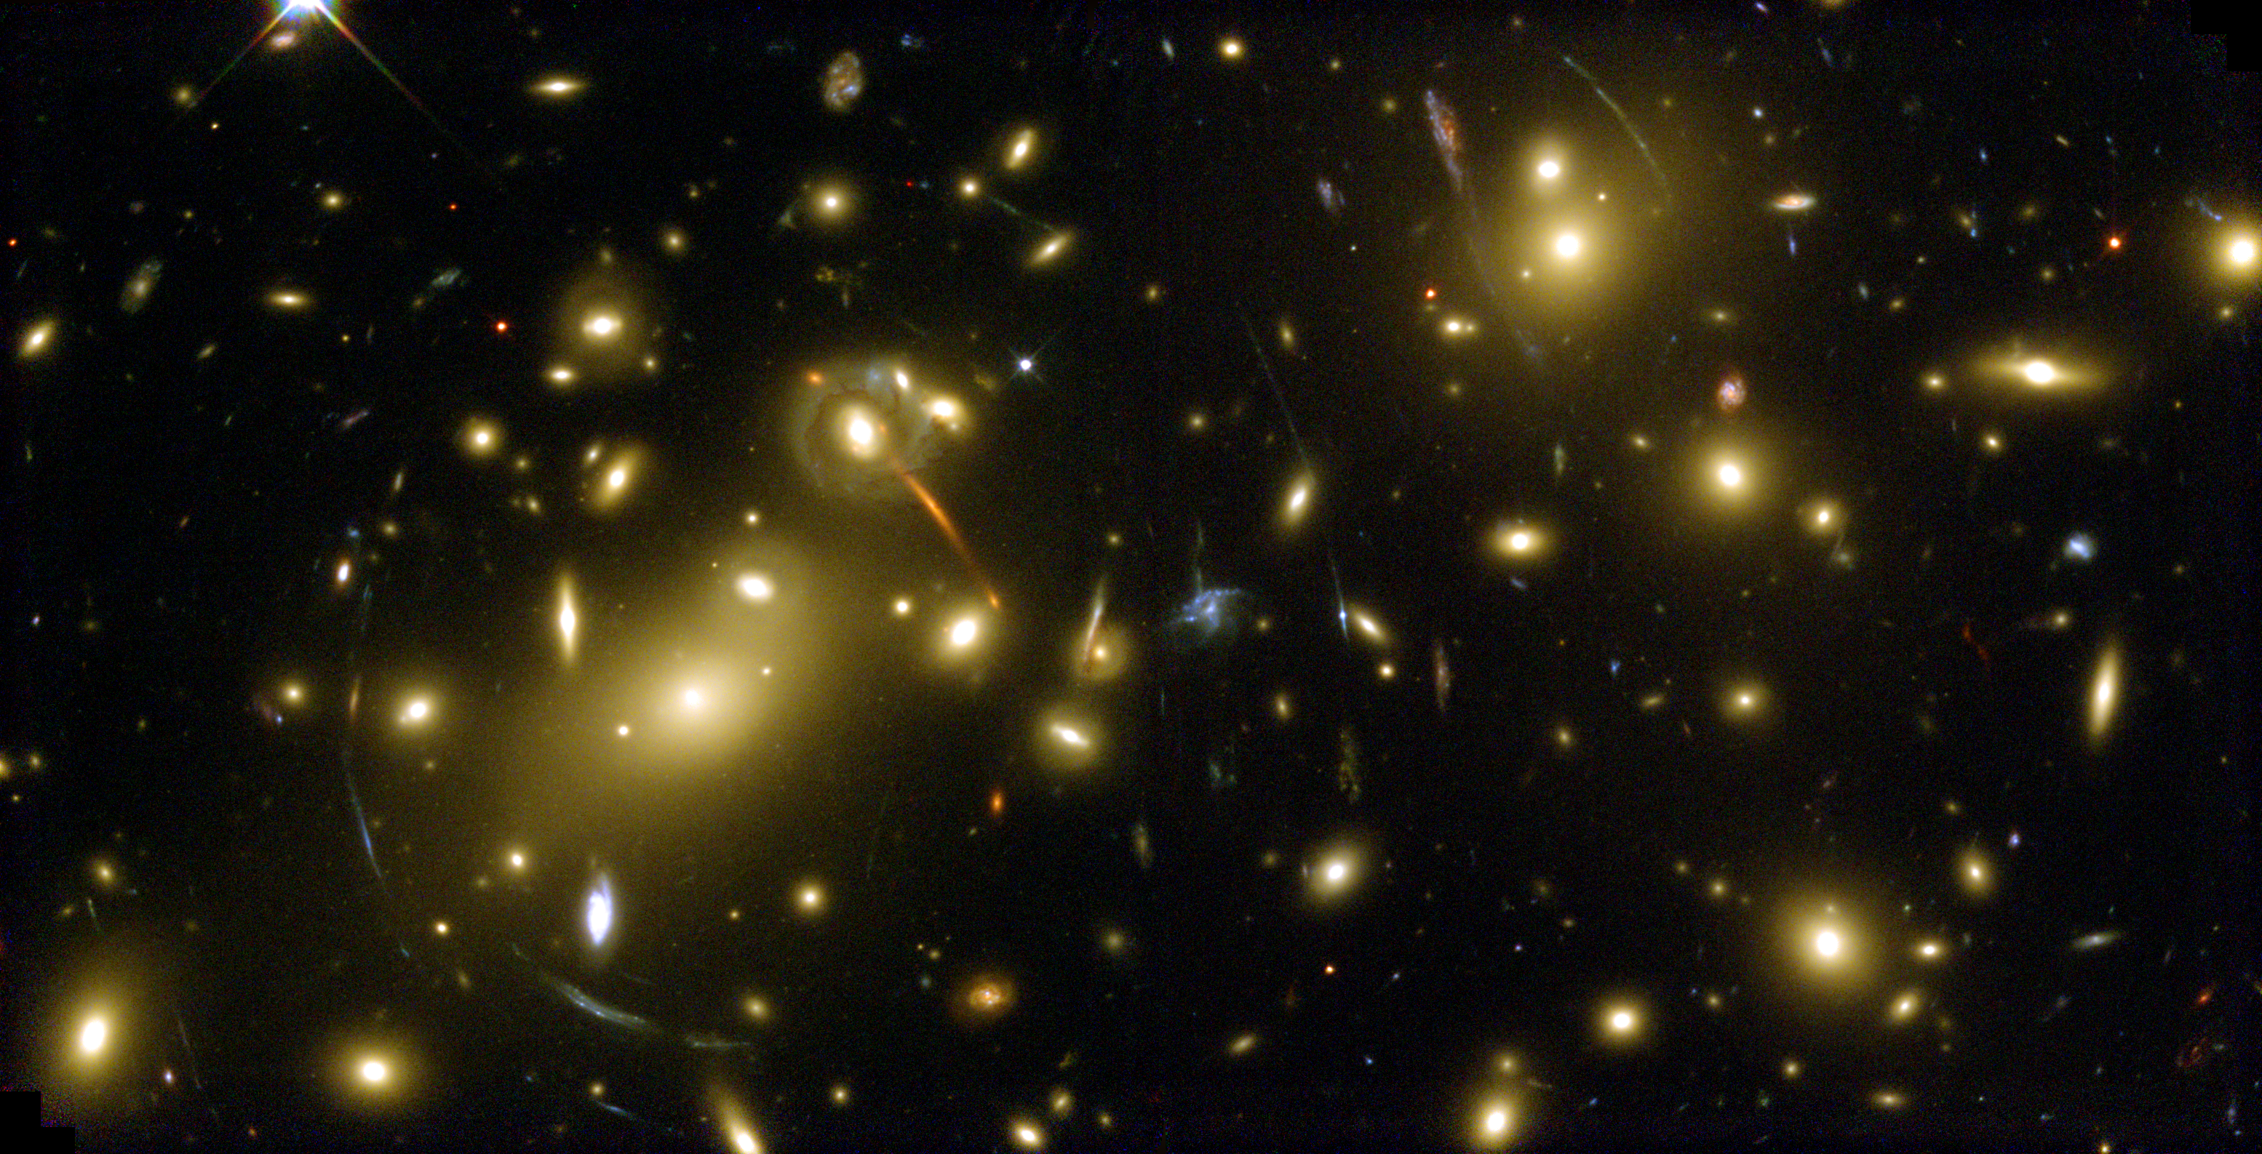
Rich clusters of galaxies: the densest and most extreme galaxy environments – laboratories that provide the best opportunity for seeing ‘nurture’ at work!
HST image of Abell 2218
up to 10³ galaxies per cubic Mpc
galaxies moving at speeds of ~ 10³ km s⁻¹
very deep/steep gravitational potential well
galaxies bathed in hot diffuse 10⁷-10⁸ K gas

Slide 4
Mid-to-late 70’s: a time of great scientific opportunity in this field:
A new era in Anglo-Australian optical/infrared astronomy with the inauguration of the 3.9m Anglo-Australian Telescope
A new era in cluster galaxy research with the first evidence of significant evolution in their populations published by Butcher & Oemler (1978)
Yours truly had just commenced PhD studies at MSSSO, ANU.

Slide 5
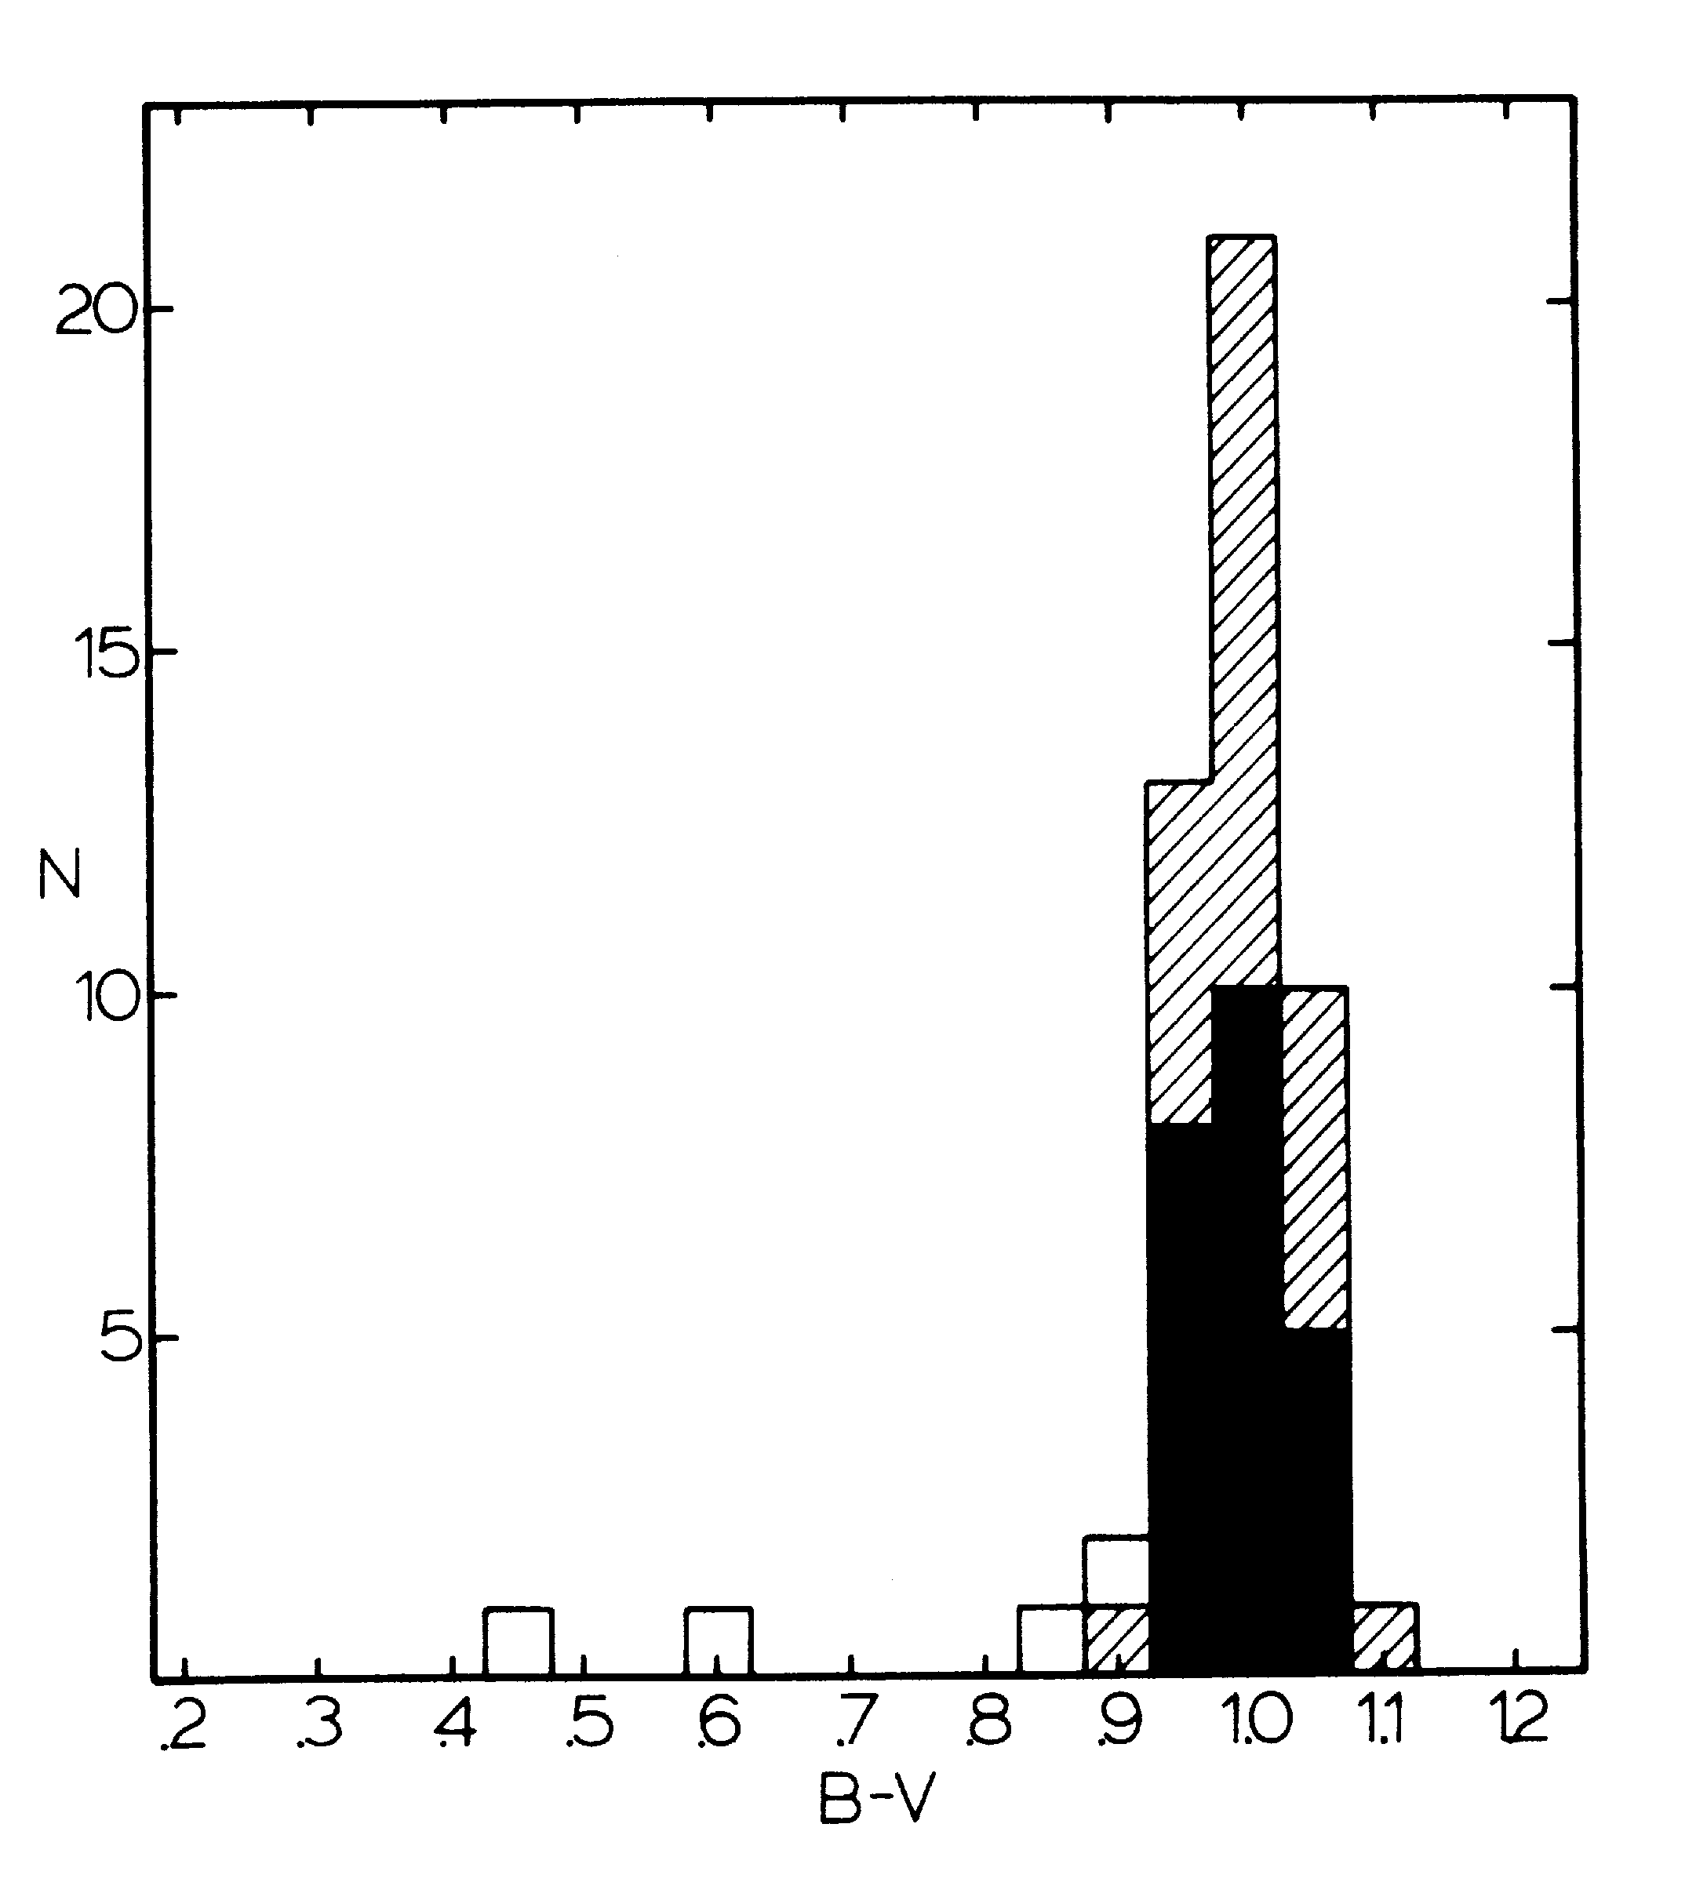
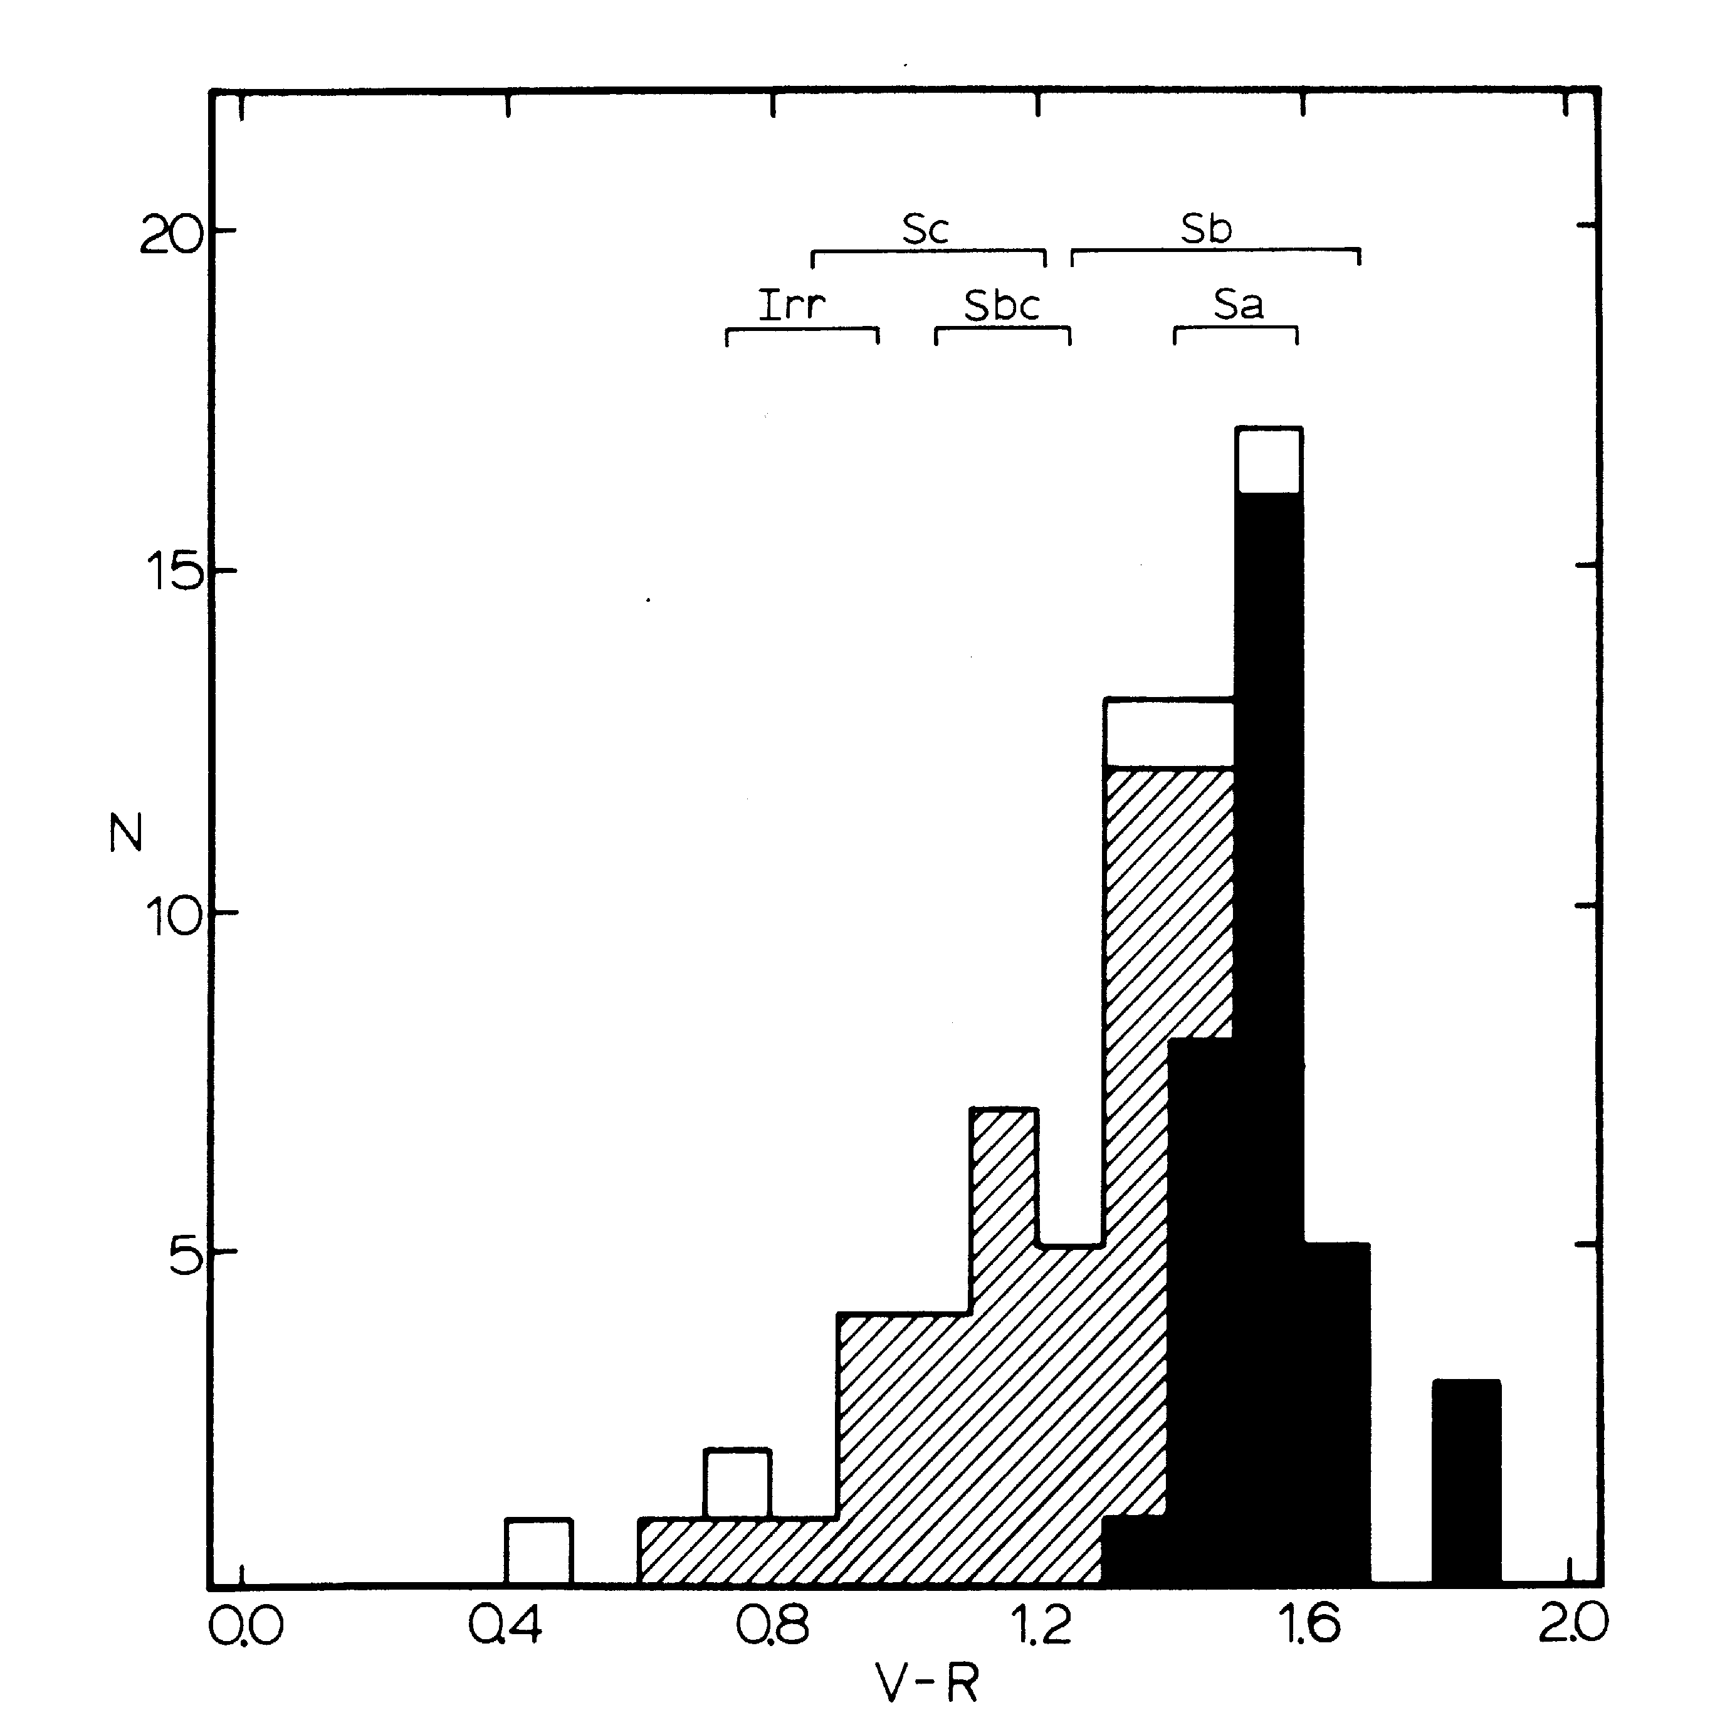
Butcher & Oemler’s (1978) discovery of significant evolution in the cores of 2 clusters at z~0.4
z ~ 0
z ~ 0.4
Significant population of BLUE galaxies
This so-called “Butcher-Oemler” effect was a controversial result!!

Slide 6
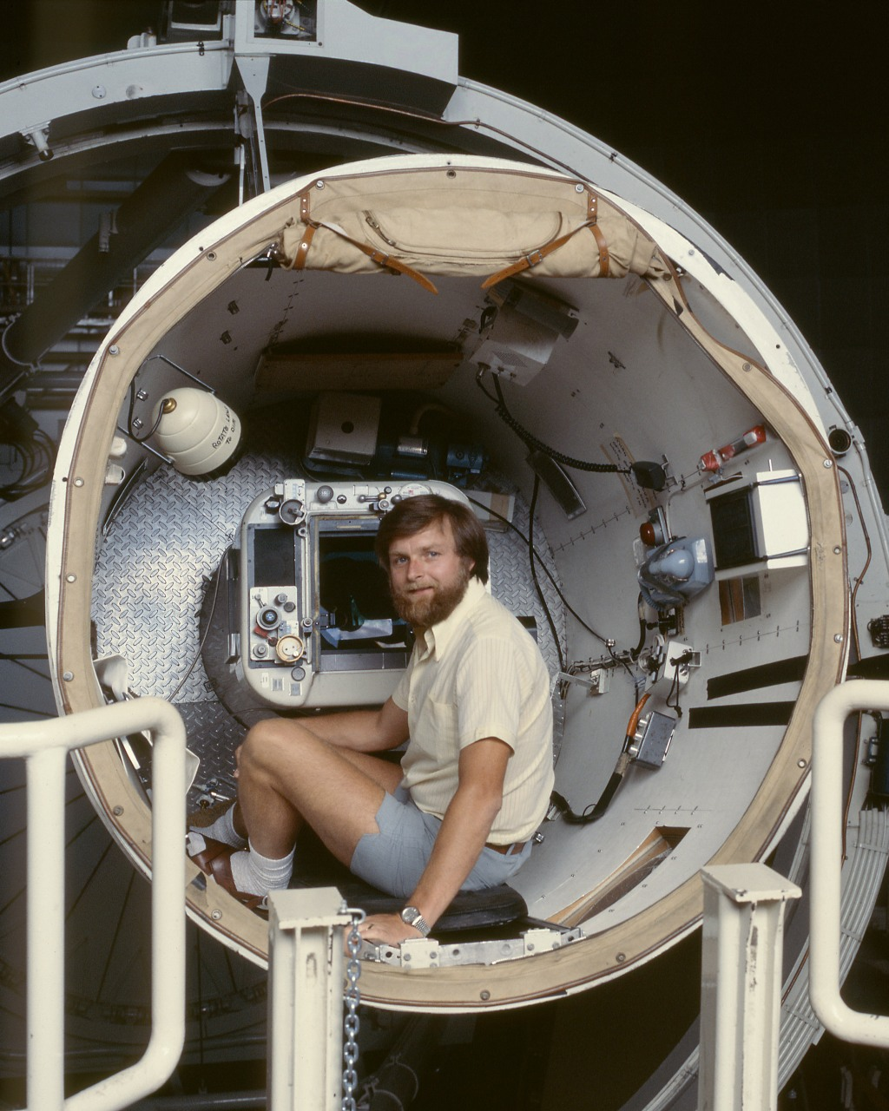
The Malin-led revolution in uniform, deep, quantitative astro-photography
Pioneered the development of techniques to hypersensitize photograph plates and ensure uniformity in their depth and quality that enabled quantitative photographic photometry to very faint limits at the prime focus of the AAT.
Made a systematic photometric study of the galaxy populations in distant clusters viable.

Slide 7
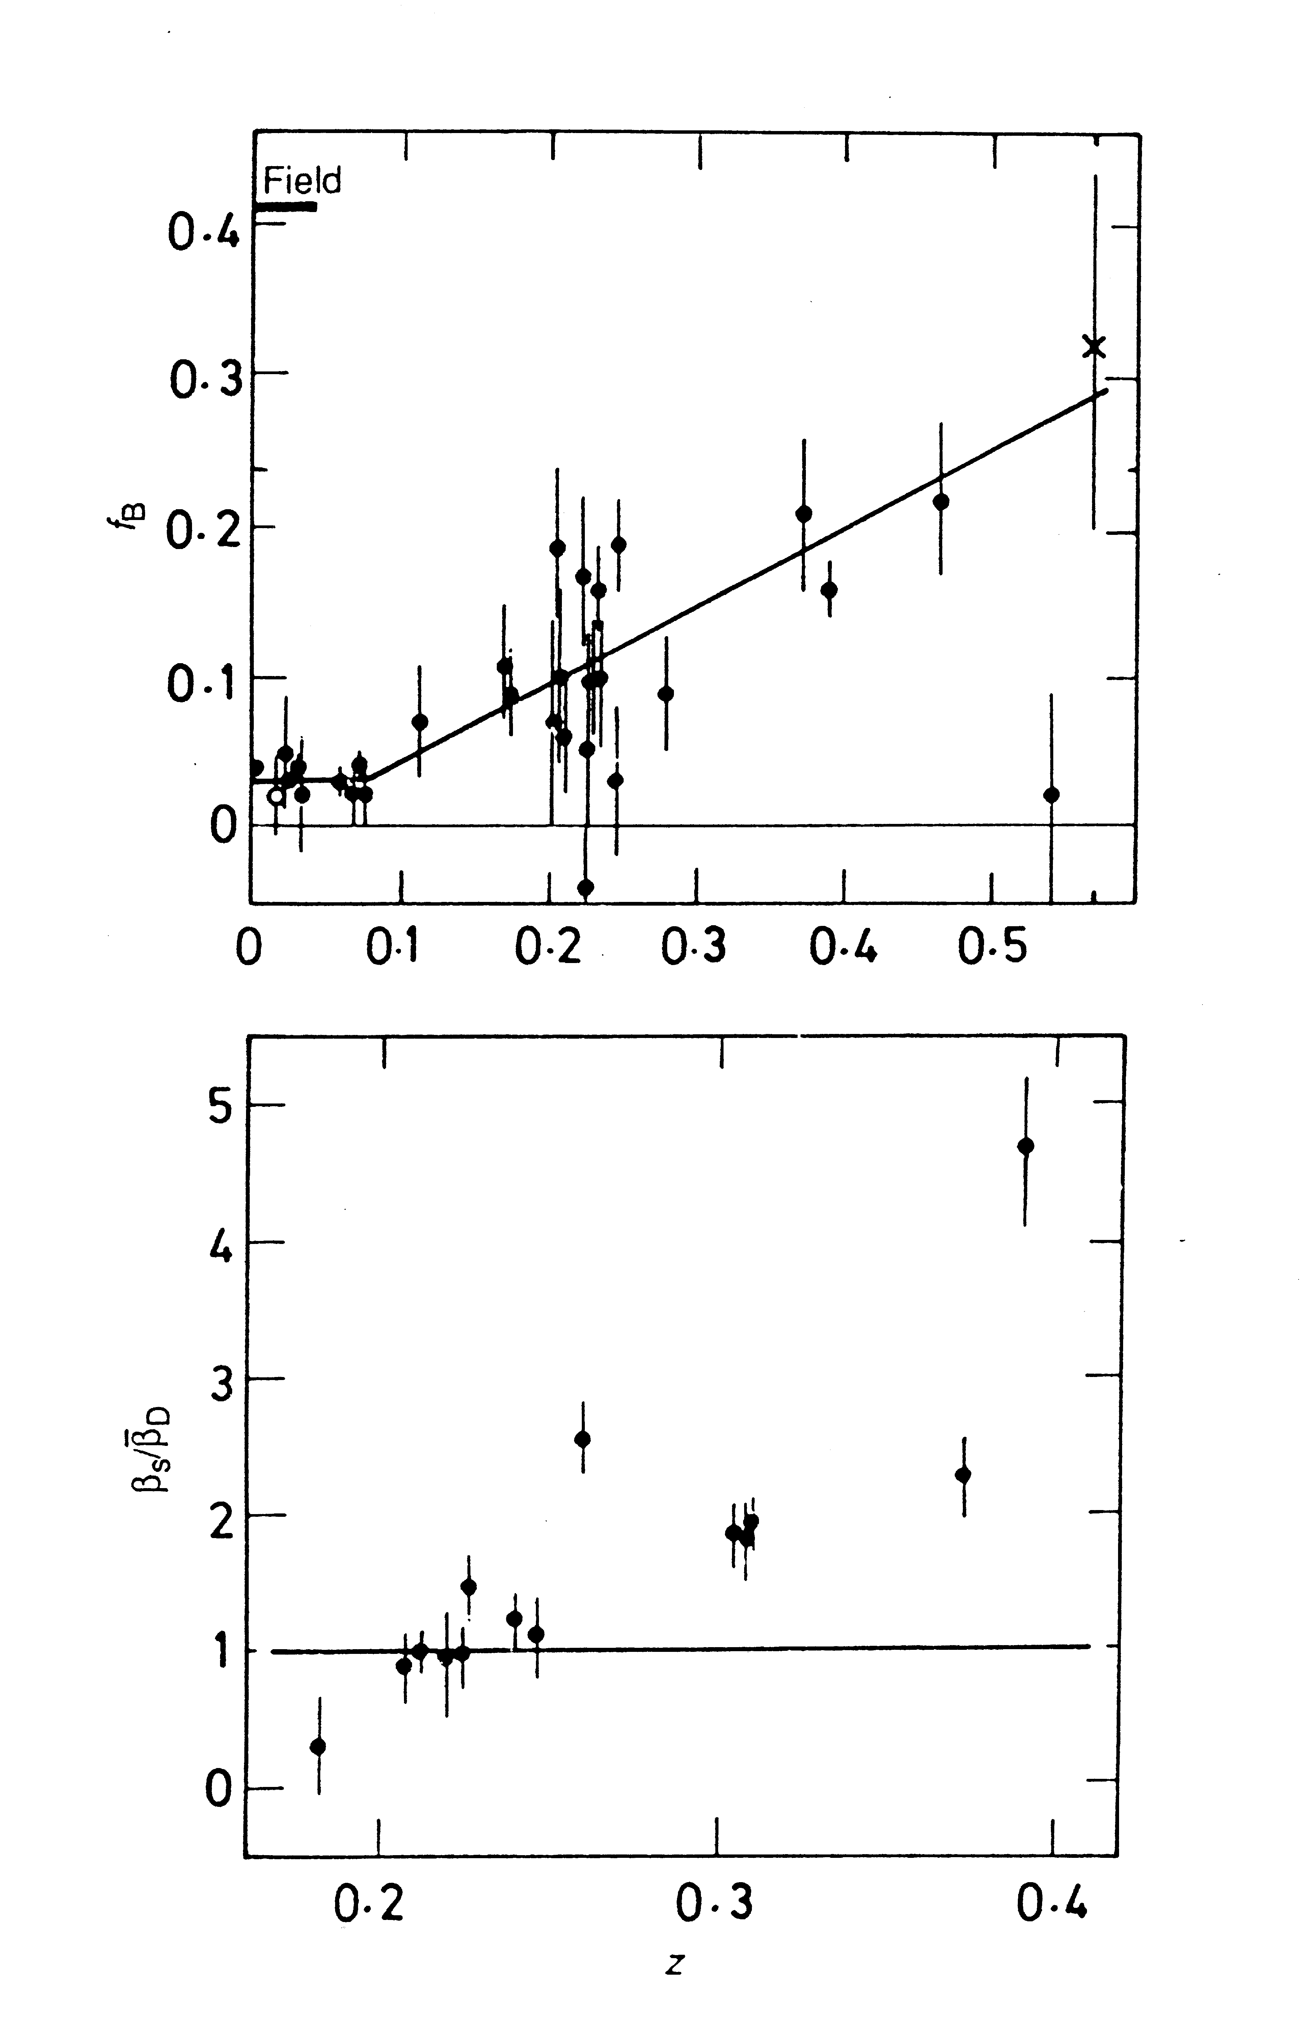
Couch & Newell (1982)
Confirmed the cores of rich clusters harboured significant populations of BLUE galaxies in their recent past (z > 0.2).
fraction of blue galaxies
Butcher & Oemler (1984)
Couch & Newell (1982) study:
14 southern rich clusters from Abell, Corwin, Olowin (1989) catalog at 0.18< z < 0.39
AAT prime-focus J,F photography, supplemented by CTIO 4m

Slide 8
AAT Distant Cluster Survey
(1985-1990)
Rationale:
Major cluster catalogues at the time (e.g. Abell) compiled from surveys of Schmidt plates – complete to only z ~ 0.2
A wealth of deep high quality AAT prime focus plates available in AAO archive
Malin’s “high contrast” film copies ➔ visually survey plates reliably & efficiently near and down to their faint limits (b_{J} ~ 24.5, r_{F} ~ 23.0)
A significantly deeper cluster catalogue over tens of square degrees of sky!

Slide 9
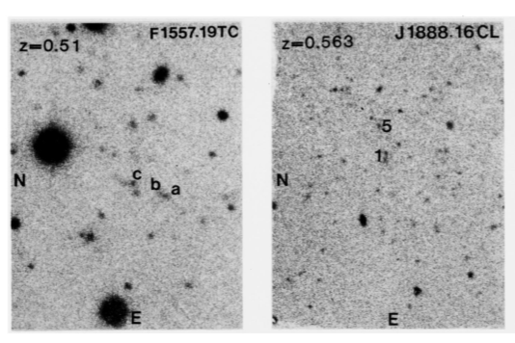
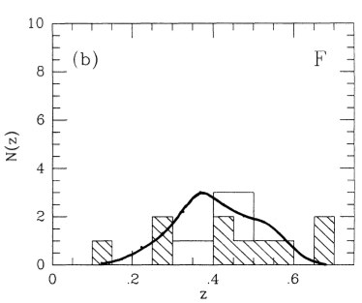
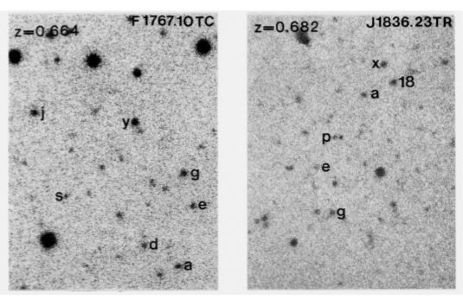
High contrast film copies of 55 AAT prime focus J and/or F plates surveyed:
Produced 112 candidate clusters with a `contrast’ factor > 2
Provided targets for the Danish-AAO Distant Cluster SNIa Survey
Spectroscopically confirmed
Couch, Ellis, Malin (1991)

Slide 10
Butcher & Oemler (1984)
Confirmed the cores of rich clusters harboured significant populations of BLUE galaxies in their recent past (z > 0.2).
fraction of blue galaxies
Couch & Newell (1982)
Q: what are the BLUE galaxies (normal star-forming spirals?) and what causes their demise?

Slide 11
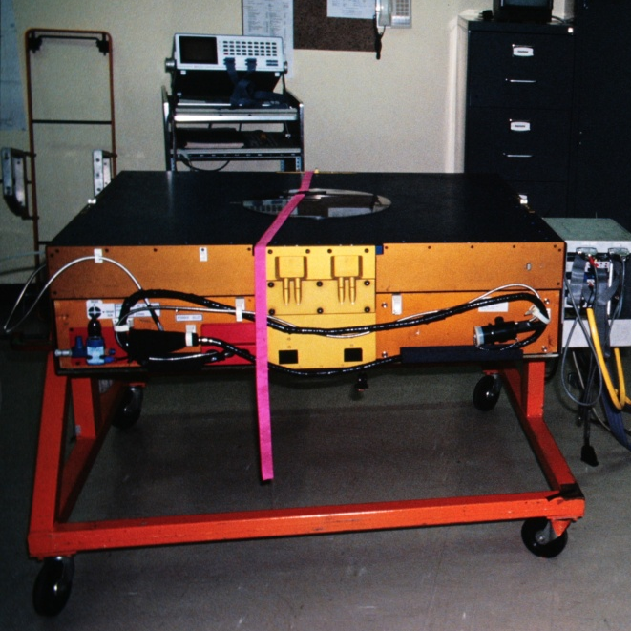
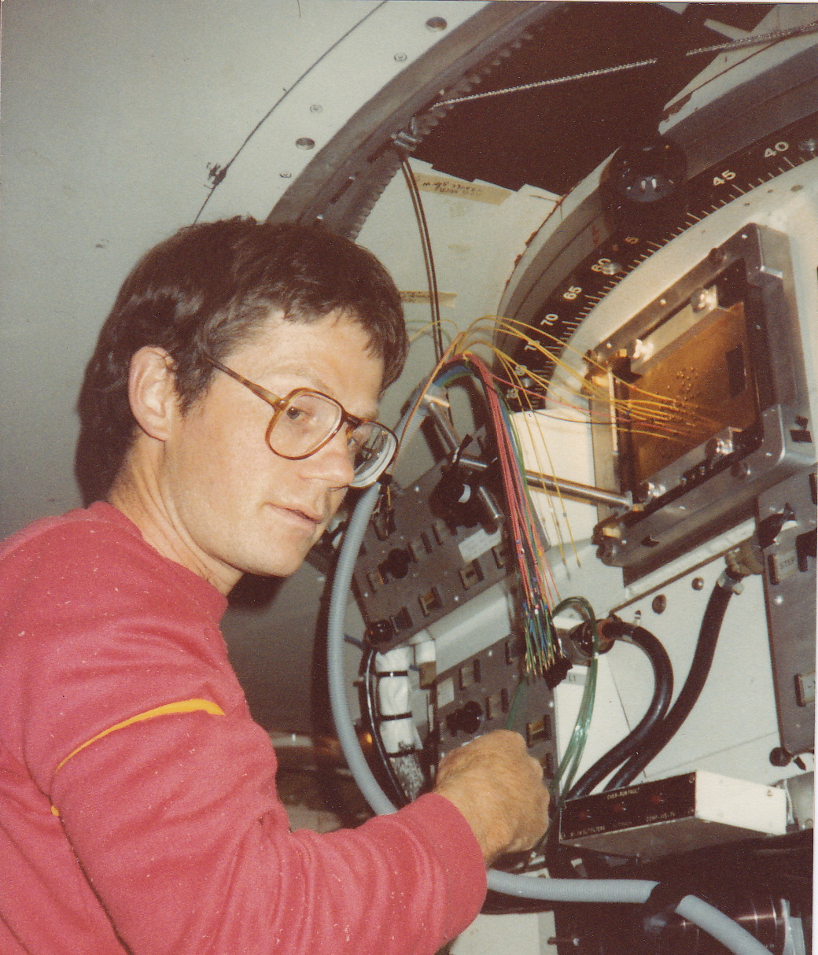
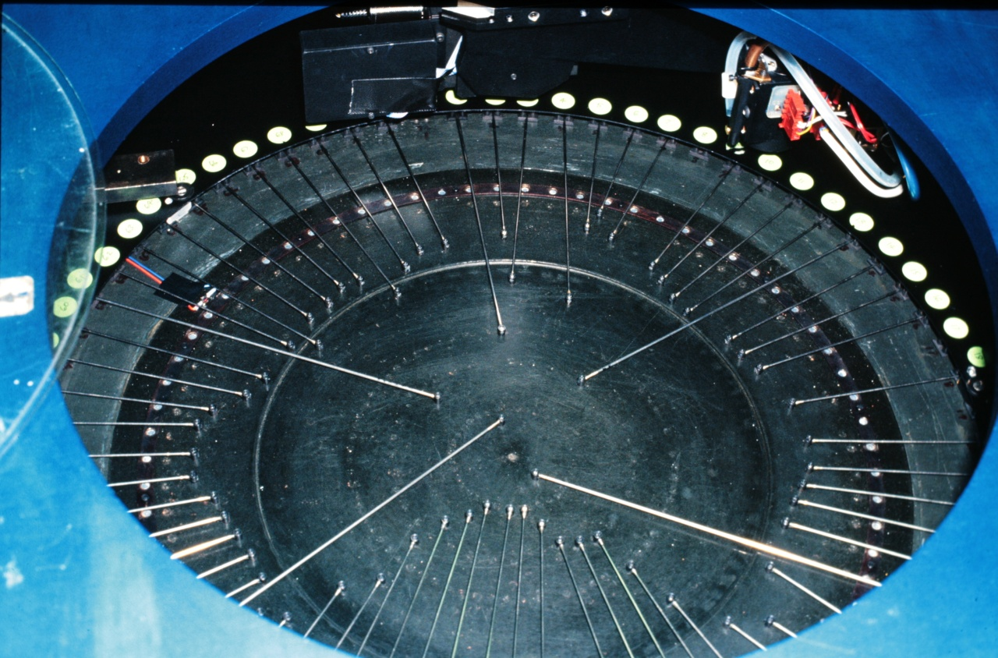
Peter Gray
Early 80’s – advent of fibre-based MOS at AAT

Slide 12
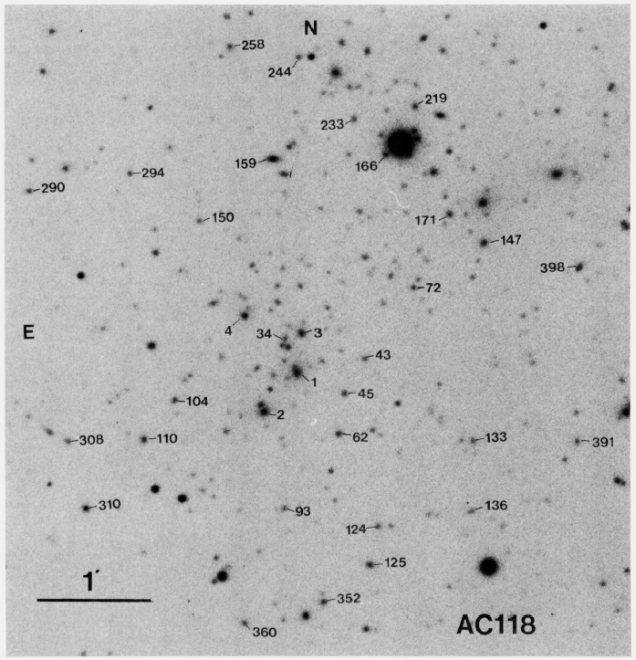
MOS Spectroscopy: FOCAP+RGOspec + IPCS used to deliver intermediate (4A) resolution spectroscopy of ~50 galaxies per cluster to R=20 in 8-9 hours
Sharples, Ellis, Couch, Gray (1985)
Couch & Sharples (1987)
All competition at time from multi-slit imaging/spectrographs on 5m Hale (PFUEI), CFHT (PUMA, HGS), ESO 3.6m (EFOSC), but with much lower resolution (>10A)
(z=0.3)

Slide 13
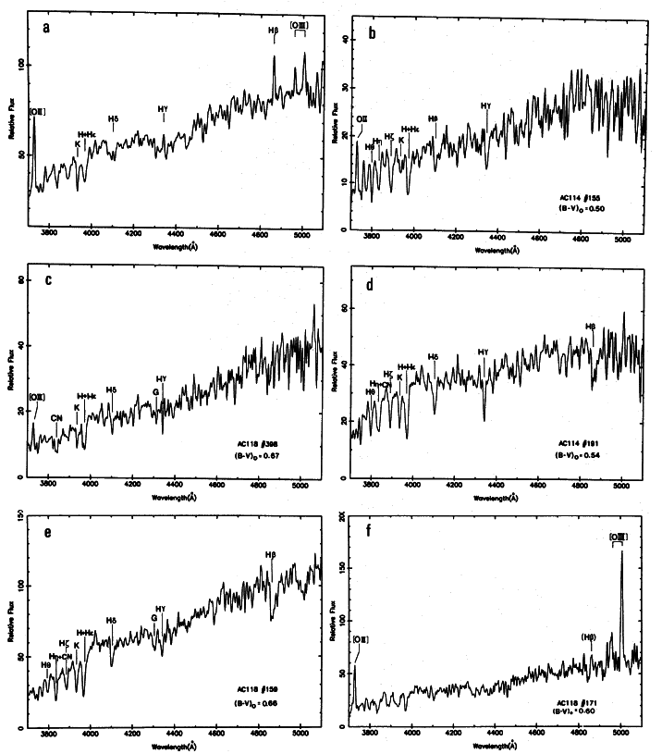
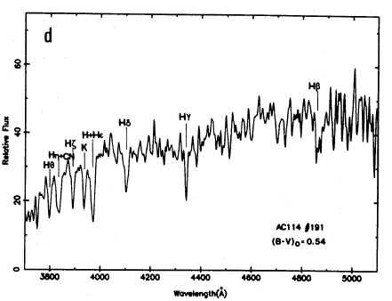
Nature of the ‘blue’ galaxies:
‘spiral’-like with [OII]3727 + mod Balmer abs
The enigmatic “poststarburst” or “E+A” galaxies
(small in number!)
‘starburst’-like with strong [OII]3727 + em-filled Balmer abs lines
(small)
curious popln of no emission + very strong Balmer abs line galaxies
(many)

Slide 14
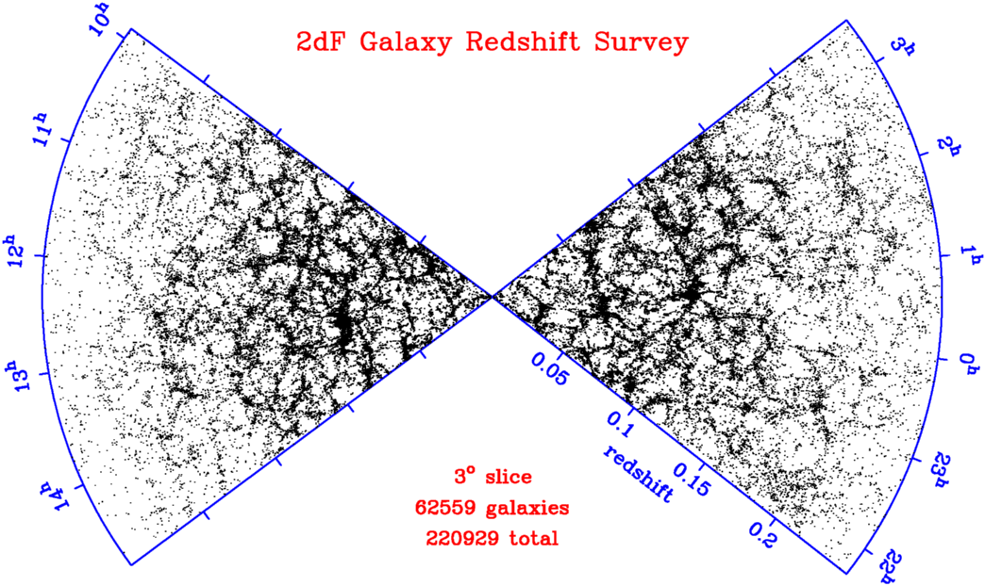
Going beyond the cluster core…the cluster ‘sphere of influence’

Slide 15
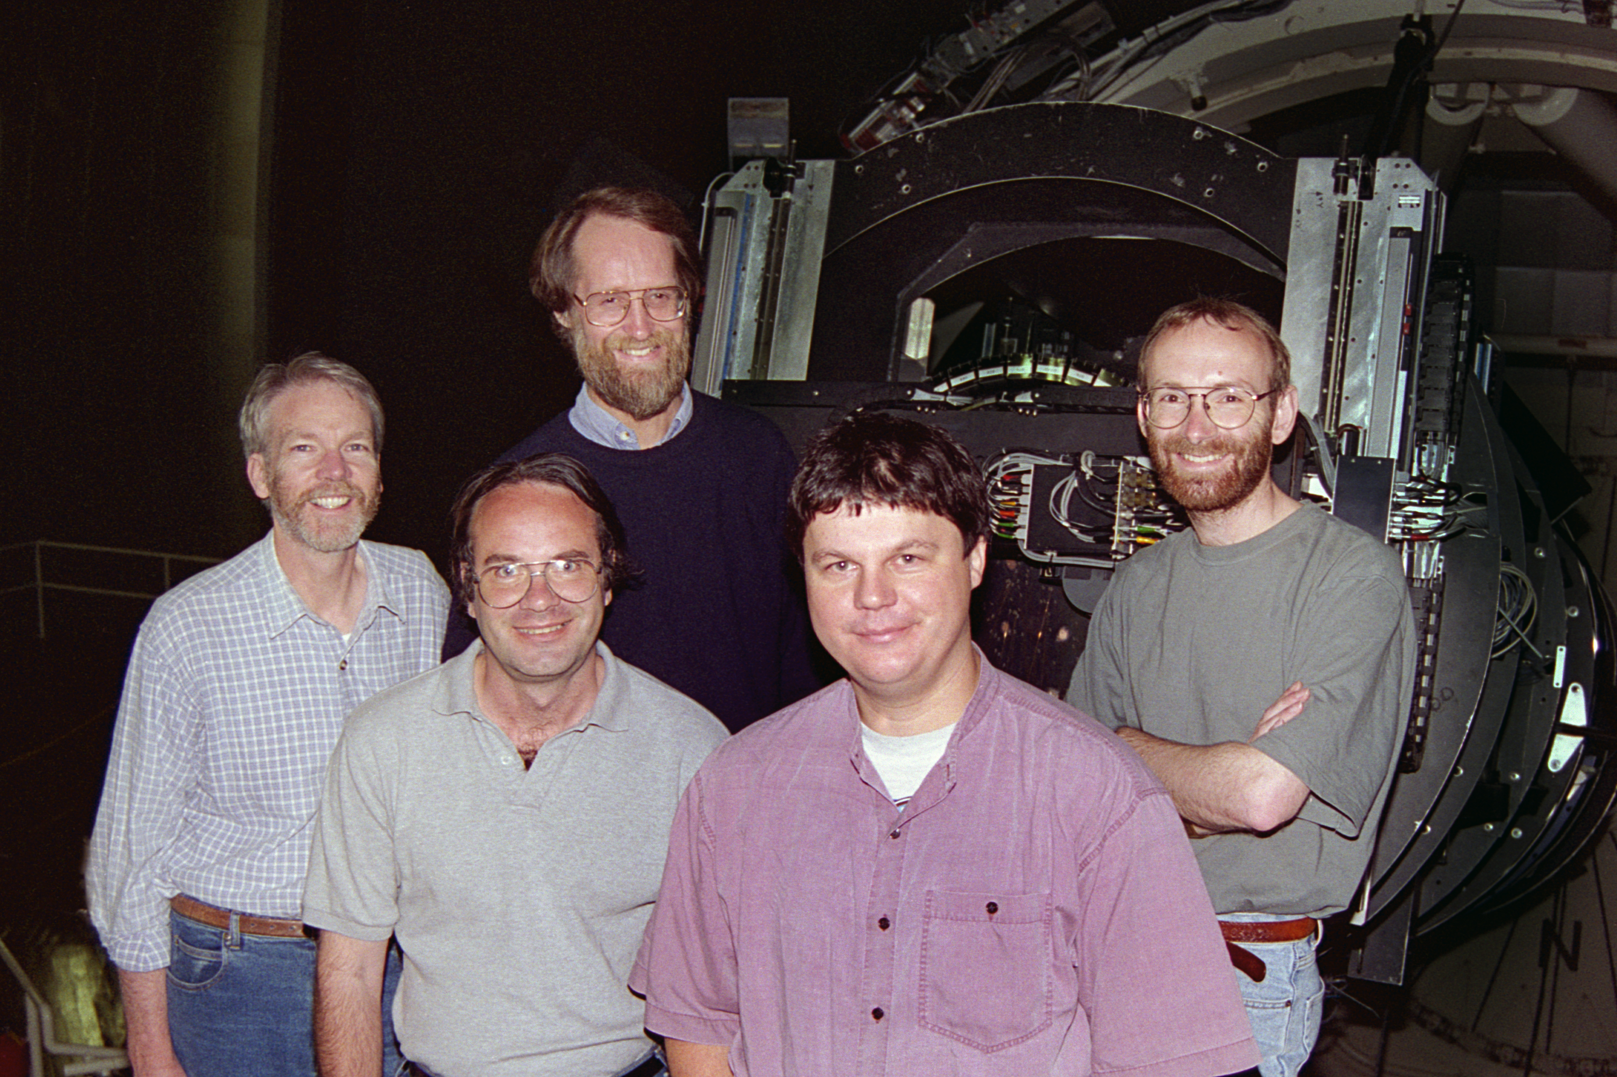
The 2dF Dream Team

Slide 16
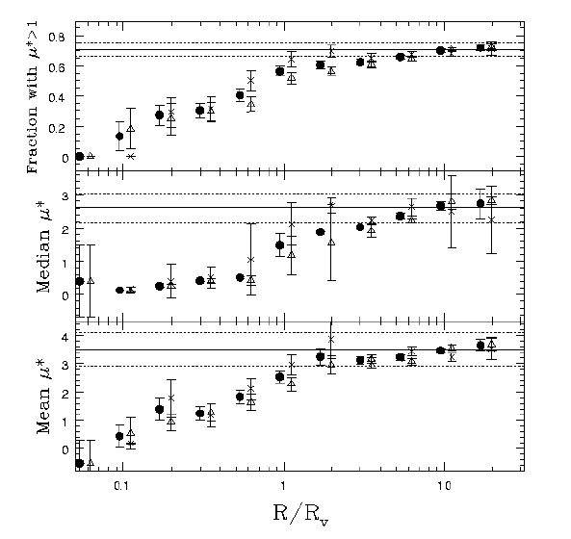
SFR versus environment (2dFGRS, Lewis et al)
Field
Normalised star formation rate (μ*) as a function of cluster-centric radius
Field
Field
SFR is below that of the field all the way out to ~3R_{vir}
The cluster ‘sphere of influence’ extends to ~3R_{vir}!

Slide 17
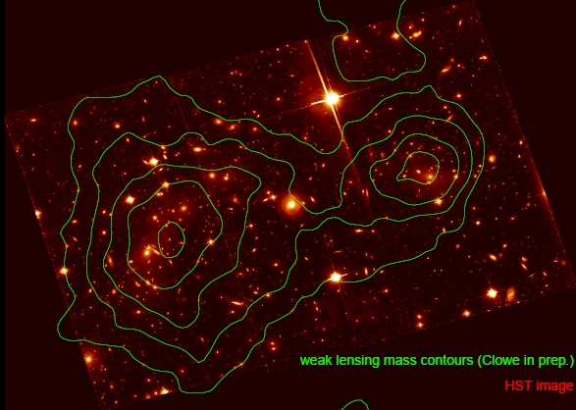
Dynamical growth of clusters as a driver of galaxy evolution
Galaxy clusters represent the pinnacle of the hierachy of collapsed structure in the Universe, whose assembly is punctuated by occasional cluster-cluster mergers. These involve up to 10⁵⁷ J of energy ➔ one of the most energetic events in the Universe!!
Q: How do we recognize such an event post facto?
Q: Is it another driver of galaxy evolution?

Slide 18
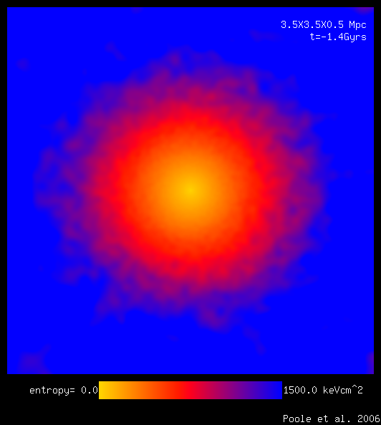
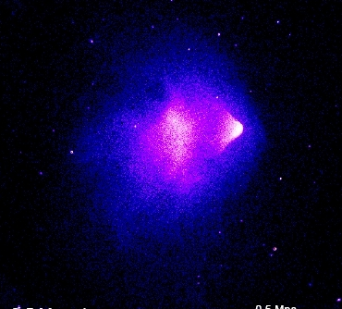
Colliding Clusters – X-ray ‘Cold Fronts’
Biggest ‘splash’ seen in the hot X-ray emitting intra-cluster gas
Chandra X-ray satellite has the resolution and sensitivity to reveal the ‘smoking gun’ signature of a recent major merger: X-ray COLD FRONTS
Galaxy populations of 10 nearby ‘cold front’ clusters studied to explore the galaxy evolution-dynamical growth connection [Owers et al 2009]
X-ray surface brightness
X-ray temperature

Slide 19
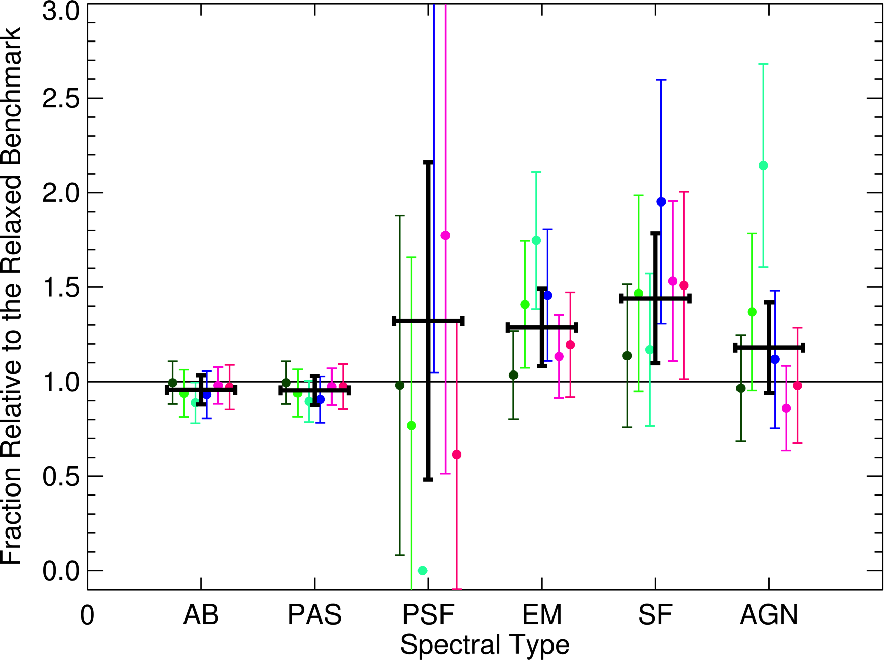
Cluster merging as a driver of galaxy evolution
Some enhancement in star formation activity in merging cluster galaxies

Slide 20

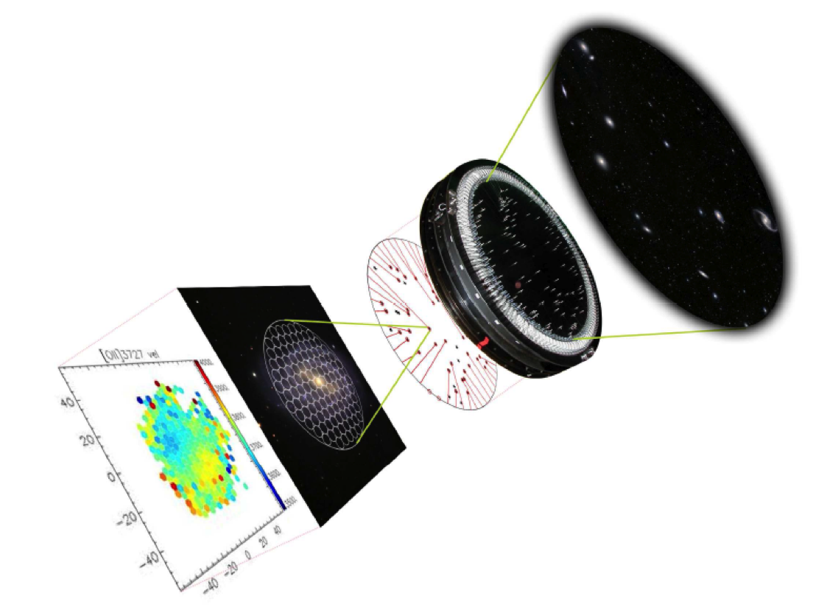


The Sydney-AAO Multi-object Integral field spectrograph
The art of galaxy dissection

Slide 21
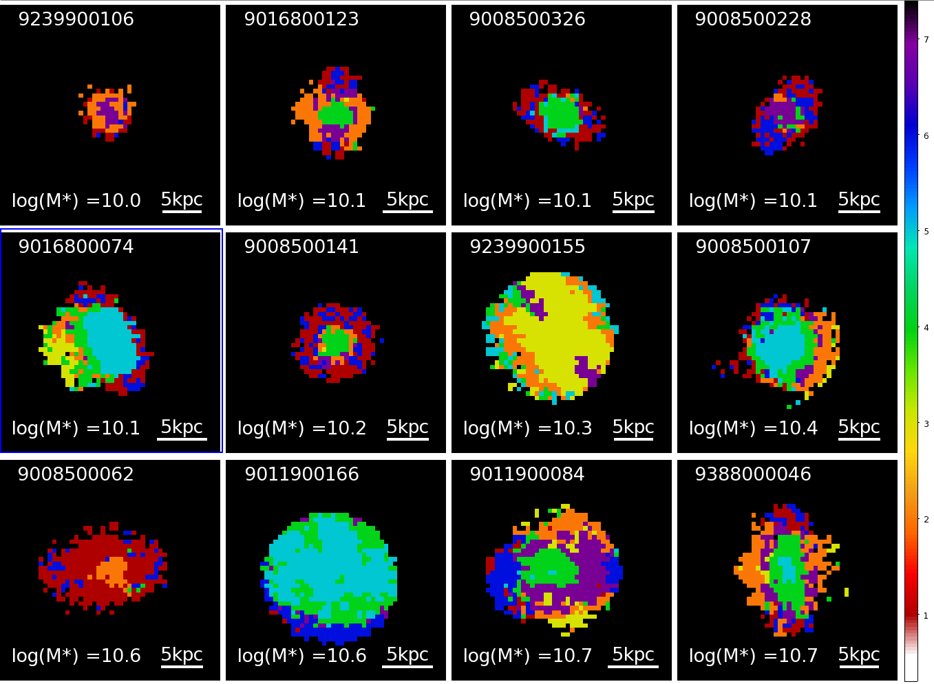
Clusters: 11% of non-passive galaxies have >10% “E+A” signature spaxels.
NSF_HDS
HDS (E+A)
SF
COMP
NSF
wNSF
Clusters f_{pas}=71%
(29% in GAMA regions)
PAS
Cluster galaxies
Notes:
Majority have emission at their centre which is classified as star-forming or composite in nature.
The HDS spaxels are generally found in the regions just beyond the Sfing regions, as found by Crowl et al.
However, only 3/10 of Crowl’s galaxies would have made it into this sample, with the others showing weaker Hdelta absorption.
Binomial 68% CLs on percentage: 8.-14%
12/113 z < 0.06, M*>10^10

Slide 22
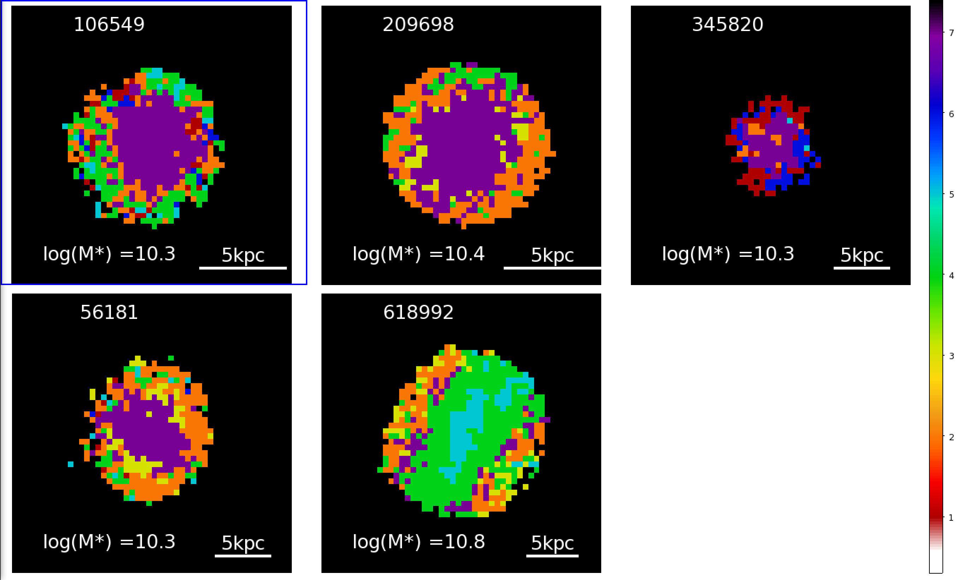
Field: Only 2% non-passive galaxies have >10% E+A signature spaxels.
NSF_HDS
HDS
SF
COMP
Mice Analogue
NSF
wNSF
PAS
Notes:
For z<0.06 (same zrange as clusters) and M*>10^10
Majority of cases the HDS is found in the central parts of the galaxy, with little evidence for ongoing SF
Almost all NSF_HDS; i.e.,
Not in massive groups: isolated or found in pairs or small groups
Binomial 68% CLs on percentage: 1.6-3.6%
5/230 z < 0.06, M*>10^10

Slide 23
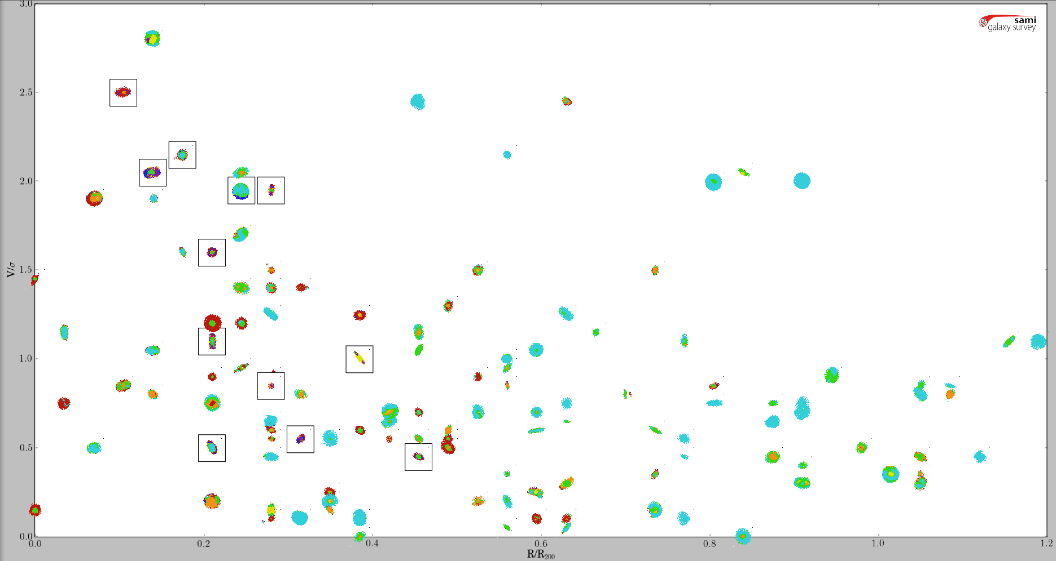
Cluster Projected Phase-Space Diagram
R/R₂₀₀ < 0.5
|V|/σ > 1.5
6/14 -> 43 (31-56)% HDS
0.5 < R/R₂₀₀ < 1.
|V|/σ > 1.5
0/7 ->0 (0-20)% HDS
Large fraction of ‘quenched’ galaxies are ‘infallers’
|V|/σ
Consistent with ram pressure stripping leading to outside-in truncation of SF
R/R₂₀₀ < 0.5
|V|/σ < 1.5
6/51 -> 12 (9-18)% HDS
0.5 < R/R₂₀₀ < 1.
|V|/σ < 1.5
0/41 -> 0 (0-4)% HDS
R/R₂₀₀
Notes:
All within 0.5R200 18.5(15 – 24): 12/65
High vel, low R galaxies likely to be intereacting with the ICM at first core passage, leading to a higher probabality of RPS -> hint of larger fraction of HDS/PSB galaxies compared with low vel, low R portion.
Low vel, low R more likely has many galaxies interacting with ICM at pericentre, and have high vel perpendicular to our LOS, but also this region probably harbors quite a number of galaxies in projection which are just beginning their descent into the cluster potential. This is because the more of the volume in the low radius cone is at large physical radius where the infall velocity has not peaked.

Slide 24

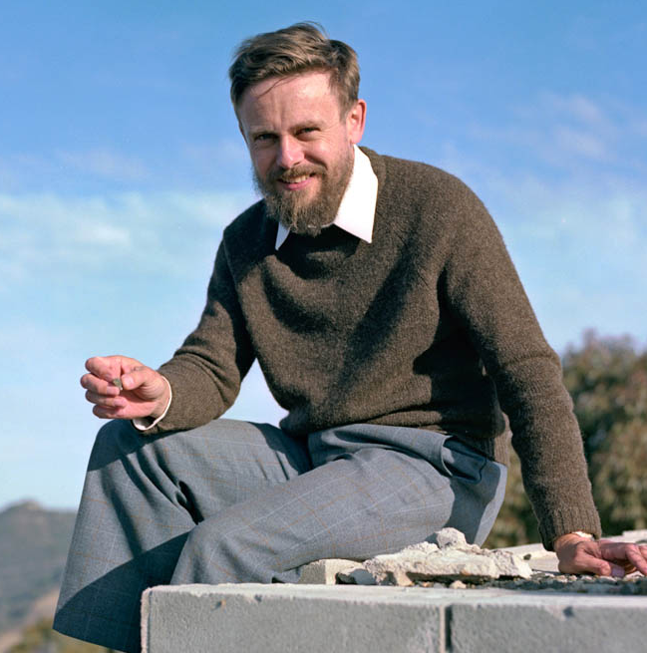
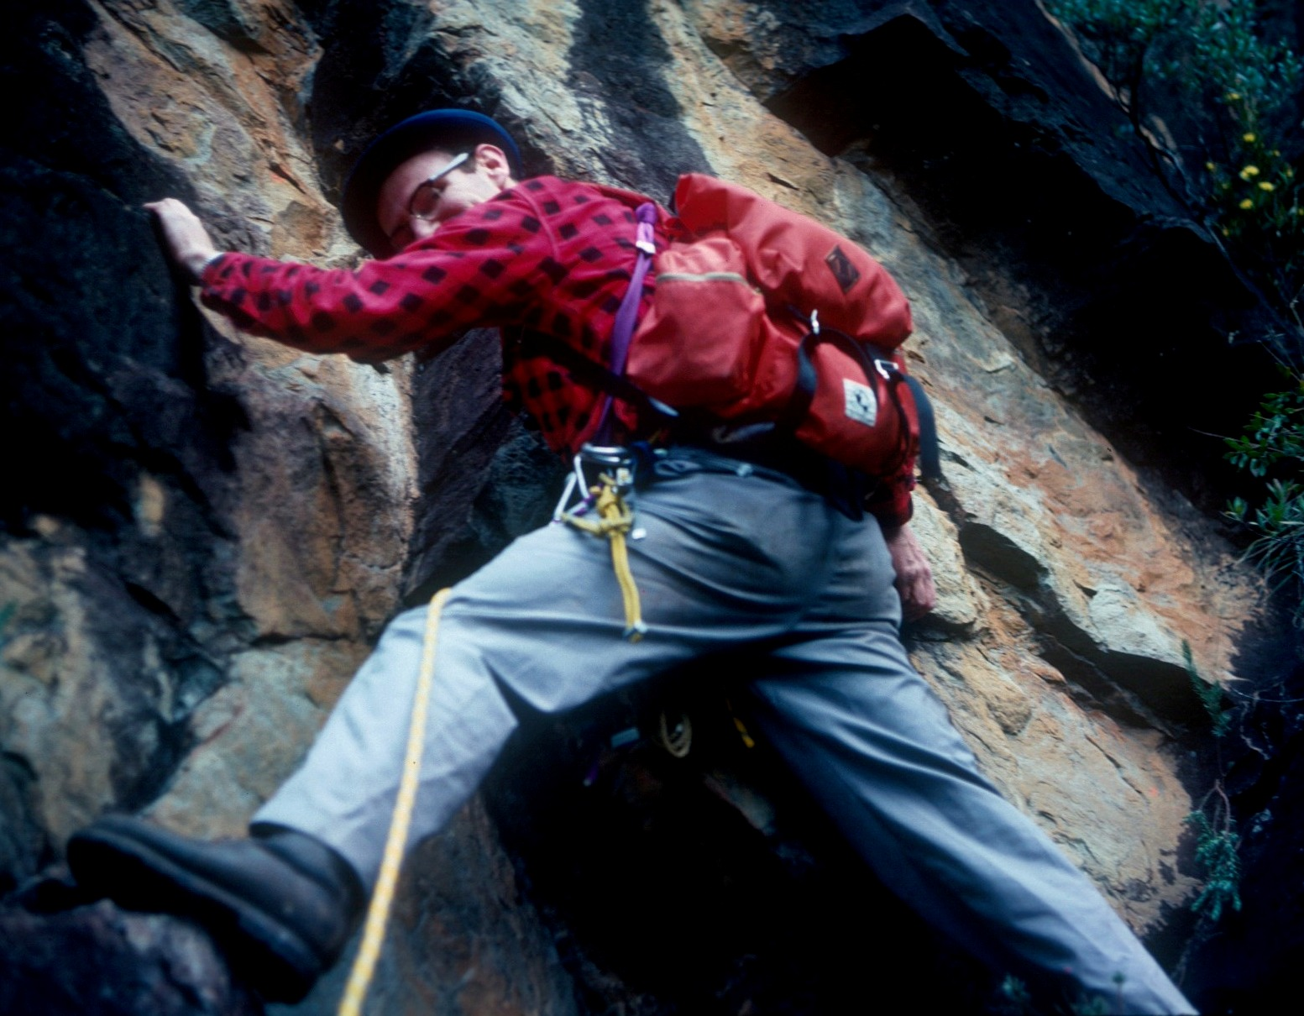
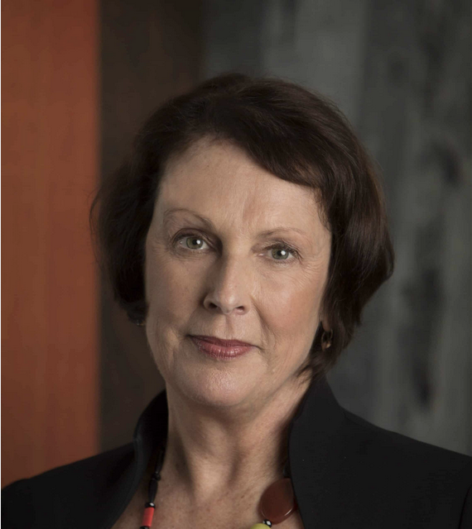
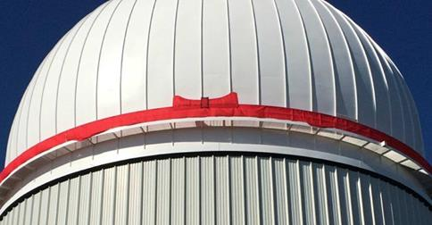
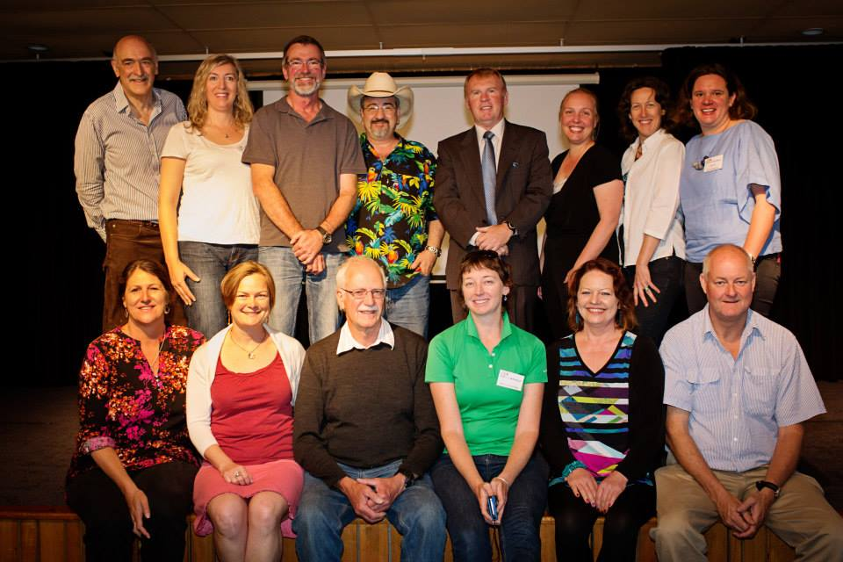
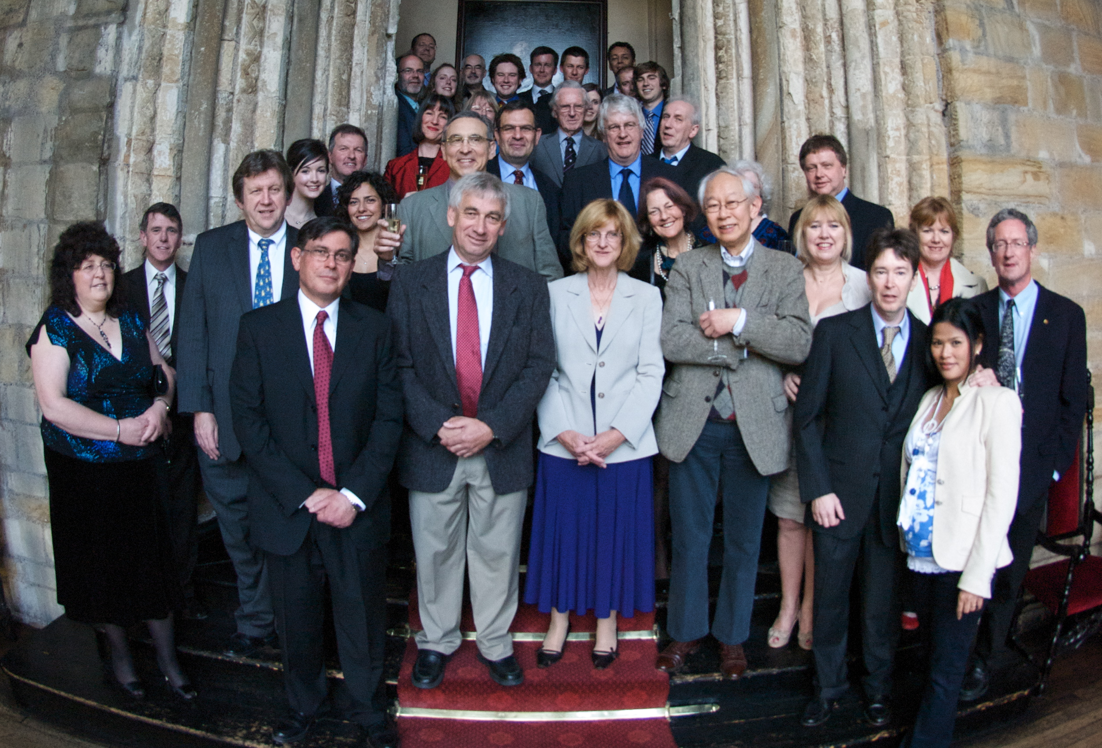
Happy 50th!!
Don Morton (AAO Director 1976-87)
Russell Cannon (AAO Director 1987-96)
Barry Newell
(PhD supervisor)
Anne-Marie Lansdown (Dep Sec, DIISR 2007-10)
SSO/AAO/AAT colleagues
Durham connection

