Slide 1
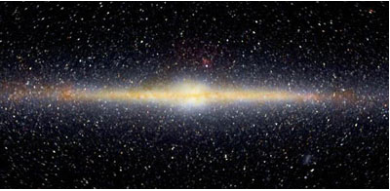
The ARGOS Survey of the Galactic Bulge
and its Ongoing Legacy
Ken Freeman
RSAA

Slide 2
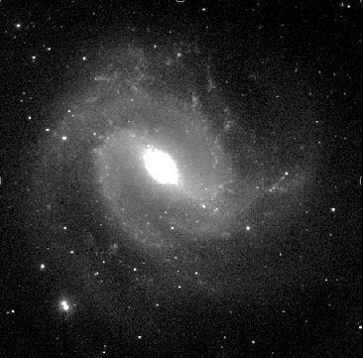
The Galactic Bulge
Our Galaxy, the Milky Way, seen edge-on in infrared light : this suppresses the dust
and shows the underlying structure.
You can see the flat spinning disk and the central boxy bulge. There is also a faint halo of very old metal-deficient stars.
The nearby barred spiral M83 in infrared: our Galaxy also has a central bar and would look much like this if seen face-on.
There is one more component ….
Notes:
The metal-poor halo - very faint but very important for GA

Slide 3
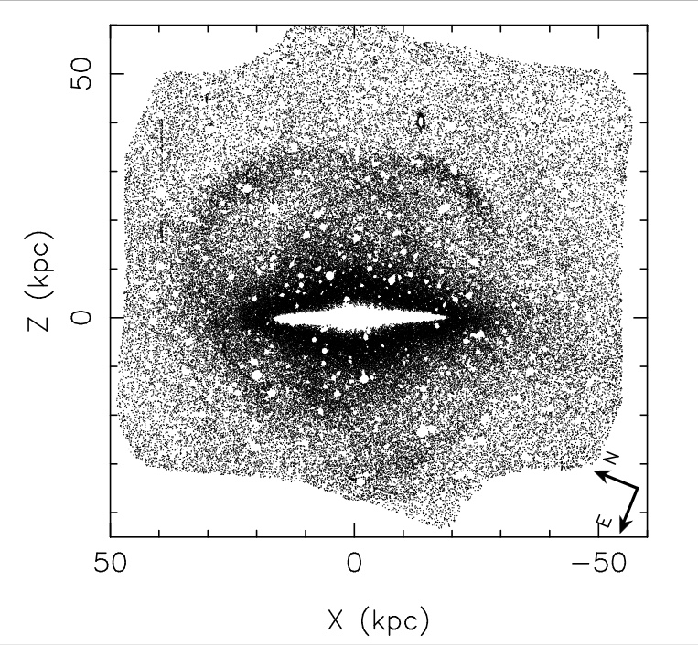
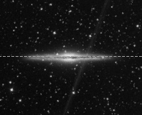
Most large spirals like the Milky Way also have a thick disk, discovered in the early 1980s.
The diamond-shaped structure around the edge-on galaxy NGC 891 below is its thick disk.
The Thick Disk
NGC 891
(Mouhcine et al
2010)
The Milky Way thick disk is ~3x thicker than the thin disk, very old (> 10 Gyr) and has about 1/3 to 1/10 of the Fe abundance of the sun.
Notes:
The diamond-shape

Slide 4
The Galactic
Boxy Bulge
Boxy bulges are usually a sign that the galaxy has a central bar.
Around 2010, there were two views about the formation of the boxy bulge :
via a major merger, or
by growth from the inner disks via dynamical instability. This view was favoured.
Simulations predicted that * boxy bulges should rotate cylindrically, and * the stars of the bulge should be a mixture of the thin disk and thick disk present in the central regions of the Galaxy before the bulge forms, plus whatever stars are formed in the process.
The ARGOS team (9 AU, 2 FR) was formed to test these predictions with spectra from AAOmega.
Notes:
Back to the boxy bulge

Slide 5
Metallicity distributions in the boxy Bulge : (Ness et al, 2013)
The ARGOS team acquired AAT spectra of 28,000 bulge stars. The cylindrical rotation of the bulge was evident. So was the expected broad metallicity distribution with multiple peaks. This favored the disk disk instability scenario.
thin disk stars
Stars within 3.5 kpc
of the Galactic center
thick disk stars
metal-rich stars
D and E peaks are metal-poor halo stars. The thick disk and thin disk components are present in the bulge: also metal-rich stars - fractions of each vary with galactic latitude
The metal-rich stars lie in a thin layer near the Galactic plane. What is this layer ?
Notes:
Answer came a few years layer

Slide 6
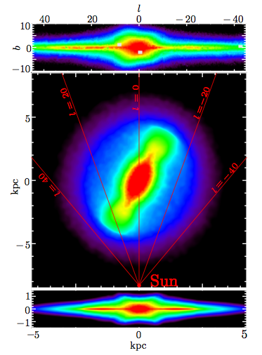
In 2015, Wegg made a detailed study of the structure of the bulge, using IR
photometry of a large sample of red clump giants in the inner Galaxy
The structure of the inner Galaxy
The boxy/peanut bar/bulge and the
extended flat bar
view from Sun
The mass of the bar/bulge is
M = 1.8. 10¹⁰ M
(Portail et al 2015).
view from pole
The underlying thin flat bar extends out to R ~ 5 kpc
(scale height 180 pc)
view fom infinity

Slide 7
Where do the ARGOS metal-rich ([Fe/H] > 0) bar/bulge stars lie ?
We see similar stars near the sun: they cannot have formed near the sun because the
ISM near the sun is not so metal-rich. The metal-rich stars near the sun are believed to
have migrated from the inner Galaxy, where the ISM is more metal rich.
The migration mechanism is not well understood. It would be useful to know exactly where the metal rich stars come from in the inner Galaxy.
Ness, Wylie et al (2021) combined ARGOS and APOGEE survey data and located the metal-rich bar/bulge stars.
They are mostly out in the thin flat bar.
The main concentration of metal-rich stars is not in the central bulge but in the flat bar region, |Z| < 0.5 kpc,
2.5 < |X| < 4.5 kpc. How did the flat bar form, and why is it so metal-rich ?
Notes:
Last sllide

Slide 9
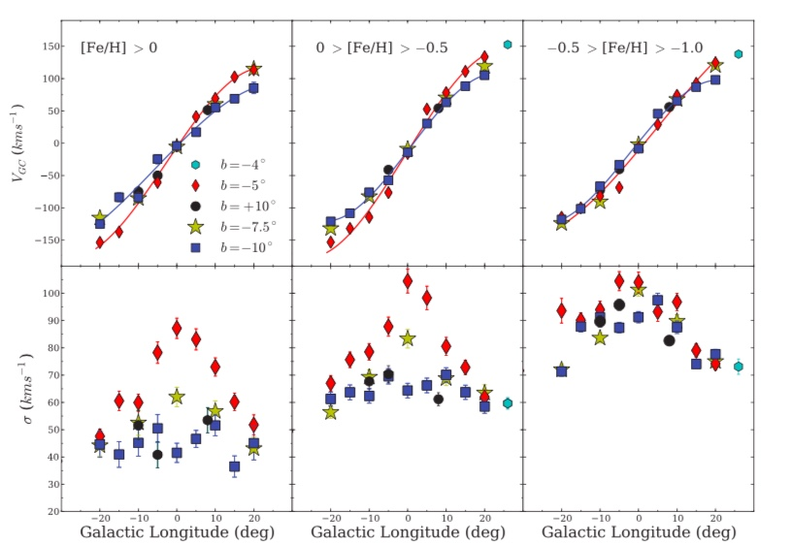
Kinematics of pop A, B, C
Ness et al 2013 (ARGOSIV)

