Slide 2
Acknowledgment of Country
The Australian Academy of Science acknowledges and pays respects to the Ngunnawal people, the Traditional Owners of the lands on which the Academy office is located. The Academy also acknowledges and pays respects to the Traditional Owners and the Elders past, present and emerging of all the lands on which the Academy operates, and its Fellows live and work. They hold the memories, traditions, cultures and hopes of Aboriginal and Torres Strait Islander peoples of Australia.

Slide 3
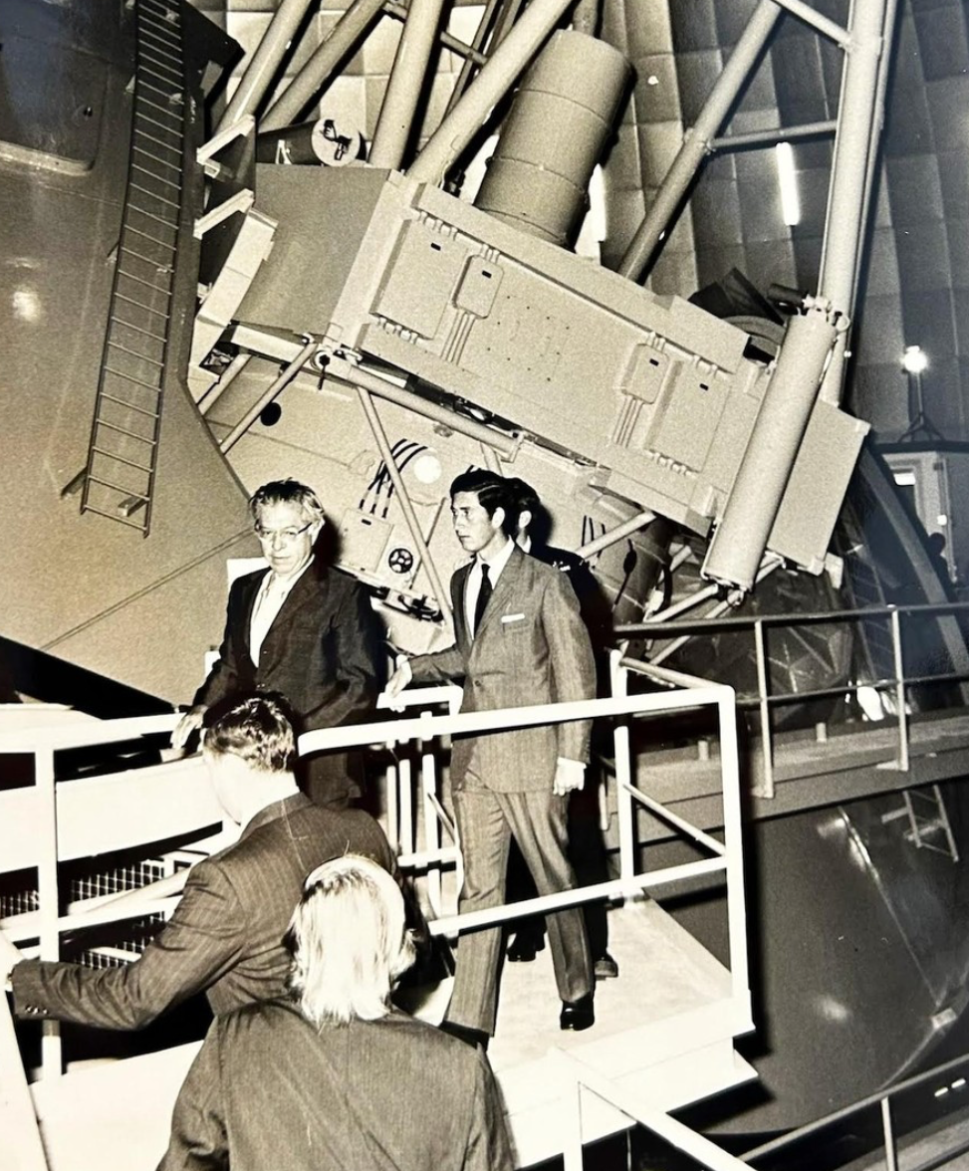
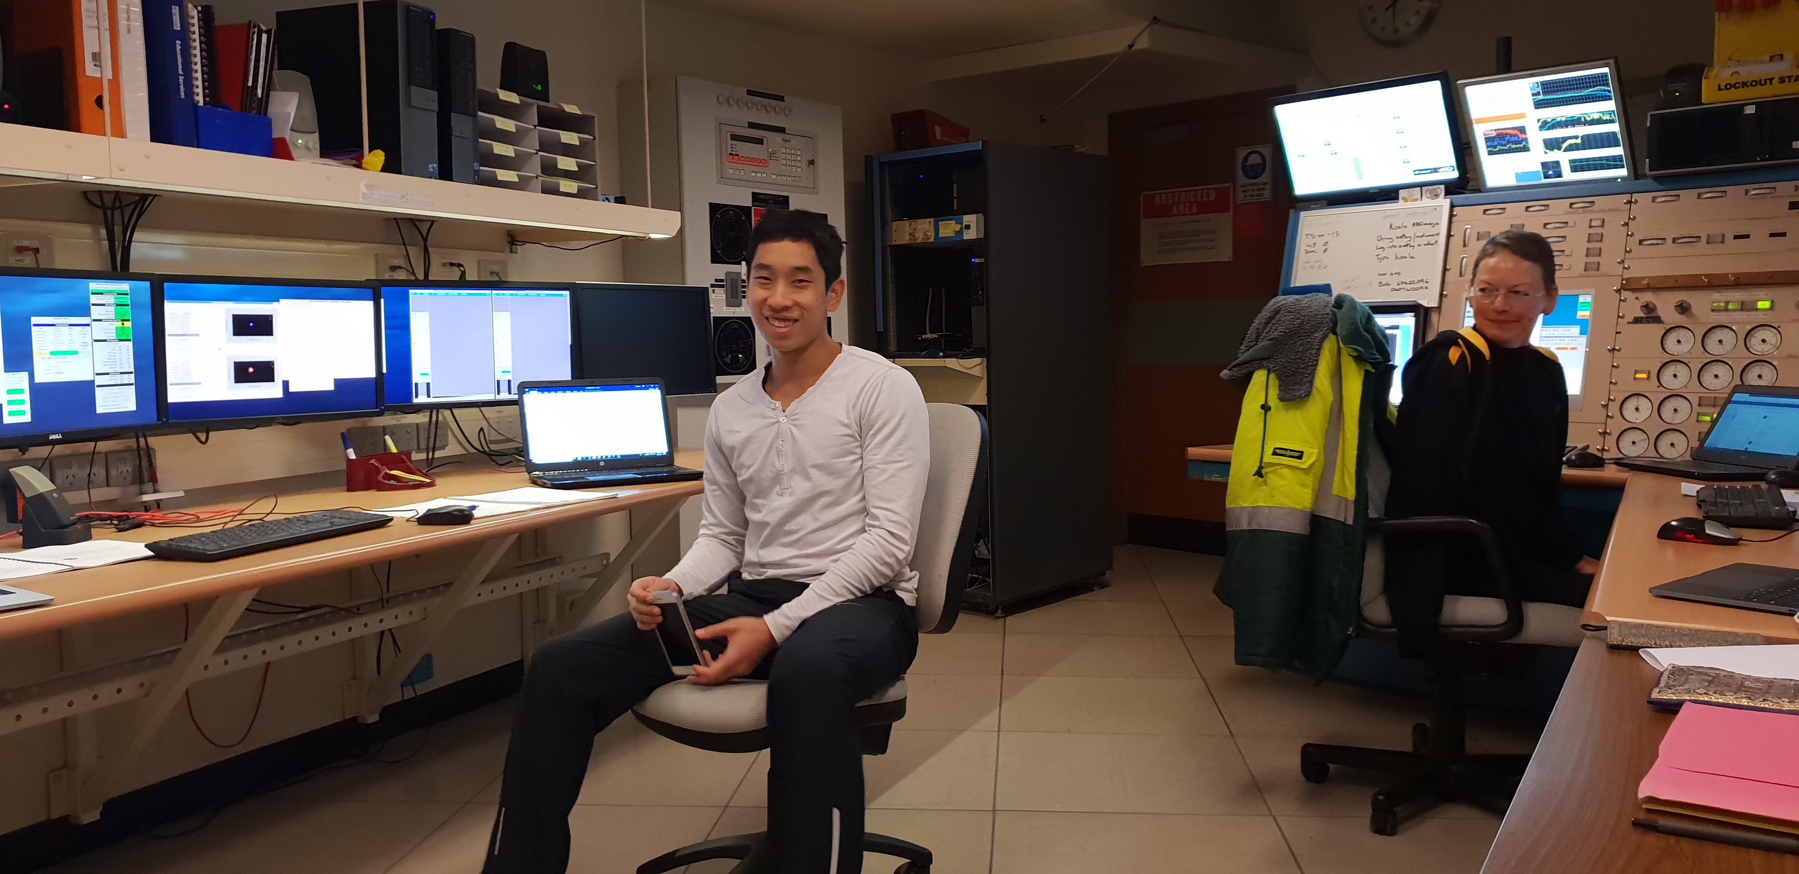
Prelude… a personal AAT timeline
4 days earlier . . . A baby was born
16th October 1974
AAT opening by HRH Prince Charles
2003 – HRH Prince Charles at Jodrell Bank Observatory
2018 – KOALA obs for Hi KIDS

Slide 4
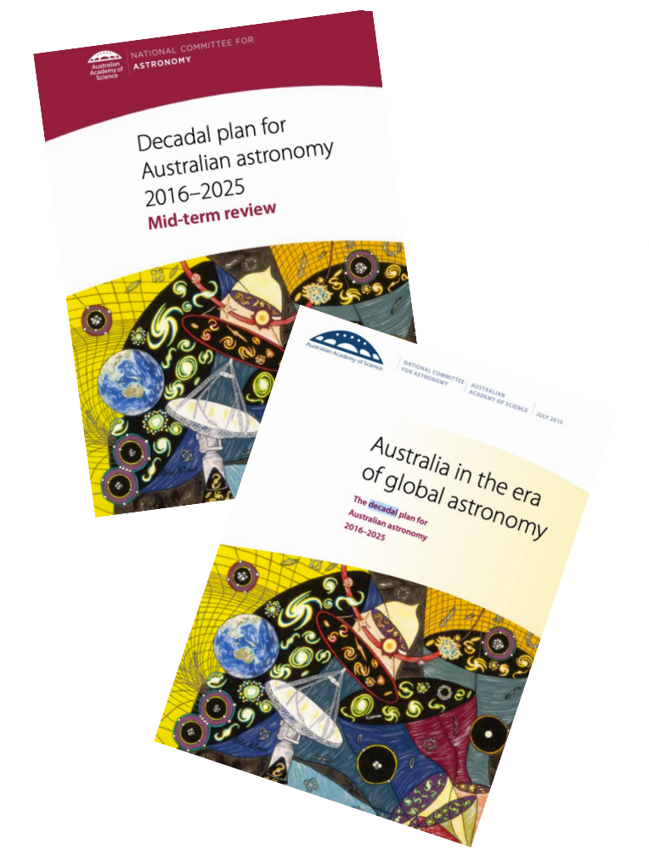
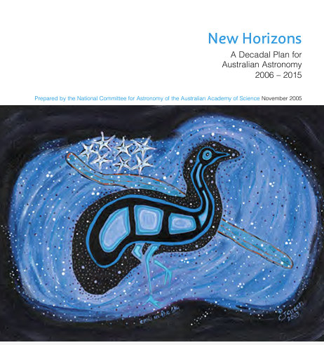
Decadal Plan - Overview
The Australian astronomical community is carrying out a formal strategic planning process on a ten-year timeframe, reviewing its goals and progress at the mid-term mark.
This process is run by the Australian Academy of Science’s National Committee for Astronomy.
It provides the opportunity for Australian astronomy to
carry out a review of its current capabilities, assess its impact both nationally and internationally,
provide a vision for the future and set priorities and develop strategies to implement the vision
Astronomy Australia Limited (AAL) supports the delivery of the infrastructure goals of the Australian Astronomy Decadal Plan

Slide 5
Vision and impact of the decadal plan
The Decadal Plan not only articulates a strategic vision for Australian astronomy but also sets a roadmap for addressing critical scientific questions and building the necessary infrastructure.
It examines:
Educational, training, and career pathways, reinforcing Australia’s research leadership globally.
Engages with governmental bodies, and industrial, and research partners worldwide, the plan secures essential funding and fosters international collaboration.
Alignment with Government priorities:
Provides advice and recommendations that directly benefit Government initiatives and priorities in the current Australian science system
Support ongoing investments and identify further scientific opportunities for Australia

Slide 6
Timeframe
June 2023 to July 2025
Date | Activity
June-December 2023 | Project initiation and establishment of working groups Presentation at ASA conference Development of working group plans and white papers
February-May 2024 | Establish an editorial committee Nation-wide town-hall meetings and online consultation
June-July 2024 | National presentation at ASA conference Development of working group reports Series of in-person town-hall meetings
September 2024 | Working group white papers provided to the NCA – September 1 Incorporation into first draft of the decadal plan by the editorial committee – September 16
September-December 2024 | Editorial committee preparation of exposure draft (including feedback by NCA / Academy of Science)
January-February 2025 | Exposure draft consultation
March-June 2025 | Report finalisation and prepublication
July 2025 | Launch of the Decadal Plan at the ASA conference
We are here

Slide 7
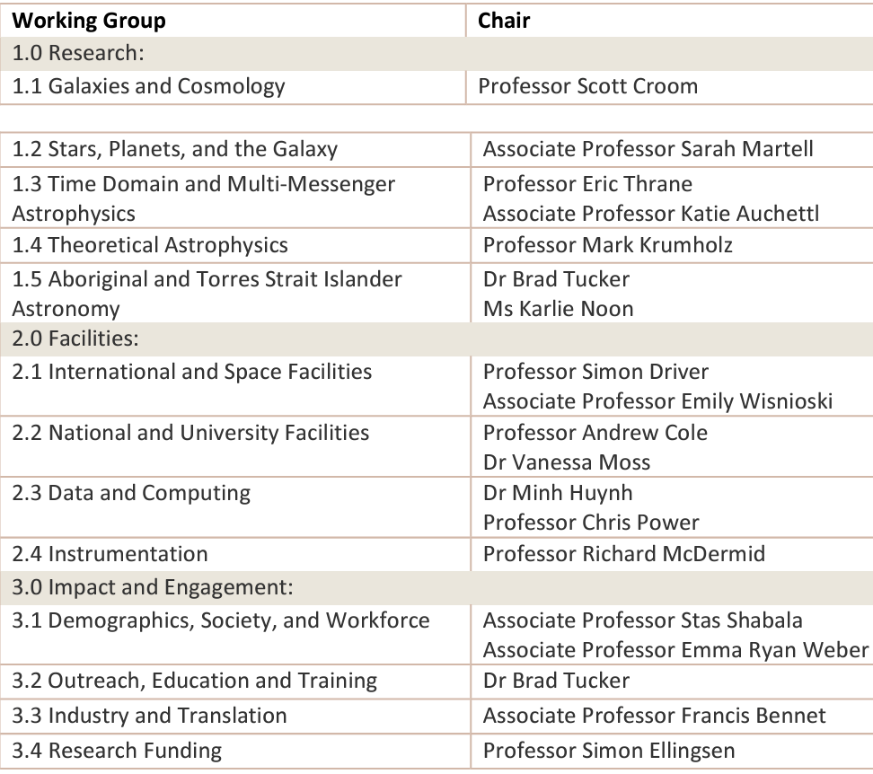
Decadal plan working groups
White papers provided by working groups provide the basis for the Decadal Plan
Working groups
13 working groups established.
Working group chairs met monthly to provide feedback to the NCA chair, and to ensure collaboration in the development of the WG white papers
Membership:
An overwhelming response from the community, with approximately 253 members contributing to various working groups. This diverse group represents a wide range of institutions, fields, and demographics, showcasing the robust engagement of our community in shaping the future of Australian astronomy.
13 white papers were delivered in September

Slide 8
Stakeholder consultation
The decadal plan is binge developed through extensive community and stakeholder consultation. The findings and recommendations will be drawn from the conclusions of working groups
Consultation is taking place throughout the two-year drafting process
National presentations and discussion at the 2023 and 2024 Annual Scientific Meetings of the ASA
Nationwide town hall and WG meetings between Feb-July 2024
Release of an exposure draft for feedback in January 2025.
Individual / institutional surveys

Slide 9
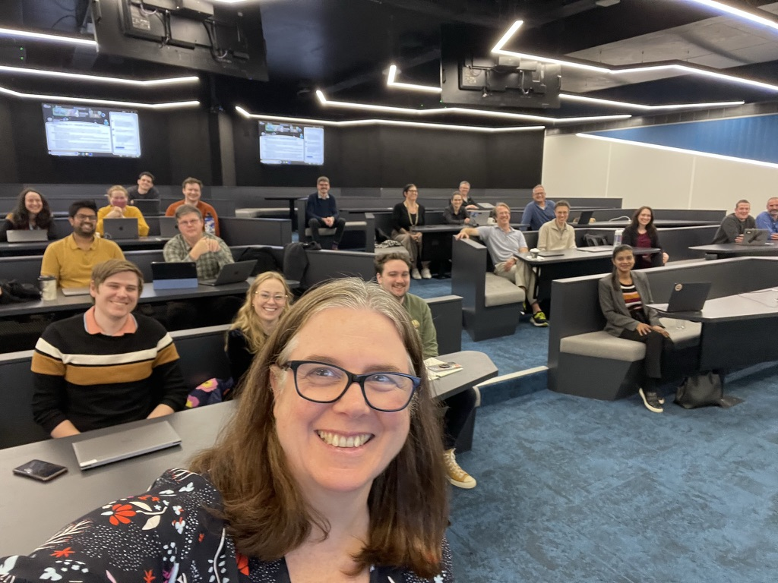
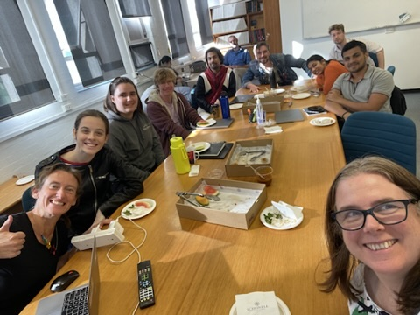
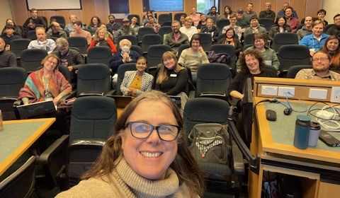
2024 Town-hall consultations
In-person town halls
Seven in-person with virtual option town halls in July/August to discuss initial findings to help white paper drafting. Led by VK, SB, Chris Power
Locations: Vic, Qld, Tas, ACT, NSW, WA, SA between July 18th to August 2nd
Outcomes – feedback to the WGs, plus a new report on Astronomy sustainability + dark skies

Slide 10
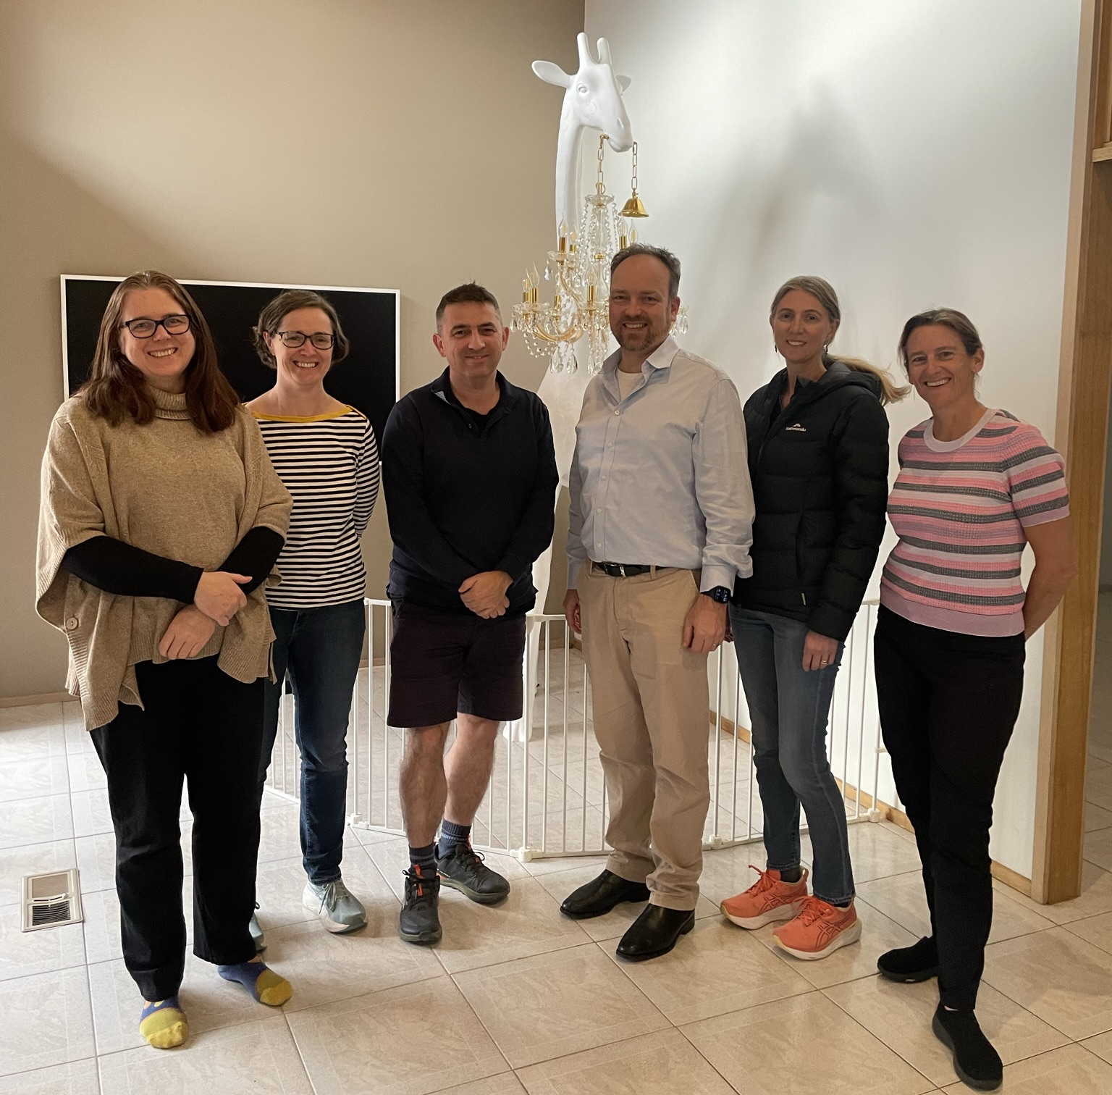
Decadal PlanEditorial Board
The editorial board is tasked with taking the community white papers and drafting the decadal plan
The EB met in mid-September to write the first draft of the DP
Editorial member | Role | State
Professor Virginia Kilborn | Chair | Victoria
Professor Sarah Brough | Deputy chair | New South Wales
Professor Tamara Davis | Board member | Queensland
Professor Cathryn Trott | Board member | Western Australia
Professor Mike Ireland | Board member | ACT
Professor Chris Power | Board member | Western Australia

Slide 11
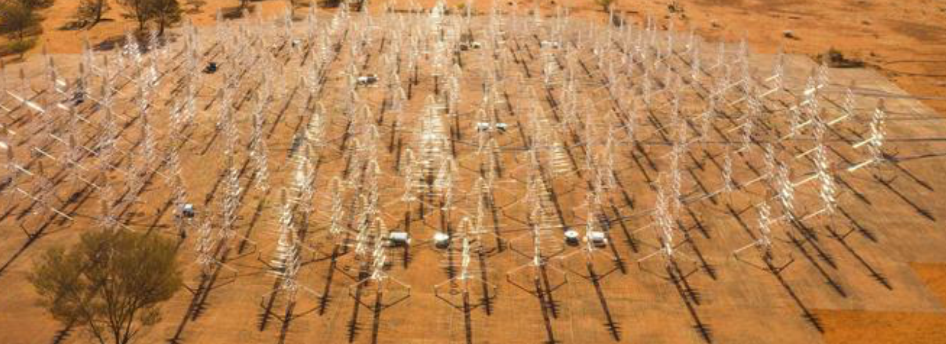
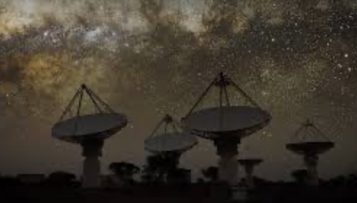
(a few) Highlights of the decade
Gravitational Waves detected by LIGO
ESO strategic partnership began
SKAO IGO establishes, construction of SKA-low
ASKAP began science operations
SAMI / GALAH / GAMA / HECTOR all saw milestones in previous decade
Matthew Bailes won the Shaw prize for FRBs
Industry and instrumentation flourished

Slide 12
Demographics
N=1119

Slide 16
Looking ahead: 2026–2035
Educational and diversity goals within STEM fields:
Advancing educational initiatives
Promote diversity in astronomy and beyond
Indigenous knowledge for the decadal plan – first time Indigenous astronomy knowledges and techniques throughout the DP
Strong theme of interconnection and coordination of the community and science
Impact of Australian astronomical technologies for the broader Australian community
Infrastructure – strong support for SKA and ESO capabilities, recognising the importance of mid-scale facilities - and the role of national facilities for science, education, training and development
Notes:
f

Slide 17
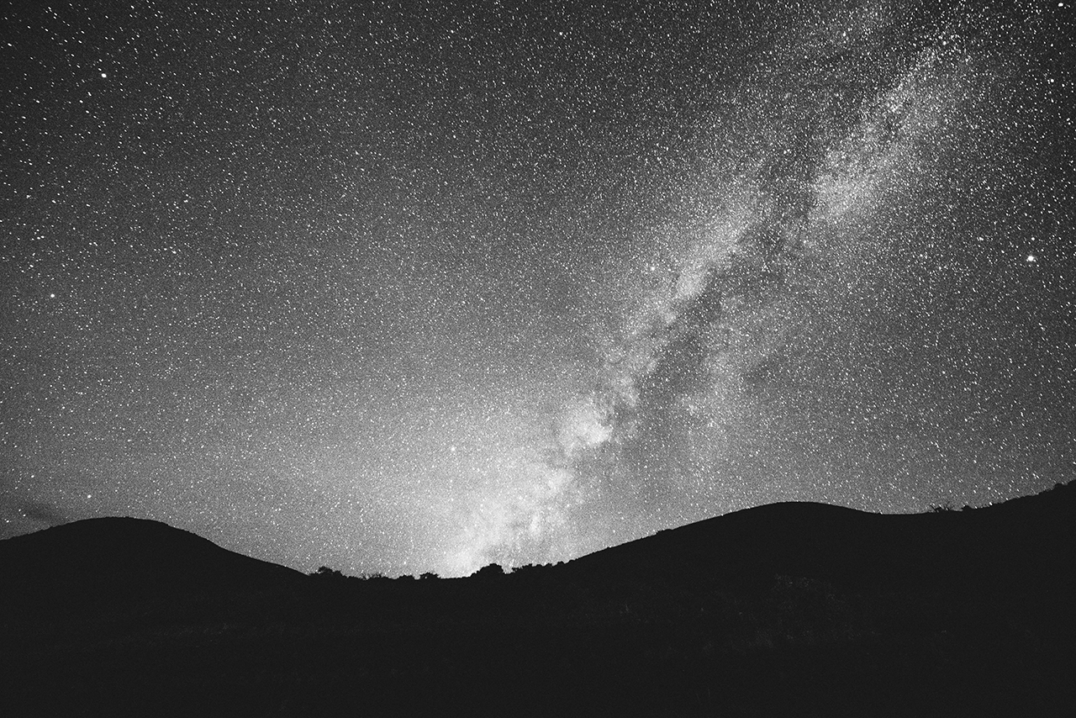
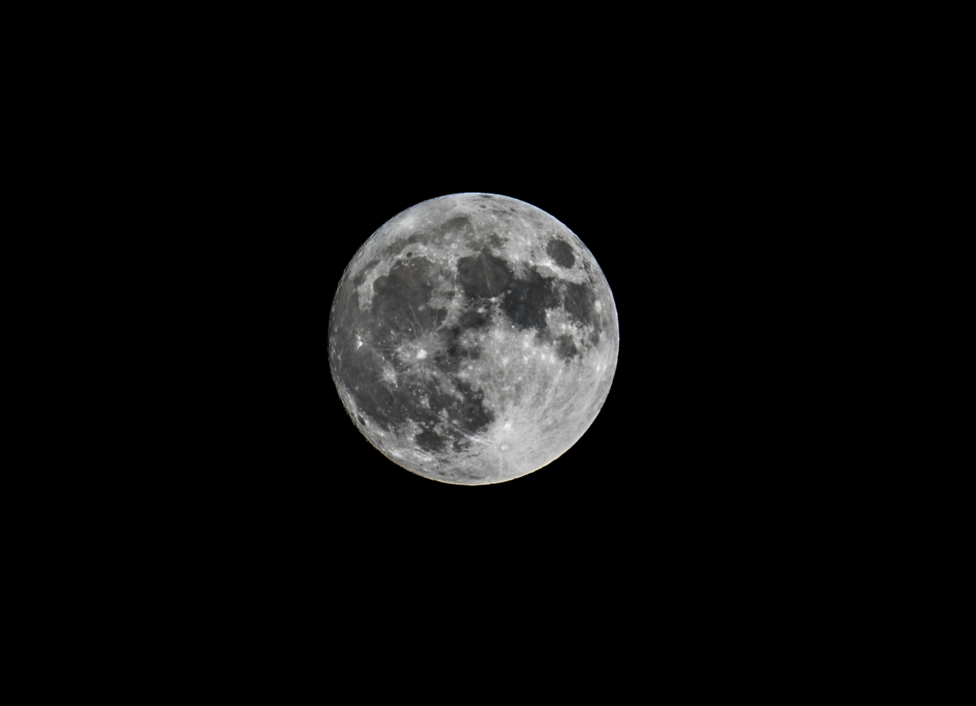
Images/ case studies for Decadal Plan
We need you to provide images and case studies to go in the decadal plan:
Please gather images for which you have the copyright, and are relevant for inclusion in the plan
Could be astronomical images, instruments, students and other people doing astronomy (please ensure correct permissions)
Upload request for images will come later this year. Send me your case studies now!

Slide 18
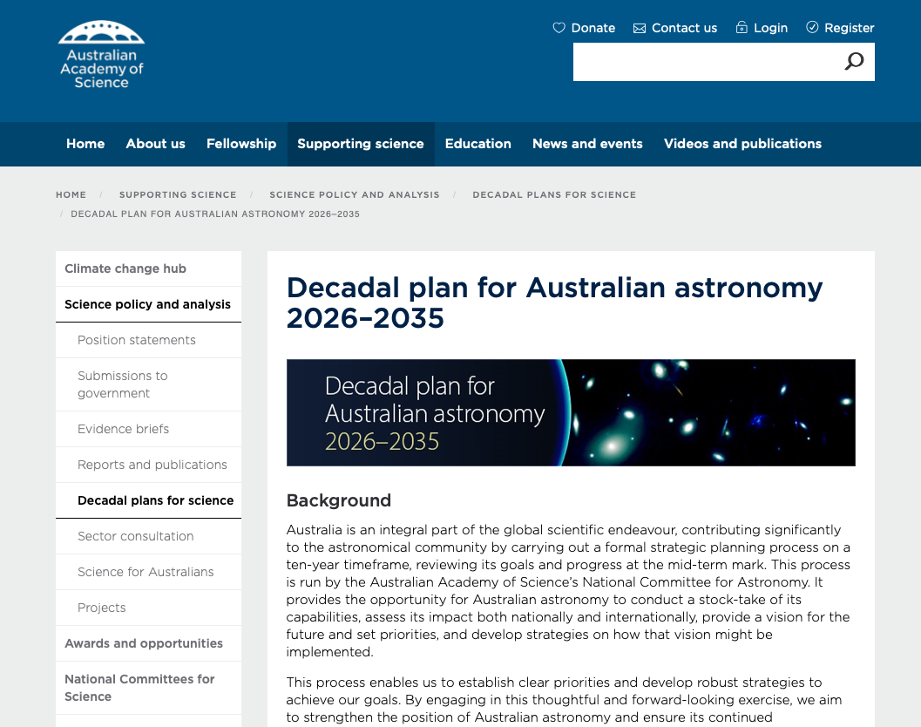
Decadal plan website
Website is a repository for documents, white papers, and working group and board memberships
https://www.science.org.au/supporting-science/science-policy-and-analysis/decadal-plans-for-science/astro2035

Slide 19
Acknowledgements
We would like to sincerely thank all working group chairs for their leadership (see next for their sparkler talks)
CSIRO for financially supporting the Decadal plan
ASA for hosting communication channel
Every astronomy community member who filled out the survey and is participating in some way in the consultation process
All astronomy group leaders and their teams for providing detailed survey information
Editorial board for agreeing to draft the DP
Swasti Devi and the whole team at the Academy of Science for their support

Slide 20
For any Questions:
For any questions reach out to Virginia at vkilborn@swin.edu.au and the Academy at nc@science.org.au
Visit the website to gather more updates

