Slide 1
The AAT and optical facilities for Australia: AAL and the collaborative, portfolio approach
Professor Orsola De Marco AAL Board Chair
Image credit: Ángel R. López Sánchez.

Slide 2
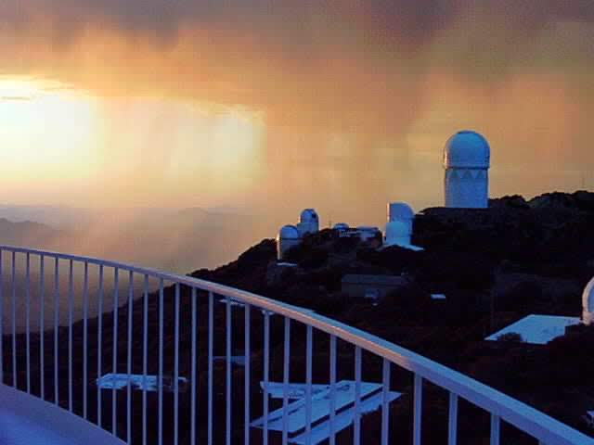
My own trip down memory lane
Orsola De Marco
Astronomer

Slide 3
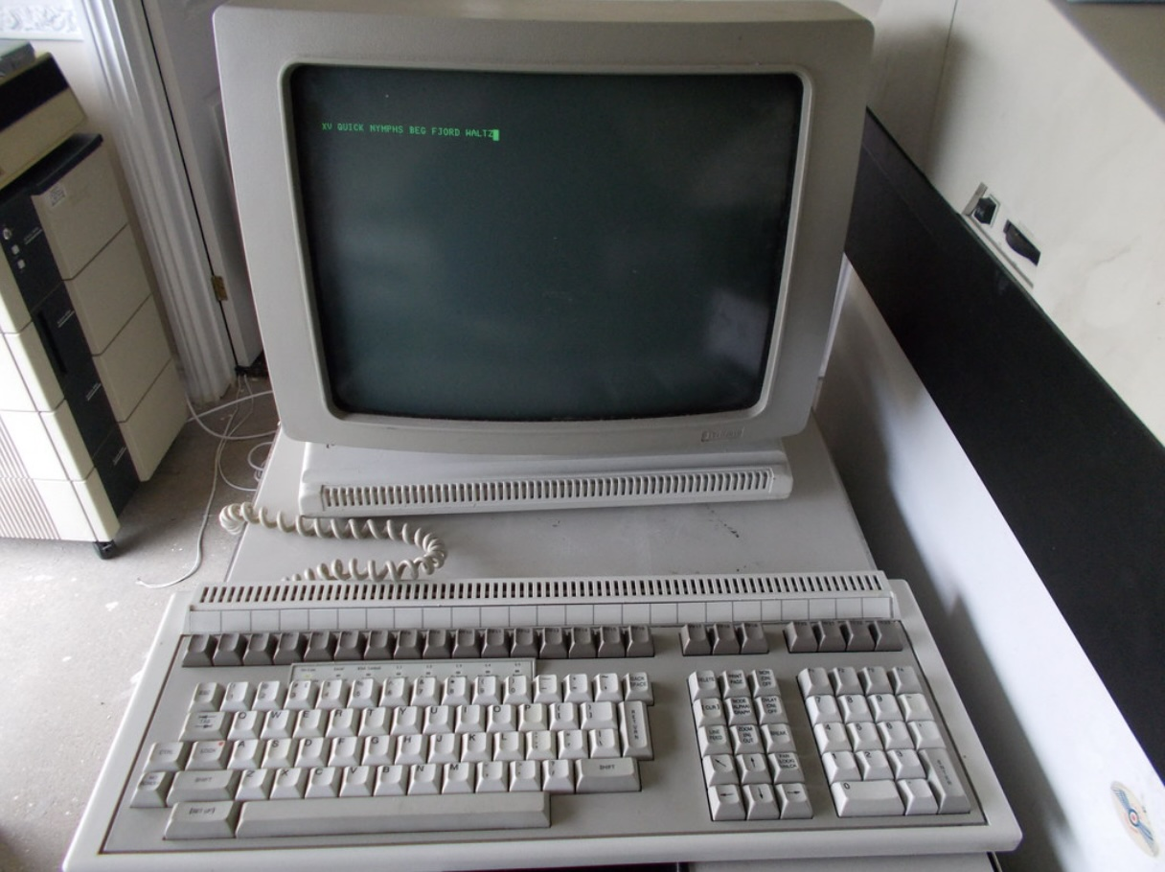
Pericom MG-600 Graphics terminal

Slide 4
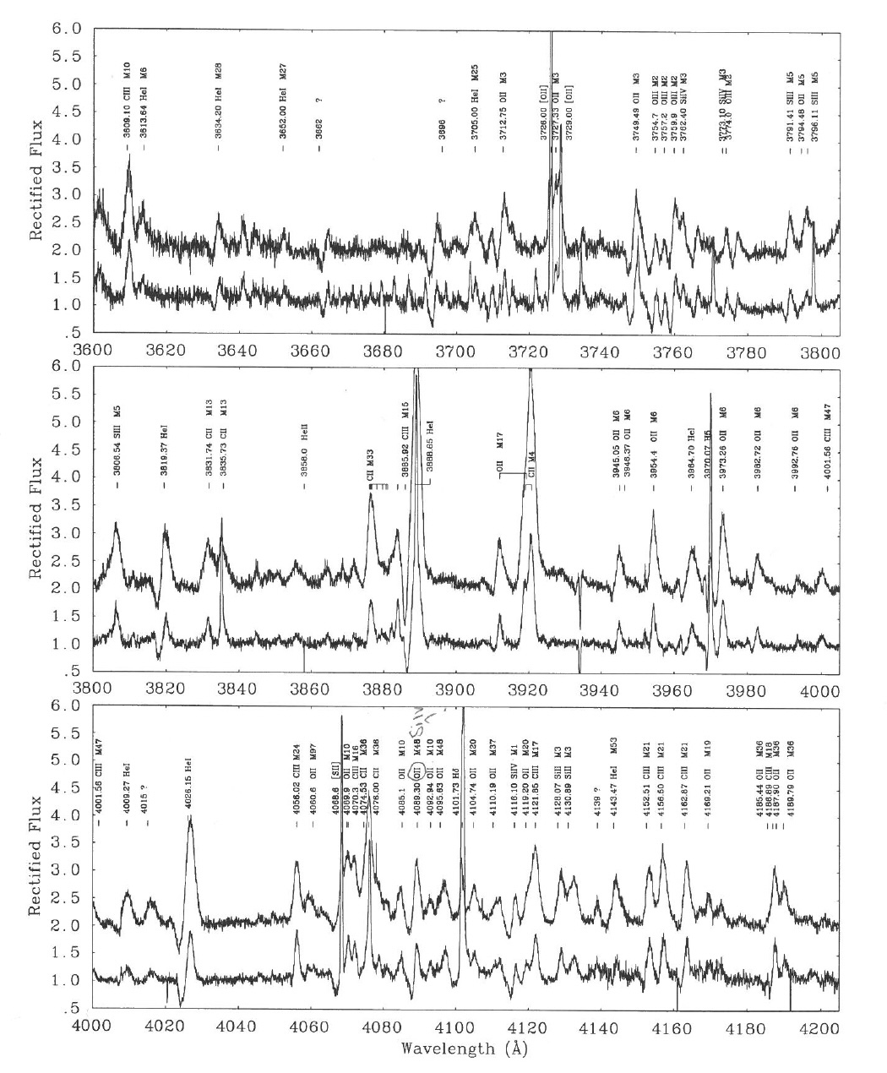
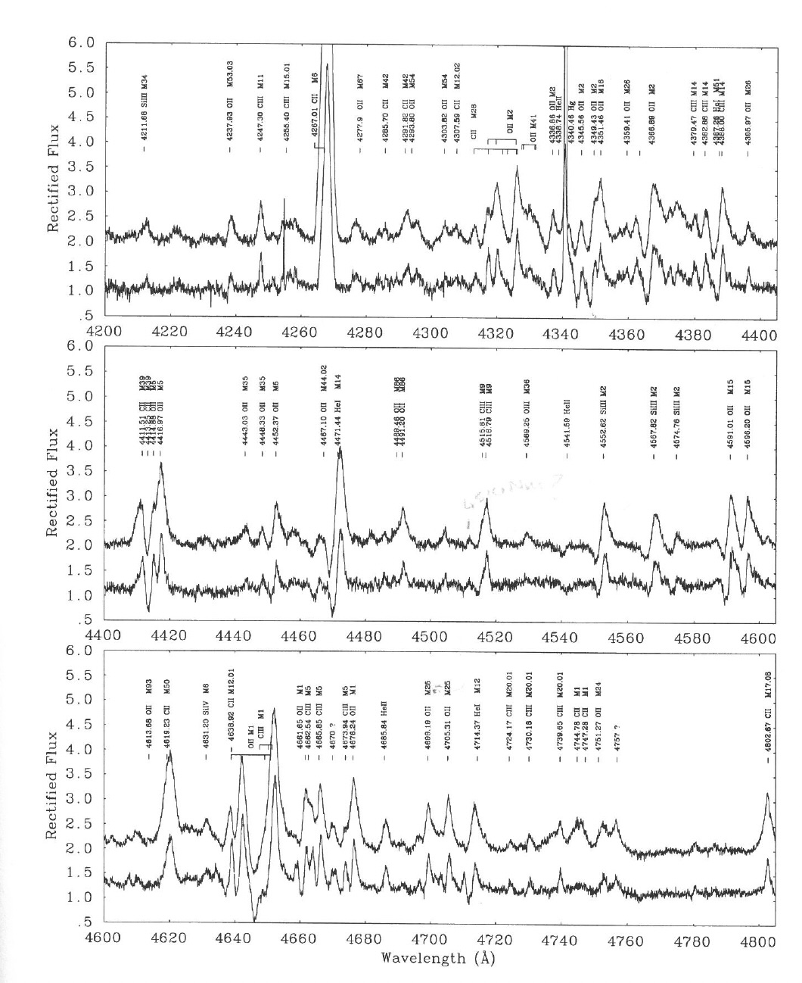
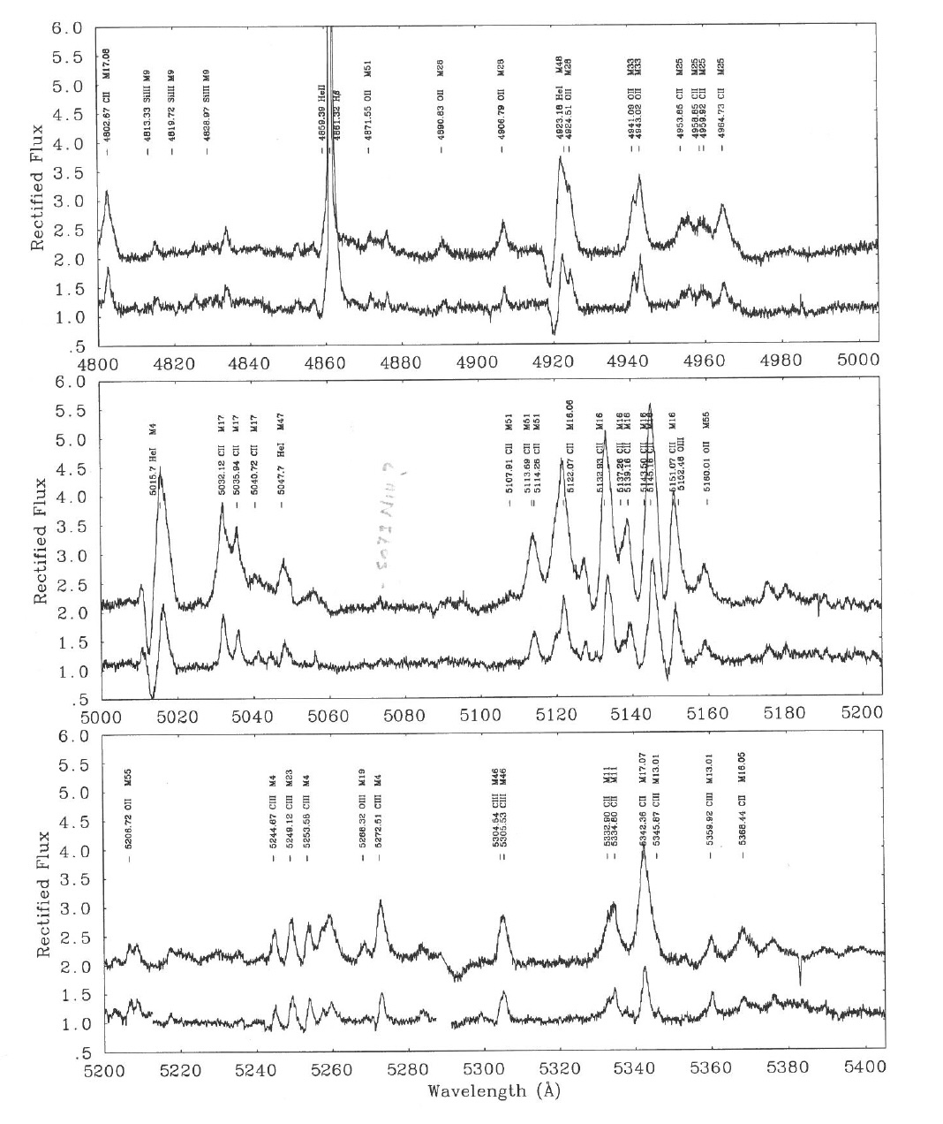
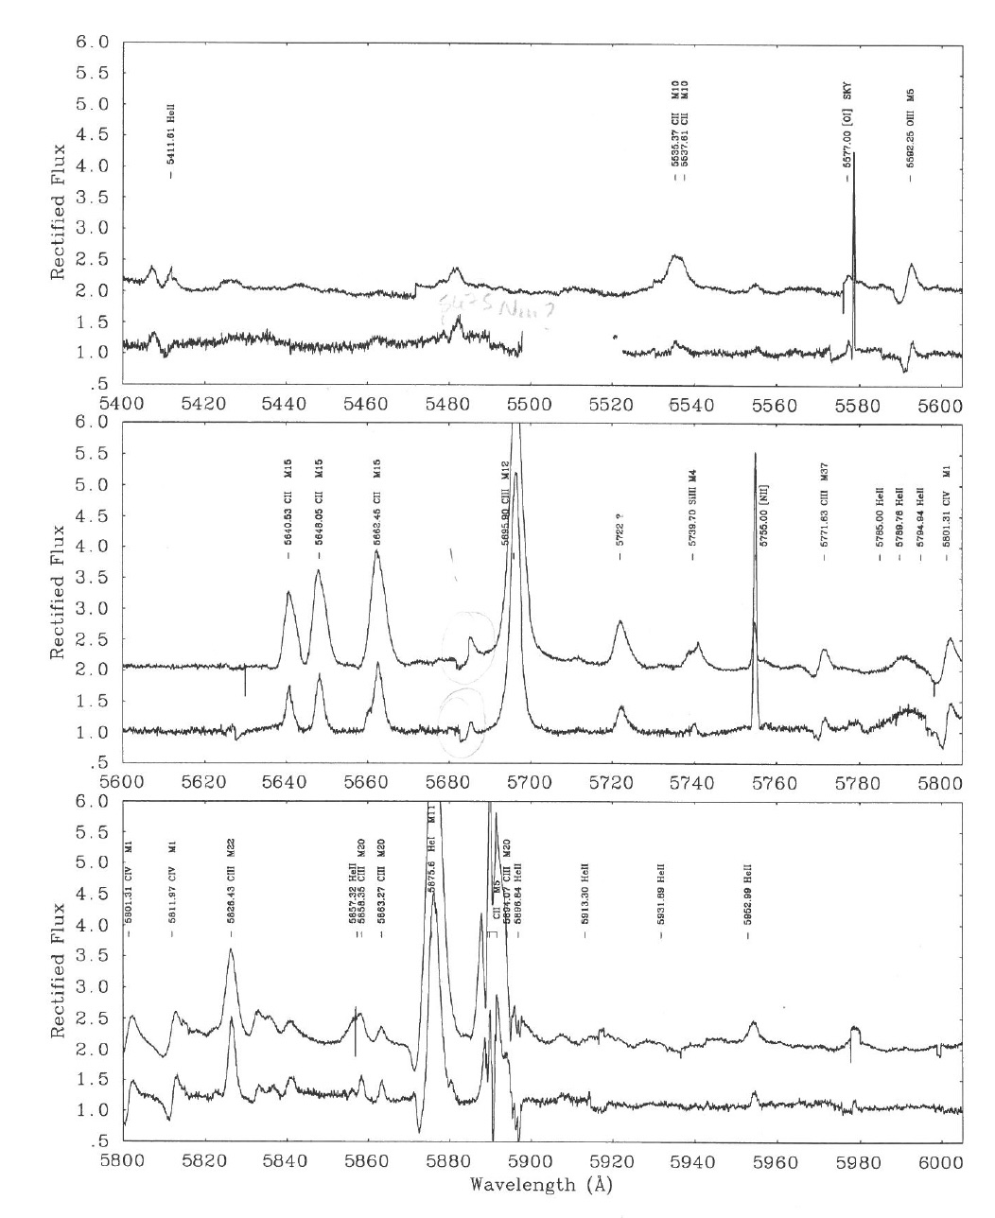
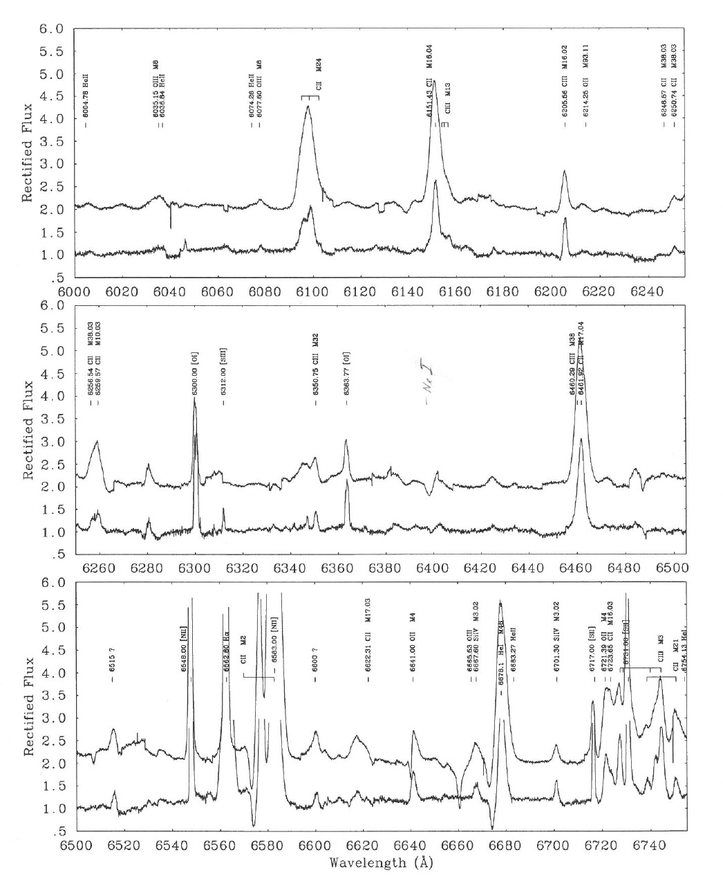
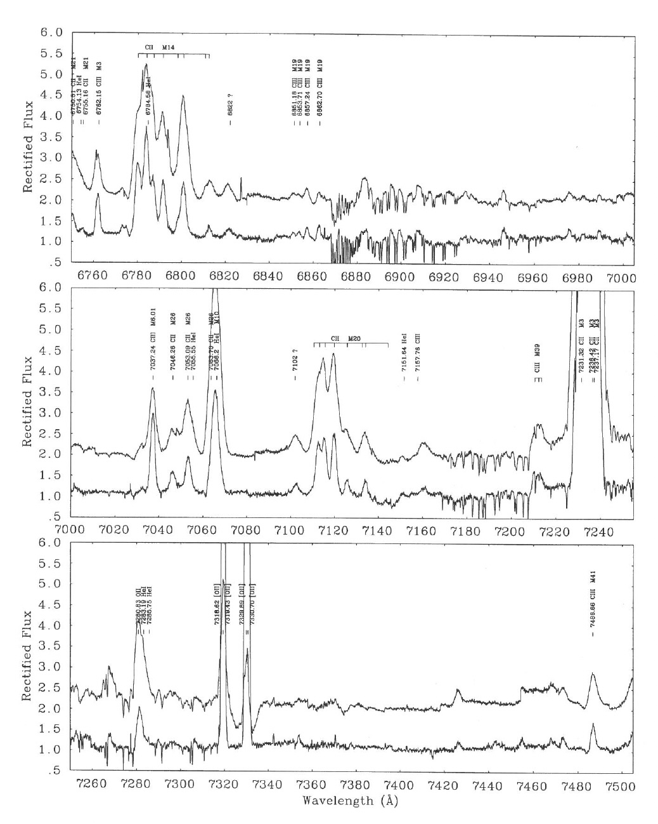
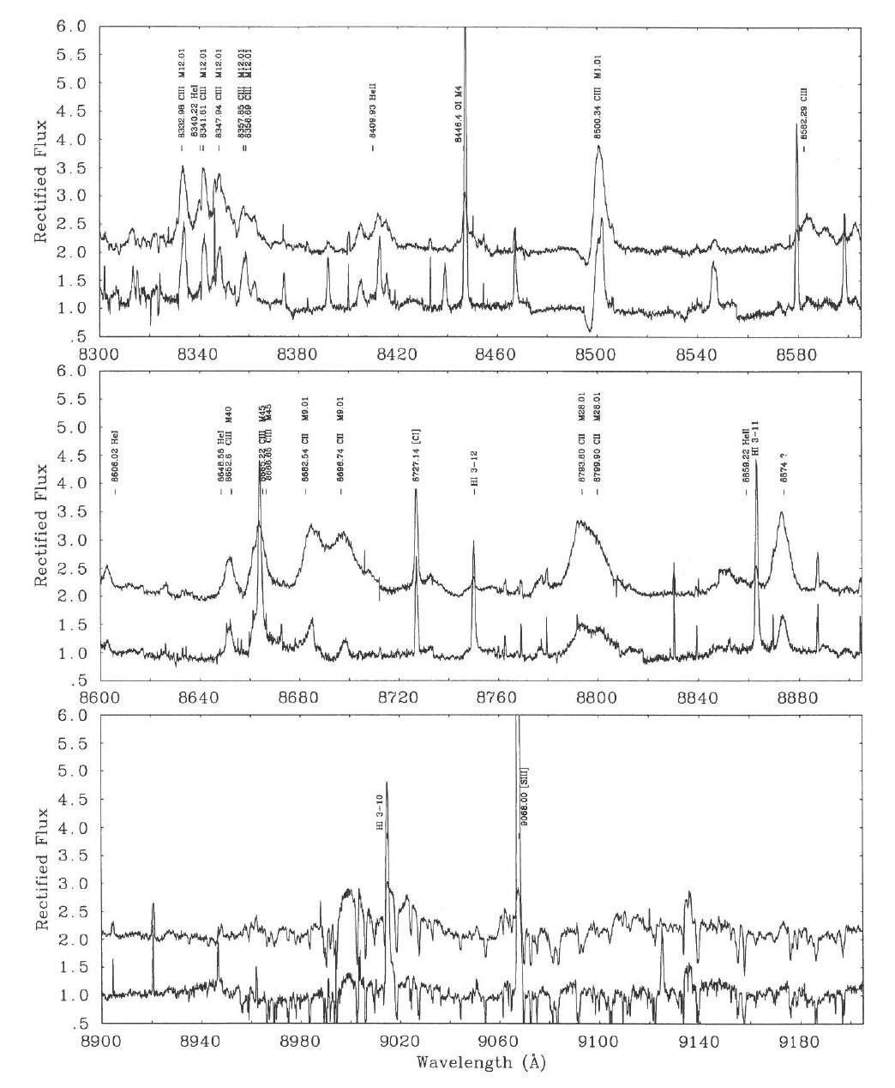
UCLES spectra of CPD-568032 and He2-113 (De Marco et al. 1997, 1998a,b)

Slide 5
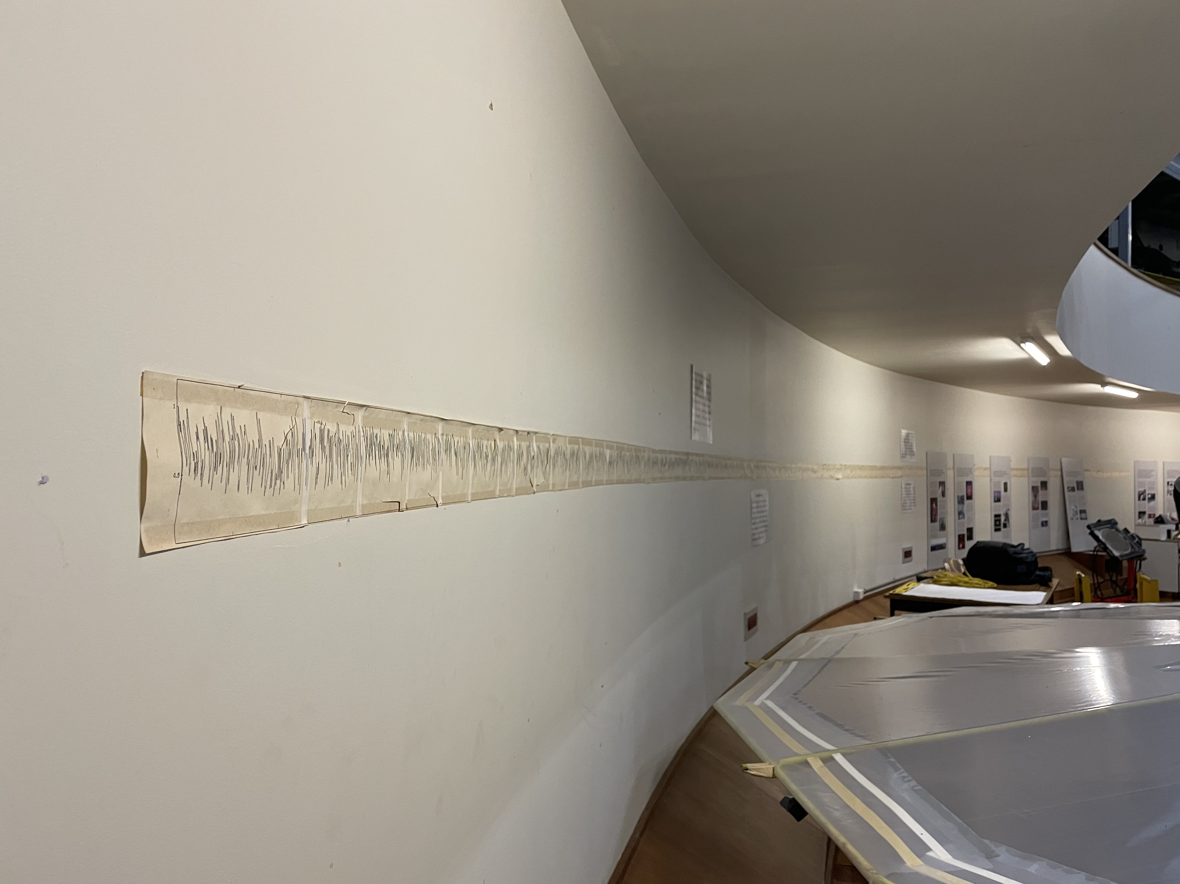

Slide 6
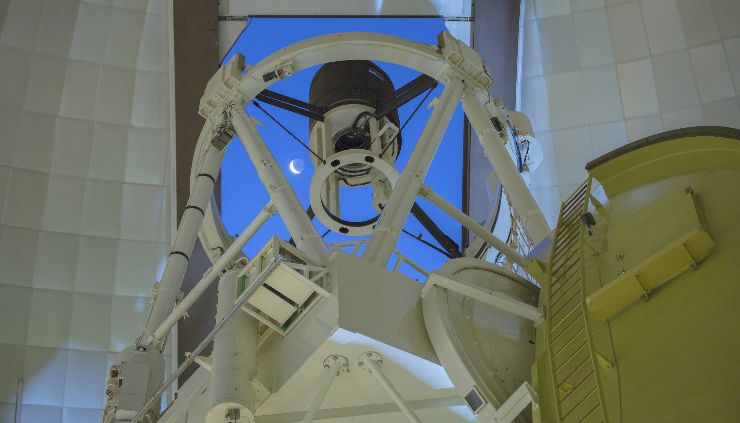
Astronomy Australia Ltd.
AAL is a not-for-profit organisation, whose members are Australian universities and research organisations with a significant astronomical research capability.
AAL works with national observatories, infrastructure providers, astronomers at universities, and the Australian Government to advance the infrastructure goals in the Australian Astronomy Decadal Plan.
AAL currently supports AAT operations on behalf of the AAT Consortium, providing support for the Council, overseeing time allocation, and conducting finance and administrative tasks.
Image credit: Ángel R. López Sánchez.

Slide 7
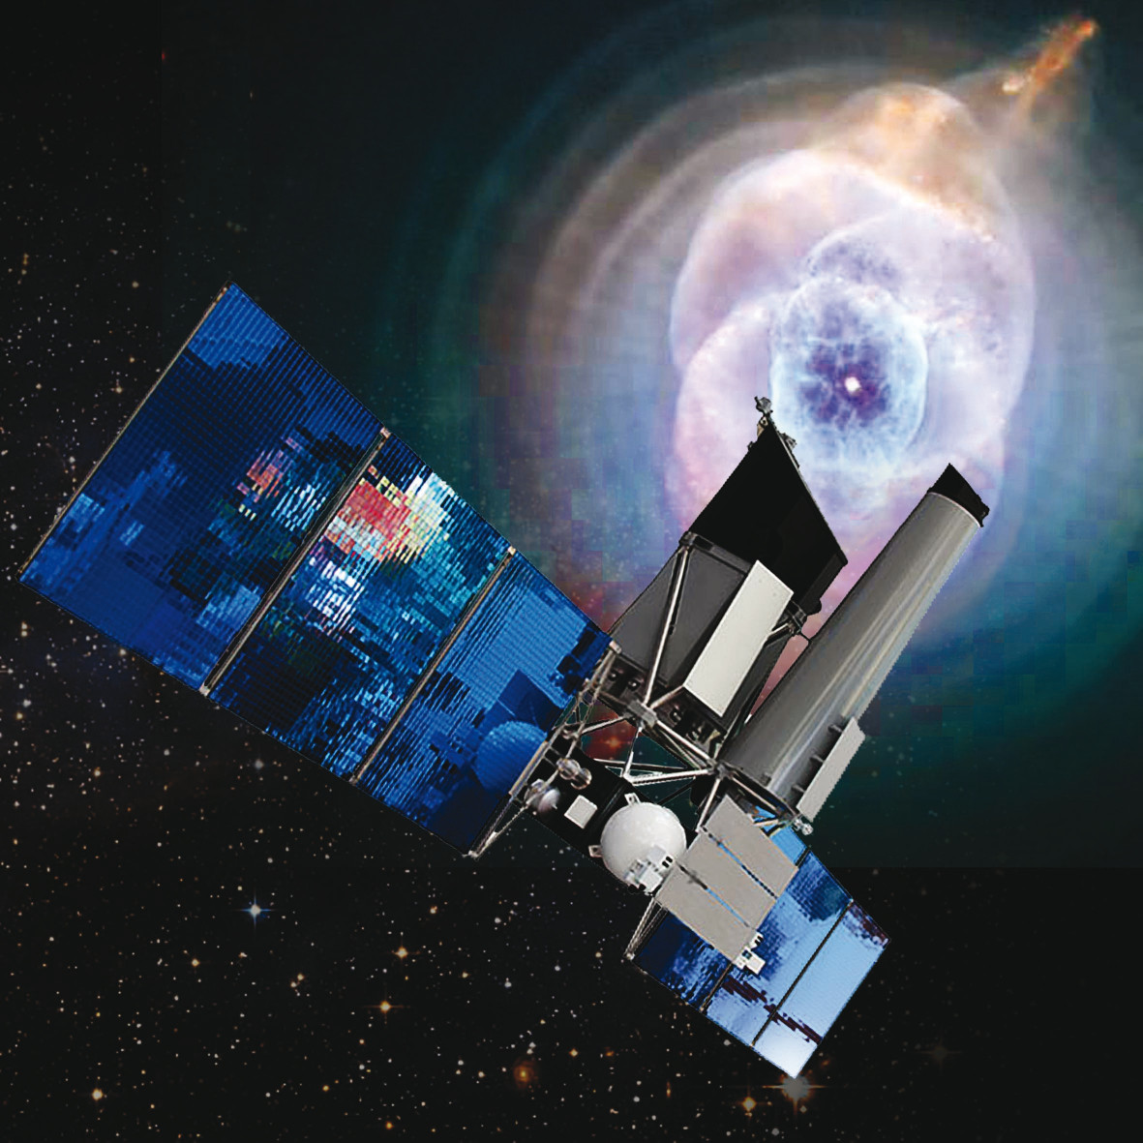
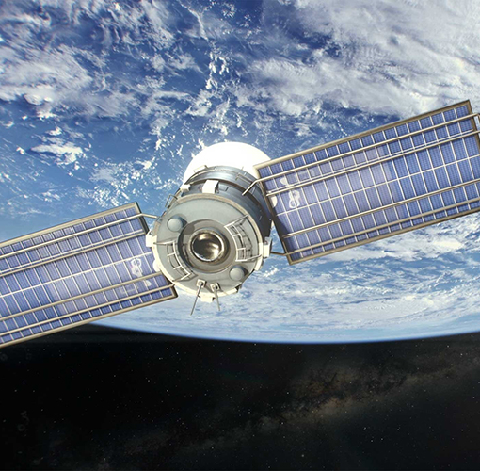
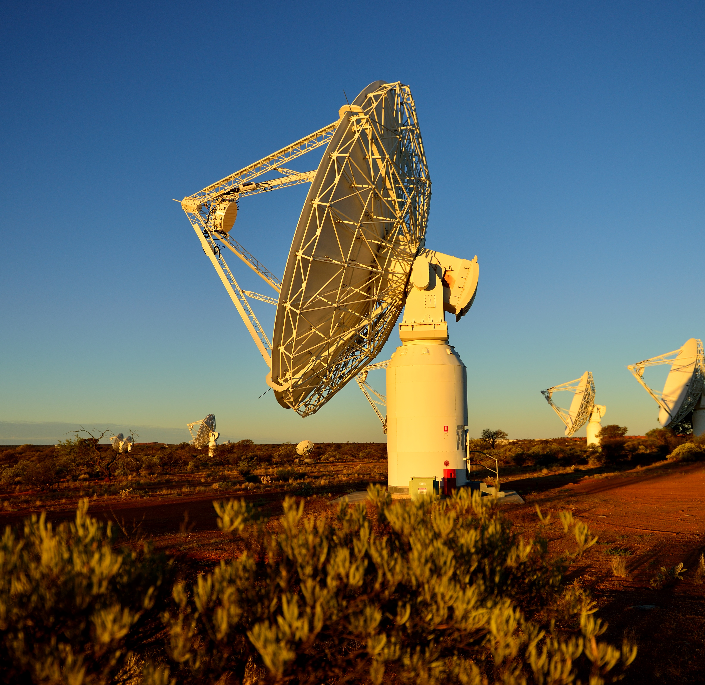
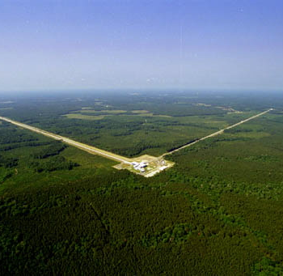
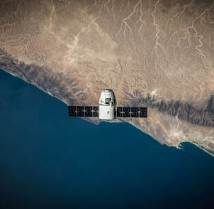
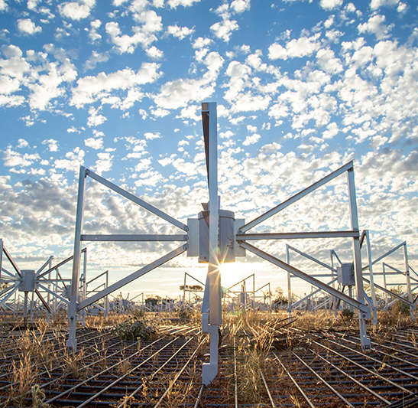
AAL portfolio approach
AAL portfolio approach instructed by the Decadal Plan
Top of the line facilities, in Australia or overseas.
AAL’s goal is for Australian astronomy to continue playing the role of key collaborator and leader for many of these programs.
ESO
AAT
Astralis
CTA
GMT
Rubin Observatory
Data & Computing
eROSITA
Space
ASKAP & MWA
GW Detector
Industry Engagement

Slide 8
AAL portfolio approach
AAL portfolio approach instructed by the Decadal Plan
Top of the line facilities, in Australia or overseas.
AAL’s goal is for Australian astronomy to continue playing the role of key collaborator and leader for many of these programs.
ESO
AAT
Astralis
CTA
GMT
Rubin Observatory
Data & Computing
eROSITA
Space
Industry Engagement
GW Detector
ASKAP & MWA

Slide 9
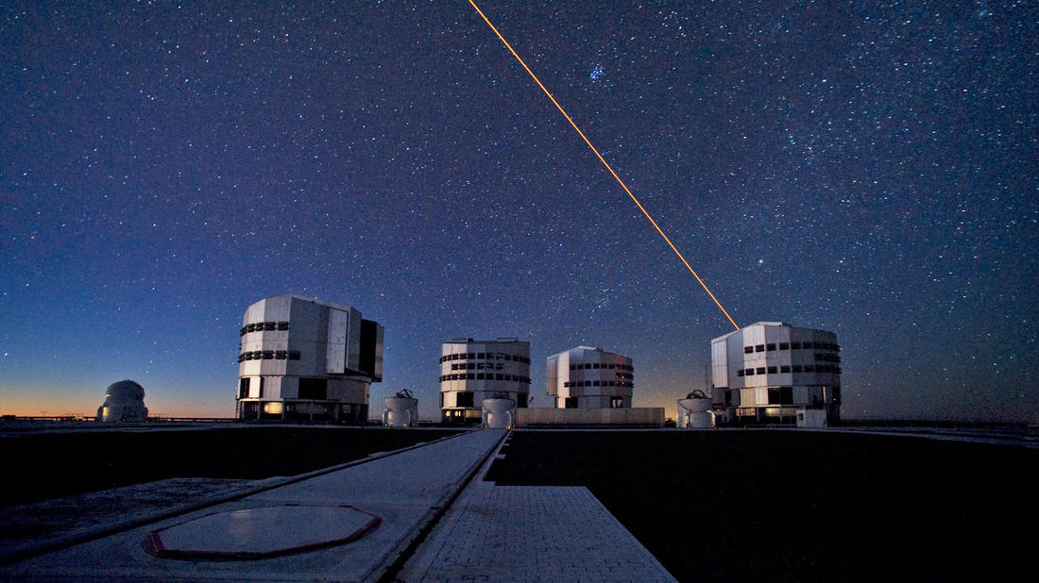
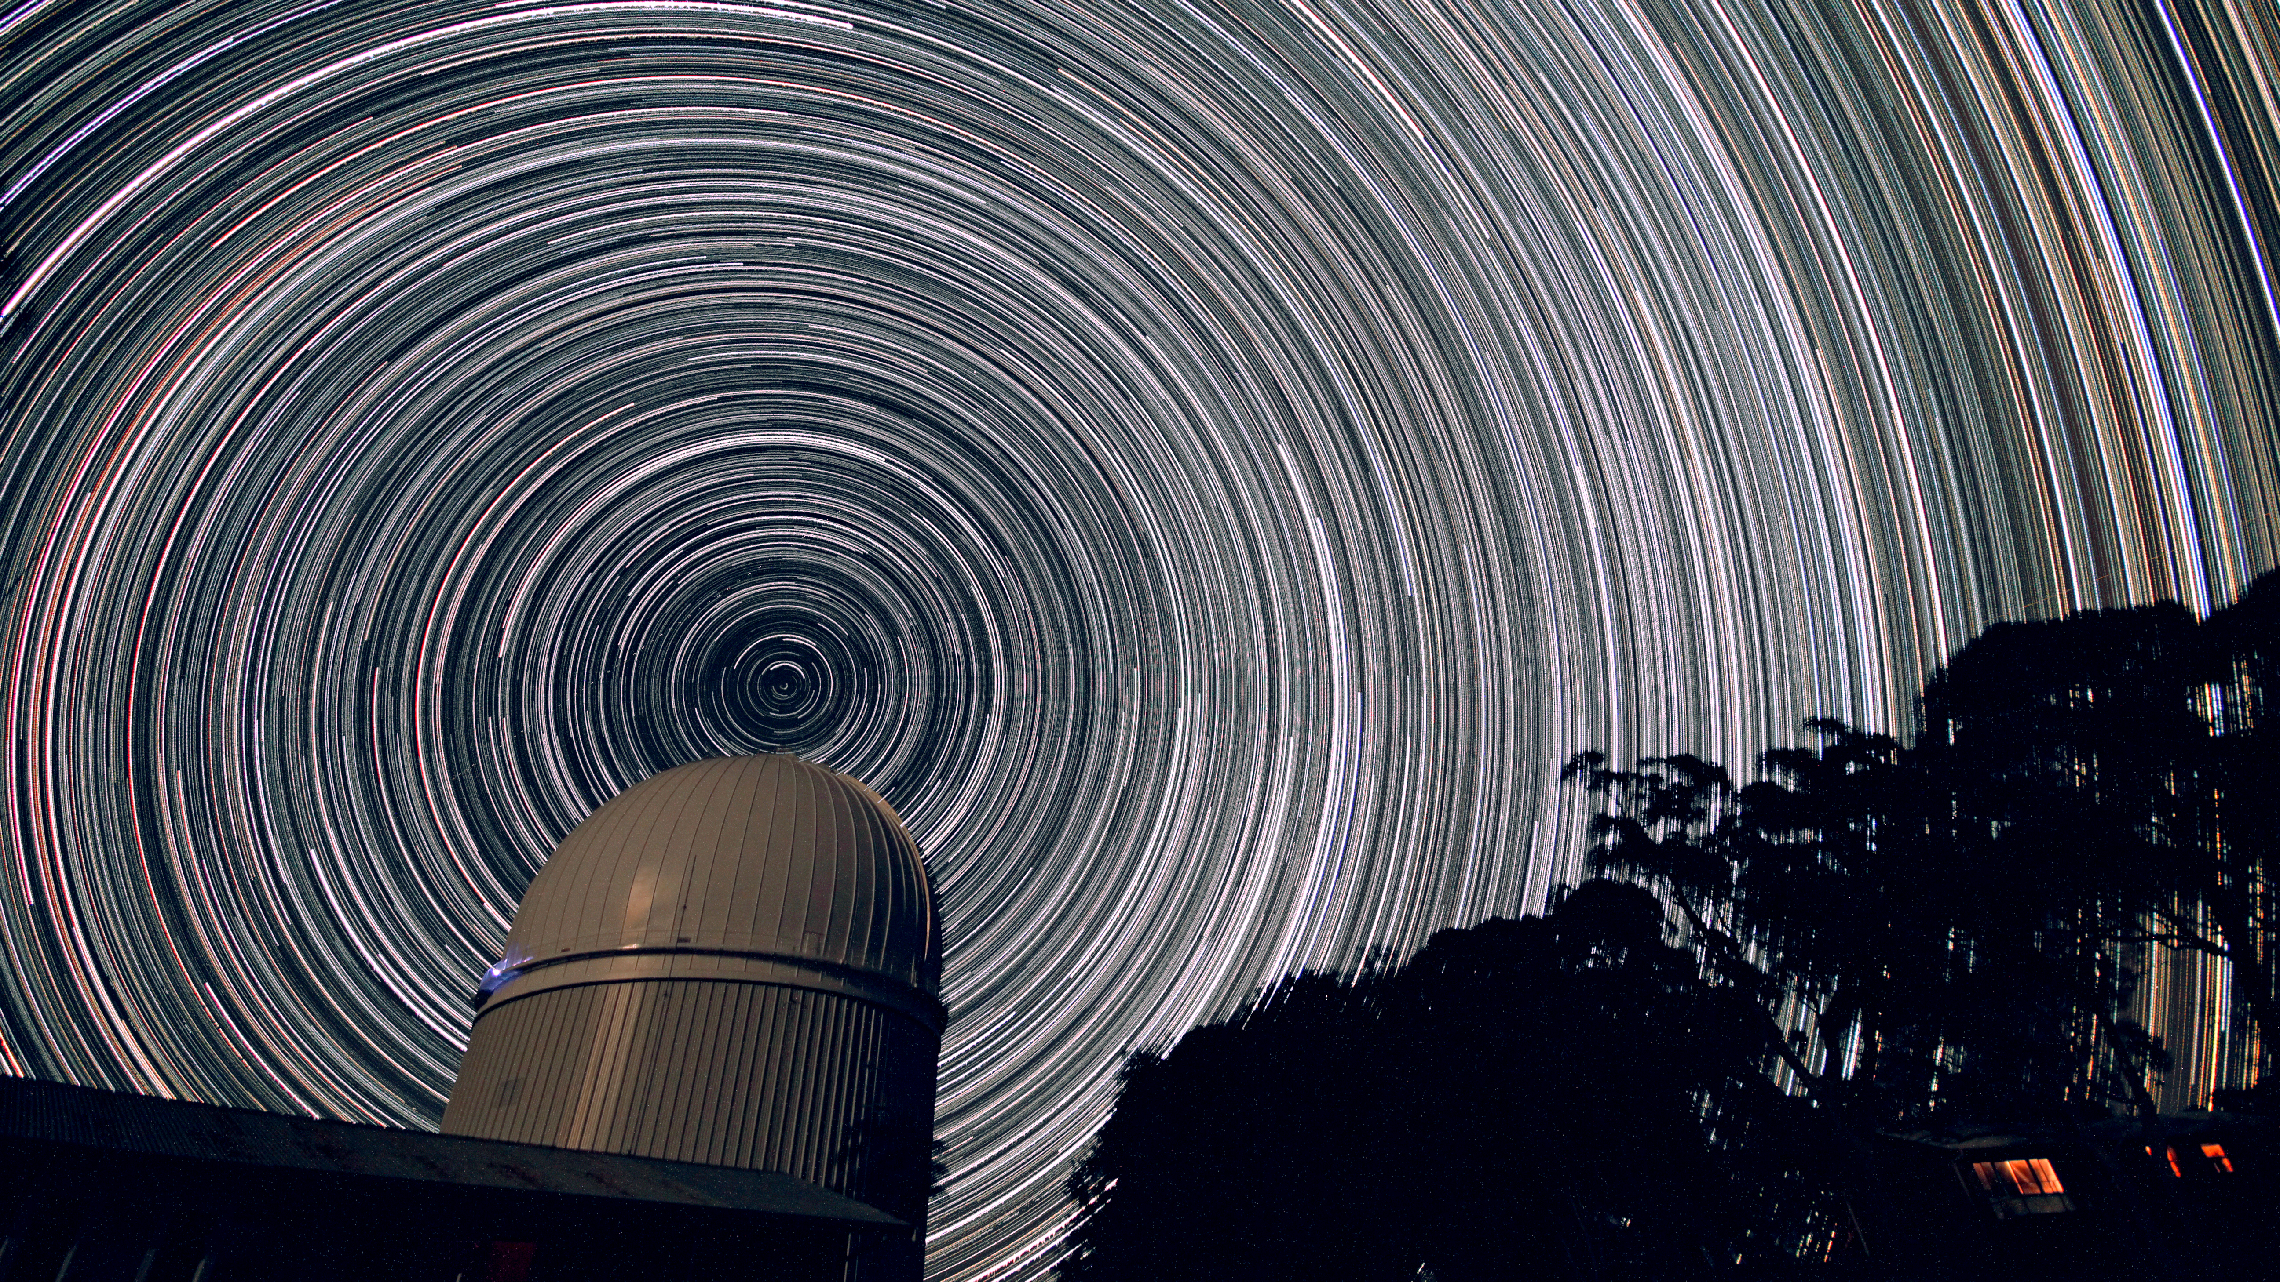
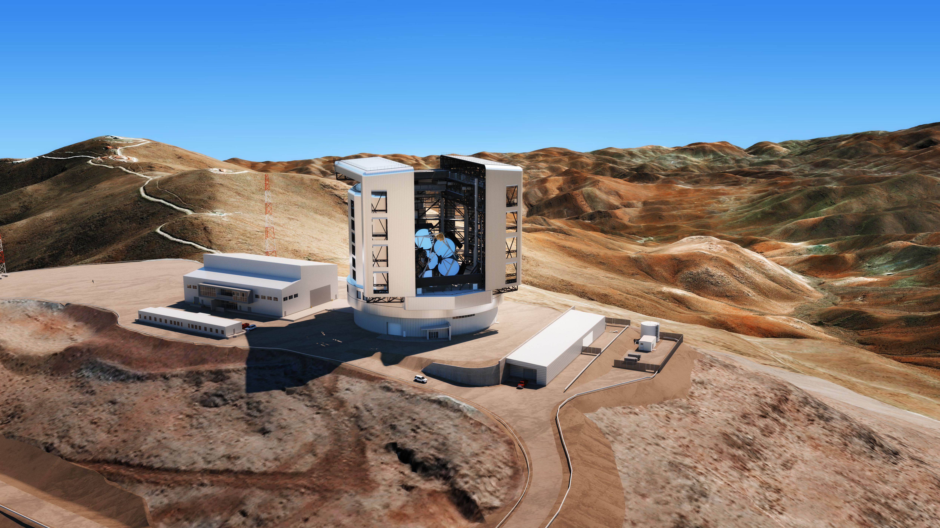
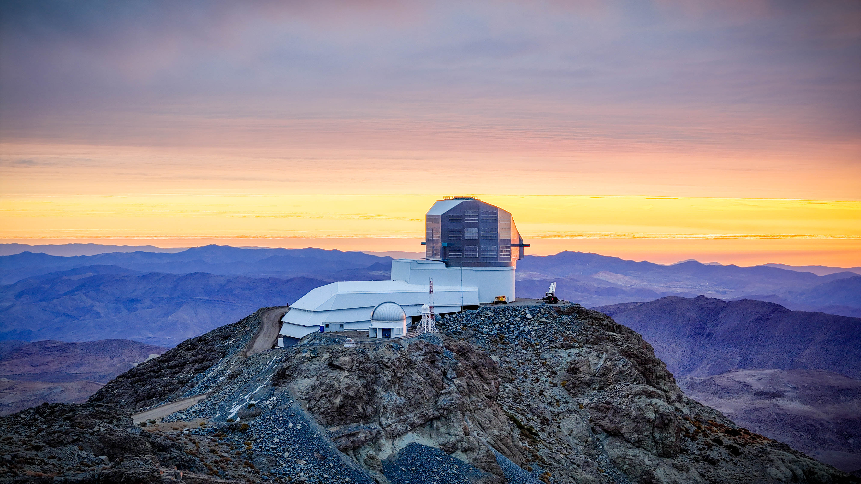
AAL portfolio: optical
AAL’s optical portfolio
Including the AAT, AAL’s optical portfolio contains:
The European Southern Observatory (ESO),
The Vera C. Rubin Observatory, and
The Giant Magellan Telescope (GMT).
It must be noted that top optical facilities cannot be built in Australia!
ESO
AAT
GMT
Rubin Observatory

Slide 10
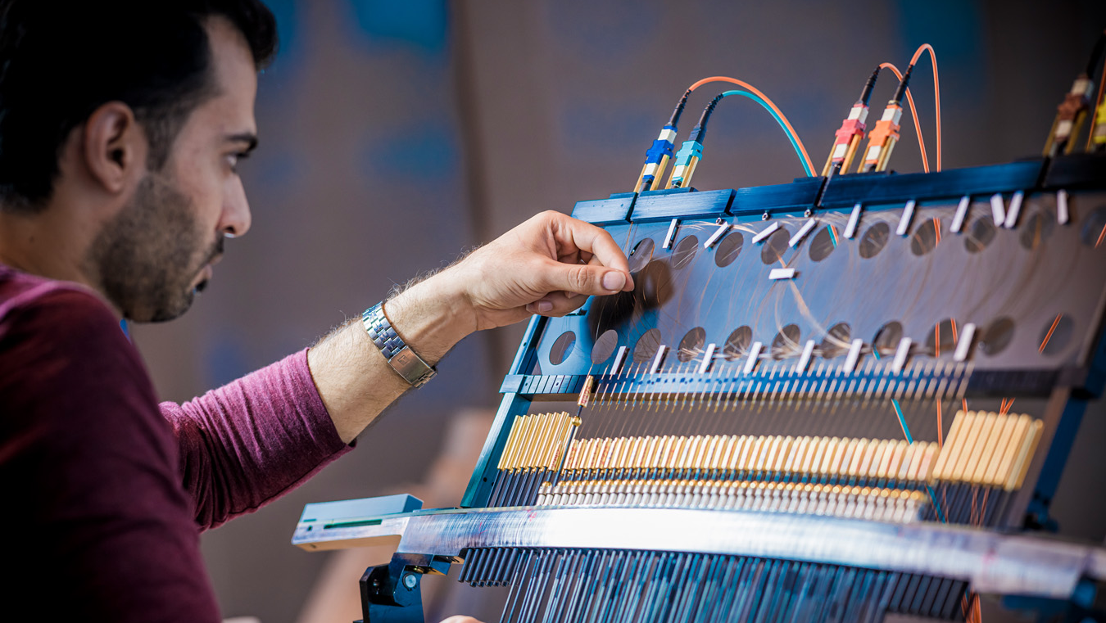
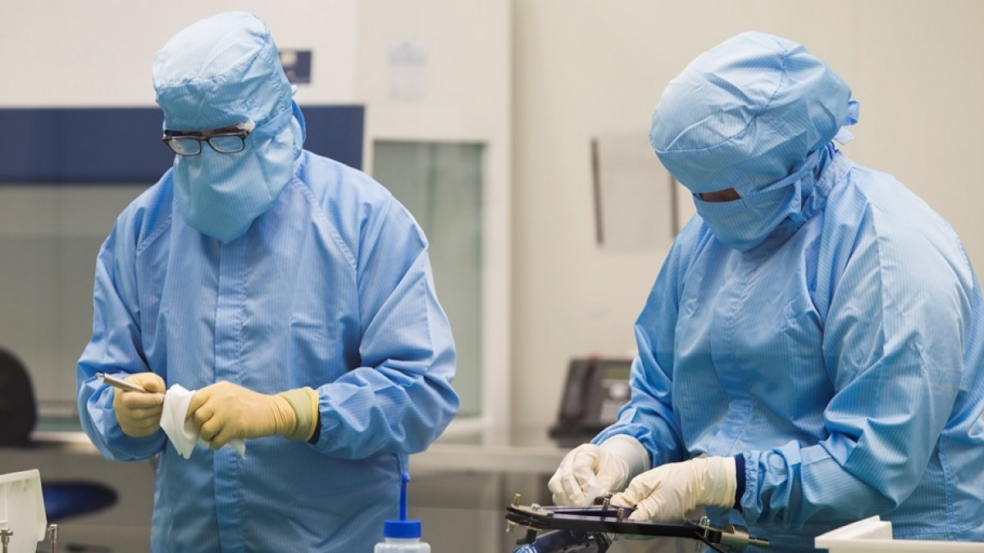
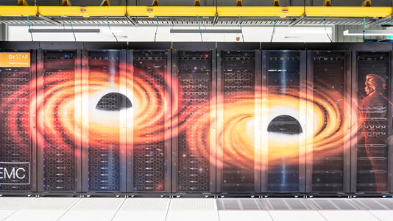
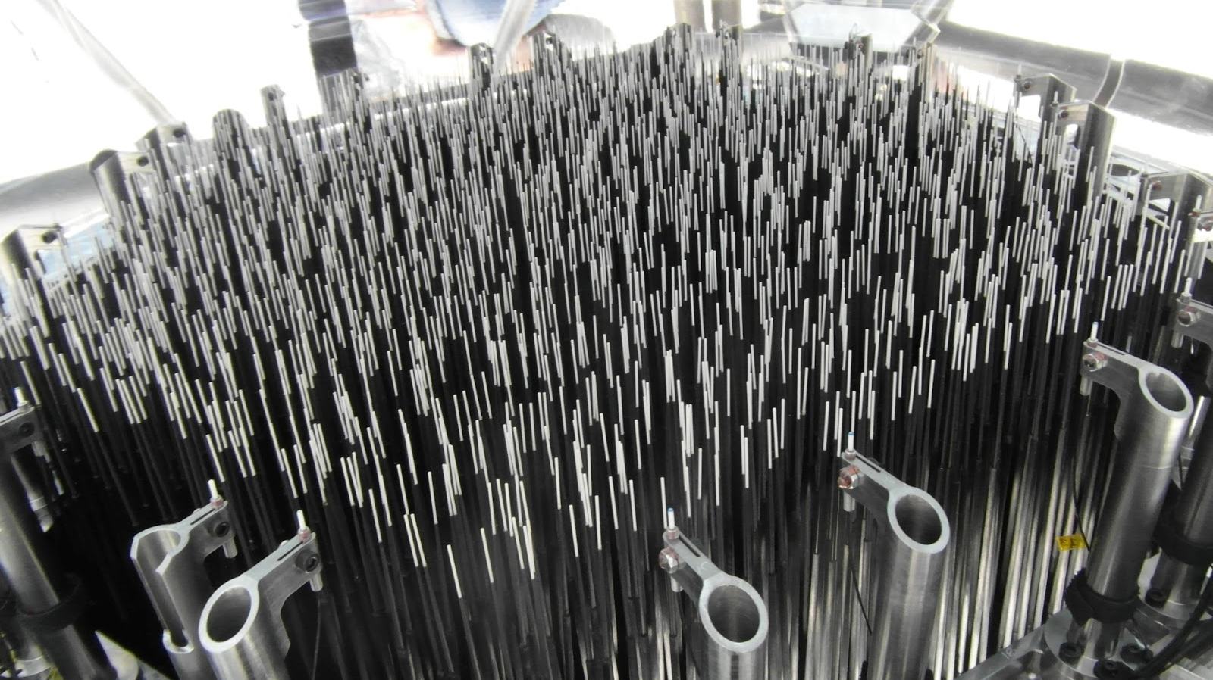
Australia’s role in optical instrumentation, software/data
Australia’s role in optical astronomy
Australia has some of the world’s best astronomy instrumentation builders, software engineers and data infrastructure.
All of this can be located on Australian soil!

Slide 11
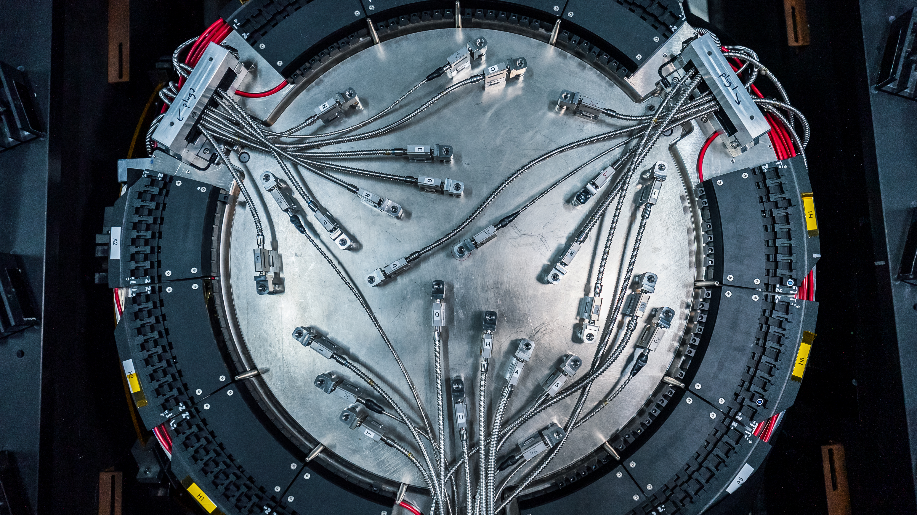
Sovereign Capability designed and built in Australia
We must rethink ‘sovereign capability’
We cannot have sovereign optical capabilities in Australia, but we can have sovereign expertise.
HECTOR. Credit: Julia Bryant.

Slide 12
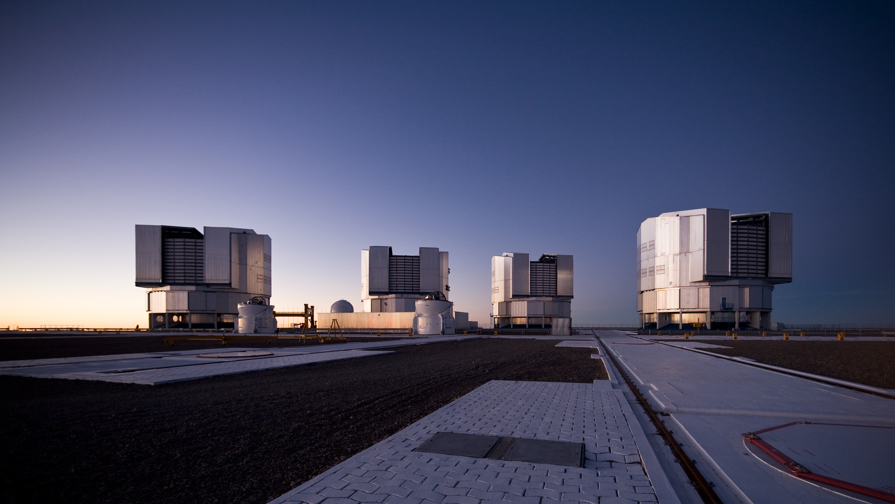
ESO The best solution
ESO is clearly the best solution for optical Astronomy in Australia.
ESO: 500M over 10 years. Excellent value when comparing the ticket price to the benefits of full membership.
Alternatives could be cheaper but would be far more expensive on a ROI basis.
Paranal platform after sunset. Credit: ESO/H.H.Heyer.

Slide 13
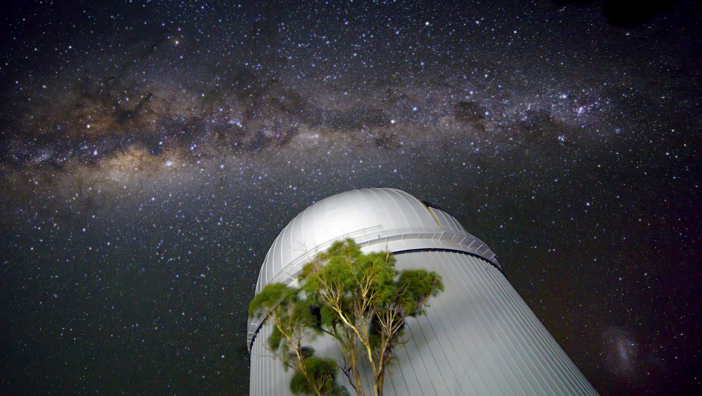
The future
Collaboration & Partnership
AAT: lessons learned
Equal partners make great ventures.
Interdisciplinary collaboration: engineers, astronomers, computer scientists, …
It takes a village …
Image credit: Ángel R. López Sánchez.
Notes:
If we can recreate the spirit of the village in future venture, future telescopes, then maybe we have a fighting change of recreating the success of the AAT

Slide 14
The future
Collaboration & Partnership
AAT: lessons learned
Equal partners make great ventures.
Interdisciplinary collaboration: engineers, astronomers, computer scientists, …
It takes a village …
We need to retain the spirit of the “village” in future optical astronomy ventures … then maybe we have a fighting change of recreating the successes of the AAT
Image credit: Ángel R. López Sánchez.
Notes:
If we can recreate the spirit of the village in future venture, future telescopes, then maybe we have a fighting change of recreating the success of the AAT

