Slide 1
Gomilaroi Country 1 (Thomas ‘Bagaay’ Avery)
Acknowledging the Gamilaraay People

Slide 2
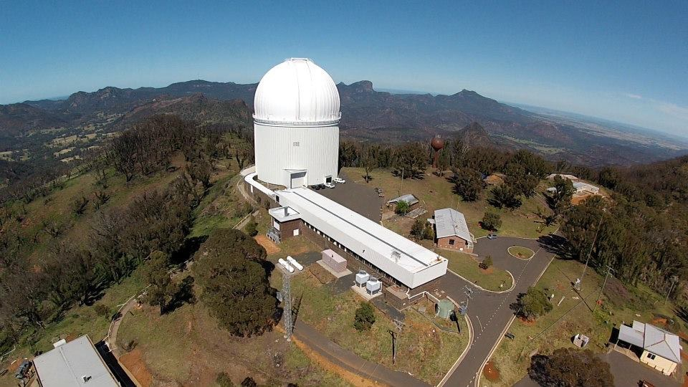
Anglo-Australian Telescope
Evaluating its role in Australian astronomy
Fred Watson
Astronomer-at-Large Department of Industry, Science and Resources
Peter Poulos, Peter Verweyen

Slide 3
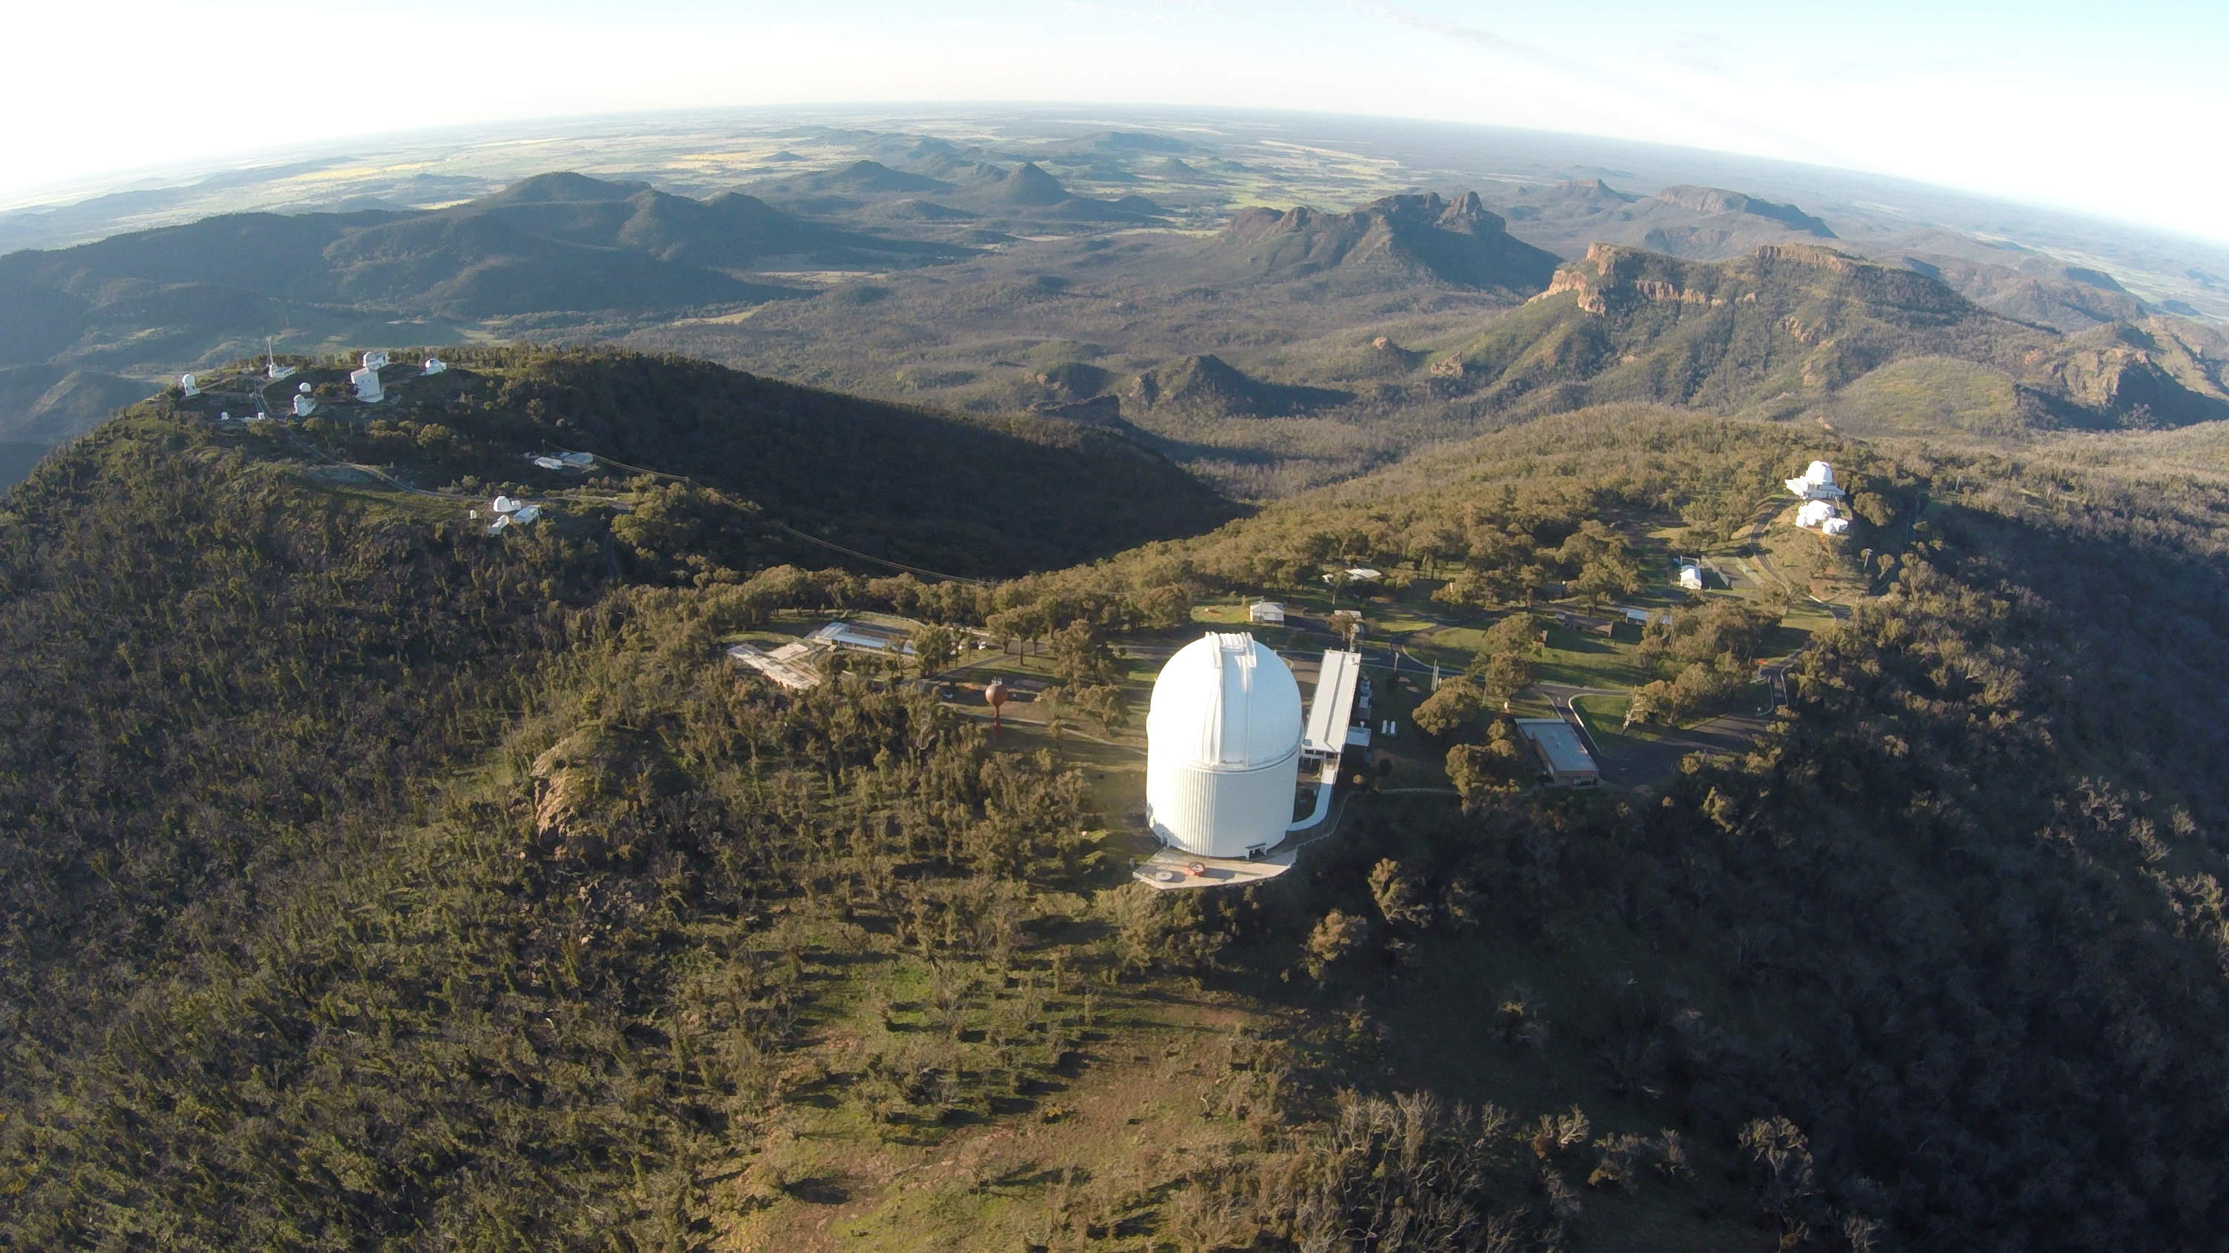
A trilogy in two parts…
Evaluating the Anglo-Australian Telescope
Celebrating its 3.9-metre mirror
Australian National University
Gamilaraay country


Slide 4
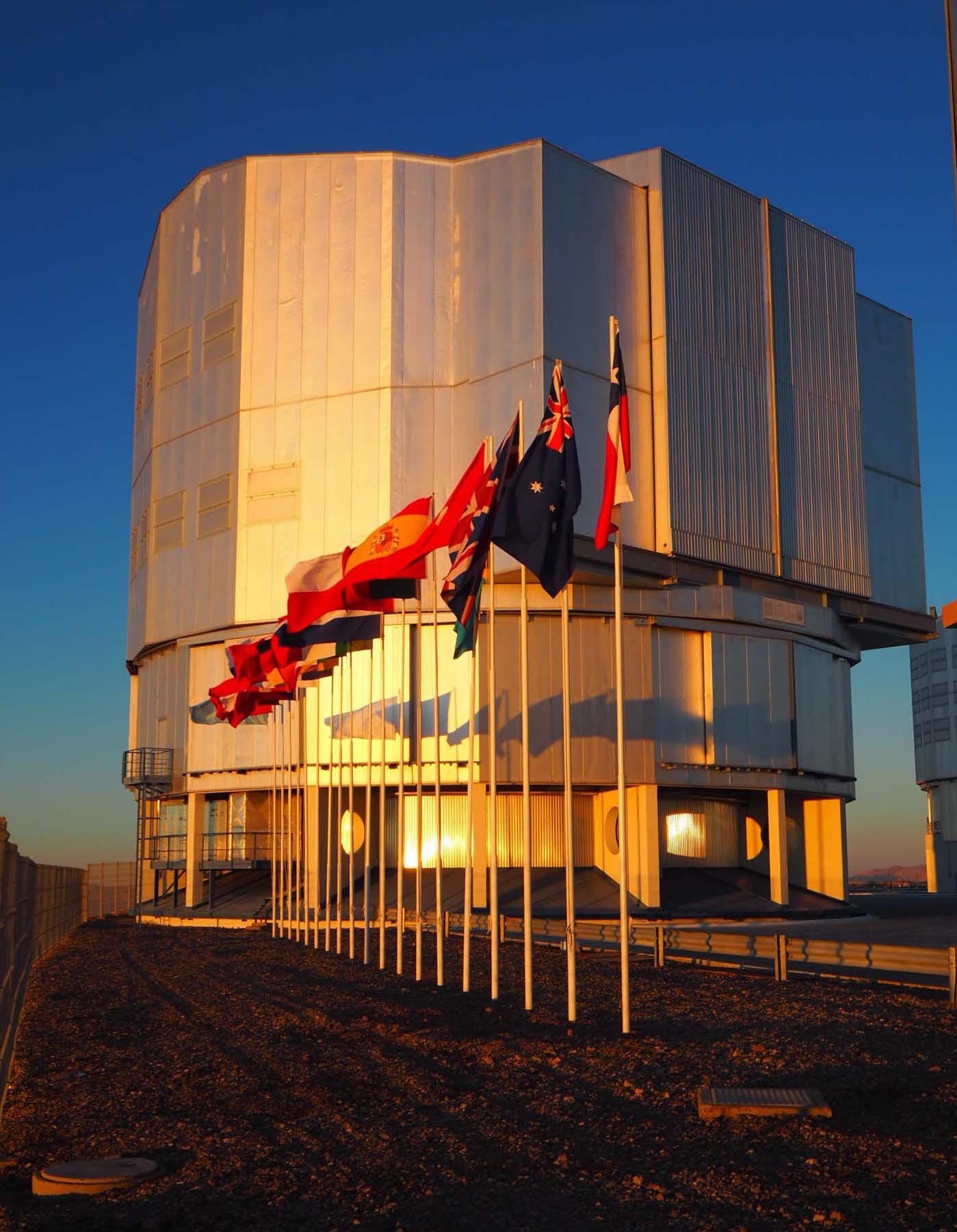
11 July 2017: A new vision for the National Observatory…
Maintaining Australia’s Optical Astronomy Capability (MAOAC) budget measure, 2017-18
A ten-year strategic partnership with ESO
AAT transition to the research sector
(Astronomical Functions Act 2010, Compilation No.3 2018)
Clare McLaughlin

Slide 5
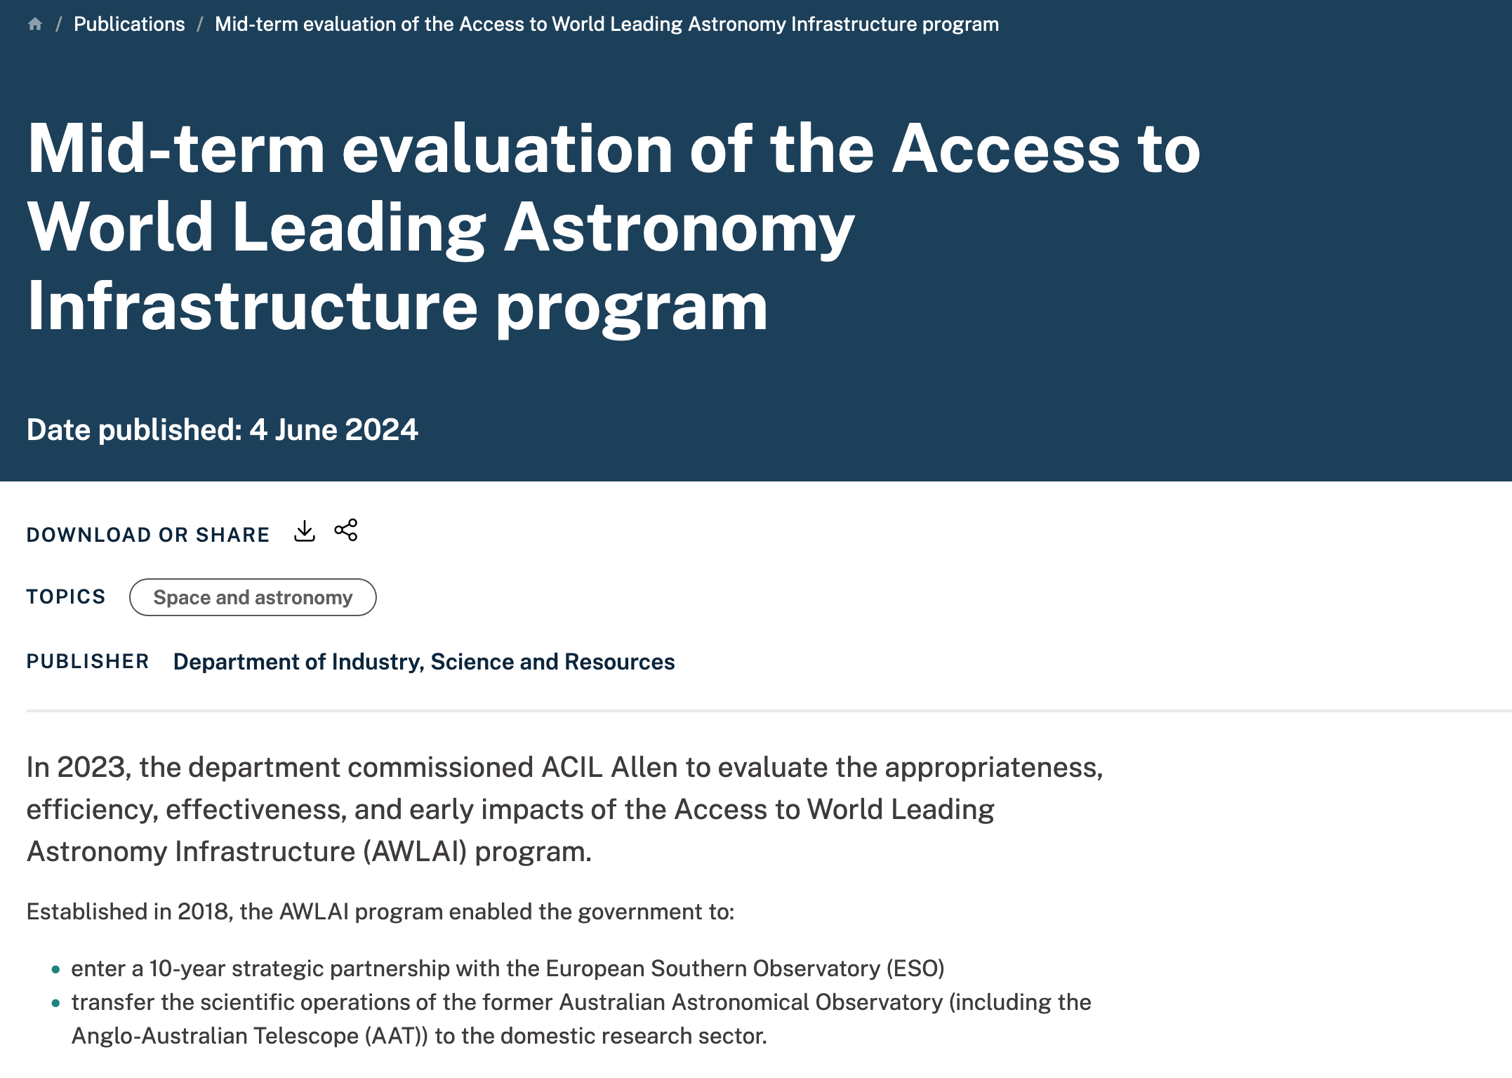
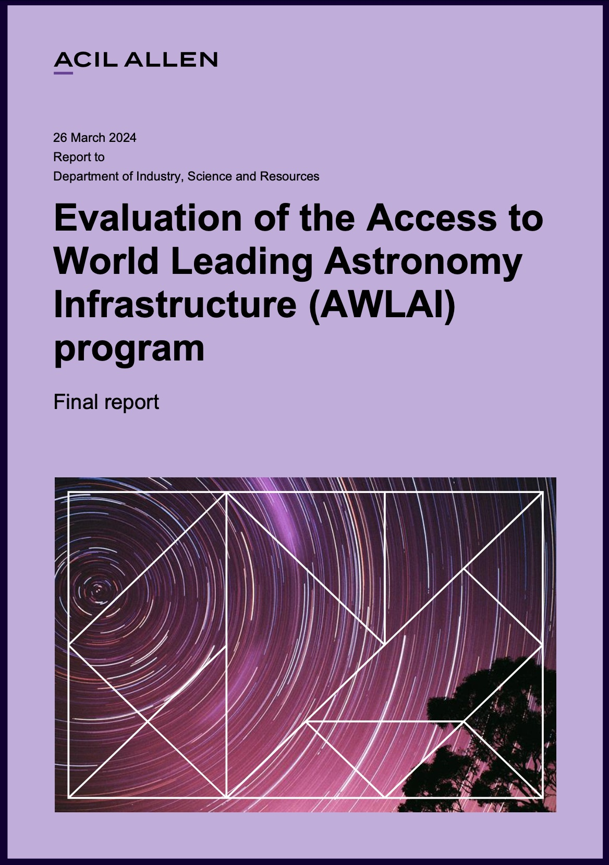
2024: All eyes on AWLAI…
Responses from 123 Australian astronomers
ACIL Allen

Slide 6
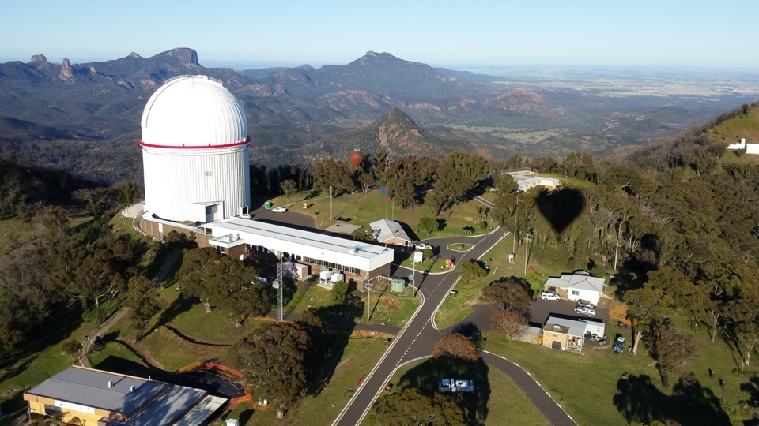
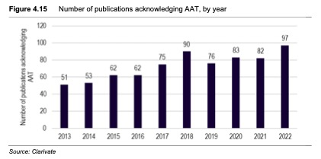
AWLAI notes a positive trend…
Anon

Slide 7
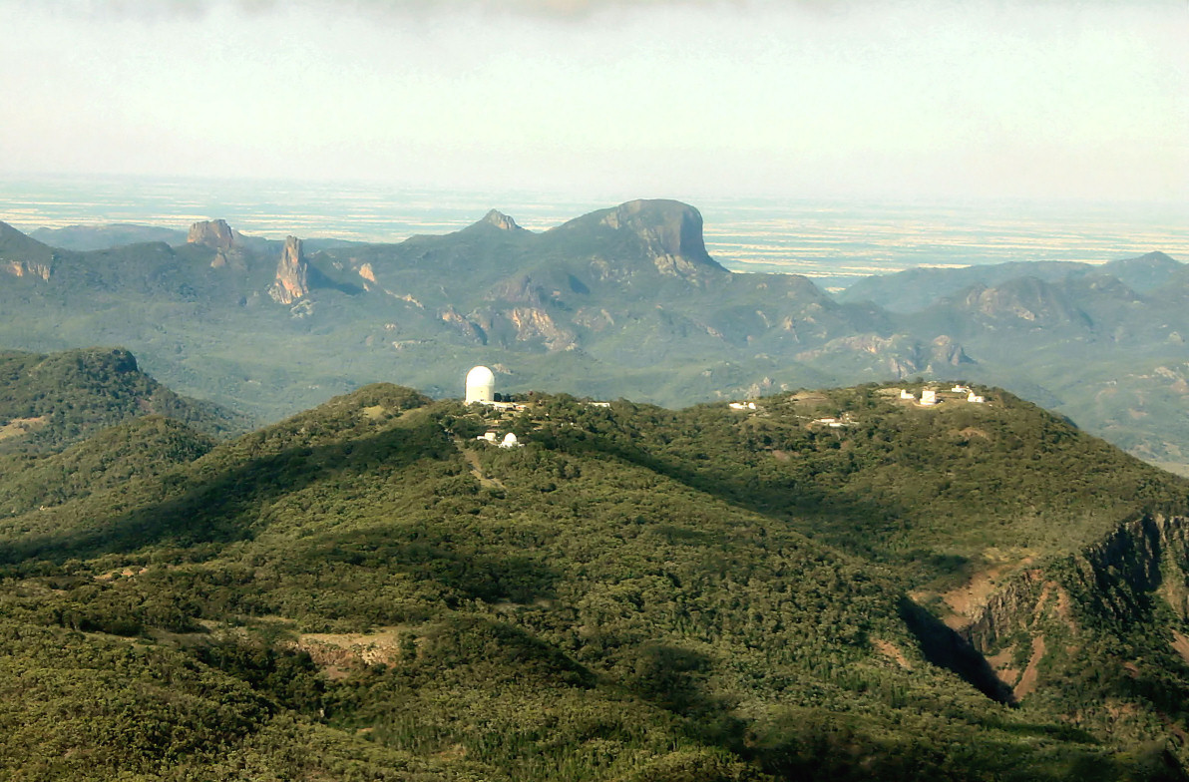
What AWLAI says about the AAT…
It is effective in observing across time, enabling large surveys and follow-up on data gained from other facilities, and in filling the gap between what telescopes in South Africa and Chile can observe.
Two leading edge instruments were commissioned in the last year (Hector and Veloce), which will be useful for surveys over the next 5 years.
All interviewees acknowledged that the AAT was ageing, and no longer considered world-class. It was not considered a suitable substitute for the telescopes accessed through the ESO-SP.

Slide 8
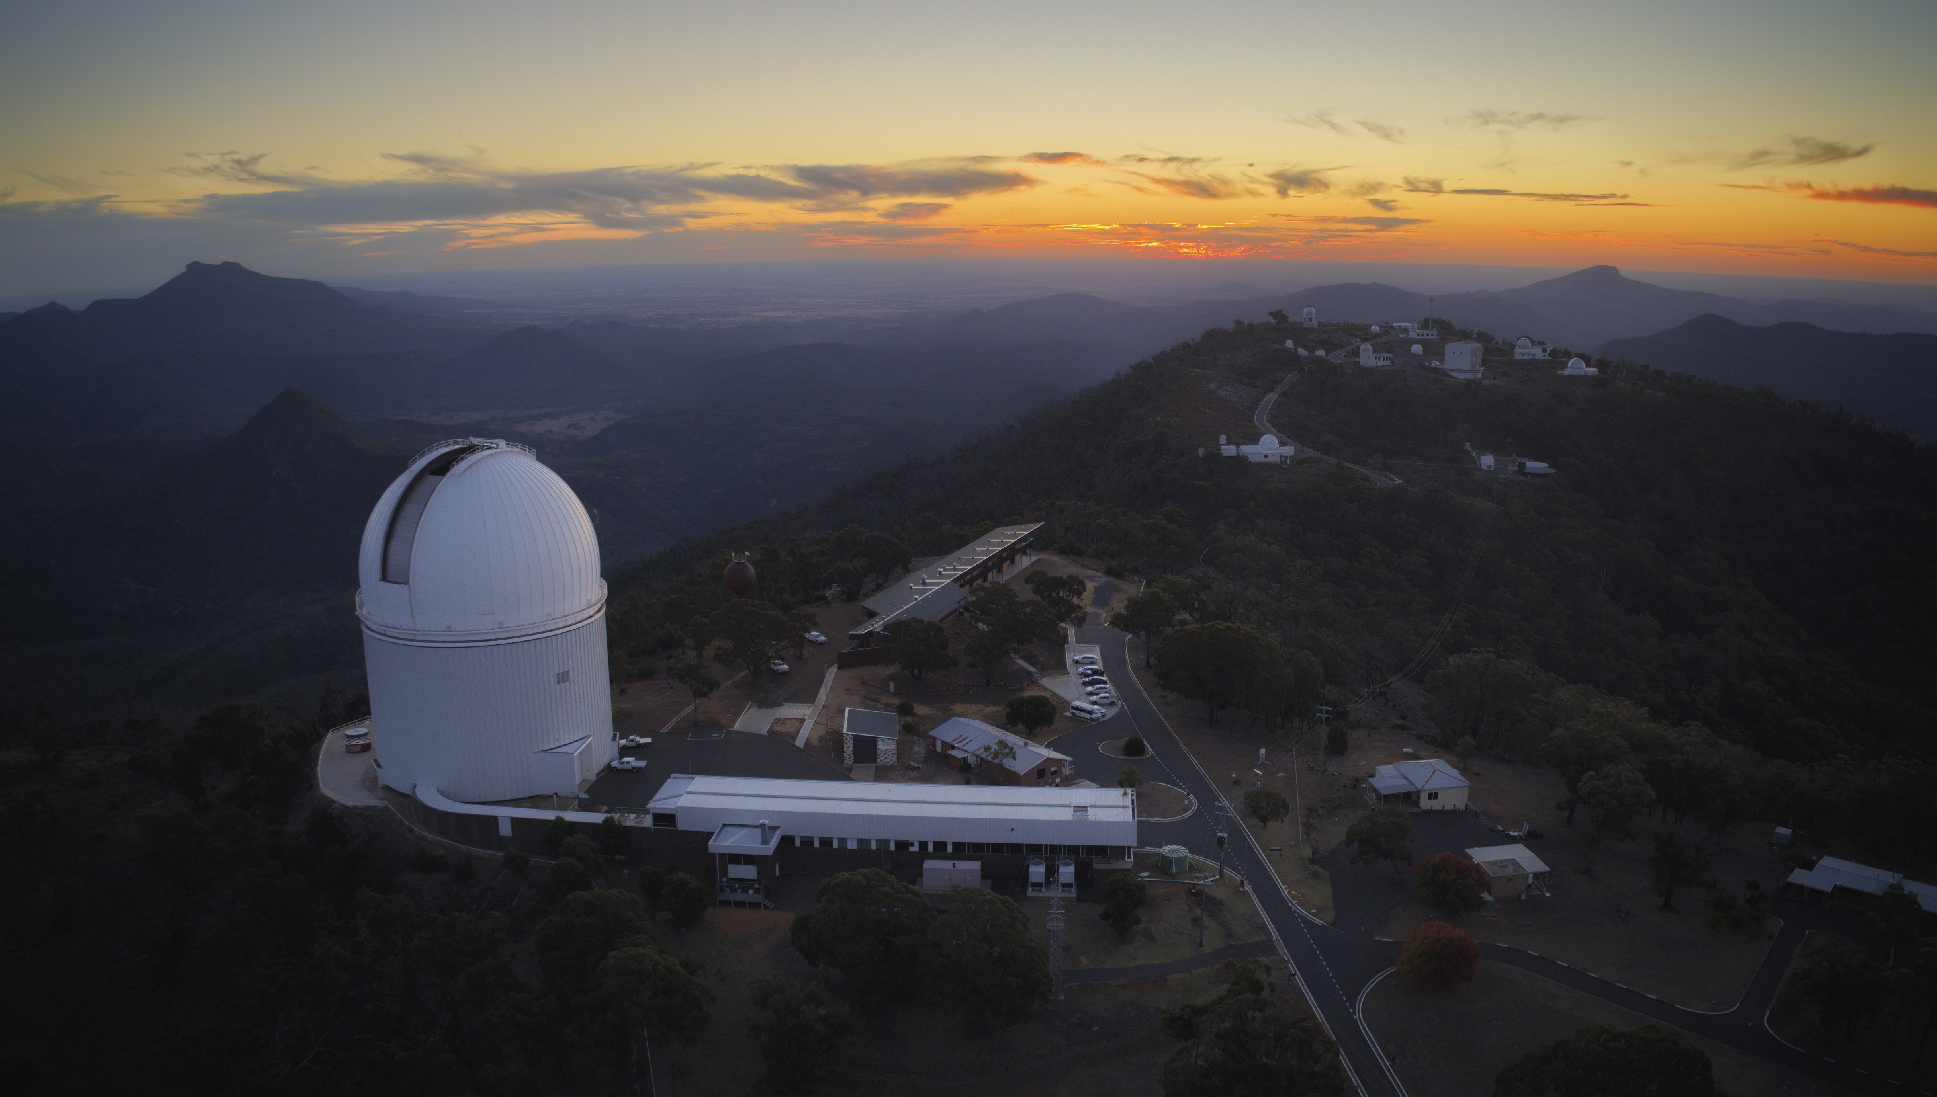
AWLAI Key Finding 11 – Impact of extending the AAT
The AAT is a well-built, high-quality facility that is oversubscribed and delivers valuable scientific output.
However, it is ageing, and no longer considered world-class.
An extension to the current arrangements for AAT beyond 30 June 2025 would likely result in gradually diminishing scientific outcomes, and as such, there needs to be some longer-term clarity in the intentions for the AAT.
Fillipo Rivetti Photography

Slide 9
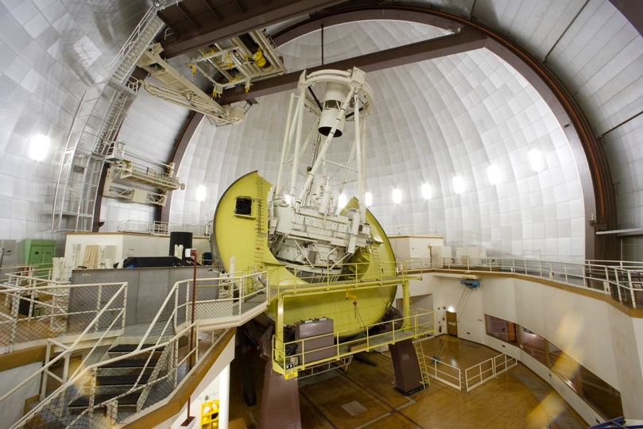
The Government is currently analysing options, including results from the evaluation, and also awaiting the outcome of an ARC grant application for the AAT before making any decisions on future funding

Slide 10
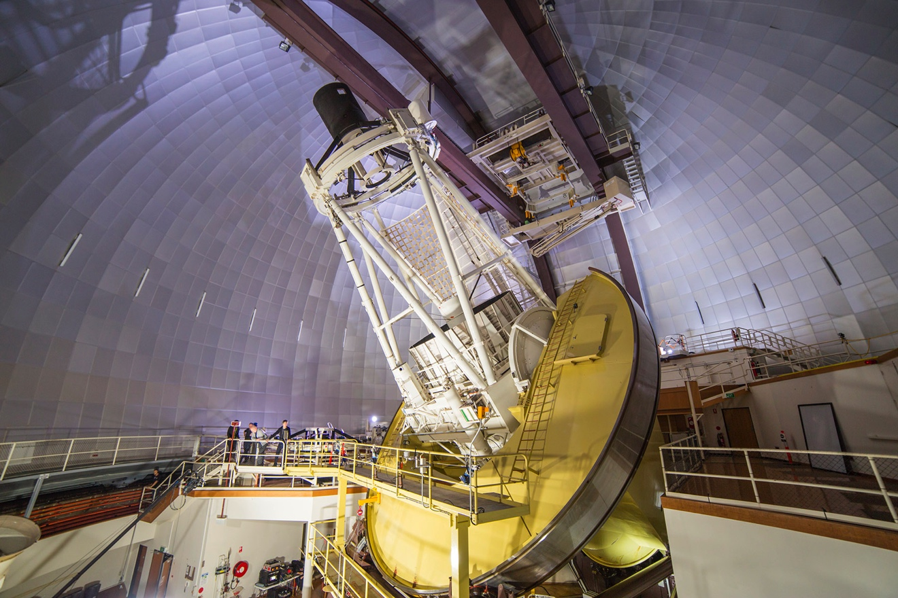
Angel Lopez-Sanchez. AAO-MQ
The Government is currently analysing options, including results from the evaluation, and also awaiting the outcome of an ARC grant application for the AAT before making any decisions on future funding

Slide 11
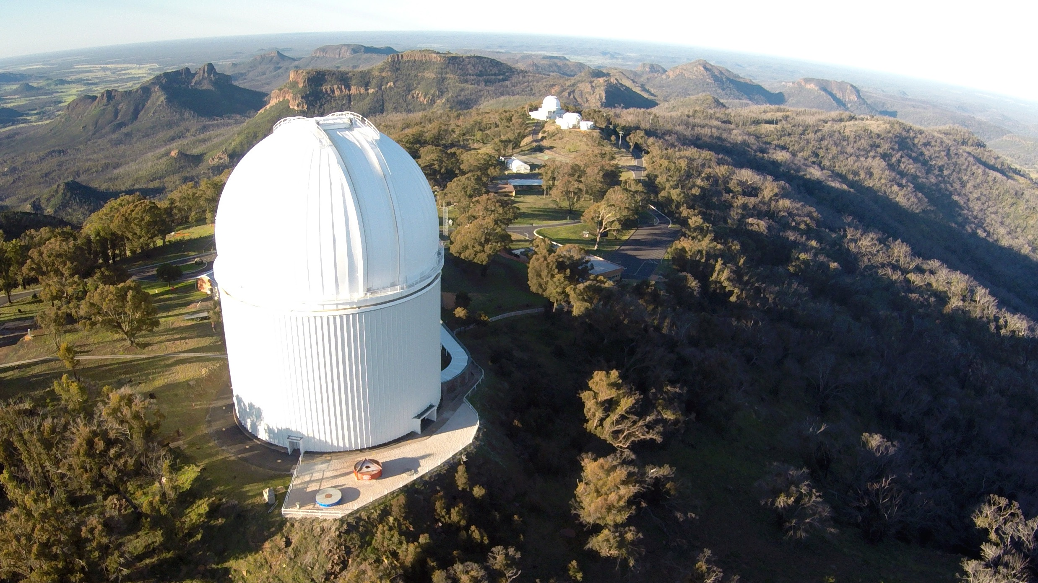
Peter Poulos, Peter Verweyen

Slide 12
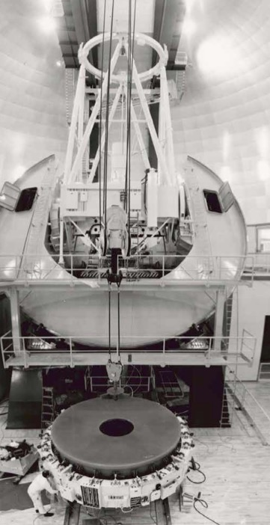
Celebrating the AAT primary mirror

Slide 13
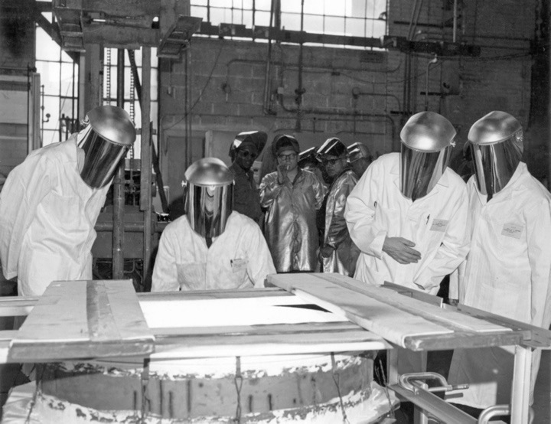
By 1967, there was already an AAT Technical Committee, seen here at Owens-Illinois Glassworks in July...
What’s going on? I can’t see anything through this...
Anyone got a light?

Slide 14
In July 1967, the newly-formed AAT Technical Committee visits the Owens-Illinois Glassworks in Ohio...

Slide 15
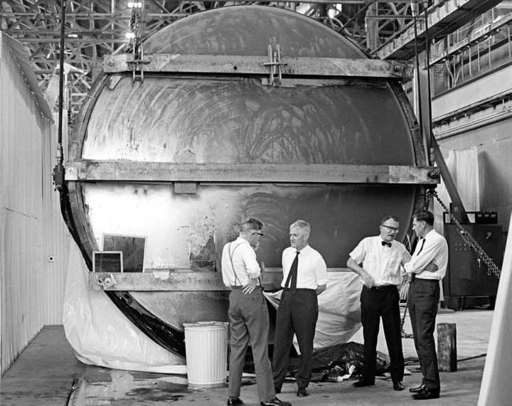
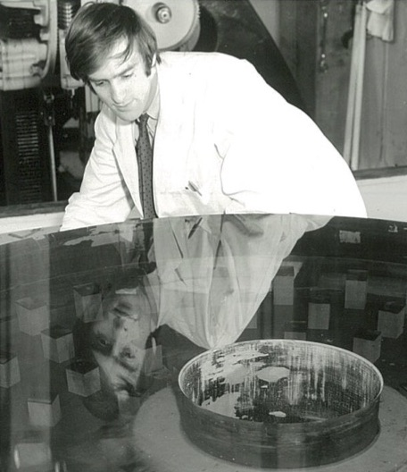
While in May 1969...

Slide 16
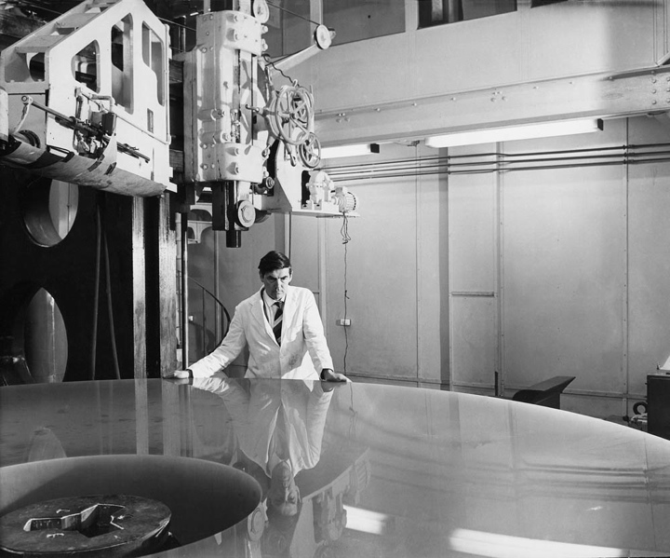
And early in 1973...

Slide 17
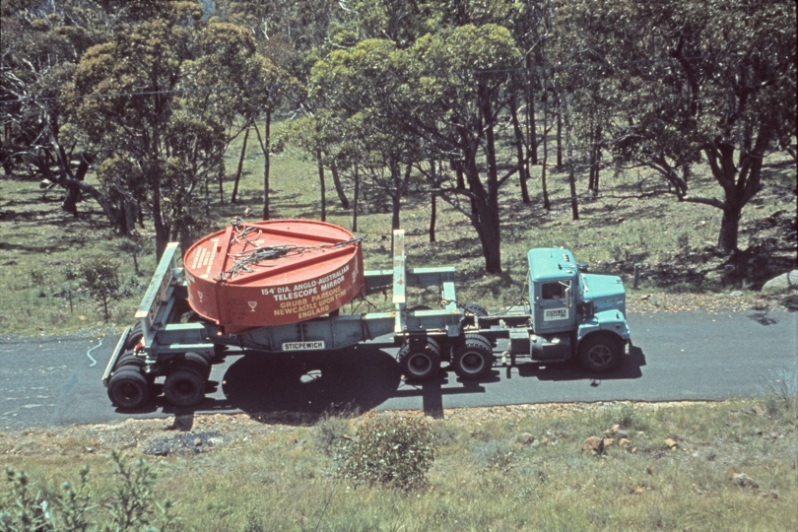

Slide 18
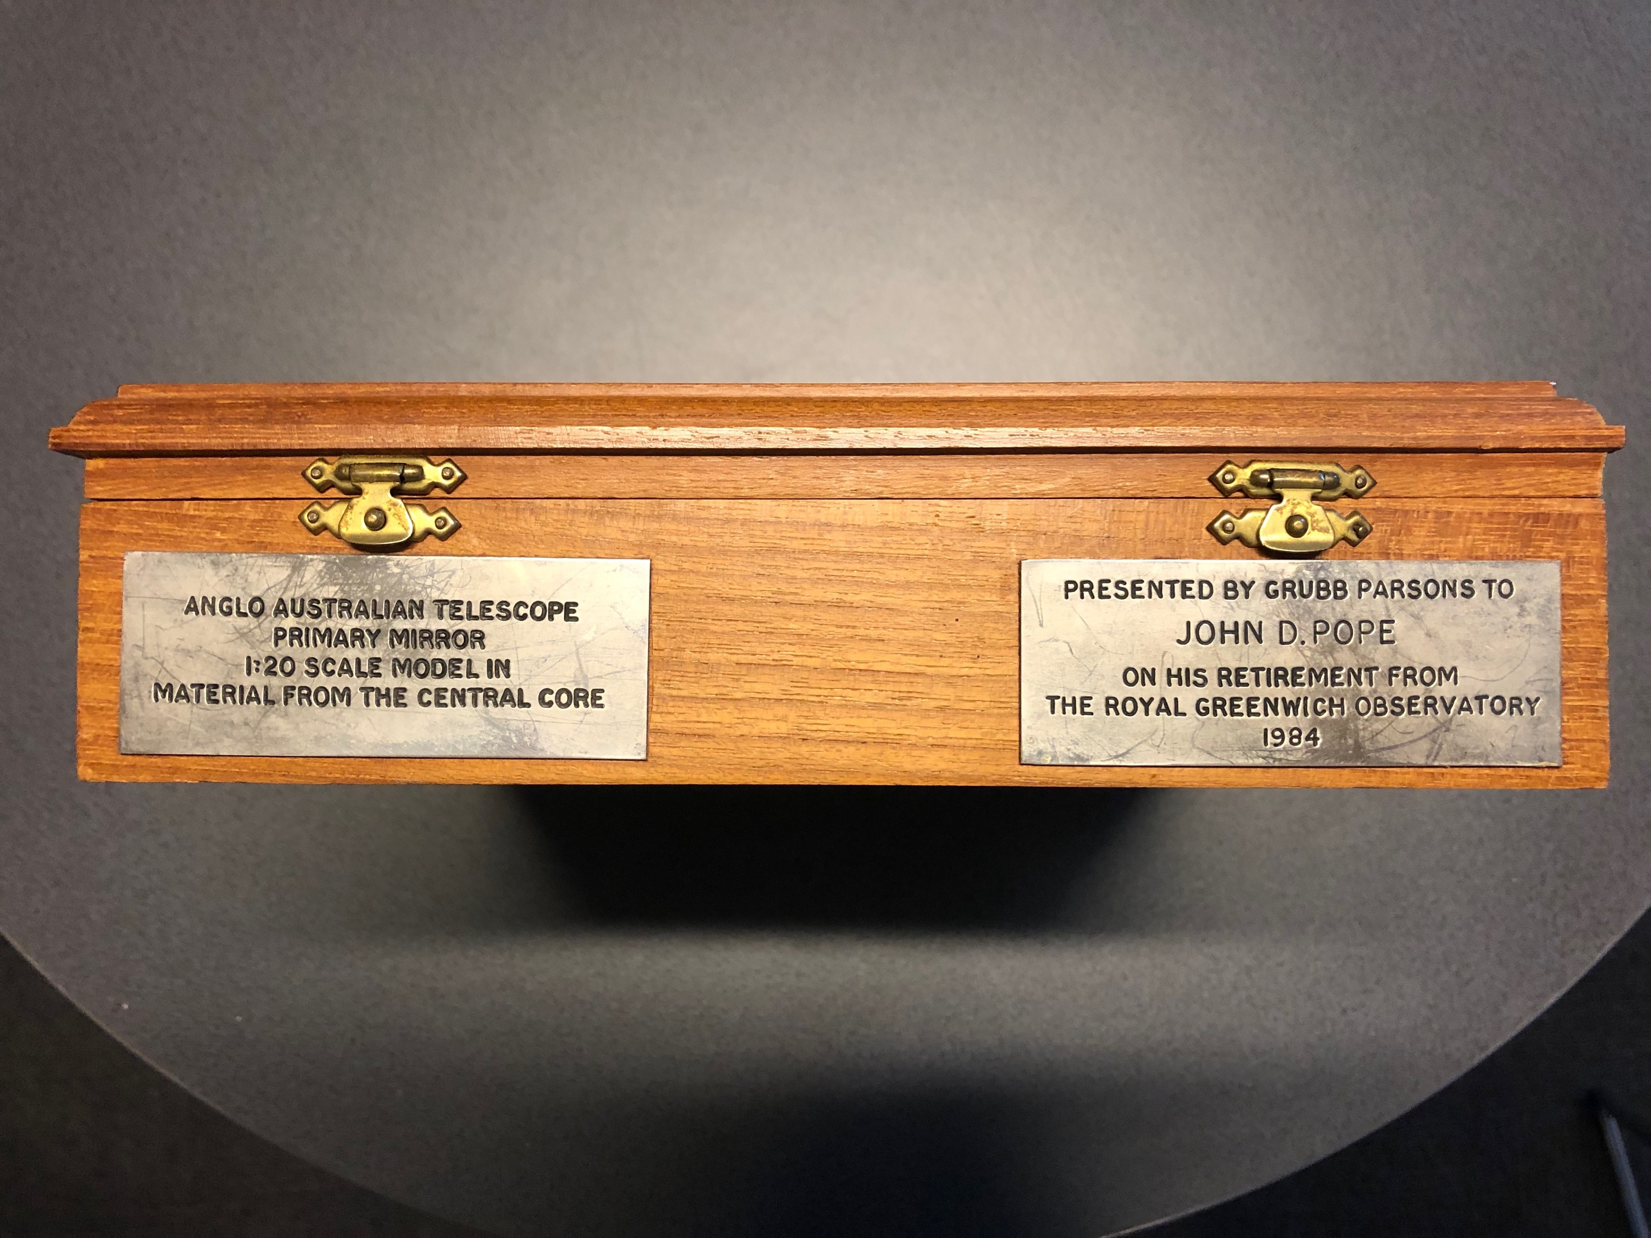
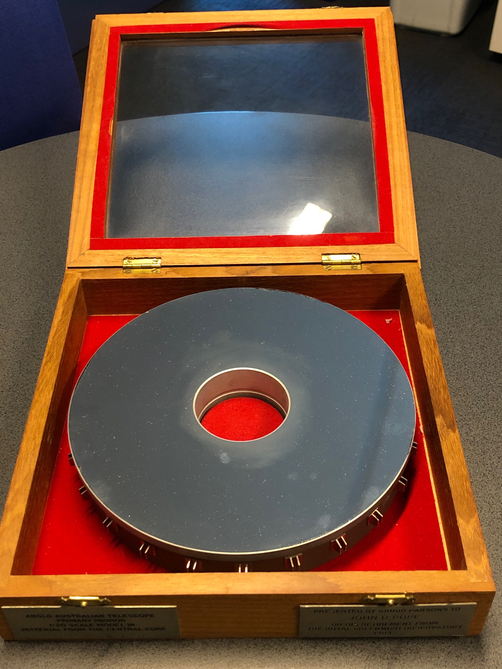
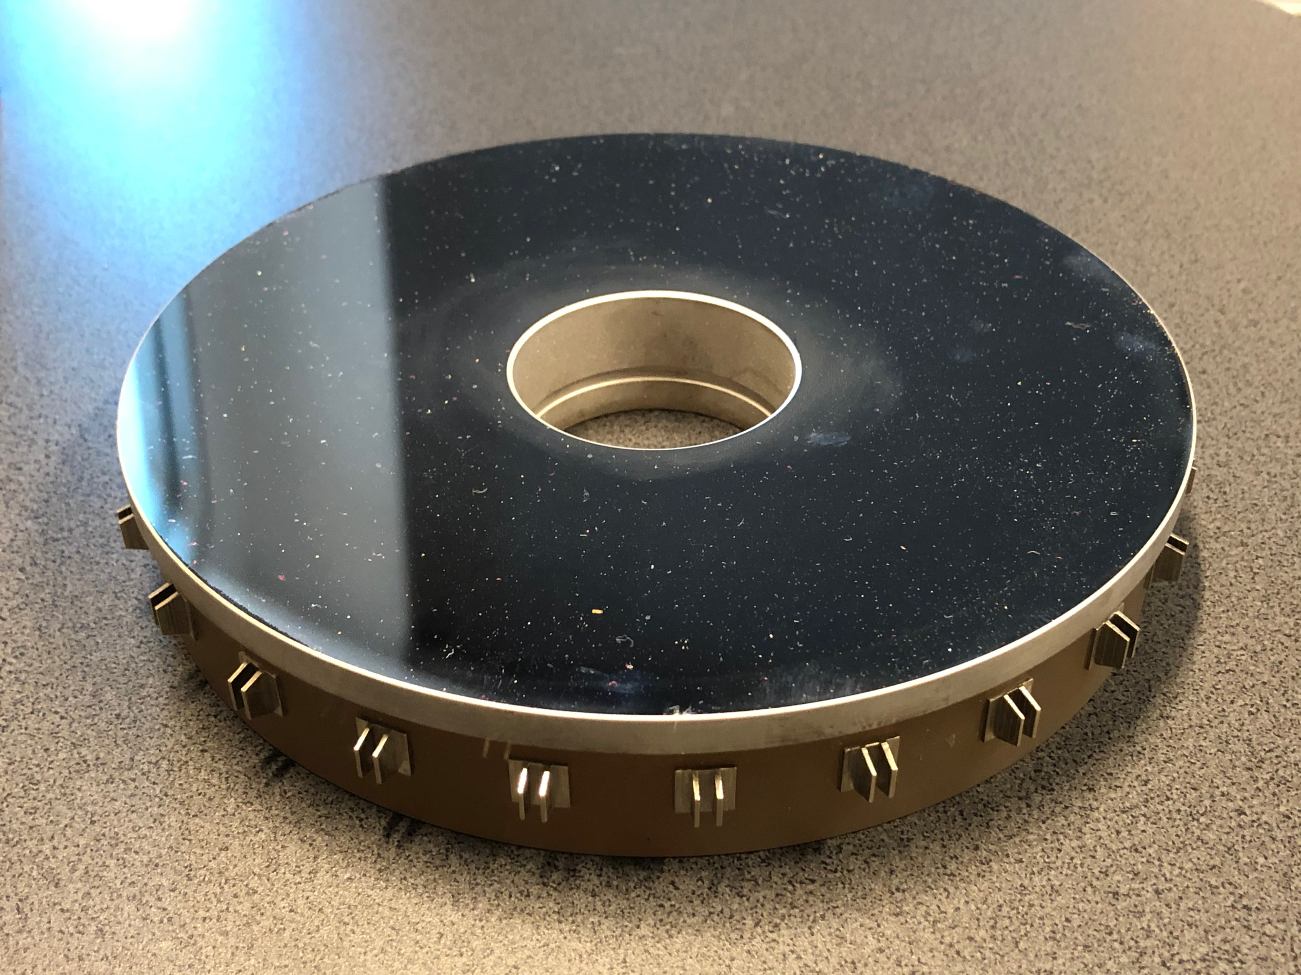

Slide 19
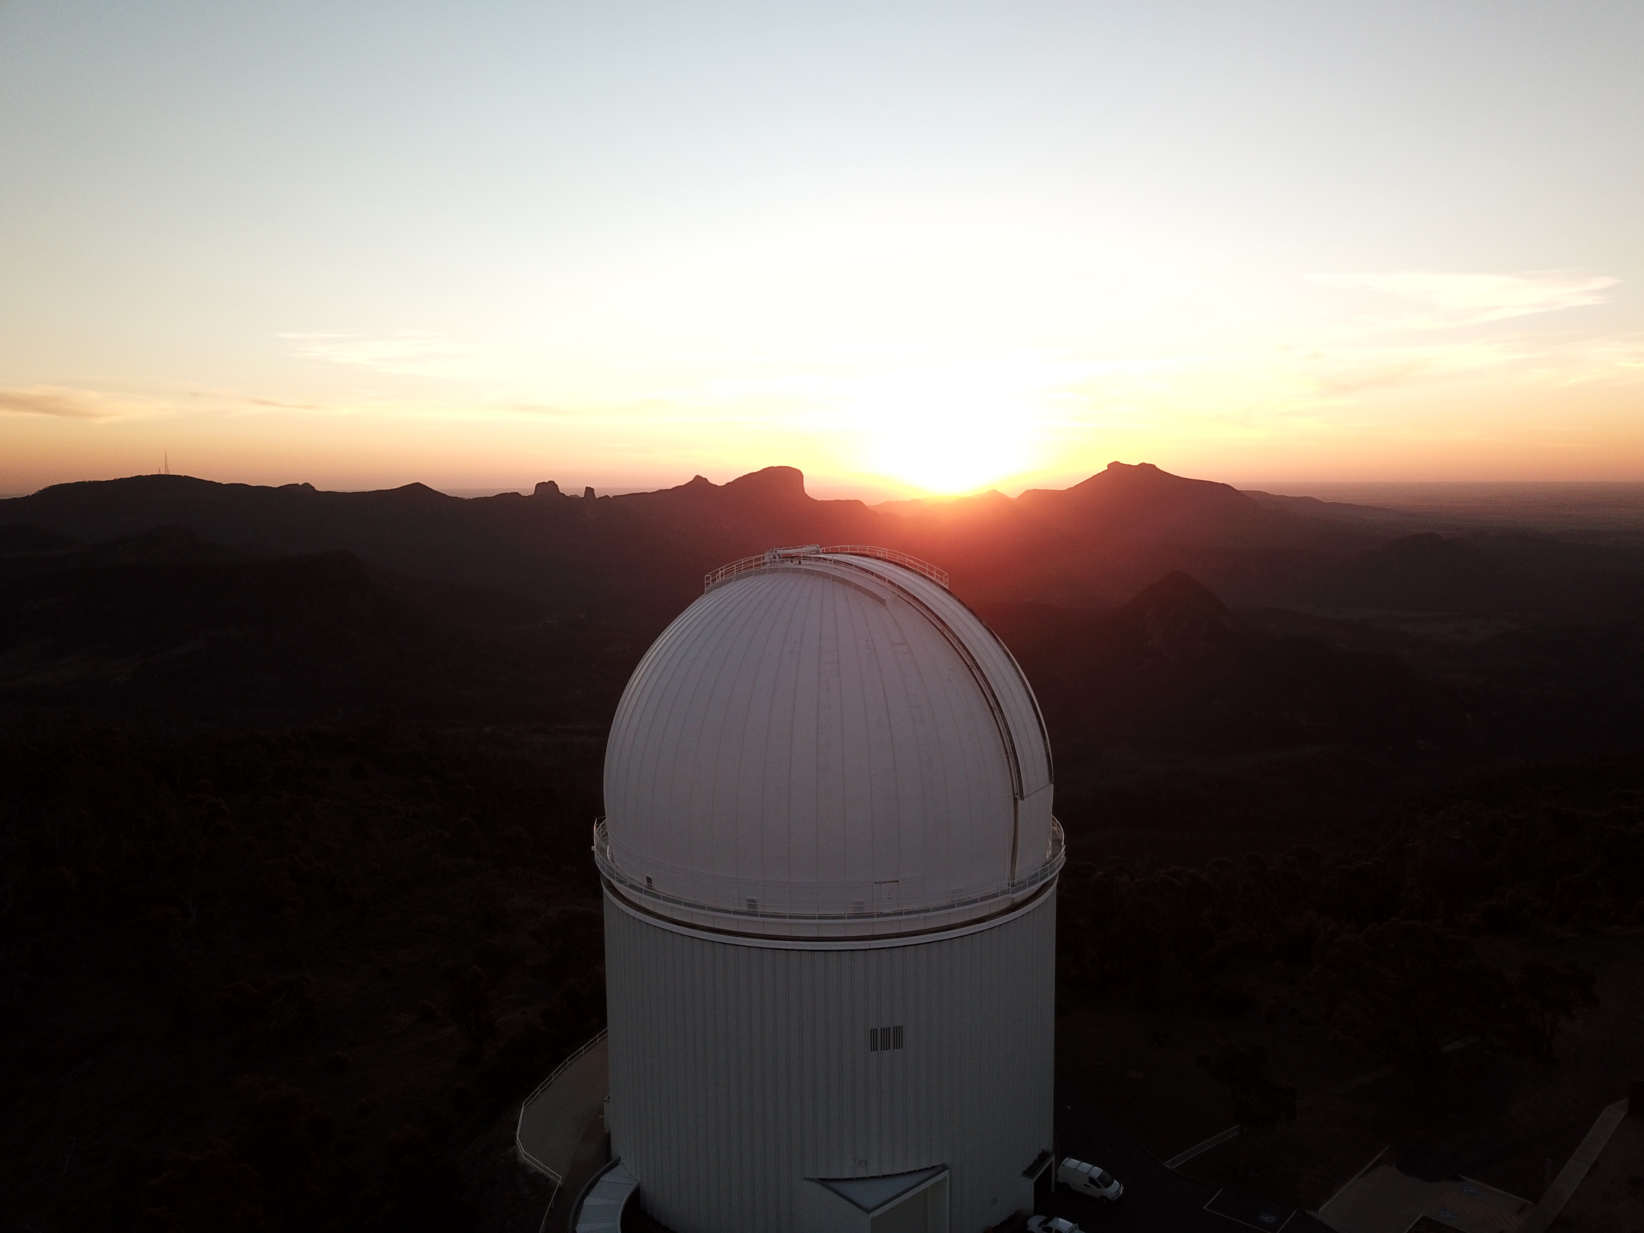
The AAT – evaluating its role in Australian astronomy
Thanks everyone!
Fred Watson
Astronomer-at-Large Department of Industry, Science and Resources
Hosein Hashemizadeh ICRAR

