Slide 1
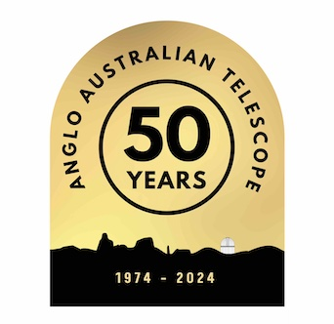
A Short WALK IN THE WARRUmbungles bush
Lew WALLER, AAO-MQ
AAT 50th Anniversary, October 2024

Slide 2
My WALK
I have worked at organisations with the acronym “AAO” since July 1983
A little more than 41 years
The first 35 of those years have been directly associated with the AAT
Probably >20 years longer than what I thought

Slide 3
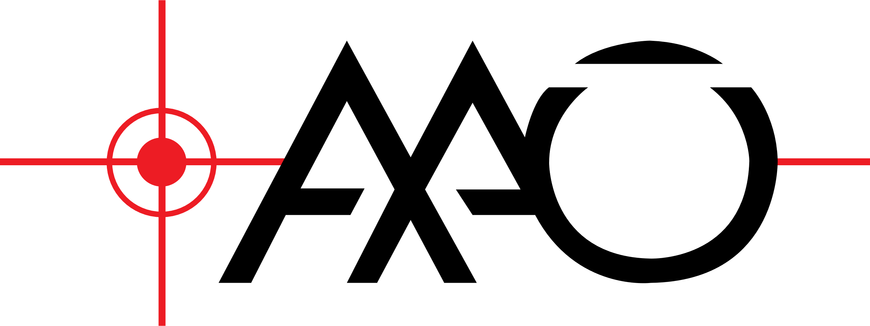
AAO – What’s in an acronym
3 different organisations – same logo, same teapot
Anglo-Australian Observatory – 1983-2010 (27)
Australian Astronomical Observatory – 2010-2018 (8)
Australian Astronomical Optics, Macquarie University – 2018-Present (6+)
All quite different and yet a little bit the same
The latter has been the biggest change, with a major disconnection from the AAT
And the teapot hasn’t been used since 2013 (or cleaned, ever)
Every Director makes changes, so within each AAO version, there have been numerous sub-versions!

Slide 4
DIRECTORS aND EXECUTIVE OFFICERS
AAO Directors
Don Morton (1.1), Russell Cannon (1.2), Brian Boyle (1.3), Matthew Colless (1.4/2.0), Warrick Couch (2.1), Mike Steel (3.0), Mark Casali (3.1), Richard McDermaid (3.2)
AAO Executive Officers
Doug Cunliffe, Ross Laing, Angela Johnson, Joan Wilcox, Neville Legg
AAT Operations Managers
Peter Gillingham, Llew Denning, Chris McCowage, Doug Gray, Rob Brookfield

Slide 5
Some background
Grew up on a farm just outside of Tamworth, past the airport
Westdale Primary School, outskirts of Tamworth on Gunnedah road
Became a border at FMAHS (Farrer), completed the HSC in 1977
Couldn’t decide between Mechanical Engineering or Electrical Engineering
Advised by a relative who was Mechanical Engineer that “Electronics” was the thing to do
Visited the Warrumbungles twice in the early 70’s, and stayed in the trams in the National Park – and probably visited SSO

Slide 6
Completed a BE (Electrical) at UNSW from 1978-1981
My interests were varied but I guess I was drawn to digital electronics, programming and microprocessors/micro computers
Work experience at Telstra, Hypertec
Obtained a cadetship with OTC in my last year, and so after finishing University, I worked in OTC head office in Martin Place for about 3 months.
Moved to Geophysical Services Inc, a division of TI, servicing computers and peripherals in a data processing centre in North Ryde for about 18 months
In April 1983, I saw an interesting advertisement in the SMH for an electronics engineering job at the Anglo-Australian Observatory, based in Eastwood
Convinced to apply by a school/university friend who was also an electronics engineer, who had worked at the AAO as a vacation student
Interviewed for the position by John Barton, Graham Bothwell and Ken Gorham

Slide 7
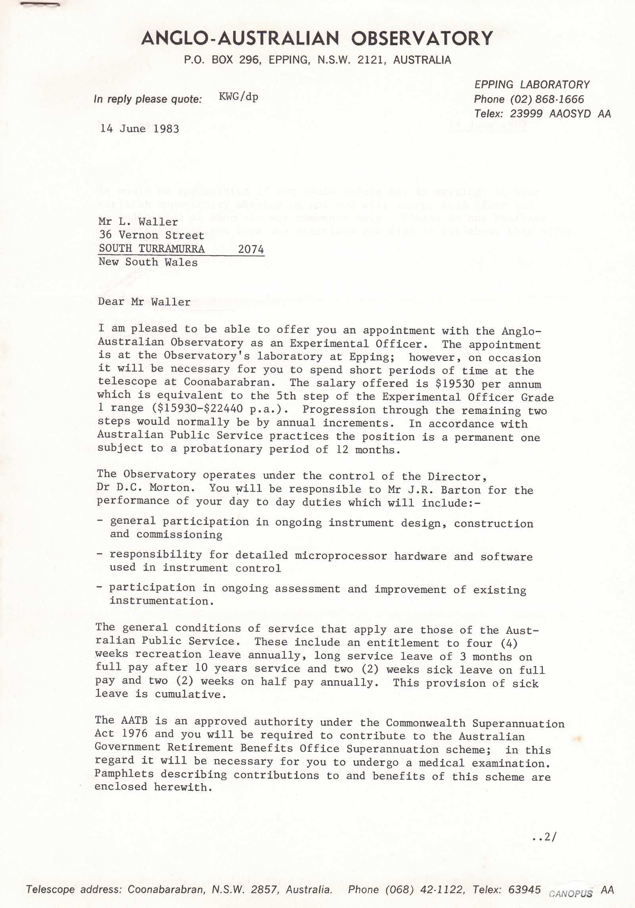
Starting At the AAO
Started at AAO in Eastwood on July 25th, 1983, as an Experimental Officer
Electronics group consisted of John (my supervisor), Graham, Don Mayfield , John Hardy and Martin Callaway
I later learned that I had replaced Roger Smith, who had moved to the US to work for CTIO/NOAO.
Astronomers included David Allen, Jeremy Bailey, Pat Roche, Keith Taylor, John Lucy, Gordon Robertson, David Malin, John Hillier
Software and Mechanical - Helen Davies, John Straede, Ken Harwood, Teresa Carty, Peter Gray, Andre Porteners, Doug Pos, Denis Whittard and more
Doug Cunliffe (EO), Ken (Gorham), Judy Huxley, Dorothy Paton, Robin Shobbrook
First trip to AAT as an employee was soon after I started
I was chaperoned around the AAT and the mountain top by David Allen
I would have met Robert Dean, Steve Lee, Peter Gillingham, Llew Denning, Tom Cragg, Kevin Cooper, Frank Freeman, Paul Lindner, Chris McCowage, John Sullivan, Gordon Schafer, John Stevenson and many others

Slide 8
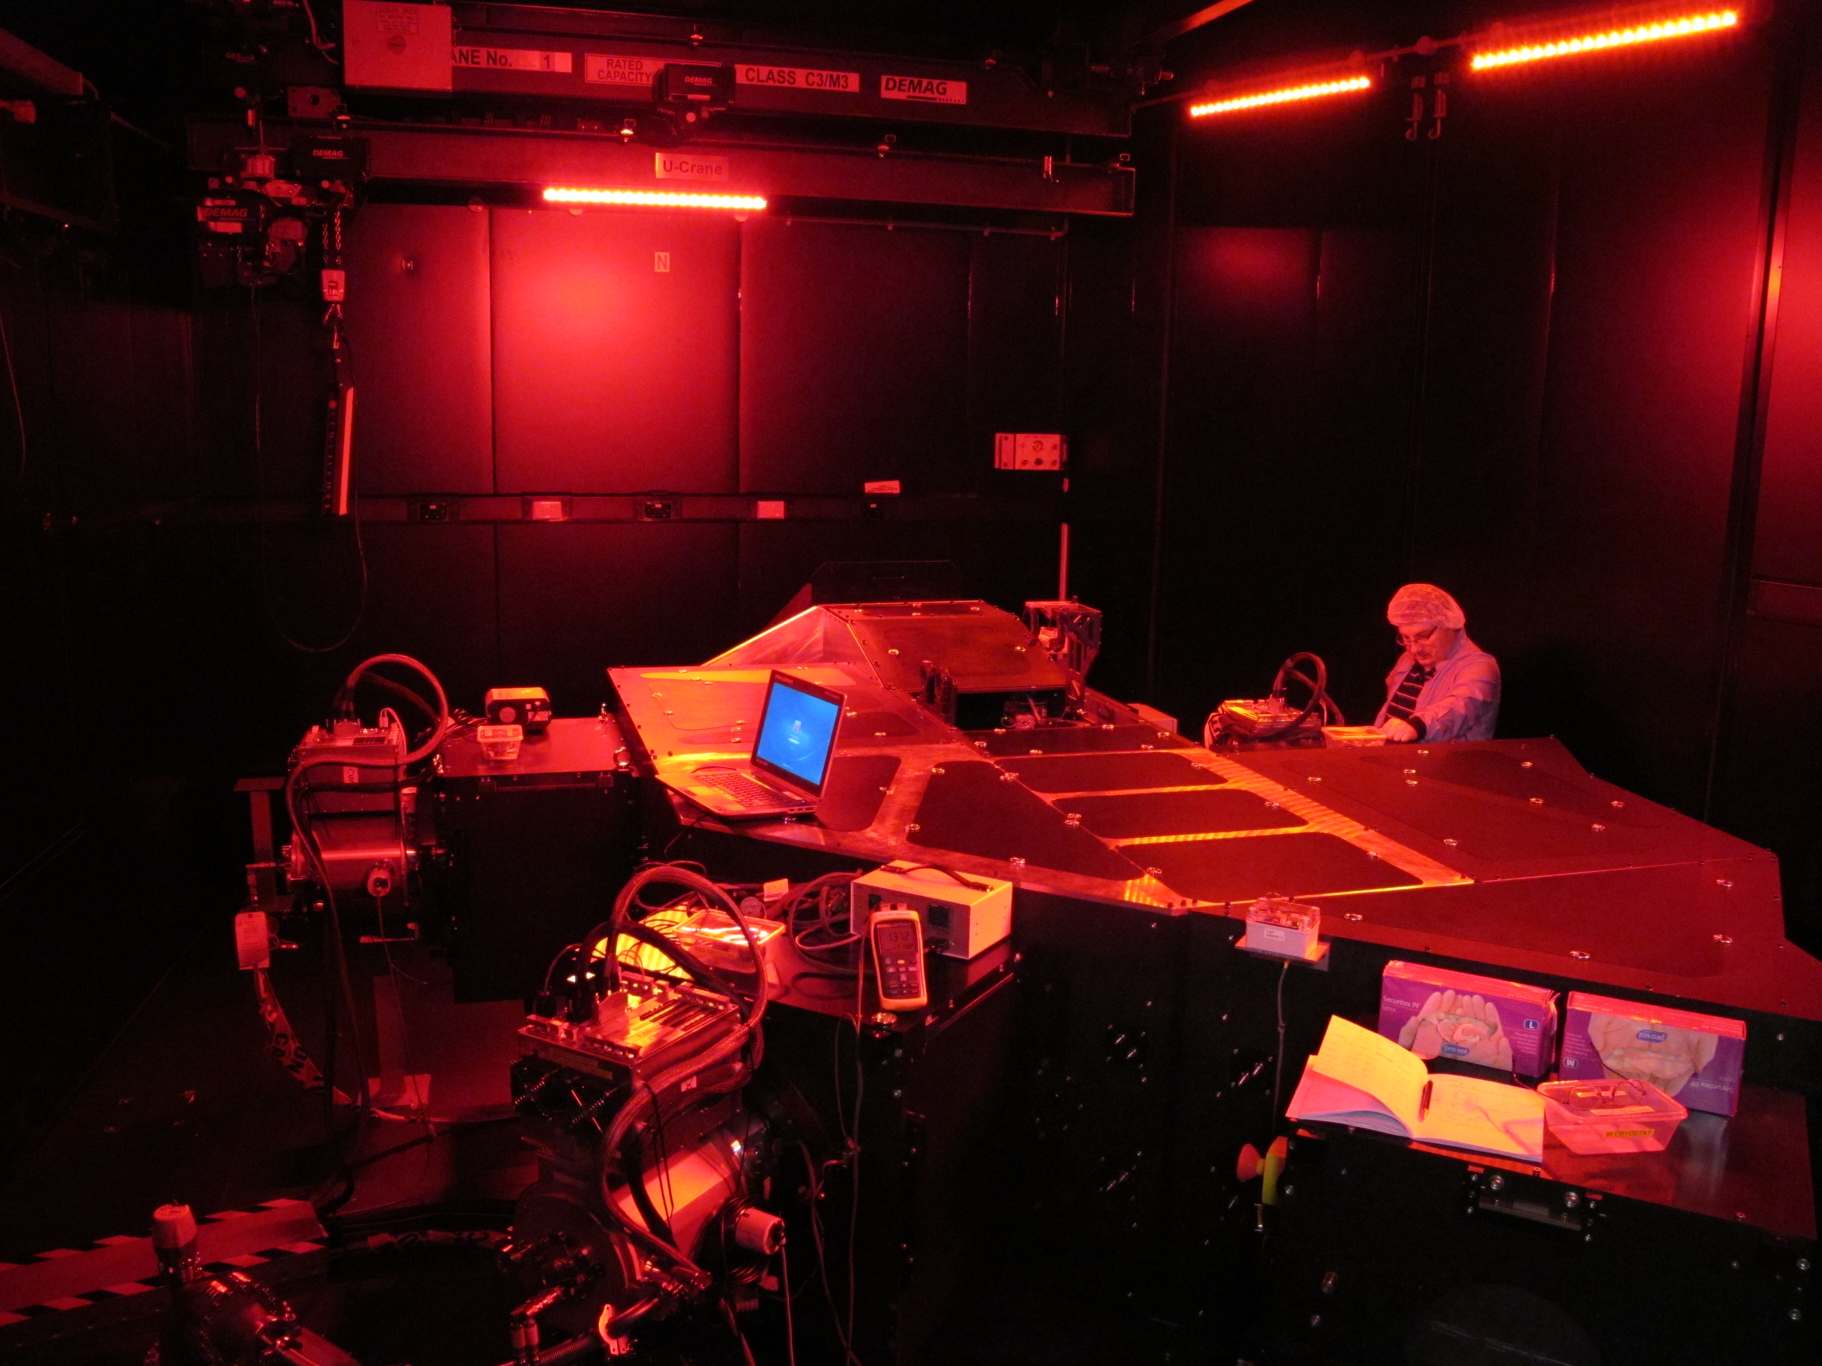
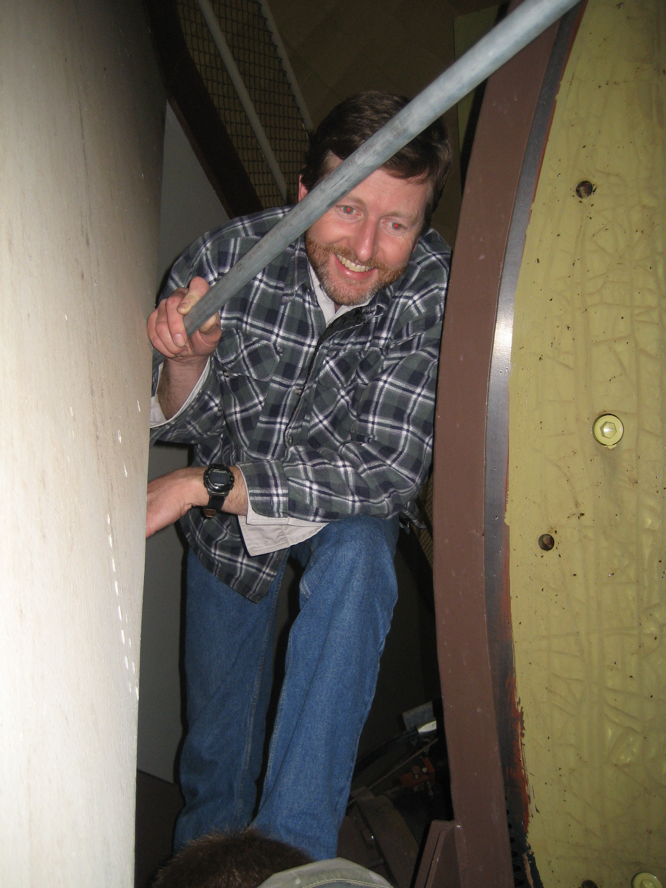
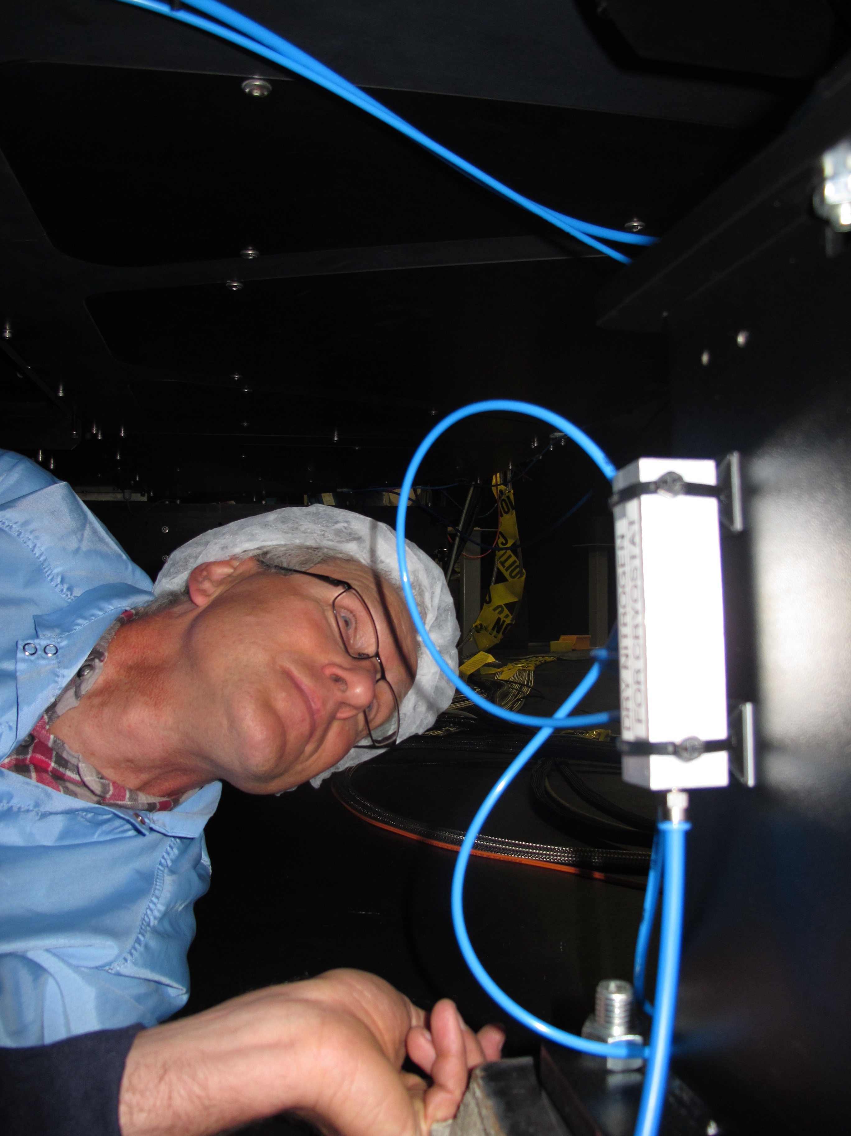
AAO (SYDNEY) Electronics GROUP
John Barton, Graham Bothwell, Don Mayfield, Martin Callaway, John Hardy
Graham left AAO in 1984 for JPL
John Hardy left in 1984 and was replaced by Tony Farrell
Martin left in 1991 and was replaced by Mark Noonan
Keith Willis joined in 1991 to work on 2dF
Mark left in 1995 and was replaced by Daniel Doyle
Keith left in 1996
Brian Hingley joined in 1998 to work on IRIS2
Daniel left in 1999 and was replaced by Tim Young
Rolf Muller joined in 1999
Brian and Tim left in 2000
Jason Griesbach joined in 2000 to work on Echidna and later on the AAO2 controller CCD upgrade
John Barton retired in 2001 to return to New Zealand
Jason left in 2002 and was replaced by Dave Correll (Echidna and AAOmega)
Ed Penny relocated from the AAT electronics group in 2002 to the Epping electronics group
Dave left in 2006 to do another tour at the AAD
Don retired in 2008, but came back in 2011 as a casual to work on HERMES and the AAOMega detector upgrade. He finally retired in 2015
Ed retired in 2013 and was replaced by Slavko Mali
Vijay Nichani joined in 2013 to work on TAIPAN/Starbugs and subsequently, AESOP
Rob Patterson worked in the group in 2019 and 2020 on AESOP
Vijay left in 2019 and was replaced by Nirmala Kunwar in 2020. She is working on AESOP, DOT HRS, MANIFEST and FOBOS

Slide 9
AAO/AAT FIRST Projects
My first projects included:
Differental Unibus Extender – which had been designed by Graham to extend the VAX 11/780 Unibus from the 2nd floor Computer room to the Control Room, where the CAMAC (computer automated measurement and control) system was based
CAMAC was a distributed system and was interfaced to the Interdata Model 70 instrumentation computers – these were to be replaced with the VAX/VMS system
Ported the VAX/VMS CAMAC drive to a MicroVAX/QBUS system for RGO for the WHT Control System (spent some time working at Herstmonceux with Lewis Jones)
Also responsible AAO CCD controller firmware and memory upgrades
CCD controller used an 8-bit microprocessor (Motorola 6809), operating at 1 MHz
Designed a 32 Kbyte memory extension card for the controller
New instrument control infrastructure, to replace CAMAC
Microprocessor based, running a real time O/S (0S9) using Eurocard boards (G64 bus) of various types
Serial links connected to first to serial ports on the VAX and then via Ethernet port servers
Took over management of VAX hardware in 1984 when Graham departed for JPL

Slide 10
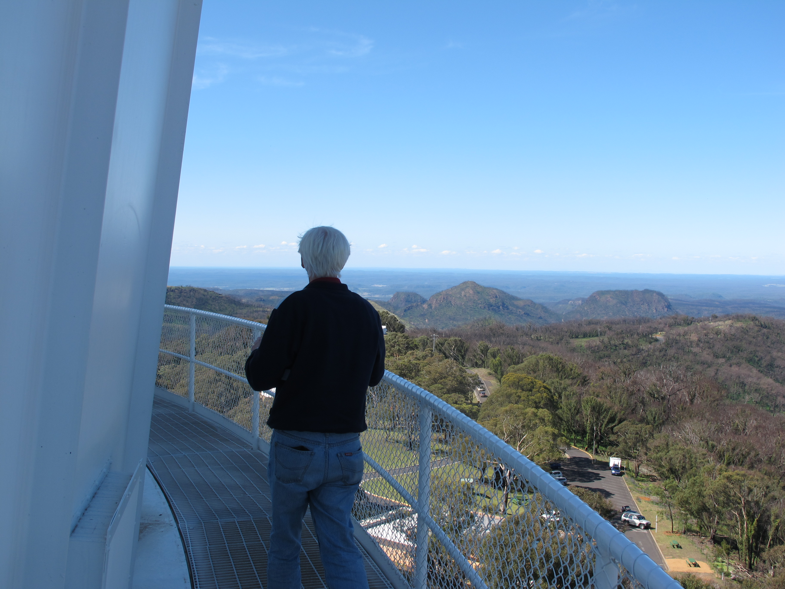
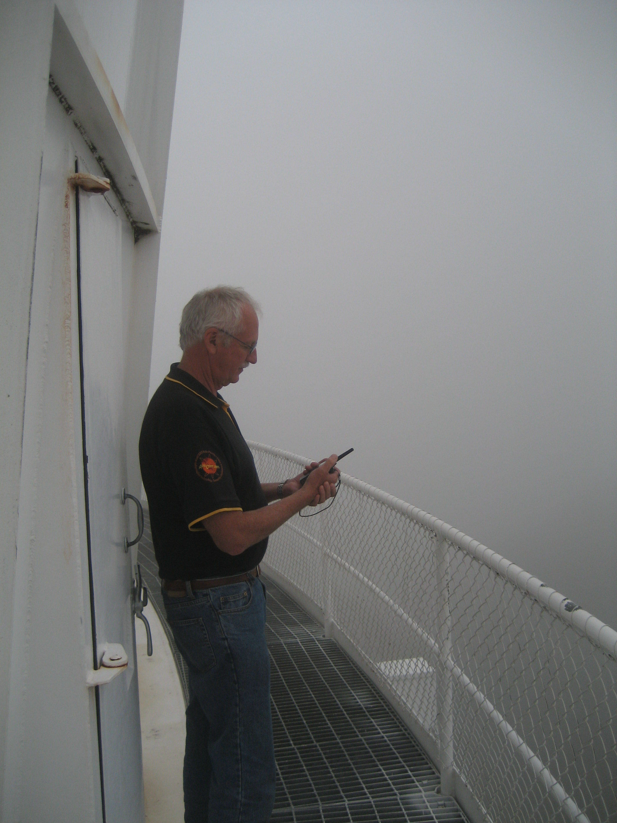
MY Mentors AT AAO
Just about everyone I’ve ever worked with, but in particular:
Graham – computers and hardware
John Barton – detectors and analog electronics
Don Mayfield – circuit design and layout
Robert Dean – the world of electronics!
Keith Shortridge – all matters software!

Slide 11
INSTRUMENT involvement
2003 – 2012:
AAO 2 detector controllers for all optical CCDs
AAOmega spectrograph
AAT TCS upgrade
Cyclops
(FMOS/Echidna fibre positioner for Subaru)
CURE/Cyclops2/Koala
2013 – 2018:
HERMES
AAOmega CCD upgrades
Veloce (interface to CURE)
(Starbugs and TAIPAN for UK Schmidt)
AESOP fibre positioner for ESO/VITA
(MANIFEST for GMT)
(GHOST for Gemini)
(MAVIS for VLT)
2023 – 20xx:
Hector
(FOBOS for Keck)
(DIRAC for ATASAM/DAG)
(HRS for ARIES/DOT)
(AOB1 for Gemini North)
1983 – 1992:
AAO 1 CCD controller – used on many instruments
Taurus II
Autofib
UCLES
Large External Memory
LBL PF camera (CCD controller)
IRIS (1) (Detector controller)
2dF (instrument control, detector control)
Fibre optic cabling infrastructure at the AAT
1993 – 2002:
Blue Thomson, Tektronix 1K² detectors
UHRF
2dF fibre positioner, spectrographs and detectors
MIT/LL 2Kx4K detectors
Nod and (charge) shuffle in AAO 1 controller
(6dF fibre positioner for the UK Schmidt and OzPoz fibre positioner for ESO/VLT)
IRIS II and AAO2 detector controller for Hawaii 1RG detector (IR)

Slide 12
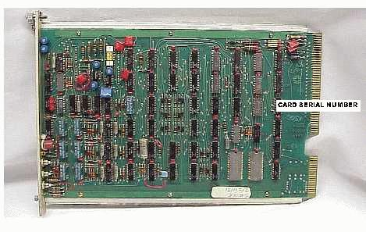
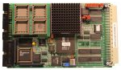
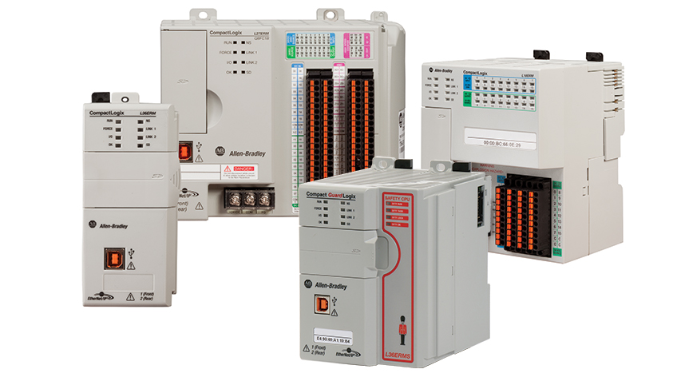
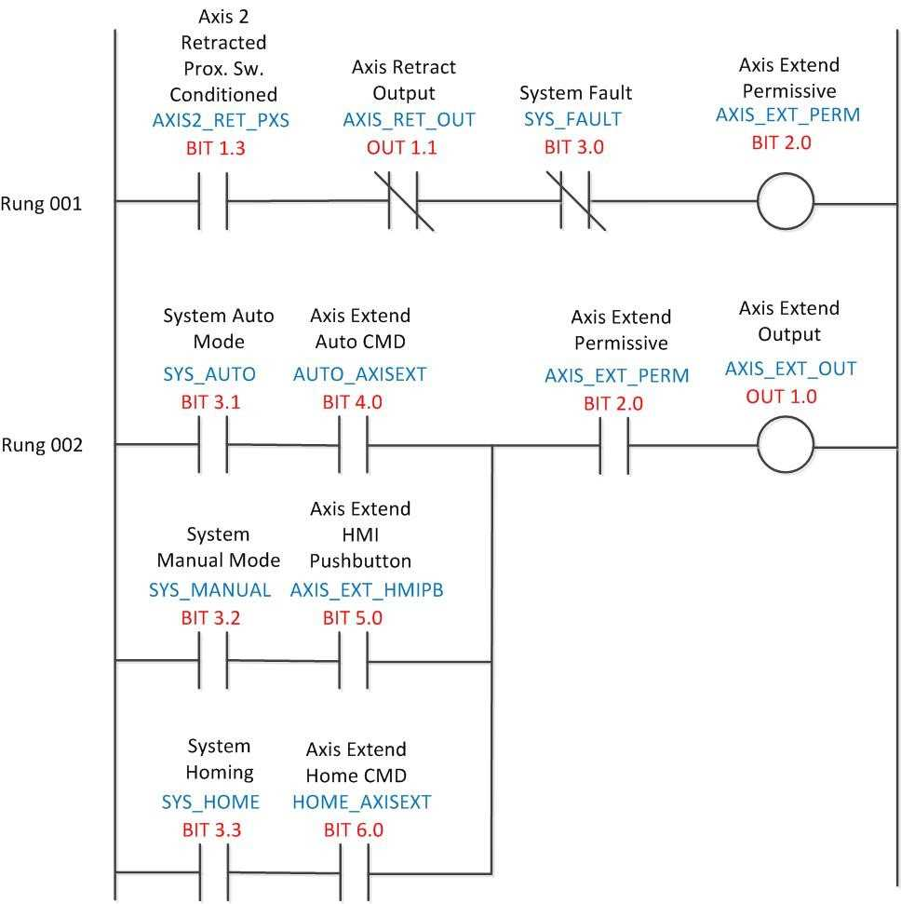
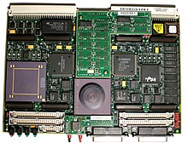
Instrument control AND INTERFACE technologies
CAMAC with interfaces to Interdata and Unibus/Qbus
Modular system
Parallel data, edge connector
System crate and branch crate
Originally connected to Interdata (PTI-70), then to VAXes/MicroVAXes (PTI-11)
G64 bus (CERN/Gespac)
Motorola 6809 processor (8-bits, 1 MHz, 64 Kbytes), OS9, C
Pin and socket connector
Seriql based systems – RS232/RS422 with in hoiuse protocols (9600 bps) and direct parallel data links
UCLES, TAURUS II, Autofib
Direct connections to VAX serial ports, then via serial to Ethernet adapters (reverse Telnet)
VMEbus Systems (Versabus Motorola Europe)
MC680x0 processor family, SPARCstation, Intel PC
OS’s – pSOS, VxWorks, SunOS/Solaris, Linux
Pin and socket connectors
Transition to Ethernet
LEM for IRIS2 and AAO2 controllers, 2dF, IRIS2, TCS, AAO2 CCD Controller
Ethernet based systems (TCP/IP)
2dF, IRIS2
Linux PC Systems
AAOMega, TCS
CANbus (Bosch/CERN)
HERMES, TAIPAN, AESOP
PLCs (Rockwell/Allen Bradley, Beckhoff)
Cyclops, CURE

Slide 13
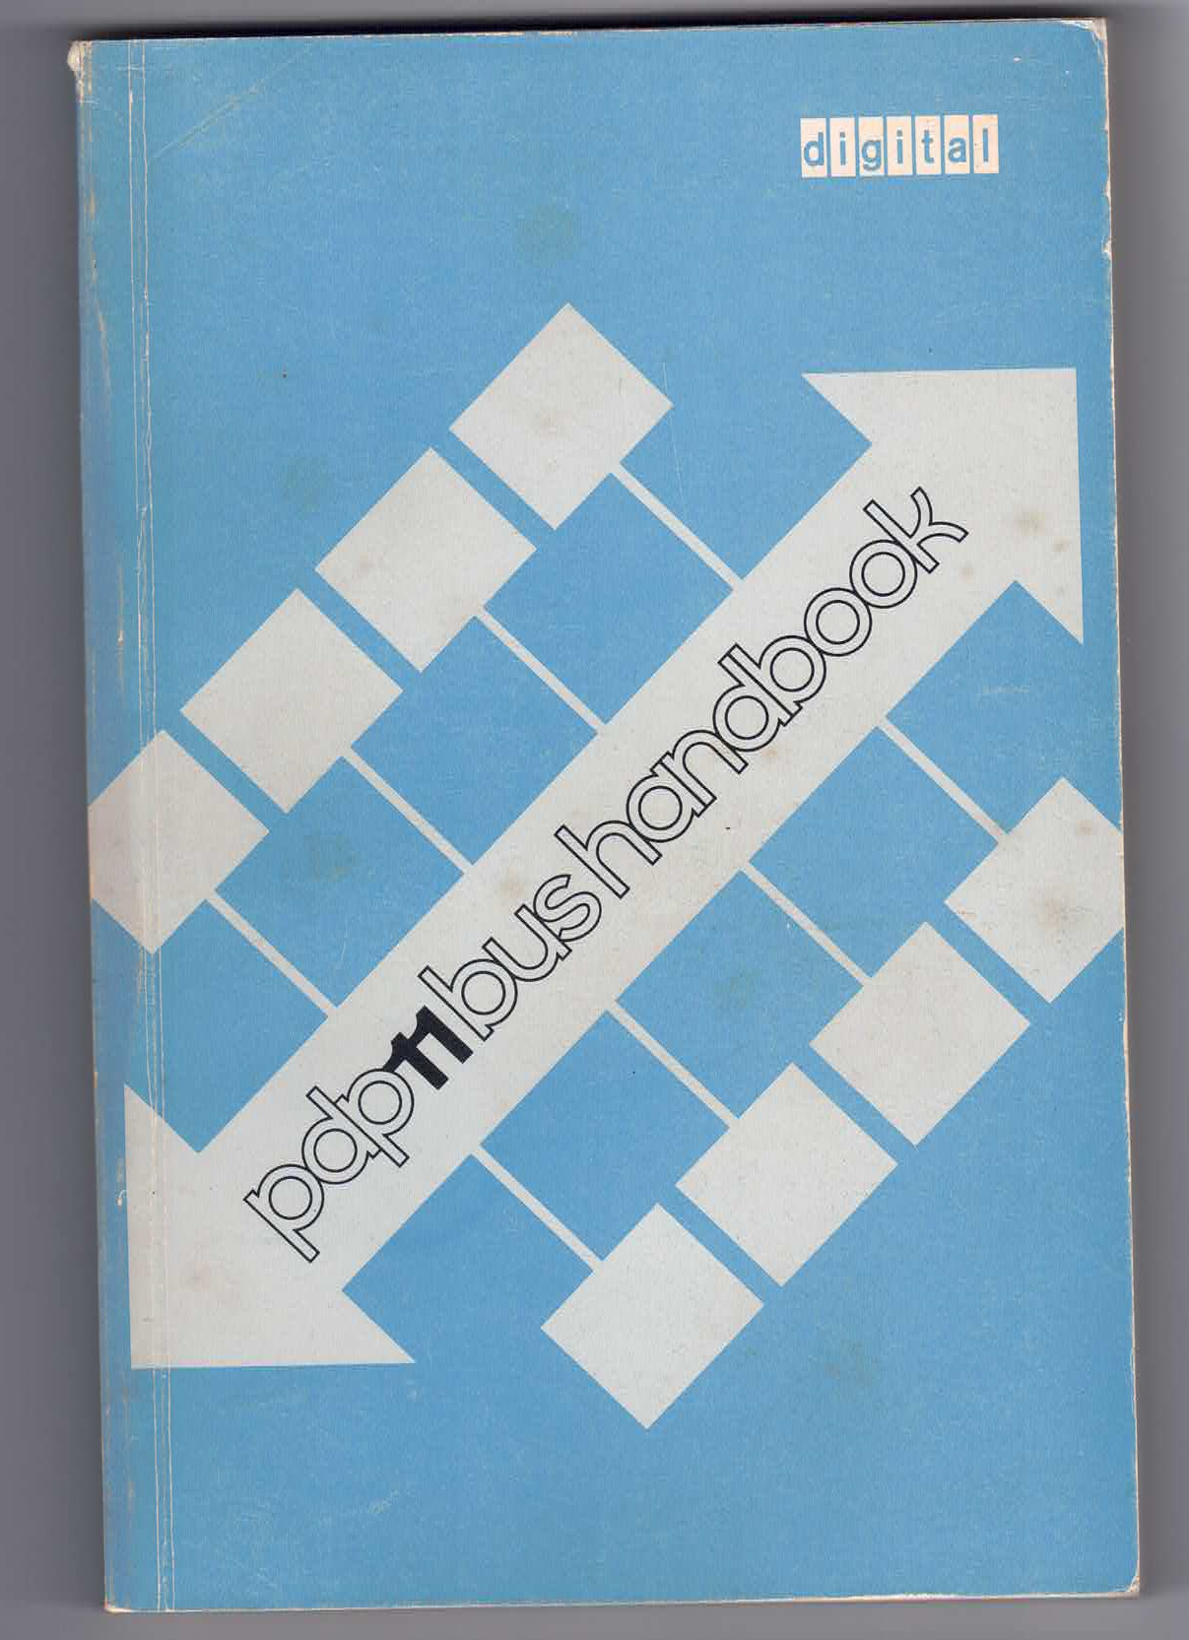
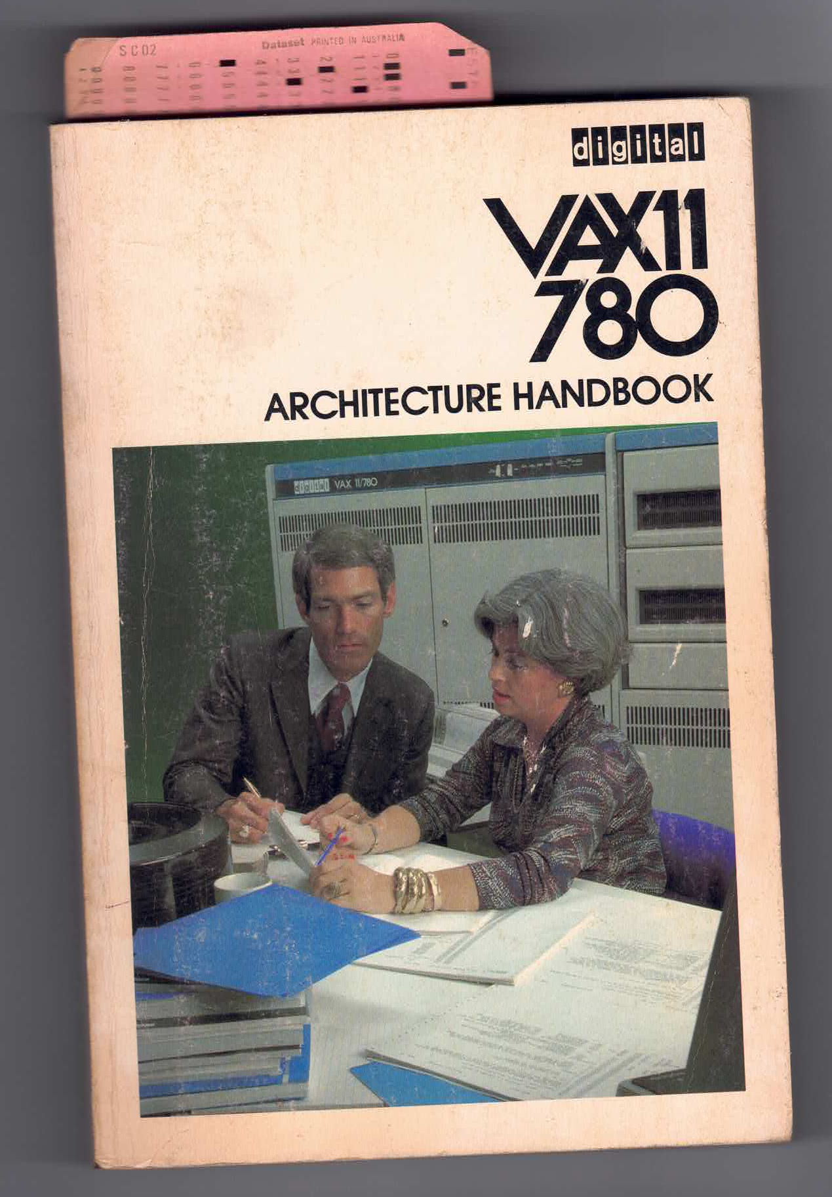
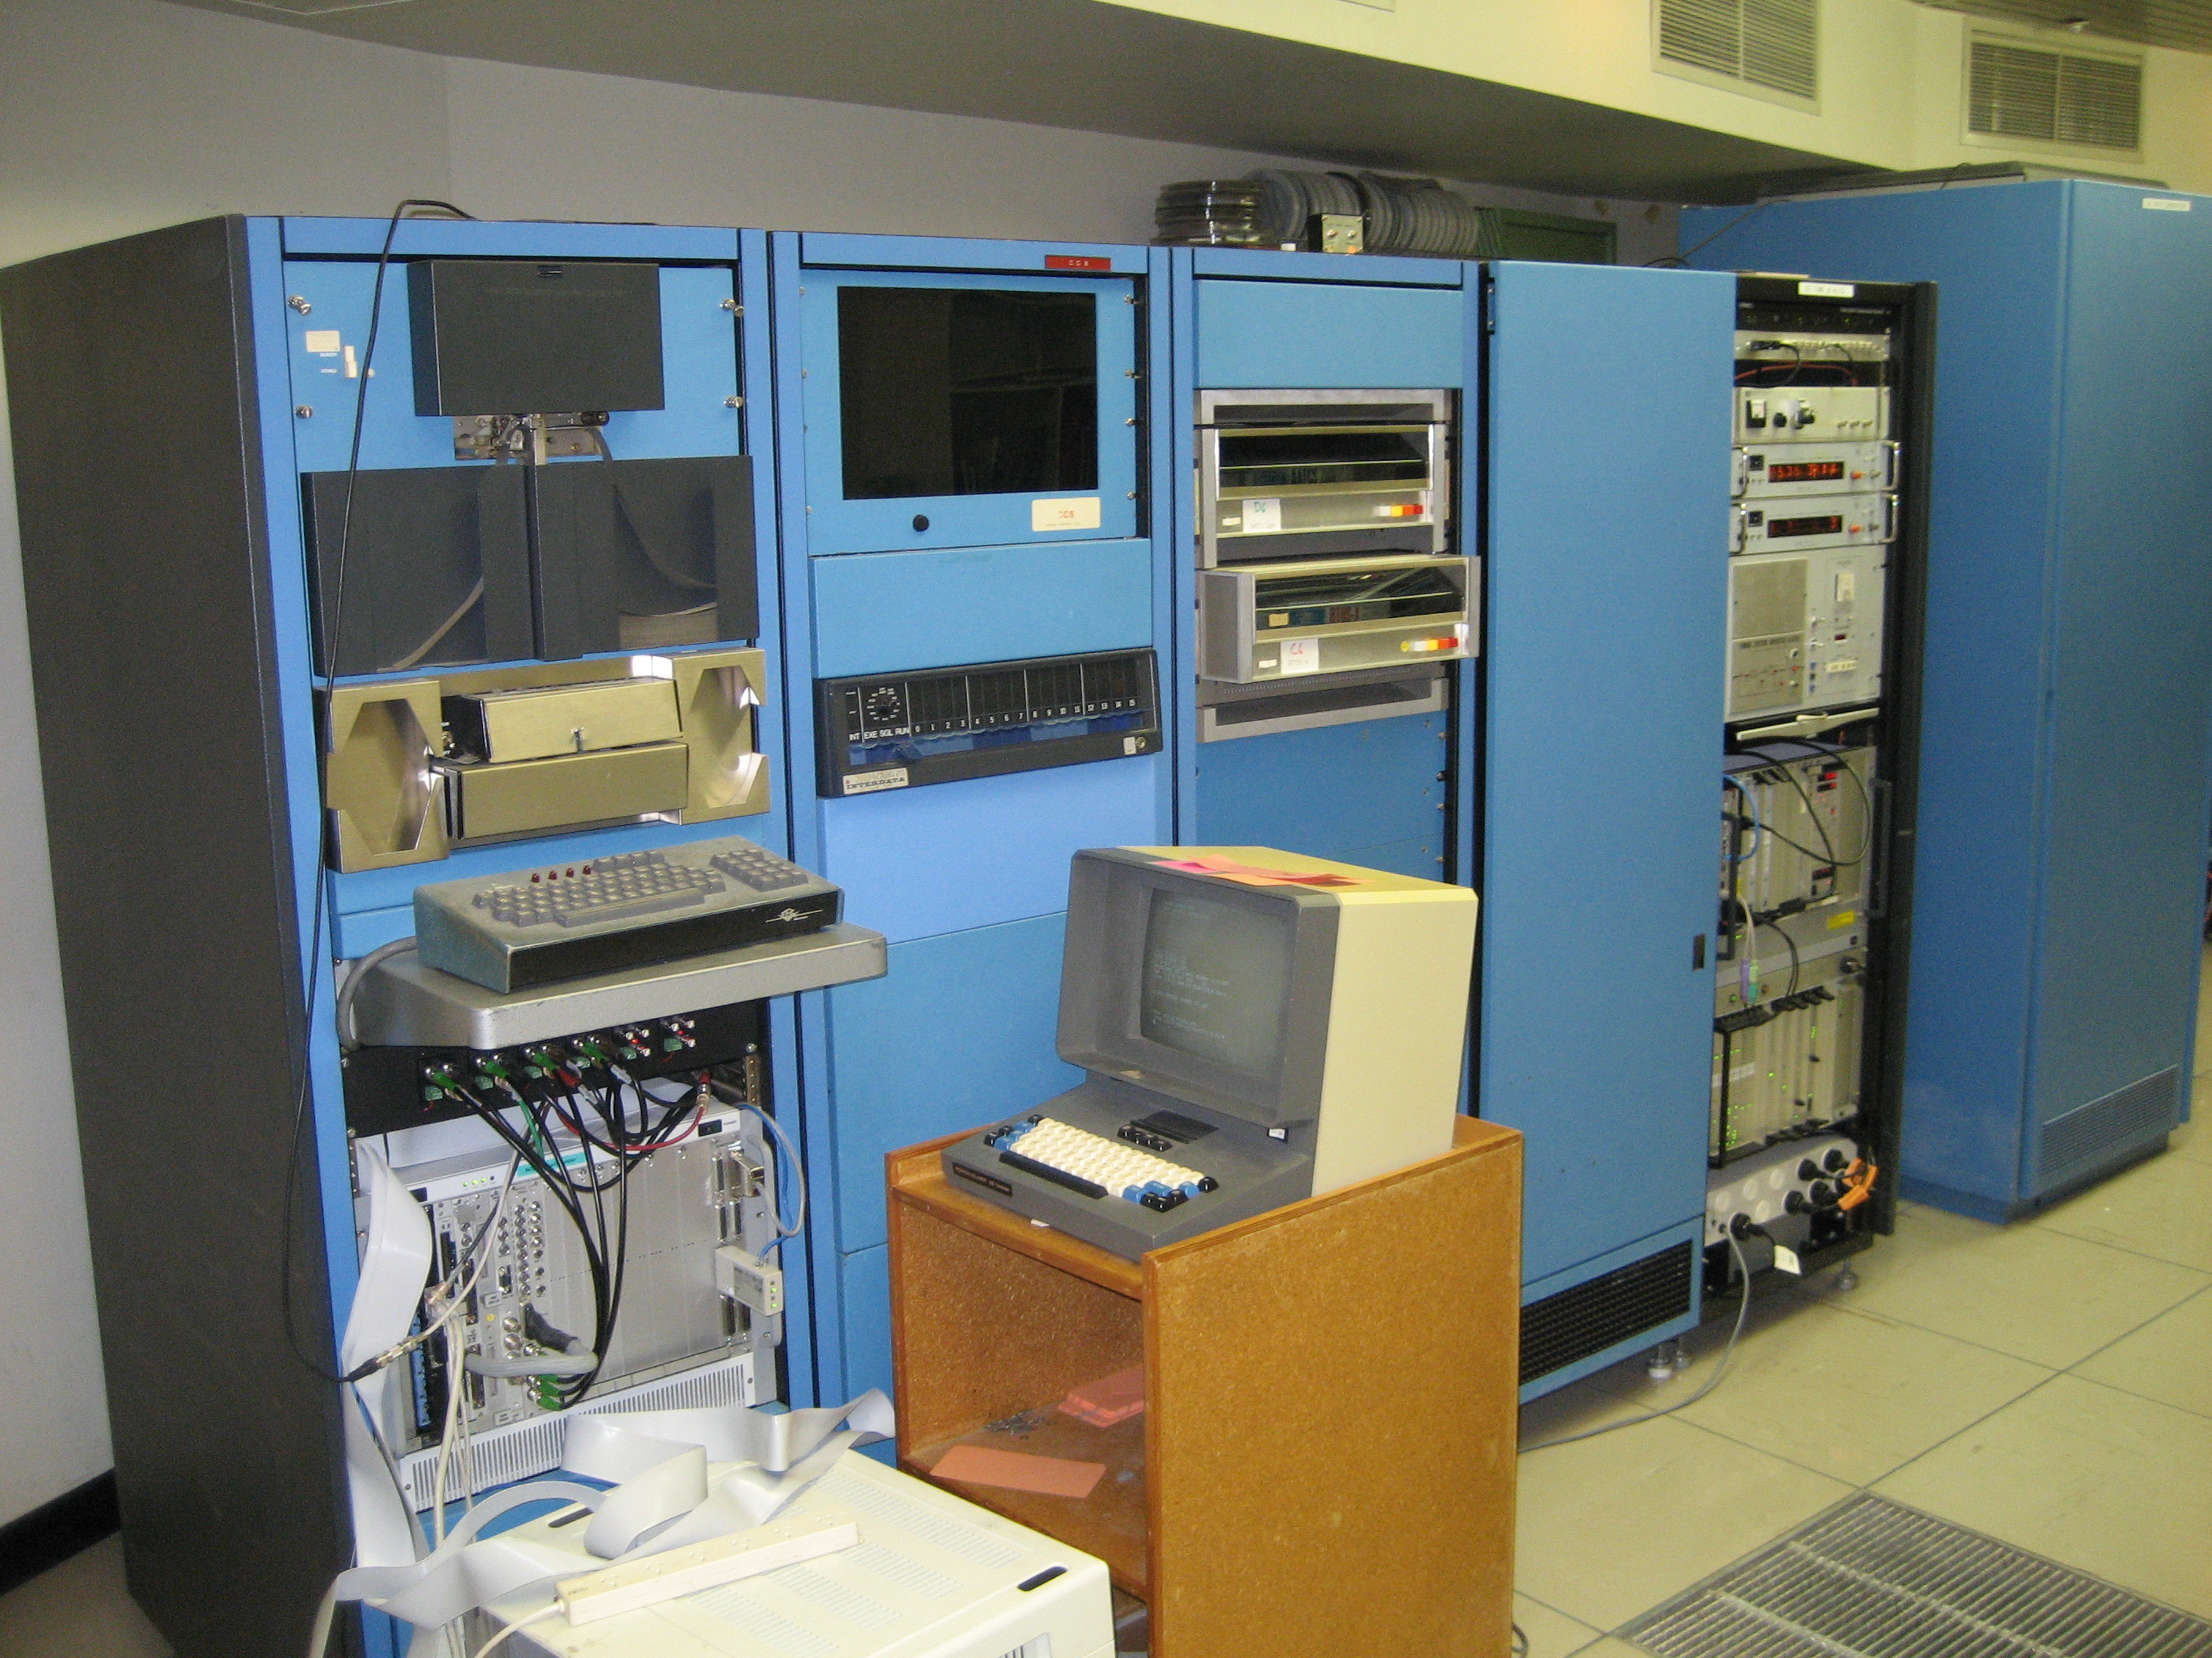
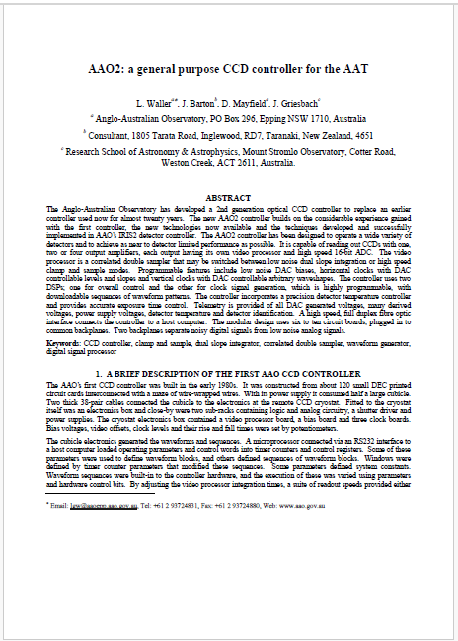
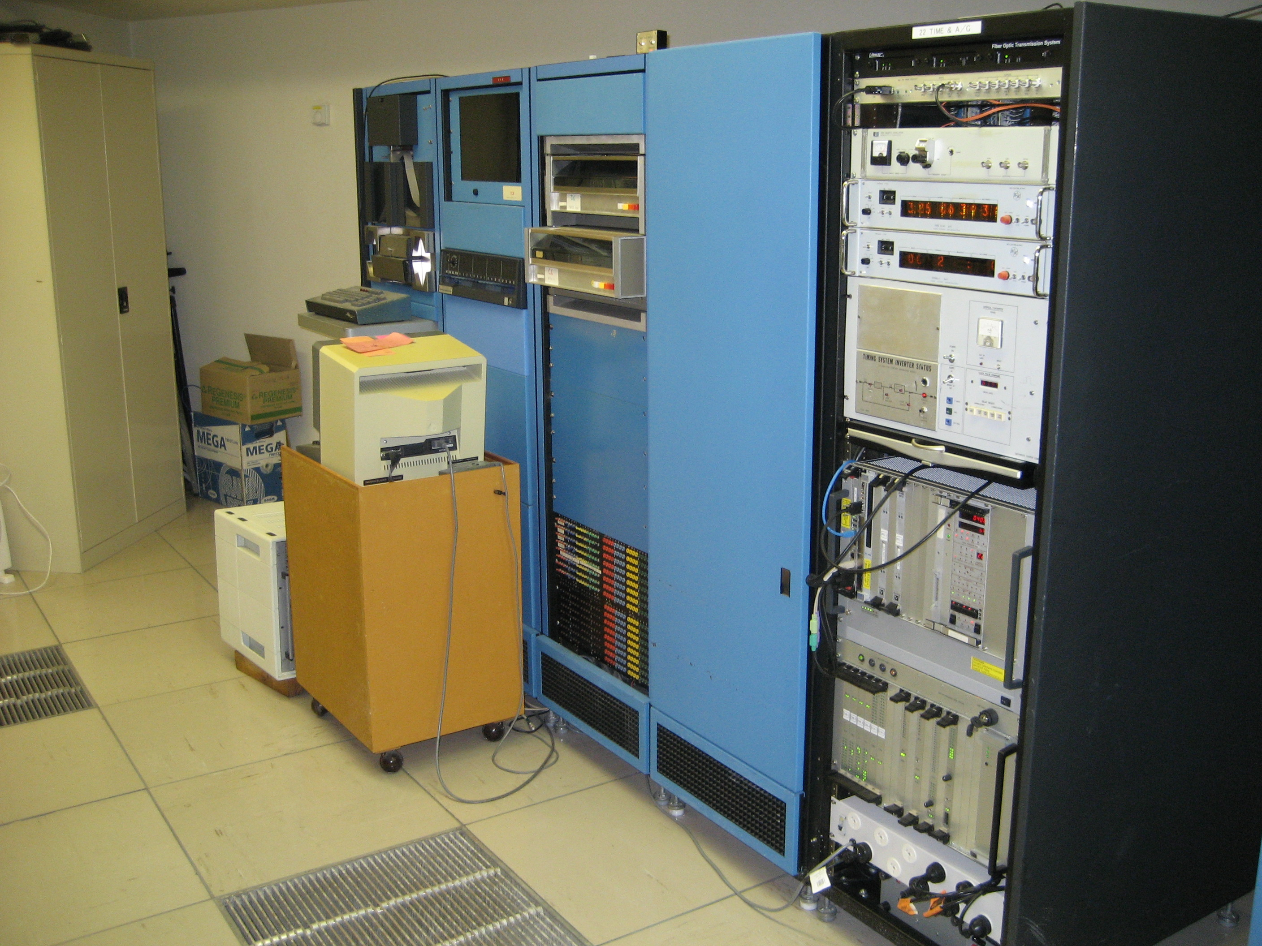
Achievements
DUE for CAMAC interface to VAX 11/780
CAMAC interfacing to MicroVAX (Q-bus)
Changes to GWBs original driver to support Qbus
Unibus cycle extender
G64 bus systems for instrument control to replace CAMAC
C compiler!
Ethernet and fibre optic cabling
VMEbus and VxWorks for LEM and for 2dF and IRIS2
1st IBM PC
1st Apple Macs
1st Sun SPARCstation (SunOS)/Solaris) and DEC Alpha system
Linux for AAOmega instrument control
Linux/VMEbus system for AAT CCS upgrade
AAO 2 CCD controller – 32-bit TI DSPs, high speed fibre optic link, VMEbus
Linux and CAN bus for HERMES (also TAIPAN and HECTOR spectrographs)
PLCs for Cyclops and CURE

Slide 14
Technolgies that have endured
Ethernet (wired and wireless) and TCP/IP
Microprocessors
Desktop/notebook computers

Slide 15
In COnCLusion
I’m proud to have been able to play a role in the success of the AAT
And I’m thankful to the AAO community which has given me opportunities that many aspiring engineers do not get
And I’m thankful for meeting
I hope that the AAT celebrates a 100th anniversary in 2074

Slide 16
Ethernet and TCP/IP
First thickwire (10BASE5), then thinwire (10BASE2), then UTP (10BASET)
Now we have 10/100/1000 Mbps on copper and fibre
Realtime OS (VxWorks) with TCP/IP protocol stacks and Ethernet drivers for interfaces allowed control and data transfer at high speeds
VAX/VMS was replaced with “Unix” flavours that had built in TCP/IP - SunOS, Solaris, Linux

Slide 17
IRIS (1)
IRIS1 was the first in-house instrument with which I was involved
Updated firmware for controller to support the infra-red detector and its various readout modes
G64 bus for instrument control electronics
Large External Memory (using MC68020 32-bit processors, 16 MHz)
Real time O/S (pSOS)
COTS hardware – VMEbus (double height Eurocards
Designed and built interface to the AAO 1 detector controller system and to the IRIS1 detector controller
Serial interface for control
16-bit parallel DMA interface to VAX (DR11W) for bulk data transfer
Moved to Ethernet for control and data
VxWorks RTOS on MC68040, 33 MHz

