Slide 1
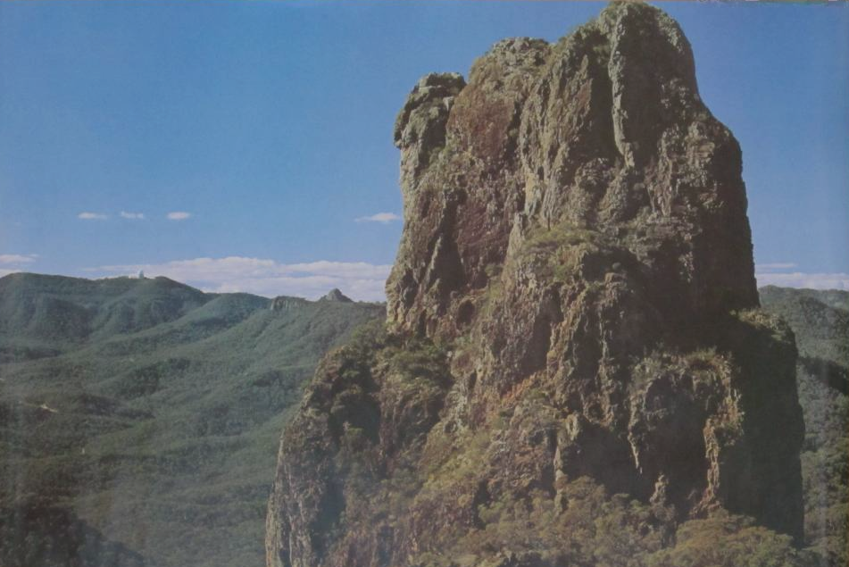
The 50th Anniversary of the Australian Telescope 2024 October 2 - 4
SOME EARLY HISTORY OF THE
ANGLO-AUSTRALIAN OBSERVATORY
by
Donald Morton
National Research Council of Canada
presented by
Christine Morton Démoré
University of Toronto
Poster by NSW Tourist Office

Slide 2
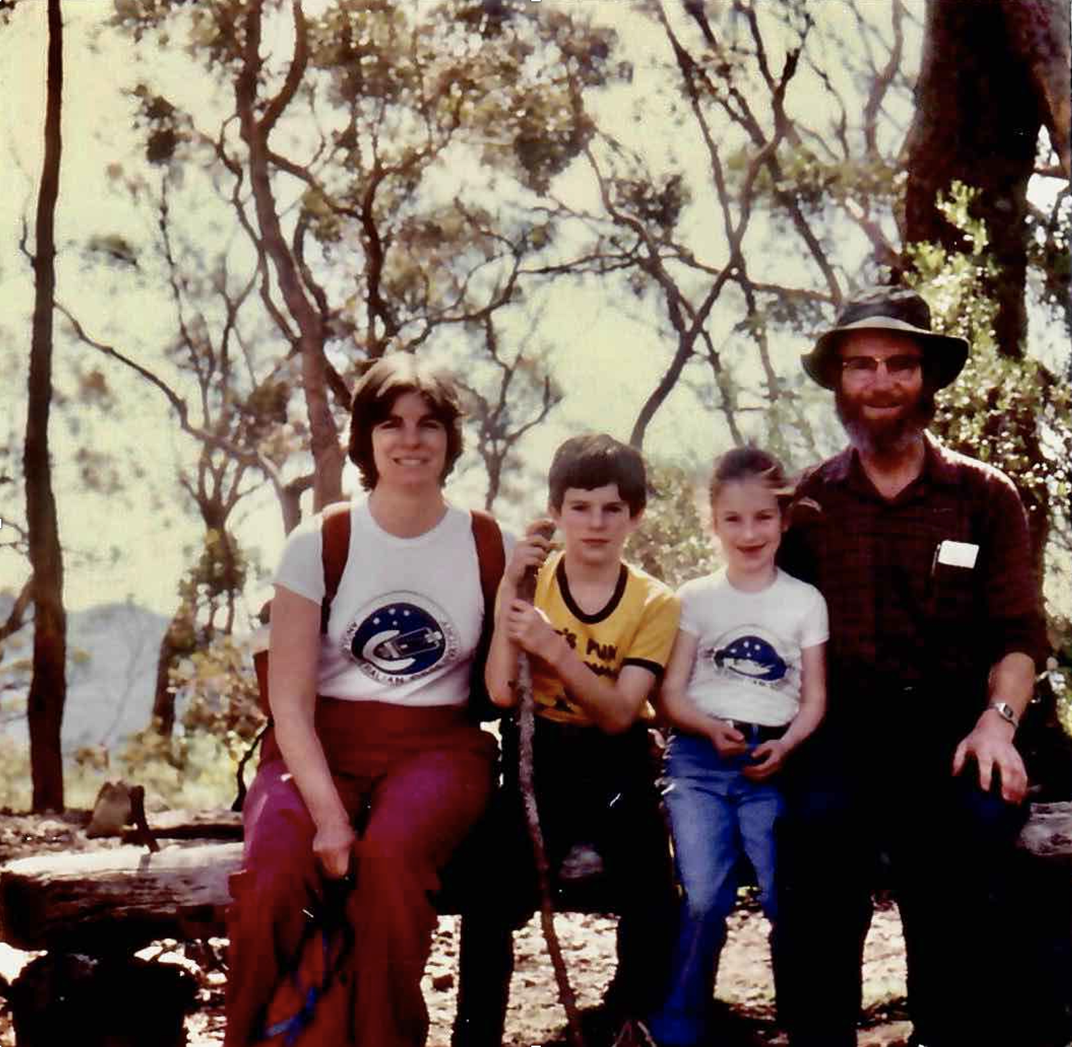
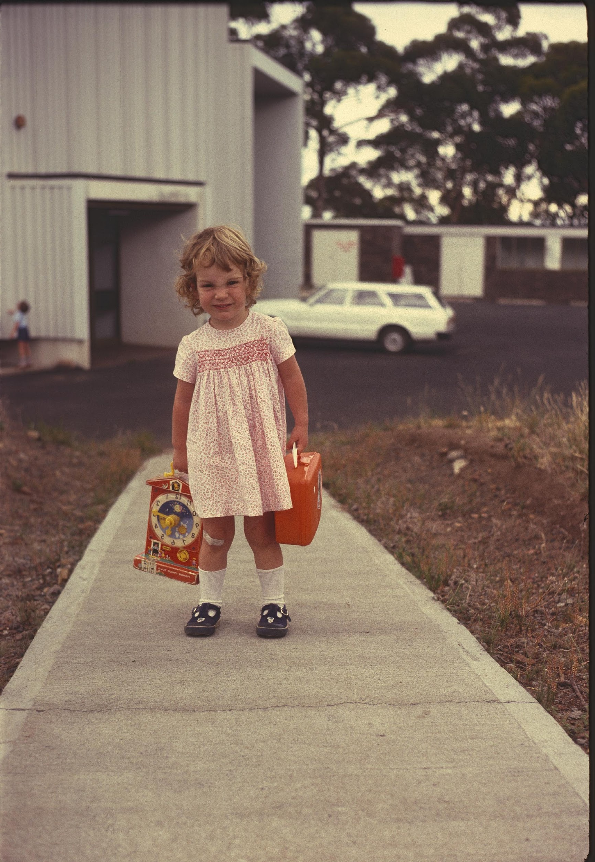
Christine (Kirsty) Morton keeping time at the AAT, 1982
Morton family in the Warrumbungles, 1985
Photos by Don Morton

Slide 3
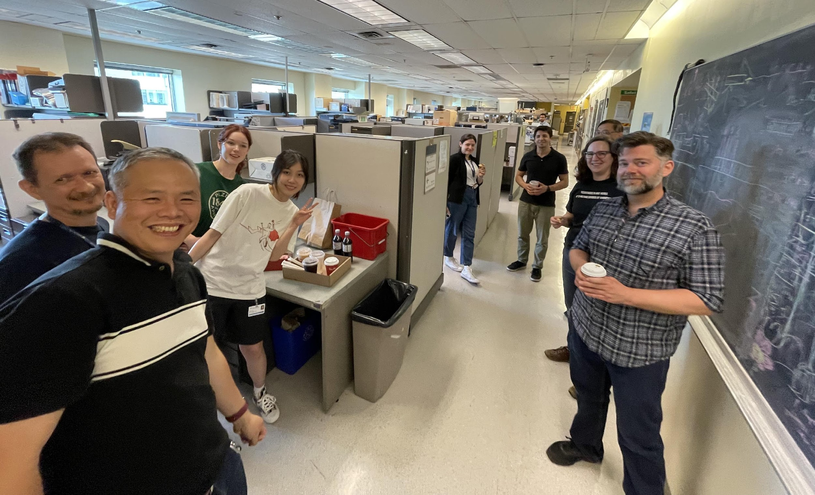
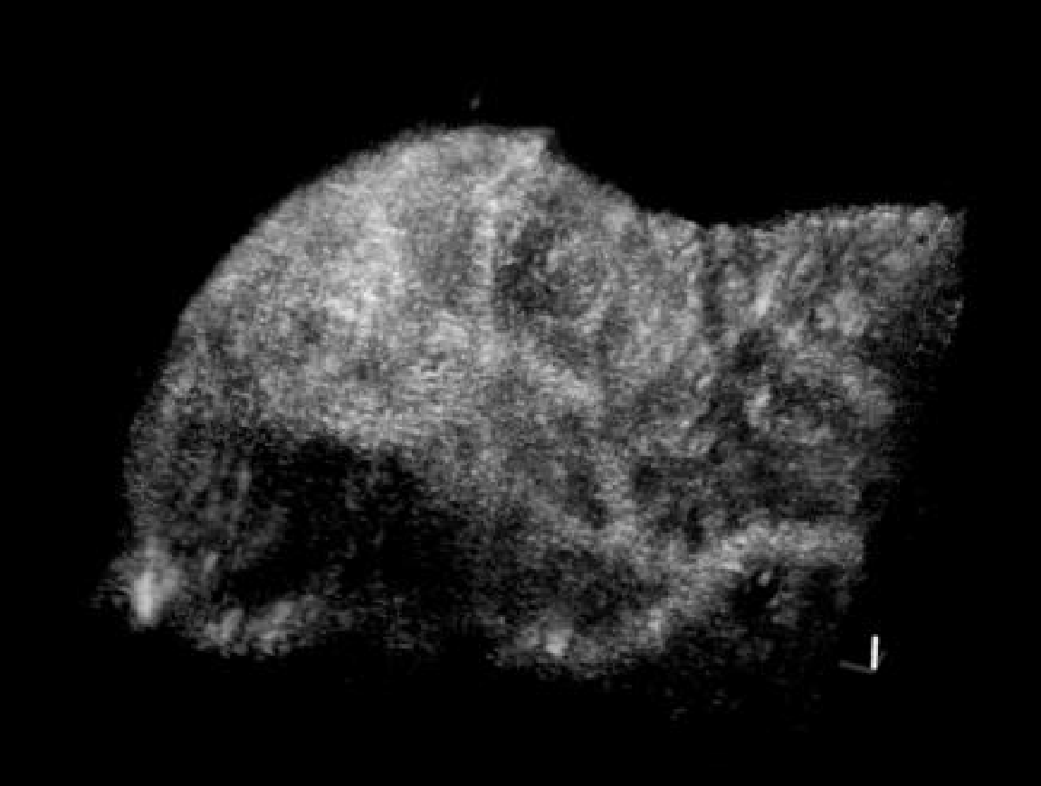
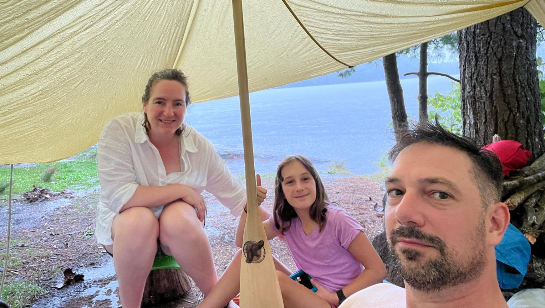
Christine Morton Demore: still studying waves
Sunnybrook Ultrasound Imaging Group
20 MHz + 2 MHz transducer array
Demore family canoe camping in Ontario, 2024
Images by Jing Yang
1 mm
High contrast image of vessels in tumour xenograft
Photo by Charles Demore

Slide 4
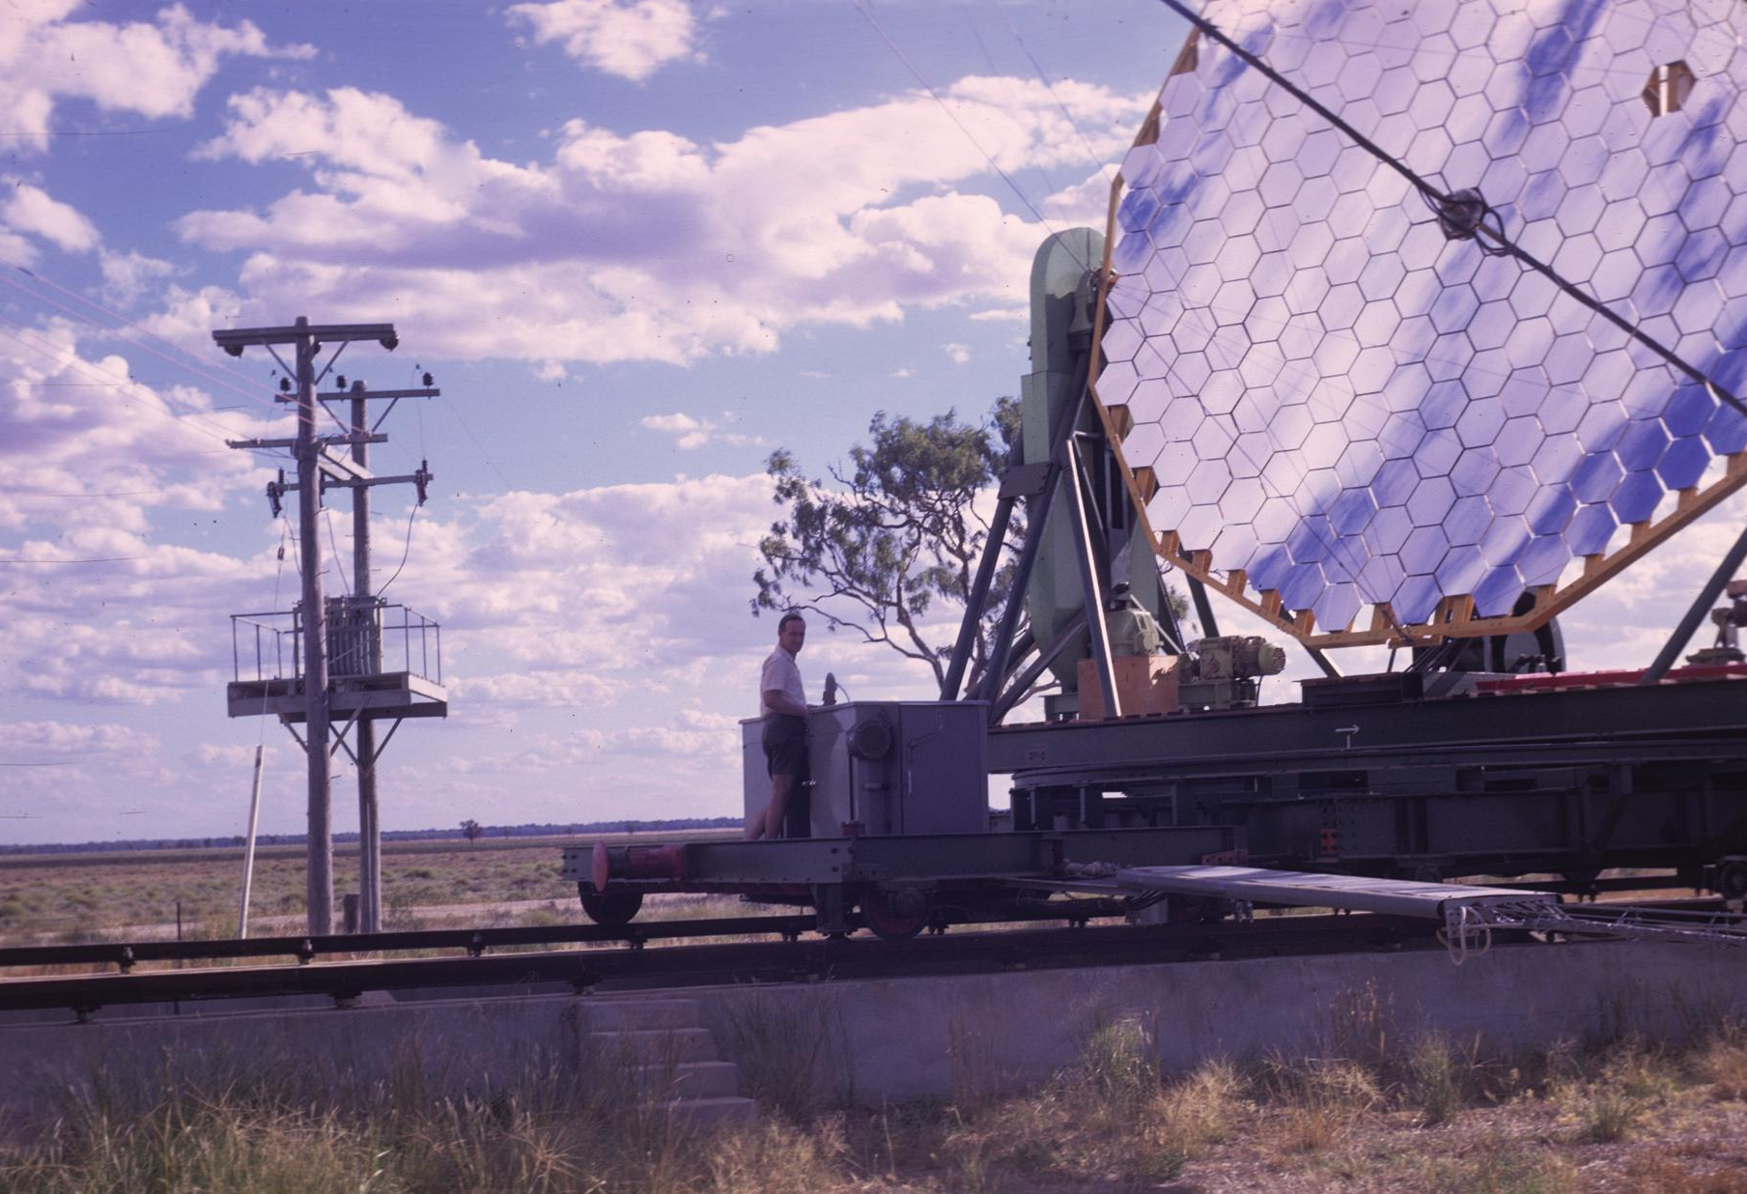
The Narrabri Intensity Interferometer Hanbury Brown, John Davis, Roy Allen
Photos by D. Morton

Slide 5
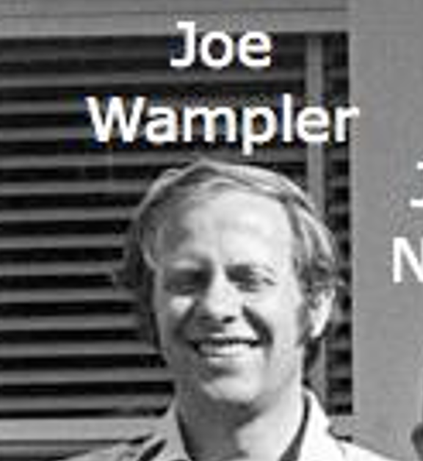
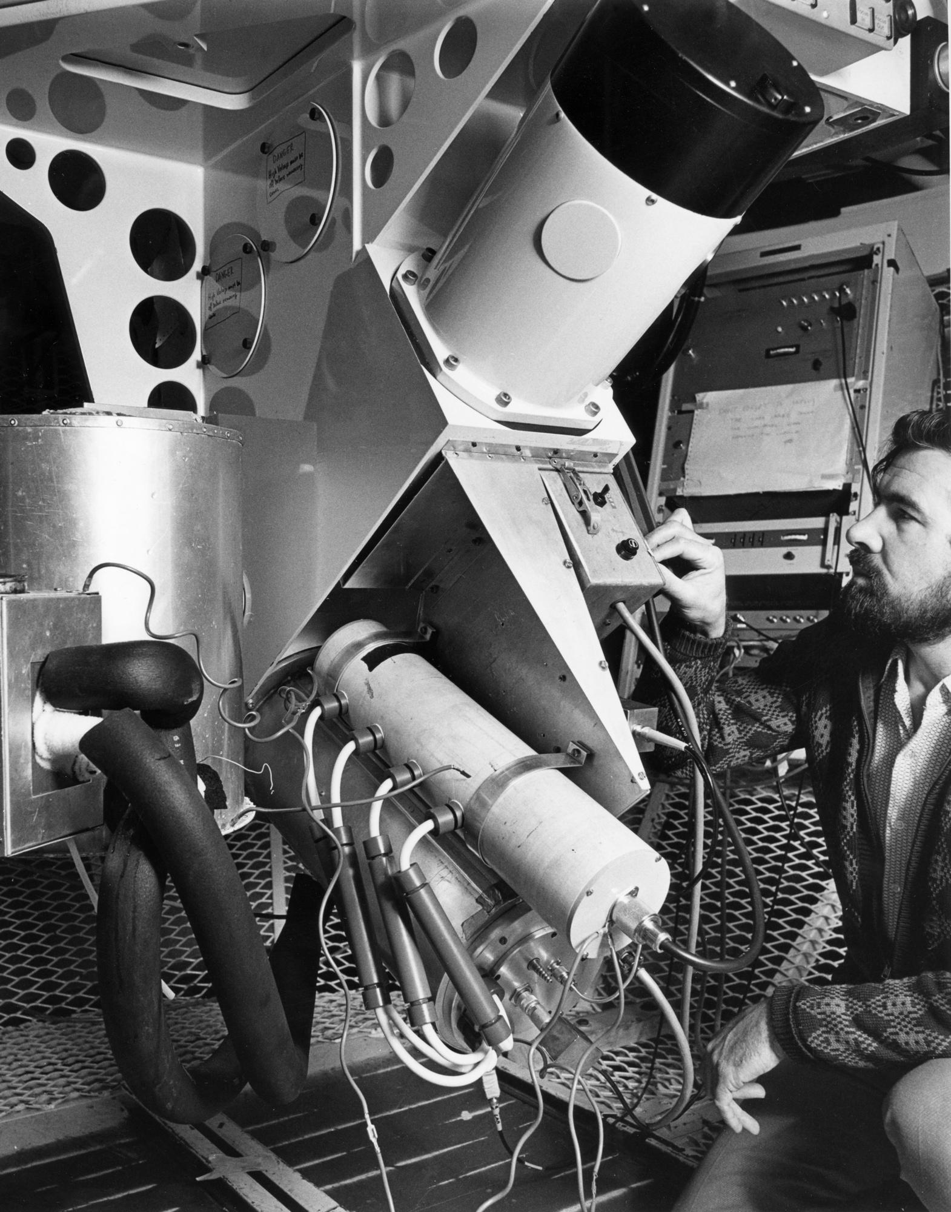
The Wampler-Robinson
Image Dissector Scanner
with John Barton and the
Boller & Chivens Spectrograph
Photos by David Malin

Slide 6
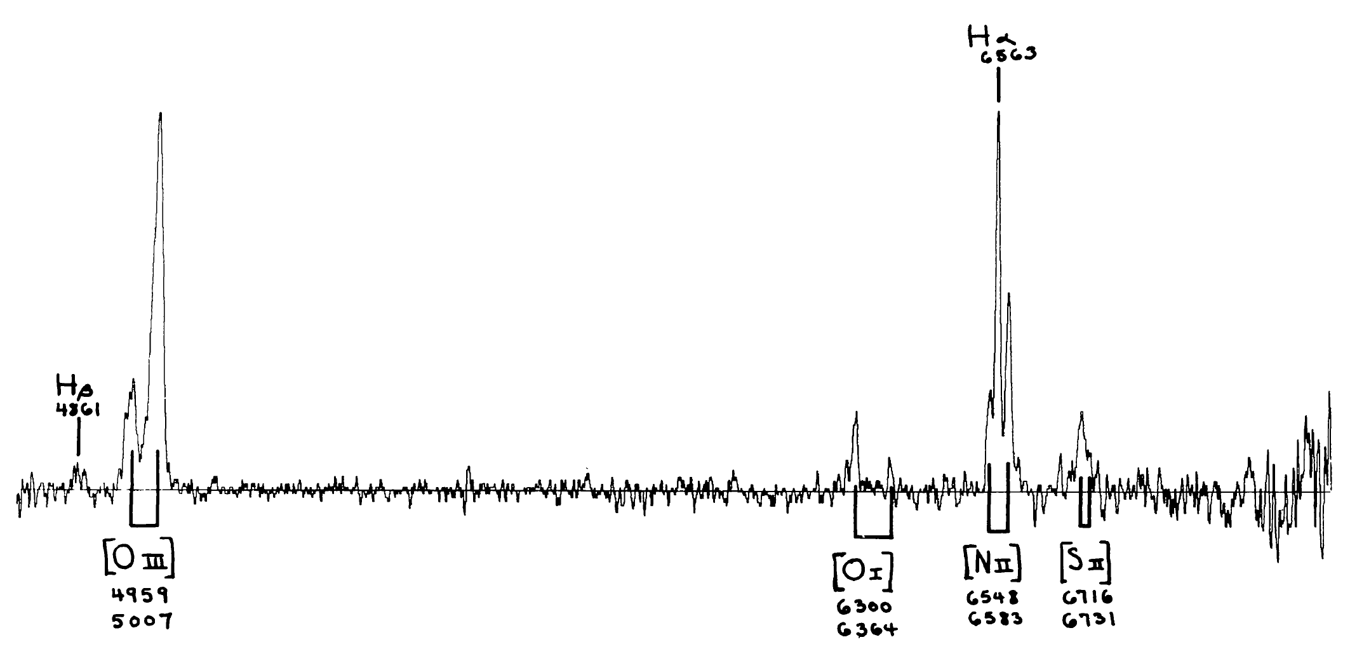
Spectrum of the Knot in the Optical Filament North-East of Cen A
by B. A. Peterson, R. J. Dickens & R. D. Cannon
Publ. Astron. Soc. Australia 2, 366 Oct 1975. Observed Mar 1975
(The AAT was inaugurated on 16 Oct 1974)
[S II] 6716/6731 indicates ne < 10^2 – 10^3
Lack of [O I] 5577 indicates Te < 3x10^4 - 4x10^4

Slide 7
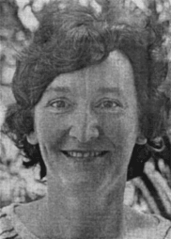
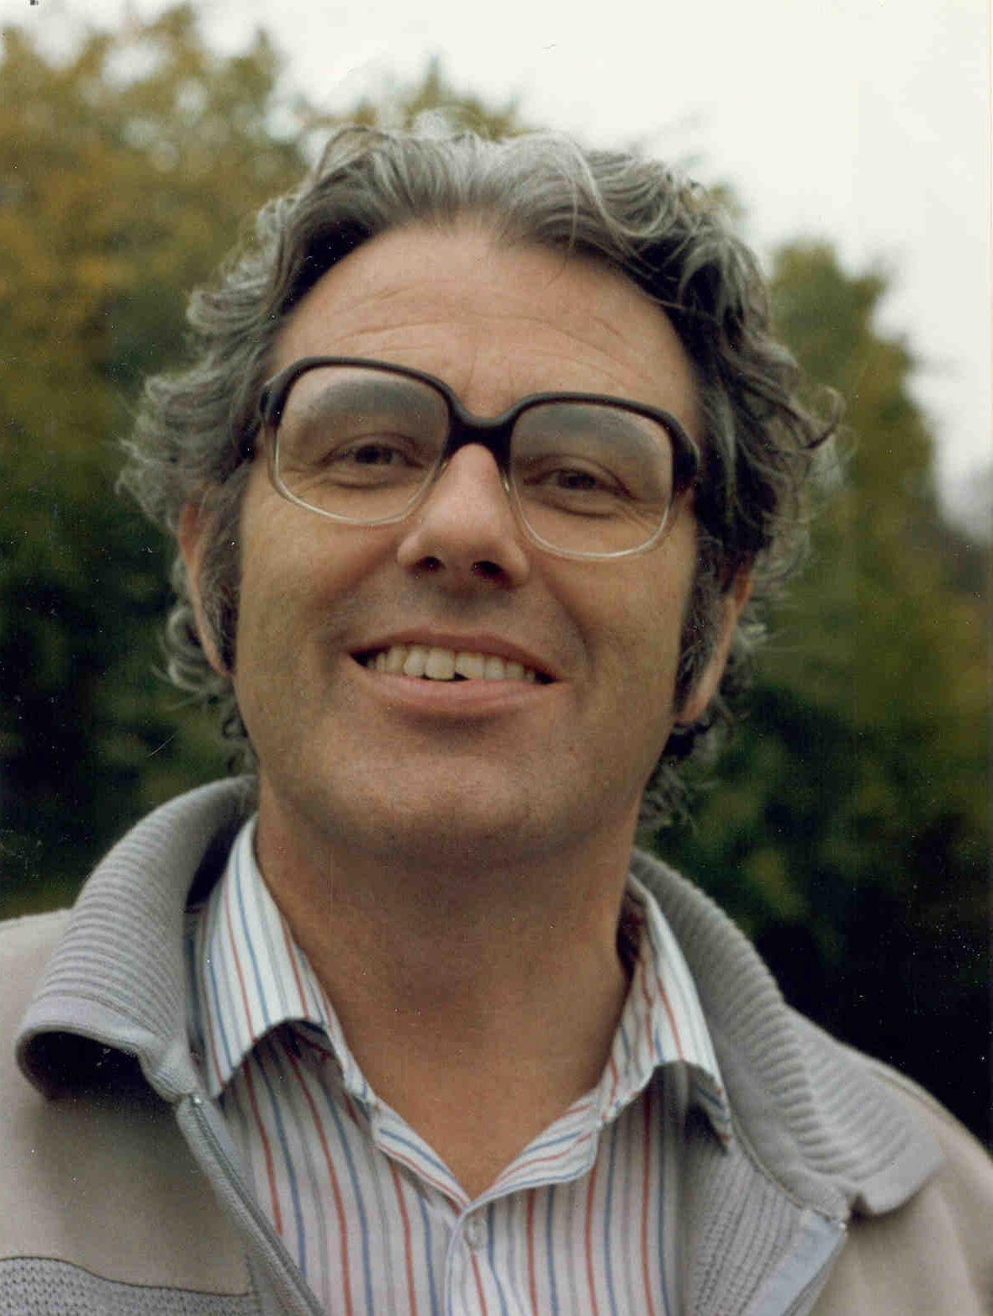
Original Staff Astronomers and UK Fellows
Louise Webster
to UNSW
Bruce Peterson
to MSSSO
Bob Fosbury
to ESO
John Danziger
to ESO
Michael Penston
to ESA
Paul Murdin
to RGO, ROE
David Allen
to AAO
John Whelan
to U Cambridge
Photos by David Malin

Slide 8
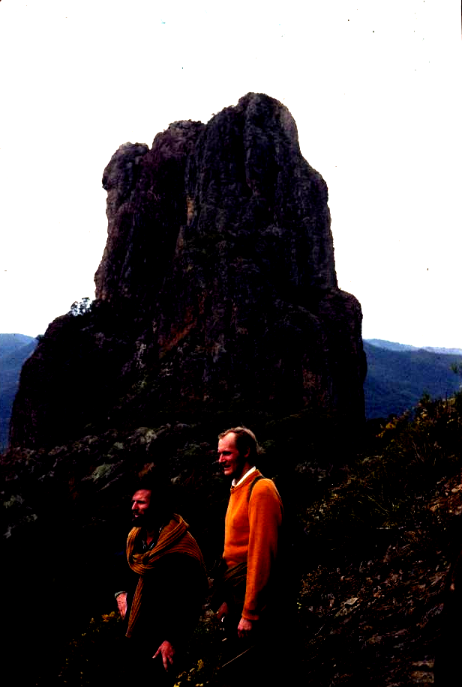
A Sunday walk in the Park to Belougery Spire with Peter Gillingham and Graham Bothwell September 1976
Photo by D. Morton

Slide 9
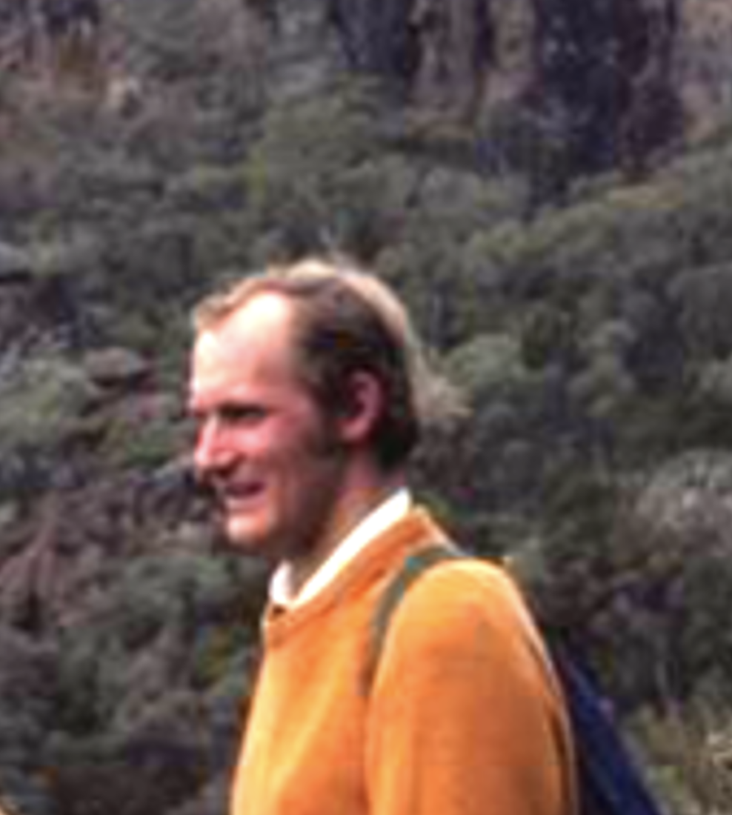
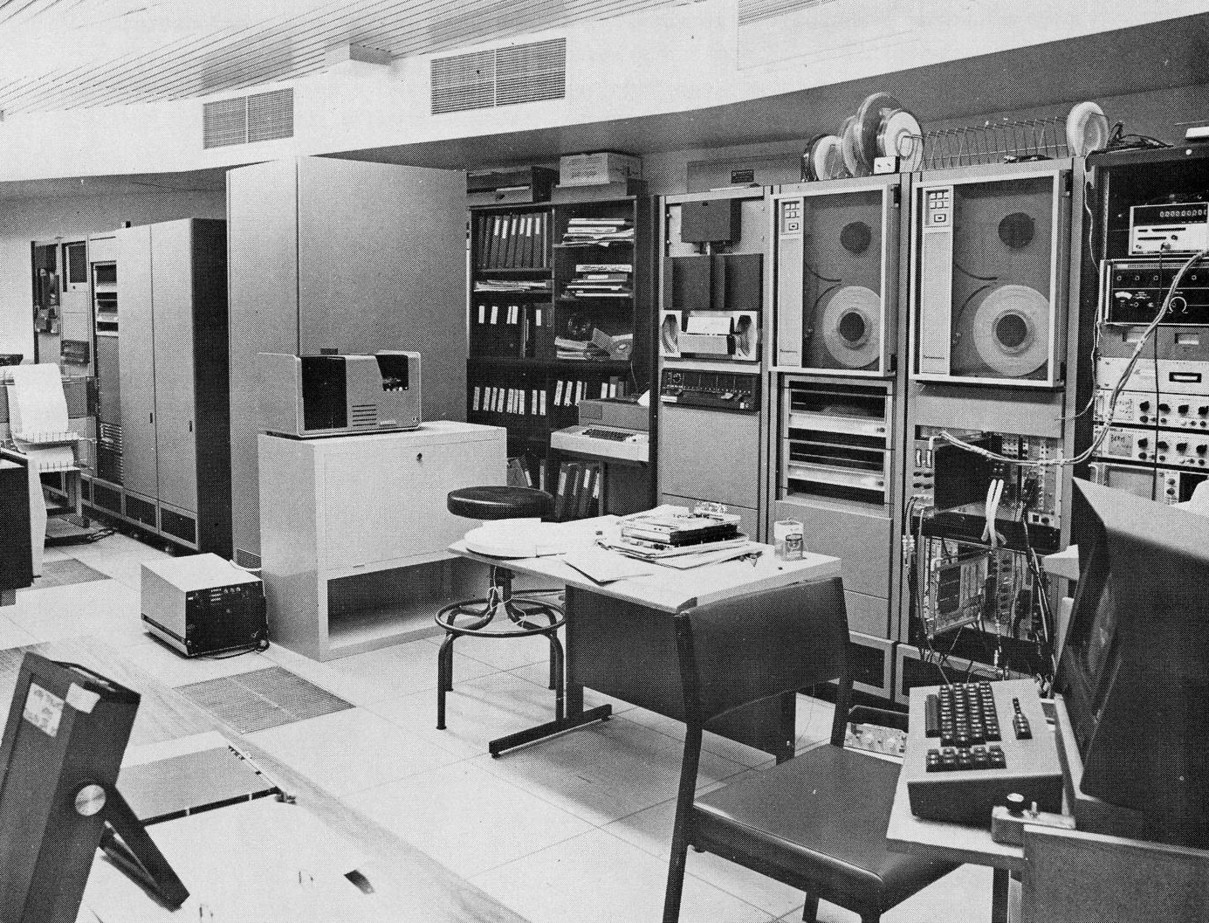
Interdata 70 Computer and CAMAC Interface ~1975
Graham Bothwell
Photo by David Malin

Slide 10
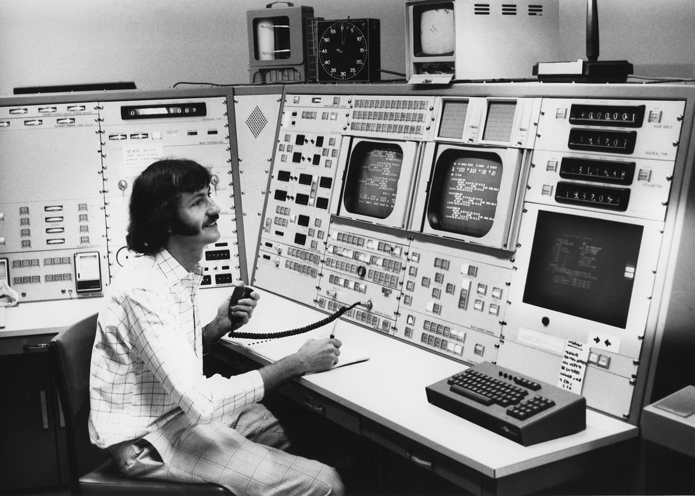
Bob Dean
Photo by David Malin

Slide 11
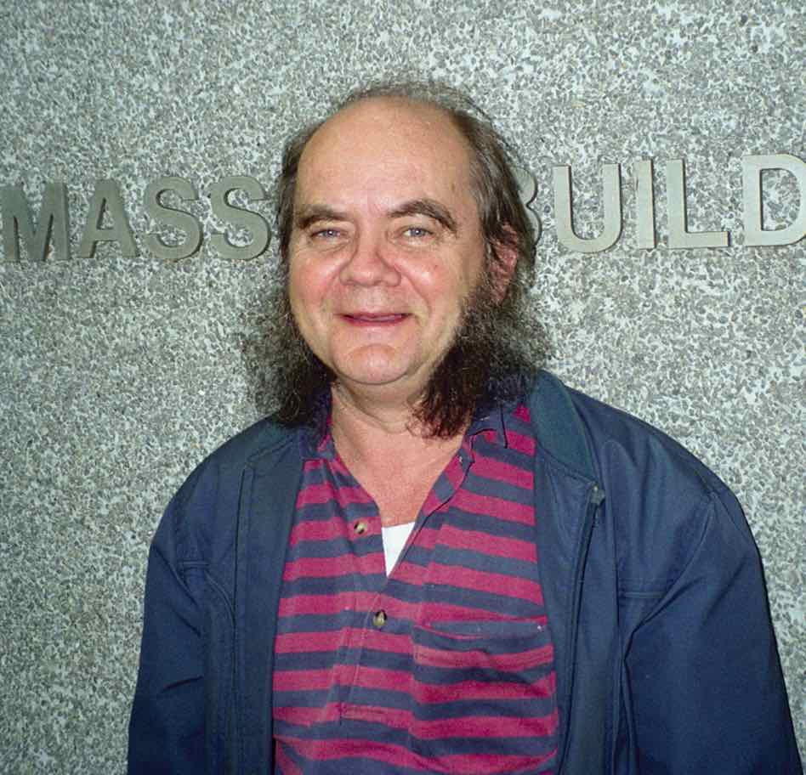
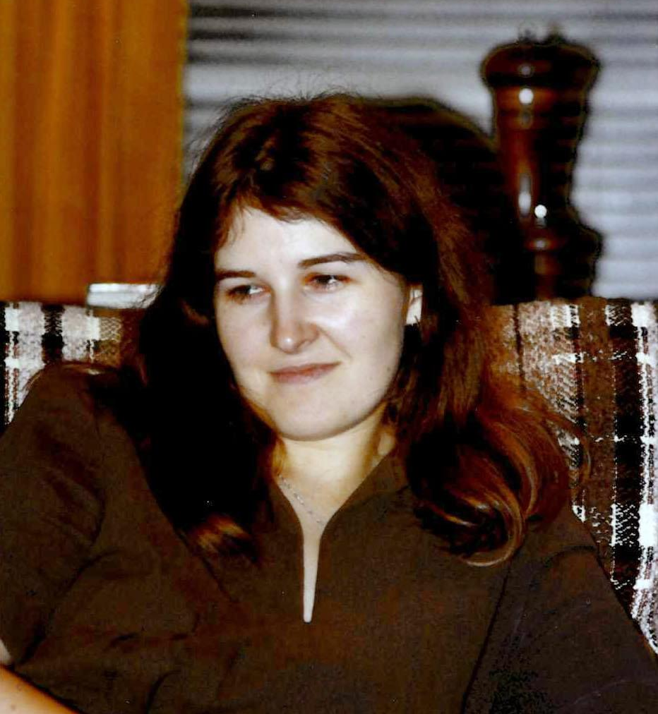
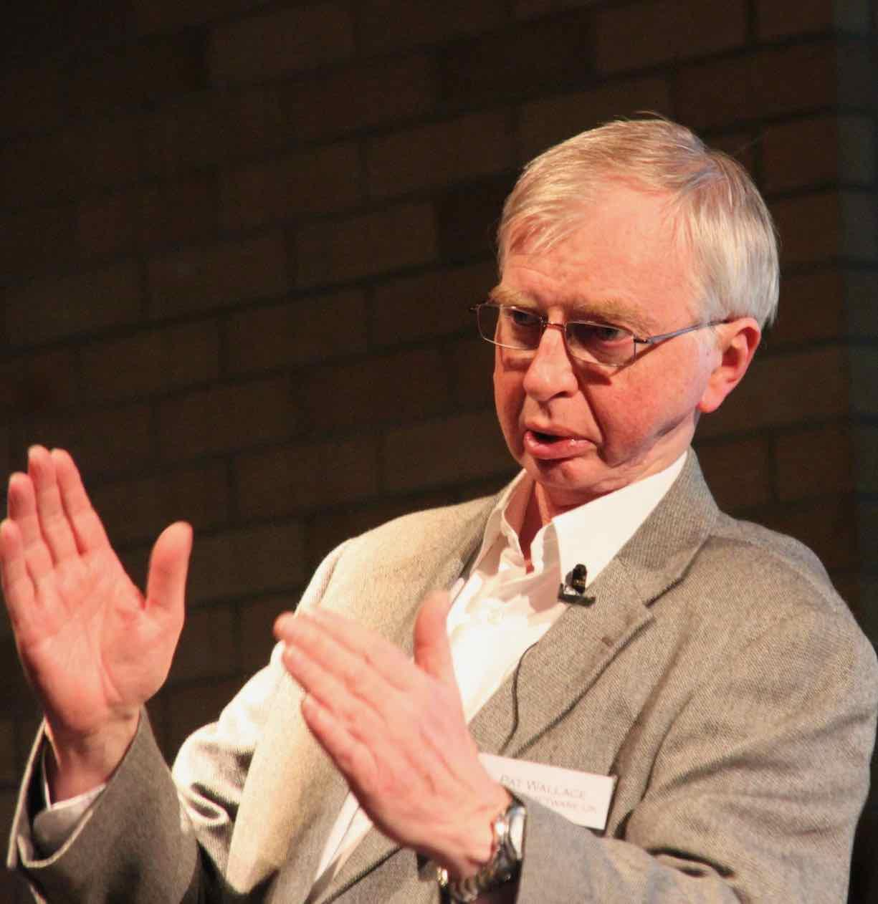
John Straede
AAO Software Team
Initially Maston Beard from CSIRO and Tom Wallace from ROE
Photo from David Malin
in
John Straede Bryony Phillips Pat Wallace
1975 - 2001 1975 - 1980 1975 - 1980

Slide 12
Photo by David Malin

Slide 13
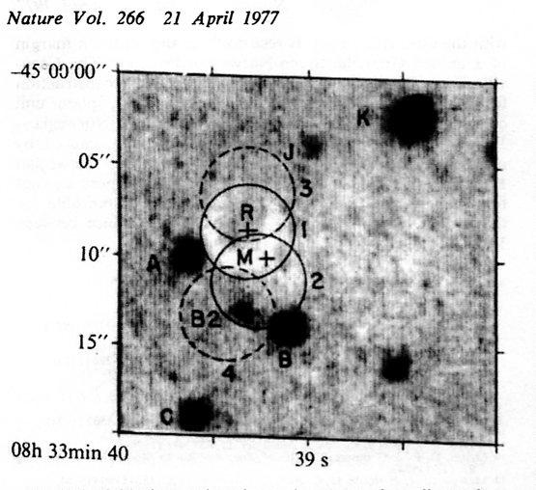
The
Vela
Pulsar
P = 89 ms
1977
Jan 24-27
Mt. Stromlo
Photometer
P.T. Wallace
B.A. Peterson
P.G. Murdin
I.J. Danziger
R.N. Manchester
F.G. Smith
M.J. Disney
K.F. Hartley
D.H.P. Jones
G.W. Wellgate
Nature 266, 692
1977
Photos by David Malin

Slide 14
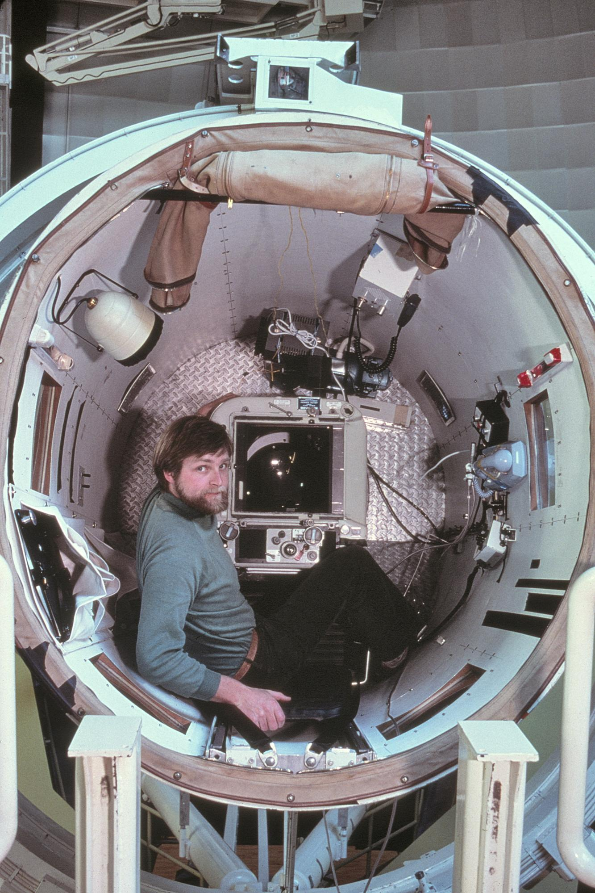
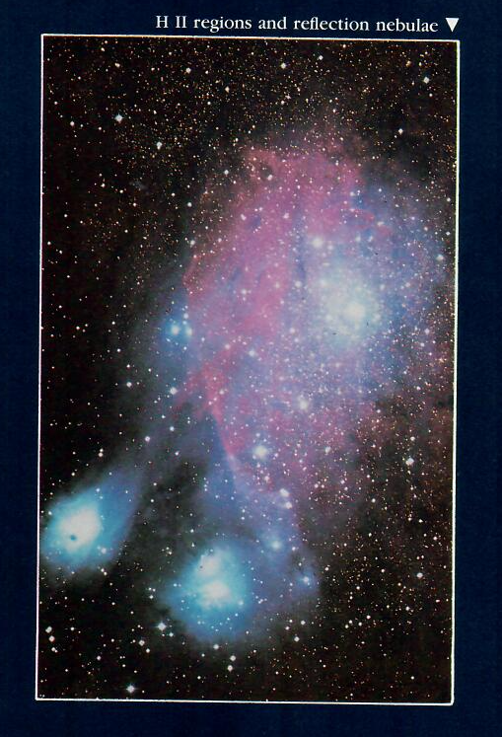
David Malin
Published in The Dynamic Universe by T. P. Snow
Photos by D. Carter

Slide 15
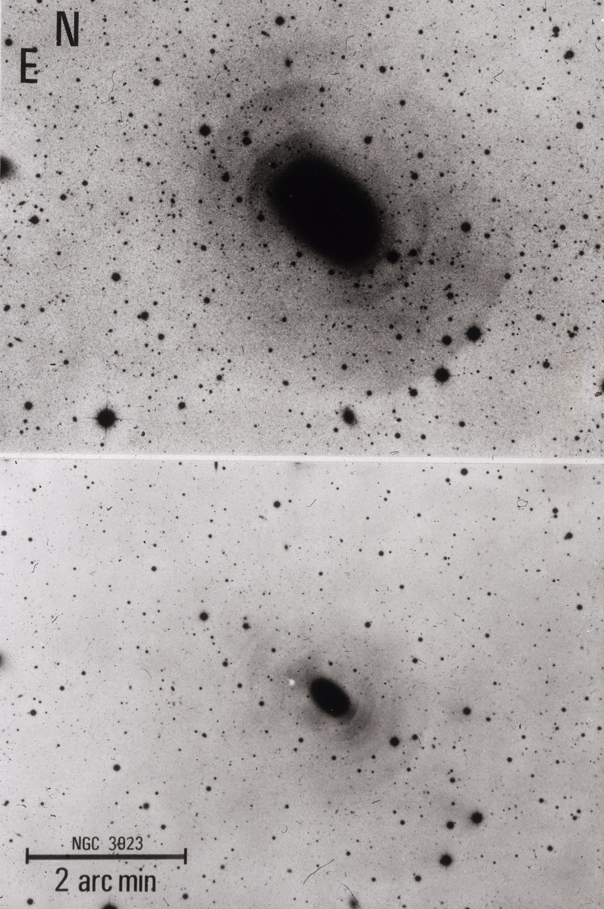
Shells of ejected stars around galaxies
Malin & Carter 1980 Nature 285, 642
Photos by D. Carter

Slide 16
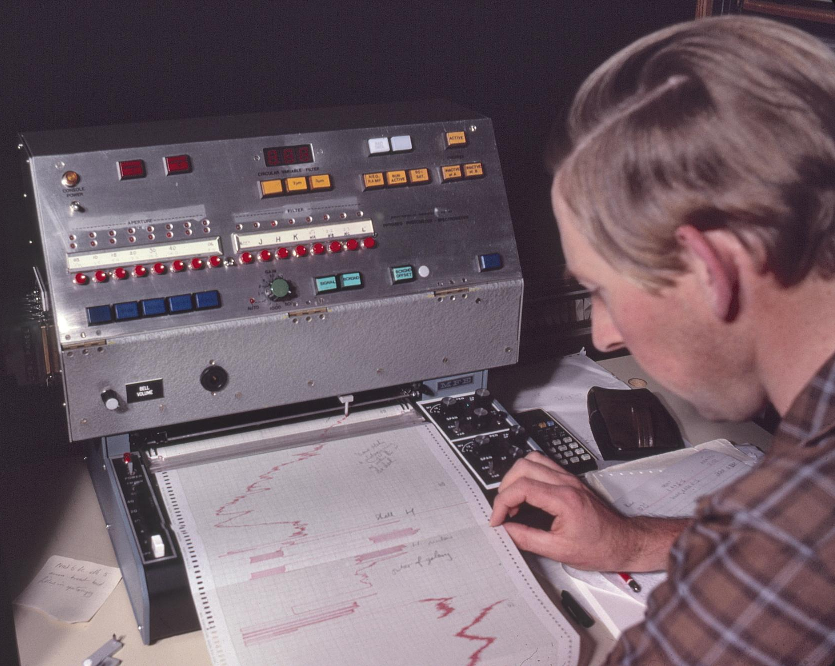
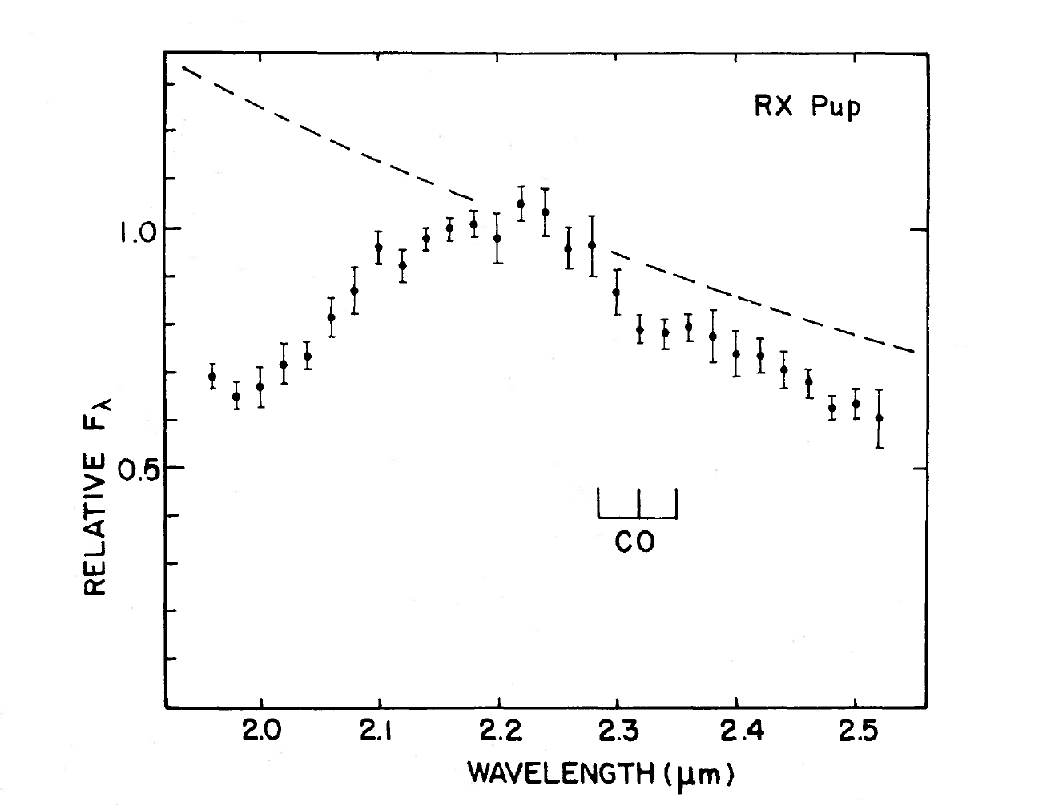
IR Photometer Spectrometer 1978
David Allen
John Barton
Photos by David Malin
Molecular Bands Show Presence of M Star
Black Body
H2O
Barton, Phillips & Allen 1979 MNRAS 187, 813
Briony Phillips
H2O

Slide 17
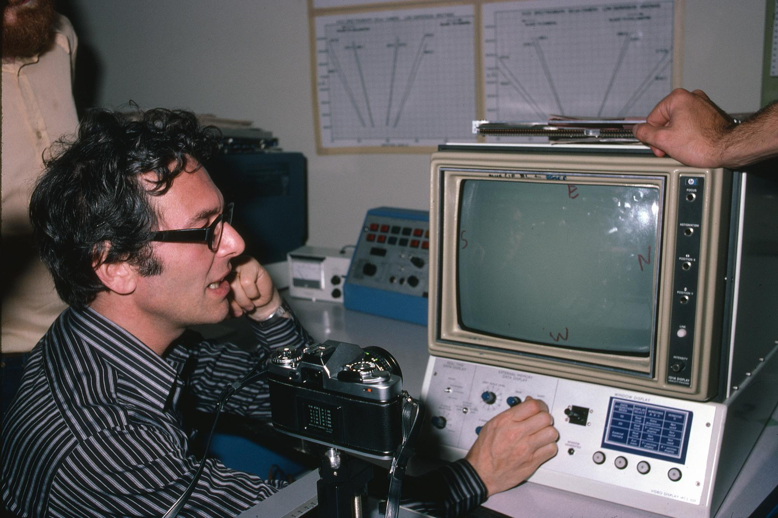
Alec Boxenberg and the Image Photon Counting System
Photo by David Malin

Slide 18
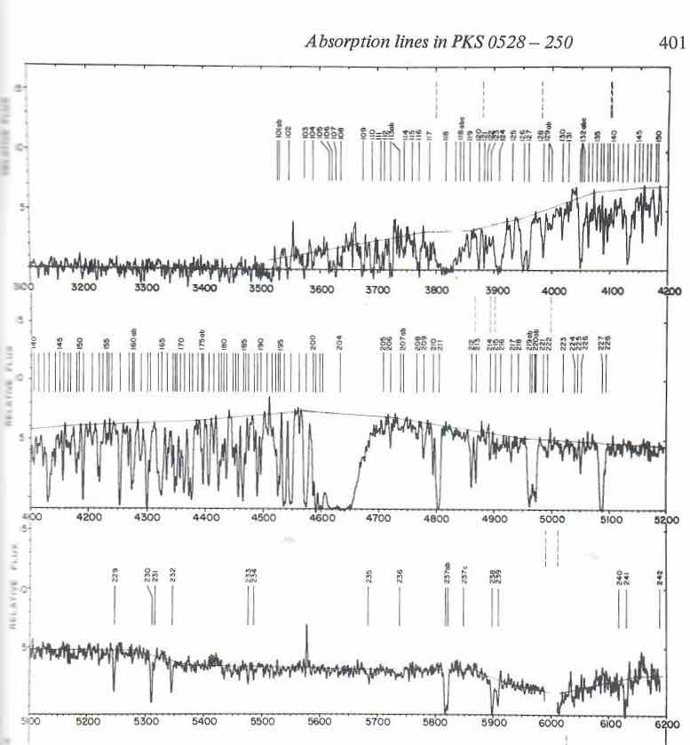
IPCS Spectra of Quasars
Radio QSO
PKS 0528-250
zem = 2.765
zabs = 2.81322
zabs = 2.81100
Zabs = 2.53758
Zabs = 2.14077
Morton, Chen, Wright, Peterson, Jauncey
1980 MNRAS 193, 399
Zabs = 2.81100

Slide 19
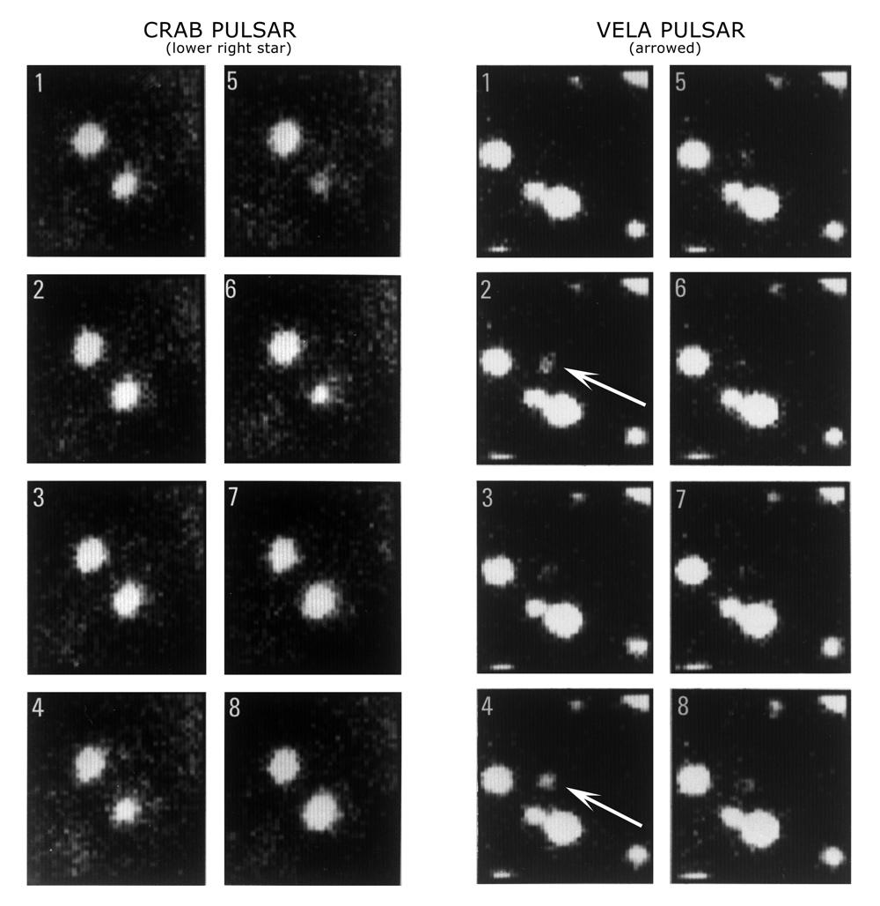
IPCS
Pulsar
Images
B. A. Peterson
P. G. Murdin
P. T. Wallace
R. N. Manchester
A. J. Penny
A. Jordan
K .F. Hartley
D. King
1978 Nature 276, 478

Slide 20
Fiber Plate at Auxiliary Cassegrain Focus 1982
Photo by David Malin

Slide 21
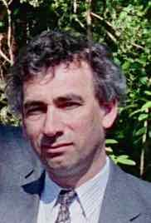
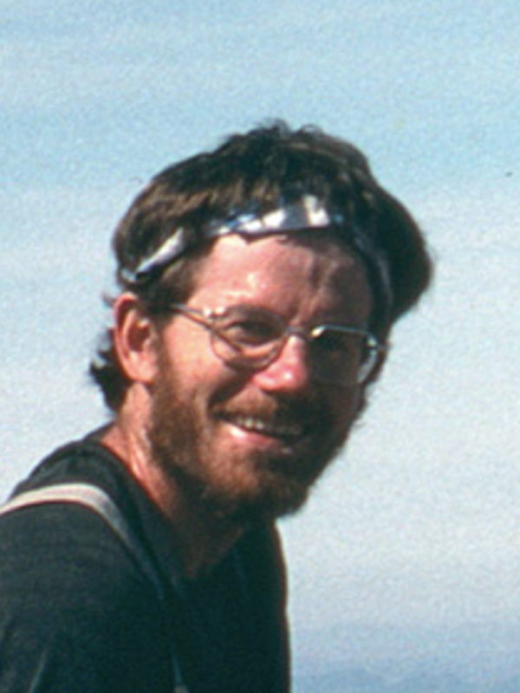
Multiple Spectra through Optical Fibers
Photo by David Malin
Richard Ellis
Durham University
Peter Gray AAO

Slide 22
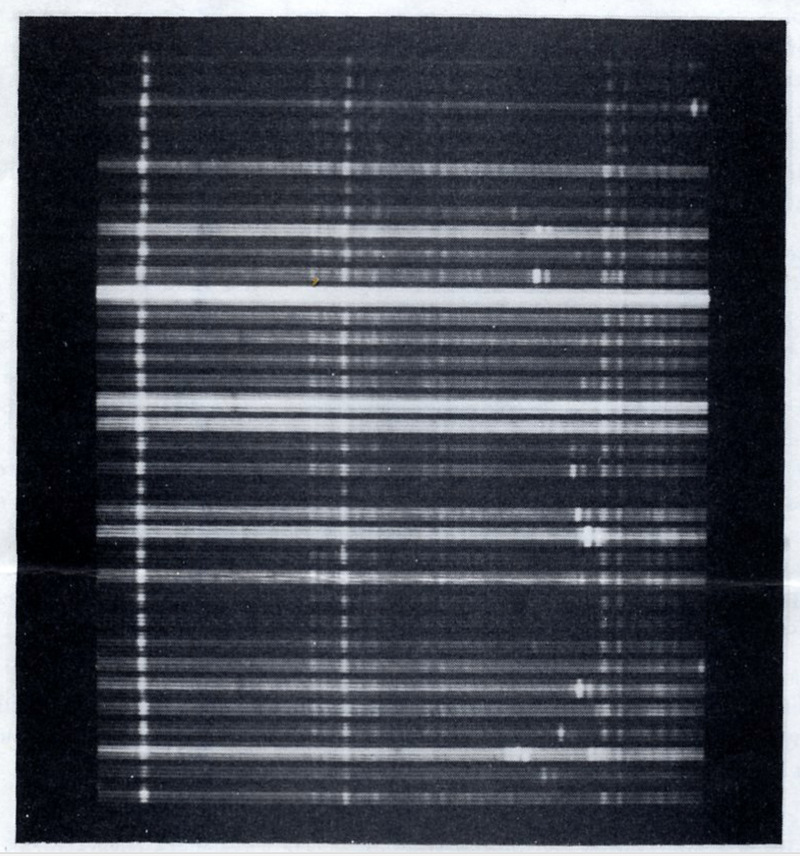
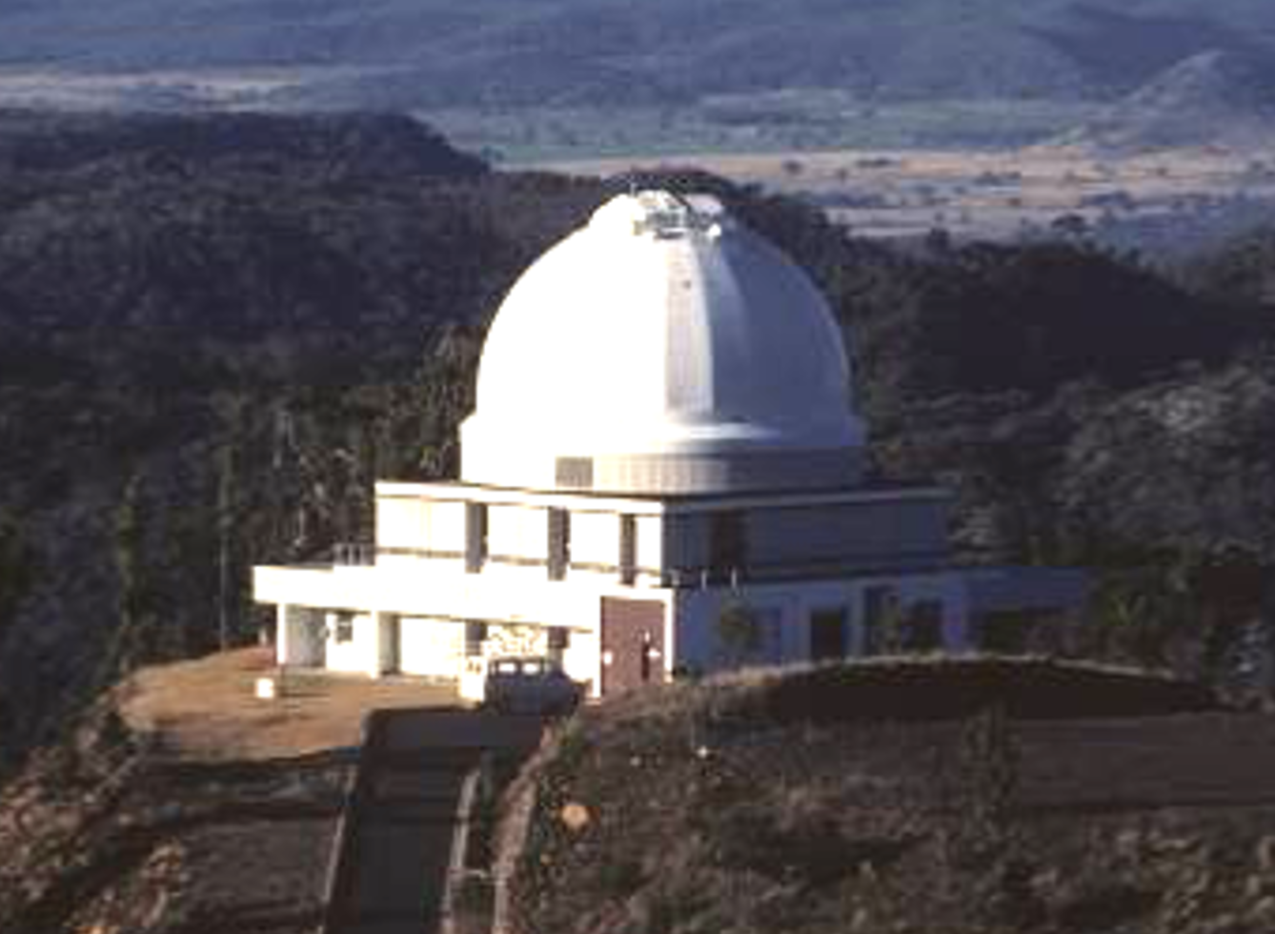
Fiber Spectra with UK Schmidt
Fred Watson
Photo by David Malin
32 galaxies, 3 sky spectra
5800 – 7000 A with Durham
CCD camera showing
[N III], Ha, [N II] em, Na abs

Slide 23
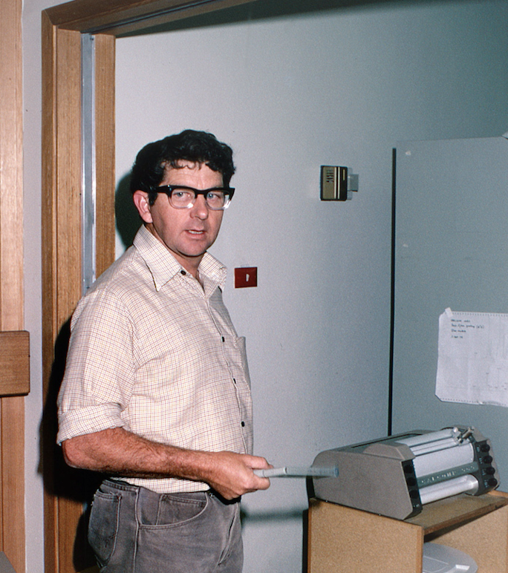
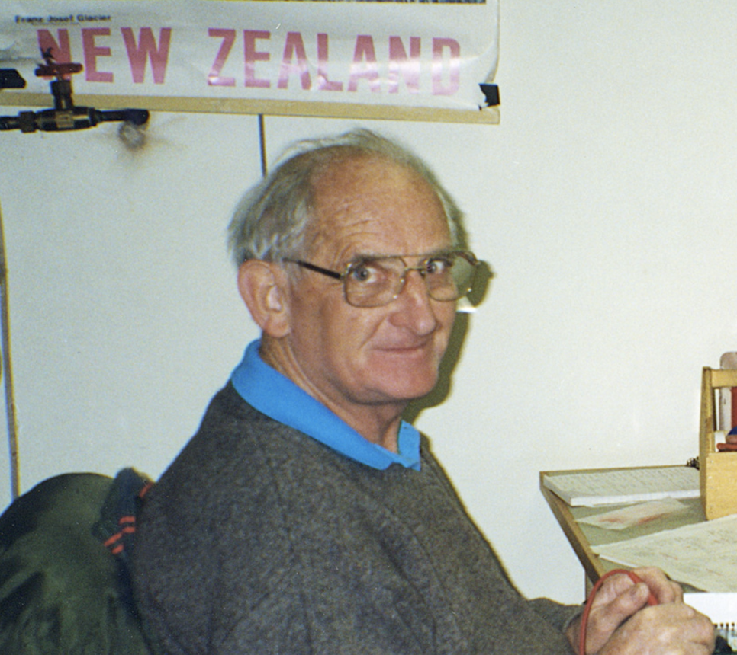
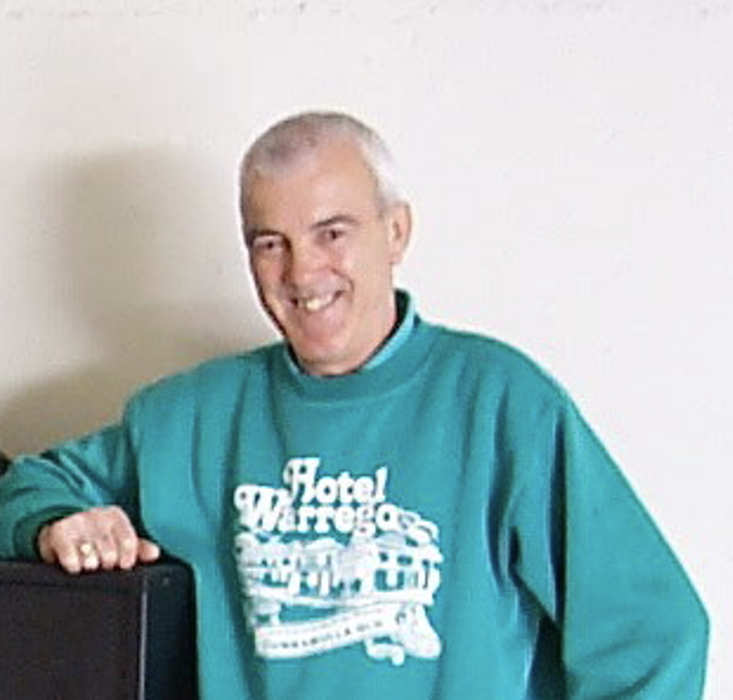
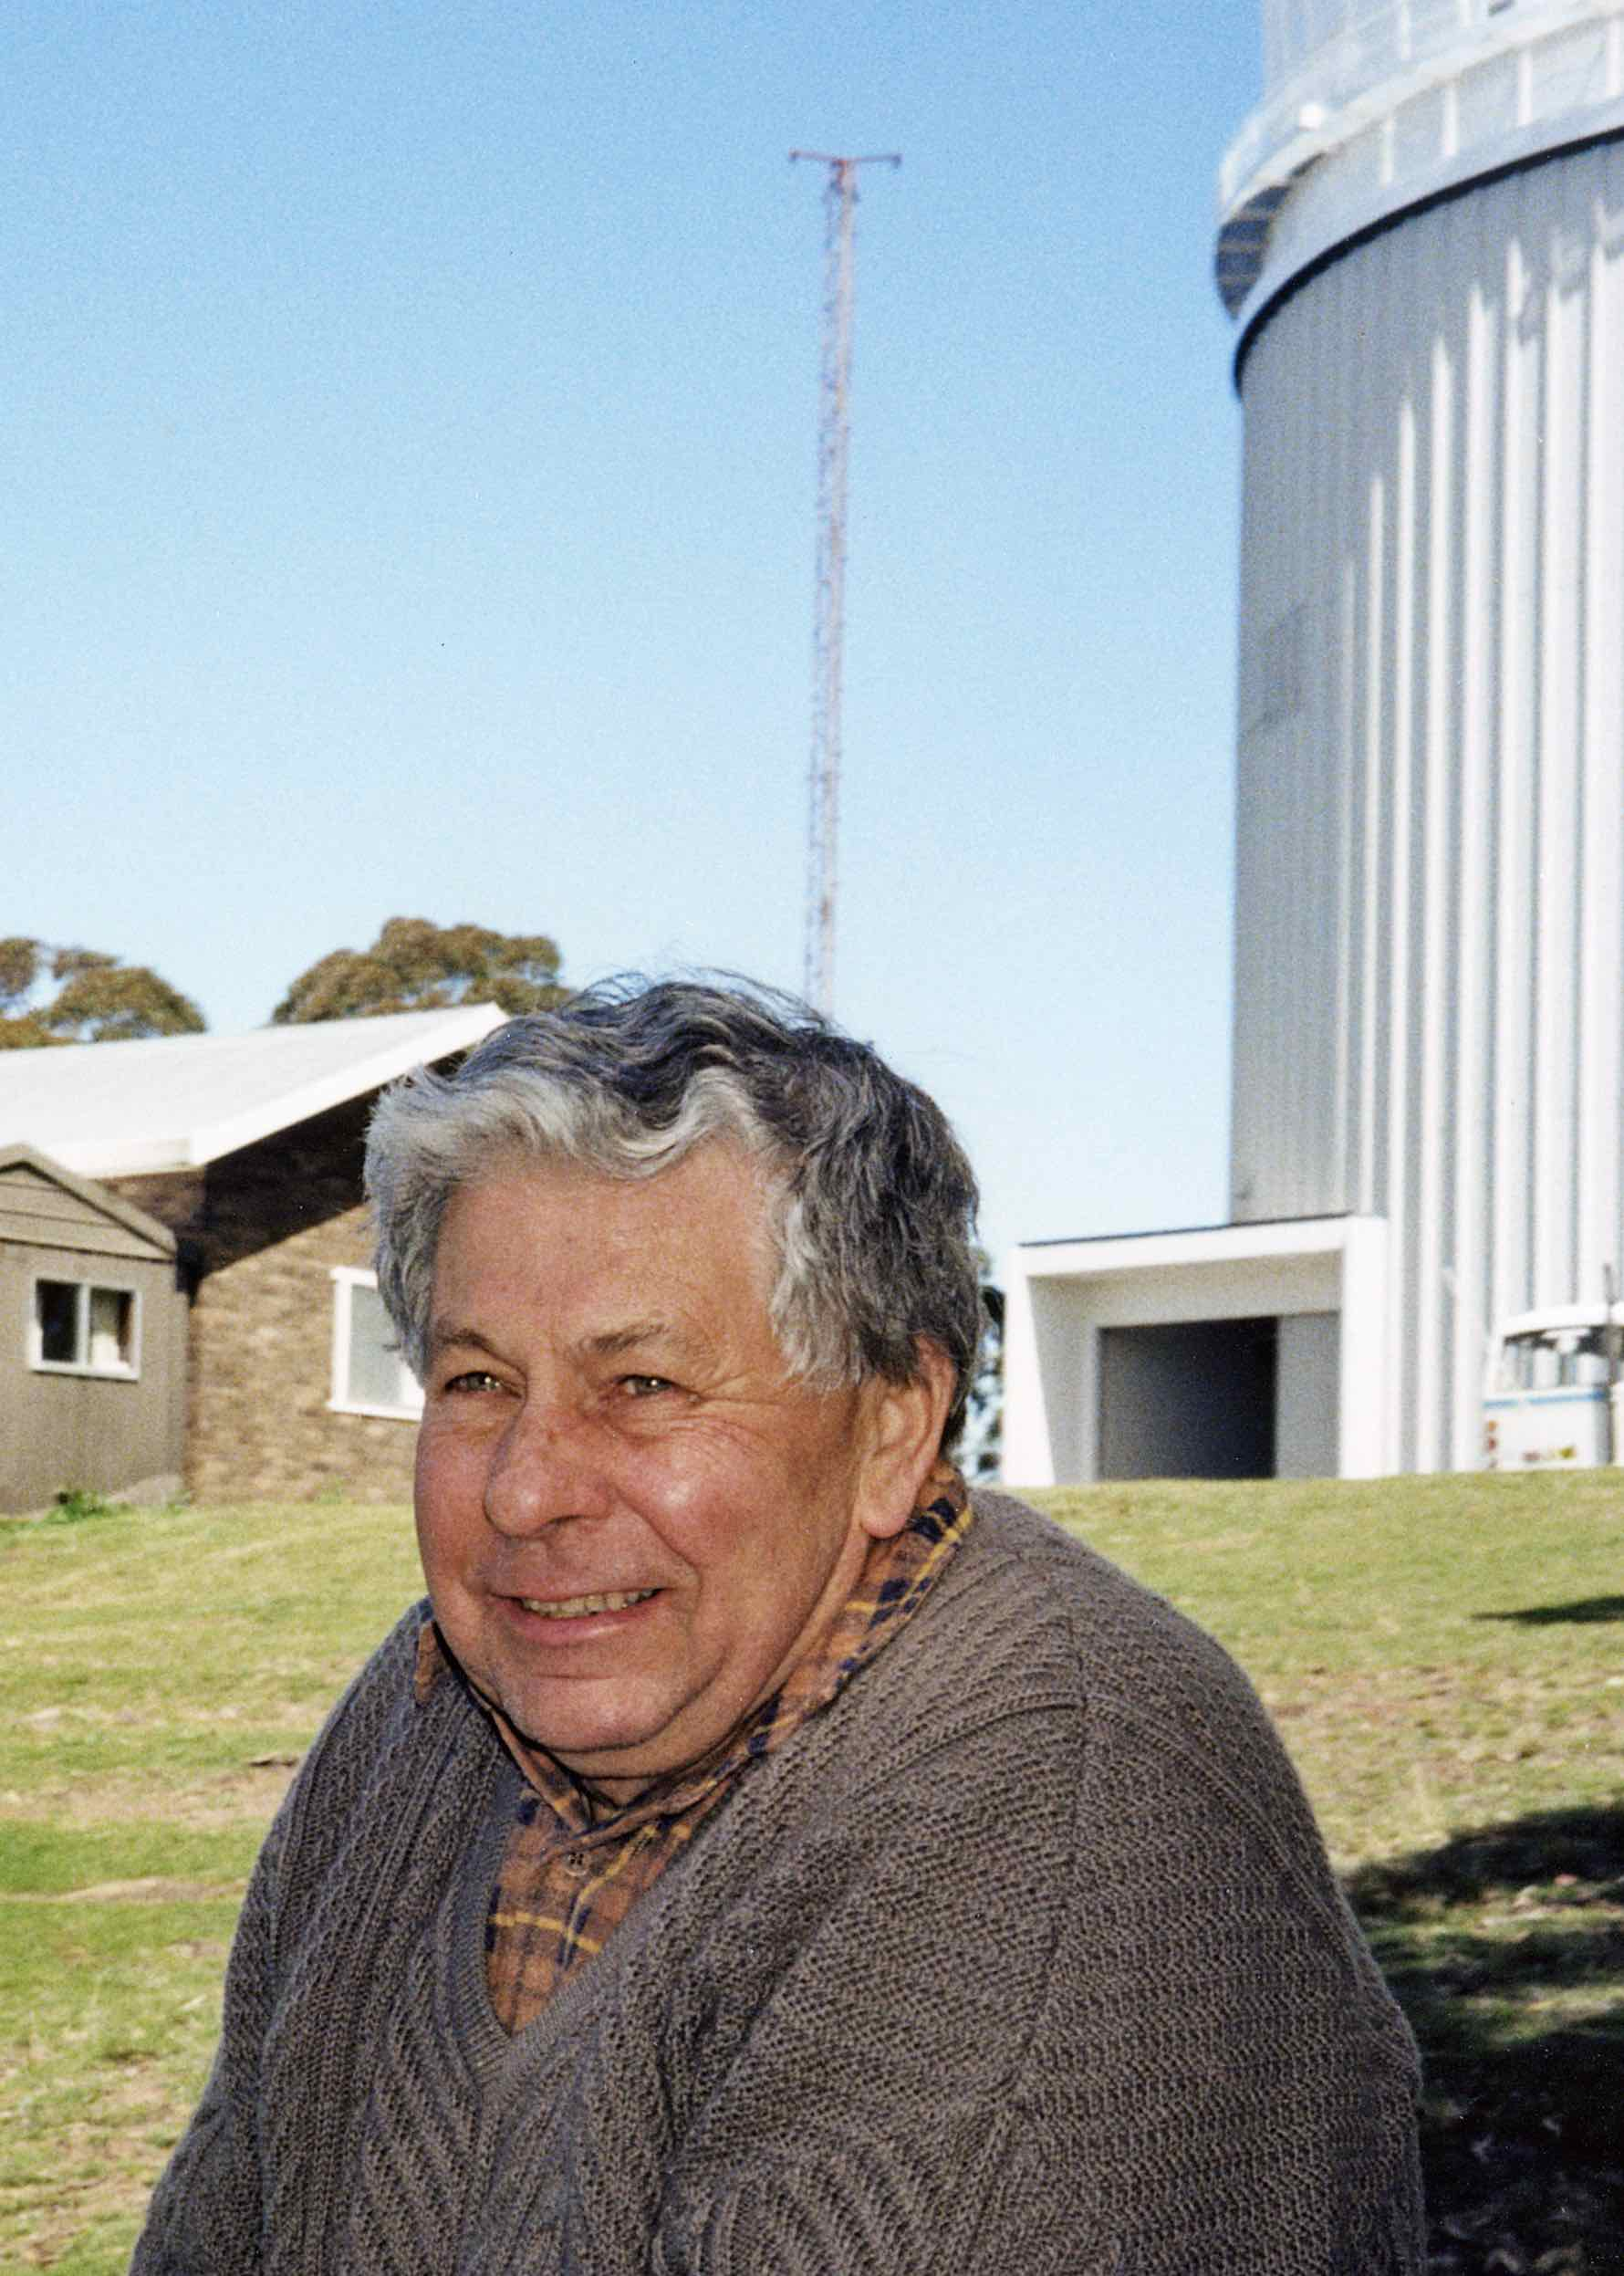
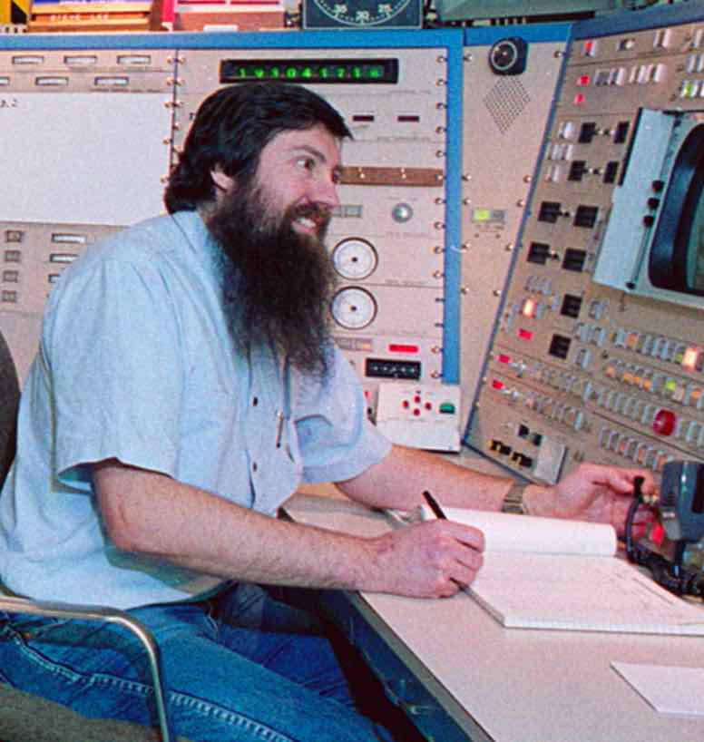
Site Electronics - Lew Denning Night Assistants
Kevin Cooper Frank Freeman
Tom Cragg Gordon Shafer Steve Lee
Photos by David Malin

Slide 24
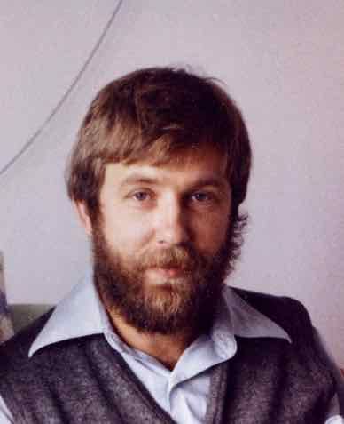
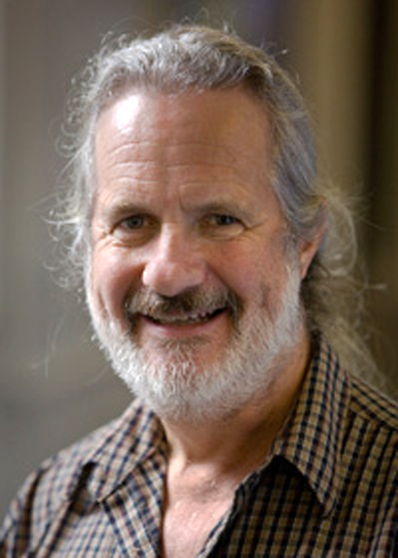
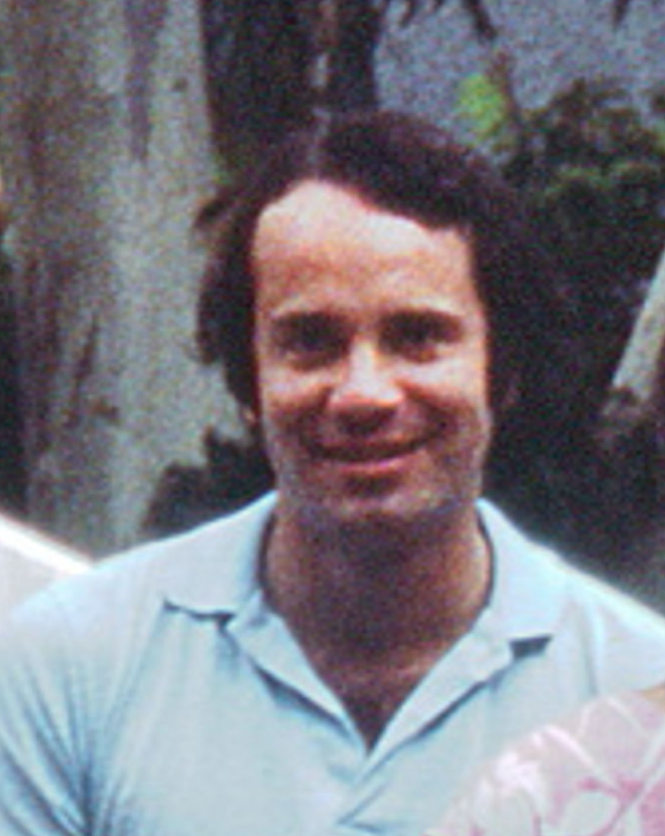
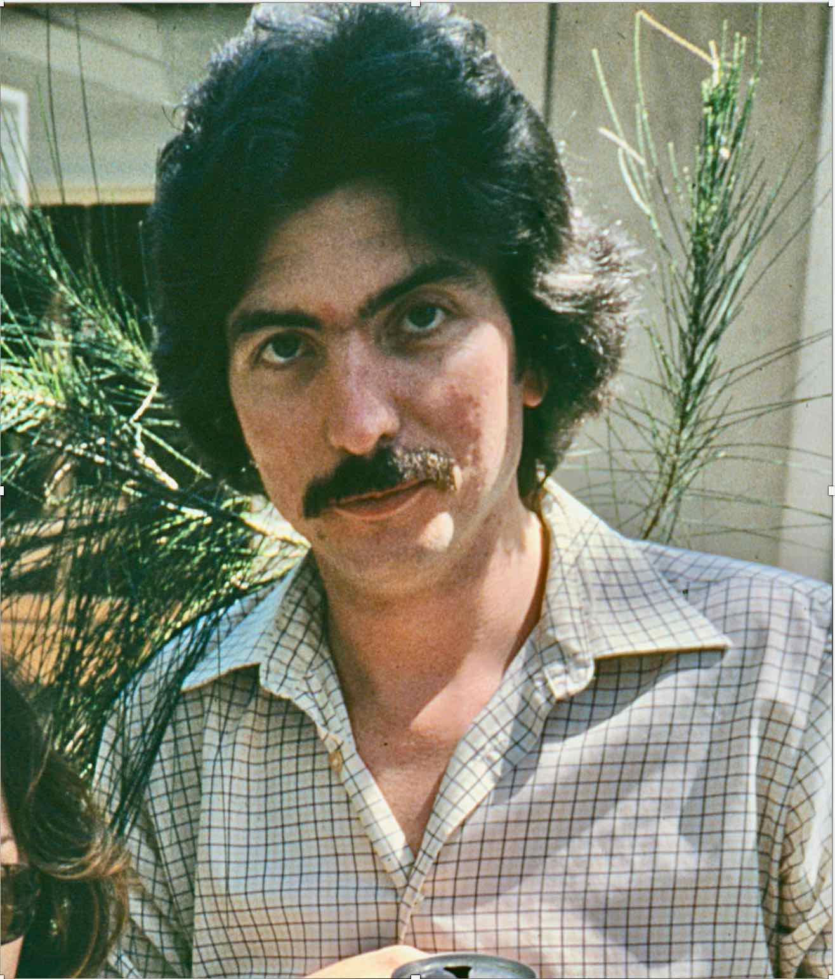
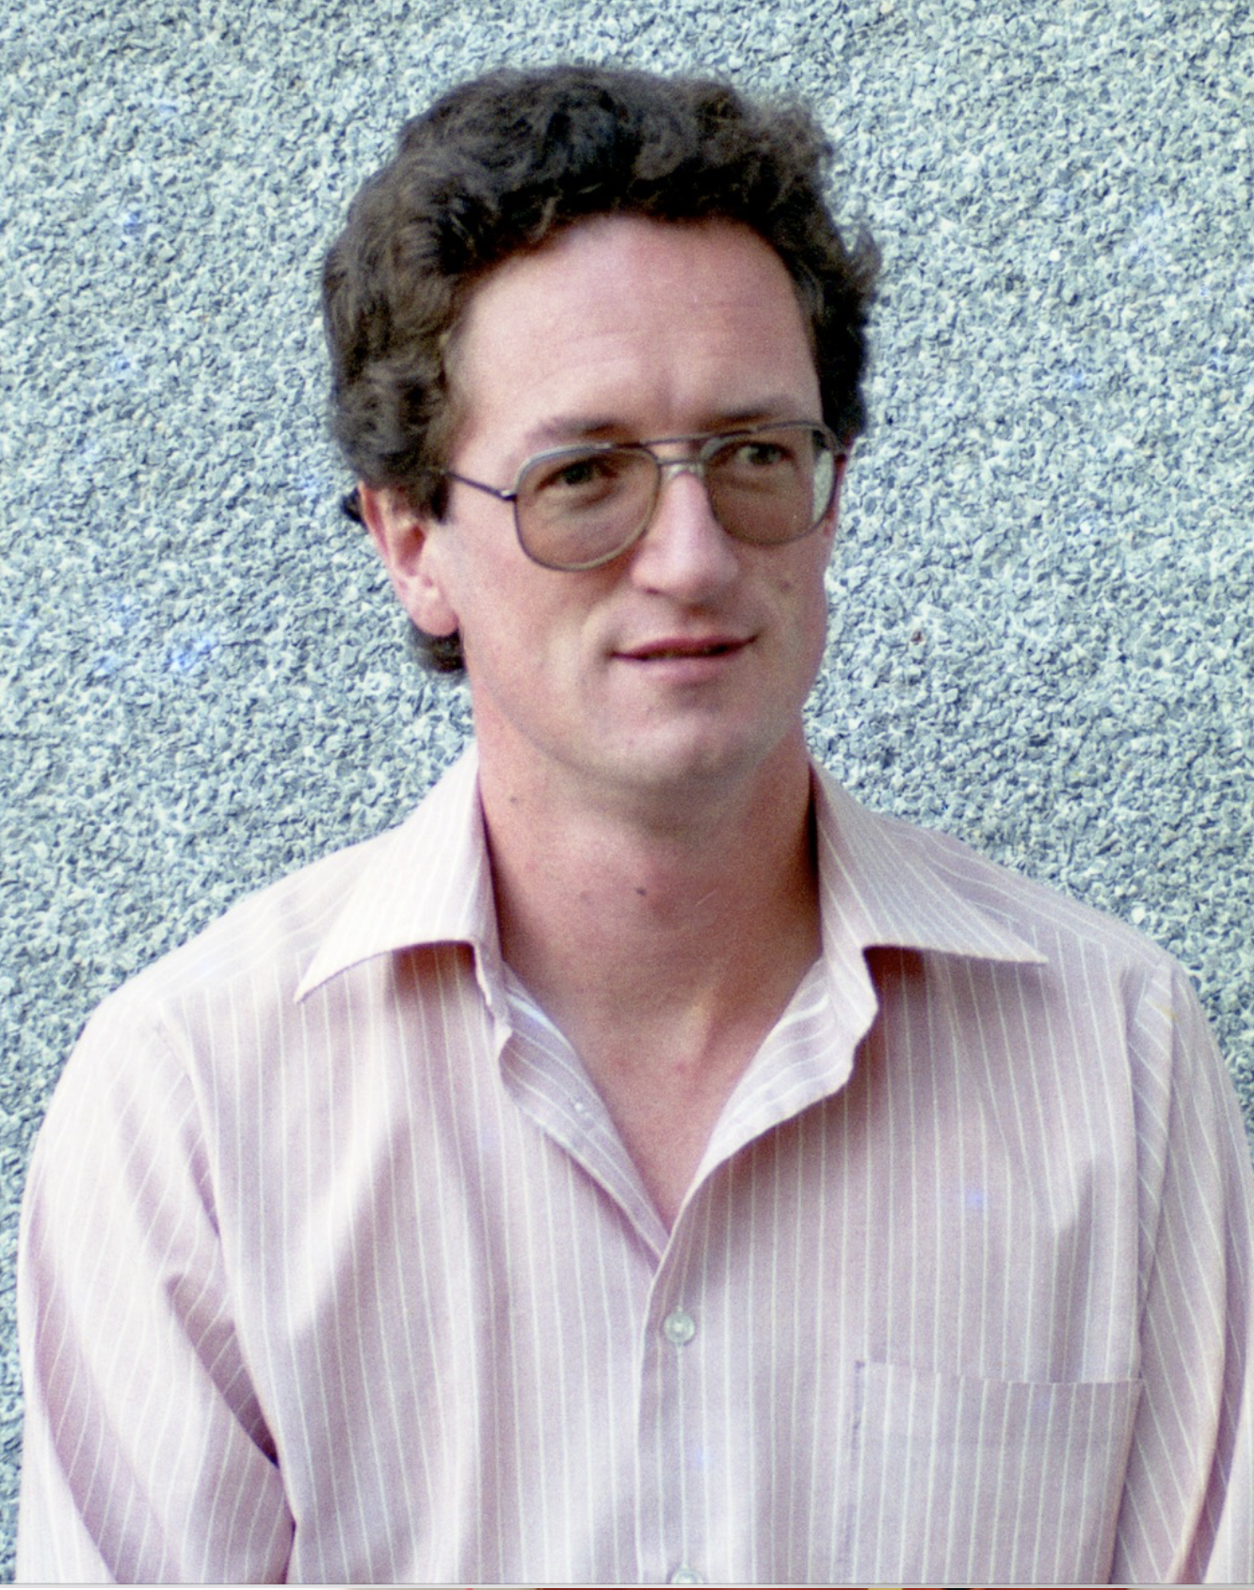
Malcolm Smith Alan Wright David Hanes Gordon Robertson
to ROE, CTIO to Parkes to Queens U, Canada to U Sydney
John Storey Jeremy Bailey Pat Roche Warrick Couch
to UNSW to UNSW to UCL, Oxford to Swinburne U
Photos by David Malin

Slide 25
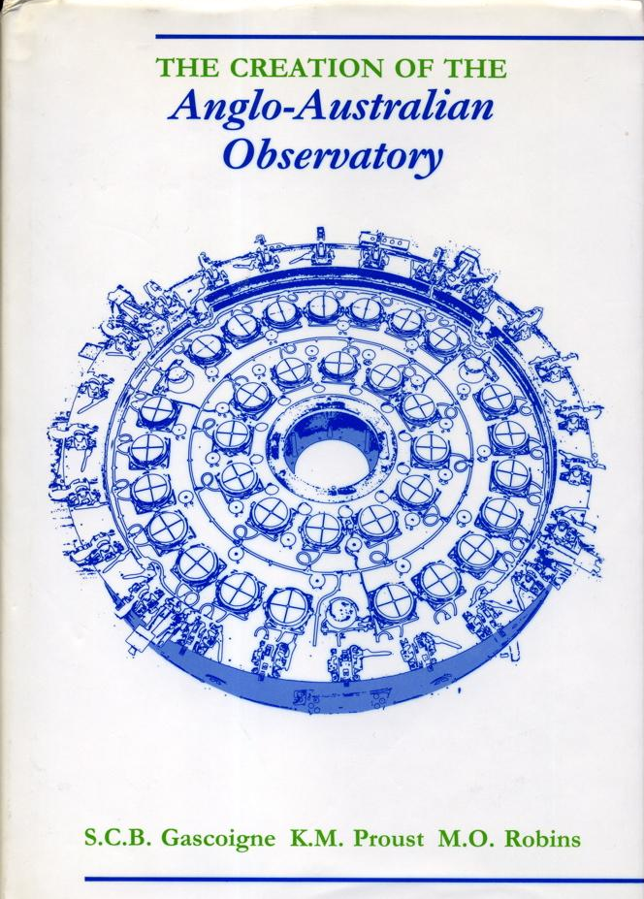
Commissioning Astronomer
Photo by David Malin
Ben Gascoigne
Mt. Stromlo & Siding Spring Observatories
Cambridge University Press 1990

Slide 26
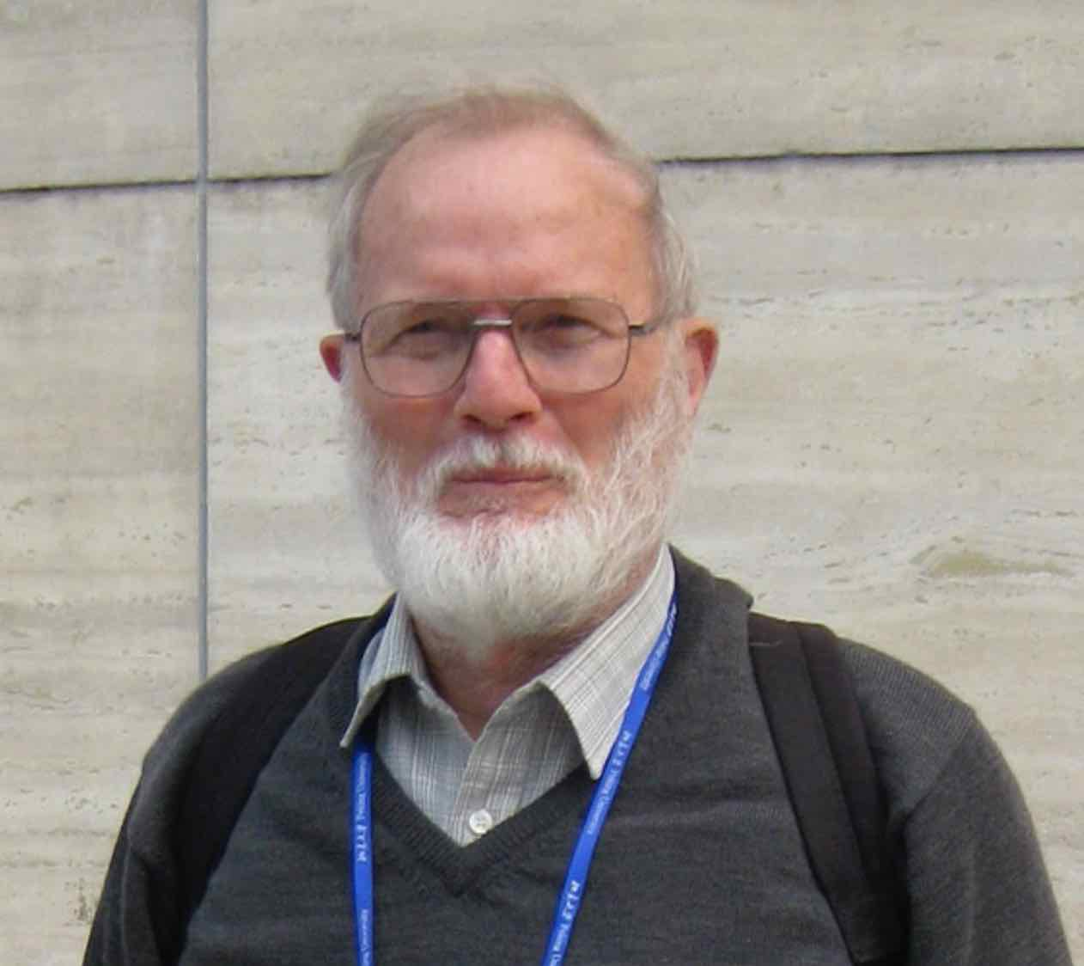
Administration Engineering
Photo by David Malin
Photos by Don Morton
Doug Cunliffe AO Peter Gillingham
1968 - 1994 1971 - 1993

