Slide 1
The UK Schmidt Telescope | The Origin
Sir Fred Hoyle
1915 – 2001
Chairman of the
AAT Board
Proposal to build UKST
in 3 years, to create a
UK base in Australia
Vincent Reddish
1926 - 2015
Royal Observatory Edinburgh
ROE contracted to build
and commission the
UKST in 2 years
Dr Russell Cannon
Head of the UKST
Telescope Unit
Dr Tim Hawarden
1943 – 2009
Astronomer
Dr Andy Longmore
Astronomer
1970
August 1973 J149 first successful Survey Plate
1975

Slide 2
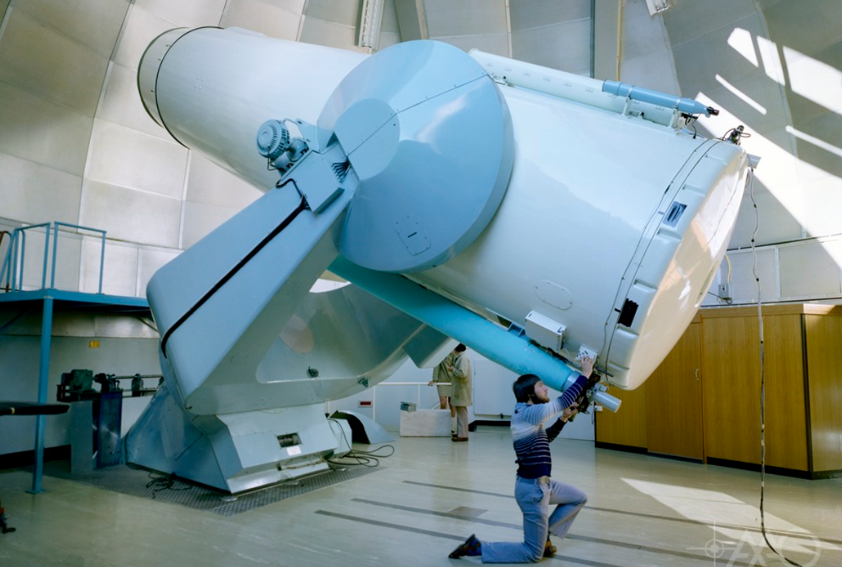
The UK Schmidt Telescope | The Origin
Credit: The UK Schmidt telescope, attended by Andy Longmore at AAO. Photograph by David Malin, August, 1977 Scanned from 4 x 5 inch colour neg (in Malin’s collection) by David Malin, Dec 2009

Slide 3
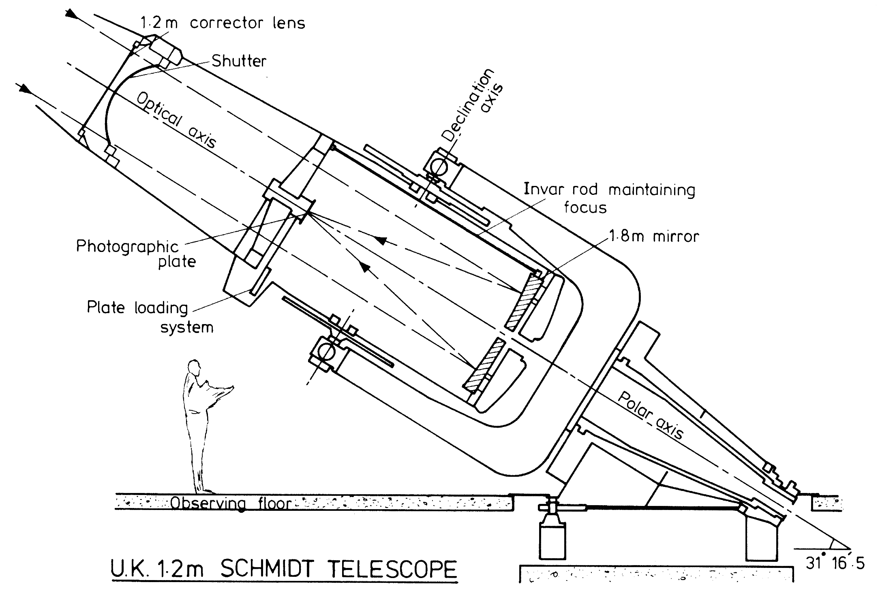
The UK Schmidt Telescope | The Origin

Slide 4
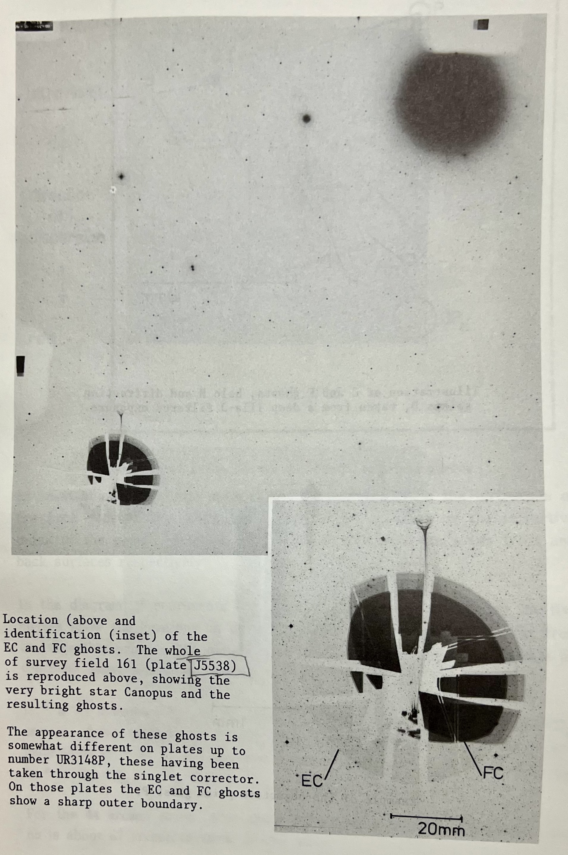
The UK Schmidt Telescope | The Origin

Slide 5
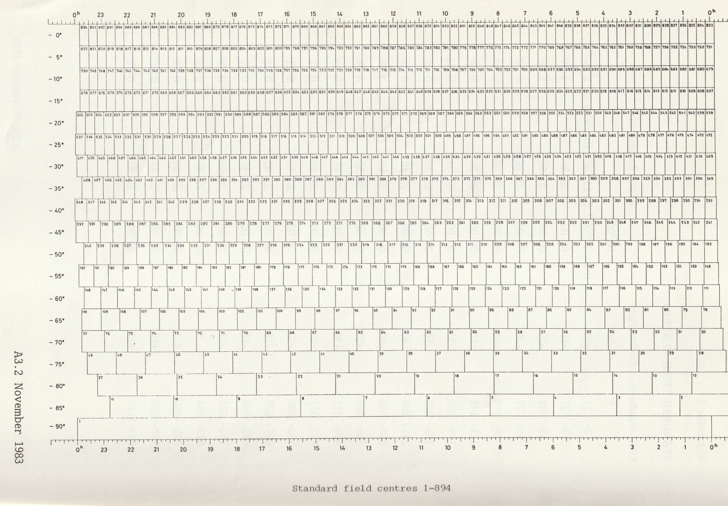
The UK Schmidt Telescope | The Origin
Original plan – 606 plates to centre -20^{O}
Chart showing plate number and their location in sky
X= right ascension
(Right ascension is the celestial equivalent of terrestrial longitude)
Y = declination
(angular distance of a point north or south of the celestial equator)
Credit: UKSTU Handbook 1983, Sue Tritton

Slide 6
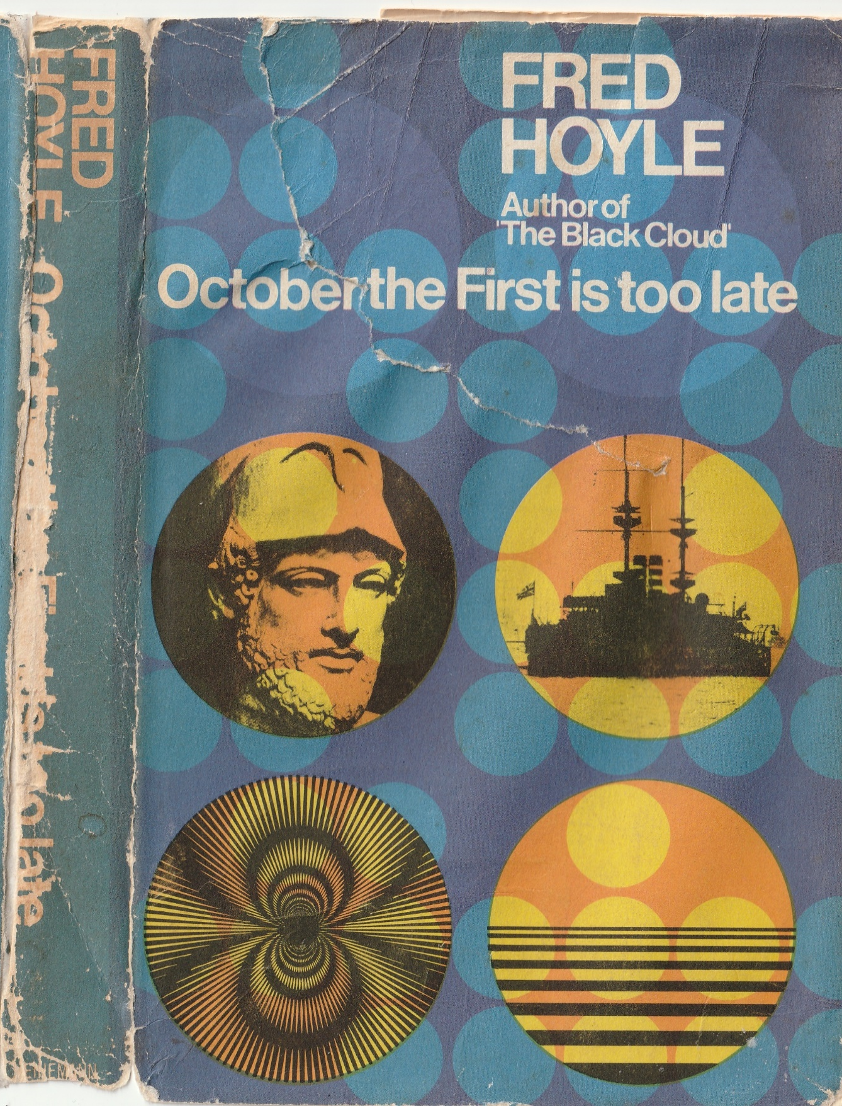
The UK Schmidt Telescope | The Origin

