Slide 1
Precision Weak Lensing
from Integral Field Spectroscopy
at SSO and the AAT (plus a little from Keck)
Edward N Taylor — entaylor@swin.edu.au — AAT@50 — October 4, 2024

Slide 2
Measuring
the masses of galaxies
based on the dynamics
of other, unrelated galaxies.
Edward N Taylor — entaylor@swin.edu.au — AAT@50 — October 4, 2024

Slide 3
Precision weak lensing:
What is the future of weak lensing science after Euclid/Roman?
First tentative detections of weak lensing in the 1990s.
Now a major motivator for Stage III & IV cosmology experiments, including KiDS, DES, HSC-SSP, VRO-LSST, Euclid, Roman, ...
With systematics well controlled, and deep imaging over large areas conventional lensing is approaching a fundamental 'shape noise' limit.
Absent a breakthrough, the field will plateau with LSST, Euclid, and Roman: new approaches are required to push past the shape noise limit.

Slide 4
Conventional weak lensing:
Lensing induces a correlation in observed position angles.
No lensing
Some lensing
Lensing magnifies and distorts the images of background sources.
Absent lensing, galaxy orientations are independent/random.
Weak (linear) lensing can be measured statistically through the alignment between galaxies seen in close projection.

Slide 5
The Hunt for Dark Matter by ERC & CNRS

Slide 6
Precision weak lensing:
Lensing distorts the axisymmetric velocity field of rotating galaxies
No lensing
Some lensing
Lensing magnifies and distorts the images of background sources.
The projected velocity field of a stably rotating galaxy is axisymmetric.
Lensing can be measured directly through the distortions in this axisymmetry.
See also: Blaine02, Morales06, Huff+13, deBurgh-Day2015a&b, diGiorgio+21

Slide 7
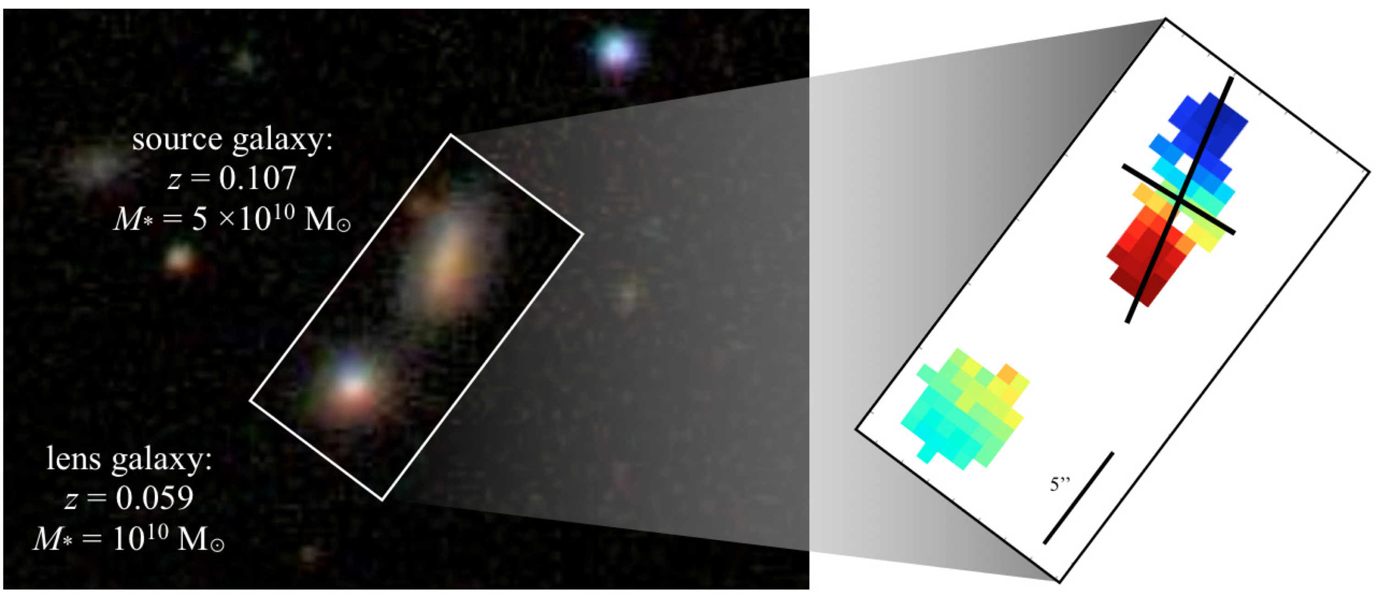
A first (not an ideal) test case— lensing by an intermediate mass galaxy at low-z.

Slide 8
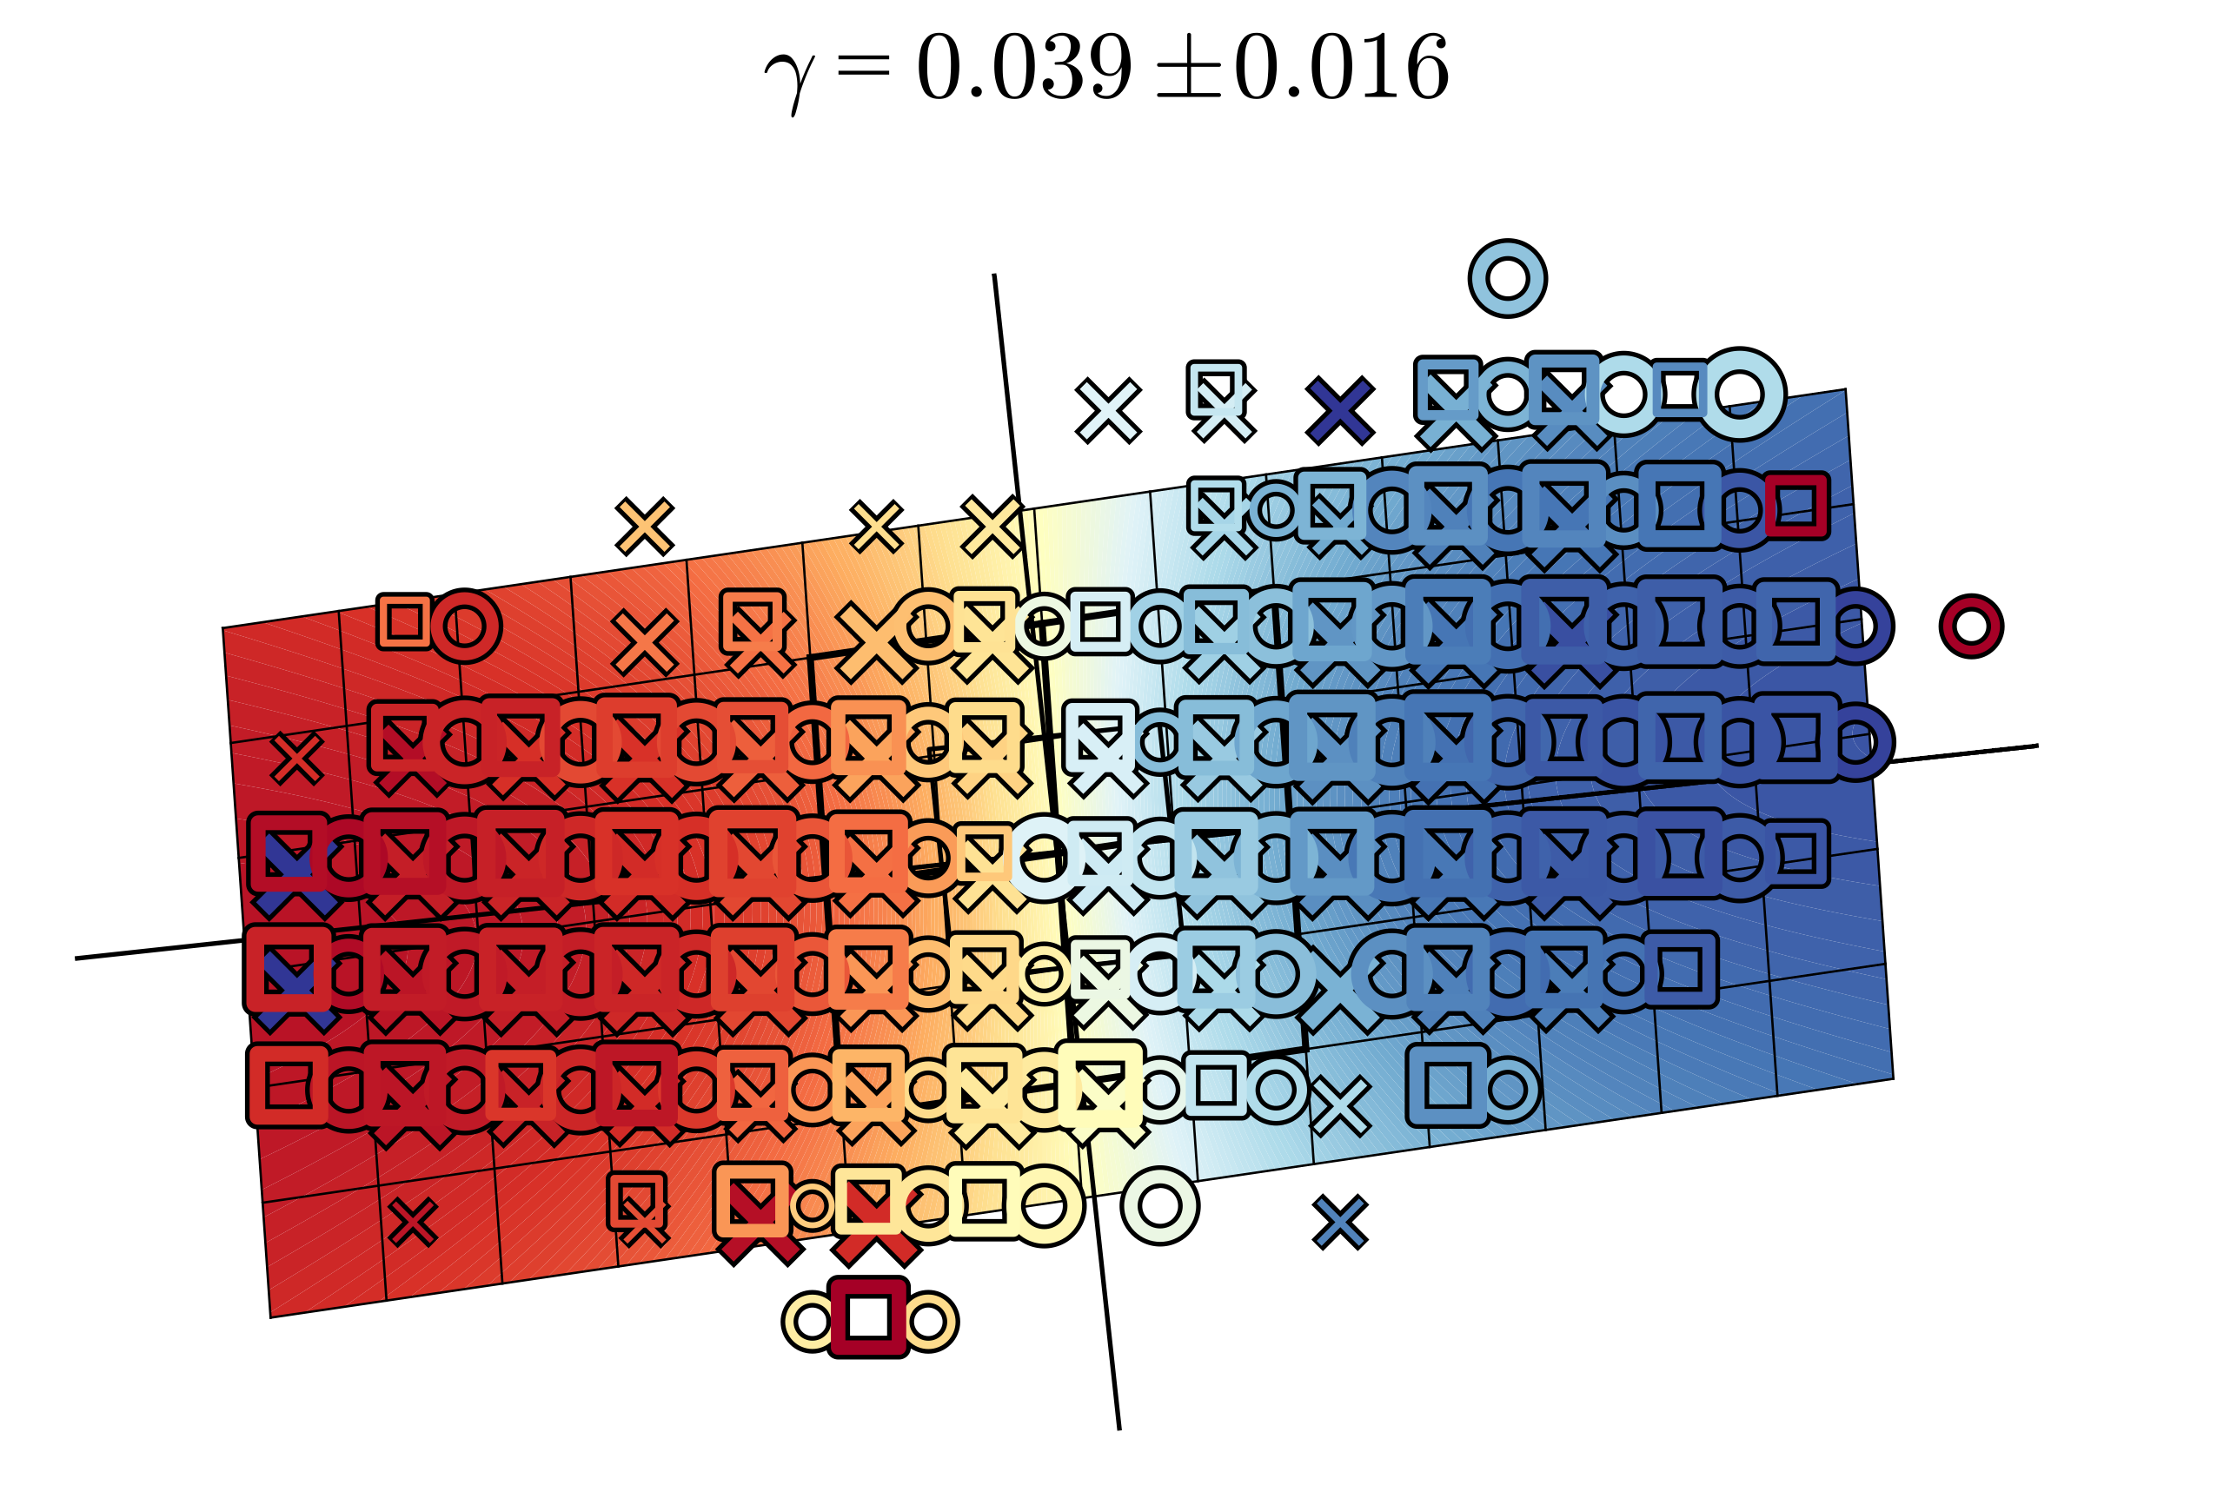
A first (not an ideal) test case— lensing by an intermediate mass galaxy at low-z.
simultaneous fit to all of three separate velocity maps

Slide 9
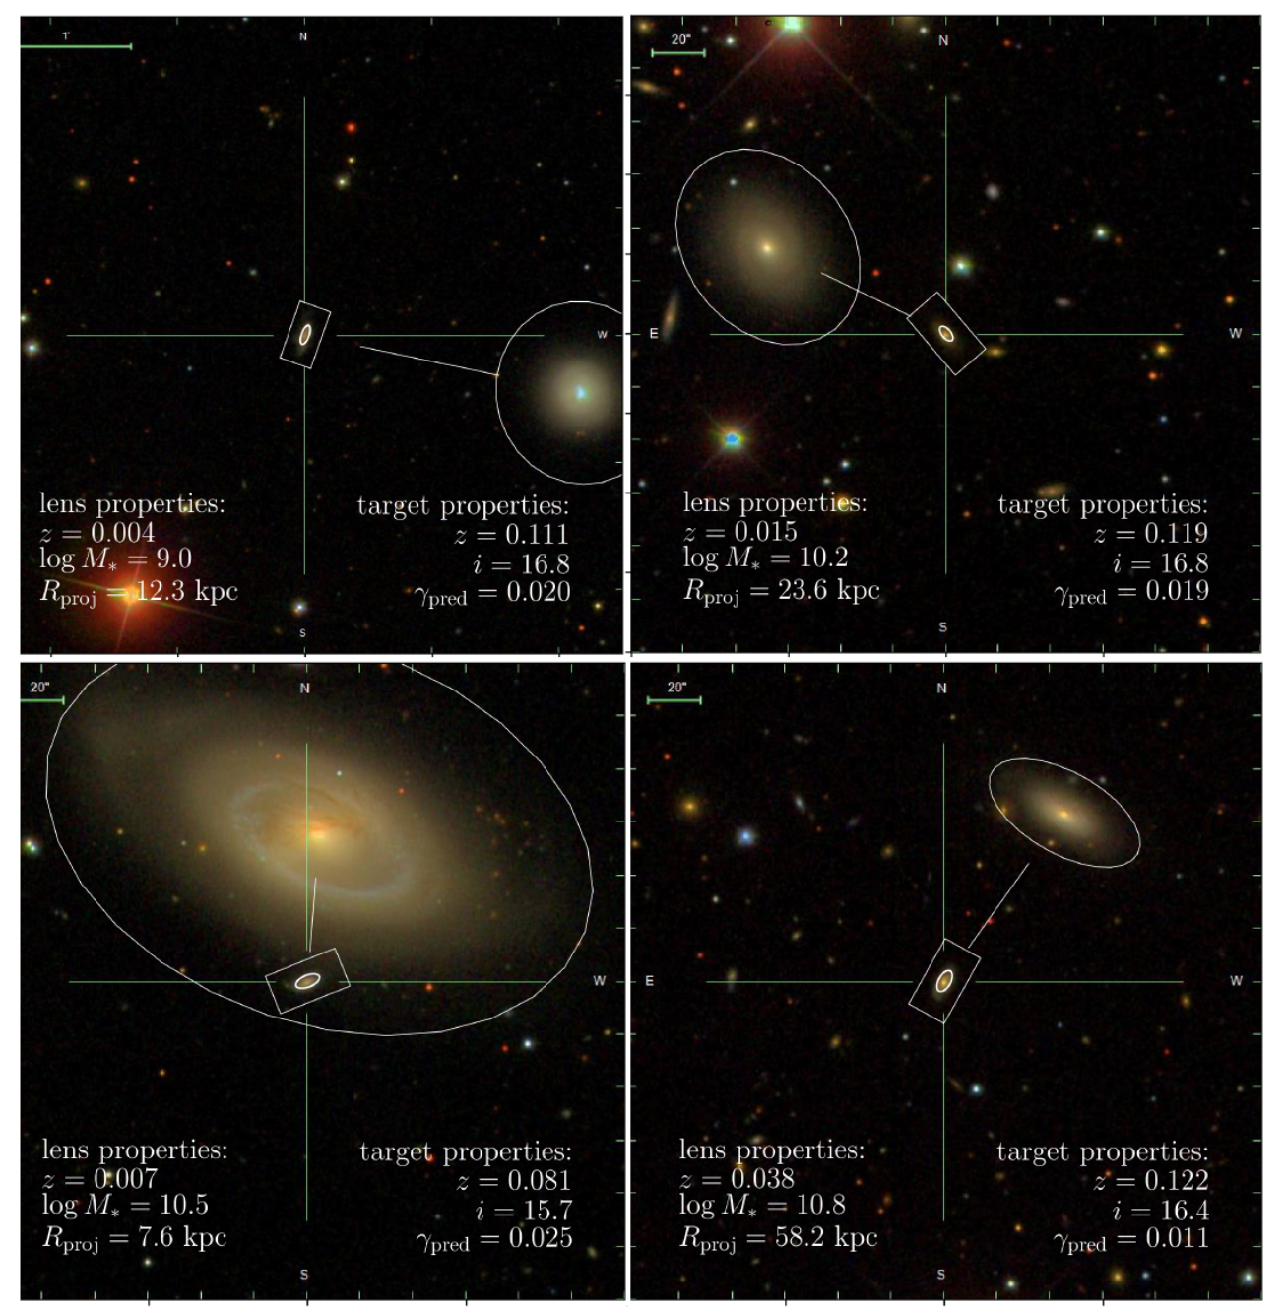
Precision weak lensing:
Gurri+20
A sample of the highest-value galaxy-galaxy lensing targets
Start from a compilation of ~2 M galaxies redshifts (incl. 6dFGS, 2dFGRS, SDSS, GAMA, ...)
Look for close projected pairs with significant Δz.
Use g/i photometry to estimate Mstar, and fiducial SHMR to estimate Mhalo.
Use Δz and Rproj to predict ɣ.
Choose good sources —> an unbiased sample of lens halos.
18 sources around 17 lenses.

Slide 10
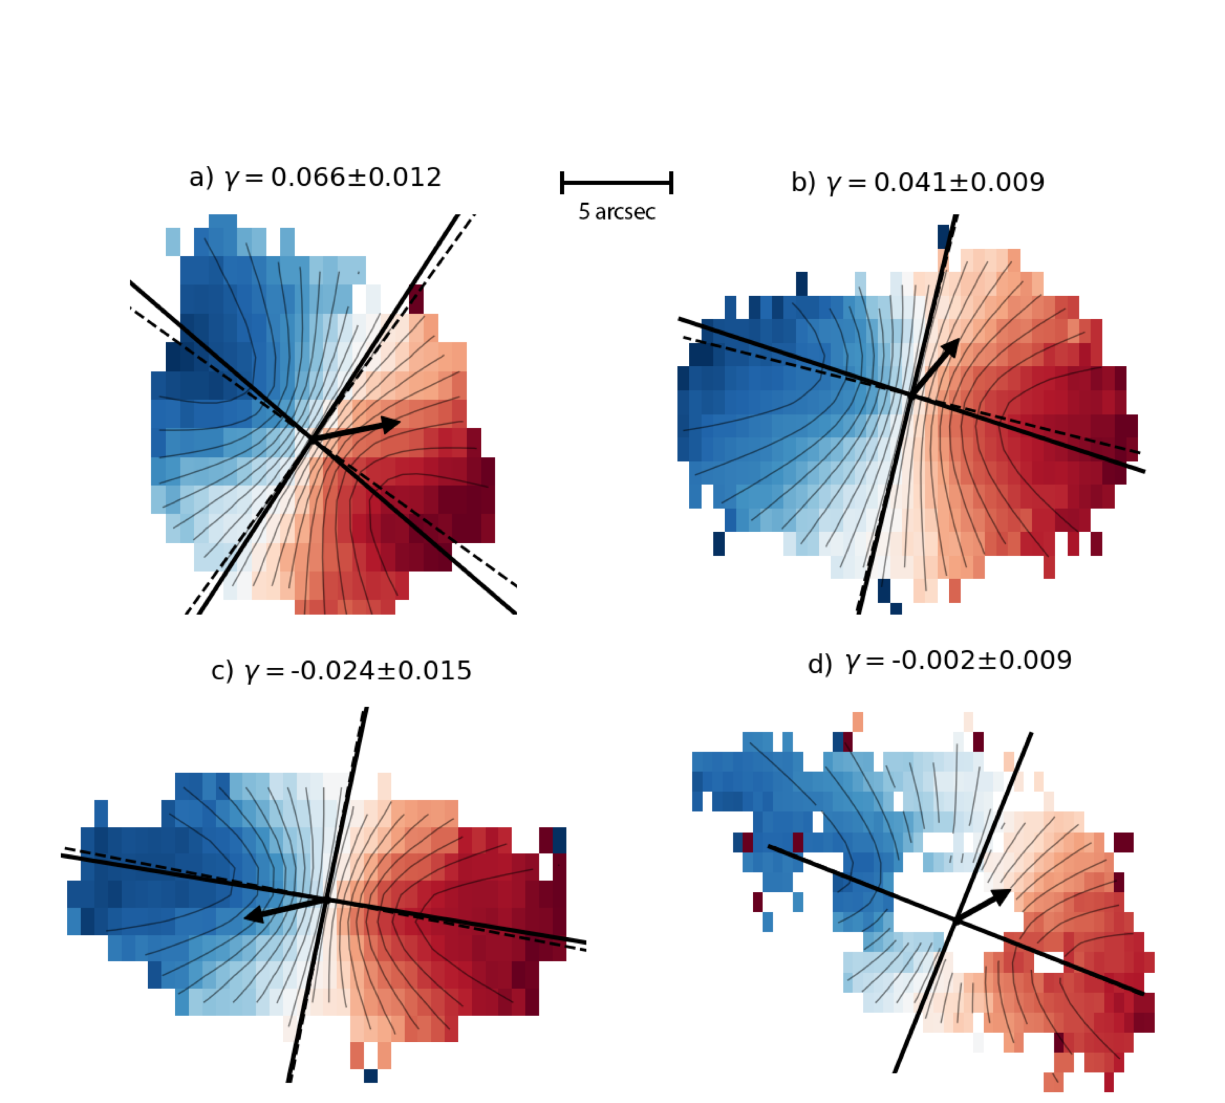
Precision weak lensing:
Gurri+20
A sample of the highest-value galaxy-galaxy lensing targets
Easy to fit a model to the velocity field.
Lensing is easily modelled as a coordinate transform in front of an ordinary velocity field model.
Can safely exclude anything that is obviously not stable rotation.

Slide 11
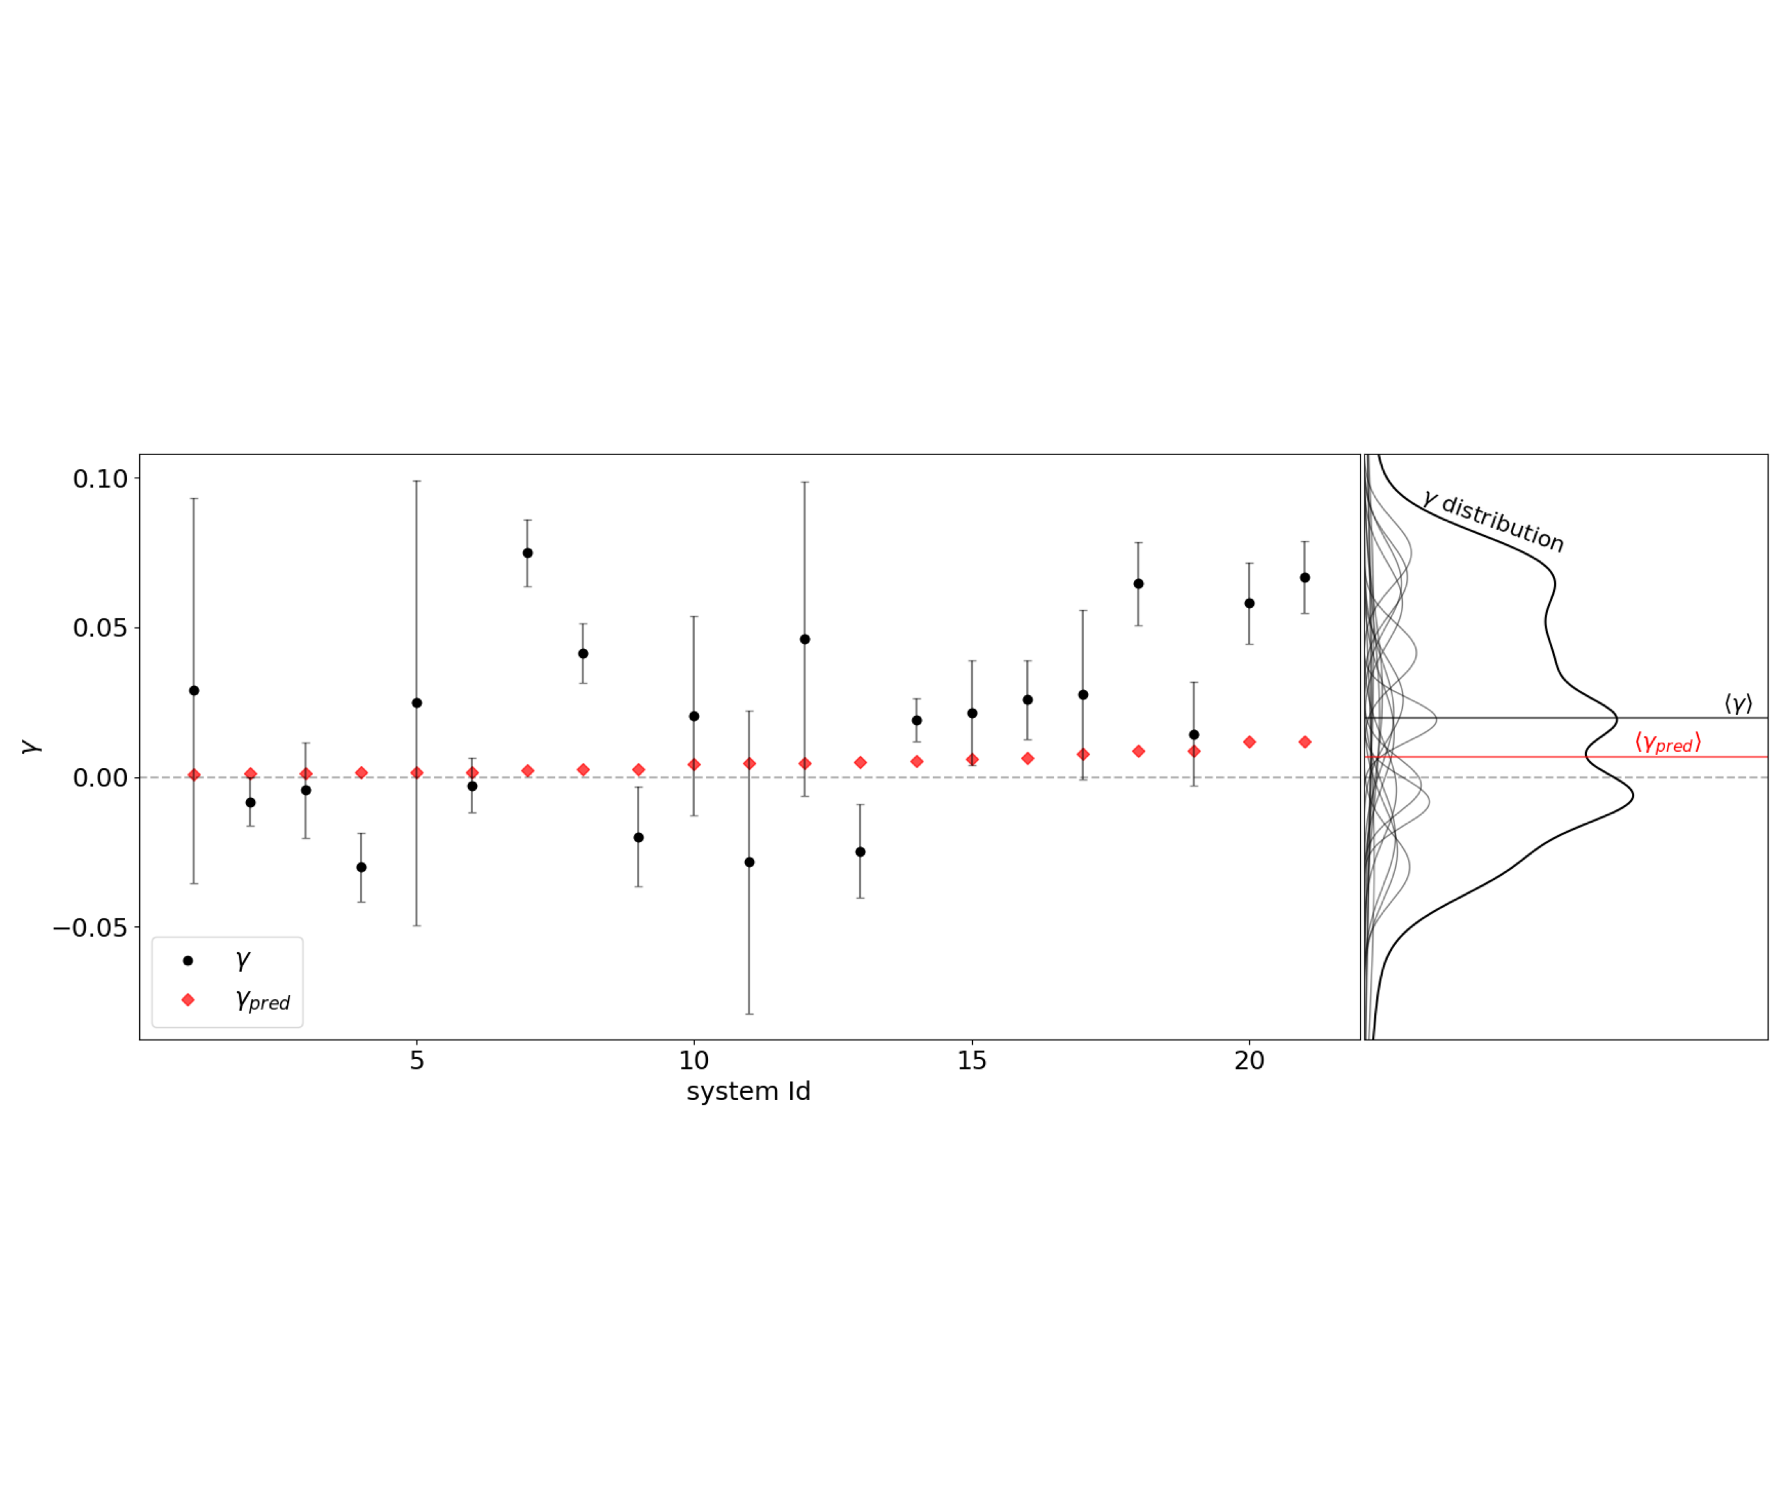
Precision weak lensing:
Gurri+20
Galaxy-galaxy lensing at ~10-80 kpc scales
Lensing has a preferred direction: positive shear shows a detection of the lensing signal (> 99.4% conf.).
Dynamic shape noise is necessarily symmetric, skewness in the distribution shows astrophysical dispersion.

Slide 12
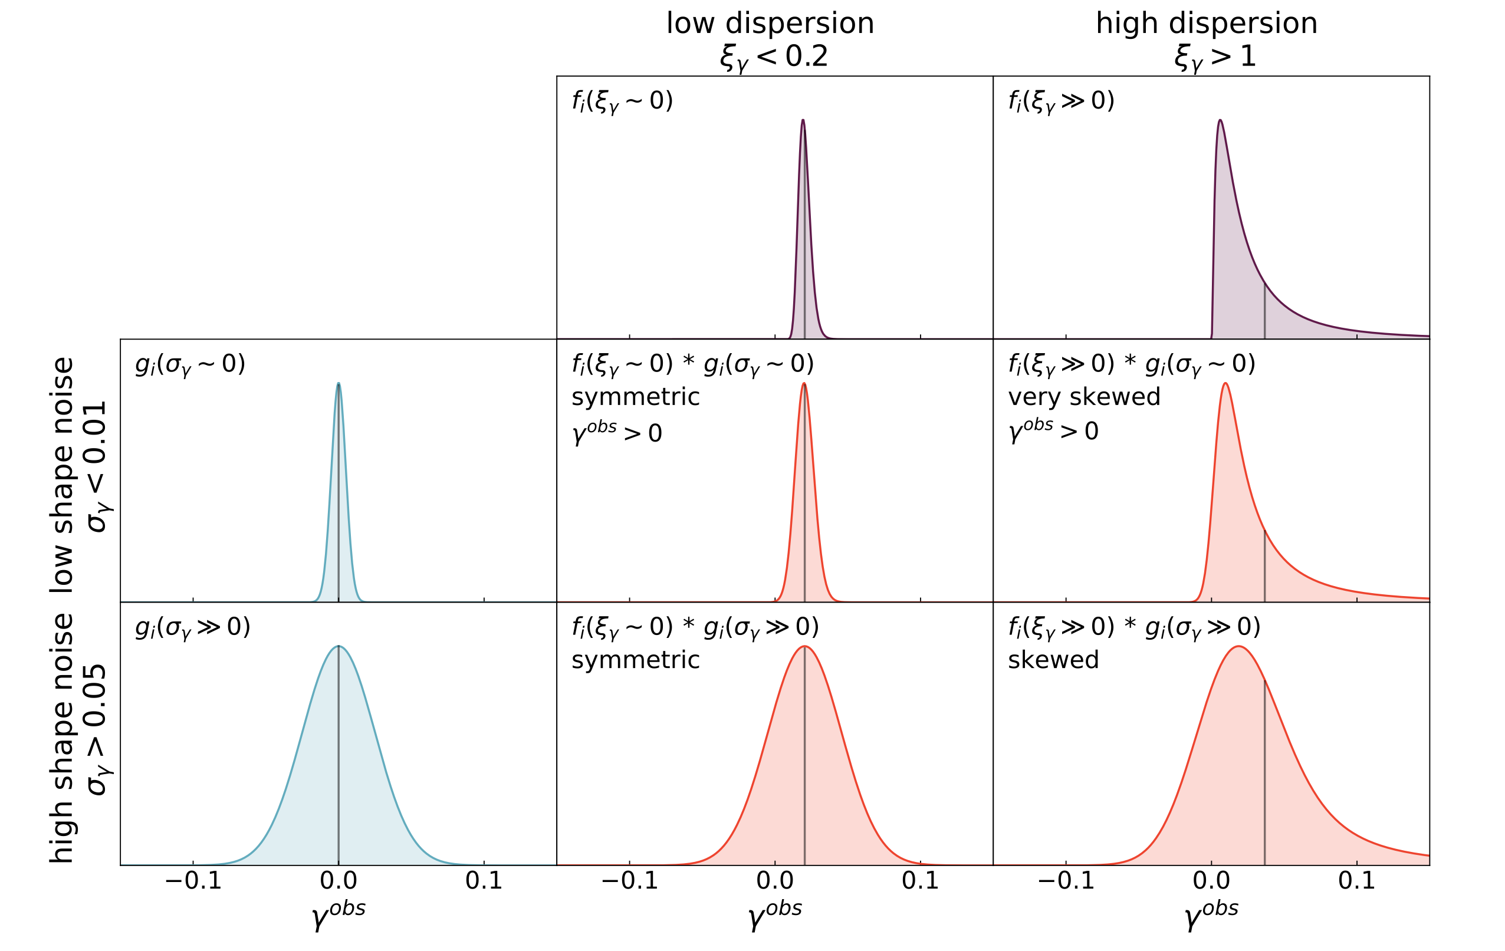
Precision weak lensing:
Gurri+21
Galaxy-galaxy lensing at ~10-80 kpc scales
Lensing has a preferred direction: astrophysical shear can be modelled as ~lognormal; (median != mean).
Dynamic shape noise is symmetric: effective shape noise can be modelled as ~normal; (median == mean).

Slide 13
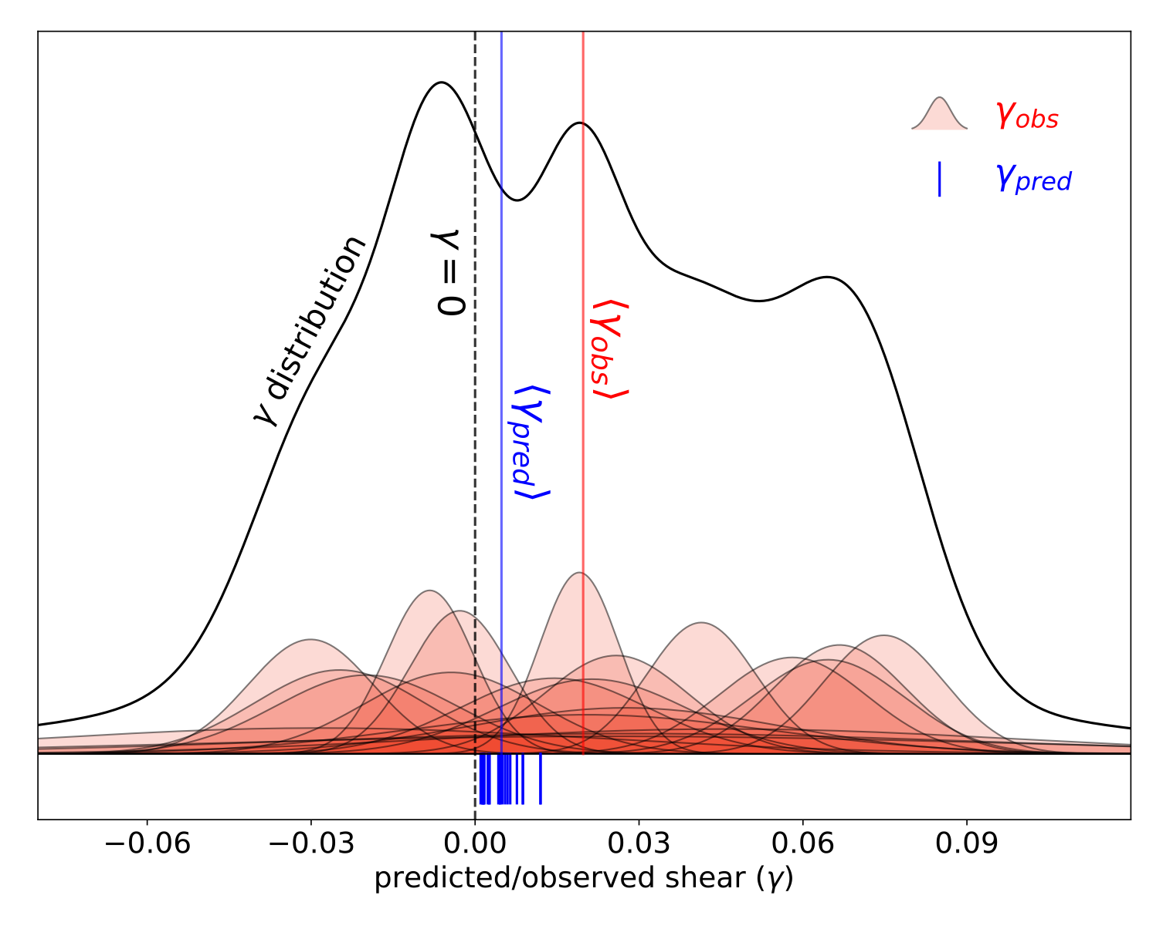
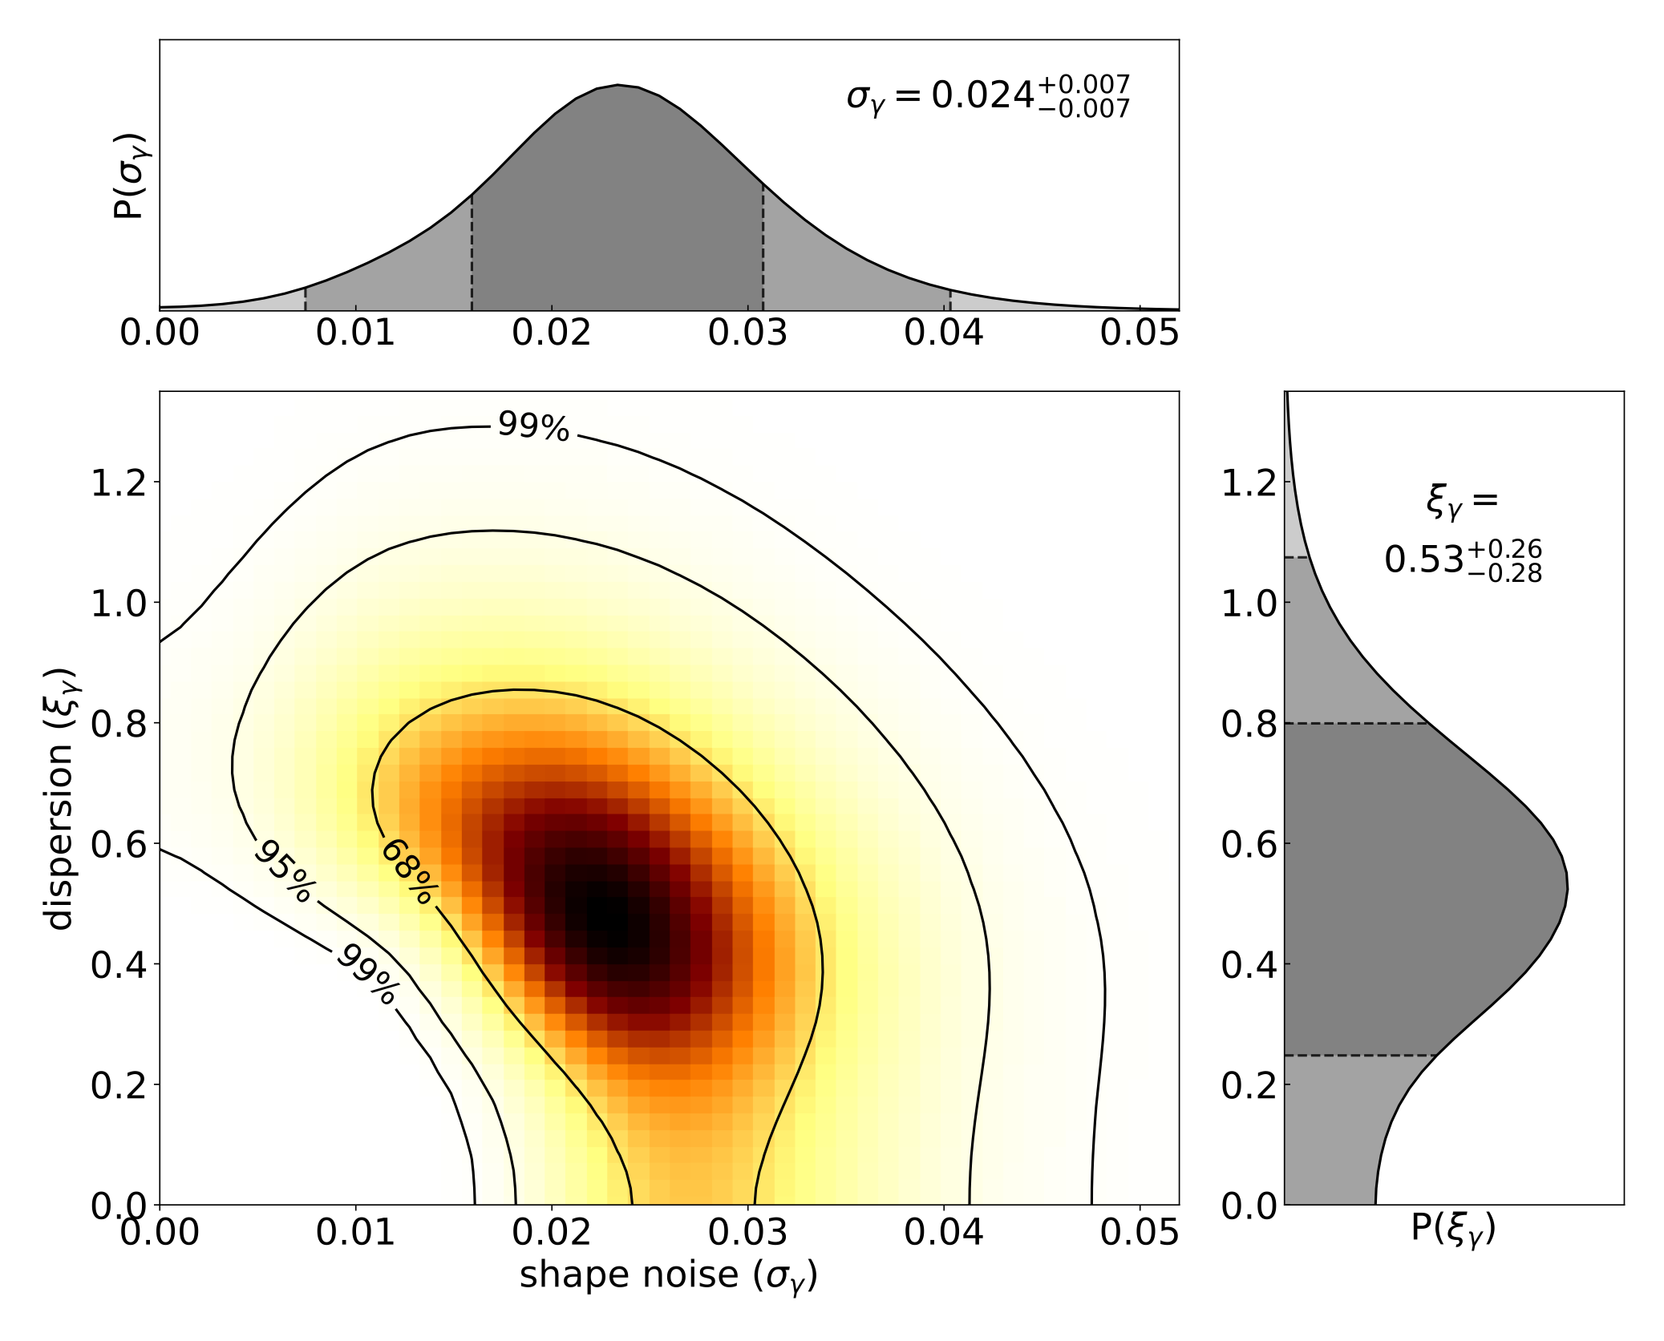
Precision weak lensing:
Gurri+21
Galaxy-galaxy lensing at ~10-80 kpc scales
Lensing has a preferred direction: astrophysical shear can be modelled as ~lognormal; (median != mean).
Dynamic shape noise is symmetric: effective shape noise can be modelled as ~normal; (median == mean).
The effective shape noise is small: ~ 0.024 !!
The lognormal dispersion is large: ~ 0.5 (+/- 0.2) dex !

Slide 14
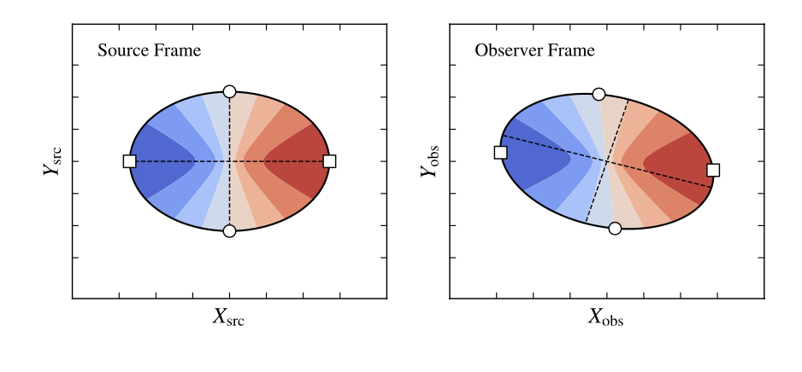
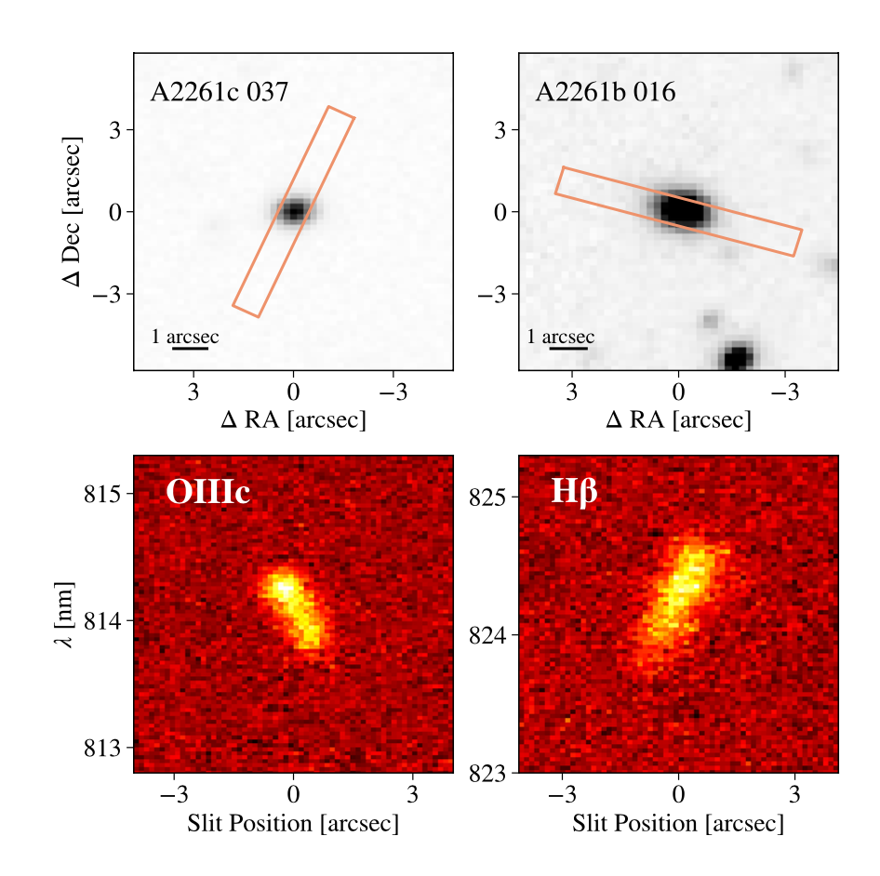
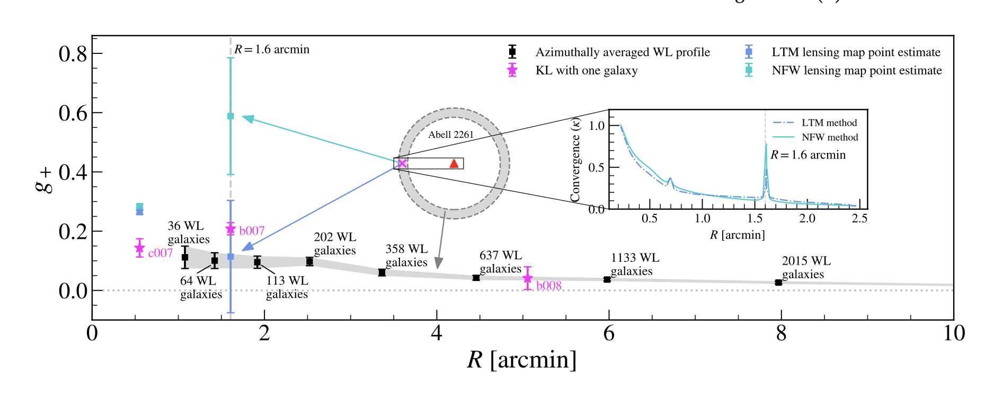

Slide 15
Precision weak lensing:
Gurri+20
A sample of the highest-value galaxy-galaxy lensing targets
Start from a compilation of ~2 M galaxies redshifts (incl. 6dFGS, 2dFGRS, SDSS, GAMA, ...)
Look for close projected pairs with significant Δz.
Use g/i photometry to estimate Mstar, and fiducial SHMR to estimate Mhalo.
Use Δz and Rproj to predict ɣ.
Choose good sources —> an unbiased sample of lens halos.
18 sources around 17 lenses.

Slide 16
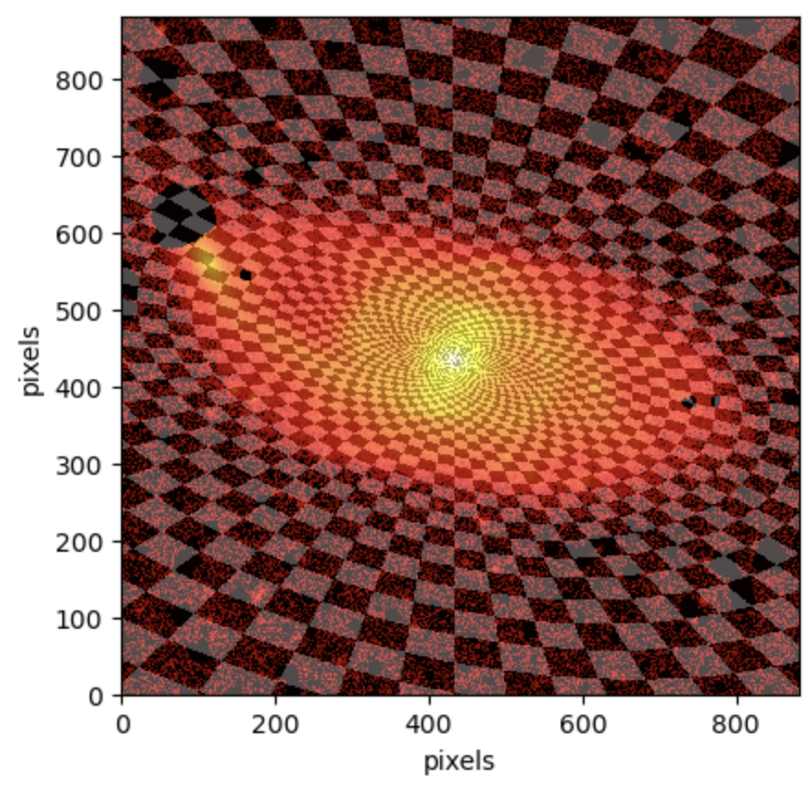
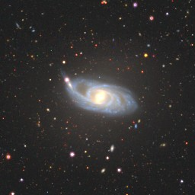
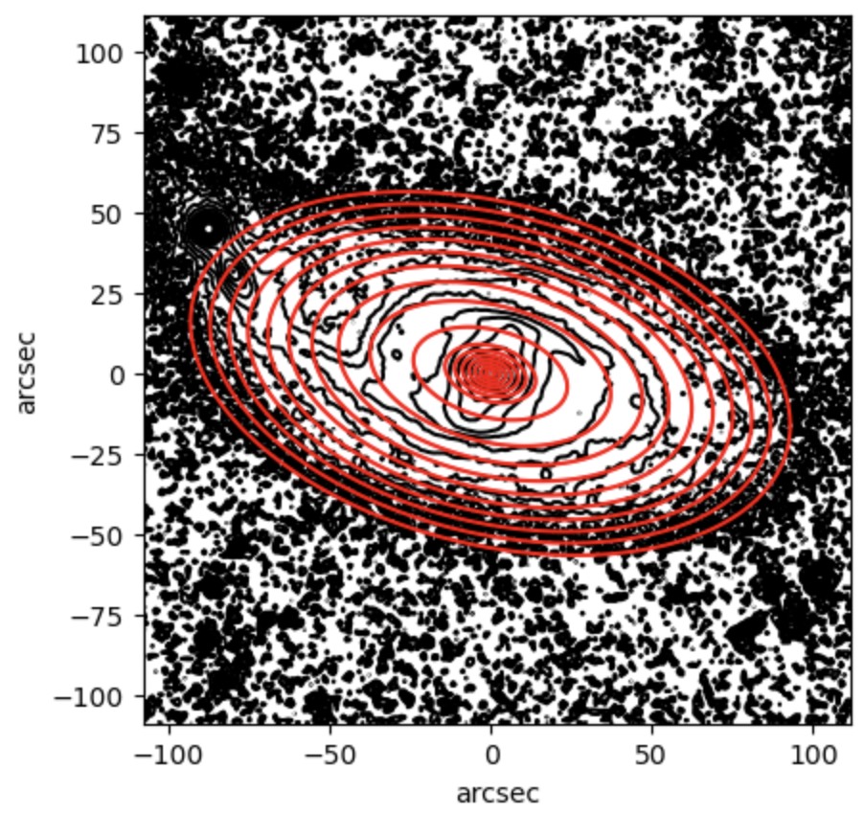
JAM MODELLING
Perform fit and get output. (This pipeline also generates the images same as of Figures 6-7 in Cappellari (2002)).
Image shows the galaxy’s surface brightness, with yellow denoting higher brightness regions.
Image displays the model's surface brightness predictions.

Slide 17
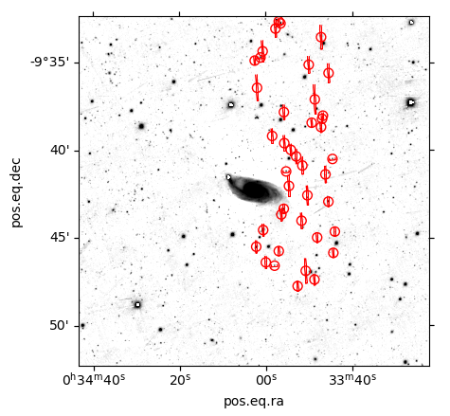
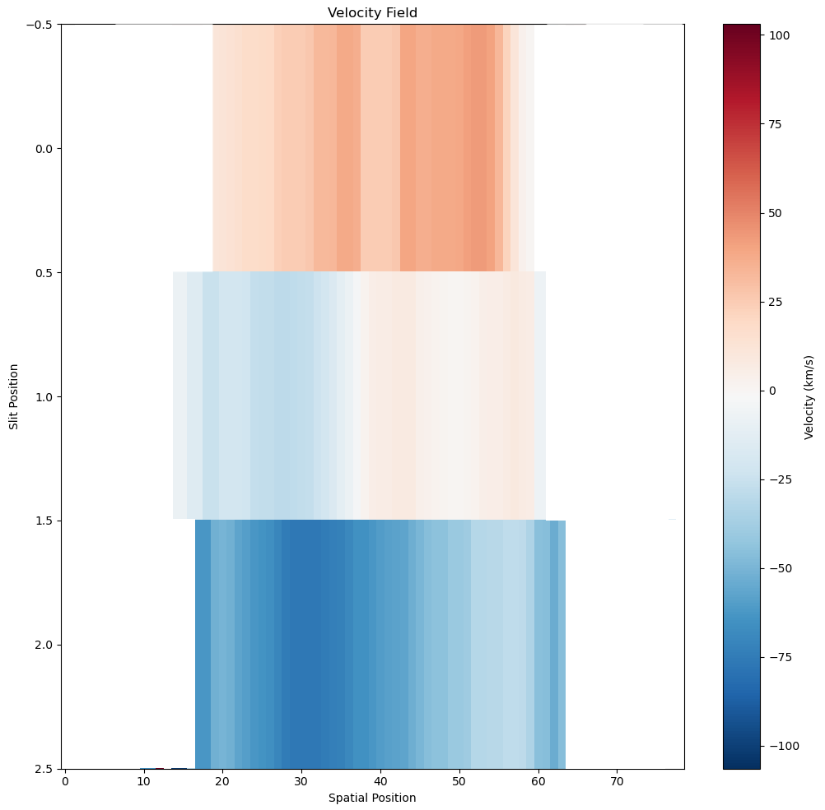
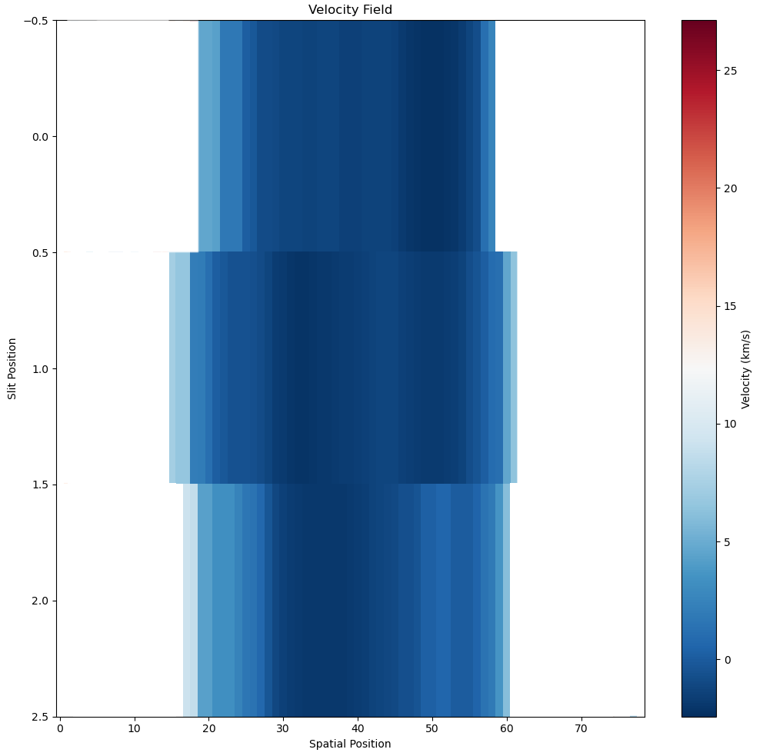
Keck II/DEIMOS Spectroscopy
More sources for the same lens (Large Sample, Limited signal in slit data)

Slide 18
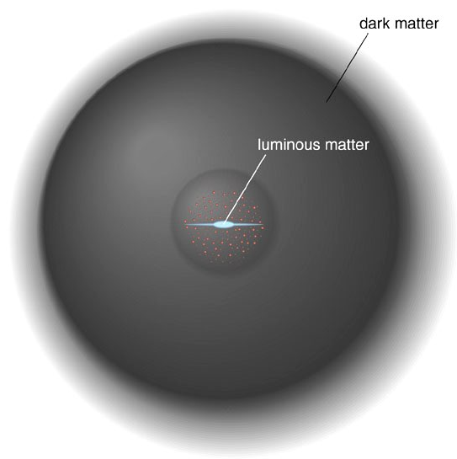
Halo Modelling (Gurri et al. 2020)
Shear Measurements &
Halo modelling (DEIMOS)
Dynamics
(WiFes & Koala)
DEIMOS Slit

Slide 19
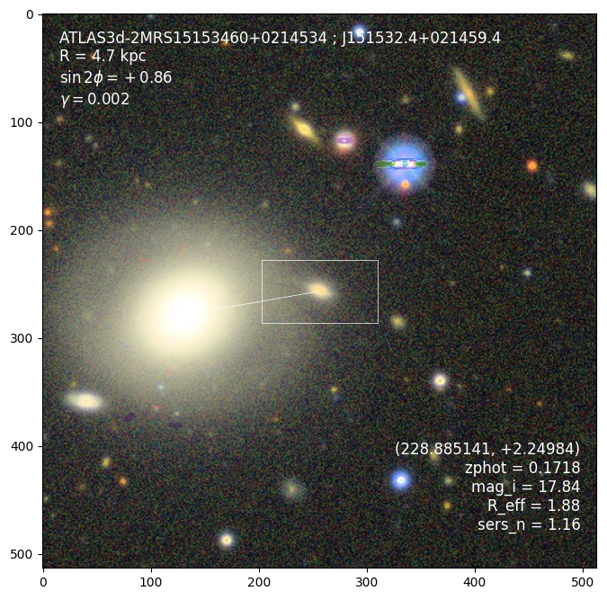
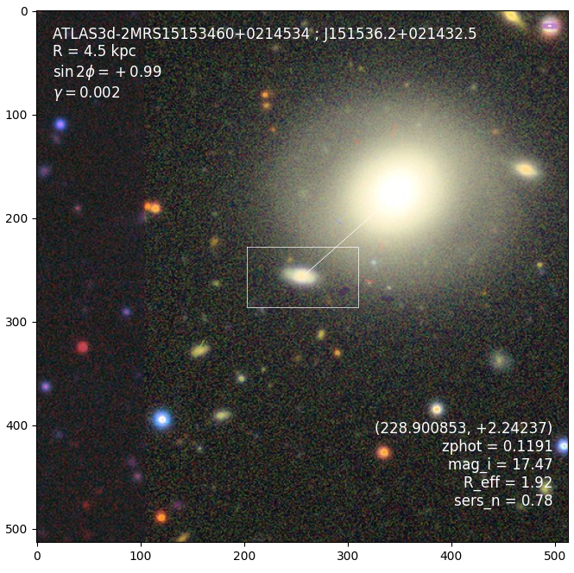
Strong Lensing galaxy: SNL-2

Slide 20
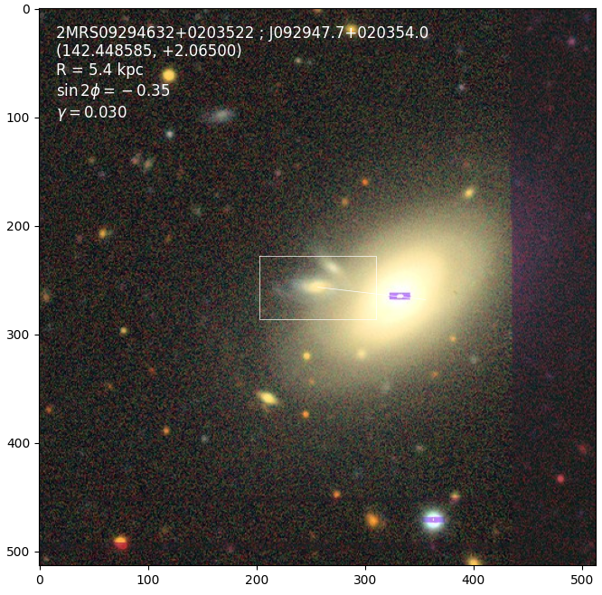
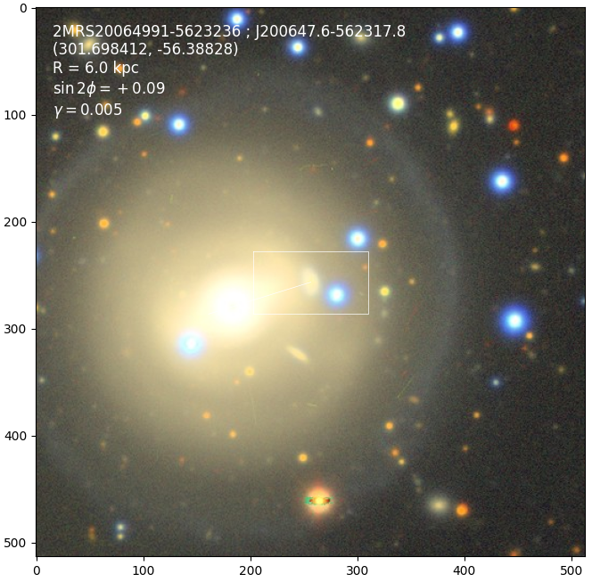
Future Work: On going Survey
J092947+020354
J200647.6-562317.8
Total 53 nights!

Slide 22
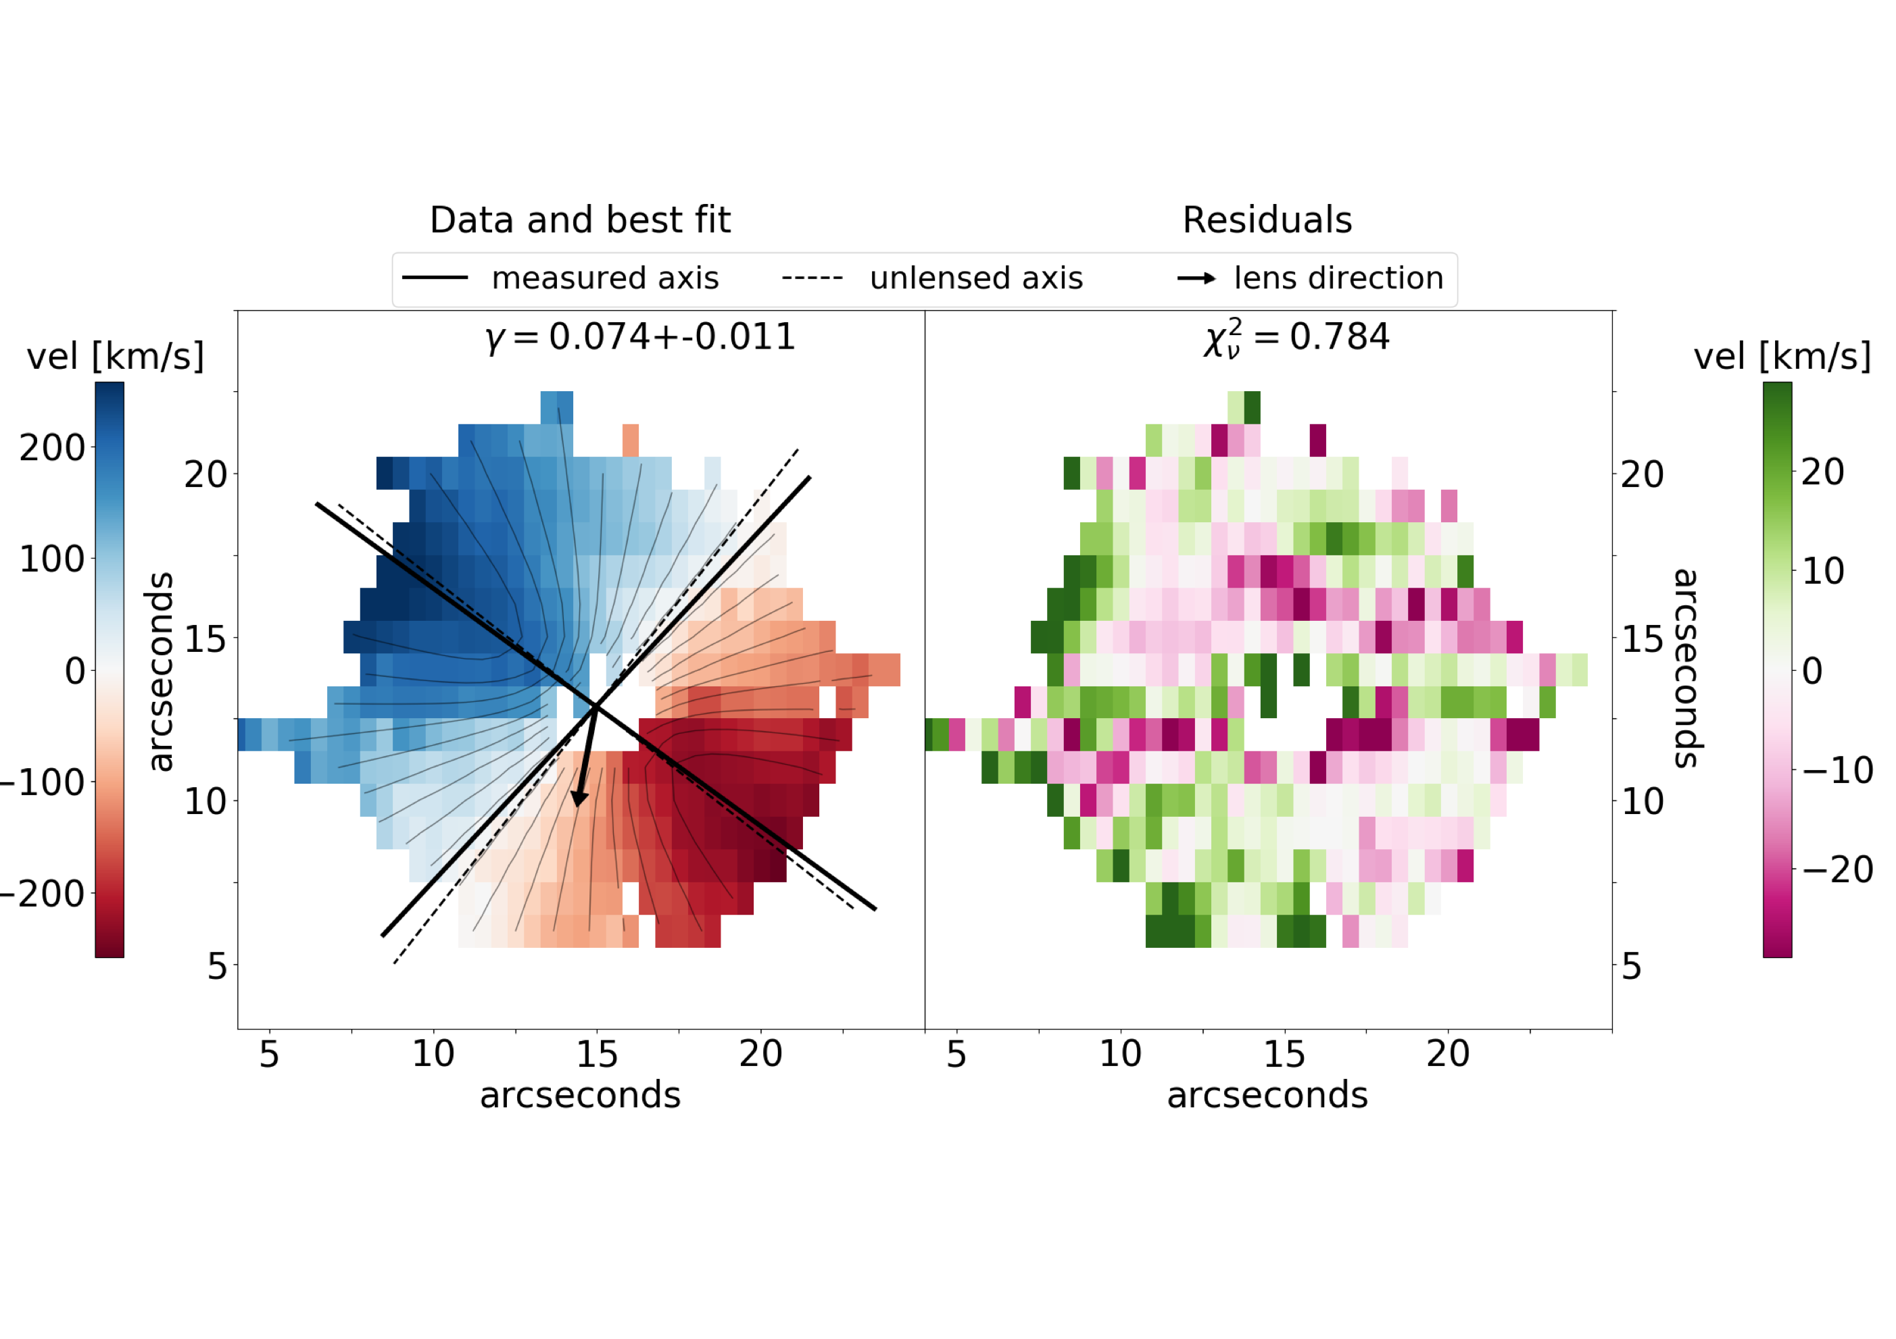
Precision weak lensing:
Gurri+20
A sample of the highest-value galaxy-galaxy lensing targets
Easy to fit a model to the velocity field.
Lensing is easily modelled as a coordinate transform in front of an ordinary velocity field model.
Can safely exclude anything that is obviously not stable rotation.

Slide 23
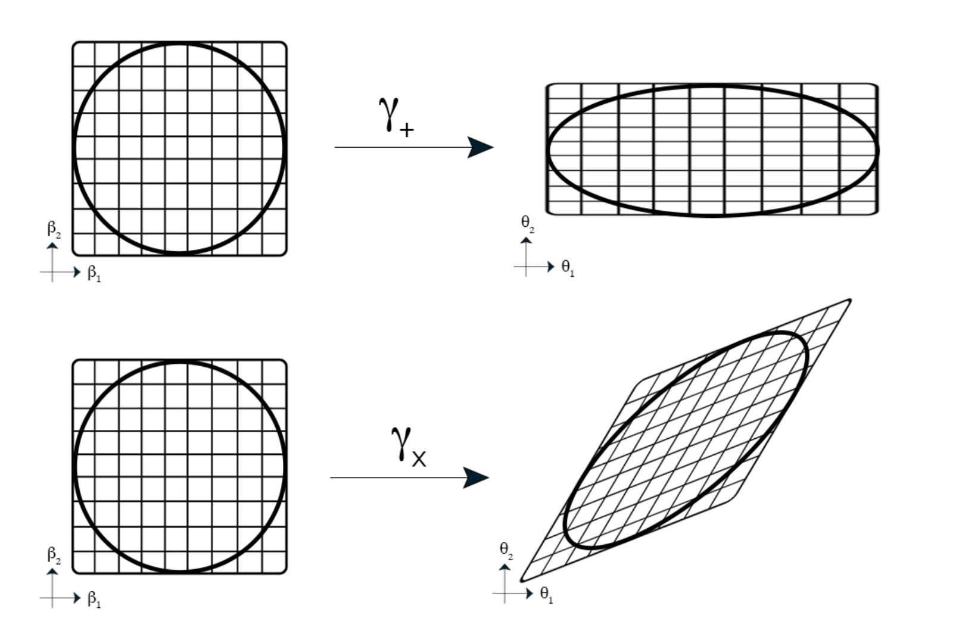
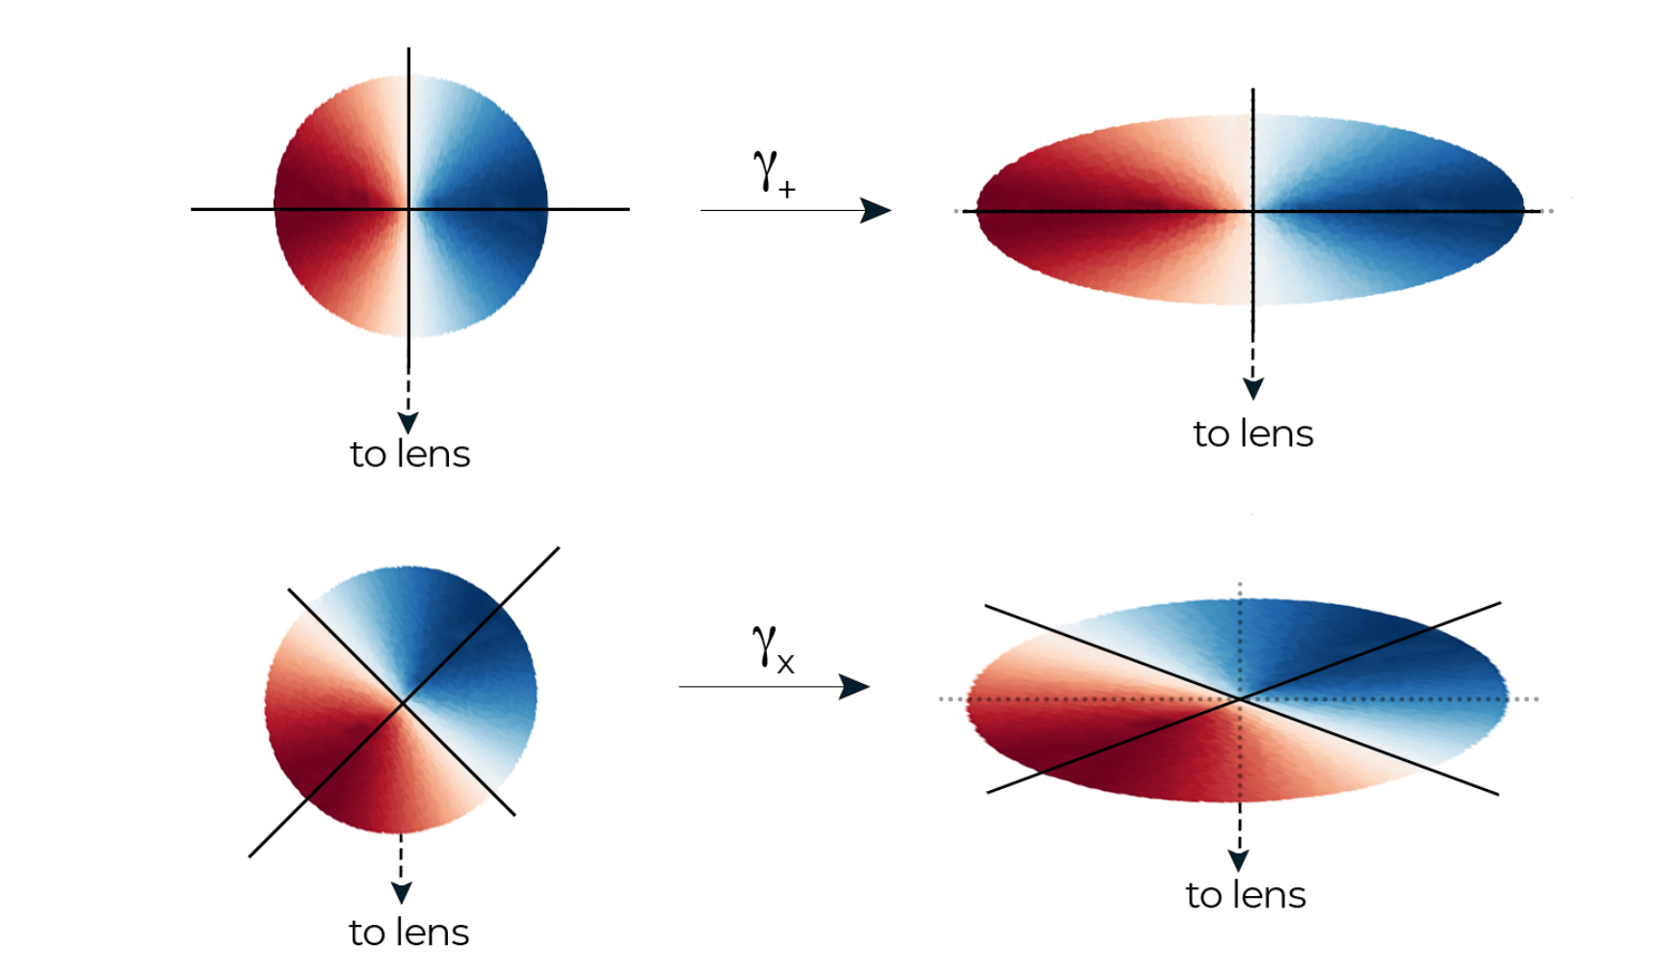
Precision weak lensing:
Lensing distorts the axisymmetric velocity field of rotating galaxies
$$A=γ\left[sin2ϕ\left(\begin{matrix}+1 & 0 \\ 0 & -1\end{matrix}\right)+cos2ϕ\left(\begin{matrix}0 & +1 \\ +1 & 0\end{matrix}\right)\right]$$

Slide 24
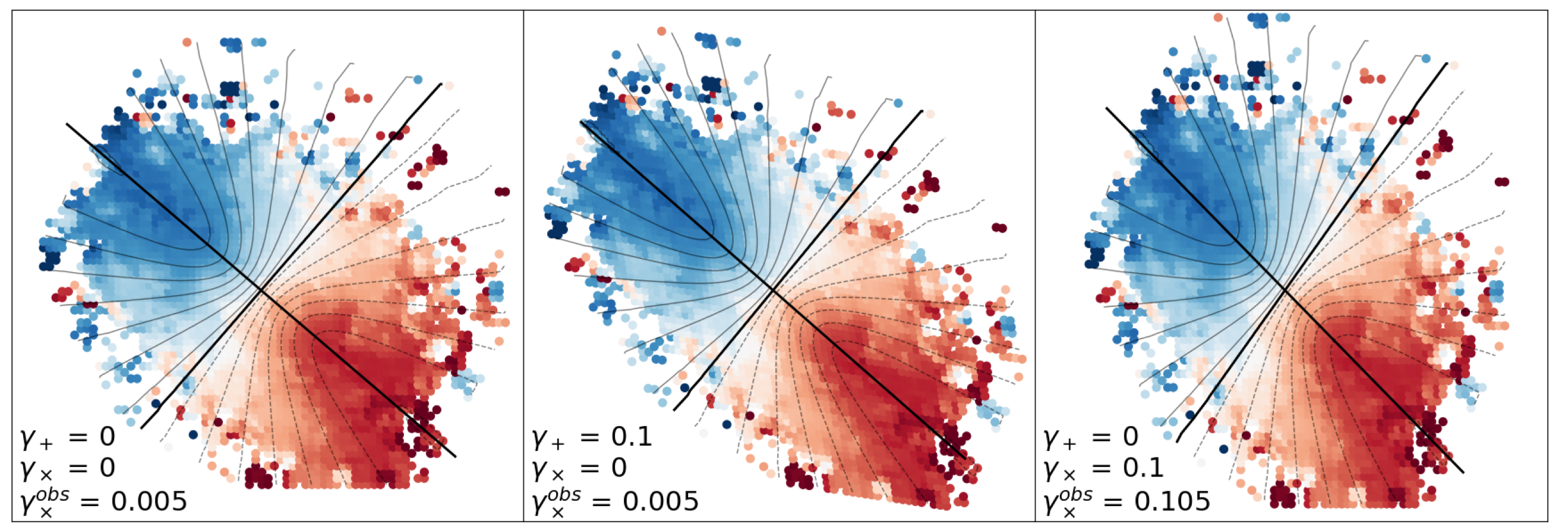
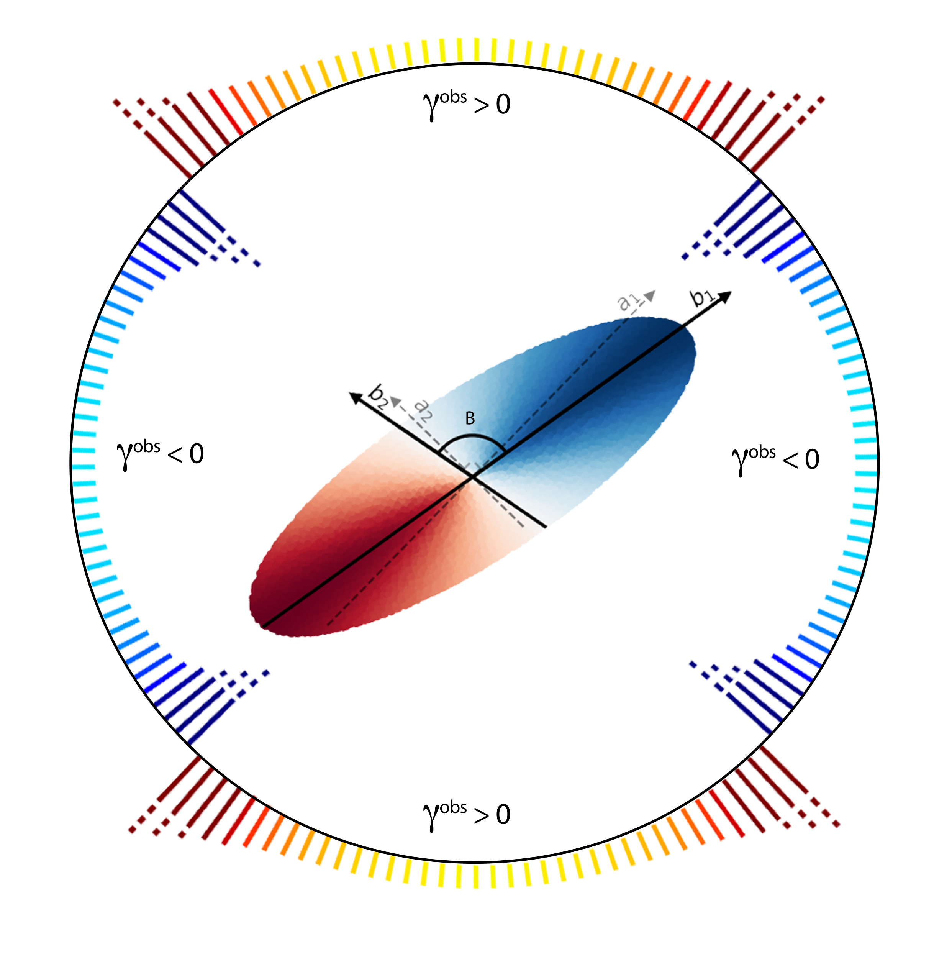
Precision weak lensing:
Gurri+21
Lensing distorts the axisymmetric velocity field of rotating galaxies
$$A=γ\left[sin2ϕ\left(\begin{matrix}+1 & 0 \\ 0 & -1\end{matrix}\right)+cos2ϕ\left(\begin{matrix}0 & +1 \\ +1 & 0\end{matrix}\right)\right]$$
Lensing has a preferred direction, insofar as mass is strictly positive.
Dynamics (only) measures the 'x' component of shear.
Dynamic shape noise is necessarily symmetric, because orientations are random.

Slide 25
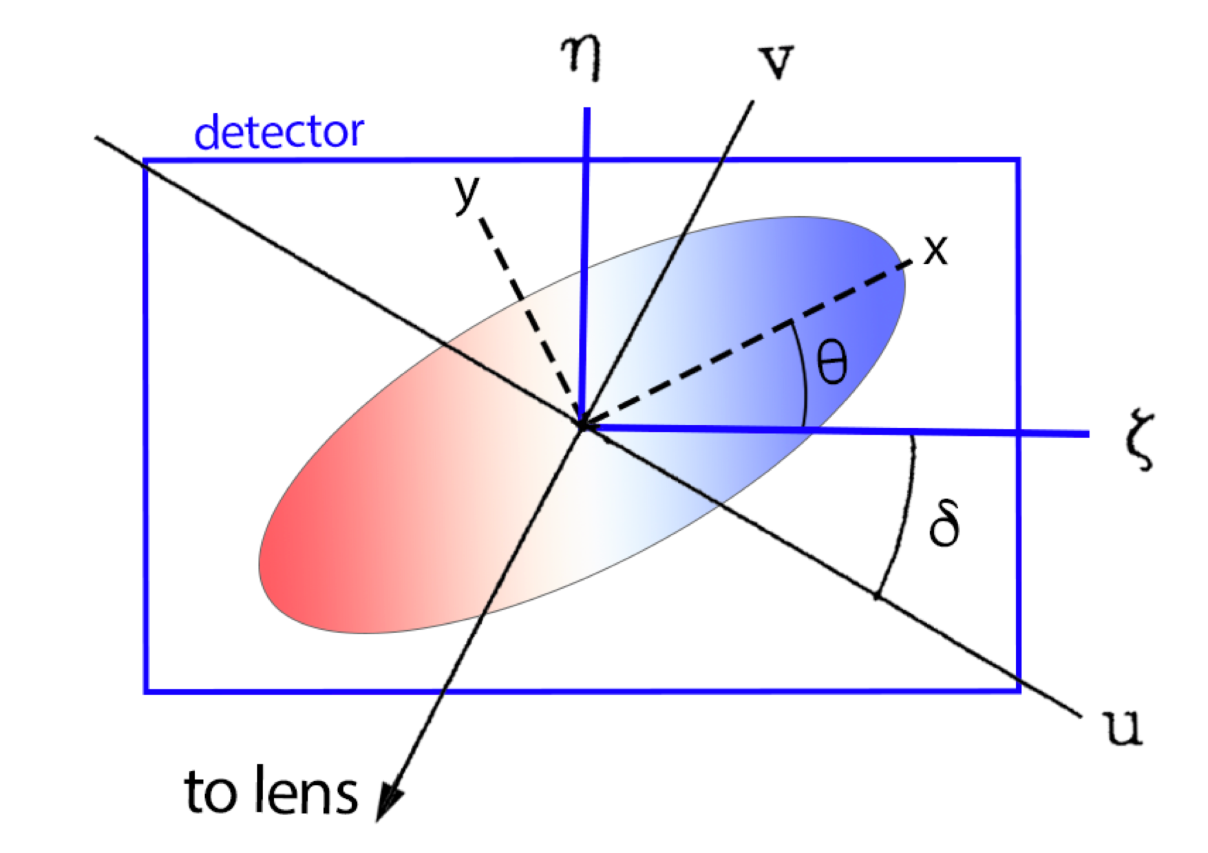
Precision weak lensing:
Intrinsic shape noise is necessarily symmetric/unbiased.
$$\overset{̂}{γ_{×}}=γ_{true}sin(2ϕ)+ϵ_{int}+ϵ_{geom}sin(2θ+θ_{geom})$$
$$\overset{̂}{γ}={\overset{̂}{γ}}_{×}/sin(2ϕ)$$
Can use measurements to infer systematic 'shear' from detector geometry: $η_{+}=-0.0043±0.0062$ ; $η_{×}=+0.0094±0.0097$

Slide 26
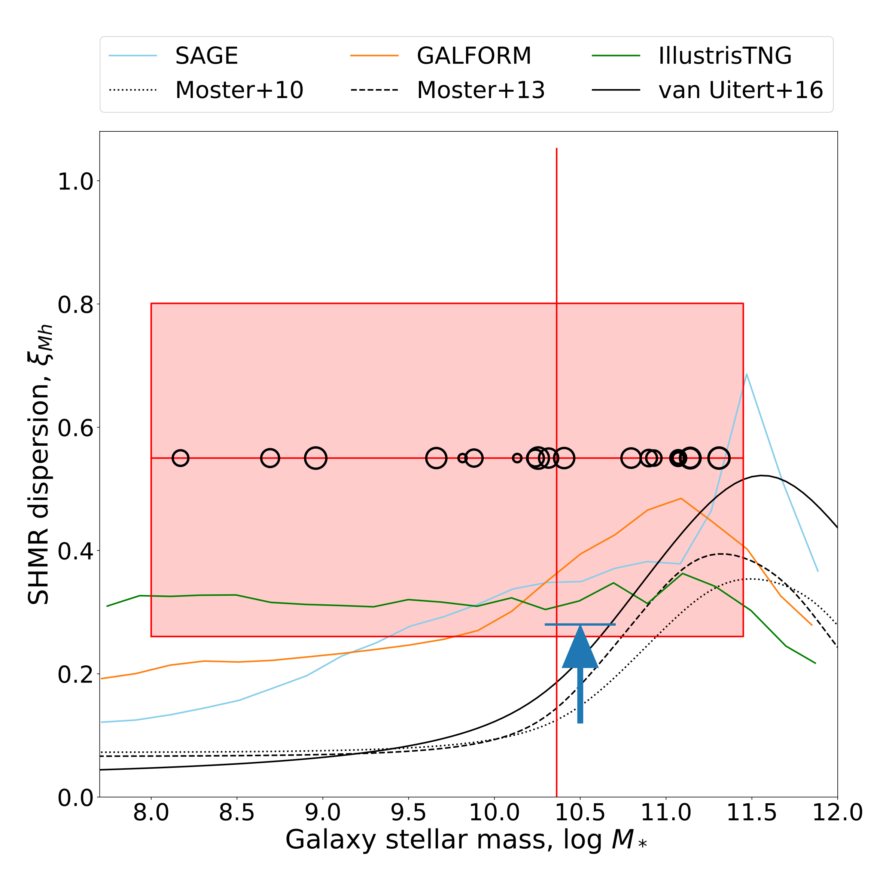
Precision weak lensing:
Gurri+21
Galaxy-galaxy lensing at ~10-80 kpc scales
The lognormal dispersion is large: ~ 0.5 (+/- 0.2) dex !!
Naively, could interpret this as greater dispersion in the SHMR.
Could also be seeing, e.g., dispersion in central halo profiles, substructure, etc.
Probing a new regime!

Slide 27
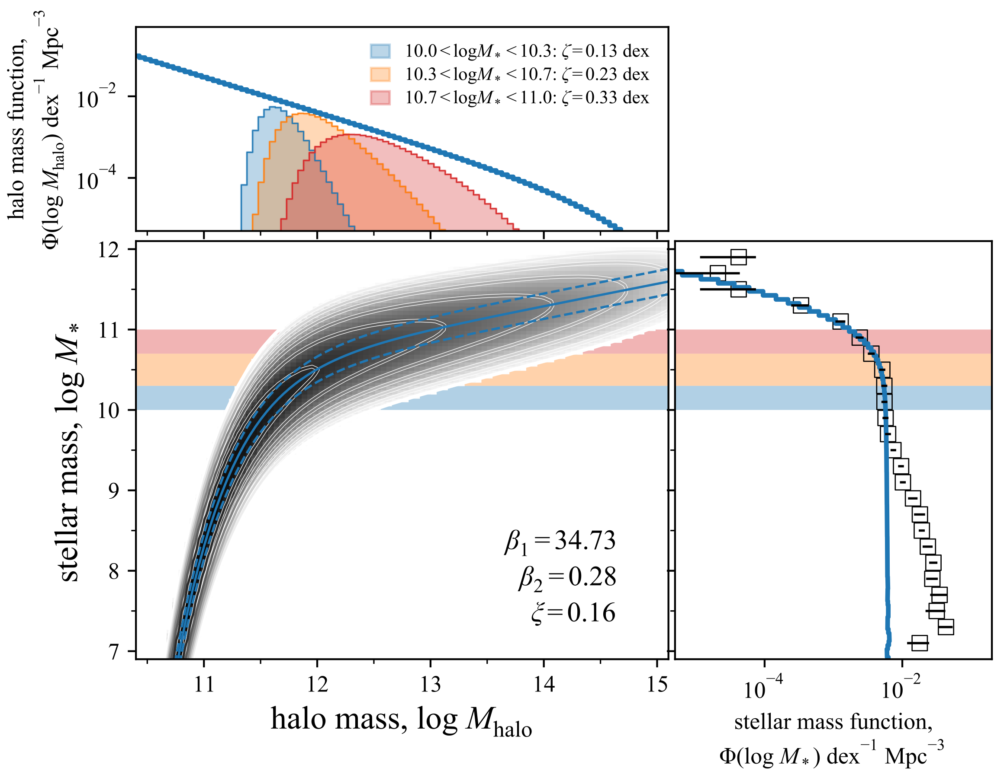
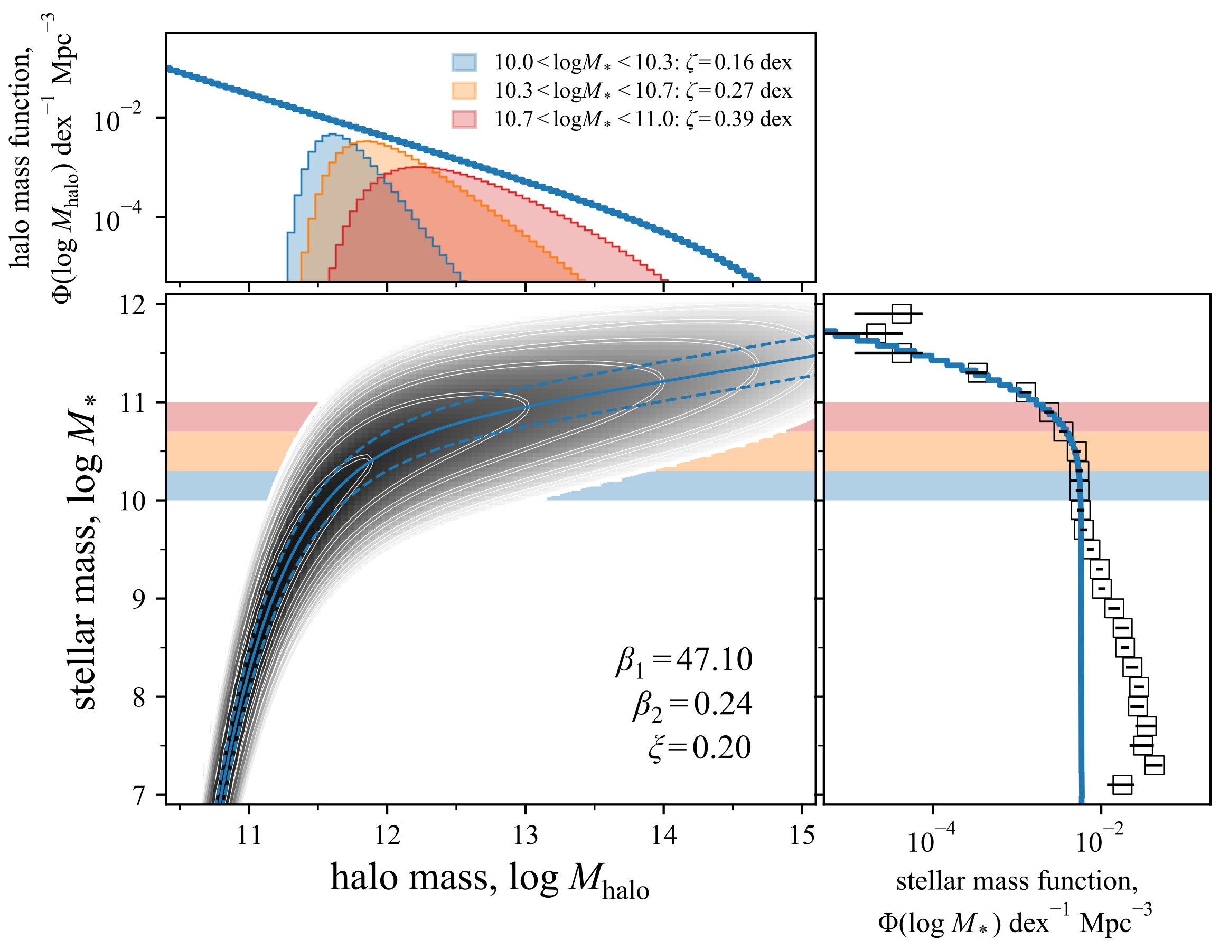
The stellar-to-halo mass relation
A boundary condition for cosmological galaxy formation
HMF: the halo mass function is a robust prediction from theory.
SMF: the stellar mass function is a well measured observable.
SHMR <— physics lives here: the stellar-to-halo mass relation can be inferred by requiring consistency between the two.
The dispersion is by far the most interesting quantity!

Slide 28
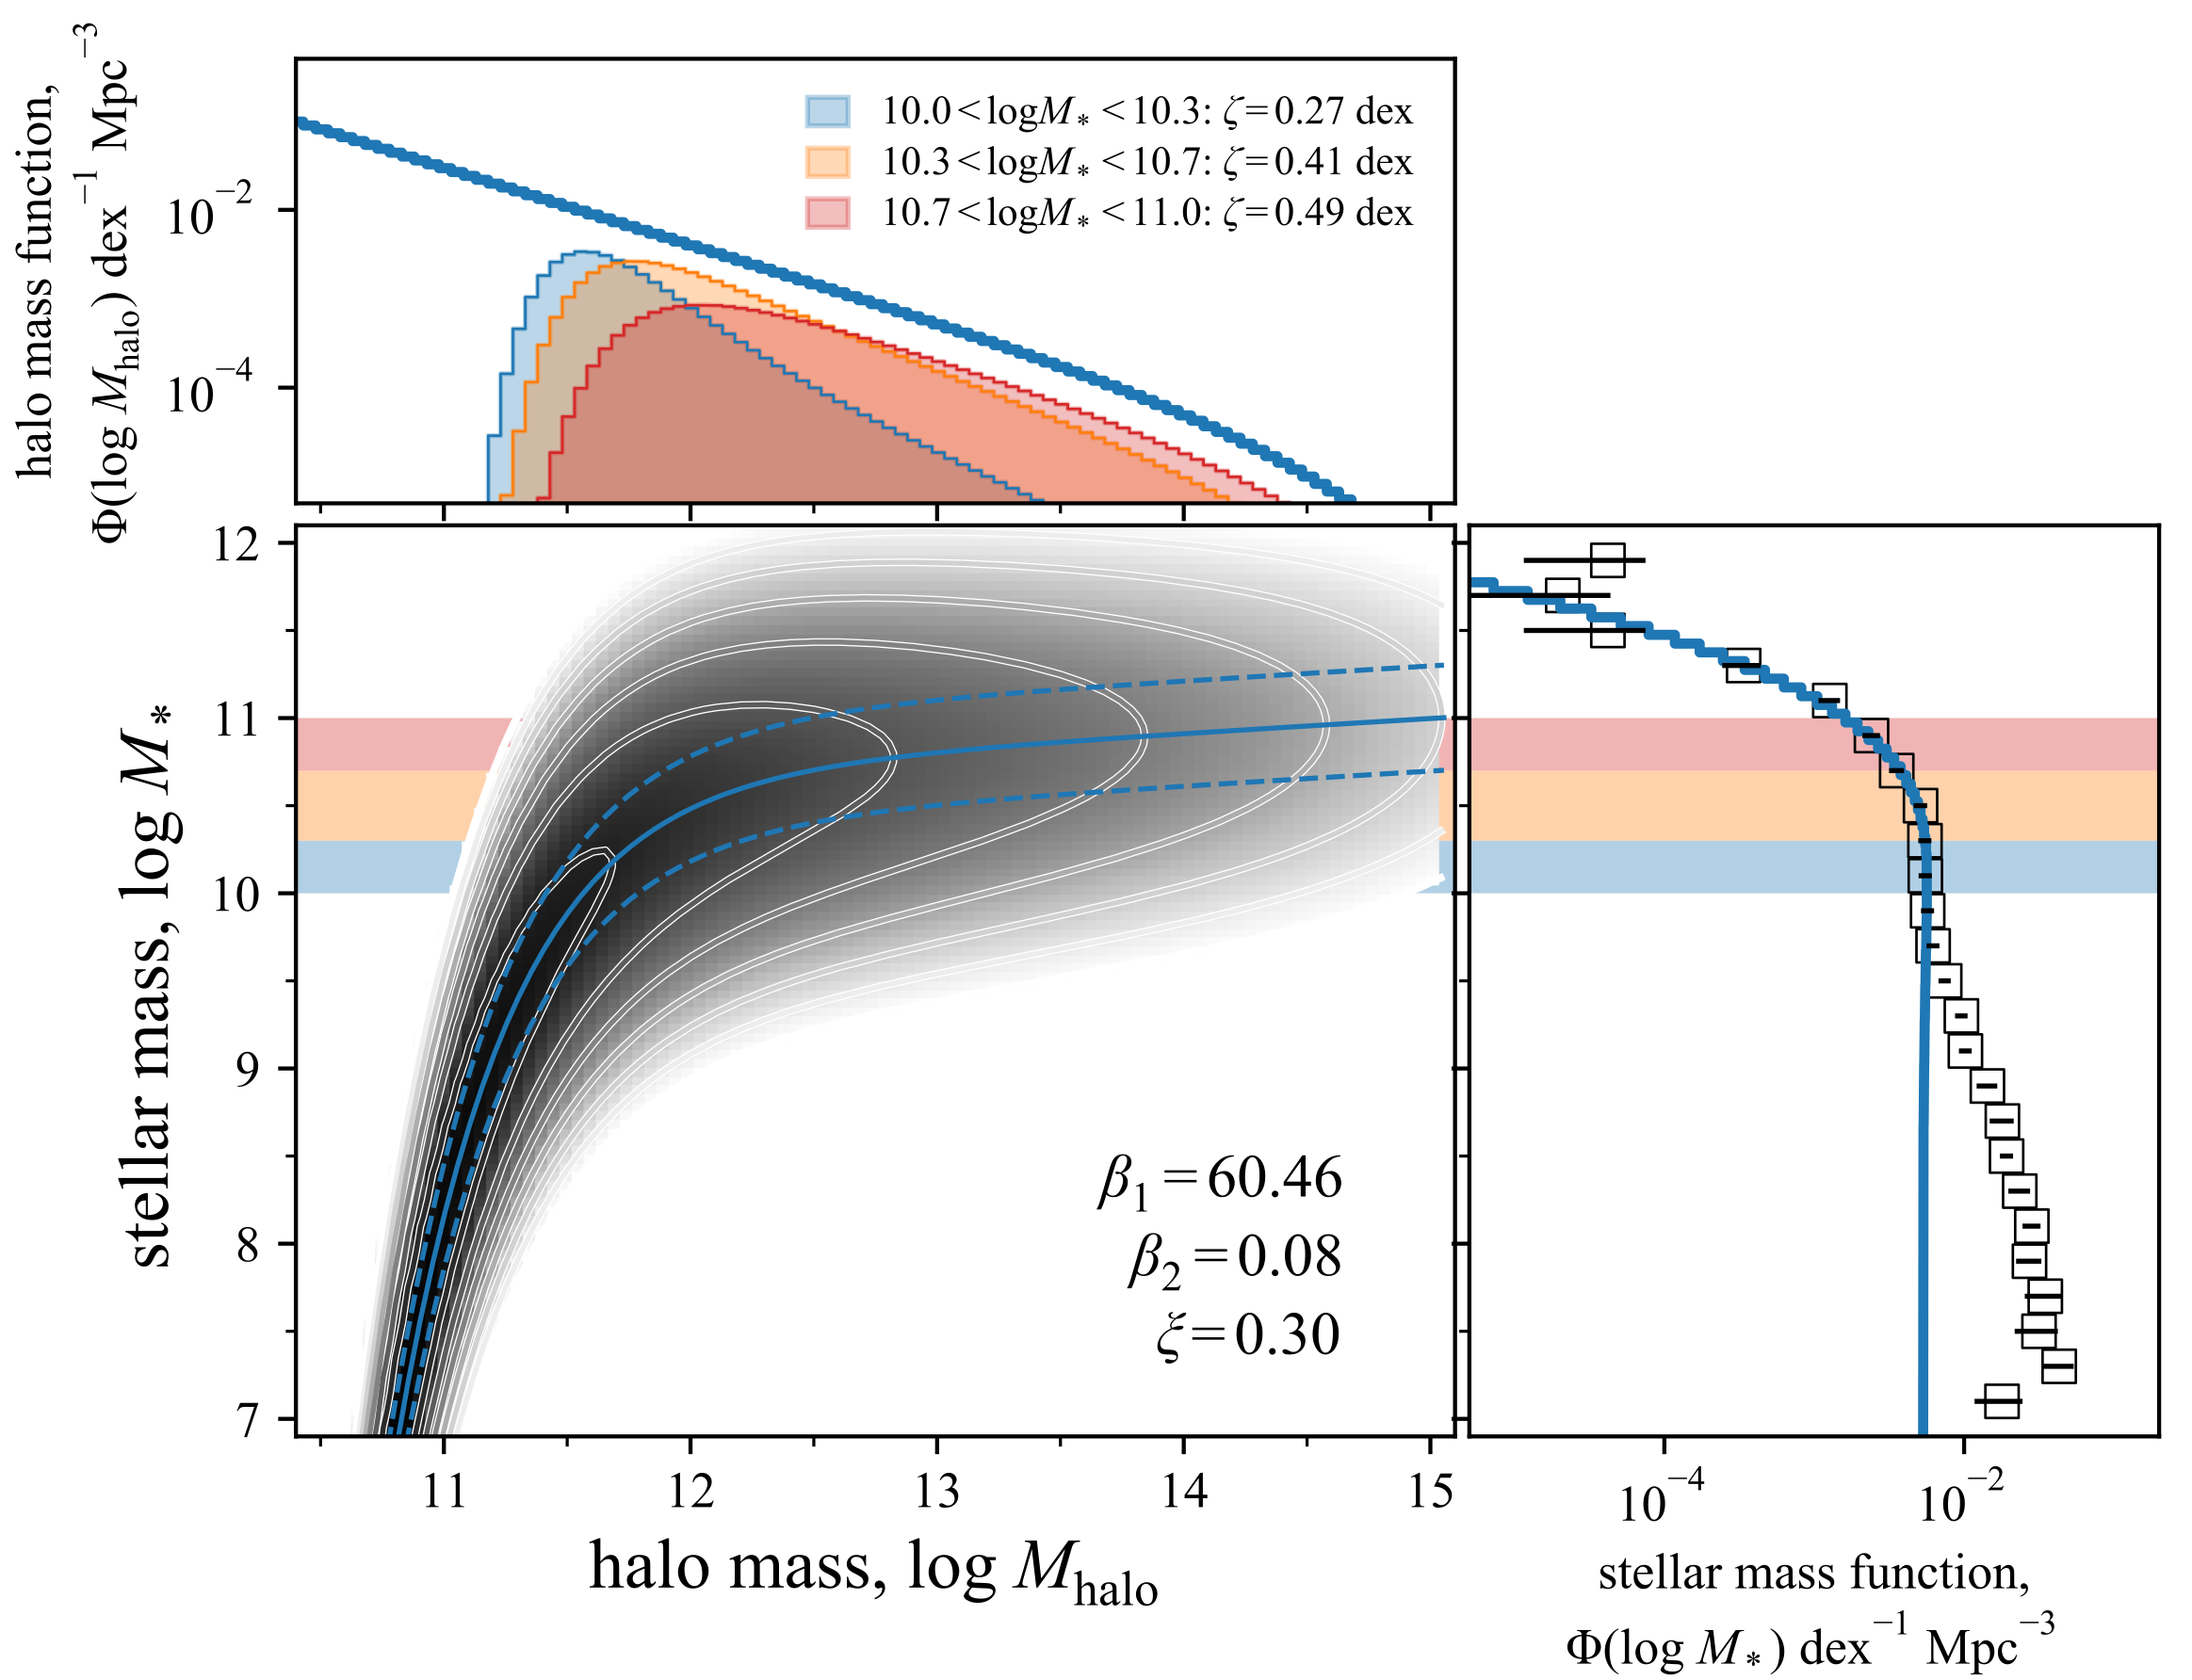
The stellar-to-halo mass relation
A boundary condition for cosmological galaxy formation
HMF: the halo mass function is a robust prediction from theory.
SMF: the stellar mass function is a well measured observable.
SHMR <— physics lives here: the stellar-to-halo mass relation can be inferred by requiring consistency between the two.
The dispersion is by far the most interesting quantity!

Slide 29
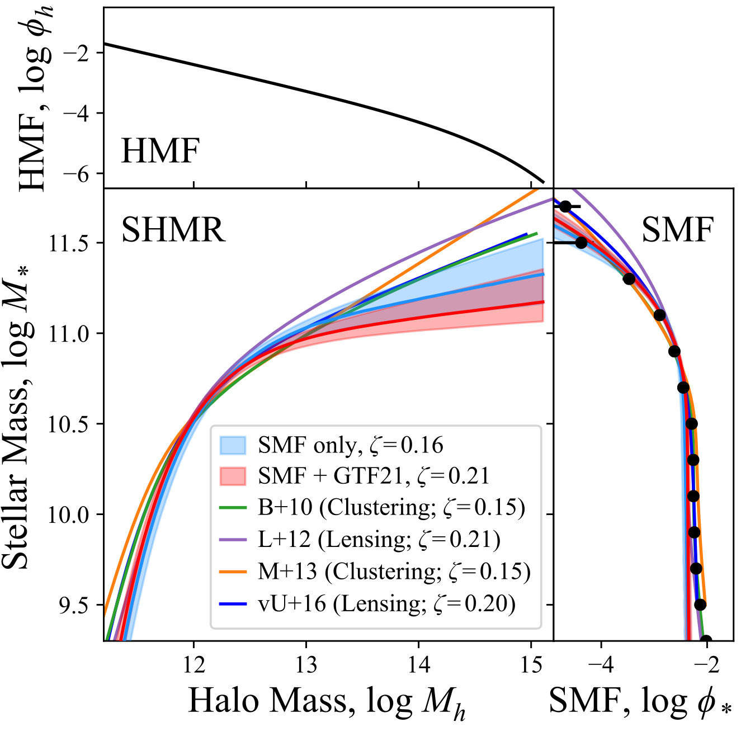
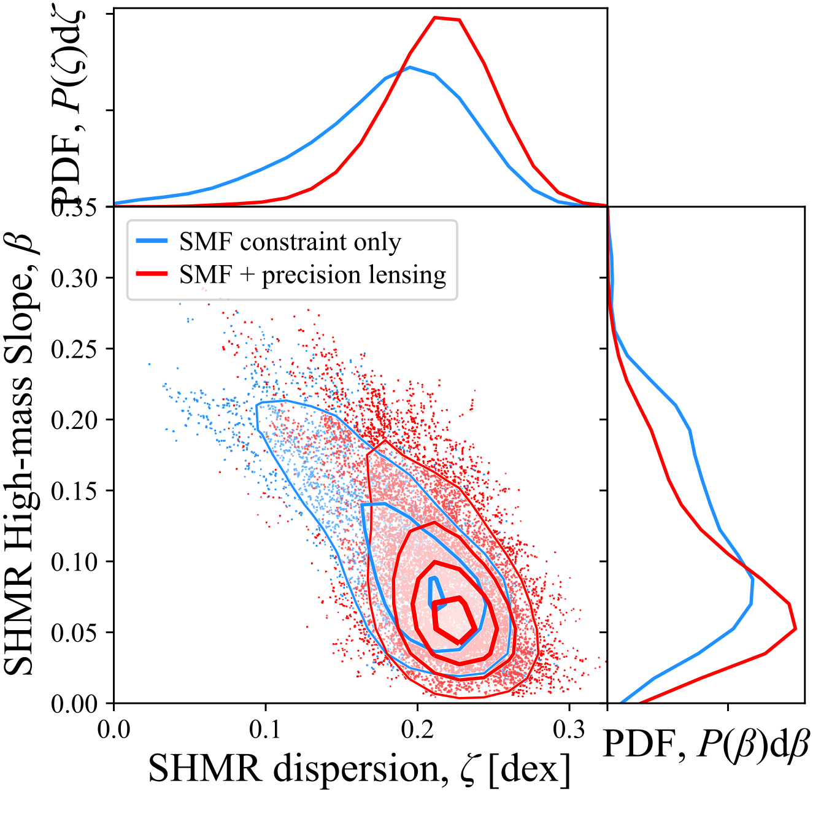
The stellar-to-halo mass relation
A boundary condition for cosmological galaxy formation
GID13.deimos_slits
Taken at face value, these precision lensing measurements seem to suggest a much weaker correlation between stellar and halo mass?

Slide 30
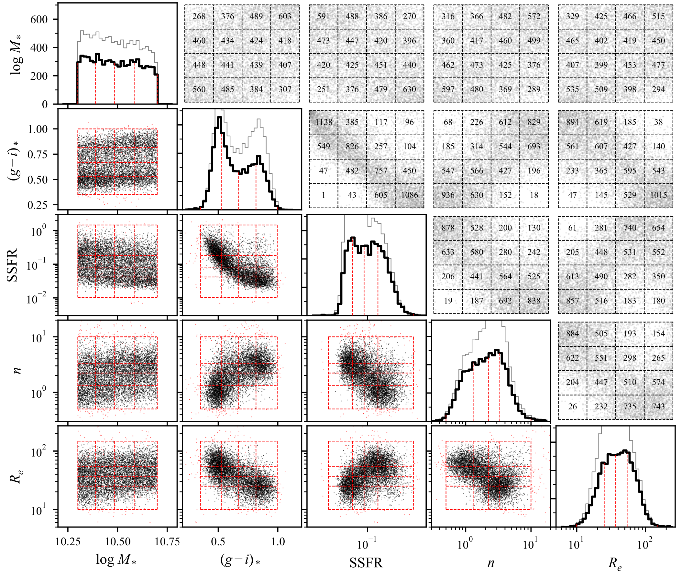
The stellar-to-halo mass relation
ent+20
Connecting halo mass to observed properties at fixed stellar mass.
Select 10.3 < log M* < 10.7 galaxies from GAMA.
Confounding: strong (but not total!) covariance between everything and nearly everything.
Use KiDS lensing measurements to explore halo variations across this sample.
What observable(s) are most tightly coupled to halo mass?

Slide 31
The stellar-to-halo mass relation
ent+20
Connecting halo mass to observed properties at fixed stellar mass.
You could do it this way; i.e. fit halo models to binned ESD.
But what bins do you choose?
But also: why bin at all?

Slide 32
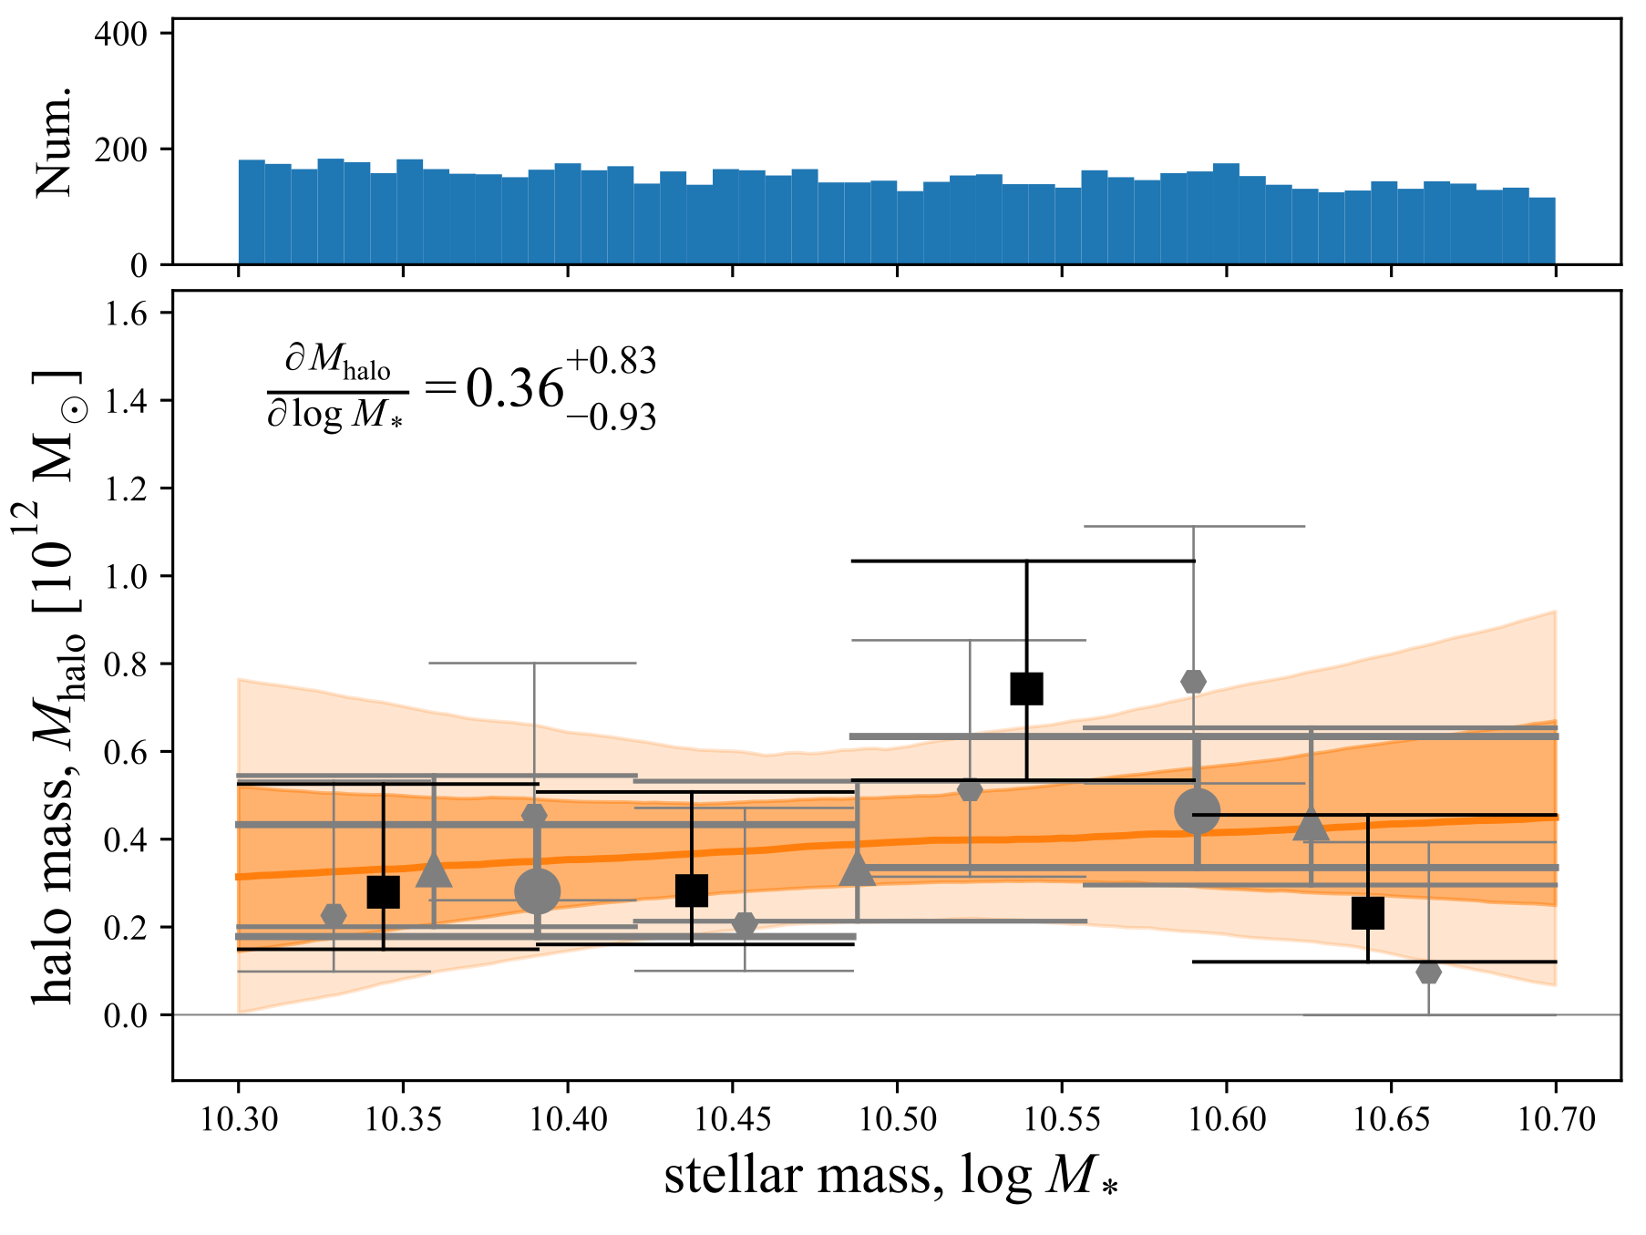
The stellar-to-halo mass relation
ent+20
Connecting halo mass to observed properties at fixed stellar mass.
Binning is sometimes useful for visualisation.
Binning can only destroy information.
Better to fit for the trend across the population!
That's what i'm doing. (Lots!)

Slide 33
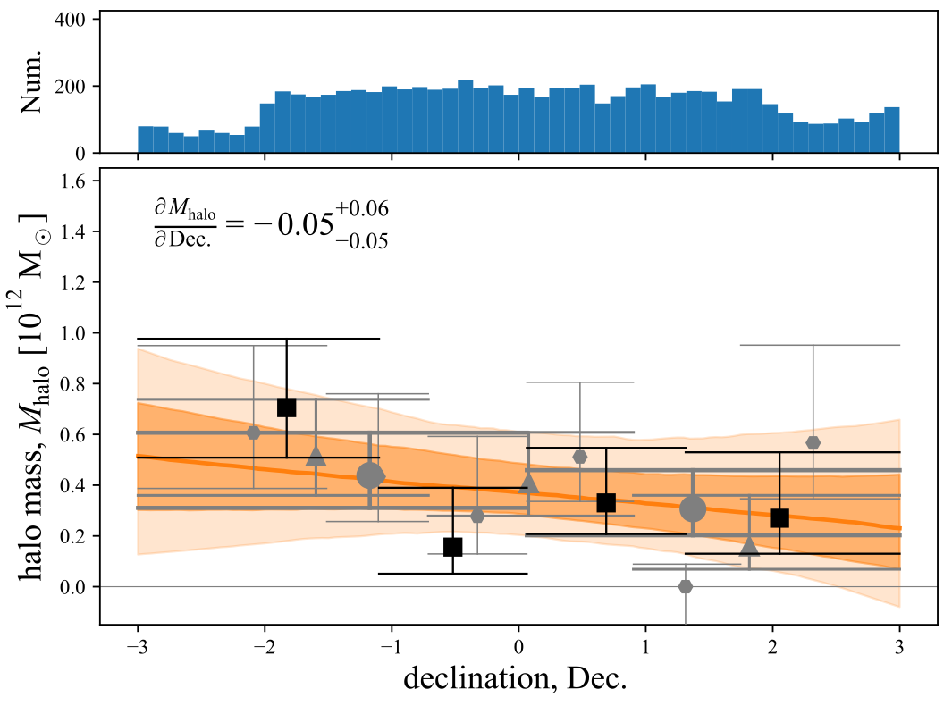
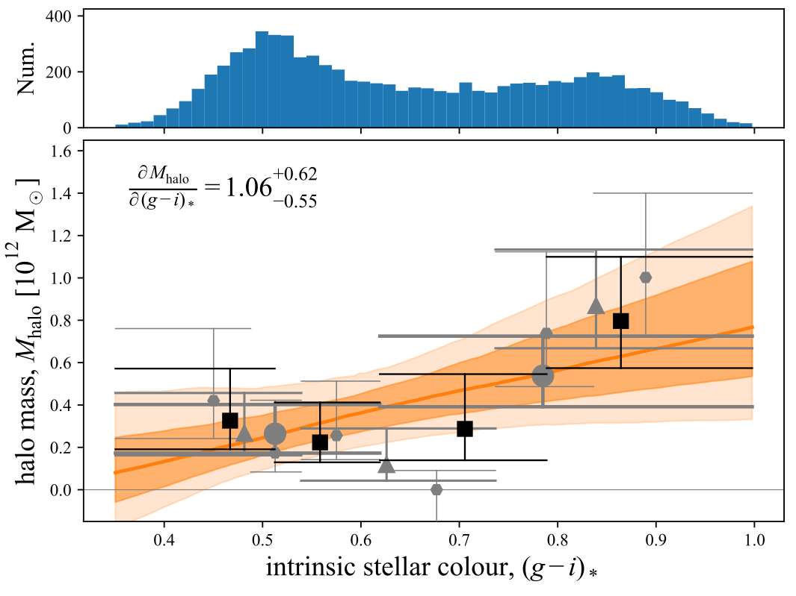
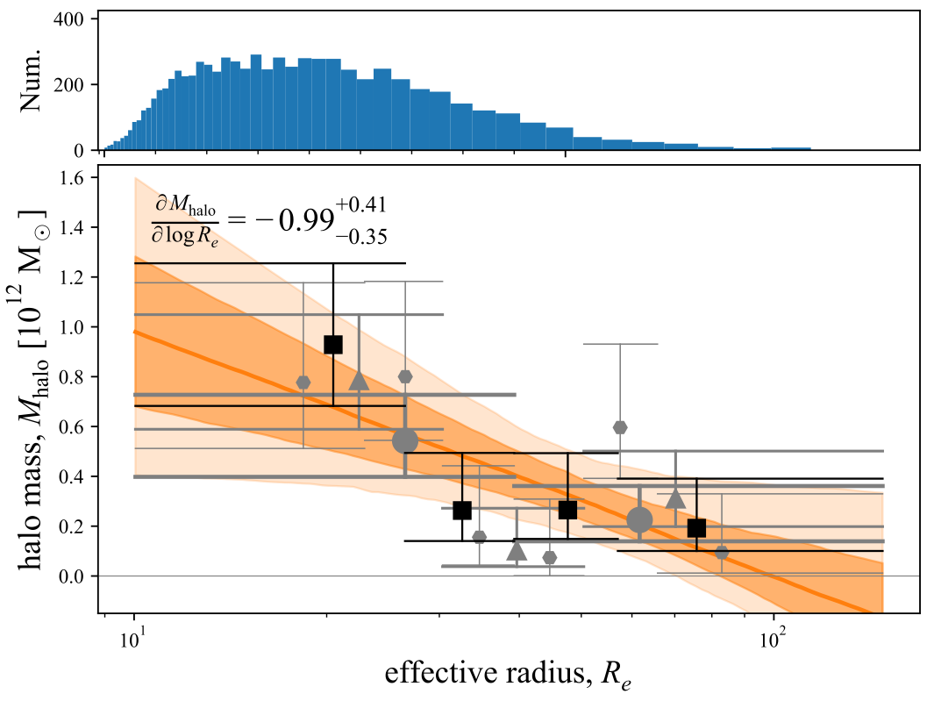
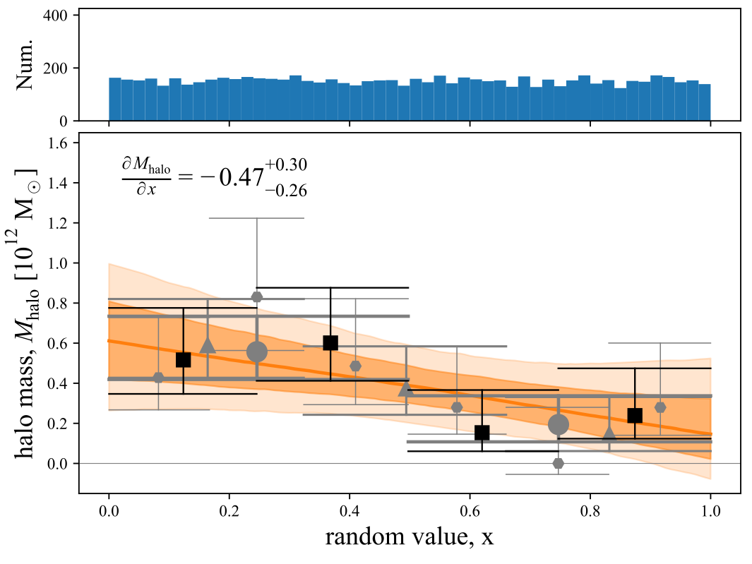
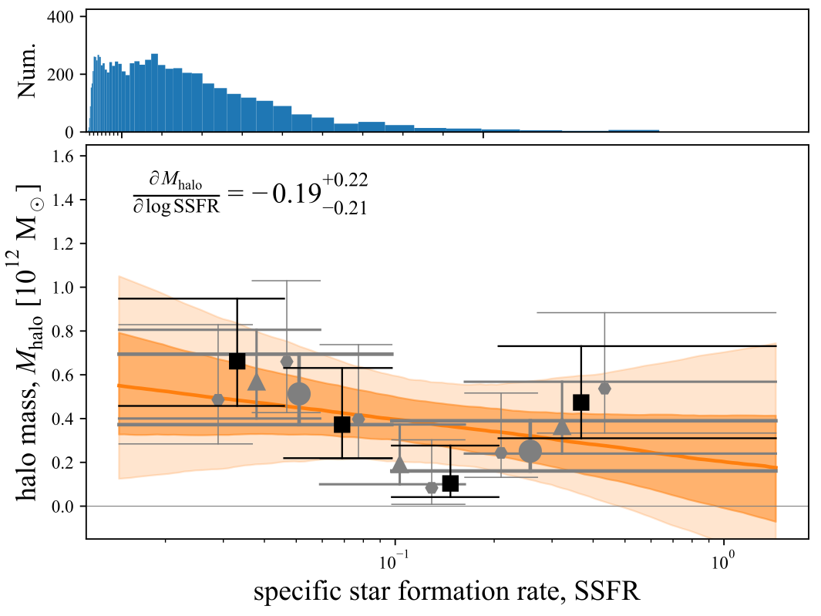
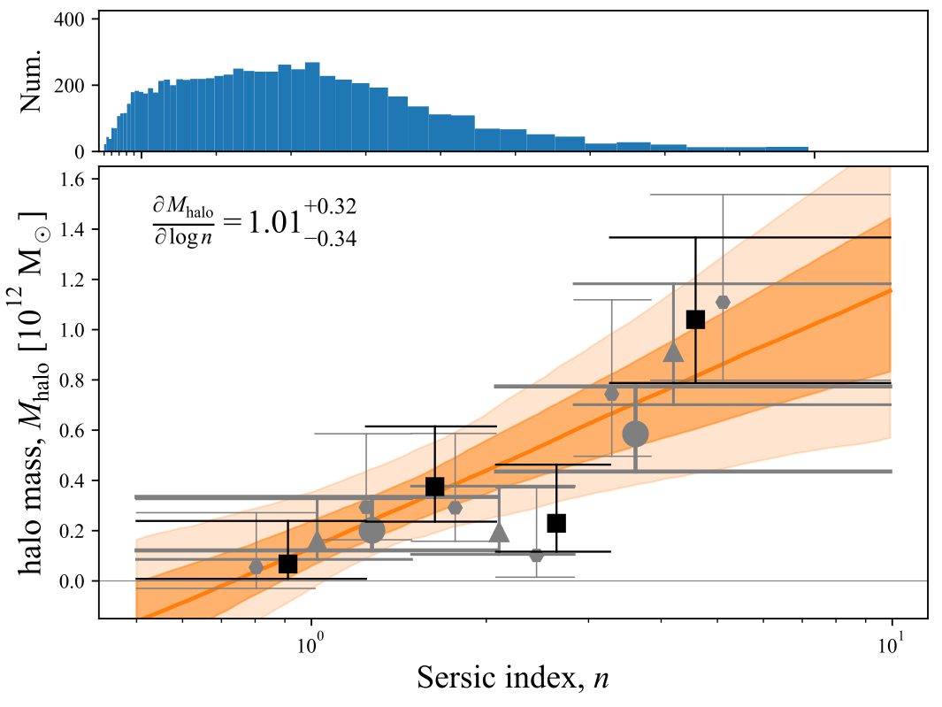
The stellar-to-halo mass relation
ent+20
Connecting halo mass to observed properties at fixed stellar mass.
$$σ_{dyn}≳0.24dex$$
Declination
Stellar Colour
Effective Radius
$$σ_{dyn}≳0.28dex$$
Random value
Specific SFR
Sersic Index

Slide 34
The stellar-to-halo mass relation
ent+20
Connecting halo mass to observed properties at fixed stellar mass.
Using a volume limited sample over a narrow mass range, as an effective way to control for (stellar) mass-dependence.
A new approach to weak lensing: fitting to the full set of unstacked shear profiles to explore trends across the ensemble.
At fixed stellar mass, ‘’early types have higher halo masses — or, equivalently, lower stellar-to-halo mass ratios.
The data have a weak preference for the idea that halo mass is more tightly coupled to structure than it is to stellar populations.
Either the dispersion in SHMR is directly coupled to structure, (i.e. a thin Mstar-Mhalo-n plane), or the dispersion is > 0.3ish dex.
The key is having a highly complete spectroscopic redshift survey to allow robust selection and detailed characterisation of lenses.
$$σ_{dyn}≳0.24dex$$
Effective Radius
$$σ_{dyn}≳0.28dex$$
ENT et al. (2020); also see P Gurri, ENT & C Fluke (2021,2022)
Sersic Index

Slide 37
4HS: the 4most hemisphere survey Uniform, wide-area spectroscopy for low-z galaxies in the South
Edward N Taylor: entaylor@swin.edu.au
4HS PIs (Cluver & Taylor): 4HS-PI@4most.eu
Notes:
Project i co-PI with Michelle Cluver; also from Swinburne
What we have set out to achieve is to obtain
I will come to uniform and wide area in a moment, but
let me start by speaking about why i think low-z spectroscopy is so important.

Slide 38
I propose an operational definition for the term ‘low-z’: low-z is where photo-zs are not useful; z ≲ 0.1ish
Whatever the astrophysics, low-z science can be driven by — or limited by — the availability of spectroscopic redshifts.
Notes:
First:
What do I mean by low redshift? I don’t mean Local Group.
A few times the BAO scale; this is approximately the homogeneity scale
So sort of defines our Local Volume.

Slide 39
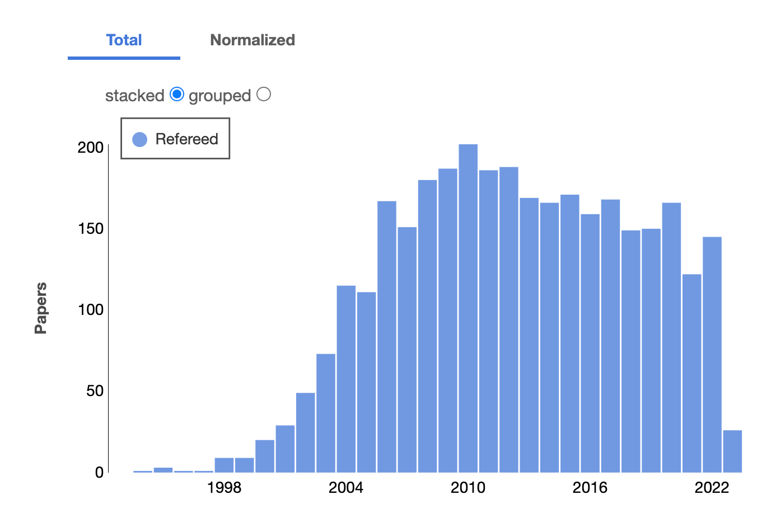
Whatever the astrophysics, low-z science can be driven by — or limited by — the availability of spectroscopic redshifts.
Notes:
And the first thing is this: SDSS is one of the most productive scientific endeavours in astronomy, and the reason is that it enabled all sorts of other science beyond its narrow motivating goals.

Slide 40
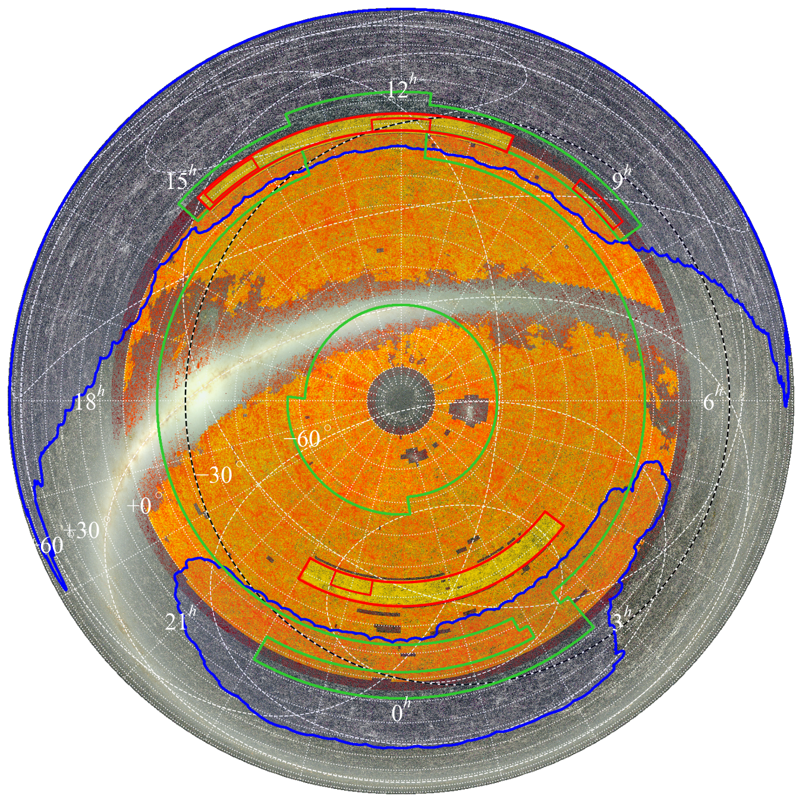
4Hs: the 4MOST hemisphere Survey
Spectroscopy and redshifts for ~6 M galaxies over ~20.000 deg² with high and unbiased completeness for z < 0.15.
NIR selected: J < 18 and (J-K) < 0.45 GAMA-like depth over ~100 times the area; near-total completeness for z < 0.15.
Main sample: ~325 / deg² x ~18.000 deg² limited by availability of VISTA imaging and foreground EBV < 0.3 in Planck dust map.
Supplemental PV cosmology sample expecting ~30.000 useful PV measurements in historic ZOA near to the Plane and Clouds
~Uniform spectroscopic data quality guarantees 98% redshift success for z < 0.15; SNR > 12 for 500.000 ETGs for FP cosmology.
Made possible by 4MOST consortium model would be prohibitively inefficient without extragalactic and stellar partner surveys.
Notes:
This is showing our version 1 input catalogue, which has been derived from a full reanalysis of the VISTA science archive; principally VHS. Colour selection pre-selects essentially volume-limited samples for z < 0.15.
Our aim is to cover the widest area possible, so bounded by the availability of VISTA imaging, and foreground dust attenuation as mapped by Planck.
You can think of this as GAMA like depth and completeness, but over 100 times the area.
Our cosmology science centres on Fundamental Plane distances and peculiar velocities. We have 2 supplemental samples to extend our volume/area even further, and in particular pressing very close to the Plane and into the Magellanic Clouds.
I won’t belabour this point, but this is only made possible by the 4MOST consortium model, where galaxy AND stellar surveys share the plane; observing in parallel.
Other facilities just cannot do this efficiently.

Slide 41
4Hs: the 4MOST hemisphere Survey
Spectroscopy and redshifts for ~6 M galaxies over ~20.000 deg² with high and unbiased completeness for z < 0.15.
4HS will:
Map mass and motion over ~1 Gpc to measure gravity and cosmological growth of structure (approaching variance limit).
Map galaxy demographics as a function of local and large scale environment, to resolve the environmental processes/effects that most influence galaxy formation and evolution.
Produce the definitive low-z galaxy reference sample for the next era of wide-area multiwavelength surveys (eROSITA, LSST, Euclid, ASKAP/MeerKAT/SKA, LISA, ...) and large/high resolution simulations (following EAGLE, IllustrisTNG, FIRE-2, SIMBA, …).
Notes:
Brings me to the 3 key science goals.
I will emphasise the second.

Slide 42
4Hs: the 4MOST hemisphere Survey
4HS will produce the definitive low-z galaxy reference sample for the VRO-LSST/Euclid/Roman/SKA/LIGO/LISA era.
Whatever the astrophysics, low-z science is driven — or limited — by the availability of spectroscopic redshifts.
4HS + ASKAP/MeerKAT/SKA: the full baryon cycle as a function of mass & environment. 4HS: redshifts, stellar populations, SF/AGN diagnostics, environment statistics; 21cm: HI masses and dynamics in the ISM and CGM — and minimal RFI at z < 0.12!
4HS + VRO-LSST/Euclid/Roman: enabling weak lensing science at all scales; e.g.: unique opportunities for matching 4HS density field to LSST-VRO lensing maps; lensing at ~kpc scales with 4HS+Euclid/Roman — only possible at low-z!
4HS as the definitive reference catalogue for low-z transient host/counterparts: Including SFRs, stellar populations, masses, group/halo/environment metrics, … for astrophysics of low-z transients of all kinds, including calibrating SN Ia systematics; Improved distance/redshift measures through group-averaging and/or bulk-flow models.
Notes:
I could spend hours on this slide, but i can’t. So i’m just going to give you a minute to scan this slide and find what interests you.
The most important thing is that photometric redshifts are useless at low-z; in fact, this is an operational definition for low-z!
Photometric redshifts are also not useful for environment or halo mass.
There is so much unique stuff that can only be done with a 4HS.
Low-z science can be driven by - or can be limited by - the availability of specs. We hope to be drivers!

